Slide 1
Chapter 14 – Resource Planning (MRP and ERP)
Operations Management
by
R. Dan Reid & Nada R. Sanders
2nd Edition © Wiley 2005
PowerPoint Presentation by R.B. Clough - UNH

Slide 2
Types of Demand
There are two types of demand.
Independent Demand
  Is the demand for finished products
  Does not depend on the demand of other products
  Needs to be forecasted
Dependent Demand
  Is the demand derived from finished products
  Is the demand for component parts based on the number of end items being produced and is managed by the MRP system

Slide 3
Evolution of Material Planning Systems
Back in the sixties, manufacturing planning systems were reorder point systems that simply determined when and how much to order
First MRP systems translated a master schedule of final products into time-phased net requirements for subassemblies, assemblies, and parts
Closed-loop MRP included production planning, master scheduling, and capacity requirements
In mid 1970’s, MRPII systems added functionality to plan and execute all internal functions

Slide 4
An Overview of MRP
MRP uses the concept of backward scheduling to determine how much and when to order and replenish
The MPS module contains the authorized schedule
The BOM module contains the product structure for each unique product
The Inventory Record module keeps track of the inventory status for each item in the database
MRP output includes schedules for all internal activities and parts as well as orders for all supply chain items

Slide 5
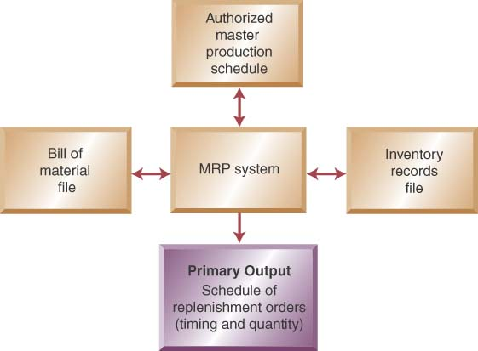
Input/Output - MRP Process

Slide 6
Objectives of MRP
Determines the quantity and timing of material requirements
  Determines what to order (checks BOM), how much to order (lot size rules), when to place the order (need date minus lead time), and when to schedule delivery (on date needed)
Maintain priorities
  In a changing environment, MRP reorganizes priorities to keep plans current and viable

Slide 7
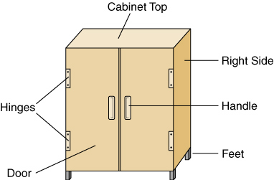
Building a CD Cabinet With MRP

Slide 8
MRP Inputs - Authorized MPS
From the authorized MPS, we calculate when we need to have replenishment orders of CD cabinets; when we need a new MPS order.

Slide 9
MRP Inputs-Inventory Records
System checks the inventory record for each BOM item to see if inventory is available or if a replenishment order is needed to build the cabinets.

Slide 10
MRP Inputs-Bills of Material
A BOM lists all of the items needed to produce one CD cabinet
The BOM is exactly like a recipe for baking a cake
The BOM’s must be complete and accurate and can only be changed by an ECN
MRP BOM’s are indented bills of materials
Indented BOM

Slide 11
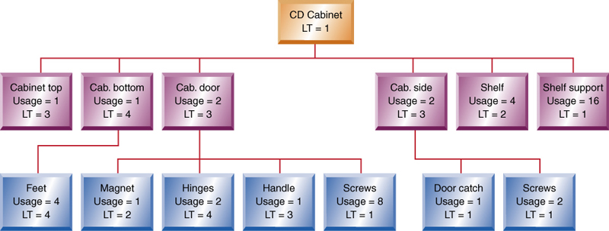
A Product Structure Tree

Slide 12
The Inventory Record

Slide 13
The MRP Explosion Process
Using this table and the product structure tree, we will work through an example of how the MRP explosion process calculates the requirements for building a CD cabinet. Next we start with the cabinet top to show how MRP calculates the gross requirements for this component.

Slide 14
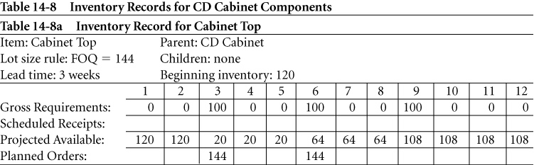
Inventory Records - Components
It was noted on the previous slide that the parent item (CD Cabinet) has planned orders in periods 3, 6, and 9.
Its children (top, bottom, door, left & right side, shelves, and supports) have gross requirements in periods 3, 6, and 9.

Slide 15
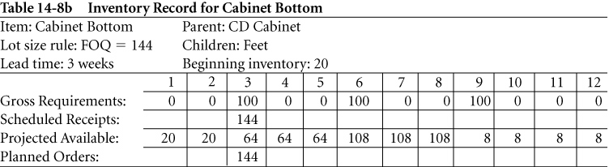
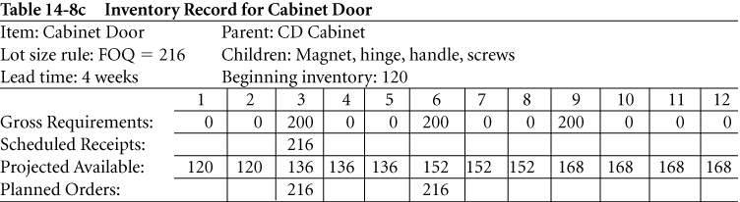
Inventory Records - Components

Slide 16
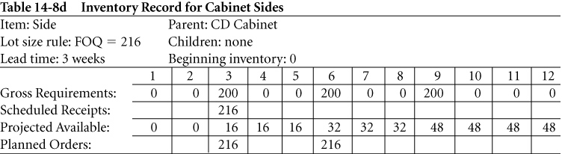
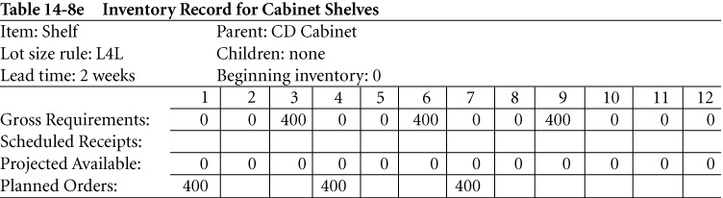
Inventory Records– Components con’t

Slide 17
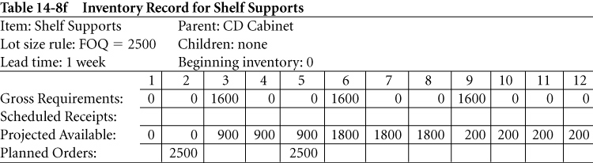
Inventory Records– Components con’t

Slide 18
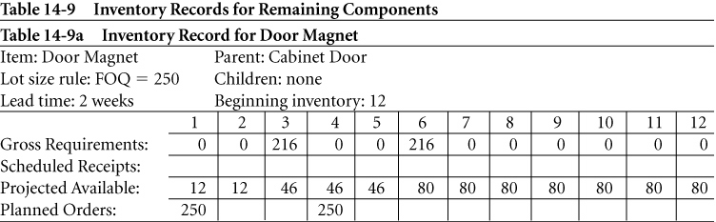
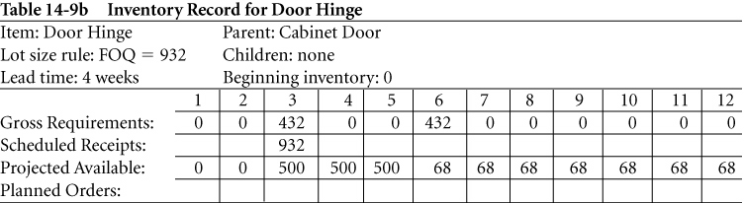
Inventory Records – Remaining Components

Slide 19
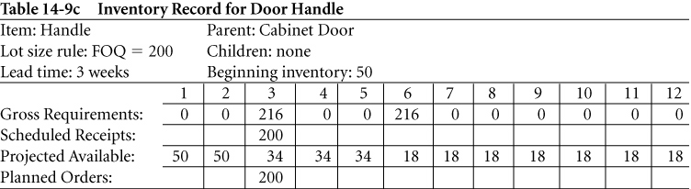
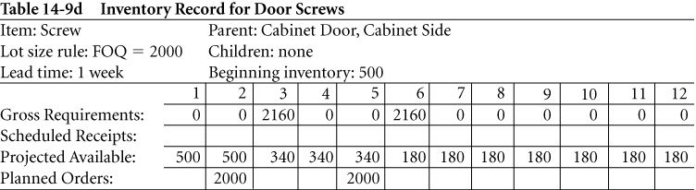
Inv. Records – Remaining Components con’t

Slide 20
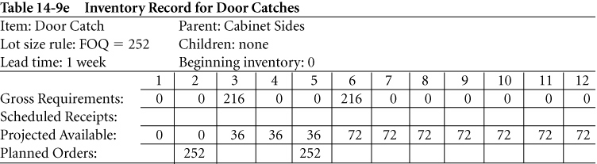
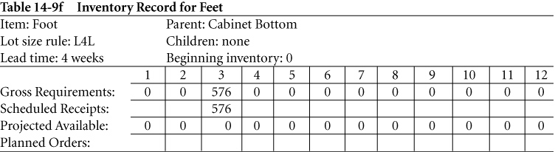
Inv. Records – Remaining Components con’t

Slide 21
MRP Explosion
A Simplified Example
CD Cabinet
LT = 1
Cabinet Door
Usage = 2
LT = 3
Hinge
Usage = 2
LT =4
Screw
Usage = 8
LT = 1
Cabinet Side
Usage = 2
LT = 3
Screw
Usage = 2
LT = 1

Slide 22
MRP Example Continued
Master Production Schedule –
  100 CD Cabinets to be delivered in Periods 4, 7, and 10
Inventory Records –
  On Hand: Door – 120, Side – 50, Hinge – 0, Screw – 600
  On Order: Door – 216 due in period 2, Hinge 932 due in period 3.
Lot Size Rules –
  CD Cabinets – Lot-for-lot, Door – FOQ 216, Side – FOQ 250, Hinge – FOQ 932, Screw – FOQ 2000

Slide 23
MRP Action Notices
Action Notices:
  Indicate items that need a production planner’s attention
  Are created when a planned order needs to be released, due dates need to be adjusted, or when there is insufficient lead time for normal replenishment
  Often require planners to rush or expedite orders

Slide 24
MRP Action Notices
Action Bucket:
  Is the current period where we take actions such as releasing, rescheduling, or canceling orders
  A positive quantity in current period’s planned order row means that an order must be released

Slide 25
Lot Sizing Rules
Rules are used to change the frequency of replenishment orders & set the quantity of each order (balance holding & ordering costs to reduce total costs)
Common rules:
  Fixed Order Quantity (FOQ)
  Lot-for-Lot (L4L)
  Periodic Order Quantity (POQ)

Slide 26
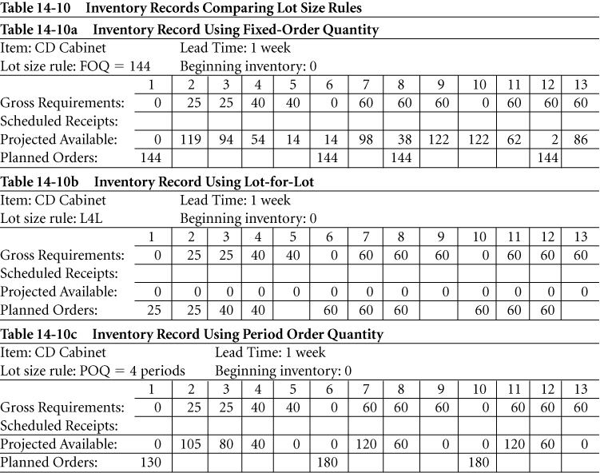
Example Comparing Lot Size Rules: Three lot sizing rules used within MRP Systems are: fixed order quantity (FOQ), lot for lot (L4L), and period order quantity (POQ). Cost comparison is based on Inventory holding costs ($0.10/period) and ordering cost ($25/order). In this example POQ is best at $133.50.

Slide 27
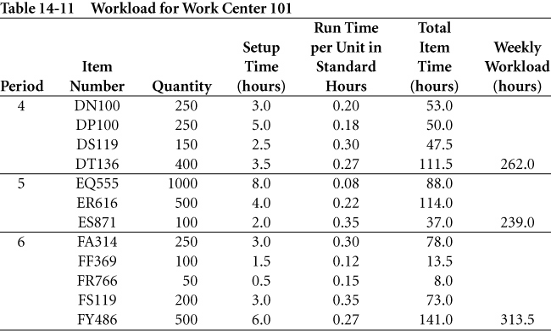
Rough Cut Capacity Example: The CRP module uses data from MRP. Calculate workloads for critical work centers based on open shop orders and planned shop orders. These shop orders are translated into hours of work by work center and by time period.
Table 14-11 show items scheduled for work Center 101.
Available = 4 machines x 2 shifts x 10 hours x 5 days x 0.85 utiliza- x 0.95 effi-
Capacity per shift per wk. tion ciency
Available = 323.0 standard hours
Capacity

Slide 28
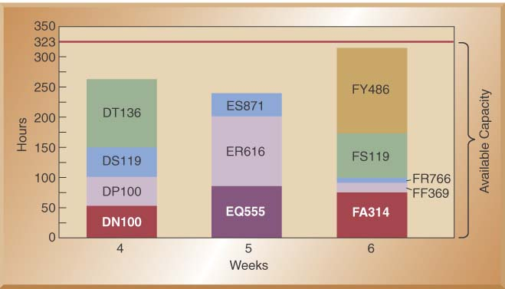
Workload Graph for Work Center 101: CRP enables a company to evaluate both the feasibility of the MRP system and how well the company is using its critical work centers.

Slide 29
Enterprise Resource Planning
What Is ERP?
  Software designed for organizing and managing business processes
  Modules share information across all business functions
  Can share customer sales data with the supply chain to help with global replenishment
  All modules are fully integrated and use a common database – some PC based

Slide 30
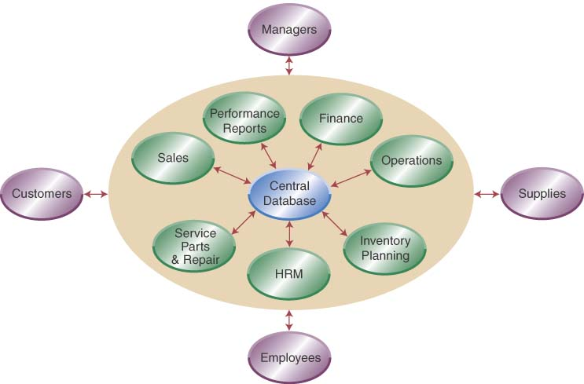
Integration of ERP

Slide 31
ERP Modules-4 Categories
Finance and accounting
  Investment, cost, asset, capital, and debt management
  Budgets, profitability analysis, and performance reports
Sales and marketing
  Handles pricing, availability, orders, shipments, & billing
Production and materials management
  Process planning, BOM, product costing, ECN’s, MRP, allocates resources, schedules, PO’s, & inventory
Human resources
  Workforce planning, payroll & benefits, & org. charts

Slide 32
Benefits of ERP Implementation
ERP presents a holistic view of the business functions from a single information and IT architecture
Increases organizational information flow
Increases ability to incorporate better management control, speedier decision making, and cost reductions
Allows replacement of disparate systems
e.g. ExxonMobile used ERP to replace 300 different systems
A study of ERP implementations reports that benefits typically start 8 months after implementation with median annual savings of $1.6 million

Slide 33
Cost and Implementation Issues
Major suppliers are SAP, Peoplesoft, Oracle, and Baan. Also smaller PC based suppliers.
Costs for larger ERP systems range from hundreds of thousands to several million dollars.
Outside consultants are usually involved in selection, configuration, and implementation.
Consultant costs can run up to 3 times the cost of the system itself according to a Gartner Group study.
Added costs also include additional people, new computer hardware, and the cost to develop a new, integrated database
Successful implementation requires leadership and top management commitment to a vision for the business

Slide 34
Homework
Problems
1 – 5, 11 – 18.

