Slide 1
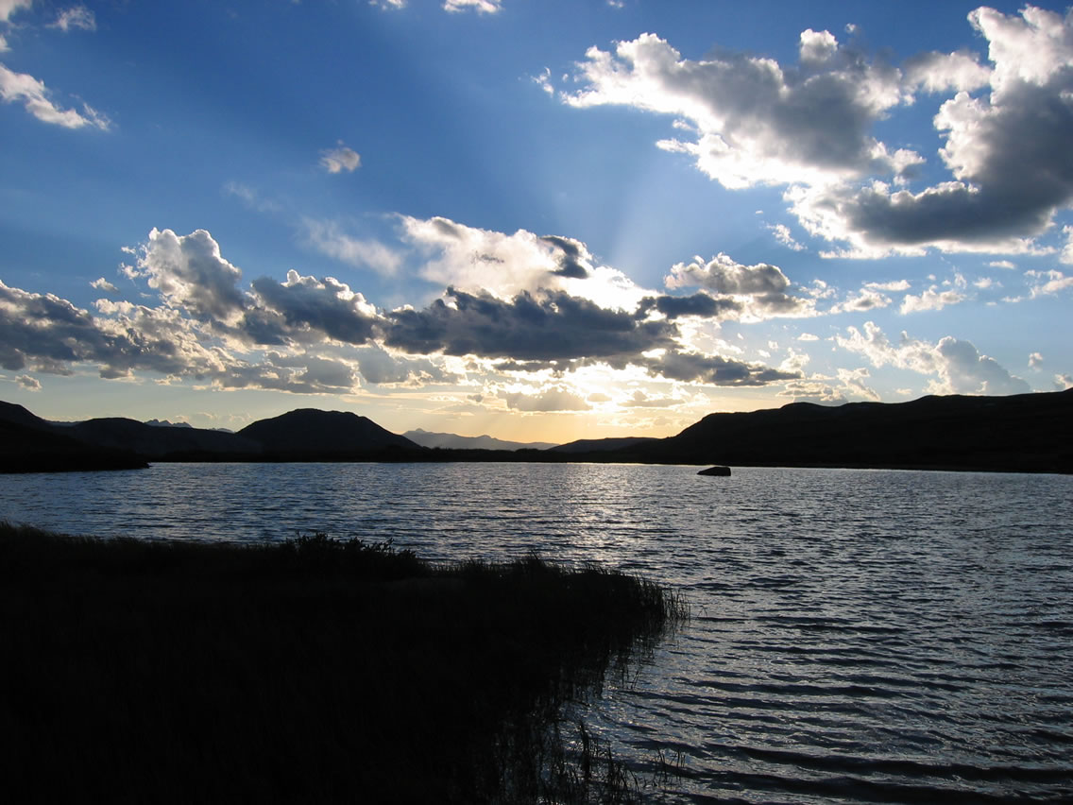
Stewardship of the Environment:
A Christian Environmental Ethic

Slide 2
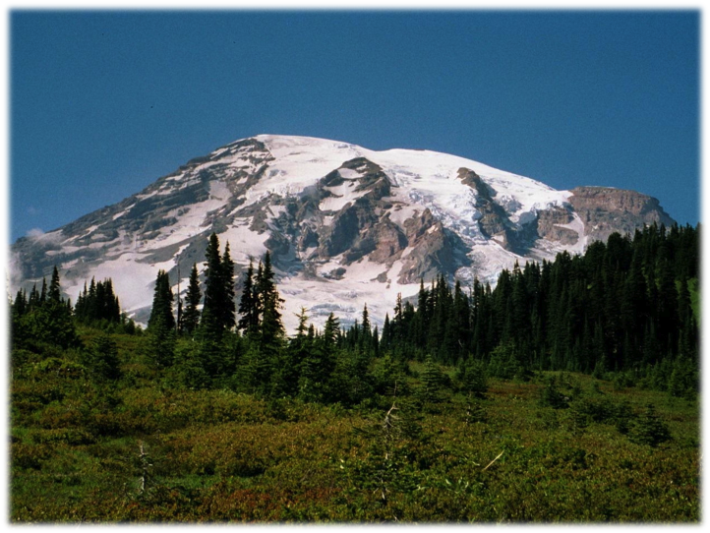
QUESTIONS
What are the major environmental concerns of our day?
How do they impact us and future generations?
What are the theological and ethical foundations of stewardship?
What is the Christian environmental ethic?

Slide 3
Human Impacts on Natural Systems
Habitat Destruction
Climate Change
Air Pollution
Acid Rain
Ozone depletion
Deforestation
Desertification and soil erosion
Water Pollution
Toxic wastes

Slide 4
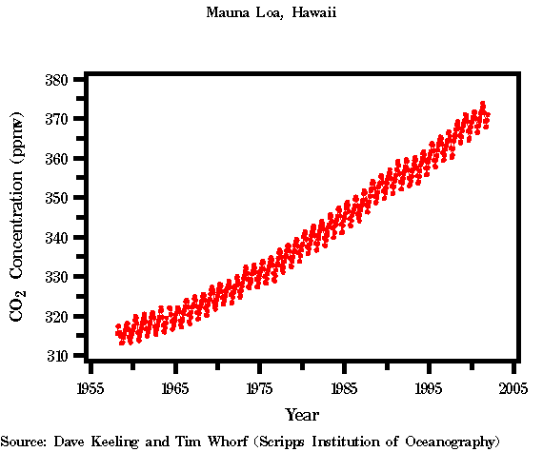
Global Warming
Started in Industrial Revolution, burning coal, petroleum, gas, vehicle emission produce CO2 and water vapor.
Deforestation cause less trees to trap CO2
2.5 - 10.4 F increase in temperature predicted in this century. Climate prediction is not an exact science.

Slide 5
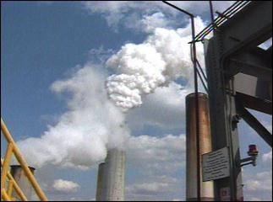
Climate Change
Extreme weather
Glacial retreat
Multiple effects on oceans
Methane Release
Forest Fires
Decreased Agricultural Production
Disease Spread

Slide 6
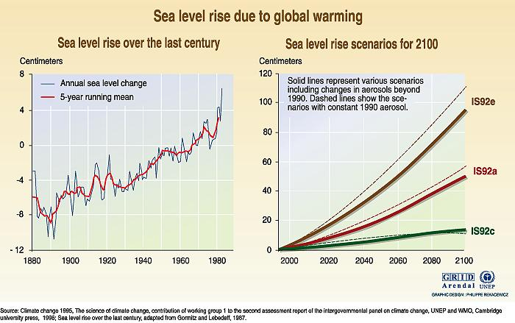
Global Warming

Slide 7
Acid Rain
Mostly in developed countries.
  Trees at higher elevations
  disappearing fish
  increased heavy metals in drinking water supplies
  loss of aquatic life
  Crop damage decrease yields of food production, death of soil microorganism
  US and Canada, 2,000 lakes totally dead to fish life and another 15,000 in danger

Slide 8
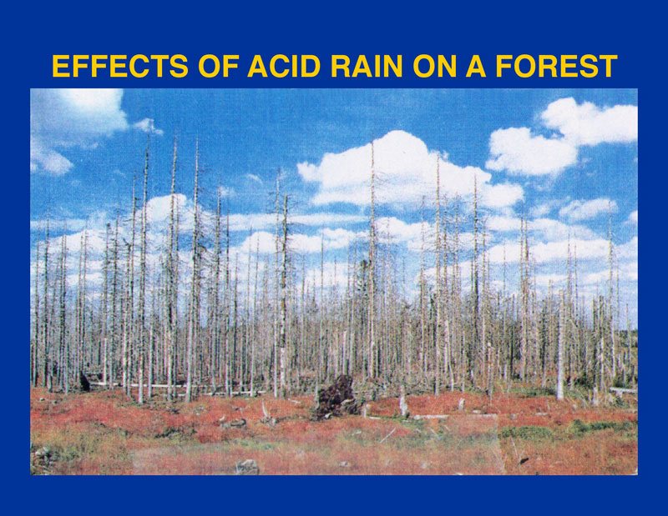
Acid Rain

Slide 9
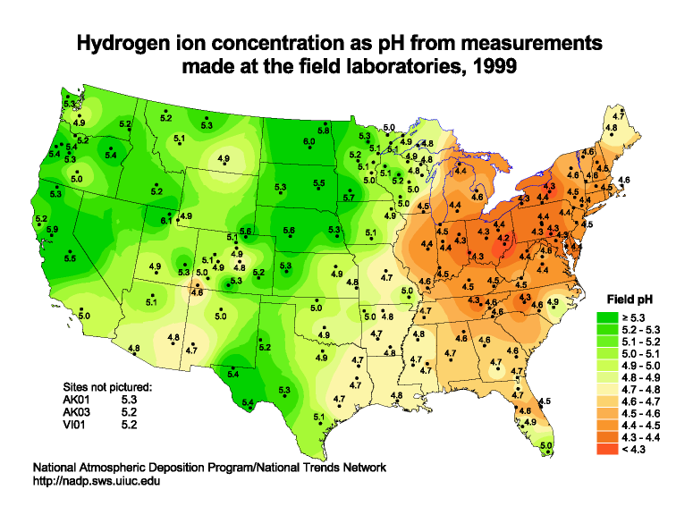
Acid Rain

Slide 10
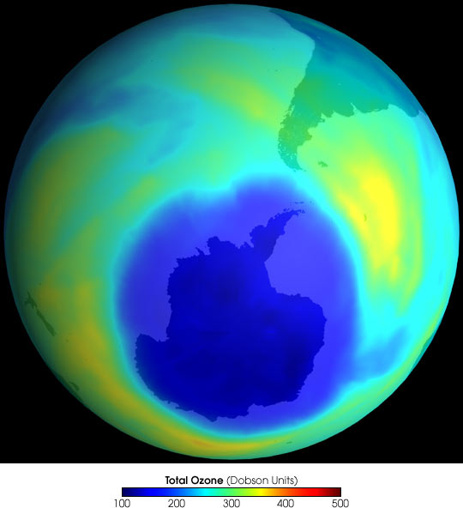
Ozone Hole

Slide 11
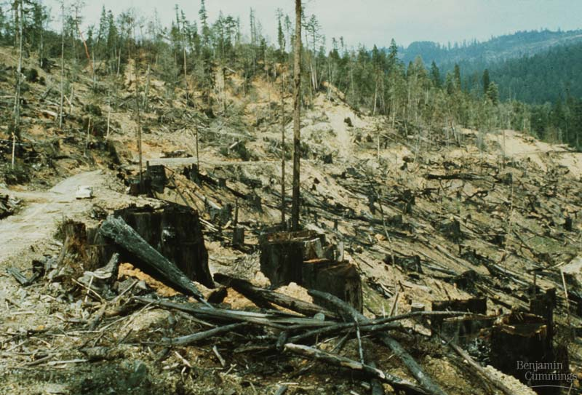
Deforestation
Three global impacts:
  1) Forest act as carbon storage and oxygen replenishers
  2) forest destruction change surface and air temperature, moisture content, and reflectivity. Estimated 3 to 5º C increase due to the clearing of S American forest.
  3) loss of biodiversity of the planet. Food sources in rainforest and storehouse of drug-yielding plants and insects will be limited.
Cutting trees in local area will increase flooding and soil erosion

Slide 12
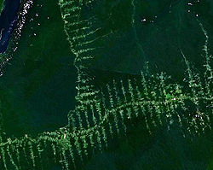
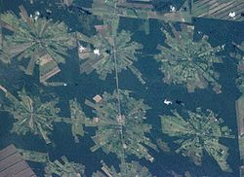
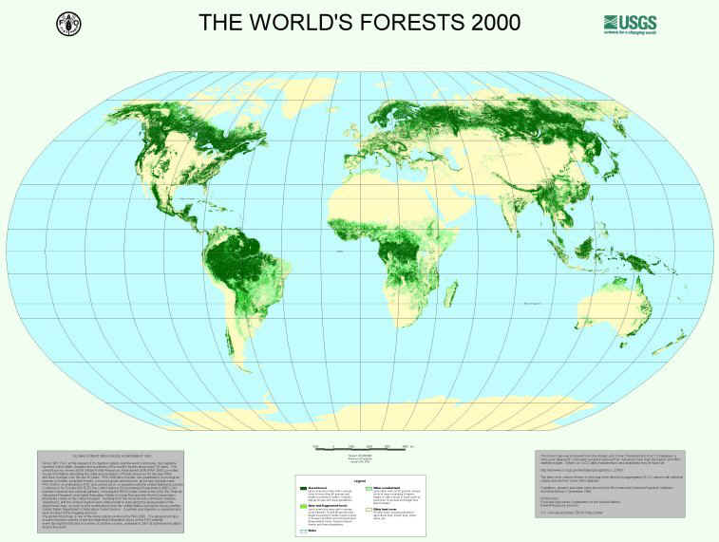

Slide 13
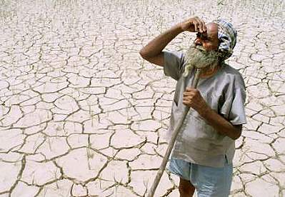
Desertification
The expansion or intensification of areas of degraded or destroyed soil and vegetation cover
1/4 of the earth’s surface is qualified as degraded semi-desert
40% of the non-desert land is in danger of human-induced desertification.
Food production drop 50% between 1950 and 1990 in area with most extensive desertification -
  Algeria, Ethiopia, Iraq, Jordan, Lebanon, Mali and Niger.
  Mali may be the first country in the world rendered uninhabitable by environmental destruction
Deforestation,farming, and grazing cause desertification

Slide 14
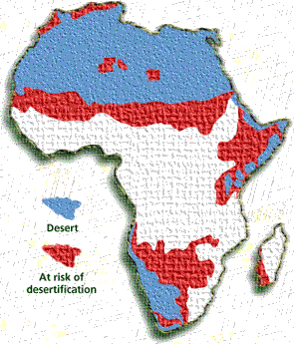
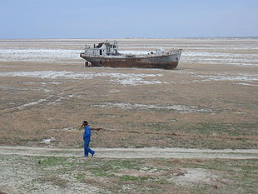
Desertifcation

Slide 15
Soil Erosion
40% of the world’s agr. land is seriously degraded -
  caused decreased yields of cultivated fields
  increased stream sediment loads and downstream deposition of silt.
15-17 million acres of existing arable land are lost to erosion each year.
The most sediment-laden of any waterway on earth - Huang (Yellow) River in China - 50% silt by weight.
US lost 2 billion tons of soil each year to erosion.
  1/3 land is in danger.
  24 billion tons of sediments washed to the oceans each year.
Quiet Crisis - Agricultural soil depletion due to soil erosion, salt accumulation, and desertification.

Slide 16
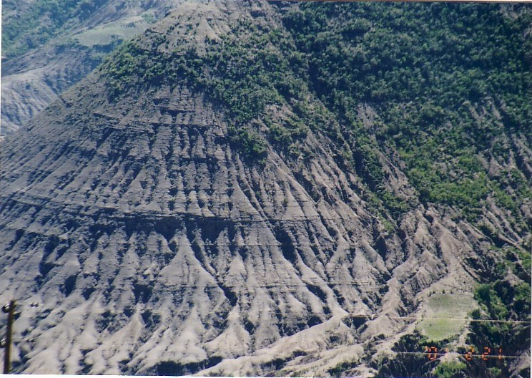
Soil Erosion

Slide 17
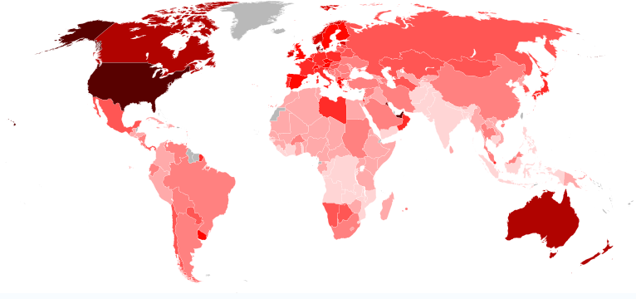
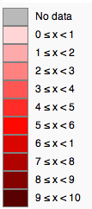
Ecological Footprint

Slide 18
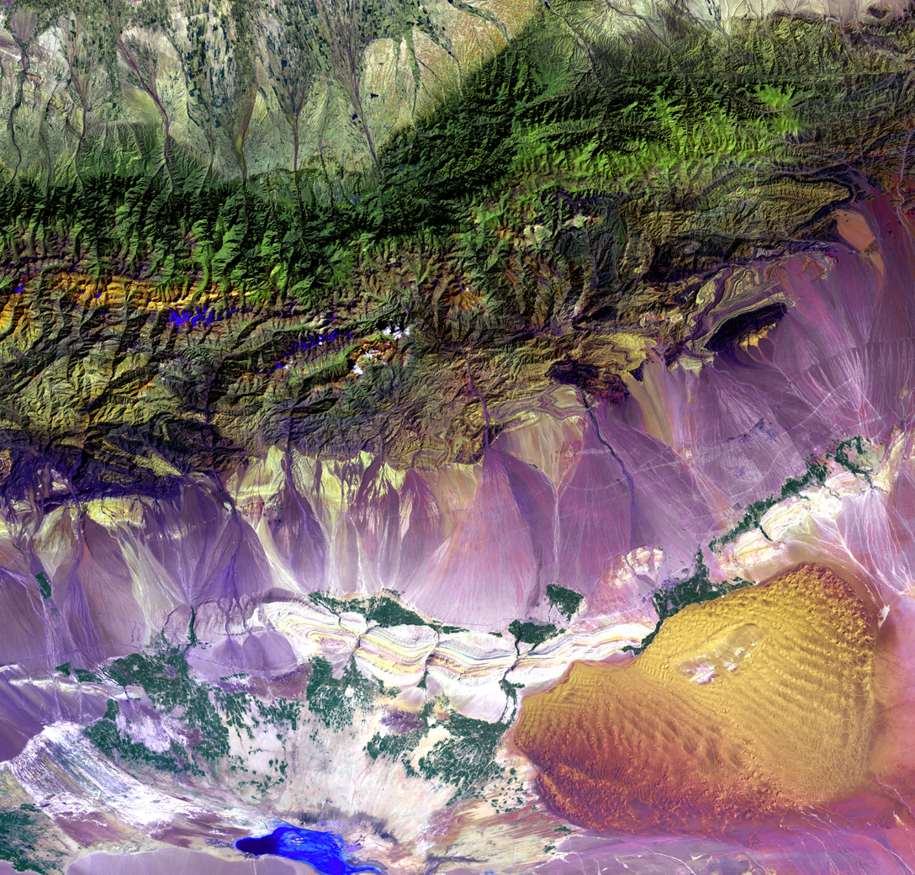
Goodness of Creation —
In Genesis 1, God pronounces His Creation "good.”
What is our purpose in Creation?

Slide 19
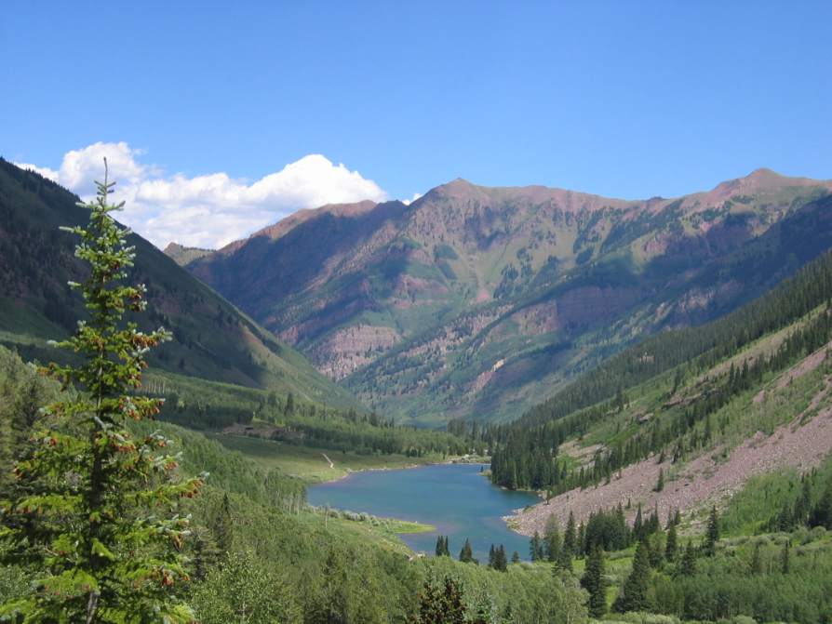
Rom. 1:20 For since the creation of the world God’s invisible qualities—his eternal power and divine nature—have been clearly seen, being understood from what has been made, so that men are without excuse.

Slide 20
Appreciating God’s Work
God, the Creator of all things, rules over all and deserves our worship and adoration
  Psa. 103:22 Praise the LORD, all his works everywhere in his dominion. Praise the LORD, O my soul.
The cosmos reveals its Creator’s wisdom and goodness
  Psa. 19:1 The heavens declare the glory of God; the skies proclaim the work of his hands. 2 Day after day they pour forth speech; night after night they display knowledge.
Creation is sustained and governed by His power and loving kindness
  Col. 1:17 He is before all things, and in him all things hold together.

Slide 21
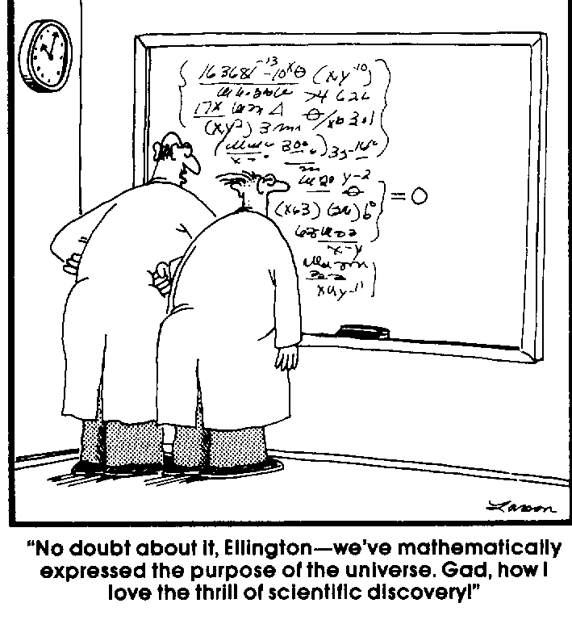
Stewardship assumes we have purpose

Slide 22
What is our purpose?
  Man's chief and highest end is to glorify God, and fully to enjoy him forever.
    Rom. 11:36 For from him and through him and to him are all things. To him be the glory forever! Amen.
    Rev. 4:11 “You are worthy, our Lord and God, to receive glory and honor and power, for you created all things, and by your will they were created and have their being.”
  We are are ambassadors for Christ
    2Cor. 5:20 We are therefore Christ’s ambassadors, as though God were making his appeal through us. We implore you on Christ’s behalf: Be reconciled to God.
  God’s ambassador’s should reflect and express an appreciation for His works

Slide 23
Stewardship
We do not own the Earth
  “The earth is the Lord’s, and everything in it.”; 1Cor. 10:26
  Col. 1:16 For by him all things were created: things in heaven and on earth, visible and invisible, whether thrones or powers or rulers or authorities; all things were created by him and for him.
We are accountable for what we do in this life
  So then, each of us will give an account of himself to God. Rom. 14:12
We are to protect the environment so that
  Others have the resources they need
  All can witness the Creator’s handiwork

Slide 24
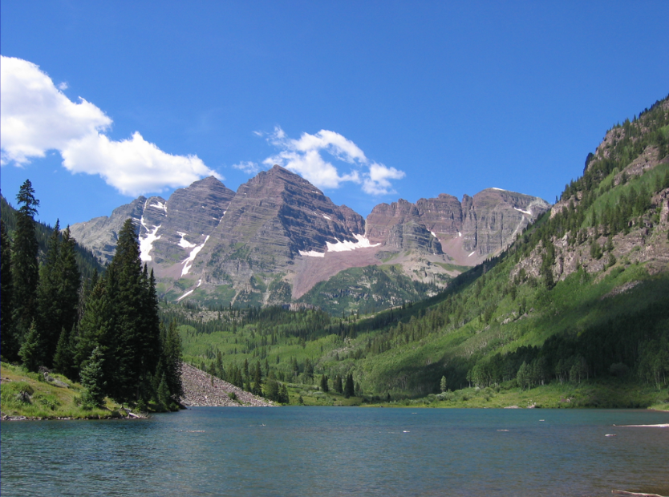
"Since the creation of the world God's invisible qualities, His eternal power and divine nature have been clearly seen, being understood from what has been made, so that men are without excuse." (Romans 1:20)

Slide 25
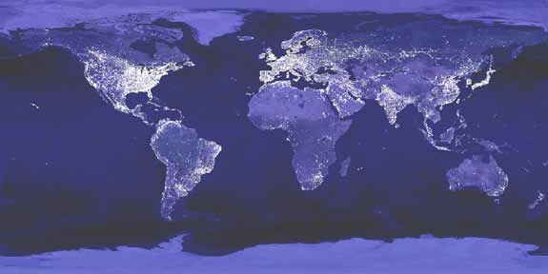
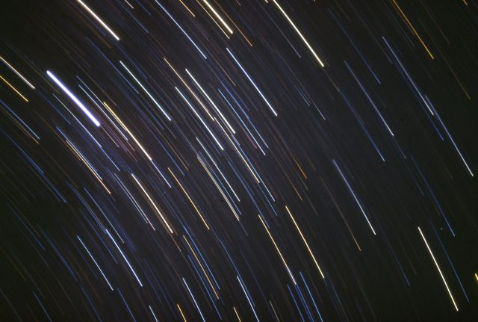

Slide 26
God Sustains Creation
The Bible says that God sustains his creation
  Matt. 6:26 Look at the birds of the air; they do not sow or reap or store away in barns, and yet your heavenly Father feeds them. Are you not much more valuable than they?
  Psa. 145:15 The eyes of all look to you, and you give them their food at the proper time. 16 You open your hand and satisfy the desires of every living thing.
Our goals should be consistent with God’s in caring for His Work

Slide 27
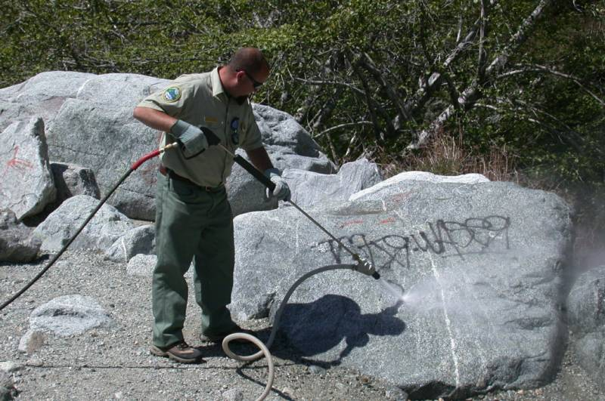

Slide 28
God Rejoices in His Creation —
Throughout Scripture, we find the Creator rejoicing in his works
  Psa. 104:24 How many are your works, O LORD! In wisdom you made them all; the earth is full of your creatures. 25 There is the sea, vast and spacious, teeming with creatures beyond number— living things both large and small. 31 May the glory of the LORD endure forever; may the LORD rejoice in his works—
He pays attention to even the most insignificant
  Matt. 10:29 Are not two sparrows sold for a penny? Yet not one of them will fall to the ground apart from the will of your Father.
God describes his creatures with awe, admiration, and pleasure.
  Gen. 1:31 God saw all that he had made, and it was very good.
Scripture commands us to tend creation so that it can be preserved and regenerate itself (Deuteronomy 22:6-7).

Slide 29
Human Responsibility Toward Creation —
Humans have a very special place within creation
  Psa. 8:3 When I consider your heavens, the work of your fingers, the moon and the stars, which you have set in place, 4 what is man that you are mindful of him, the son of man that you care for him?
  Psa. 8:5 You made him a little lower than the heavenly beings and crowned him with glory and honor. 6 You made him ruler over the works of your hands; you put everything under his feet: 7 all flocks and herds, and the beasts of the field, 8 the birds of the air, and the fish of the sea, all that swim the paths of the seas.
Our commission is to serve as stewards of creation.
  Gen. 2:15 The LORD God took the man and put him in the Garden of Eden to work it and take care of it.
Scripture provides us with a mandate to take care of what God has made

Slide 30
STEWARDSHIP
We are stewards of God's creation, not owners.
Stewardship is an act of worship.
Stewardship of creation is an act of responsibility for future generations. We are commanded to look out for the needs of others.
  Phil. 2:4 Each of you should look not only to your own interests, but also to the interests of others.
We act on behalf of the One above or those to come to maintain and assure the fruitfulness of God's Creation.

Slide 31
We have not been good stewards
"Is it not enough for you to feed on the good pasture? Must you also trample the rest of your pasture with your feet? Is it not enough for you to drink clear water? Must you also muddy the rest with your feet?" (Ezekiel 34:18)
"Hear the word of the Lord...because the Lord has a charge to bring against you who live in the land: There is no faithfulness, no love, no acknowledgment of God in the land.... Because of this the land mourns, and all who live in it waste away; the beasts of the field and the birds of the air and the fish of the sea are dying." (Hosea 4:1-3)
“Woe to you who add house to house and join field to field till no space is left and you live alone in the land.” (Isaiah 5:8)

Slide 32
Stewardship of Natural Resources
Scripture teaches that humans can enjoy the benefits of creation (Genesis 1:29-30).
One can not enjoy the benefits of something that no longer exists.
All creation is to enjoy these benefits, not just us.
We are to share with others, and guard against greed as we enjoy the resources God has entrusted to us.
  Luke 12:15 Then he said to them, “Watch out! Be on your guard against all kinds of greed; a man’s life does not consist in the abundance of his possessions.”

Slide 33
Christian Environmental Ethic
1. God rules over all and deserves our worship and adoration.
2. The universe reveals its Creator's wisdom and is sustained and governed by His power and loving kindness.
3. We were created in the image of God, and commanded to exercise stewardship of the earth.
Environmental Stewardship affirms that human well-being and the integrity of creation are dynamically interdependent realities.

Slide 34
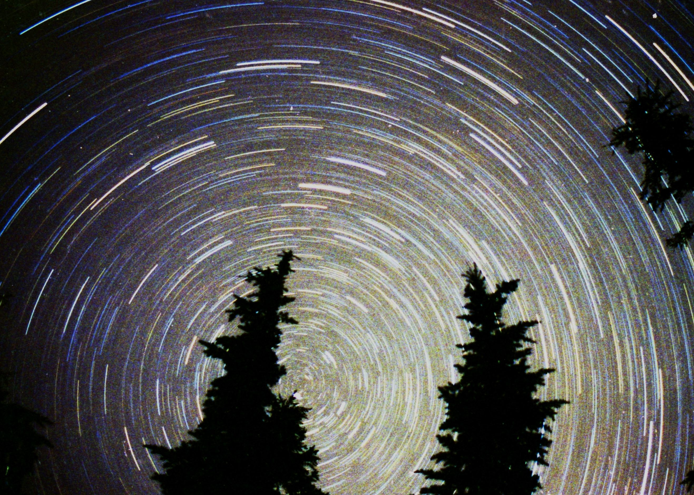
Eccl. 3:11 He has made everything beautiful in its time. He has also set eternity in the hearts of men; yet they cannot fathom what God has done from beginning to end.

Slide 35
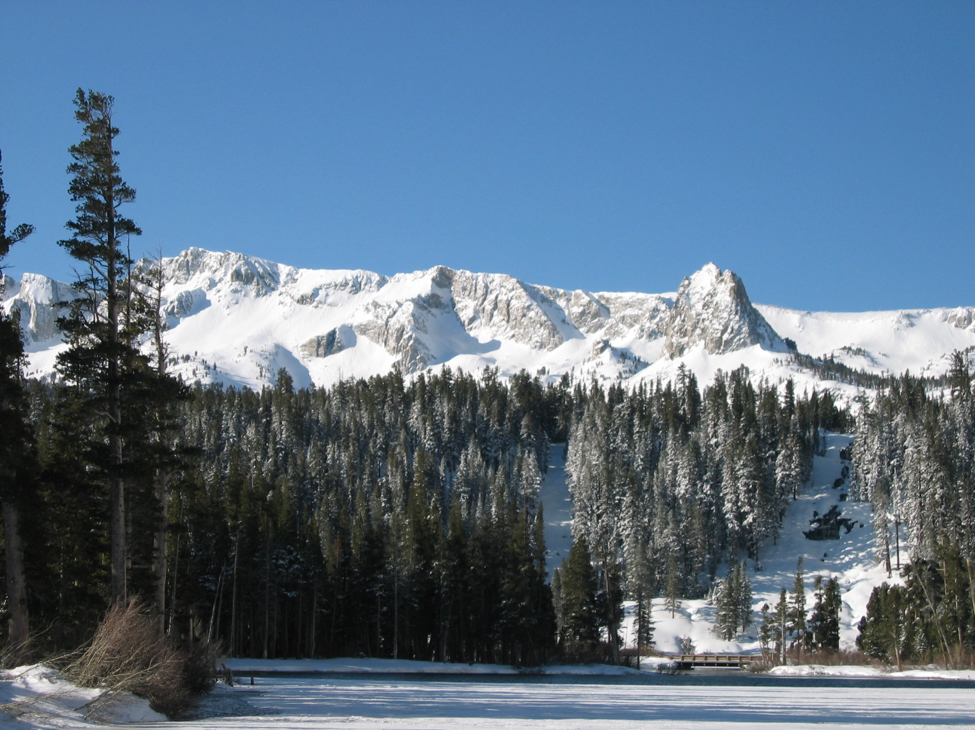
For the beauty of the earth,
For the glory of the skies,
For the love which from our birth
Over and around us lies.
  Lord of all to Thee we raise
  This our hymn of grateful praise.

