Slide 1


Data Mining Journal Entries for Fraud Detection: A Pilot Study
Symposium on Information Systems Assurance
October 1-3, 2009
Roger S. Debreceny
Shidler College of Business
University of Hawai‘i at Mānoa
Glen L. Gray
College of Business & Economics
California State University, Northridge

Slide 2



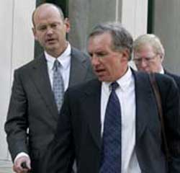
Learning from History

Slide 3
Some Bad Boys
WorldCom
  Many adjusting journal entries from expense accounts to capital expenditure accounts
  Amounts large and well known in organization
  Not well hidden—large, round amounts
  Designed to influence disclosure rather than recognition
  JEs made at corporate level
Cendant Corporation
  Many small JEs
Xerox, Enron, and Adelphia…

Slide 4
Learning from History -Cendant
“shows to have been a carefully planned exercise”
.. with a large number of “unsupported journal entries to reduce reserves and increase income were made after year-end and backdated to prior months; merger reserves were transferred via inter-company accounts from corporate headquarters to various subsidiaries and then reversed into income; and reserves were transferred from one subsidiary to another before being taken into income”
  Special report to Audit Committee

Slide 5
Research Background

Slide 6
Background
Financial statement manipulations
Journal entry manipulations
Increased emphasis on fraud detection as element of financial audit
  SAS 99 & IAS 240
  Sarbanes-Oxley Act 2002

Slide 7
Background
Recommended SAS 99 tests:
  Non-standard journal entries
  Entries posted by unauthorized individuals or individuals who while authorized do not normally post journal entries
  Unusual account combinations
  Round number
  Entries posted after the period-end
  Differences from previous activity
  Random sampling of journal entries for further testing

Slide 8
Background
JE data mining literature = 0
Audit firms are doing JE data analysis with IDEA/ACL/Excel/Access [Frequency & depth?]
Challenge: JEs = Too much evidence
  Atomic level JEs
  Jumbo JEs
  Potential for massive false positives
RQ1: What is the potential of JE data mining?
RQ2: What are the general characteristics of a JE data set? (e.g., Does Benford’s Law apply?)

Slide 9
JE Data Mining Questions
What are the sources of the JEs? How do those sources influence data mining? For the particular enterprise?
Are there unusual patterns in the JEs between classes of accounts?
Does the class of JE influence the nature of the JE? For example, do adjusting JEs carry a greater probability of fraud?
Is there evidence of unusual patterns in the amount of the JEs either from the left most digits (Benford’s Law) or from the right most digits (Hartigan and Hartigan’s dip test)?
How can we triangulate and combine these various possible drivers of fraud in the JEs to allow directed data mining?

Slide 10
The Data

Slide 11
Journal Entry Dataset
36 real organizations—only names changed
29 organizations = Balanced JEs for 12 months
Variety of…
  Size
  Industries
  Mix of public, private, not-for-profit
Good news/bad news: JEs are messy real-world JEs
(e.g., compound JE where a specific debit has no relationship to specific credit)

Slide 12
JE Dataset Preparation
Created master (standardized) chart of accounts w/ 5-4 structure
  1,672 accounts in the master Chart of Accounts, with 343 primary (five digits) accounts
Converted existing chart of accounts to master chart of accounts
  496,182 line items converted

Slide 13
Active Accounts in Organizational Chart of Accounts
Minimum | 43
Maximum Active Accounts | 1036
Median Active Accounts | 107
Average Active Accounts | 164

Slide 14
Transactions Per Five Digit Accounts
Minimum | 1
Maximum | 44,916
Median | 86
Mean | 1,401
Standard Deviation | 4,784

Slide 15
Expected Digit Distribution under Benford’s Law
Digit | Probability | Digit | Probability
1 | 30.1% | 6 | 6.7%
2 | 17.6% | 7 | 5.8%
3 | 12.5% | 8 | 5.1%
4 | 9.7% | 9 | 4.6%
5 | 7.9%

Slide 16
Benford’s Law Results
The distributions for all 29 organization was statistically different than expected distribution
Now what?
  Auditor: Investigate why certain numbers are occurring more frequently. (e.g., storage units rent for $100, $200, or $300)
  Researcher: Investigate if JEs violate one or more underlying Benford’s Law assumptions.

Slide 17
Last (Right-most) Digits
Should be random (uniform) distributions with the same number of 0's, 1's, etc.
However, even the 4th digit left of the decimal point did not have uniform distributions
  8 organizations had at least one number that appeared 3 times the expected distribution
Looking at the 3 last digits (to the left of the decimal point)
  For 4 organizations, the top-5 most frequent combinations appears in 30% to 60% of the lines vs. the expected 0.5%

Slide 18
Unusual Temporal Patterns
Most common forms of financial fraud center on revenue recognition
Red flag = unusual activity at quarter end and/or year end
But first must determine normal activity
2 of 29 organizations had highest volume in last month
1 of 29 organizations had highest average dollar values in last month

Slide 19
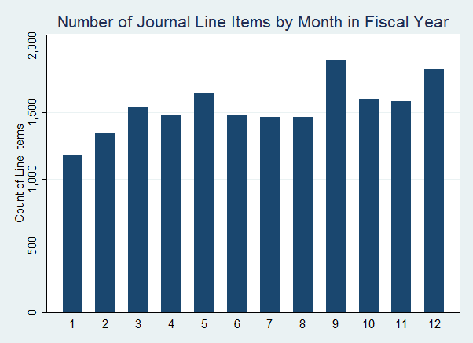
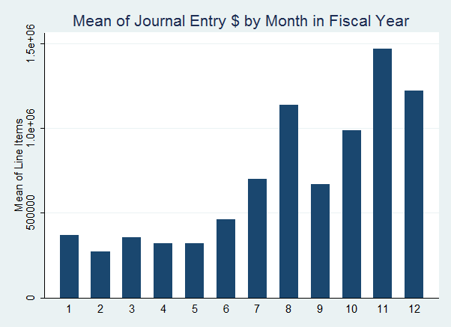
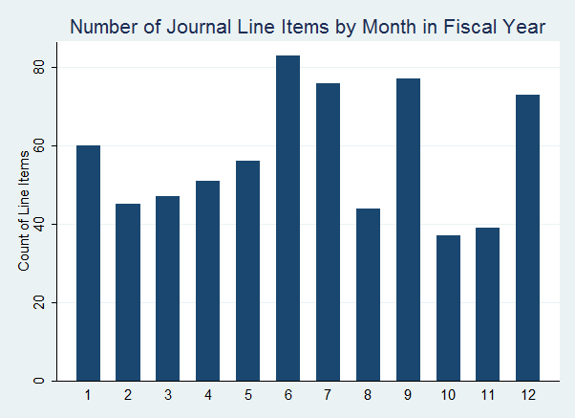
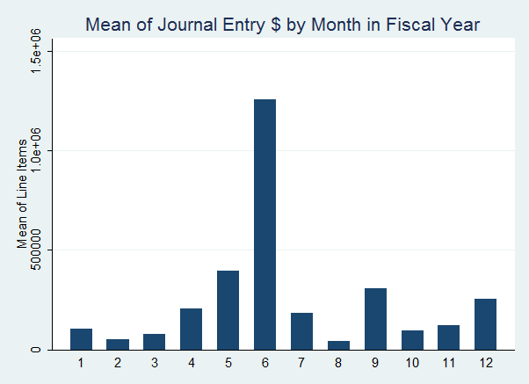
Unusual Temporal Patterns

Slide 20
Conclusions
The real world is messy.
For all 29 entities, the Chi-square distribution indicates that the first digits of journal dollar amounts differs from that expected by Benford's Law. Why?
8 of the 29 entities had one of the fourth digits being three times more than expected. Why?

Slide 21
Conclusions
Regarding the distribution of last 3 digits…
  4 entities had a very high occurrences of the top-five three-digit combination involving only a small set of accounts,
  1 had a low occurrences of the top-five three-digit combination involving a large set of accounts, and
  24 had a low occurrences of the top-five three-digit combination involving a small set of accounts
  All else being equal, the first 4 firms probably pose the highest risk of fraud

Slide 22
Future
Apply many more data mining techniques to discover other patterns and relationships in the data sets.
Seed the dataset with fraud indicators (e.g., pairs of accounts that would not be expected in a journal entry) and compare the sensitivity of the different data mining techniques to find these seeded indicators
Leverage the Matrix relationships of Journal Entries systematically

