Slide 1
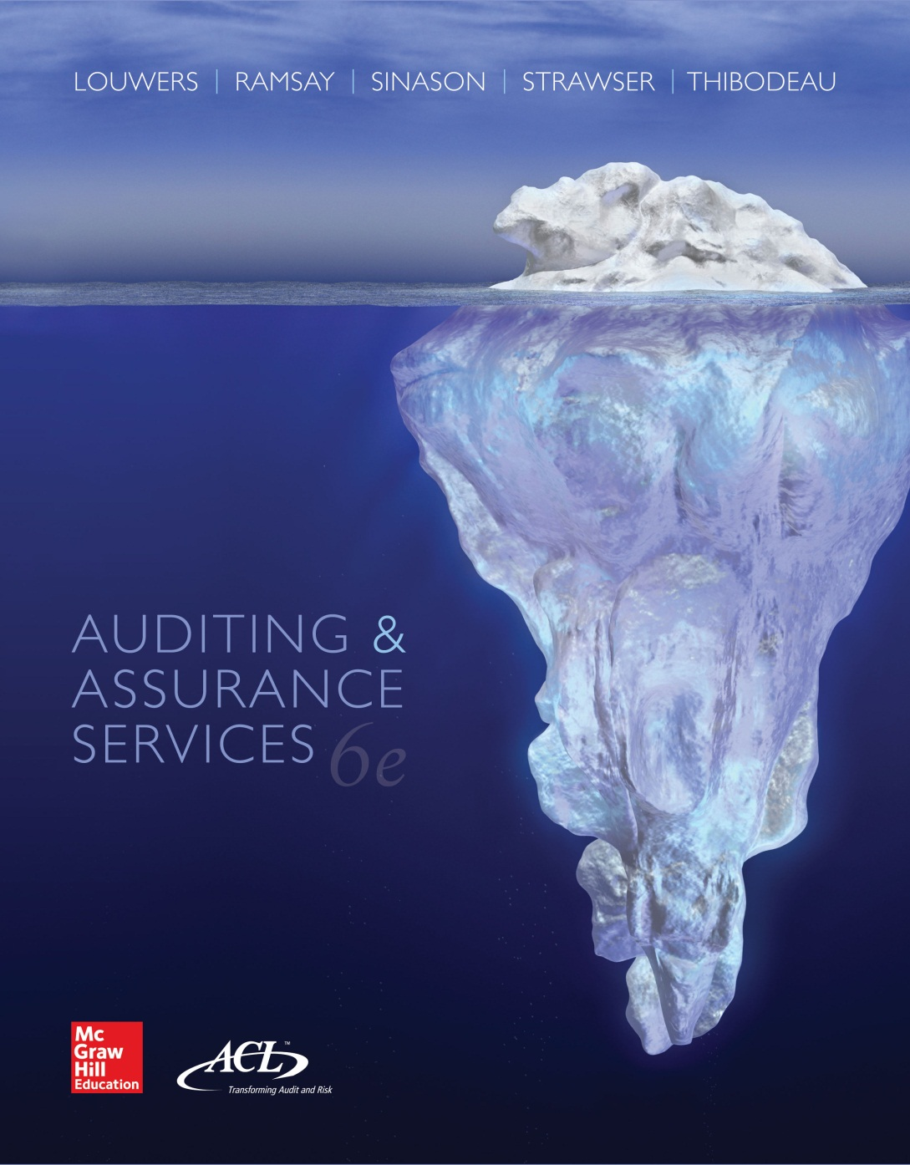
Auditing & Assurance Services, 6e

Slide 2
Module H
Auditing and Information Technology
"To err is human, but to really foul things up you need a computer.“
--Paul Ehrlich, American biologist, author, and technology commentator
“A common mistake people make with trying to design
something completely foolproof is to underestimate the ingenuity
of complete fools.”
--Douglas Adams , author of The Hitchhiker’s Guide
to the Galaxy
Mod H-2

Slide 3
Module H Objectives
Identify how the use of a automated transaction processing system impacts the audit examination.
Provide examples of general controls and understand how these controls relate to transaction processing in an accounting information system.
Provide examples of automated application controls and understand how these controls relate to transaction processing in an accounting information system.
Describe how the audit team assesses control risk in a IT environment.
Identify how audit teams perform tests of controls in a IT environment.
Describe the characteristics and control issues associated with end-user and other computing environments.
Define and describe computer fraud and the controls that can be used to prevent it.
Mod H-3

Slide 4
Major Topics
Background
General Controls
Automated Application Controls
Tests of Computer Controls
End-Use Computing and Other
Mod H-4

Slide 5
Issues Introduced in a IT environment
Input errors
Systematic vs. random processing errors
Lack of an audit trail
Inappropriate access to computer files and programs
Reduced human involvement in processing transactions
Mod H-5

Slide 6
Impact of Automated Transaction Processing on the Evaluation of I/C
Phase | Effect(s)
Understanding | Understand and document controls related to automated processing of transactions
Assessment | Consider controls related to automated processing of transactions in preliminary assessment of control risk
Testing | Identify , test, and evaluate degree of compliance of controls related to automated processing of transactions
Mod H-6

Slide 7
Types of Computer Controls
General Controls
  Relate to all applications of an accounting information system (pervasive)
  Deficiencies will affect processing of various types of transactions
Automated Application Controls
  Relate to specific business activities
  Directly address management assertions
Mod H-7

Slide 8
Major Topics
Background
General Controls
Automated Application Controls
Tests of Computer Controls
End-Use Computing and Other
Mod H-8

Slide 9
Categories of General Controls
Program development controls
Program change controls
Computer operations controls
Access to programs and data controls
Mod H-9

Slide 10
Program Development Controls
Acquisition and development of new programs is properly authorized and conducted with organization policies
Appropriate users participate in process
Programs and software are tested and validated prior to use
Programs and software have appropriate documentation
Mod H-10

Slide 11
Systems Development Life Cycle
Identify
Requirements
Conversion/
Implementation
Feasibility
Analysis
Employee
Training
Determine
System
Specifications
Daily
Operations
Develop
Programs
Maintenance/
System Auditing
System Analysis
Design
Procedures
Mod H-11

Slide 12
Program Change Controls
Modifications to existing programs are properly authorized and conducted with entity policies
Appropriate users participate in process
Programs are tested and validated prior to use
Programs have appropriate documentation
Additional controls related to “emergency” change requests and migrating new programs into operations
Mod H-12

Slide 13
Computer Operations Controls
Relate to processing of transactions and backup and recovery of data
Processing environments
  Batch processing: Similar transactions collected and processed simultaneously
  Real-time processing: Transactions processed as they occur without delay
Mod H-13

Slide 14
Examples of Computer Operations Controls
Methods of resolving processing failures
Separation of duties
  Systems analysts
  Programmers
  Computer operators
Files and data
  Labels to ensure use of appropriate file
  Storage in remote, protected locations (disaster recovery)
  Grandfather-father-son
Mod H-14

Slide 15
Access to Programs and Data Controls
Relate to restricting use of programs and data to authorized users
Examples
  Passwords
  Automatic terminal logoff
  Review access rights and compare to usage (through logs)
  Report and communicate security breaches
Mod H-15

Slide 16
General Controls and Assertions
Assertion | Explanation | Examples
Accuracy | Ensure accuracy of data and testing computer programs prior to implementation | Hardware controls Program development controls Program change controls Computer operations controls
Occurrence | Restricting inappropriate access reduces probability of fictitious transactions | Computer operations controls Access to programs and data controls
Mod H-16

Slide 17
Major Topics
Background
General Controls
Automated Application Controls (I-P-O)
Tests of Computer Controls
End-Use Computing and Other
Mod H-17

Slide 18
Input Controls
Provide reasonable assurance that input is properly authorized and accurately entered for processing
  All transactions input
  Transactions input once and only once
  Transactions input accurately
Mod H-18

Slide 19
Summary of Input Controls
 | Input accurate | All transactions entered | Transactions entered only once
Data entry and formatting | X
Check digits | X
Record counts |  | X | X
Batch totals | X | X | X
Hash totals | X | X | X
Valid character test | X
Valid sign tests | X
Missing data tests | X
Mod H-19

Slide 20
Summary of Input Controls (Continued)
 | Input accurate | All transactions entered | Transactions entered only once
Sequence tests |  | X
Limit and reasonableness tests | X
Error correction and resubmission | X
Mod H-20

Slide 21
Processing Controls
Provide reasonable assurance that
  Transactions are processed accurately
  All transactions are processed
  Transactions are processed once and only once
Examples
  Test processing accuracy of programs
  File and operator controls
  Run-to-run totals
  Control total reports
  Limit and reasonableness tests
  Error correction and resubmission
Mod H-21

Slide 22
Output Controls
Provide reasonable assurance that
  Output reflects accurate processing
  Only authorized persons receive output or have access to files generated from processing
Examples
  Review of output for reasonableness
  Control total reports
  Master file changes
  Output distribution limited to appropriate person(s)
Mod H-22

Slide 23
Major Topics
Background
General Controls
Automated Application Controls
Tests of Computer Controls
End-Use Computing and Other
Mod H-23

Slide 24
Forming an Assessment of Control Risk
Identify specific types of misstatement that could occur
Identify points where misstatements could occur
Identify control procedures designed to prevent or detect misstatements
  General controls and automated application controls
Evaluate design of control procedures
  Are tests of controls cost-effective?
Mod H-24

Slide 25
Testing Computer Controls
Testing controls
  Inquiry
  Observation
  Inspect documentary evidence
  Reperformance (including test data)
Evaluating computer processing and programs
  Test processing of actual transactions
  Test processing of simulated transactions
Mod H-25

Slide 26
Test Data
Test data: Simulated transactions containing known errors to test the client’s controls
Only one type of each kind of transaction error needs to be tested.
Auditors’
Manual
Processing
Client
System
Processing
Compare
Mod H-26

Slide 27
Major Topics
Background
General Controls
Automated Application Controls
Tests of Computer Controls
End-Use Computing and Other
Mod H-27

Slide 28
End-User Environments
Control issues
  Lack of separation of duties
  Lack of physical security
  Lack of documentation and testing
  Limited computer knowledge of personnel
Implications
  Limit concentration of functions and increase supervision
  Access to program and data controls are critical
Mod H-28

Slide 29
Computer Abuse/Fraud
Use of computer technology by perpetrator to achieve gains at the expense of a victim
Controls
  Preventative: Stop fraud from entering system
  Detective: Identify fraud when it enters system
  Damage-limiting: Reduce monetary impacts of fraud and control to specified levels
Mod H-29

