Slide 1
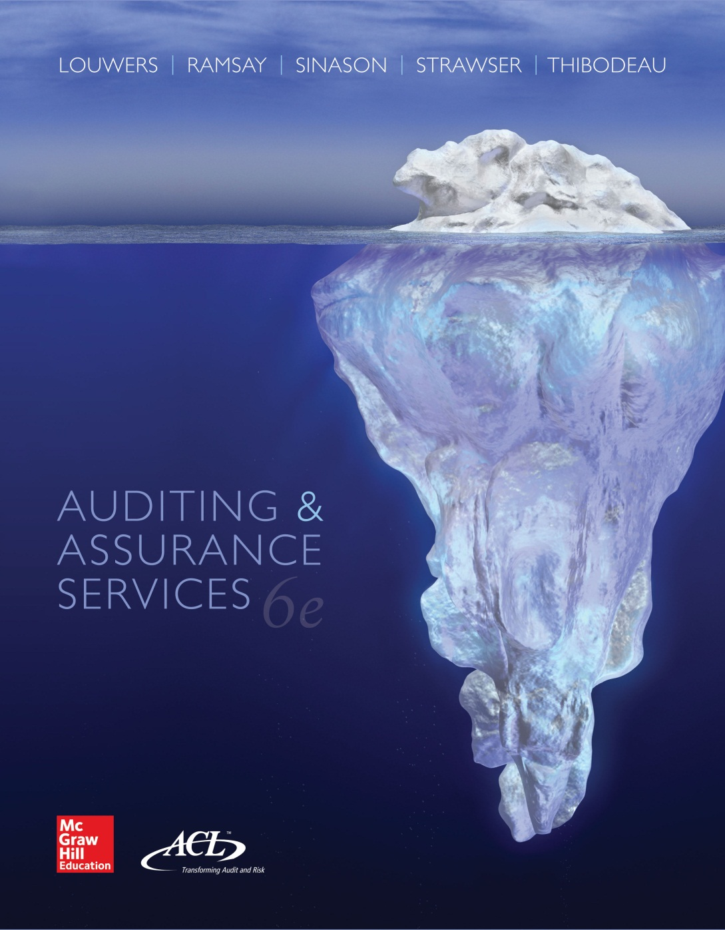
Auditing & Assurance Services, 6e

Slide 2
Module B
Professional Ethics
“Auditors must approach their jobs with independence and skepticism. How do we instill those necessary traits in auditors? This may be the most important auditing question of our time.”
James Doty, PCOAB Chairman, remarks made at SEC Reporting Conference, June 2, 2011
“To educate a person in mind and not in morals is to educate a menace to society.”
Theodore “Teddy” Roosevelt, 26th President of the United States
“Always do right—this will gratify some and astonish the rest.”
Mark Twain, famous American novelist
Mod B-2

Slide 3
Learning Objectives
Understand general ethics and a series of steps for making ethical decisions.
Reason through an ethical decision problem using the imperative, utilitarian, and virtue theories of moral philosophy.
Identify the different entities that make ethics rules for CPAs and public accounting firms.
With reference to American Institute of Certified Public Accounting (AICPA), Government Accountability Office (GAO), Public Company Accounting Oversight Board (PCAOB), and Securities and Exchange Commission (SEC) rules, analyze factual situations and decide whether an accountant’s conduct does or does not impair independence.
With reference to AICPA rules on topics other than independence, analyze factual situations and decide whether an accountant’s conduct does or does not conform to the AICPA Code of Professional of Conduct.
Explain the types of penalties that can be imposed on accountants.
Mod B-3

Slide 4
General Ethics
Mod B-4
Ethics
  that branch of philosophy which is the systematic study of reflective choice, of the standards of right and wrong by which it is to be guided, and of the goods toward which it may ultimately be directed.
  - Wheelwright, 1959
Key elements
  Decision problems
  Moral principles
  Consequences

Slide 5
What is an Ethical Problem?
Mod B-5
A problem situation exists when an individual must make a choice among alternative actions and the right choice is not absolutely clear.
An ethical problem situation may be described as one in which the choice of alternative actions affects the well-being of other persons.
More often, there is a conflict between what we should do and what we want to do.

Slide 6
An Ethical Decision Process
Mod B-6
Define all facts and circumstances
Identify stakeholders
Identify stakeholders’ rights and obligations in general and to each other
Identify alternatives and consequences
Choose superior alternative with respect to consequences and/or rules

Slide 7
Philosophical Principles in Ethics
The Imperative Principle
The Principle of Utilitarianism
  Act-utilitarianism
  Rule-utilitarianism
Virtue Ethics
Mod B-7

Slide 8
The Imperative Principle (Kant)
Directs a decision maker to act according to the requirements of an ethical rule
Strict versions of imperative ethics maintain that a decision should be made without trying to predict whether an action will create the greatest balance of good over evil
Ethics in the imperative sense is a function of moral rules and principles and does not involve a situation-specific calculation of the consequences
Mod B-8

Slide 9
The Principle of Utilitarianism (J.S. Mill)
Emphasizes examining the consequences of an action rather than following rules
The criterion of producing the greater good is made an explicit part of the decision process
In act-utilitarianism, the center of attention is the individual act as it is affected by the specific circumstances of a situation
Rule-utilitarianism emphasizes the centrality of rules for ethical behavior while still maintaining the criterion of the greatest universal good
Mod B-9

Slide 10
The Generalization Argument
A judicious combination of the imperative and utilitarian principles
Considers the consequences of a decision made by similar persons acting under similar circumstances
“What would happen if everyone acted in that certain way?”
If the answer to the question is that the consequences would be undesirable, the conclusion is that the way of acting is unethical and should not be done.
Mod B-10

Slide 11
      Virtue Ethics (Aristotle)
Setting self-focused standards for instilling intra-personal excellence and building character:
      Virtues such as honesty, openness, integrity, etc.
      Behavior you would be proud to have widely reported.
Mod B-11

Slide 12
Ethical Codes of Conduct
U.S. Securities and Exchange Commission (SEC)
The Public Company Accounting Oversight Board (PCAOB)
The International Federation of Accountants (IFAC)
The Professional Ethics Executive Committee (PEEC) of the American Institute of Certified Public Accountants (AICPA)
Applicable State Society of CPAs
Applicable State Board of Accountancy
Mod B-12

Slide 13
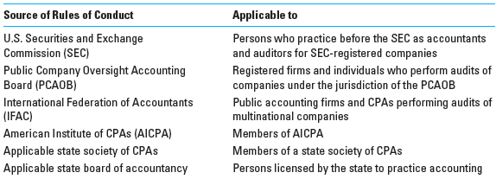
Ethical Codes of Conduct
Mod B-13

Slide 14
AICPA Code of Professional Conduct
Ideal standards of ethical conduct
Minimum standards of ethical conduct stated as specific rules
Interpretations of the rules by the AICPA division of professional ethics
Published explanations and answers to questions about rules of Conduct
Principles
Rules of Conduct
Interpretations
Ethical Rulings
Mod B-14

Slide 15
AICPA Code of Professional Conduct:
Principles
Basic tenets of ethical conduct
Responsibilities - exercise sensitive professional and moral judgment
Public Interest - honor the public trust
Integrity - perform responsibilities with the highest sense of integrity
Objectivity - impartial, unbiased, and independent, free of conflicts of interest and independent in fact and appearance
Due care - diligence, competence, thorough, prompt
Scope and nature of services - observe the principles when considering the scope and nature of services provided
Mod B-15

Slide 16
AICPA Code of Professional Conduct
Rules of Conduct
Interpretations
Ethics Rulings
Authority is derived from the Bylaws of the AICPA
Mod B-16

Slide 17
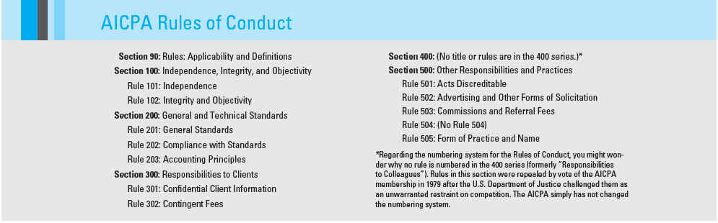
AICPA Rules of Conduct
Mod B-17

Slide 18
An Emphasis on Independence
Rule 101: Independence
  A member in public practice shall be independent in the performance of professional services as required by standards promulgated by bodies designated by Council.
Mod B-18

Slide 19
Conceptual Framework for AICPA Independence Standards
In April 2006, the PEEC adopted the Conceptual Framework for AICPA Independence Standards, which describes the PEEC’s risk-based approach to analyzing independence issues that arise:
  Identify and evaluate threats to independence.
  Determine whether safeguards eliminate or sufficiently mitigate the identified threats.
  Determining whether independence is impaired.
Mod B-19

Slide 20
Threats to an Auditor’s Independence
Familiarity threat. CPAs having a close or longstanding relationship with a client.
Adverse interest threat. CPAs acting in opposition to clients (e.g., through litigation).
Undue influence threat. Attempts to coerce or otherwise influence the CPA member (e.g., significant gifts or threats to replace the auditor over an accounting principles disagreement).
Self-review threat. CPAs reviewing their own work.
Financial self-interest threat. CPAs having a financial relationship with a client.
Management participation threat. CPAs taking on the role of client management or otherwise performing management functions.
Advocacy threat. CPAs promoting a client’s interests or position.
Mod B-20

Slide 21
Who is a Covered Member?
Covered members include
All individuals participating in an engagement.
An individual in a position to influence the engagement.
A partner or manager who provides nonattest services to an attest client.
A partner in the office where engagement partner practices.
The firm’s benefit plan.
An entity that can be controlled by any person considered a member.
Mod B-21

Slide 22
AICPA Code of Professional Conduct
Rule 101: Independence
Applies to attestation engagements (audits and reviews)
Financial relationships
  No direct financial interest
  No material indirect financial interests
  No material joint ventures with client, officers, directors, or shareholders
  Loans - normal lending practices, collateral required
Managerial relationships
  Cannot act as a promoter, underwriter, or equivalent to an employee (i.e., no decision making)
Mod B-22

Slide 23
AICPA Code of Professional Conduct
Rule 101: Independence
For the purpose of independence
Immediate family members have the same restrictions as the member
  Spouse, spousal equivalent, or dependent cannot have
    A direct financial interest
    A material indirect financial interest
    Hold a position of influence with an audit client
Close relative
  All immediate family members and parents, siblings, or nondependent child cannot
    Ownership or control of an audit client
    Employment with a client in an audit sensitive position
Mod B-23

Slide 24
AICPA Code of Professional Conduct
Rule 101: Independence
Write-up services are allowed if:
Client understands and accepts the statements as their own
Auditor does not assume a role of employee or management
No other relationship that impairs integrity and objectivity
Exception: Cannot do write-up services for public company clients
Mod B-24

Slide 25
AICPA Code of Professional Conduct
Rule 101: Independence
Loans from financial institutions are permitted if:
Obtained prior to 2/5/01 under old rules.
Obtained prior to the lender becoming a client.
The loan was sold to an attest client.
The loan was obtained before the CPA became a member.
Loans on life insurance.
Fully collateralized by cash deposits, loans, leases, etc.
Credit cards and cash advances less than $10,000.
Mod B-25

Slide 26
AICPA Code of Professional Conduct
Rule 101: Independence
Threatened litigation impairs independence if
management and the auditors are suing each other.
But, Lawsuits from 3rd parties do not effect independence.
Management
Auditor
Mod B-26

Slide 27
AICPA Code of Professional Conduct
Rule 101: Independence
Financial interest in a nonclient may impair
independence when the nonclient has a financial
interest in the client.
Owns
Owns
Auditor
Nonclient
Client
Audit
Mod B-27

Slide 28
SEC & PCAOB Independence Rules
An auditor’s independence depends on auditors both having the proper mental state and passing the appearance test. Thus they must have:
Independence in fact
  A mental state of objectivity and lack of bias
Independence in appearance
  depends on whether a reasonable investor, with knowledge of all relevant facts and circumstances, can conclude that the auditor is not capable of exercising objective and impartial judgment.
Mod B-28

Slide 29
SEC & PCAOB Independence Rules
The SEC and PCAOB rules prohibit or place restrictions on the following types of nonaudit services provided to audit clients:
Financial information systems design and implementation;
Appraisal or valuation services;
Actuarial services;
Internal audit services;
Management functions;
Human resources;
Broker-dealer services;
Legal services;
Expert services;
Any service for an audit client for a contingent fee or commission;
Tax services that are based on judicial proceedings or aggressive interpretations of tax law;
Planning or opining on the tax consequence of a transaction;
Tax services for key company executives.
Mod B-29

Slide 30
SEC & PCAOB Independence Rules
SEC rules require that companies (not auditors) disclose the following in proxy statements delivered to their shareholders :
Total audit fees to the public accounting firm for the annual audit and the reviews of quarterly financial information;
Total fees to the public accounting firm for tax and other advisory work;
Whether the audit committee or the board of directors considered the public accounting firm’s advisory work to be compatible with maintaining the auditor’s independence;
If more than 50 percent, the percentage of the audit hours performed by persons other than the principal auditor’s full-time, permanent employees.
Mod B-30

Slide 31
AICPA Code of Professional Conduct
Rule 102: Integrity and Objectivity
CPAs must remain free of conflicts of interest
  A conflict of interest may exist when there is a significant relationship with a person, entity, product, or service that could be viewed as impairing the members objectivity
Do not knowingly misrepresent facts.
May not subordinate judgments to others.
Do not knowingly make false or misleading entries in an entity’s financial records.
Mod B-31

Slide 32
AICPA Code of Professional Conduct
Rule 102: Integrity and Objectivity
If disagreements exist concerning the preparation of financial statements or the recording of transactions, accept the supervisor’s position if acceptable.
  Report to higher level if supervisor’s position is not acceptable.
  Consider resigning if upper management will not take appropriate action.
Mod B-32

Slide 33
AICPA Code of Professional Conduct
Rule 201: General Standards
Rule 202: Compliance with Standards
Rule 203: Compliance with Accounting Principles
Follow professional standards and interpretations.
Perform only those services that can be completed with professional competence.
Exercise due care.
Adequately plan and supervise all engagements.
Obtain sufficient relevant data to afford a reasonable basis for all conclusions and recommendations.
Mod B-33

Slide 34
AICPA Code of Professional Conduct
Rule 301: Confidentiality of Client Information
Mod B-34
A CPA cannot disclose confidential information without client's consent.
Exceptions:
  To remain in compliance with standards (Rule 203)
  If workpapers are subpoenaed by court
  As part of a PCAOB peer or quality review of practice
  As part of an ethics violation for a state board of accountancy investigation

Slide 35
AICPA Code of Professional Conduct
Rule 302: Contingent Fees
Mod B-35
Contingent Fees: Those fees based on a particular finding or outcome
Not permitted for attest engagements
Not contingent if:
  Fixed by courts
  Based on hours worked or services provided
Allowed for non-attest (tax, consulting, litigation support) engagements

Slide 36
AICPA Code of Professional Conduct
Rule 501: Acts Discreditable
A member shall not commit an act discreditable to the profession (including, but not limited to):
Discrimination
Failure to follow GAGAS on a Governmental audit
Making false or misleading journal entries
Failure to met requirements of a Governmental body, commission, or regulatory body
Failure to file personal income tax return
Disclosure of CPA examination questions or answers
Mod B-36

Slide 37
AICPA Code of Professional Conduct
Rule 502: Advertising and Solicitation
Mod B-37
Advertising and solicitation of new clients is permitted.
Advertising: Cannot be “false, misleading, or deceptive”
  Cannot create false or unjustified expectations of favorable results
  Cannot state ability to influence third parties
  Cannot underestimate fees (“low balling”)

Slide 38
AICPA Code of Professional Conduct
Rule 503: Commissions and Referral Fees
Commissions: Receiving fees for recommending the products or services of clients or third parties (non-CPA)
  Permitted for non-attest, if disclosed
  Prohibited for attest engagements
Referrals: Receiving fees for recommending the services of CPAs
  Permitted for any engagement, if disclosed
Mod B-38

Slide 39
AICPA Code of Professional Conduct
Rule 505: Form of Organization and Name
A firm can practice in any form permitted by state including:
  Limited Liability Partnership (LLP)
  Limited Liability Corporation (LLC)
Firm name should not be misleading.
All partners must be CPAs or members of AICPA if included in firm name.
Mod B-39

Slide 40
International Ethics Standards Board for Accountants (IESBA) Code
The IESBA Code must be followed by auditors whenever an audit engagement is completed for a multinational client.
The importance has increased dramatically in recent years with the globalization of companies and their audits.
As a result, the PEEC of the AICPA has recently undertaken a project to recodify the AICPA Code of Professional Conduct to converge with the IESB ethical standards.
Project is expected to be completed by the end of 2014.
Mod B-40

Slide 41
Regulation and Quality Control
Mod B-41
Self-Regulatory Discipline
  AICPA
  State Societies of CPAs
Public Regulation Discipline
  State Boards of Accountancy
  SEC
  PCAOB
  IRS

