Slide 1
World War II
(in 70 minutes)

Slide 2
Origins?
- in Europe
- in Asia

Slide 3
Legacy of The Great War
Resentment
Germany and the Treaty of Versailles
Japan and “Western condescension”

Slide 4
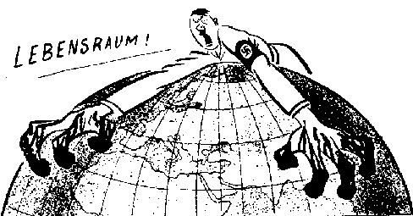
Hitler and “Lebensraum”

Slide 5
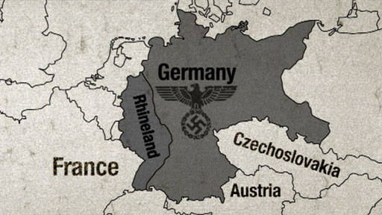
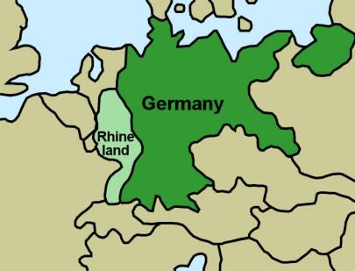
Reoccupation of the
Rhineland – March 1936

Slide 6
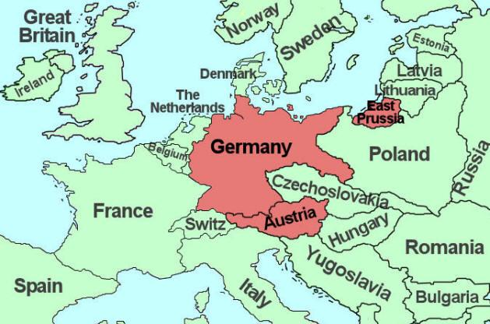
“Anschluss”
- March 1938

Slide 7
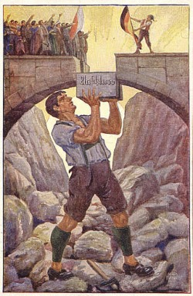

Slide 8
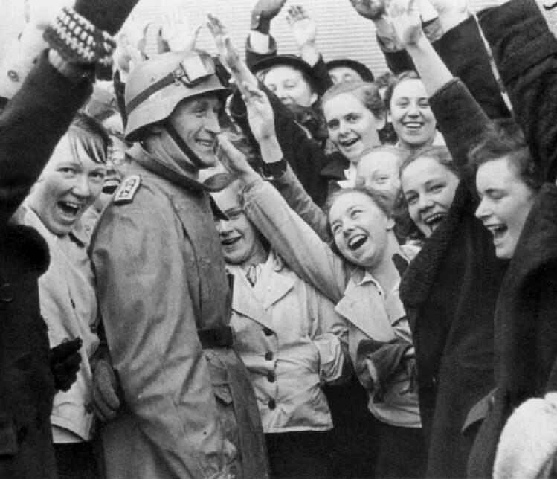

Slide 9
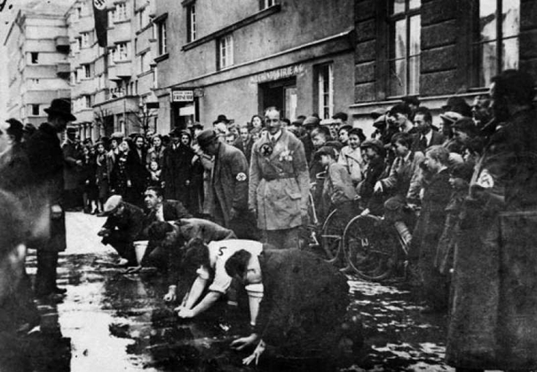

Slide 10
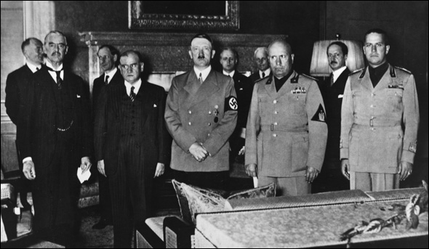
The Munich Agreement
September 1938

Slide 11
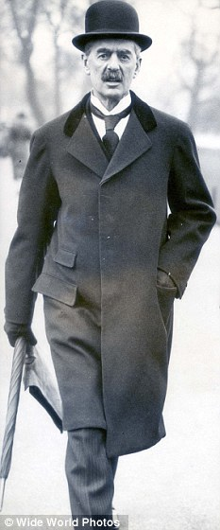
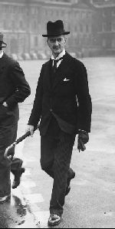

Slide 12
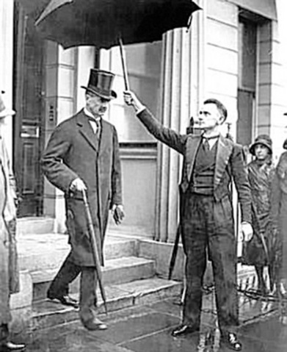

Slide 13
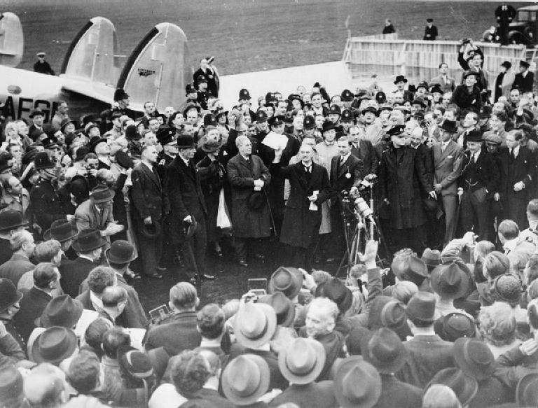

Slide 14
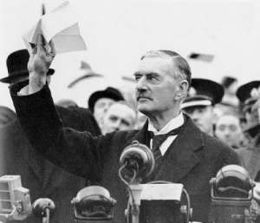

Slide 15
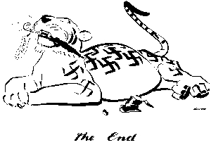

Slide 16
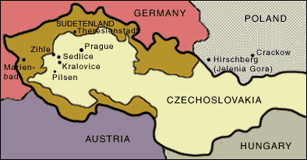
The Sudetenland
- October 1938

Slide 17
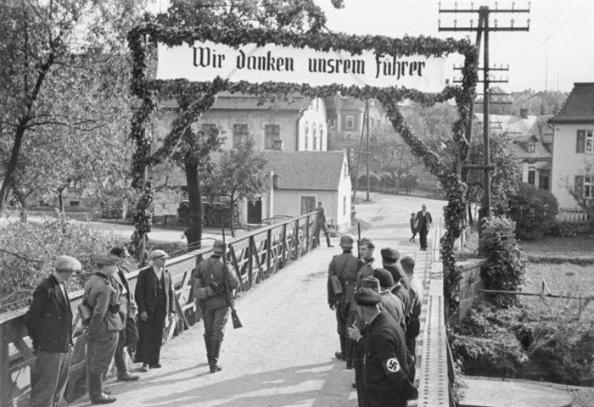

Slide 18
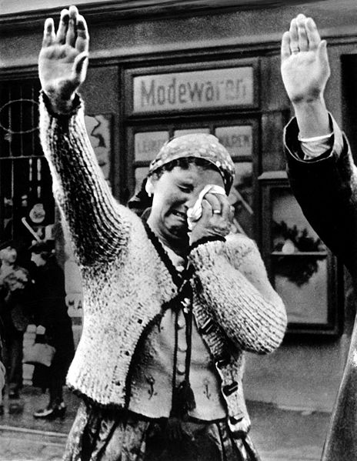

Slide 19
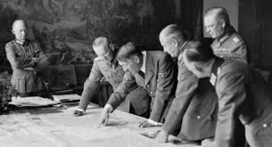
What’s next for Hitler?
-- France?
-- Great Britain?

Slide 20
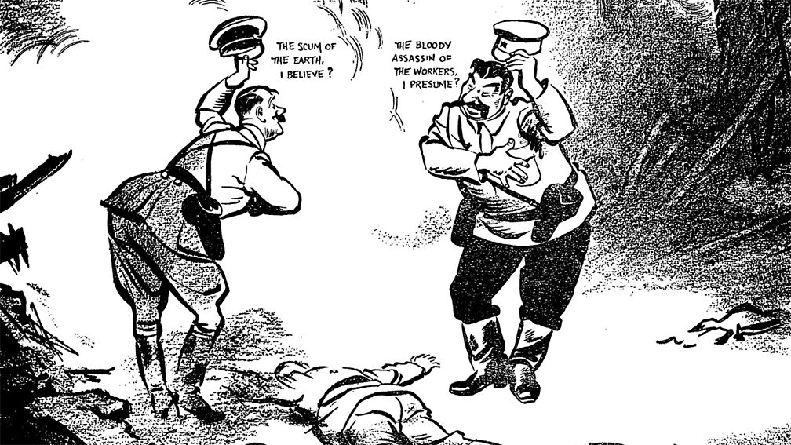
Nazi-Soviet Pact

Slide 21
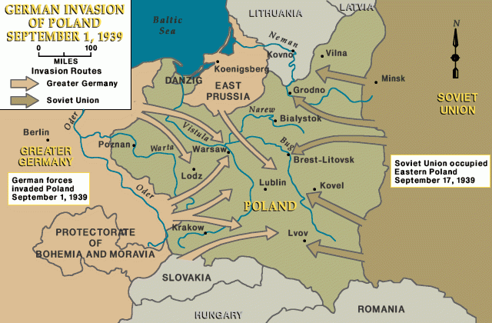
Invasion of Poland
September 1, 1939

Slide 22
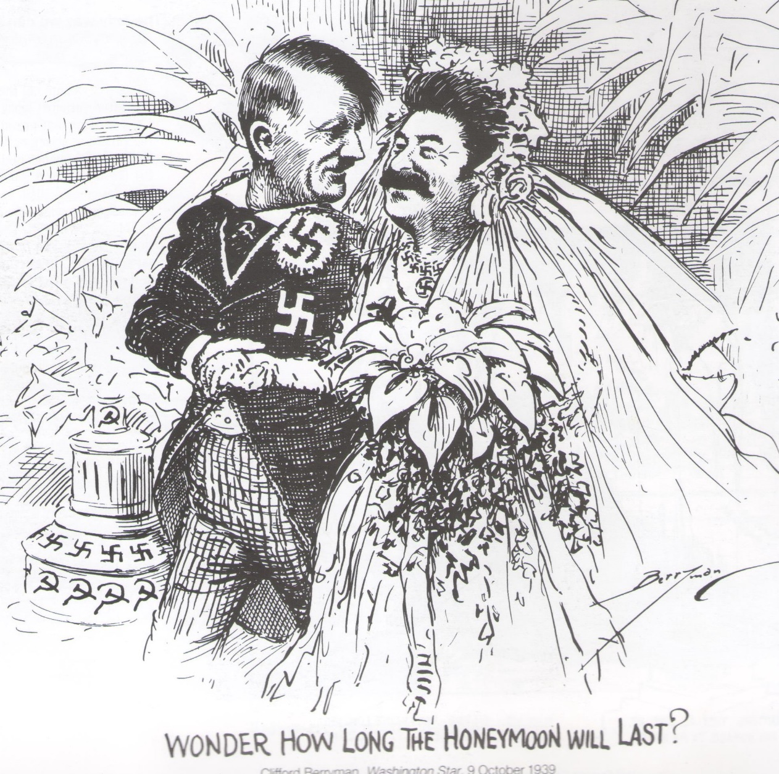

Slide 23
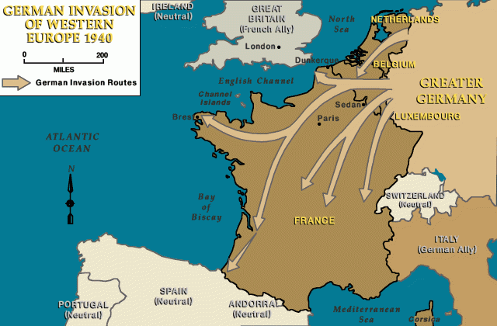
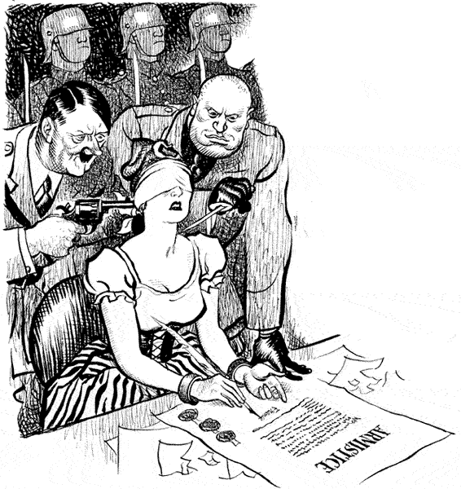
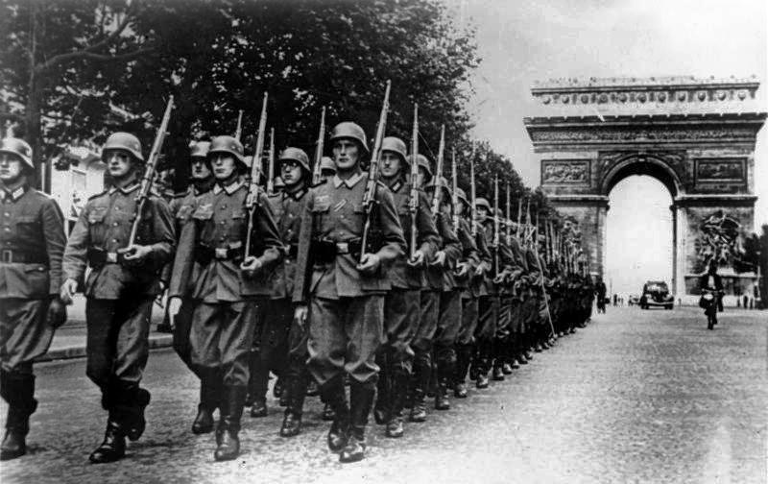
The Fall of France
May - June 1940

Slide 24
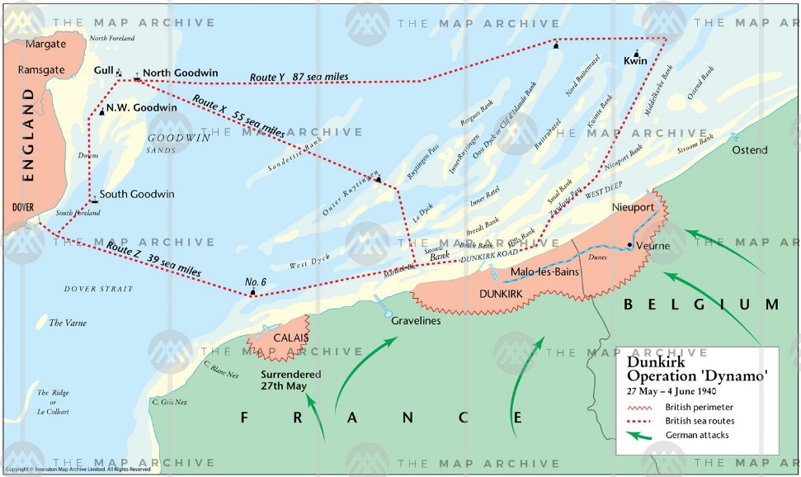
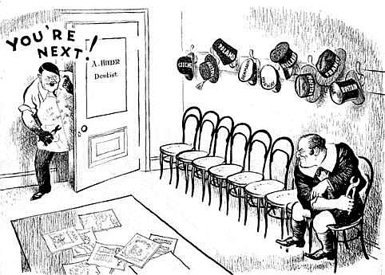
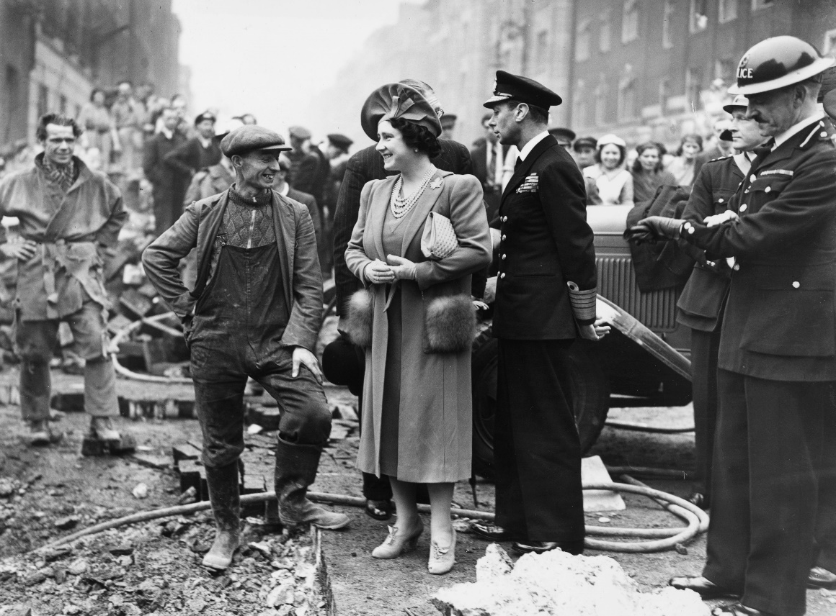
Dunkirk and the Battle of Britain

Slide 25
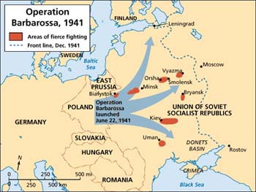
Operation Barbarossa

Slide 26
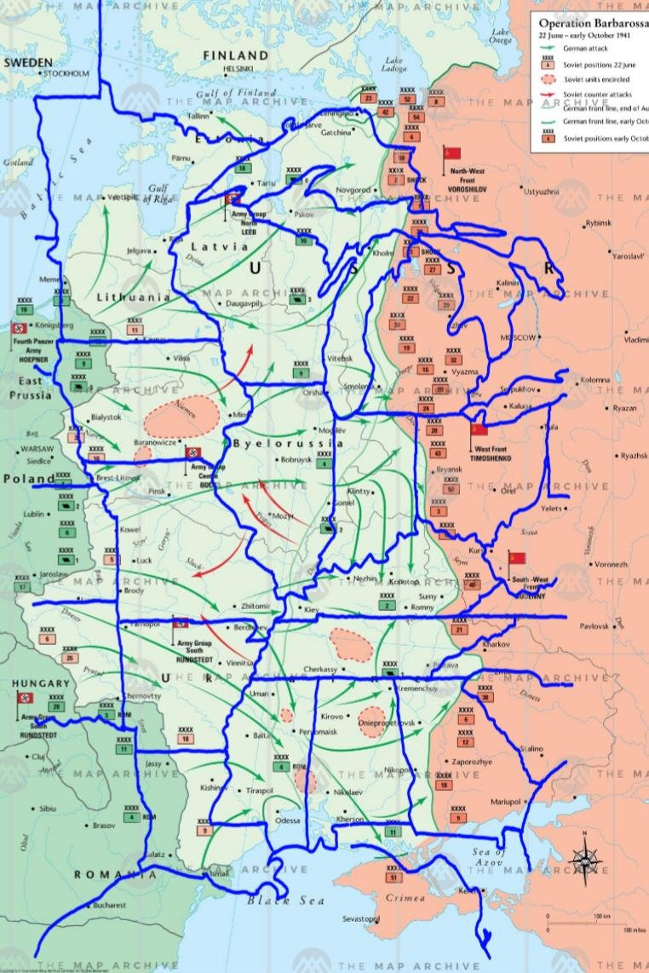

Slide 27
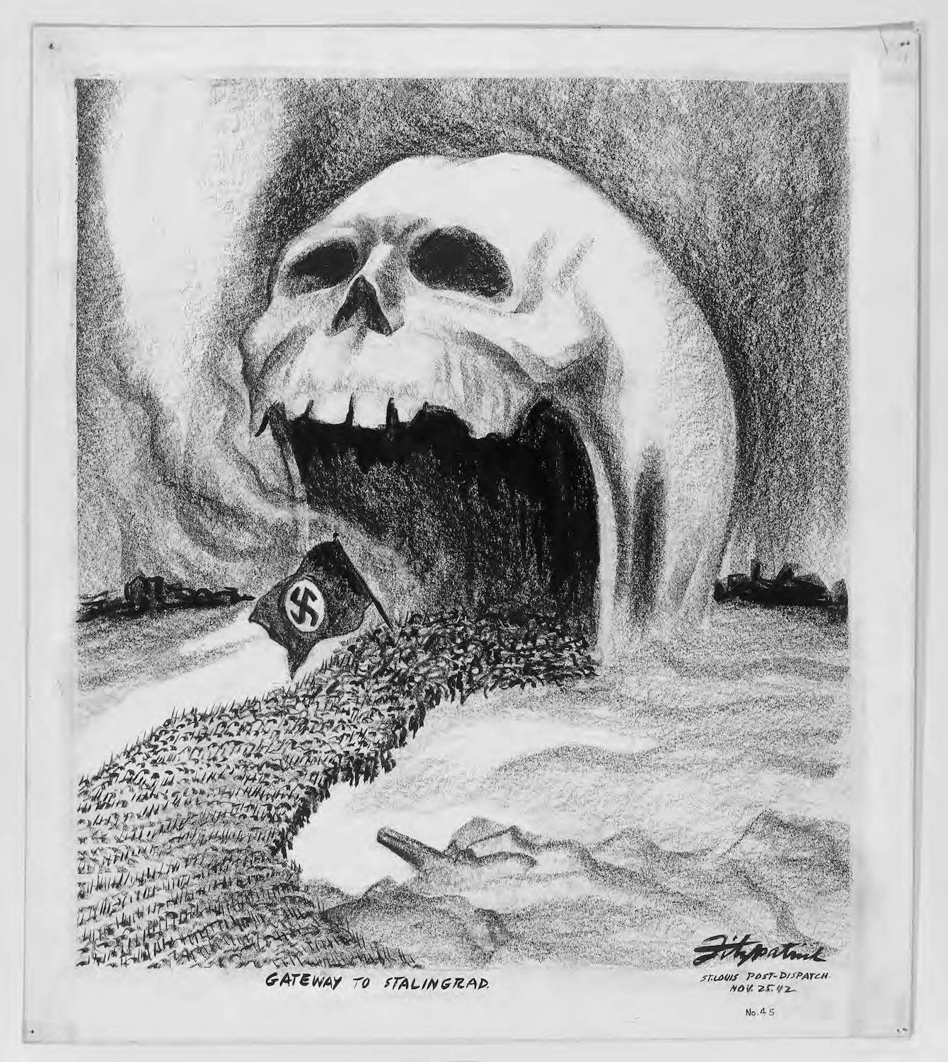
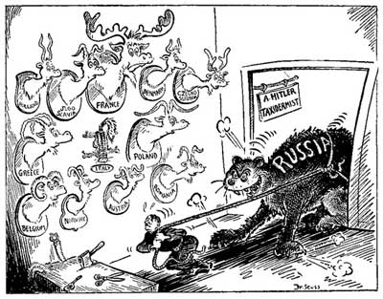
Invading Russia = Bad Idea

Slide 28
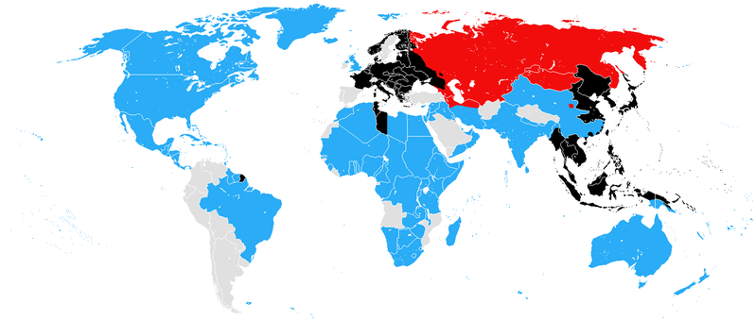
The U. S. Role?
FDR and the idea of a “Second World War”

Slide 29
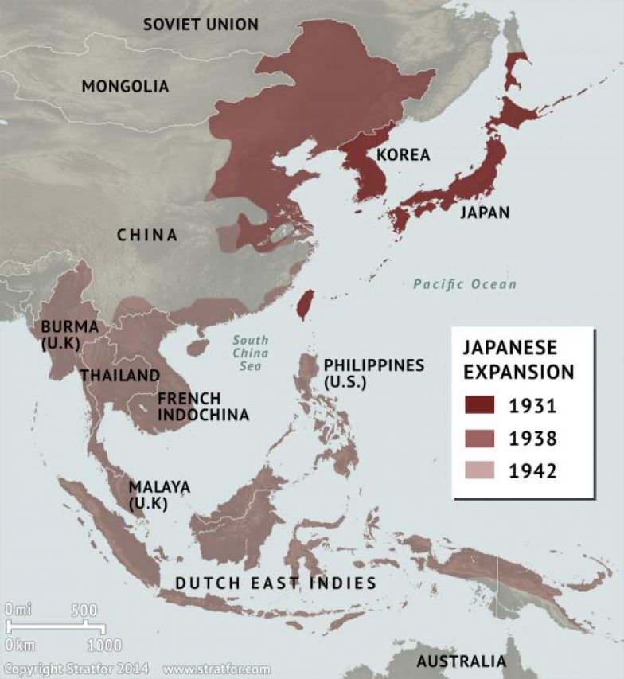

Slide 30
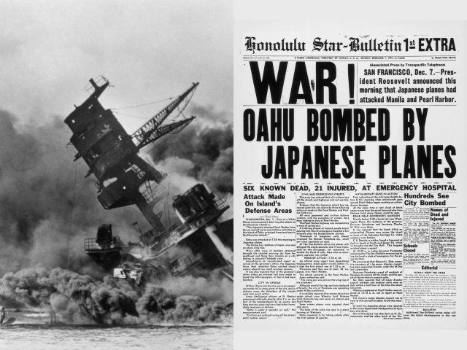
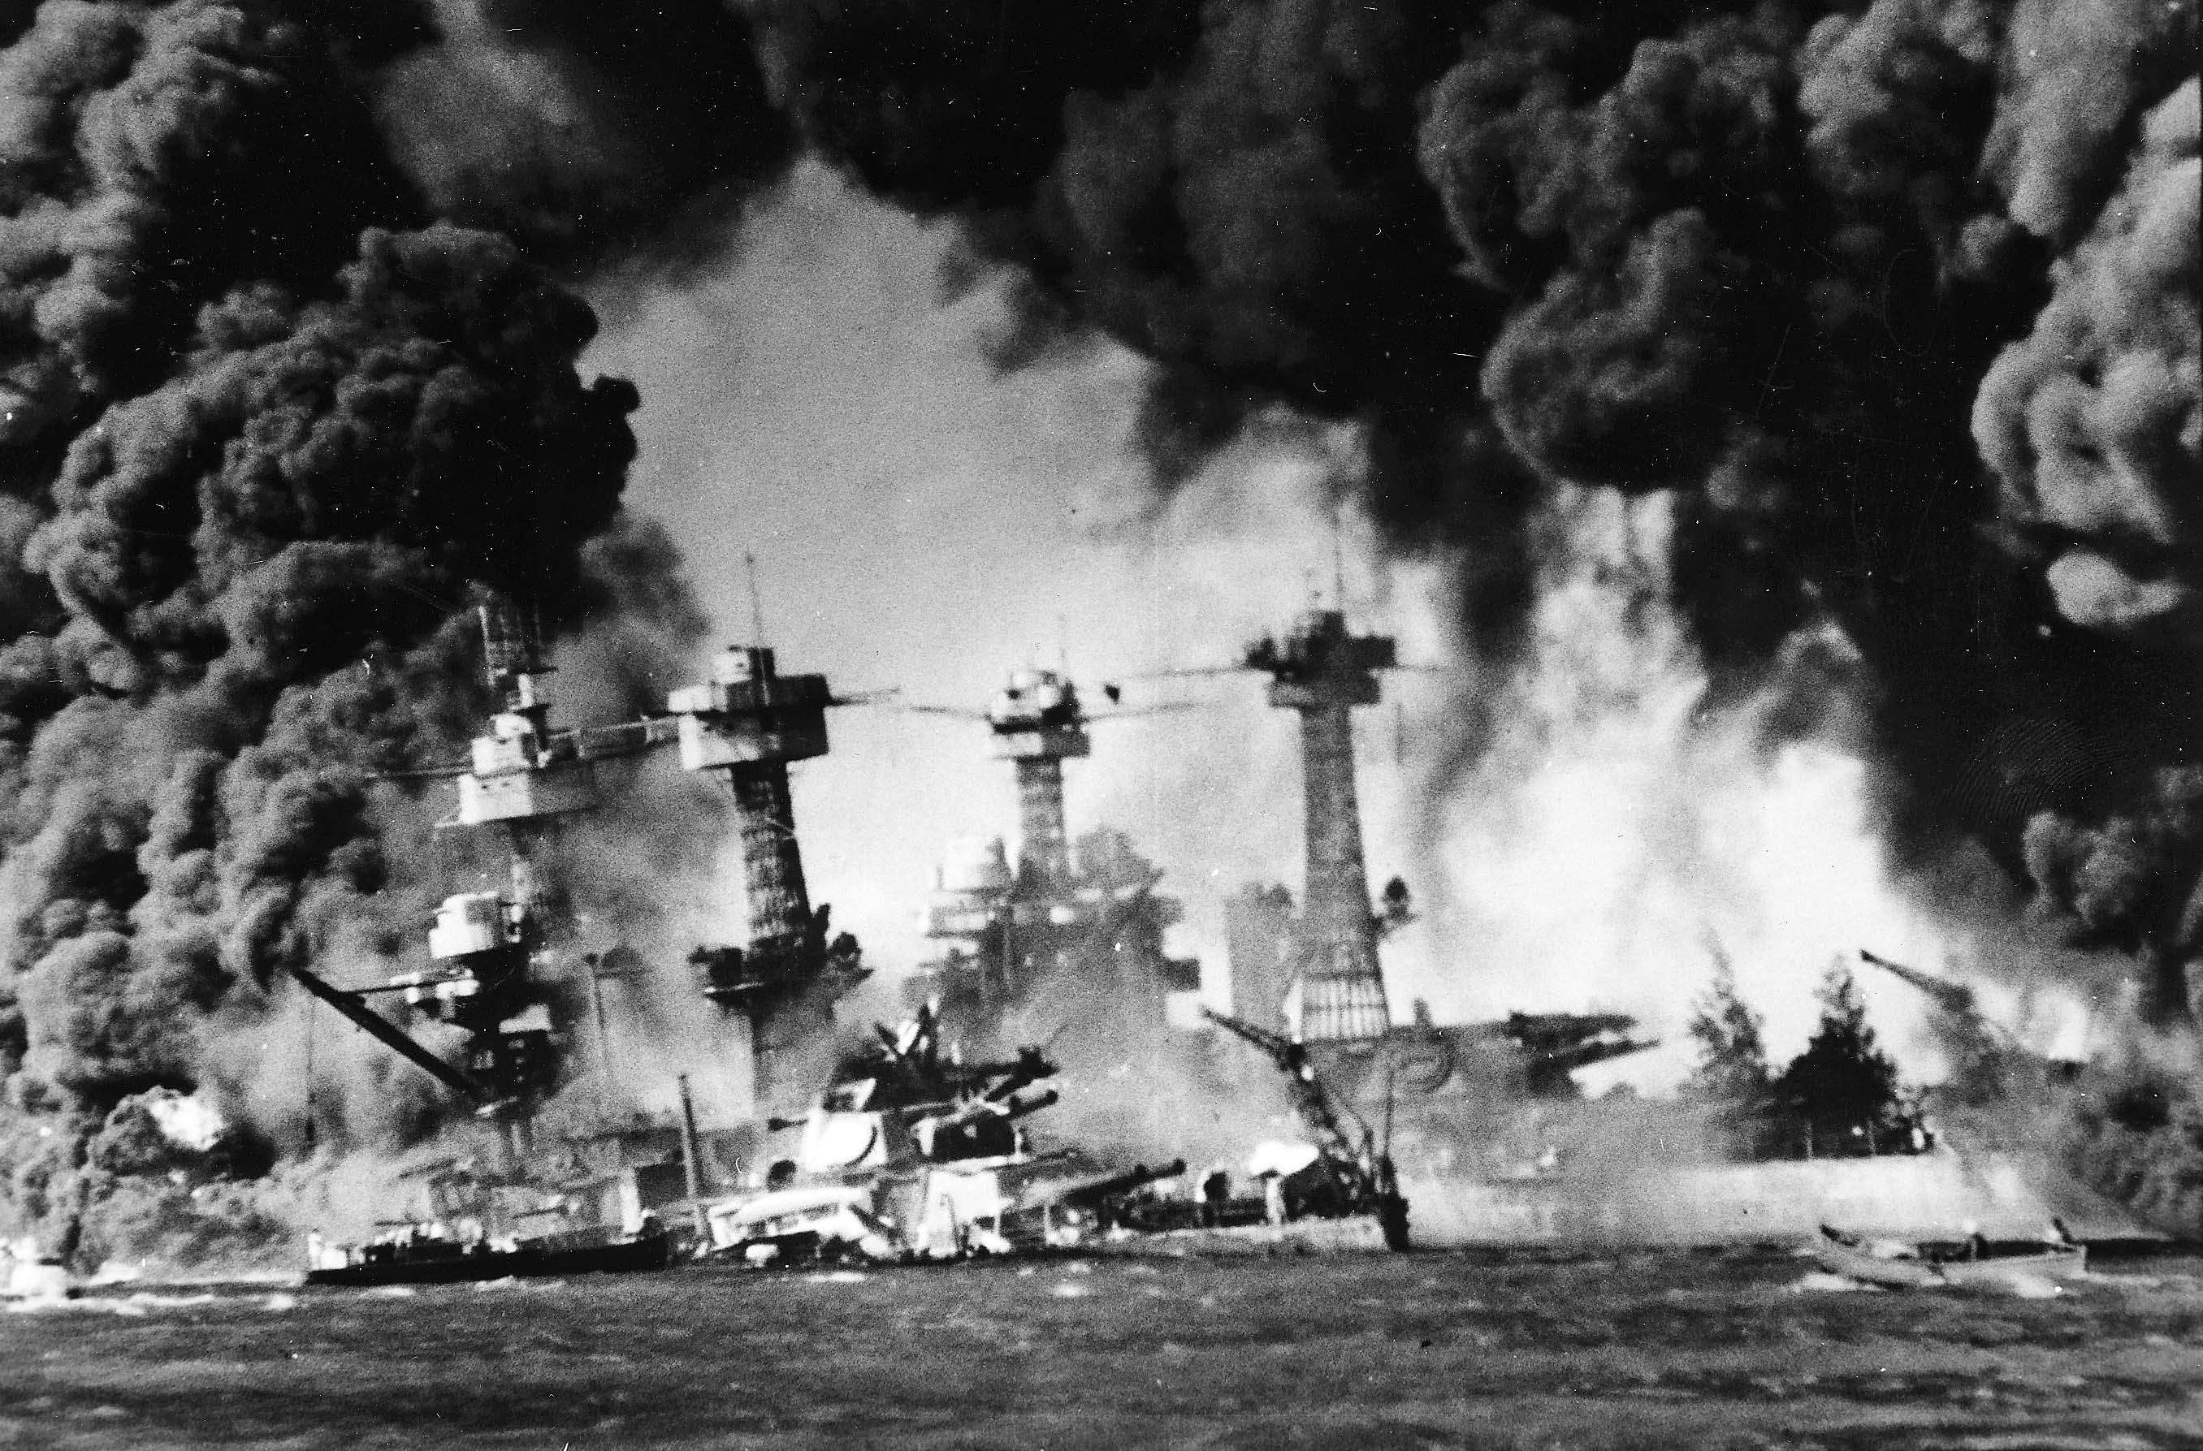
Day of Infamy

Slide 31
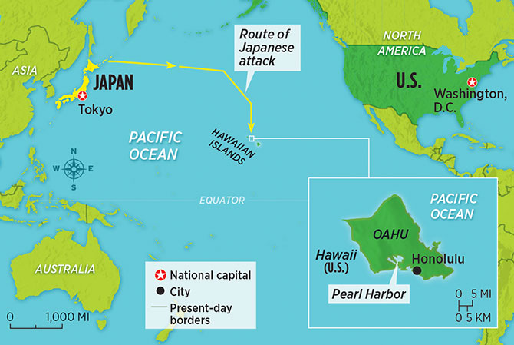

Slide 32
“I went to bed and slept the sleep of the saved…. Now at this very moment I knew that the United States was in the war, up to the neck and in to the death….Our history would not come to an end ... Hitler's fate was sealed. Mussolini's fate was sealed. And as for the Japanese, they would be ground to a powder.”
--Winston Churchill

Slide 33
"I shall run wild considerably for the first six months or a year, but I have utterly no confidence for the second and third years.“
--Isoroku Yamamoto, Marshall Admiral of the Japanese Imperial Navy

Slide 34
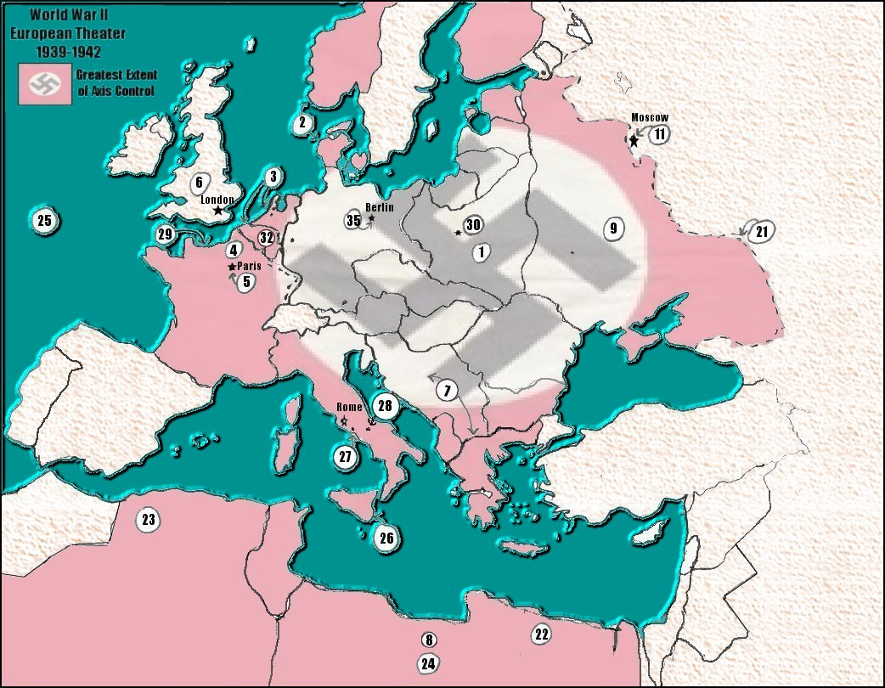
The European Theater -- 1942

Slide 35
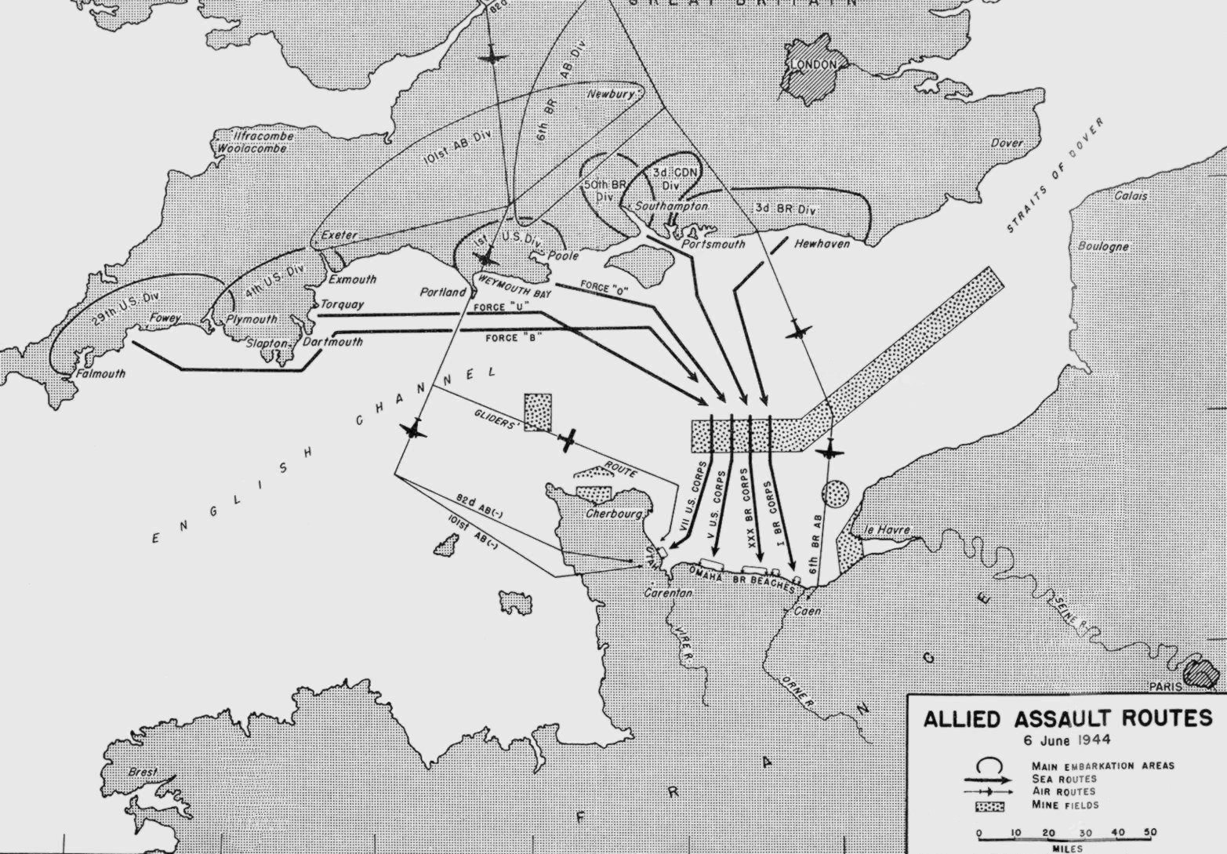
“D- Day”

Slide 36
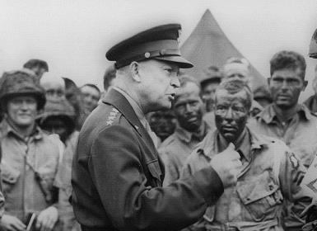

Slide 37
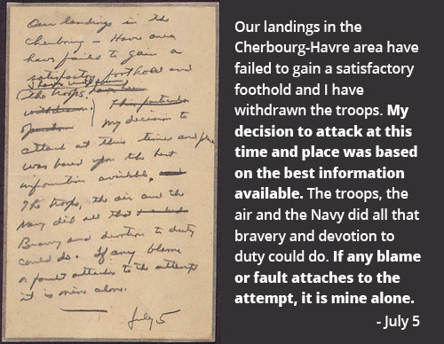

Slide 38
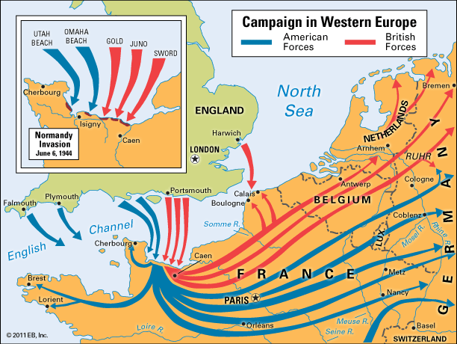

Slide 39
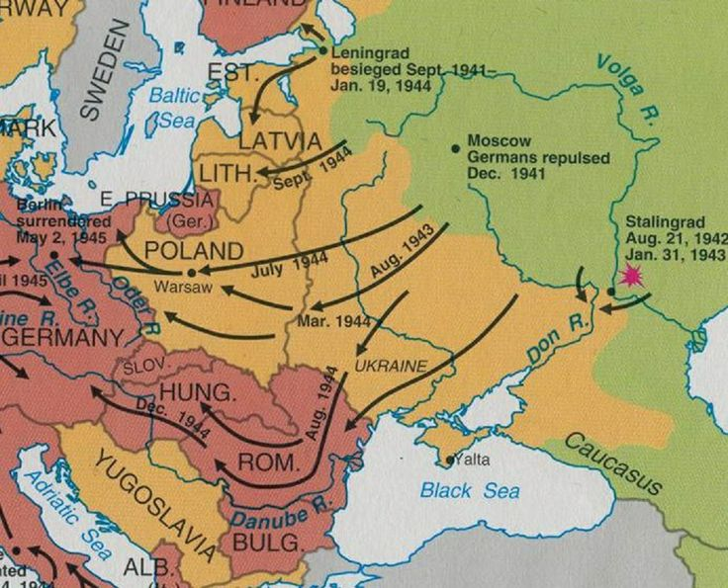
Eastern Front

Slide 40
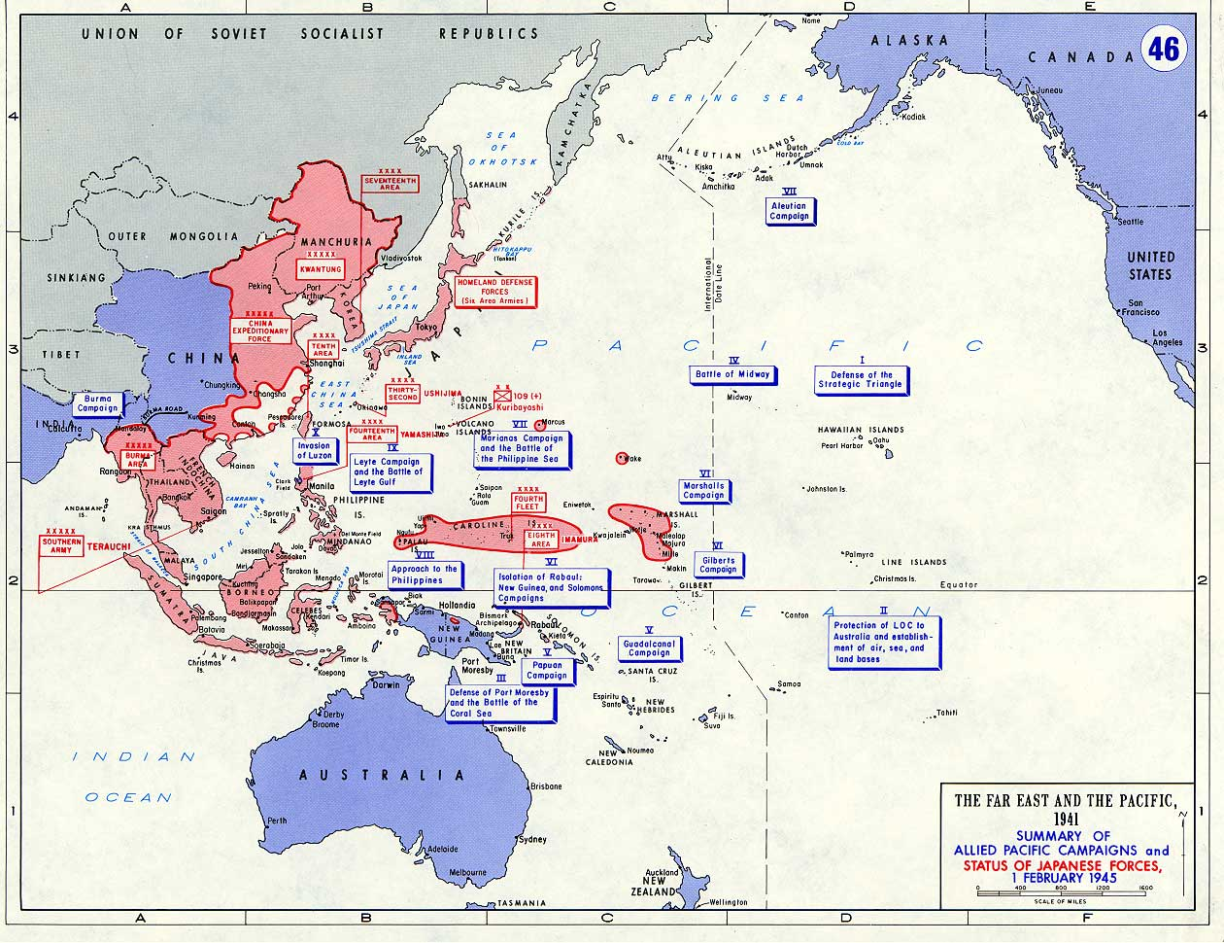
Pacific “Island Hopping”

Slide 41
