Slide 1
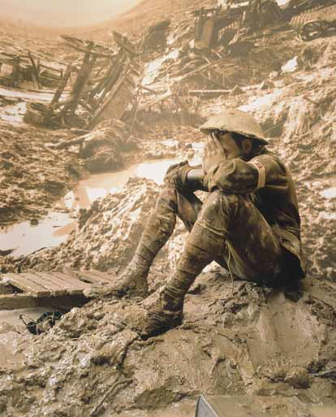
World War I – 1914 -1918

Slide 2
Four Major Questions:
Why did war break out in Europe in August 1914?
How did the United States respond to the European War?
Why did the United States support the Allies (Great Britain and France)?
What did Woodrow Wilson hope to achieve during and after the war?

Slide 3
So What?
U.S. emerges as a world power.
U.S. introduces an “American style” of foreign policy that remains with us today (for good or ill).
World War I unleashes forces that continue to cause bloody conflicts in the 21st Century.

Slide 4
Why did the war break out in Europe in August 1914?
Short term reasons
Long term reasons

Slide 5
Assassination of Archduke Franz Ferdinand
- Threat to the Austro-Hungarian Empire
- Catalyst for broader European conflict

Slide 6
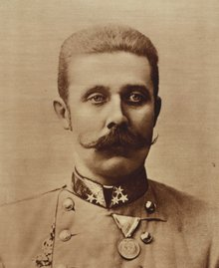
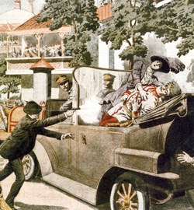
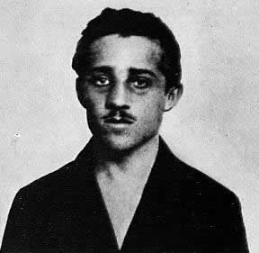

Slide 7
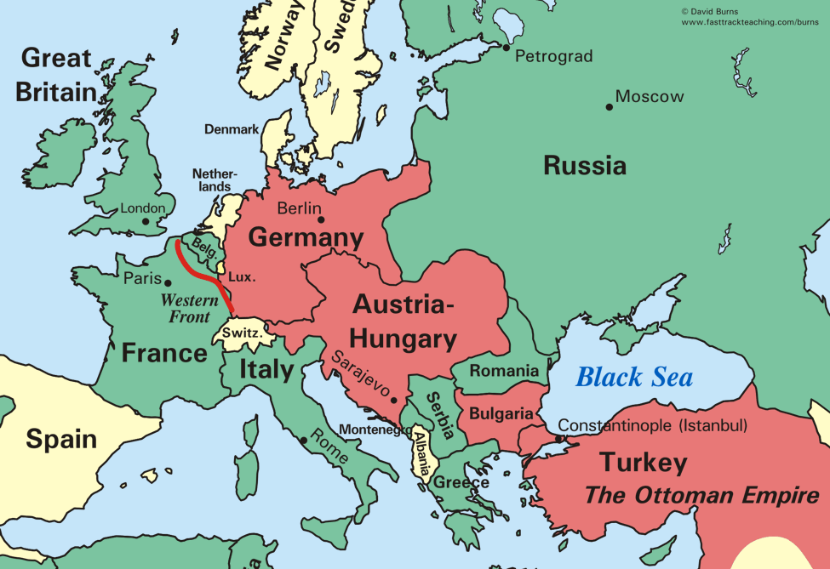

Slide 8
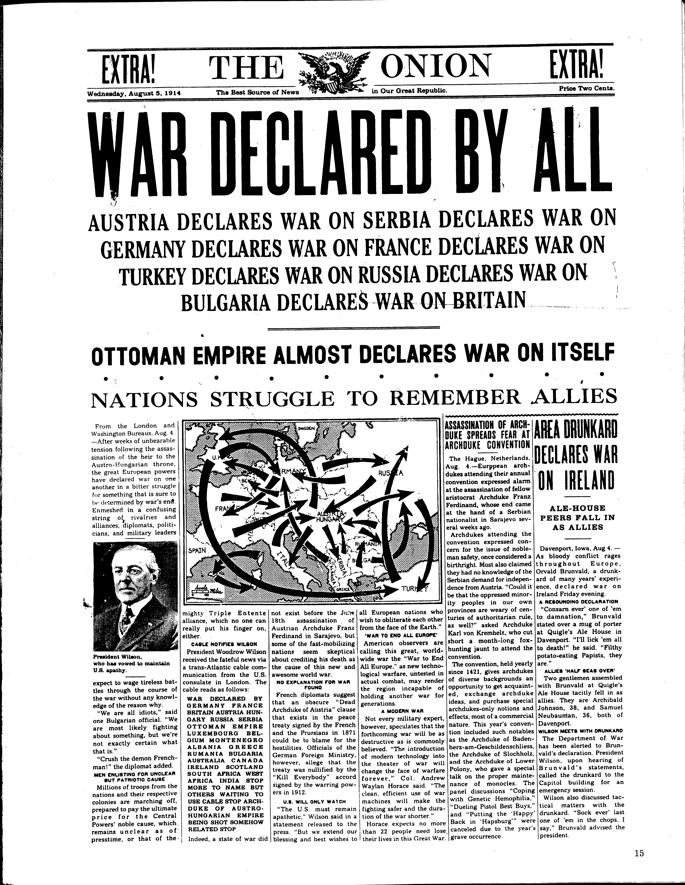

Slide 9
Long-term Causes
Germany “left behind” in scramble for colonies
British apprehension about Germany navy
Lingering resentment of France against Germany

Slide 10
“The lamps are going out all over Europe, we shall not see them lit again in our life-time.”
-- British Foreign Secretary Sir Edward Grey

Slide 11
NOT “home by Christmas”
-- Trench warfare
-- Weapons technology outpaces the advance of medicine

Slide 12
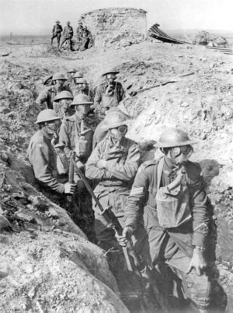

Slide 13
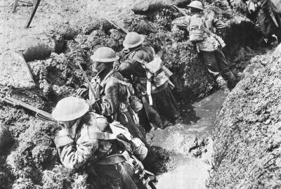

Slide 14
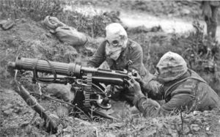

Slide 15
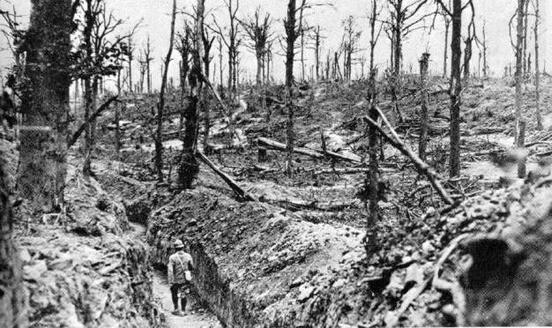

Slide 16
How did the U.S. respond to the European war?

Slide 17
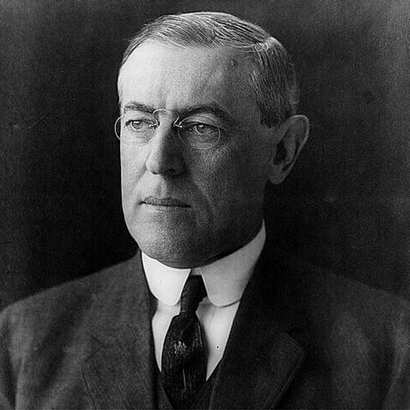

Slide 18
“Wilsonian” Foreign Policy
Progressives set out to “reform” the world.

Slide 19
“Like a troubled man angered by his own uncertainty, the country aggressively demanded international conformity to democratic goals it now believed might be slipping out of domestic reach.”
-Robert Dallek

Slide 20
“Old World” Tyranny vs “New World” Democracy

Slide 21
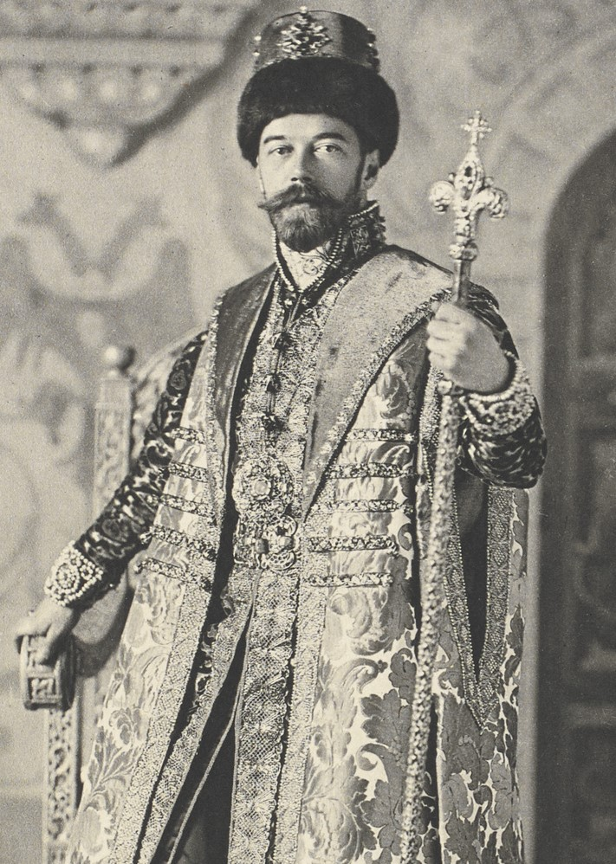
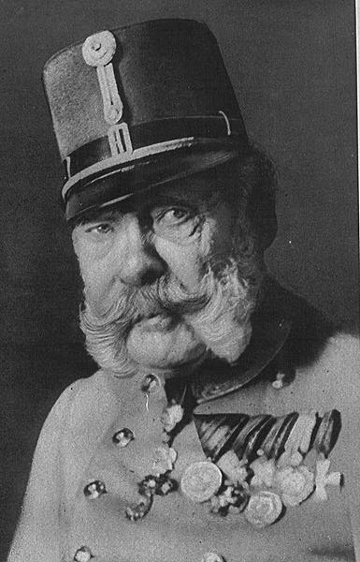
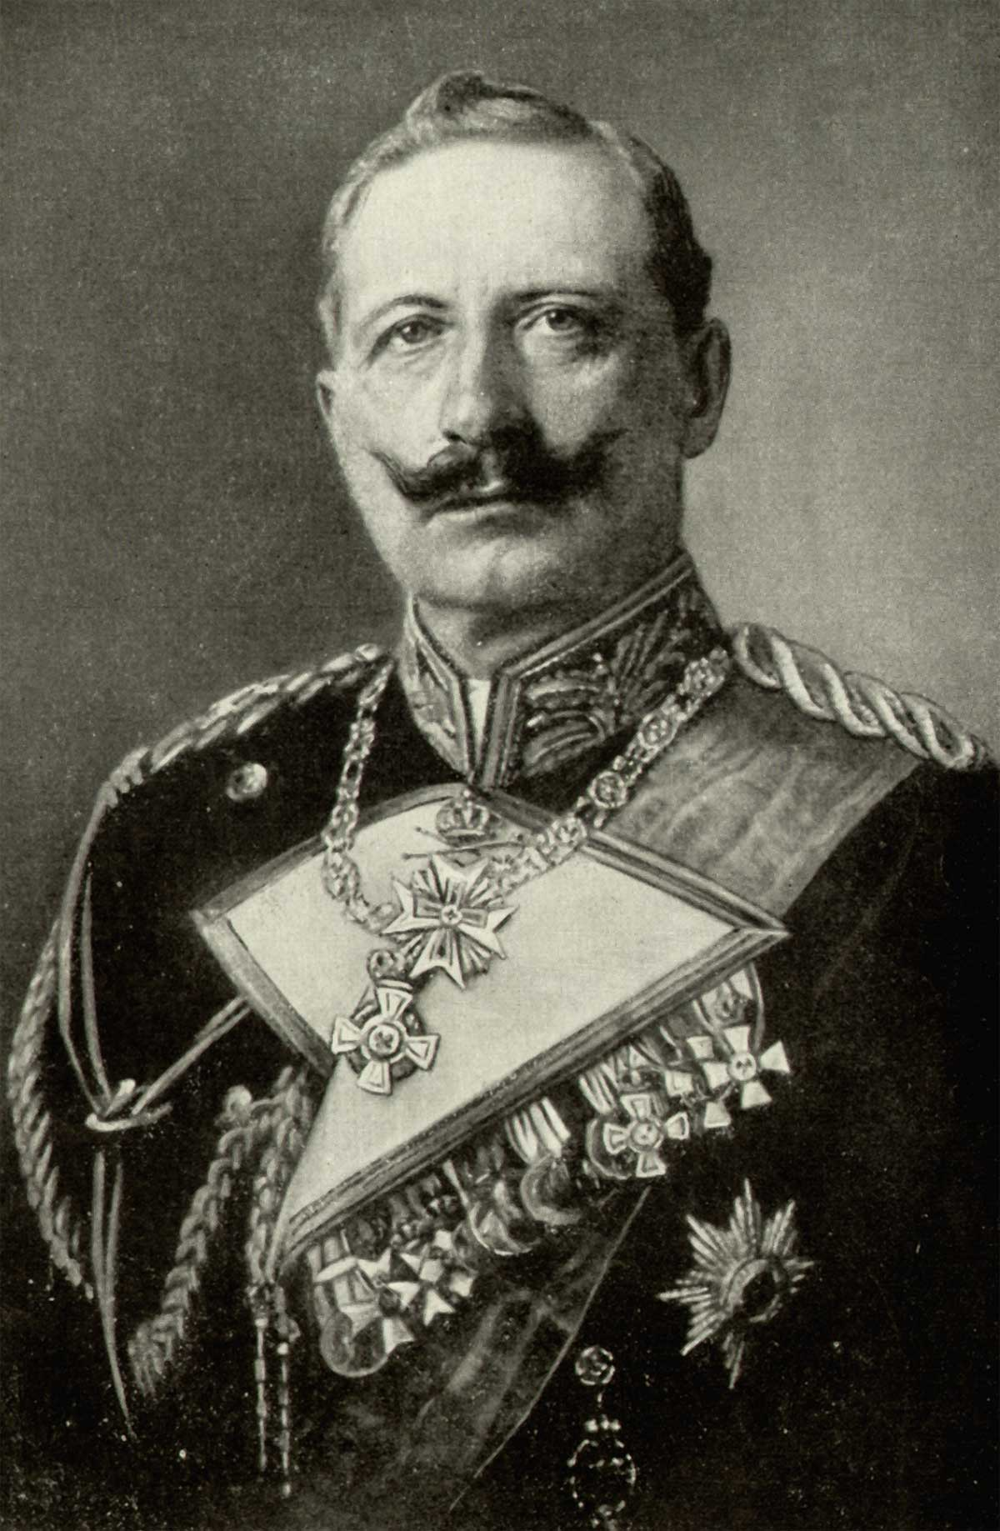

Slide 23
Neutrality: Idealism or Naivete?

Slide 24
Why can’t we trade with everyone?

Slide 25
Is trade with the British and French a good thing?

Slide 26
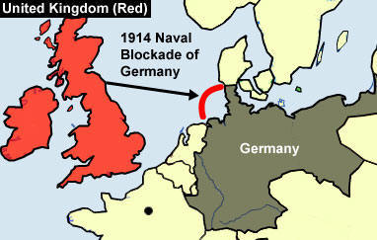

Slide 27
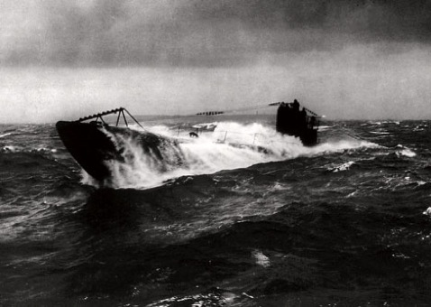
How do the Germans Respond?

Slide 28
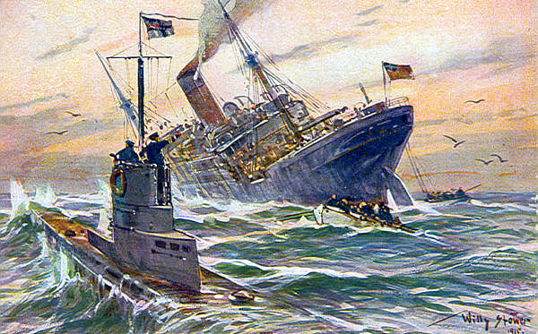

Slide 29
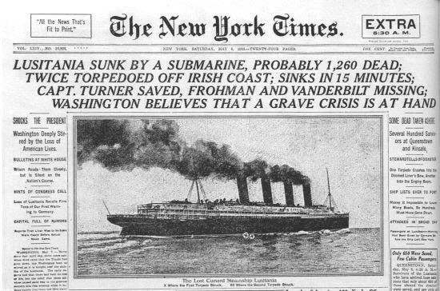

Slide 30
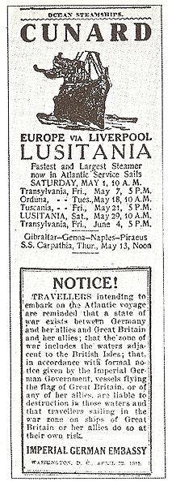

Slide 31
“Sussex Pledge”

Slide 32
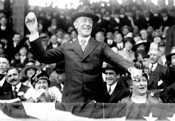

1916 Presidential Election

Slide 33
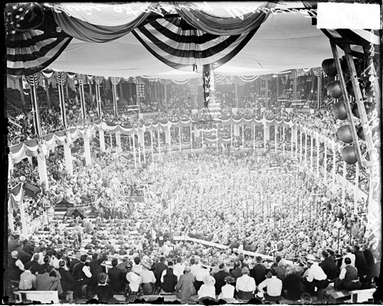
“He kept us out of war!”

Slide 35
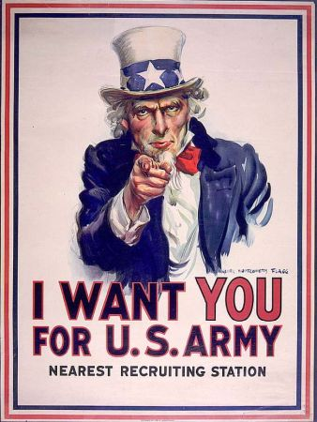
After staying out so long, why are we getting in?

Slide 36
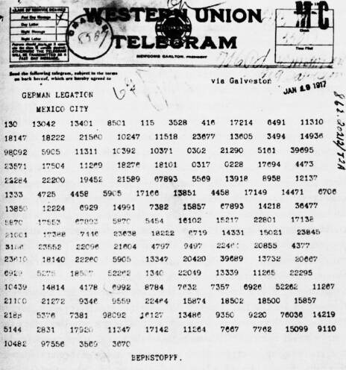
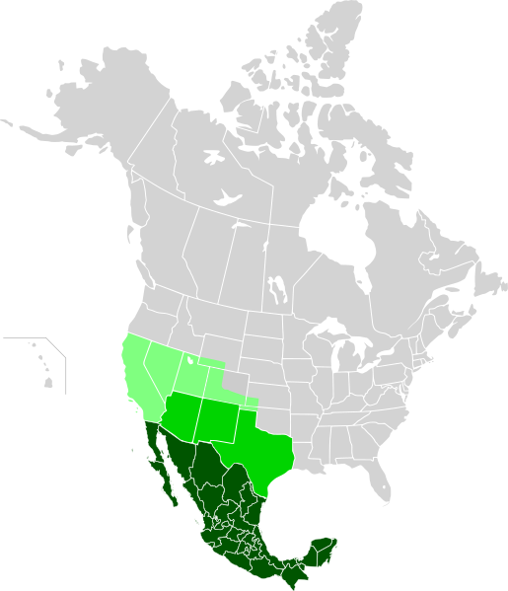
Zimmermann Telegram

Slide 37
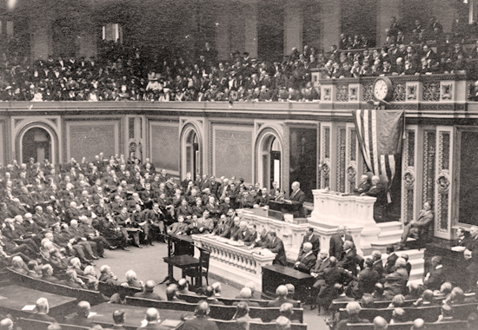
Unrestricted Submarine Warfare

Slide 39
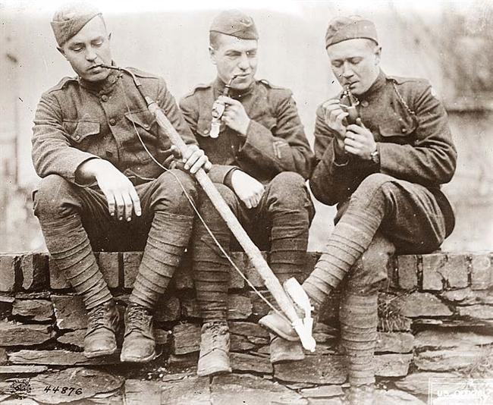
American Expeditionary Force “Doughboys”

Slide 40
What did Woodrow Wilson hope to achieve during and after the war?

Slide 41
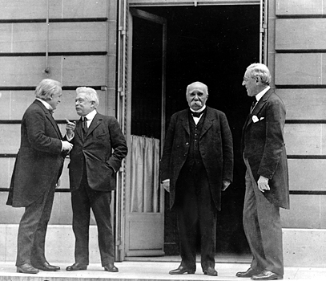
Treaty of Versailles

Slide 42
Lives Lost: Russians – 3.3 million Germans – 2.6 million French – 1.9 million Austro-Hungarians – 1.5 million British 1.2 million USA – 117,000

Slide 43
The Fourteen Points 1-8 Recommendations for New Boundaries in Europe

Slide 44
The Fourteen Points 9-13 Open Diplomacy Freedom of Navigation Removal of Trade Barriers Arms Reductions Self-Determination for Nations and Colonies

Slide 45
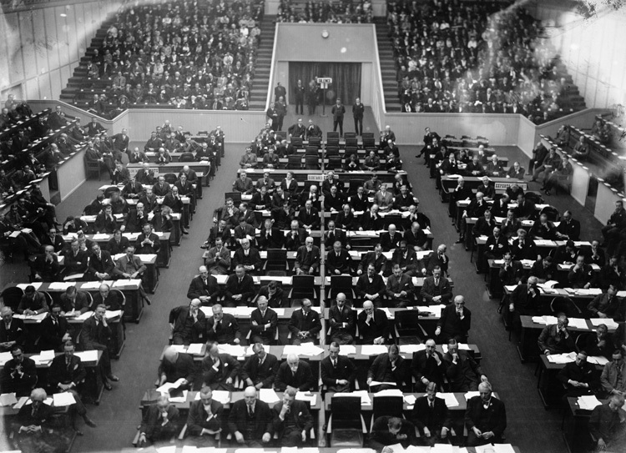
The Fourteenth Point A League of Nations

Slide 46
What’s Wrong With The 14 points?

Slide 47
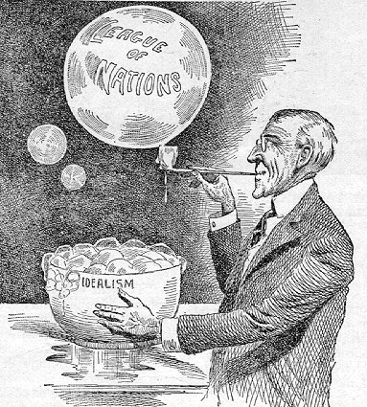

Slide 48
"God gave us the ten commandments and we broke them. Now Mr. Wilson has given us the Fourteen Points. We shall see."
--Georges Clemenceau

Slide 49
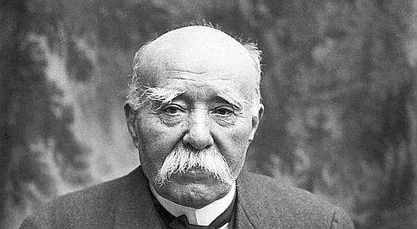

Slide 50
“There are twenty million Germans too many!”

Slide 51
Reparations? War Guilt?

Slide 52
Legacies of World War I - Disillusionment with Progressivism and crusading idealism - Treaty of Versailles sets up economic instability

