Slide 1
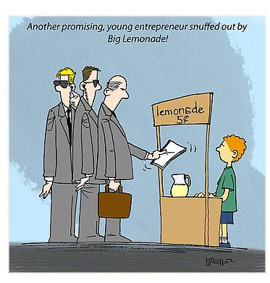
The Rise of Big Business in the Late Nineteenth Century

Slide 2
Some basic questions:
#1
What caused it (or at least helped it along)?

Slide 3

The Railroad as a Catalyst for Economic Expansion

Slide 4
The Railroads as a Catalyst
How do the railroads fuel economic expansion?

Slide 5
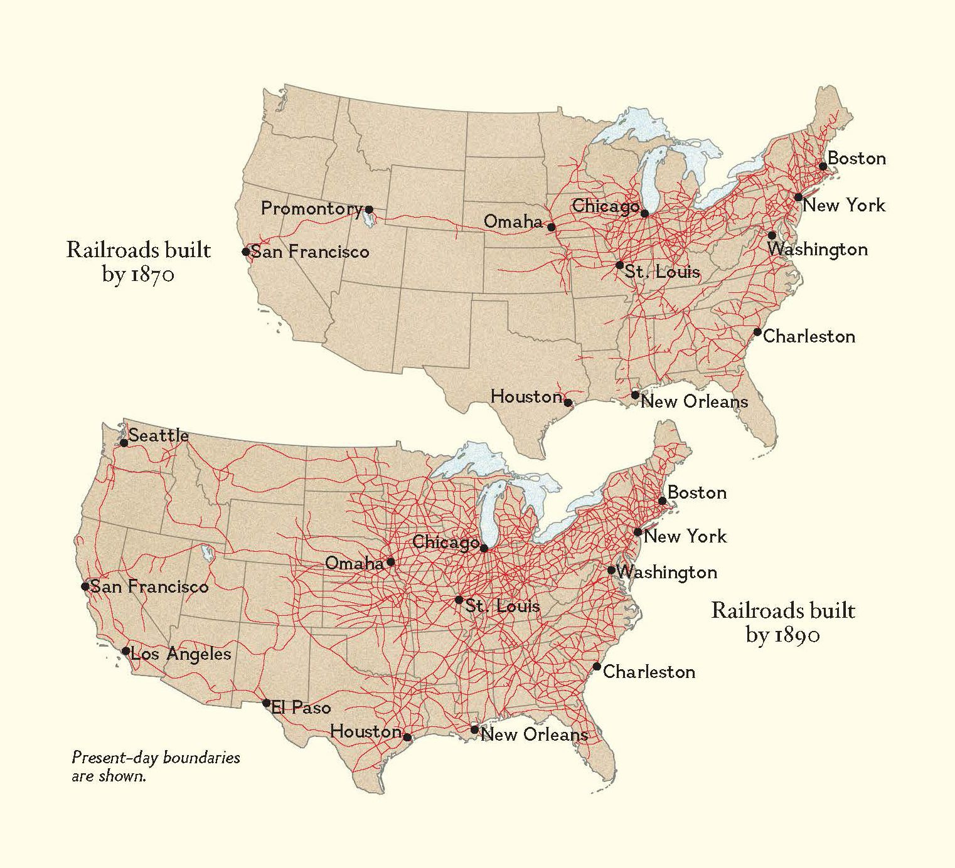
The 19th Century Internet

Slide 6
How did the railroads monetize “latent resources”?

Slide 7
How did the railroads create markets?

Slide 8
How did the railroad create jobs?

Slide 9
How did the railroads promote migration to the West?

Slide 10
How did the railroads change the way of “doing business”?

Slide 11
What other factors encourage economic growth?

Slide 12
More importantly…
How did each factor encourage economic growth?

Slide 13
Abundance of natural resources
Diversity of materials

Slide 14
Foreign investment
Follow up question:
Why Great Britain?

Slide 15
Government assistance to business

Slide 16


Slide 17
Government assistance to business
-- subsidies
(land and loans)

Slide 18
Government assistance to business
-- subsidies
-- tariffs

Slide 19
Government assistance to business
-- subsidies
-- tariffs
-- legal rights
(a corporation = a person)

Slide 20
Government assistance to business
-- subsidies
-- tariffs
-- legal rights
(a corporation = a person)
-- military force

Slide 21
New Strategies and Processes
Economies of Scale and Scope
Division of Labor
Continuous Flow

Slide 22
New methods of financing and administering businesses
-- limited liability
-- stocks, trusts, and holding companies
-- sophisticated accounting methods
-- management information systems

Slide 23
#2
HOW did the process of modern industrialization occur?

Slide 24
The Four “C”s

Slide 25
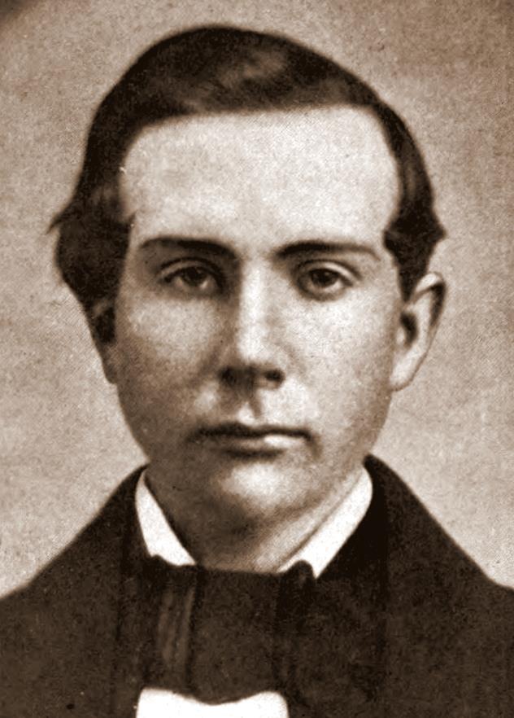
John D. Rockefeller
(No one ever called him “Jack”)

Slide 26


Slide 27

The Four “C”s
1- Competition

Slide 28
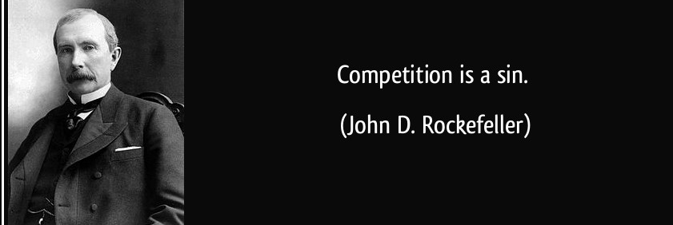

Slide 29
The Four “C”s
1 - Competition
2 - Cooperation

Slide 30


Slide 31
The Four “C”s
1 – Competition
2 – Cooperation
3 – Consolidation
(Horizontal Integration)

Slide 32
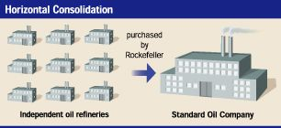

Slide 33
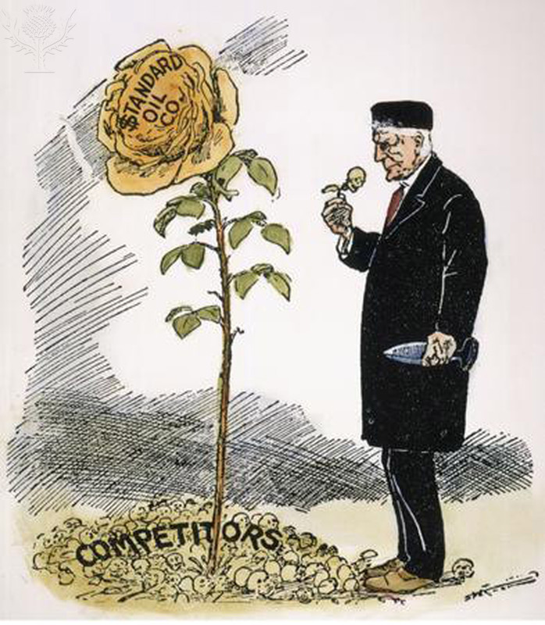

Slide 34
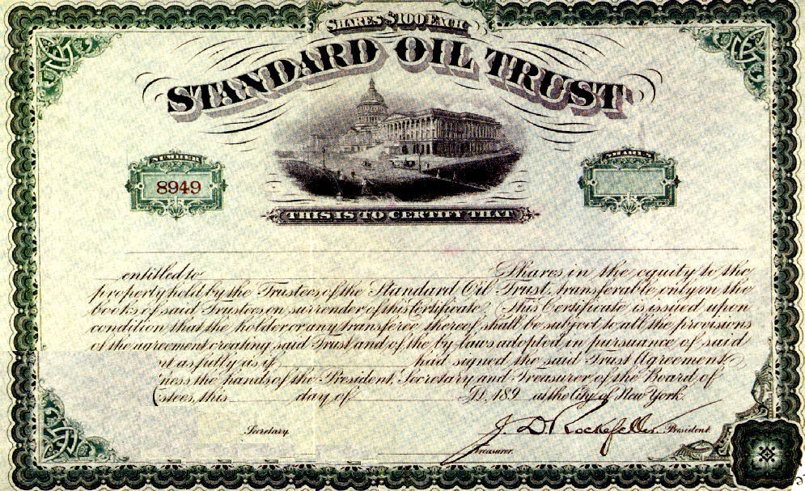

Slide 35
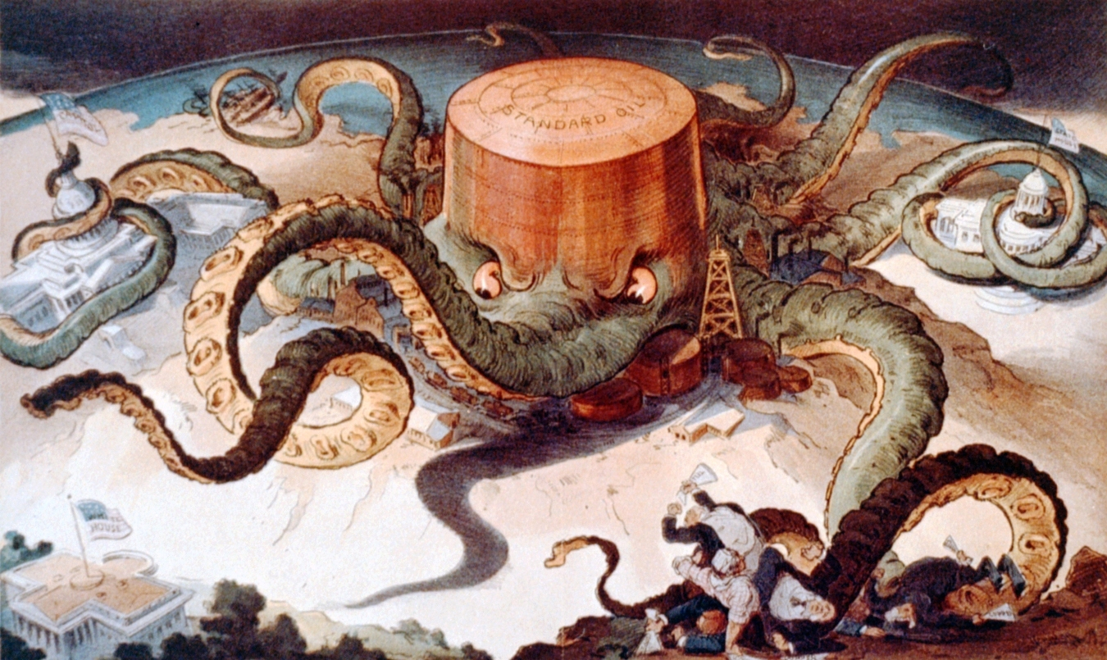
“Let us Prey”

Slide 36
The Four “C”s
1 – Competition
2 – Cooperation
        3 – Consolidation
(Horizontal Integration)
        4 – Centralization
(Vertical Integration)

Slide 37
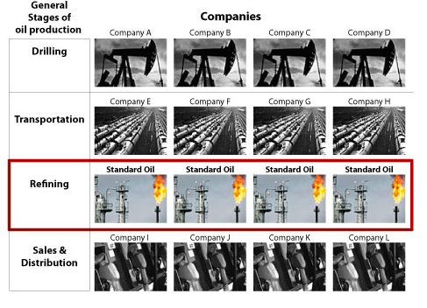

Slide 38
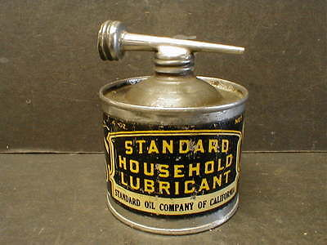

Slide 39
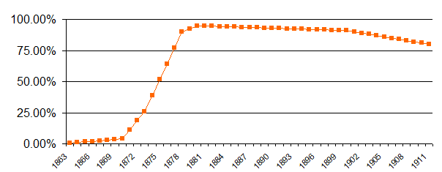
Rockefeller’s Market Share 1863-1911

Slide 40
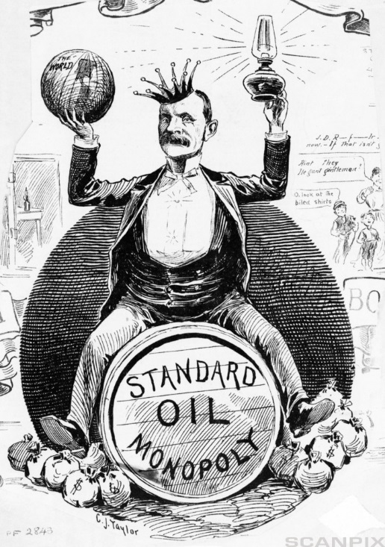

Slide 41
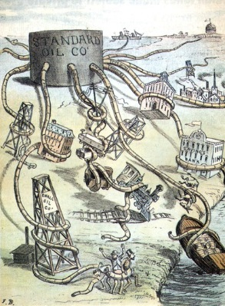

Slide 42
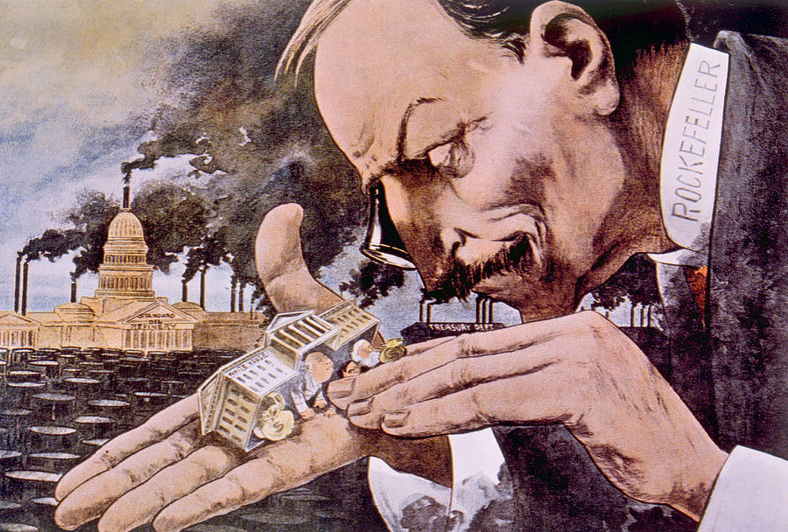

Slide 43
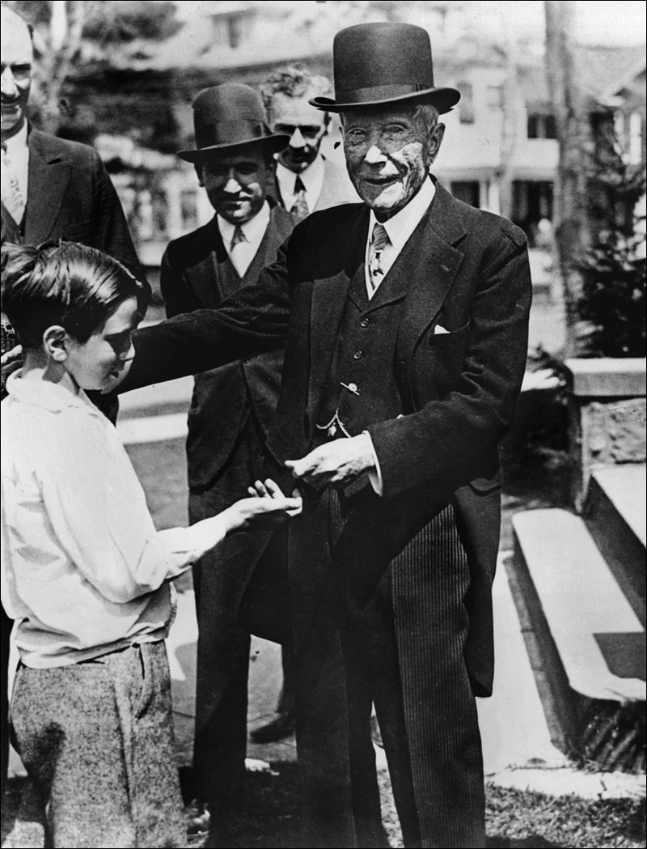

Slide 44
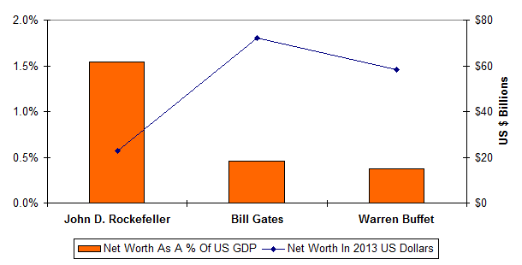

Slide 45
#3
How did the new economy affect people?

Slide 46
