Slide 1
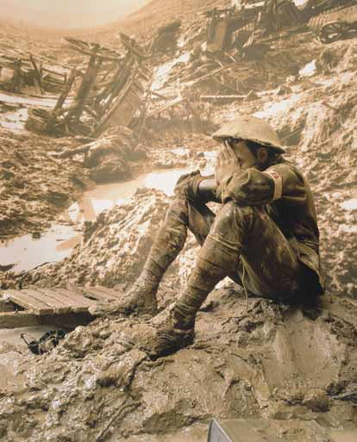
World War I – 1914 -1918

Slide 2
Four Major Questions:
Why did war break out in Europe in August 1914?
How did the United States respond to the European War?
Why did the United States support the Allies (Great Britain and France)?
What did Woodrow Wilson hope to achieve during and after the war?

Slide 3
So What?
U.S. emerges as a world power.
U.S. introduces an “American style” of foreign policy that remains with us today (for good or ill).
World War I unleashes forces that continue to cause bloody conflicts in the 21st Century.

Slide 4
Why did the war break out in Europe in August 1914?
Short term reasons
Long term reasons

Slide 5
Assassination of Archduke Franz Ferdinand
- Threat to the Austro-Hungarian Empire
- Catalyst for broader European conflict

Slide 6
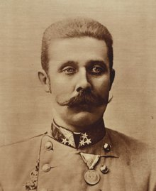
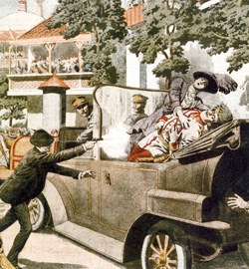
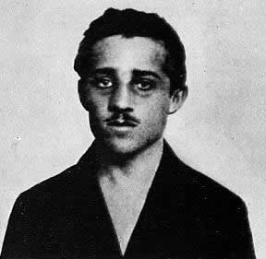

Slide 7
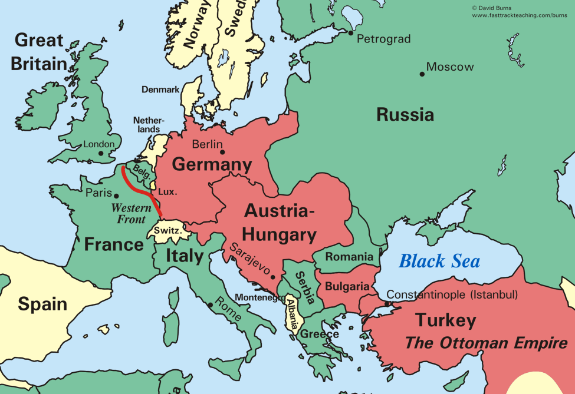

Slide 8
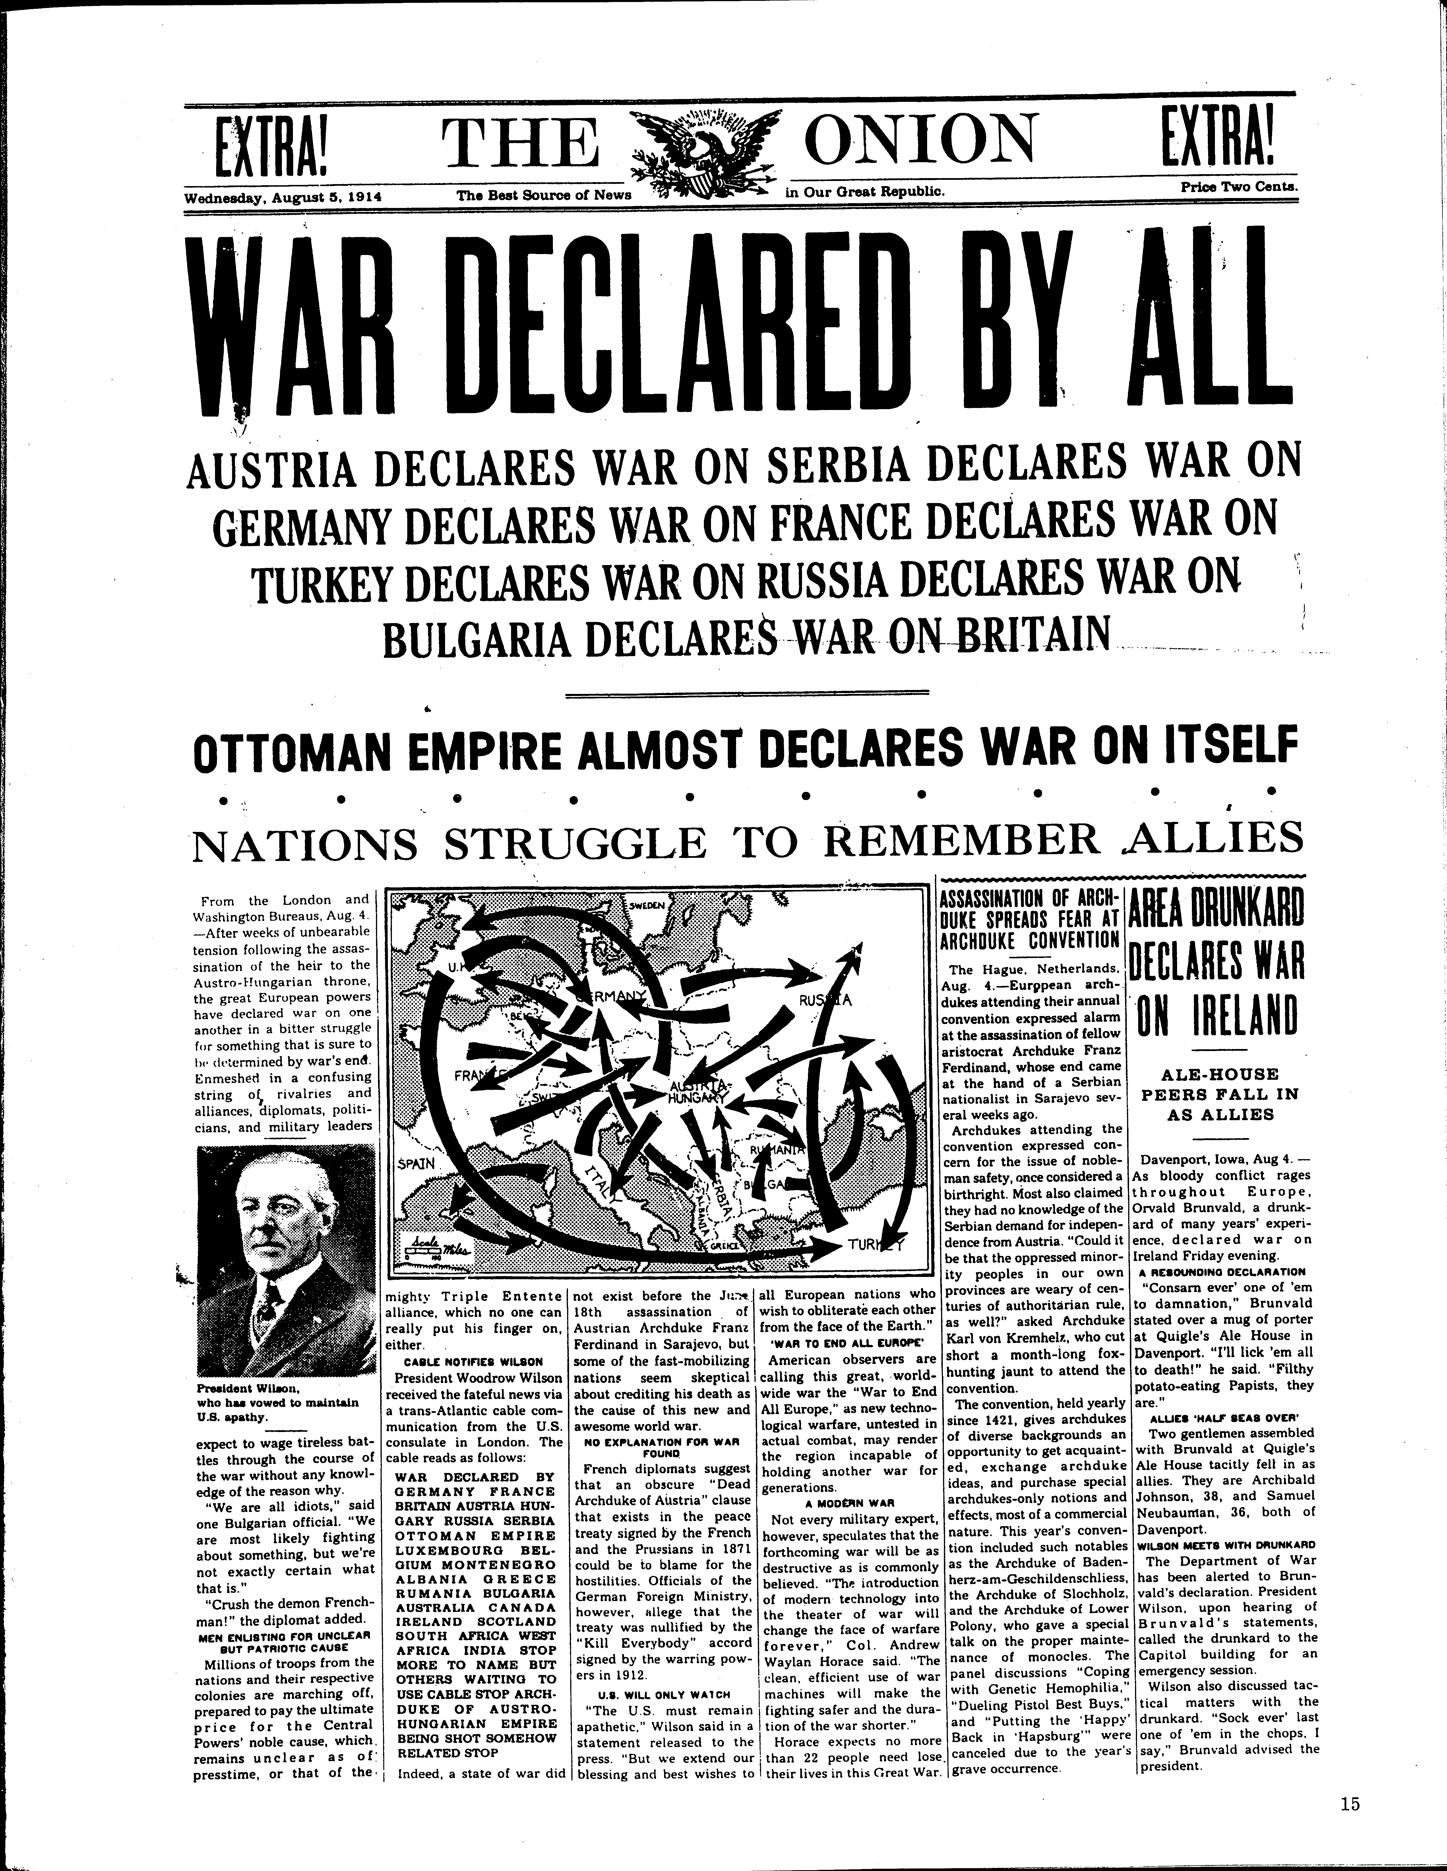

Slide 9
Long-term Causes
Germany “left behind” in scramble for colonies
British apprehension about Germany navy
Lingering resentment of France against Germany

Slide 10
“The lamps are going out all over Europe, we shall not see them lit again in our life-time.”
-- British Foreign Secretary Sir Edward Grey

Slide 11
NOT “home by Christmas”
-- Trench warfare
-- Weapons technology outpaces the advance of medicine

Slide 12
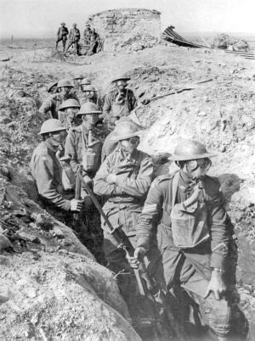

Slide 13
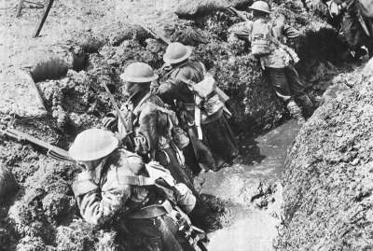

Slide 14
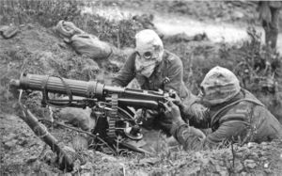

Slide 15
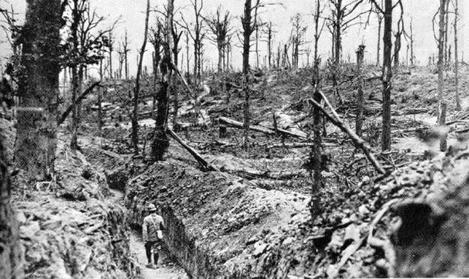

Slide 16
How did the U.S. respond to the European war?

Slide 17
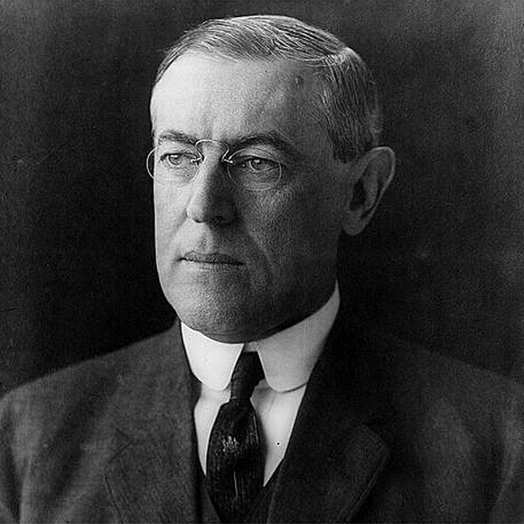

Slide 18
“Wilsonian” Foreign Policy
Progressives set out to “reform” the world.

Slide 19
“Like a troubled man angered by his own uncertainty, the country aggressively demanded international conformity to democratic goals it now believed might be slipping out of domestic reach.”
-Robert Dallek

Slide 20
“The United States was chosen …to show the way to the nations of the world how they shall walk in the paths of liberty.”
-Woodrow Wilson

Slide 21
Making “Them” more like “Us”

Slide 22
“Old World” Tyranny vs
“New World” Democracy

Slide 23
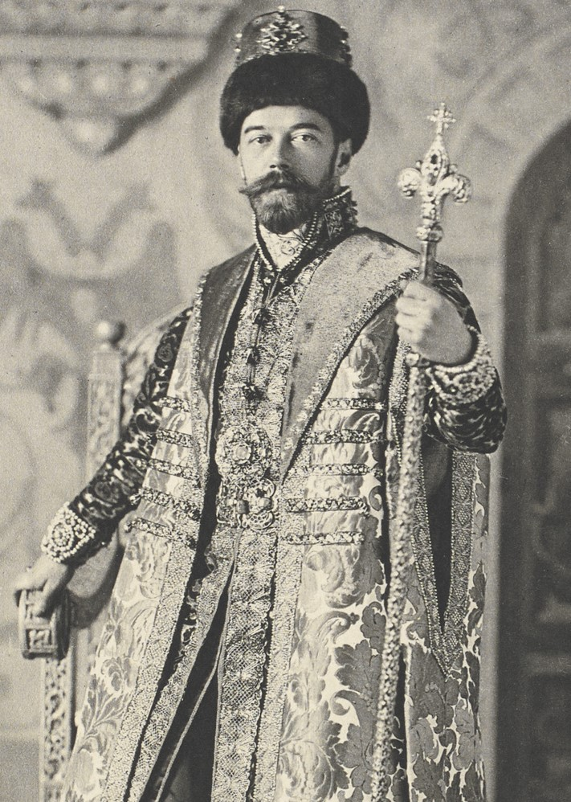
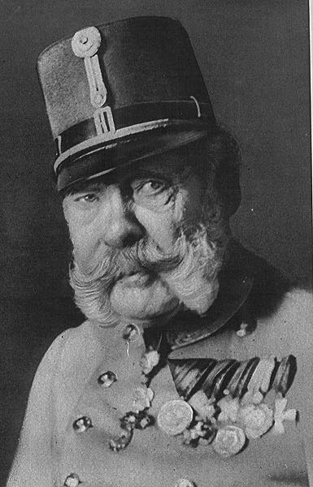
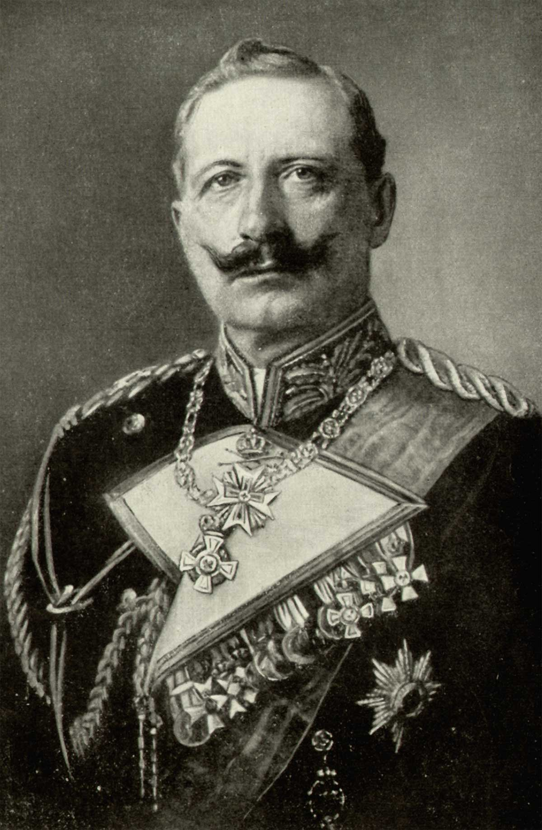

Slide 25
Neutrality:
Idealism or Naivete?

Slide 26
Why can’t we trade with everyone?

Slide 27
Is trade with the British and French a good thing?

Slide 28
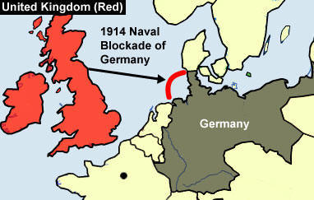

Slide 29
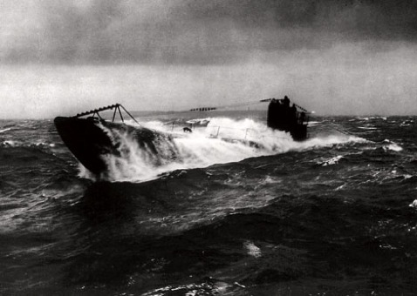
How do the Germans Respond?

Slide 30
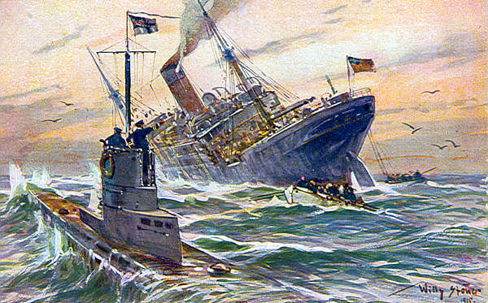

Slide 31
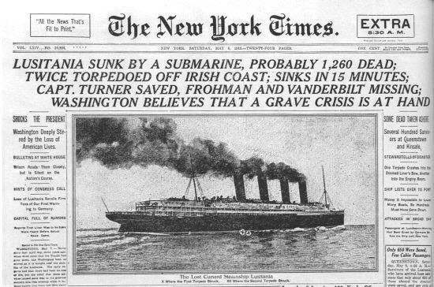

Slide 32
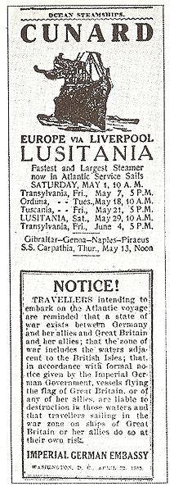

Slide 33
“Sussex Pledge”

Slide 34
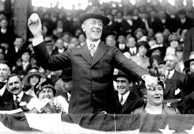

1916 Presidential Election

Slide 35
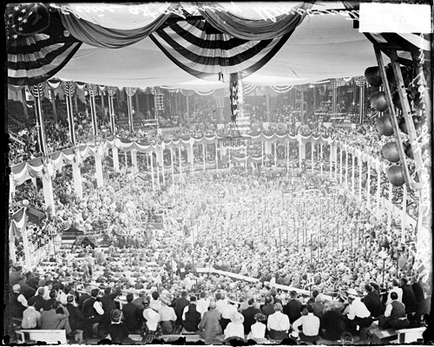
“He kept us out of war!”

Slide 37
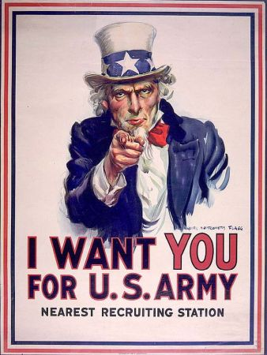
After staying out so long, why are we getting in?

Slide 38
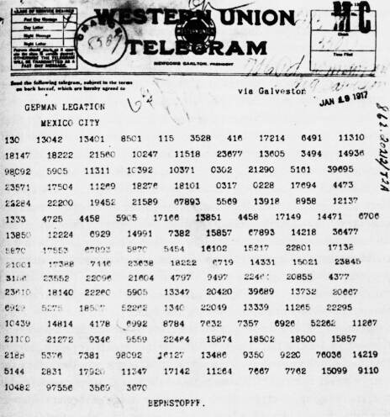
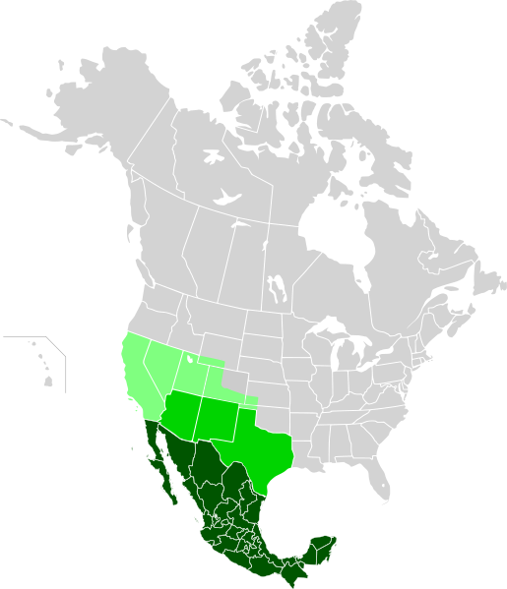
Zimmermann Telegram

Slide 39
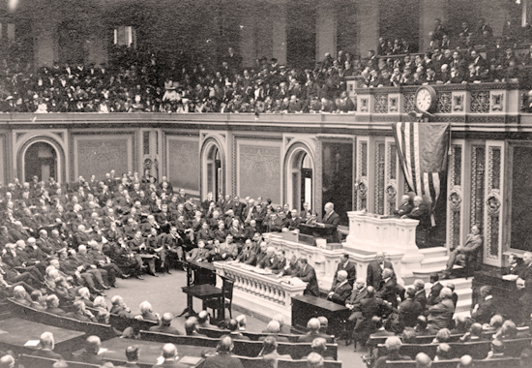
Unrestricted Submarine Warfare

Slide 41
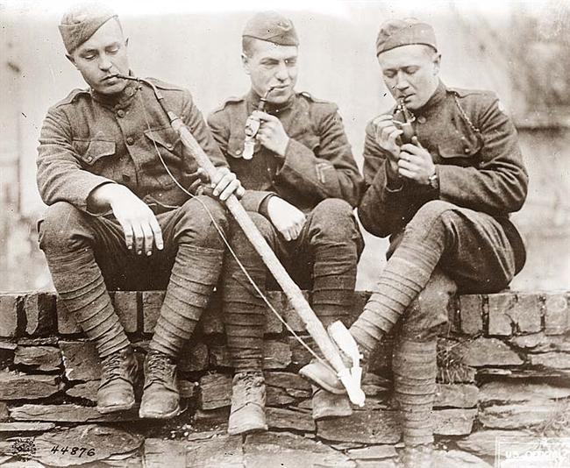
American Expeditionary Force
“Doughboys”

Slide 42
What did Woodrow Wilson hope to achieve during and after the war?

Slide 43
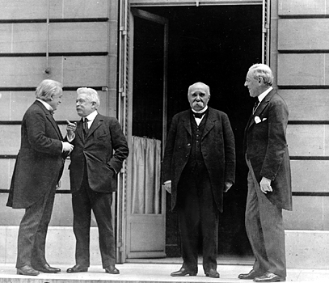
Treaty of Versailles

Slide 44
Lives Lost:
Russians – 3.3 million
Germans – 2.6 million
French – 1.9 million
Austro-Hungarians – 1.5 million
British 1.2 million
USA – 117,000

Slide 45
The Fourteen Points
1-8
Recommendations for New Boundaries in Europe

Slide 46
The Fourteen Points
9-13
Open Diplomacy
Freedom of Navigation
Removal of Trade Barriers
Arms Reductions
Self-Determination for Nations and Colonies

Slide 47
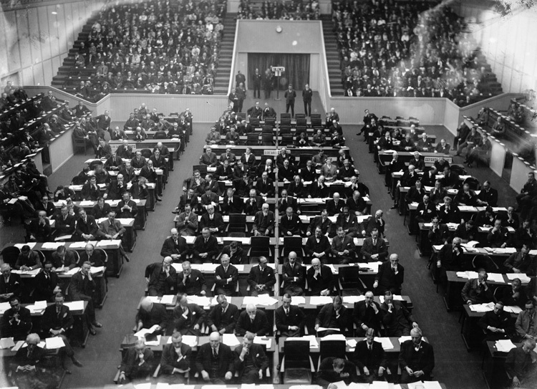
The Fourteenth Point
A League of Nations

Slide 48
What’s Wrong With The 14 points?

Slide 49
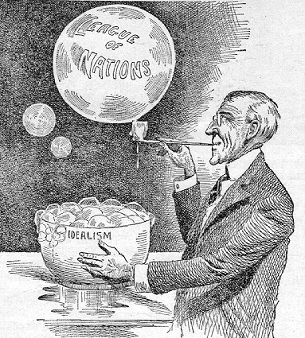

Slide 50
"God gave us the ten commandments and we broke them. Now Mr. Wilson has given us the Fourteen Points. We shall see."
--Georges Clemenceau

Slide 51
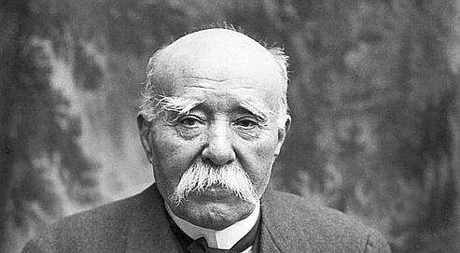

Slide 52
“There are twenty million Germans too many!”

Slide 53
Reparations?
War Guilt?

Slide 54
Article X
If one League member is attacked by another, all League members are obliged to come to the defense of the nation that has been attacked.

Slide 55
Legacies of World War I
- Disillusionment with Progressivism and crusading idealism
- Treaty of Versailles sets up economic instability

