Slide 1
“The Iron Horse”
The emergence of the transcontinental railroads

Slide 2
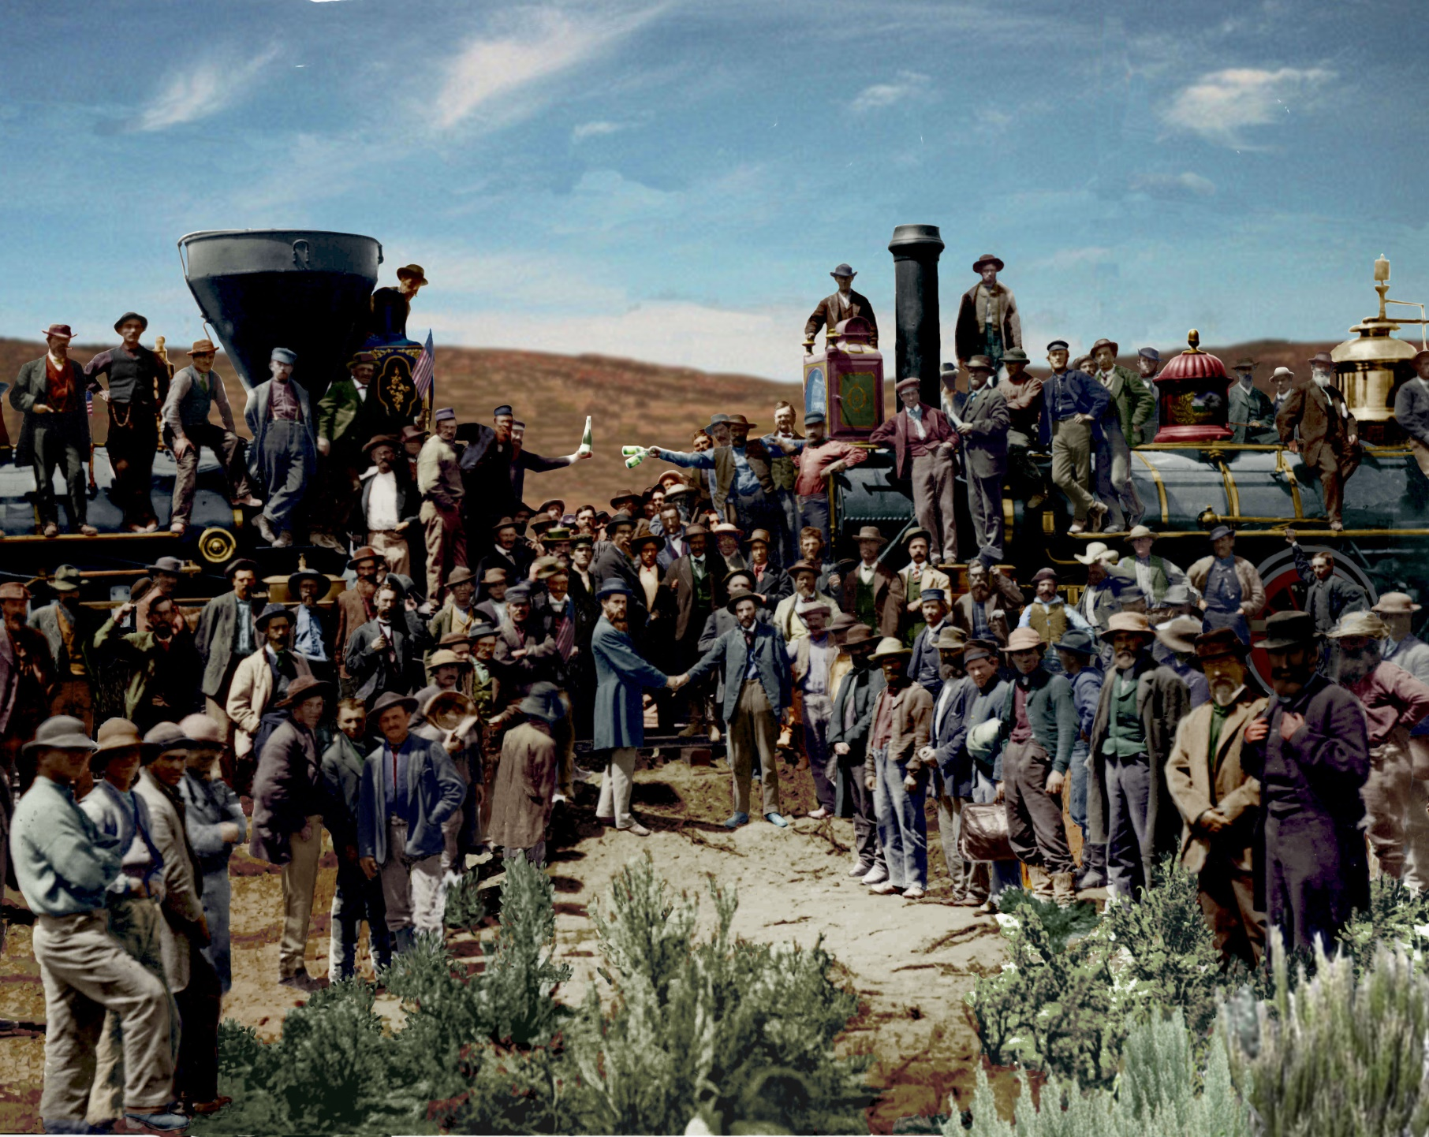

Slide 3
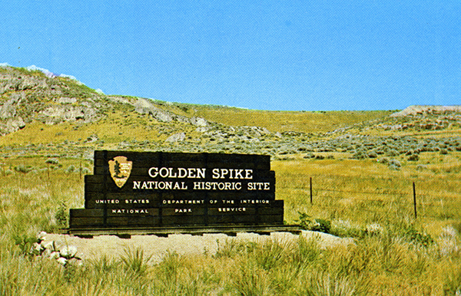

Slide 4
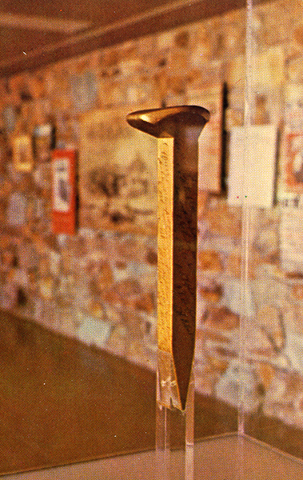

Slide 5
The conventional Wisdom:
“Unless the government had been willing to build the transcontinental lines itself, some system of subsidy was essential.”

Slide 6
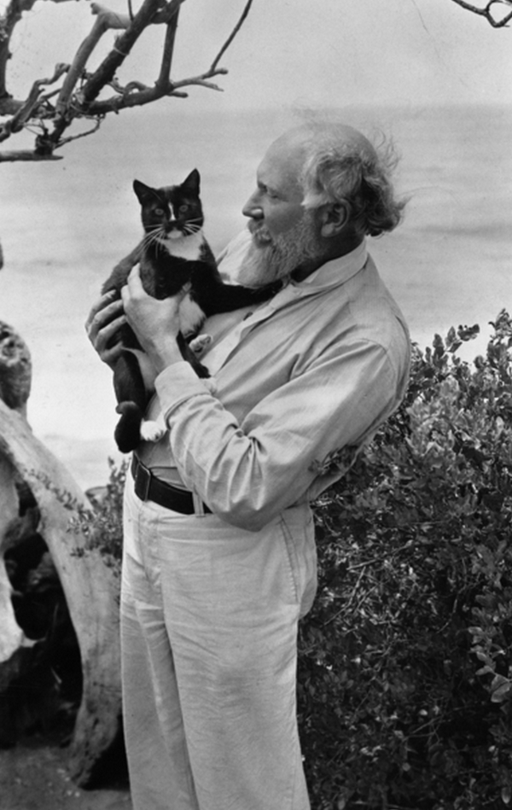
James J. Hill

Slide 7
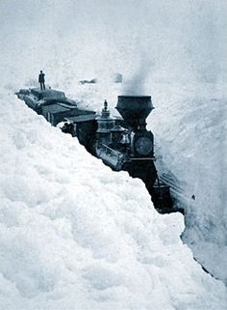
Subsidies…
What went wrong and why?

Slide 8
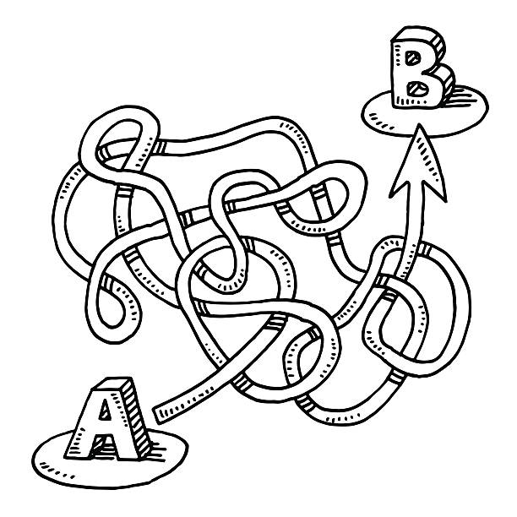

Slide 9
“Those [railroad line builders] who got federal aid ended up being hung by the strings that were attached to it.”
Folsom, 29

Slide 10
“The aid bred inefficiency; the inefficiency created consumer wrath; the consumer wrath led to government regulation; and the regulation closed the UP’s options and helped lead to bankruptcy.”
Folsom, 22

Slide 11
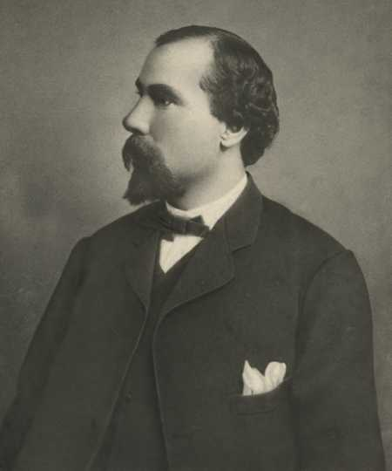
No subsidies? No problem!
“The Hill Alternative”

Slide 12
Hill’s Business Model
Why did Hill succeed in building profitable railroads without subsidies?
What made his approach to railroad building different?

Slide 13
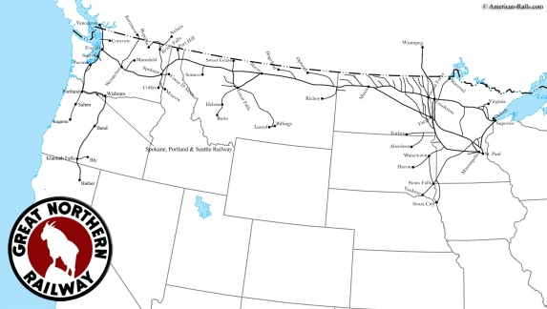

Slide 14
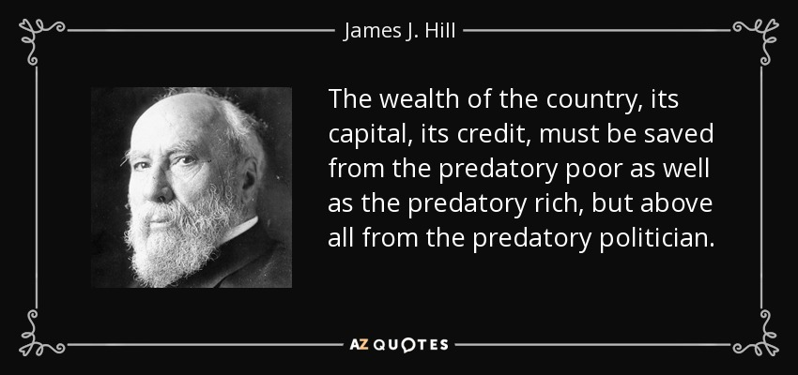
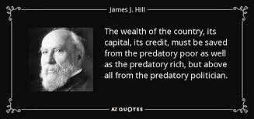

Slide 15
Railroads and the…
1. Reorganization of Nature & the Environment
2. Reorganization of Space & Time
3. Reorganization of the Economy

Slide 16
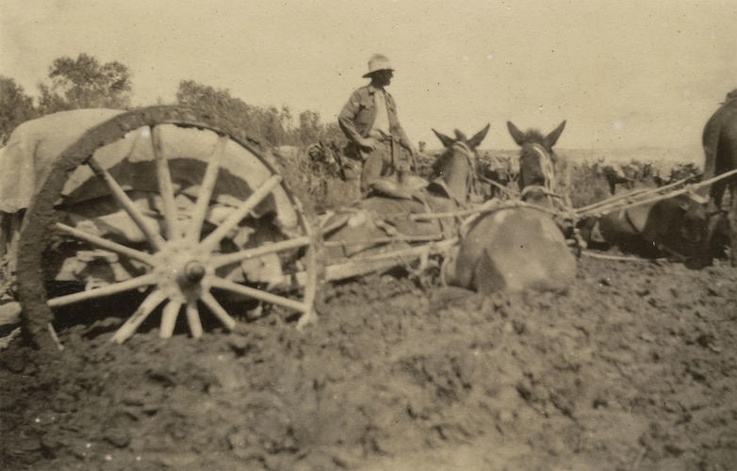
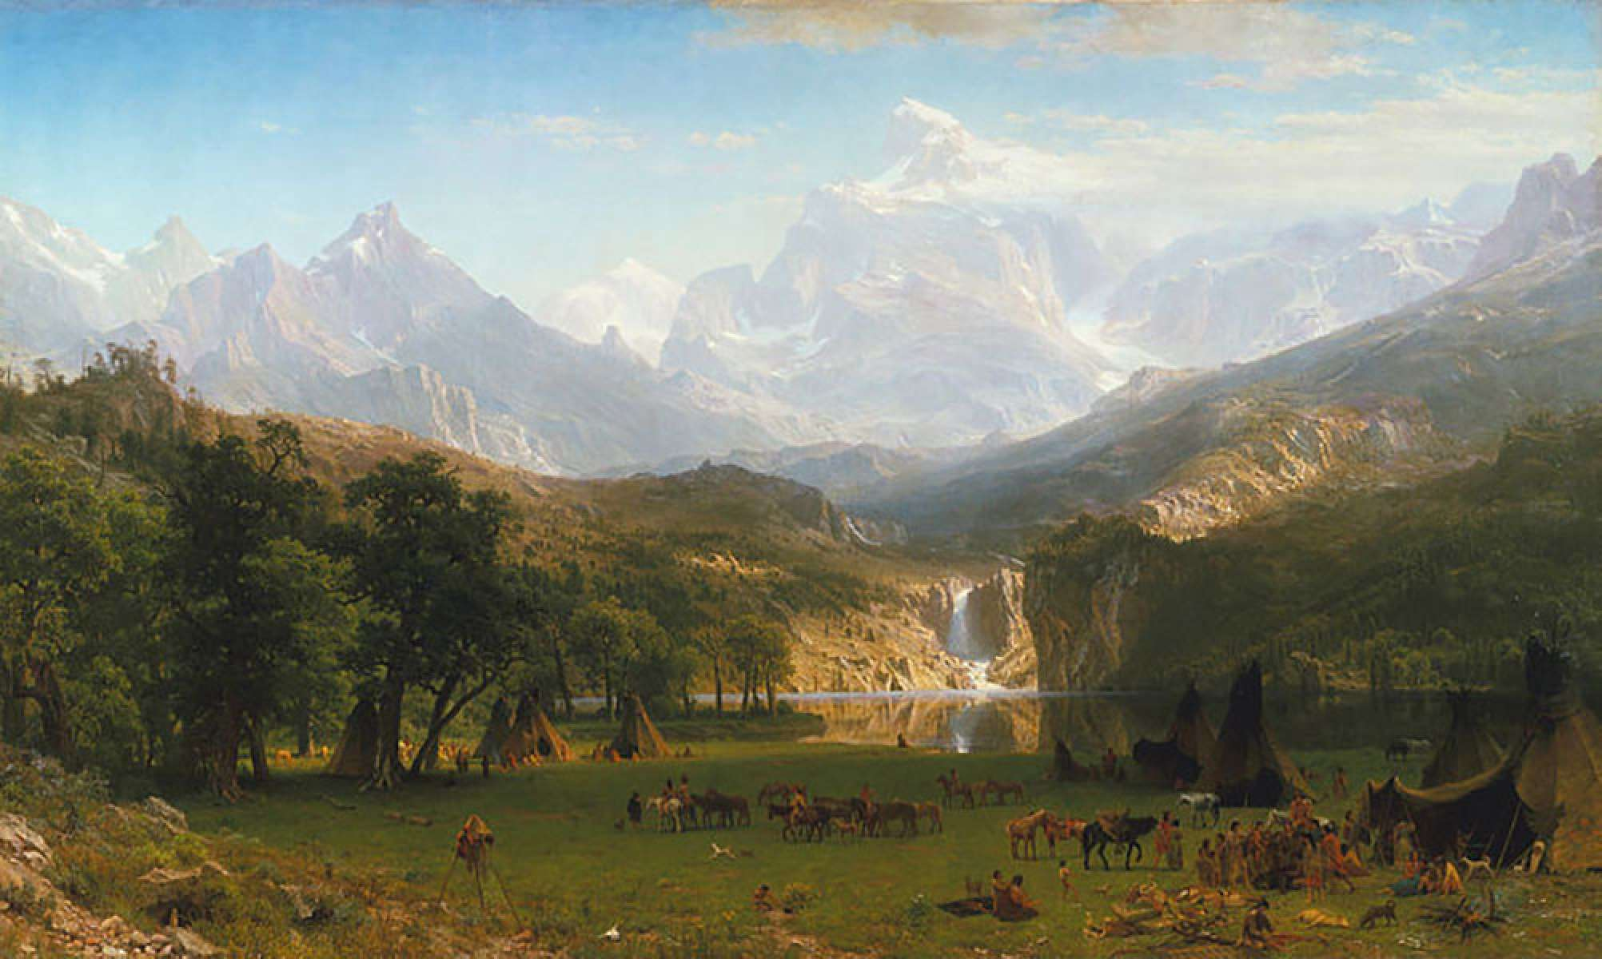
Railroads and the Environment

Slide 17
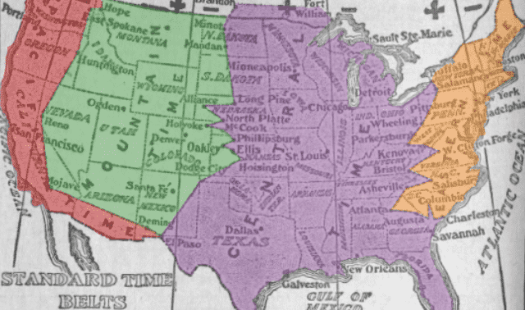
Railroads, Space, and Time:
- The “value” of time
- The contraction of space

Slide 18

The Railroad as a Catalyst for Economic Expansion

Slide 19
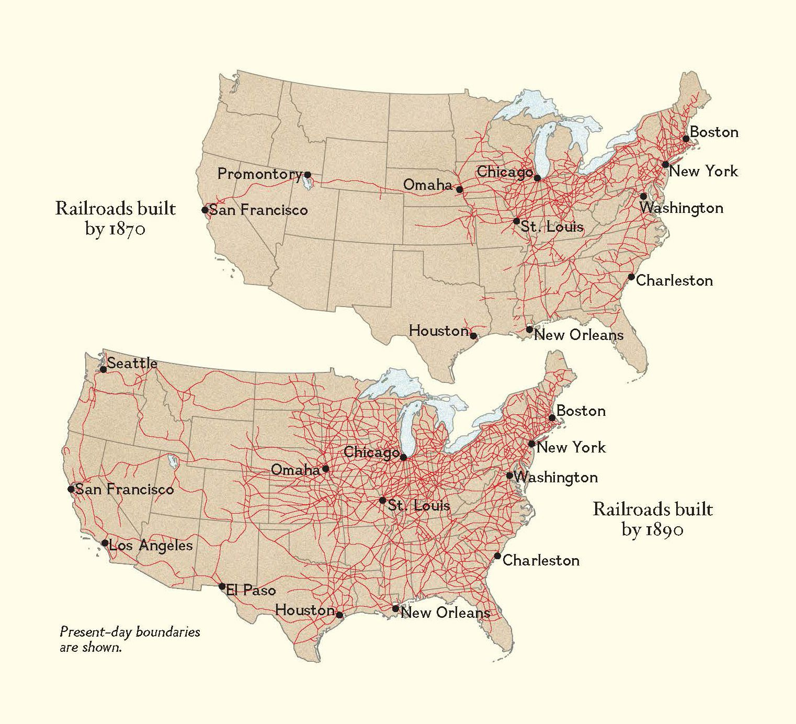
The 19th Century Internet

Slide 20
How did the railroads monetize “latent resources”?

Slide 21
How did the railroads create markets?

Slide 22
How did the railroads promote migration to the West?

Slide 23
How did the railroad create jobs?

Slide 24
How did the railroads change the way of “doing business”?

