Slide 1
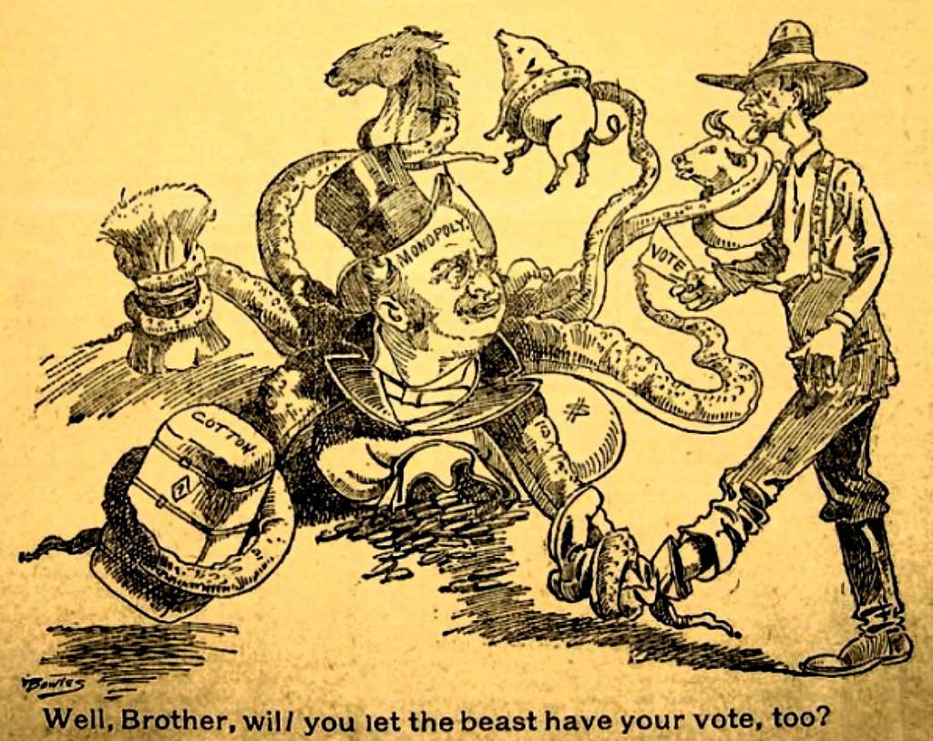
POPULISM:
Fire on the Prairie
1880s-1890s

Slide 2
Three Overall Questions…
1. Why are farmers hurting?
2. Who do they blame?
3. How do they propose to solve their problems?

Slide 3
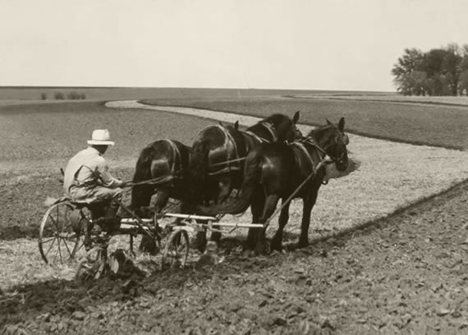
If I’m producing MORE, why am I making LESS??

Slide 4
Farmers’ Common Problems:
1.Debt
2. Middlemen and Speculators

Slide 5
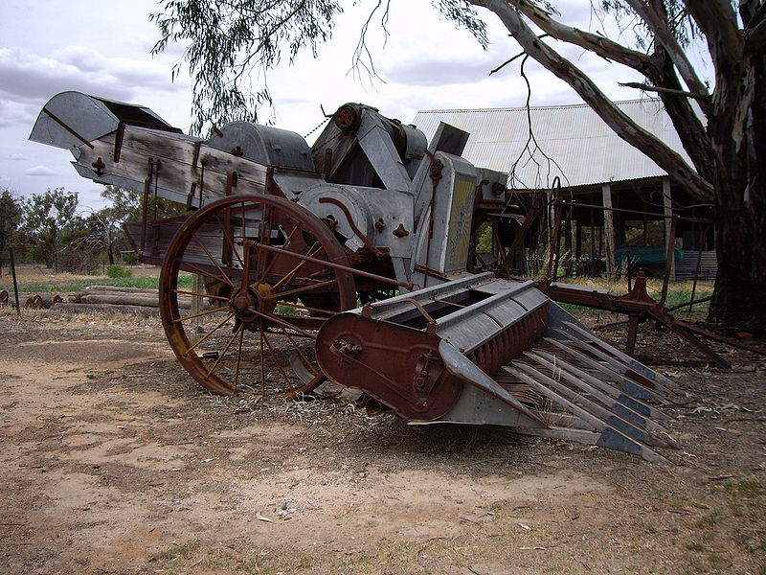
Why are Prices So Low?

Slide 6
Who are the EVIL MIDDLEMEN?

Slide 7
Who are the EVIL MIDDLEMEN?
RAILROADS

Slide 8
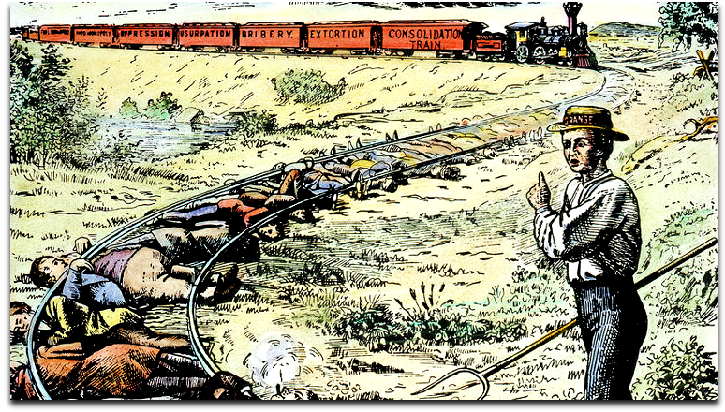

Slide 9
Who are the EVIL MIDDLEMEN?
RAILROADS
GRAIN ELEVATOR OPERATORS

Slide 10
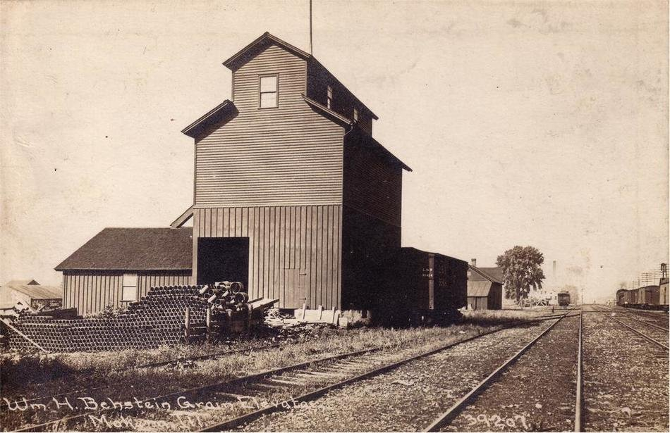

Slide 11
Who are the EVIL MIDDLEMEN?
RAILROADS
GRAIN ELEVATOR OPERATORS
SPECULATORS AND TRADERS

Slide 12
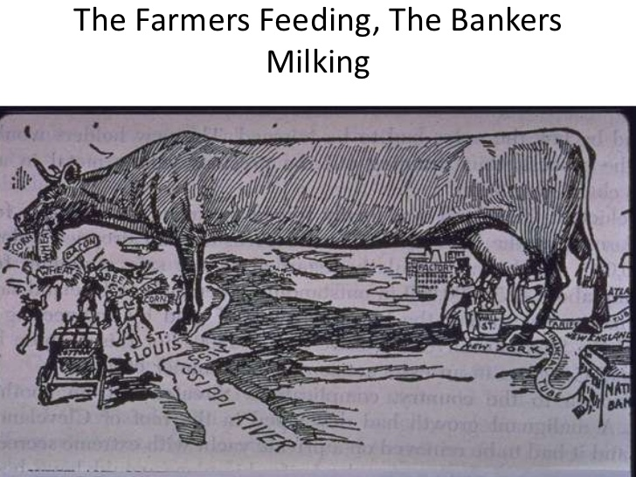

Slide 13
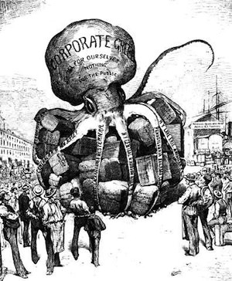

Slide 14
How do you get around the Middleman?

Slide 15
Self-help
1. Cooperatives
2. Farmer Alliances

Slide 16
Government Assistance
1. Granger Laws
2. Subtreasury System
3. Regulate the Railroads

Slide 17
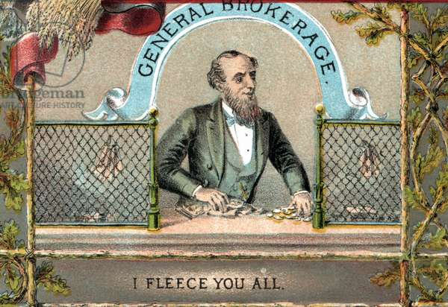
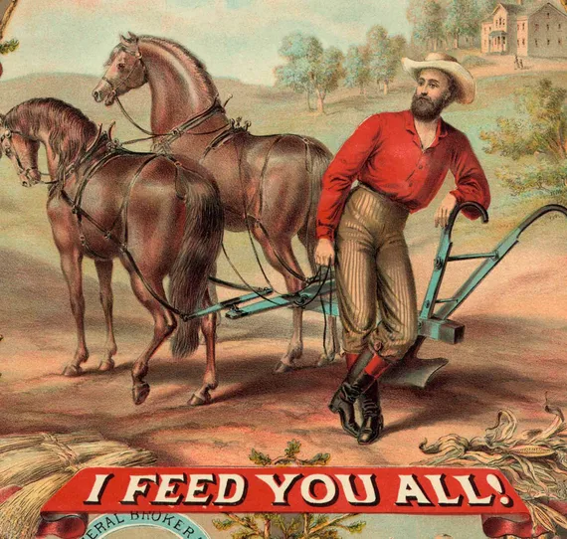
Granger Laws

Slide 18
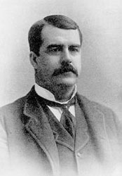
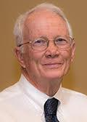
Subtreasury System
-- Access to Credit
-- Leverage over Prices
Charles W. Macune

Slide 19
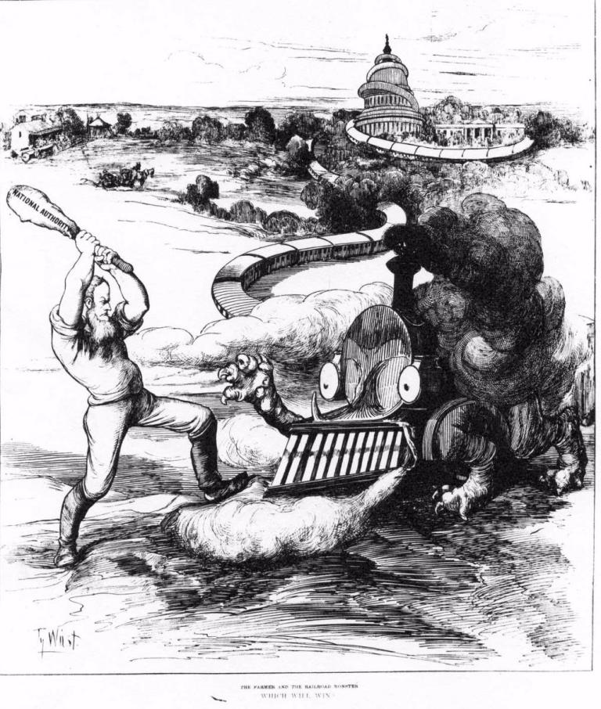
Railroad Regulation

Slide 20
What is DEFLATION and How Does it Affect DEBTORS?

Slide 21
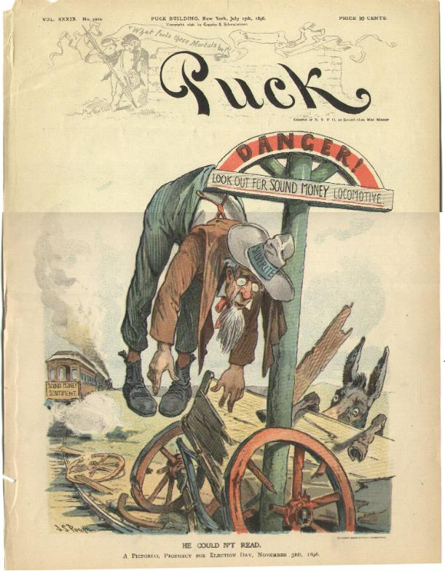
When all else fails…
Inflate the Currency
Why Silver?

Slide 22
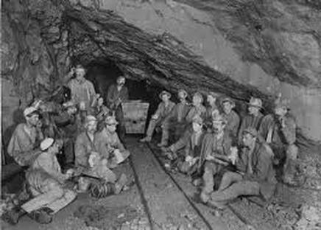
Who else might be for coinage of Silver?

Slide 23
What is INFLATION and how does it affect CREDITORS?

Slide 24
How does INFLATING the currency affect bankers, business owners, and workers?

Slide 25
What’s the argument for keeping the Gold Standard?

Slide 26
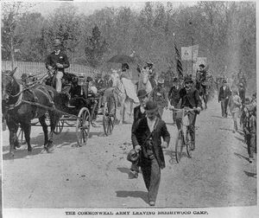
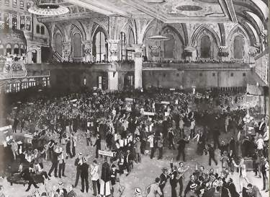
What happens in 1893?

Slide 27
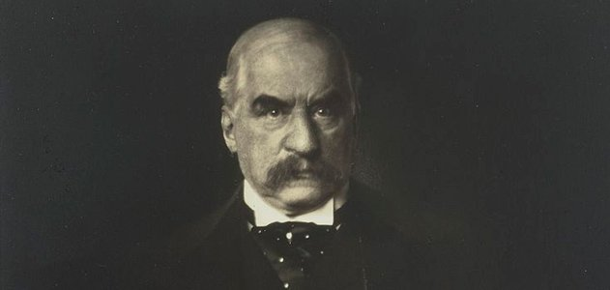
“I’ve got this.”
-- J. P. Morgan

Slide 28
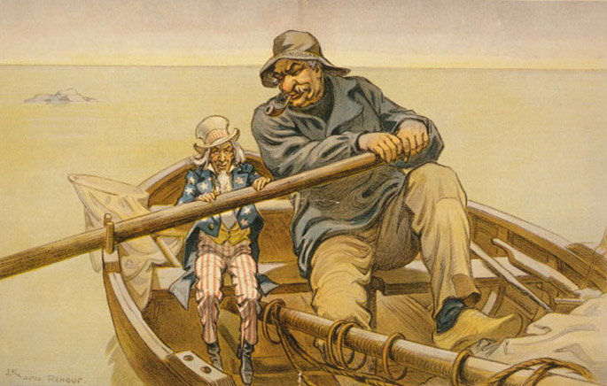
Economic Crisis → Political Debate

Slide 29
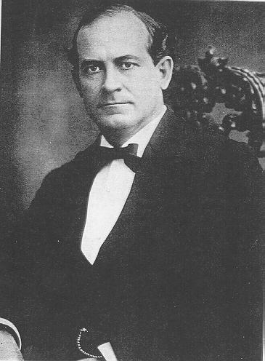
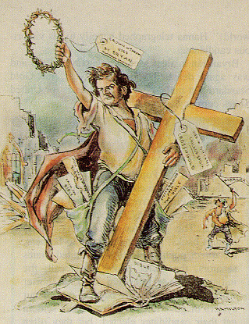
William Jennings Bryan

Slide 30
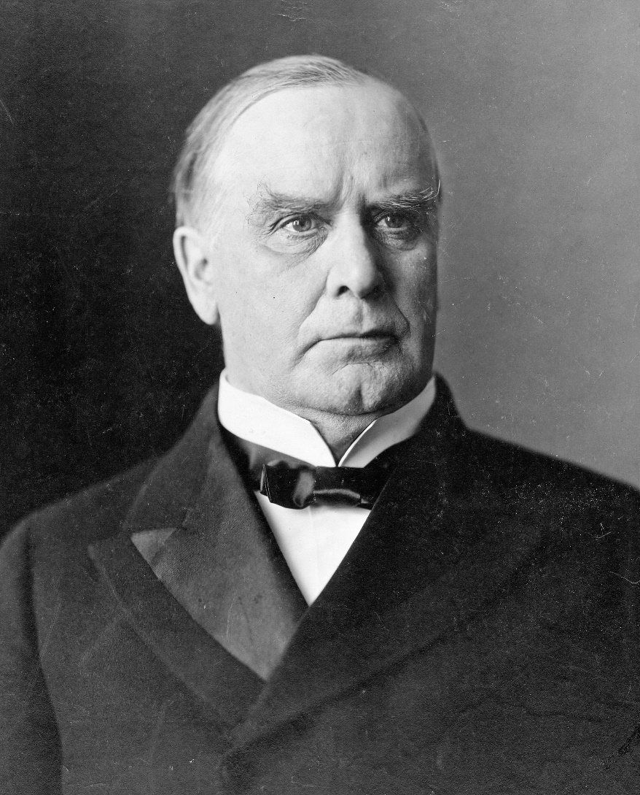
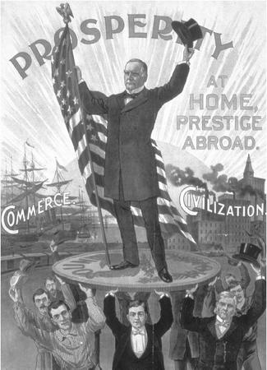
William McKinley

Slide 31
Why didn’t city workers join with farmers against the guys with money?

Slide 32
The Real Lesson of the Election of 1896?
As long as the “have nots” (workers and farmers) remain divided, it will be hard to challenge the power of the “haves” (the corporate elite).

