Slide 1
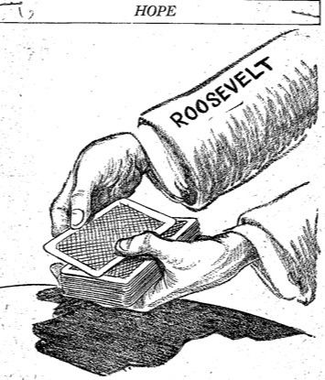
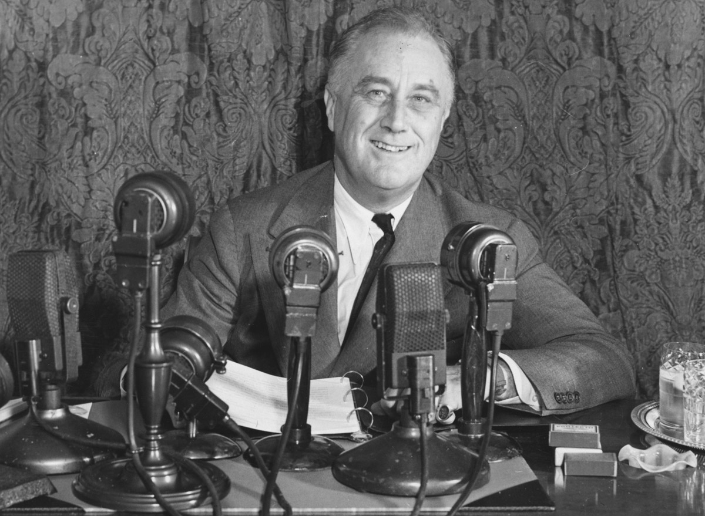
Solving the Problems of the
Great Depression
Franklin d. Roosevelt and the “new Deal”

Slide 2
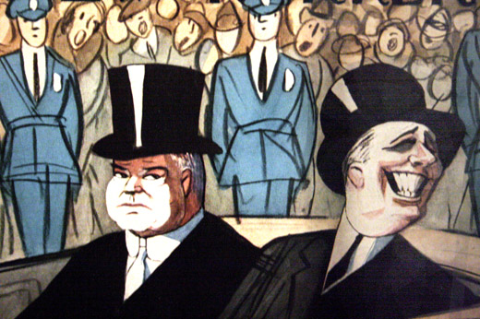
Happy Days are Here Again?

Slide 3
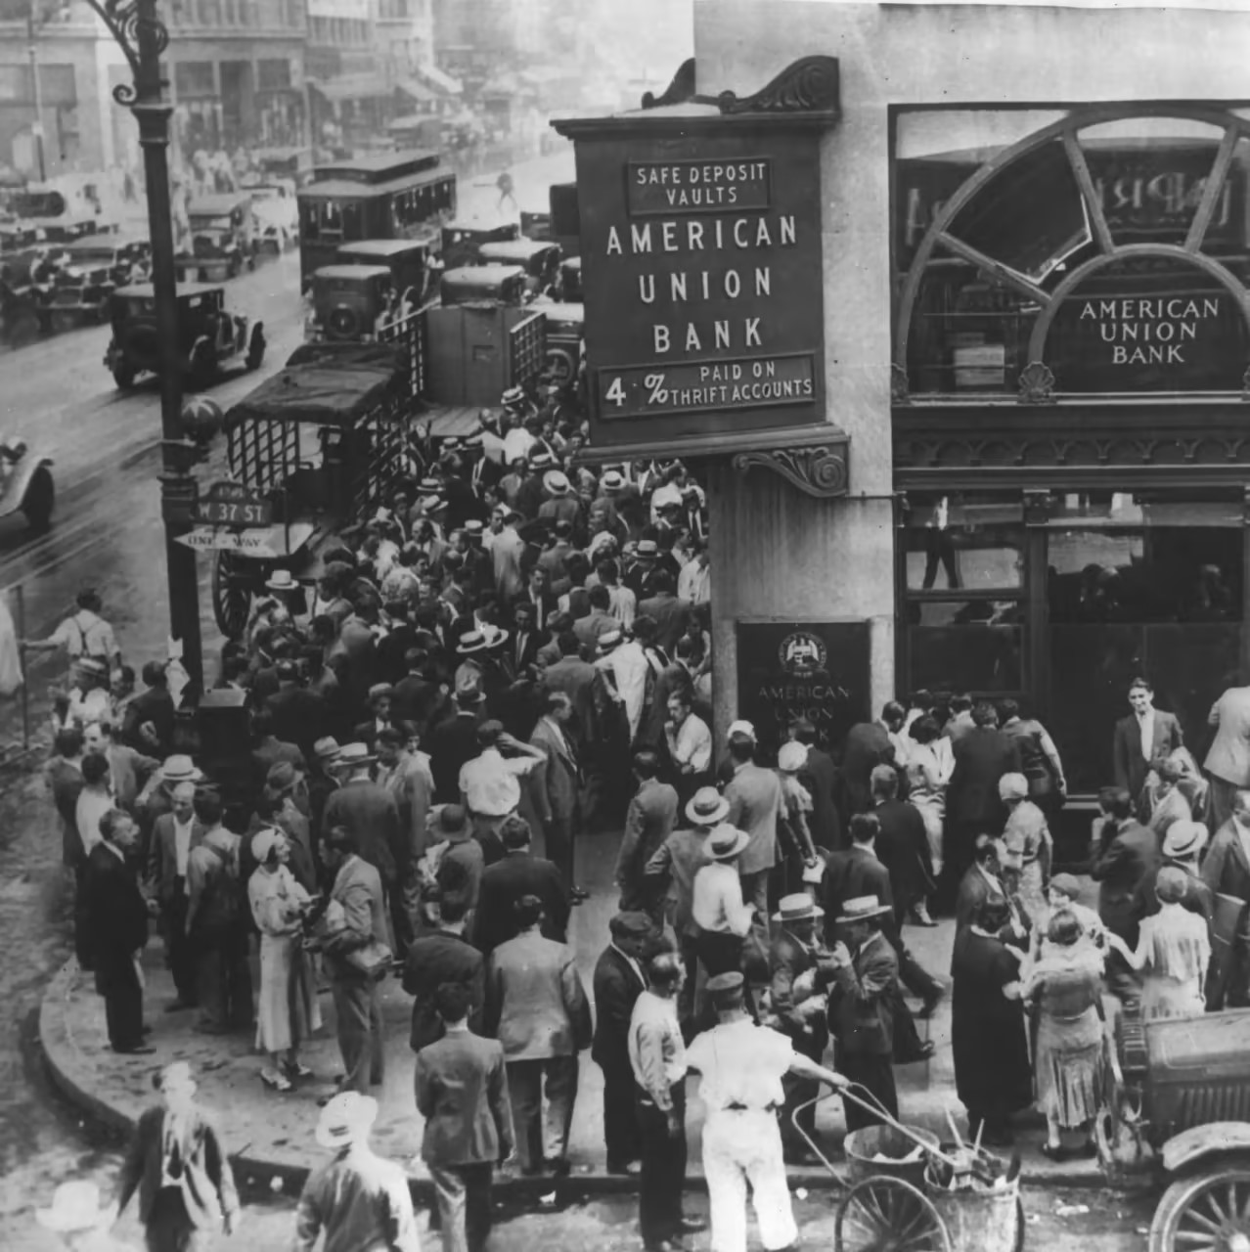
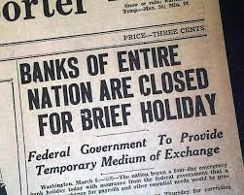
Problem #1 – The Financial Sector
Saving the Banks

Slide 4
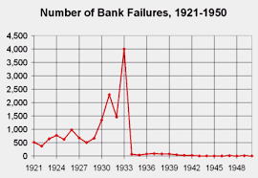
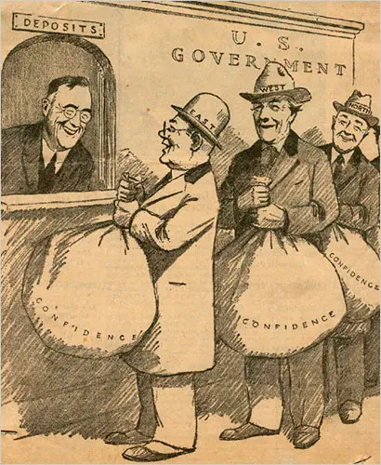

Federal Deposit Insurance Corporation

Slide 5
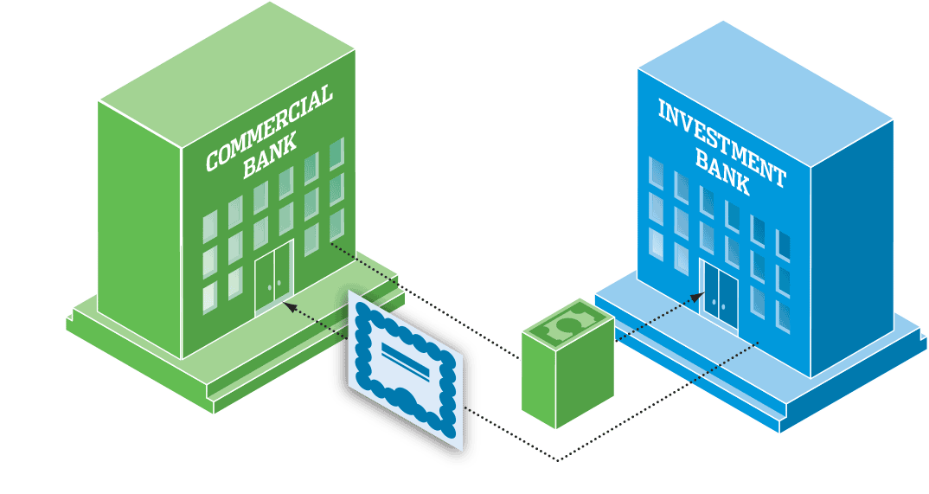
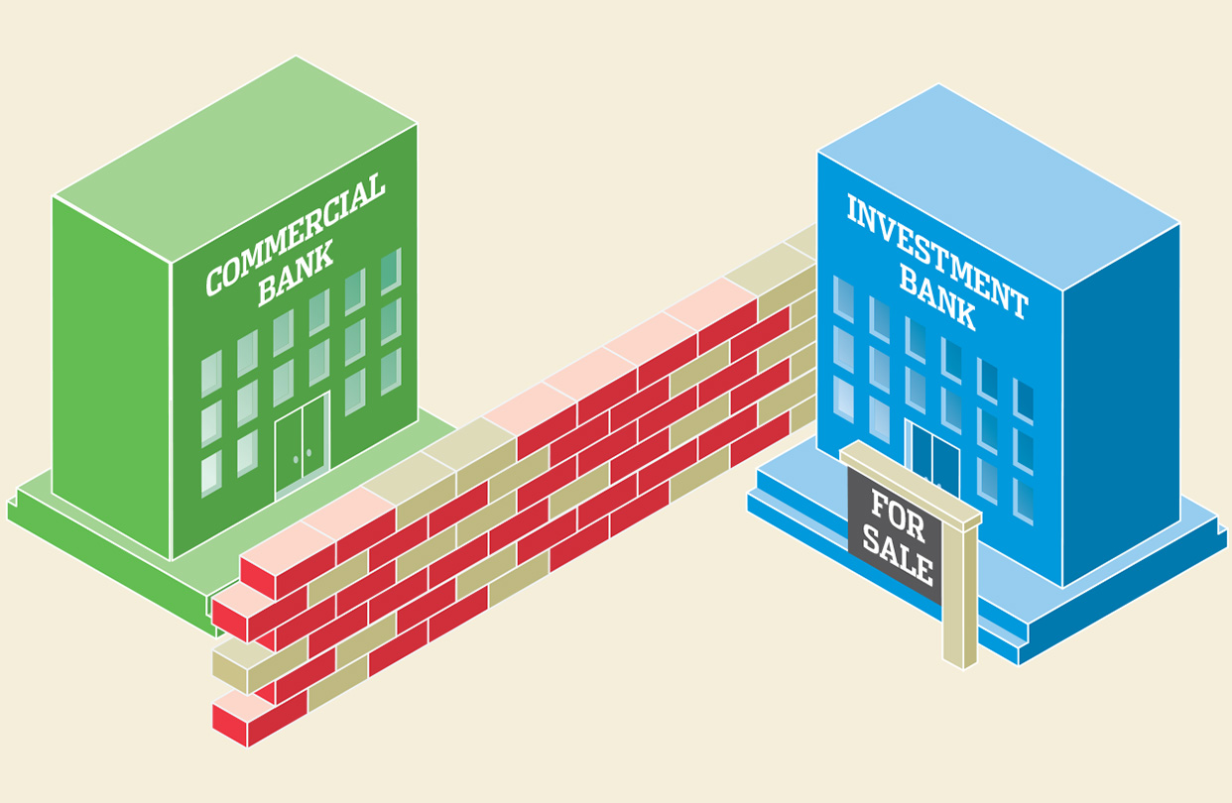
The Glass-Steagall Act
Separates Commercial and
Investment banks

Slide 6
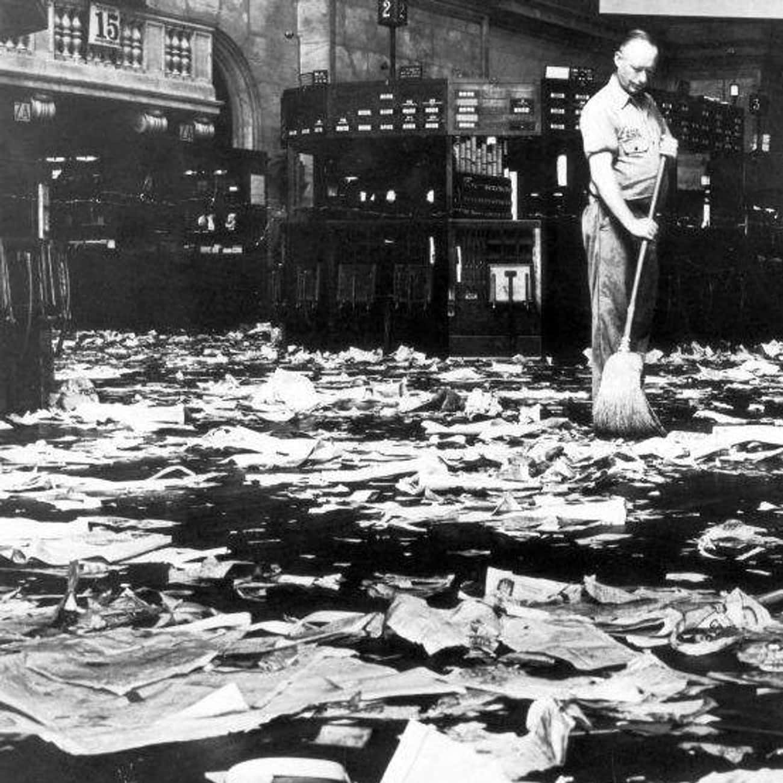
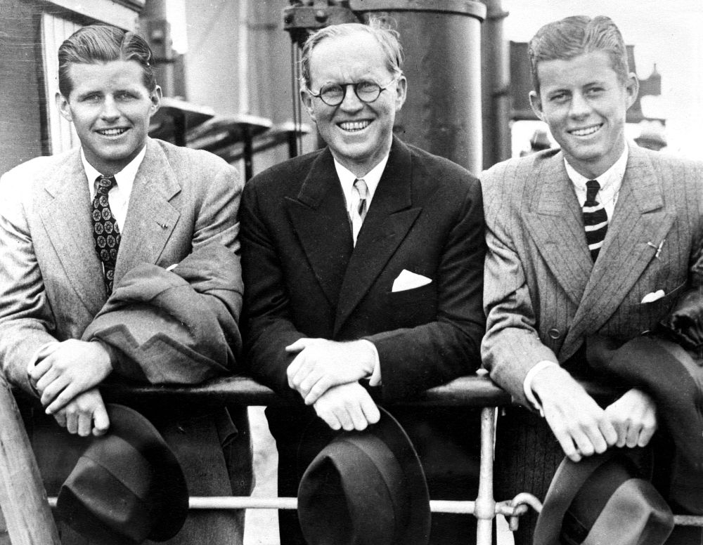
Securities and Exchange Commission (SEC)
-insider trading regulations
-transparency
-standardized accounting procedures
“Wall street clean-up”

Slide 7
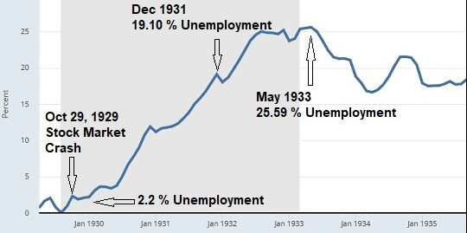
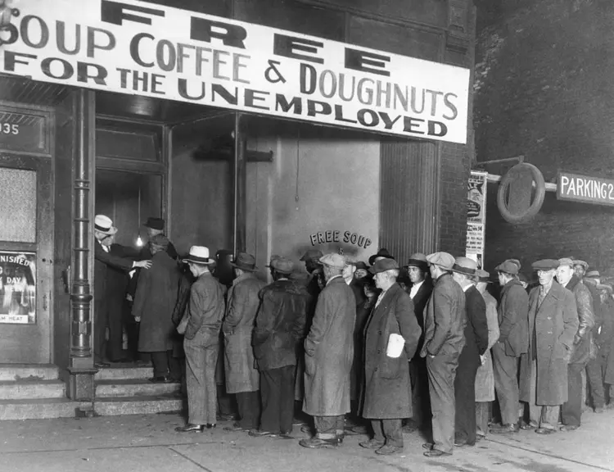
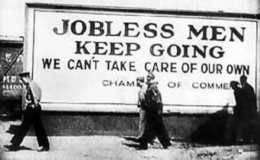
Problem #2 – Unemployment
October 1929 – 2.2 %
March 1933 – 25.6 %

Slide 8
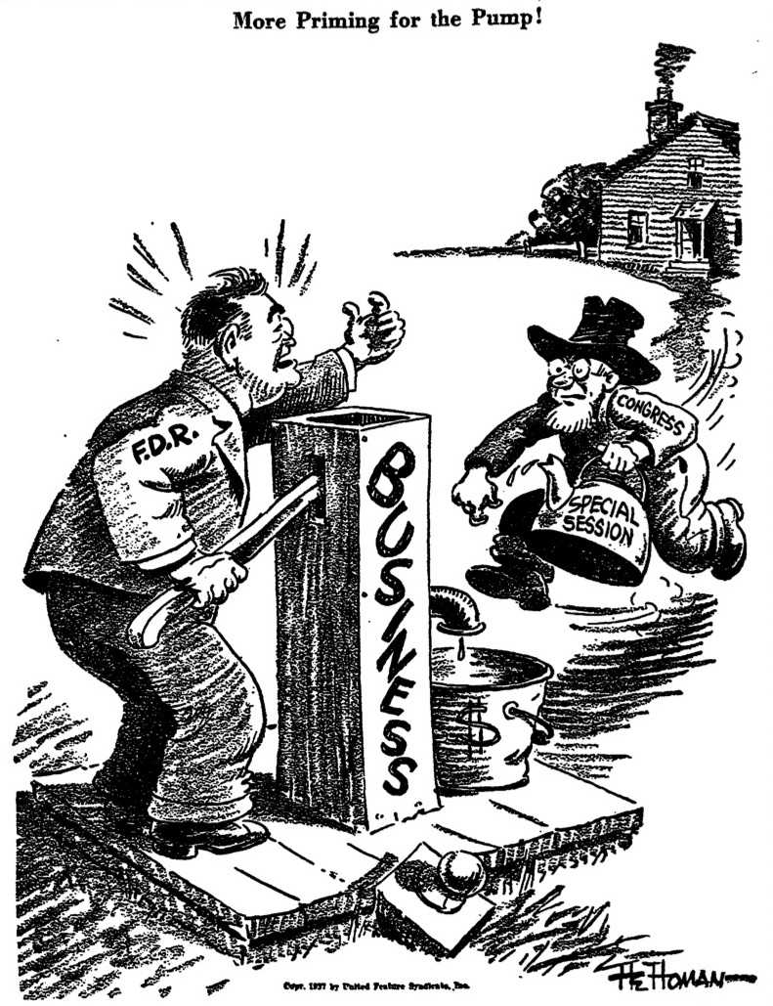
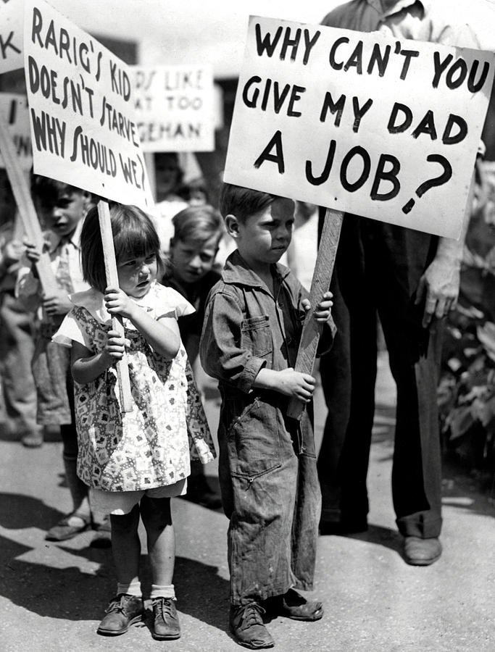
“Priming the Pump”

Slide 9
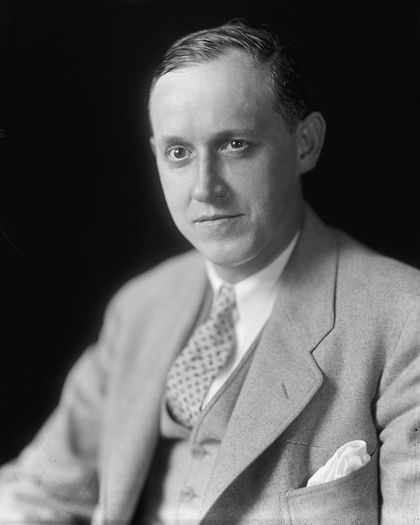
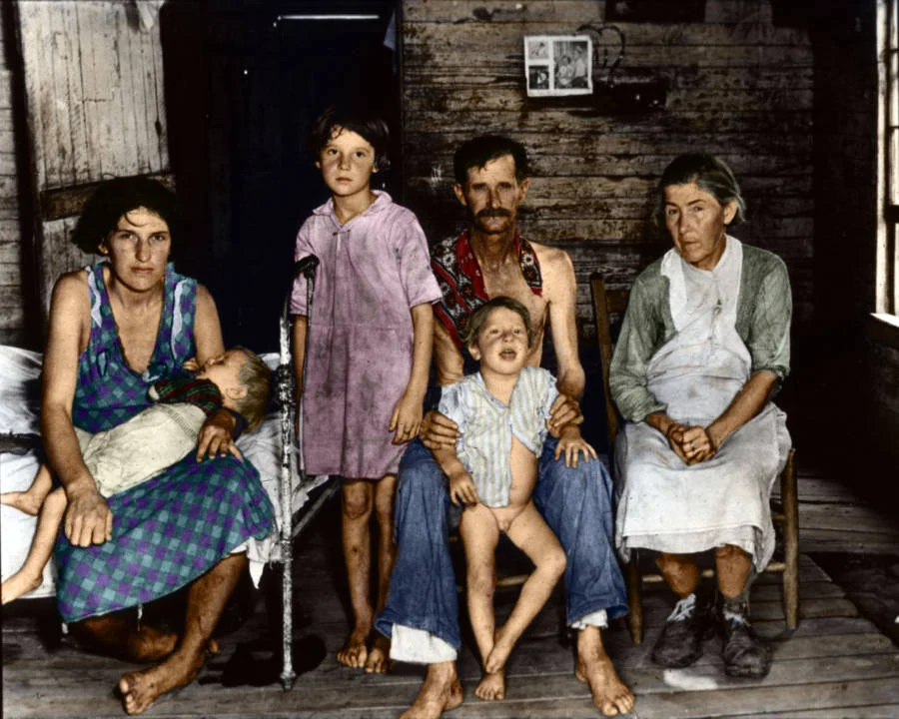
Federal Emergency Relief Administration
Harry hopkins

Slide 10
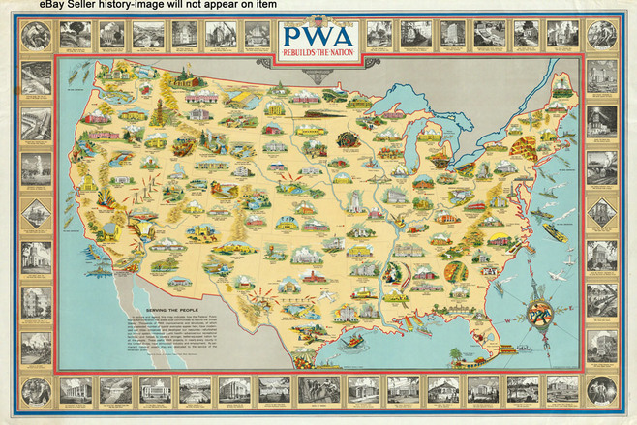
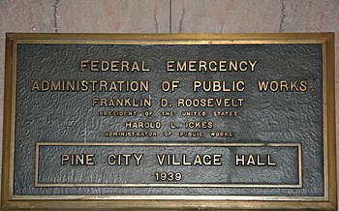
Public Works Projects
No “Dole”
“multiplier effect”
“Big bucks on big projects”

Slide 11
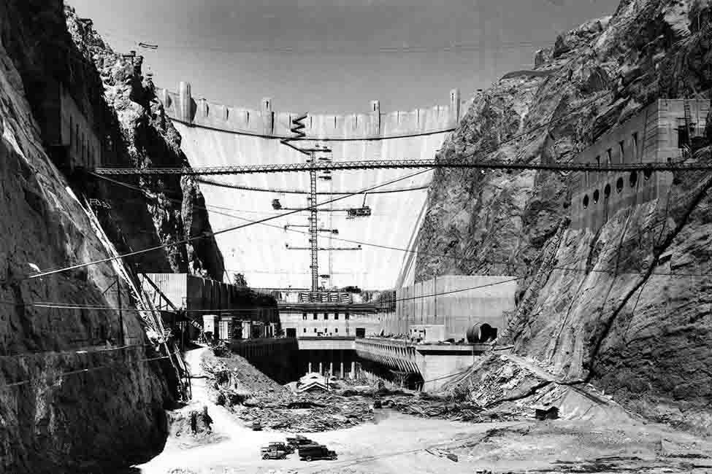
“Boulder” Dam

Slide 12
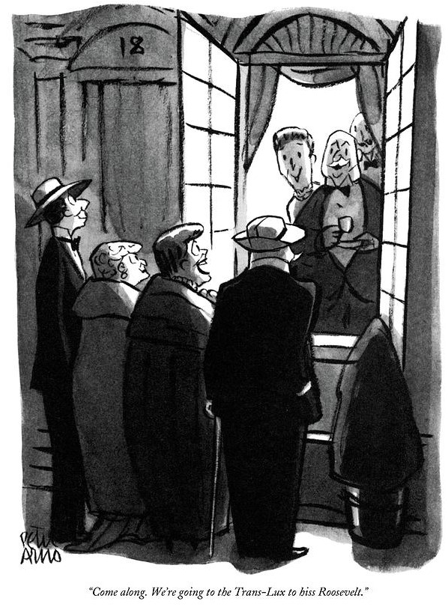
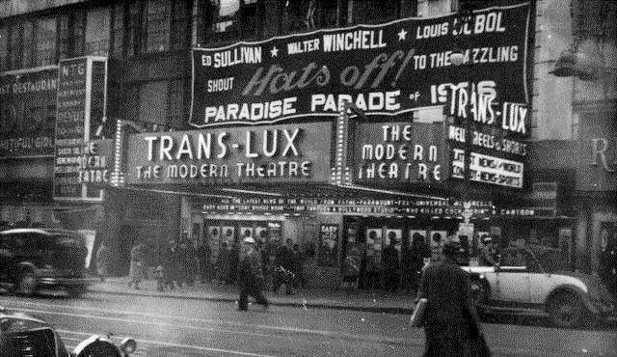
New Deal Critics
“Come Along! We’re going to the trans-Lux to hiss
Roosevelt”

Slide 13
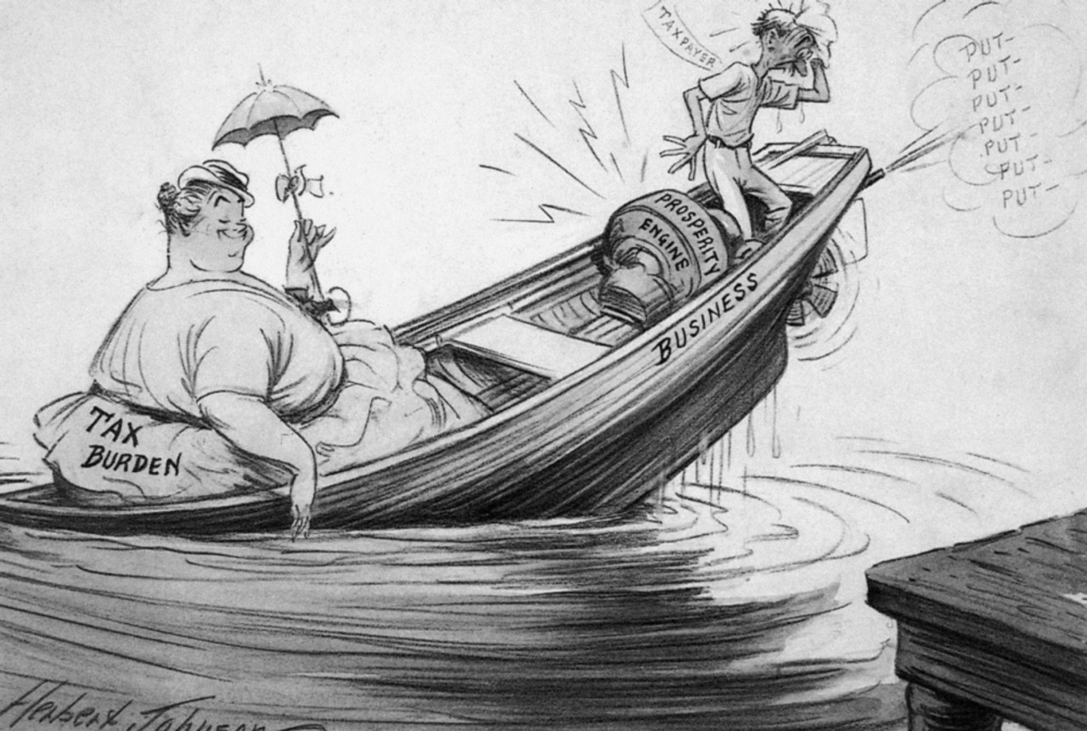
Who Pays?
A debate over deficits,
Patronage,
And business regulation

Slide 14
Problem #3 –
Agricultural Overproduction and
Industrial Competition

Slide 15
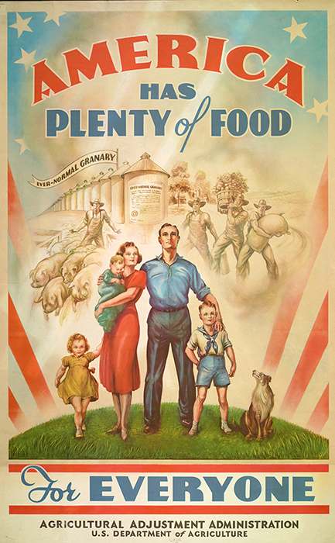

Slide 16
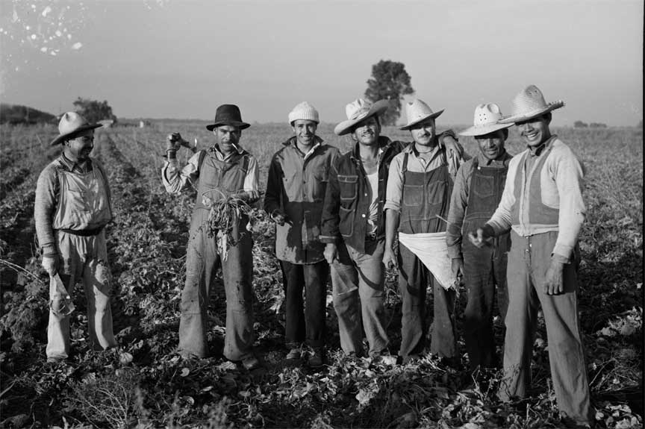
Agriculture Adjustment Act
Goals:
Limit production
Raise Prices

Slide 17
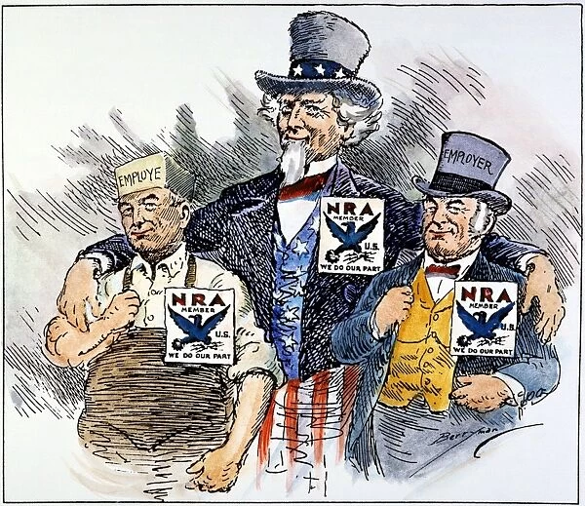

National Recovery Administration
Goals:
Limit “cutthroat competition”
Raise wages (set minimum wage)
Empower unions

Slide 18
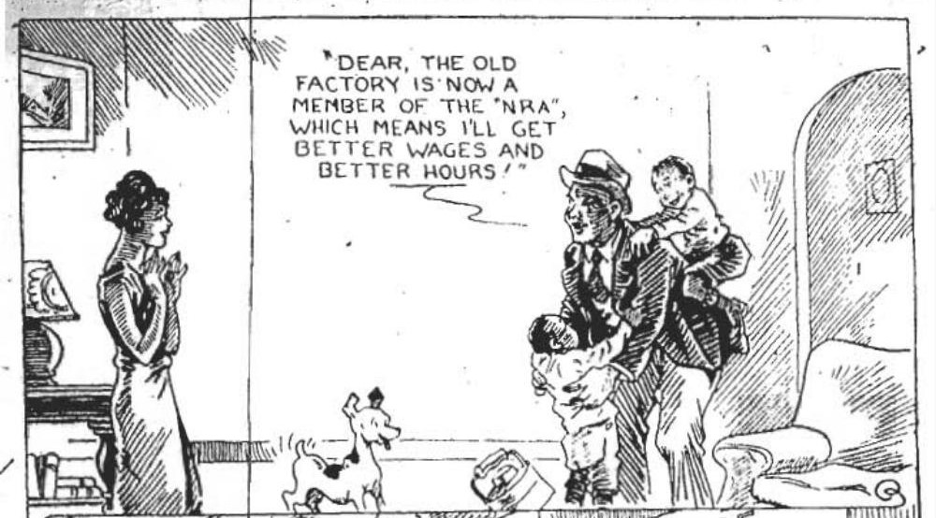
Negros Ruined Again?
Chicago defender on
Nra and African americans

Slide 19
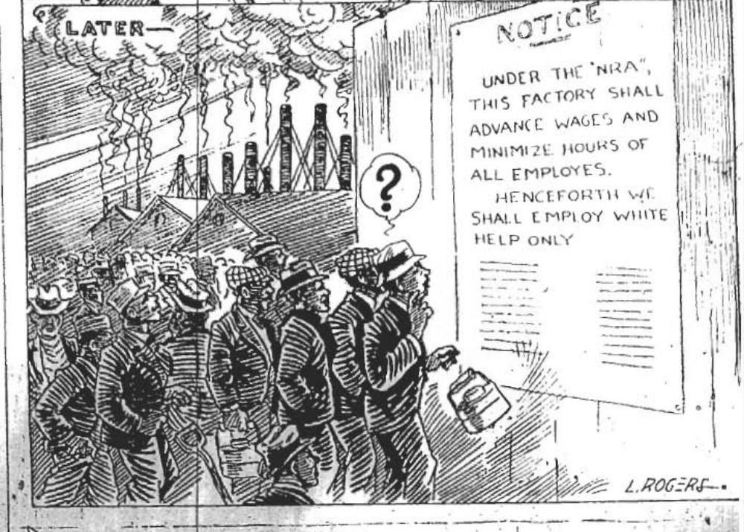

Slide 20
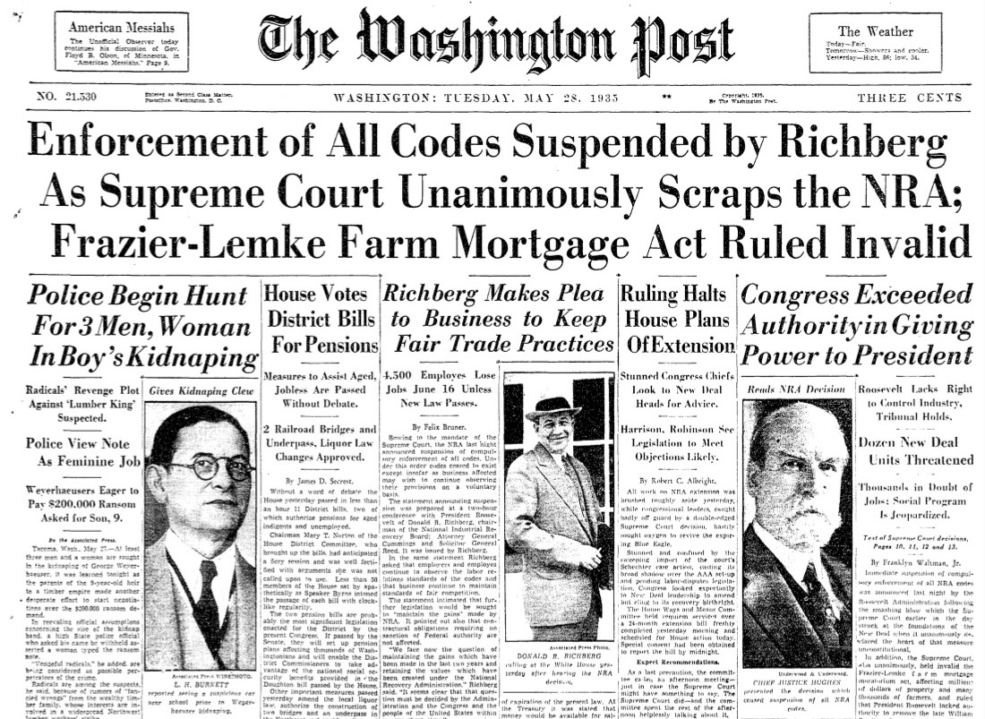

Slide 21
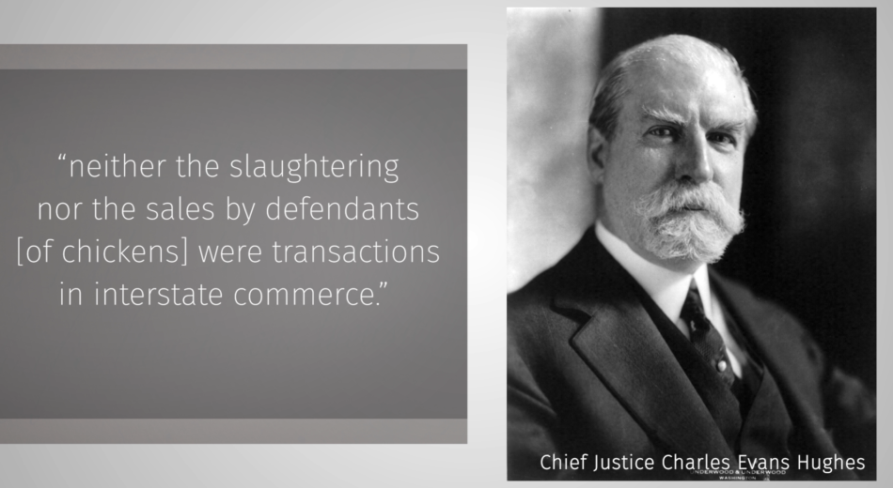

Slide 22
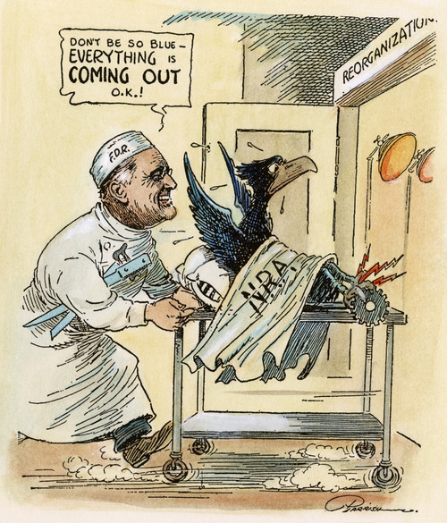
NRA 2.0
Price codes – gone
Union recognition -- stays

Slide 23
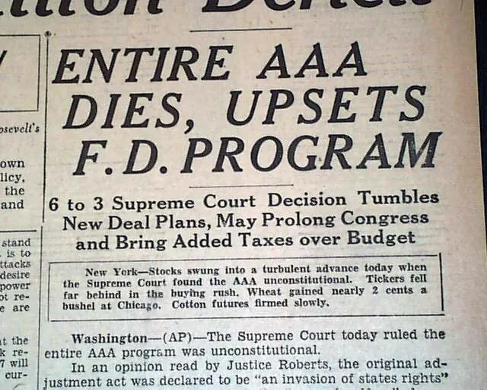

Slide 24
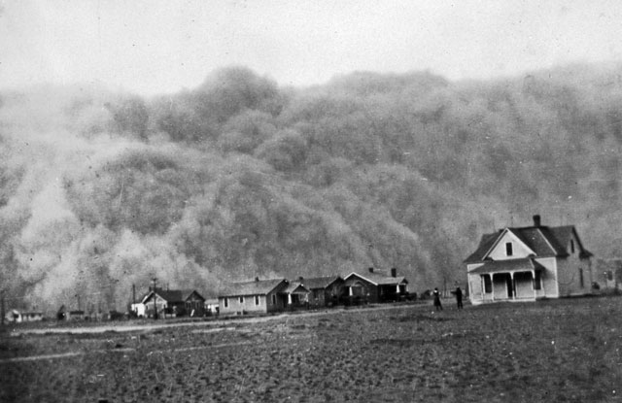
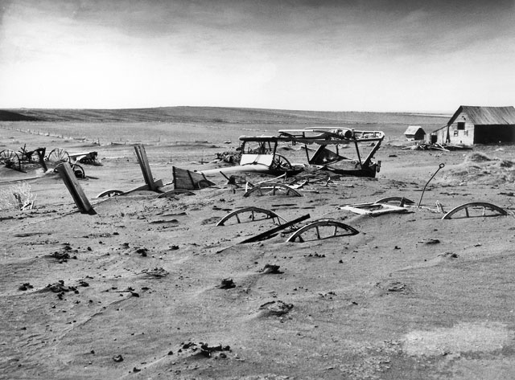
“Dust Bowl”
Texas, 1935
South Dakota, 1936

Slide 25
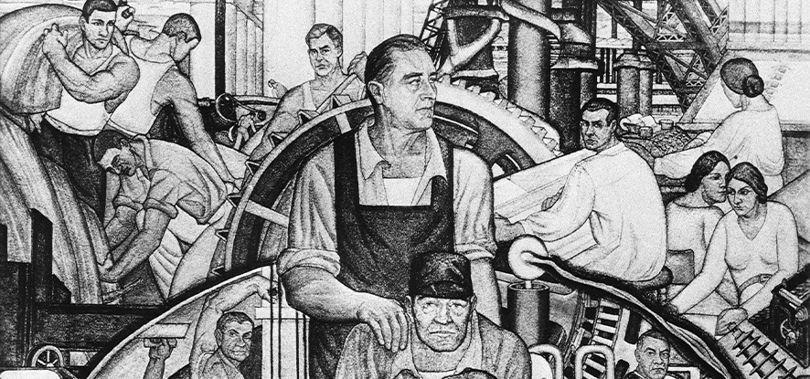
Problem #4 – Protect Americans from Future Depressions
Long term reform
Short term impediments to recovery

Slide 26
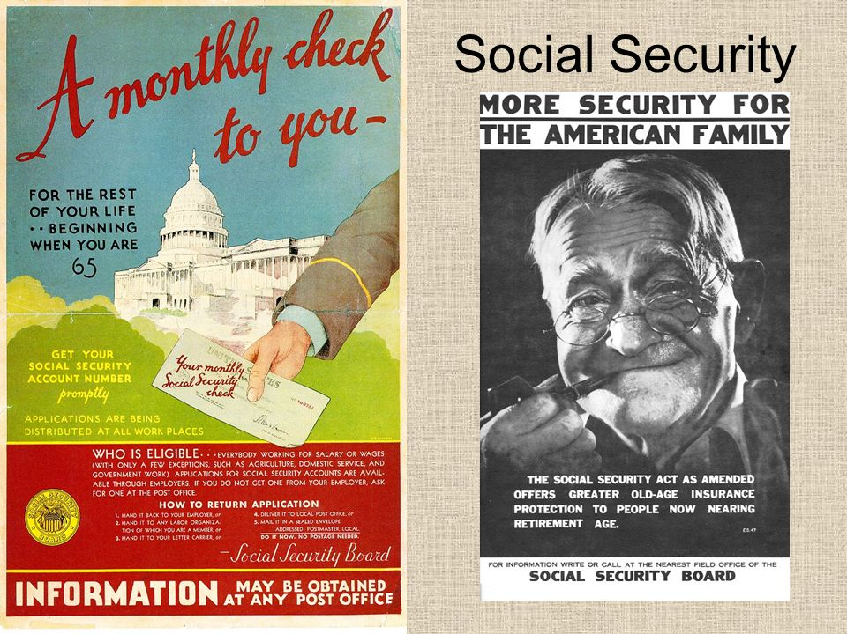
Social Security
Retirement “insurance”
Is an “Entitlement”

Slide 27
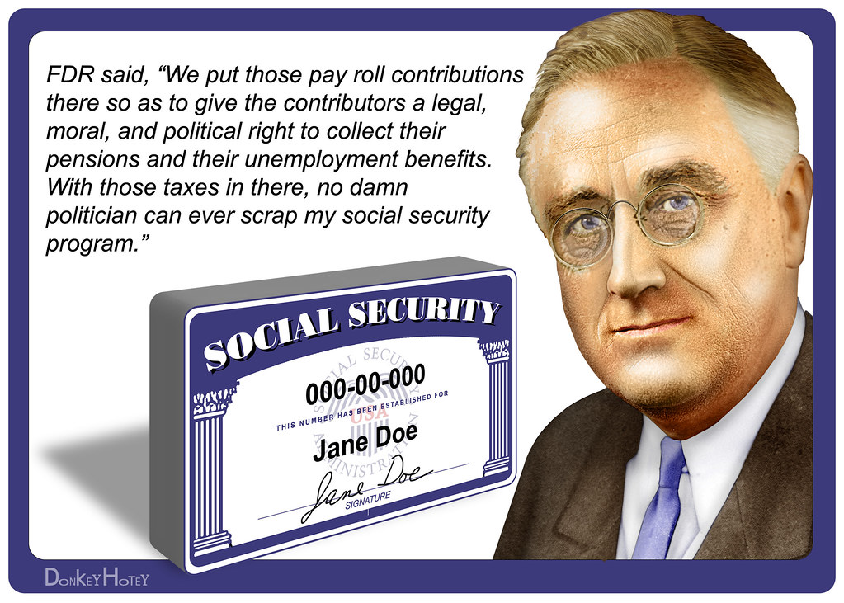

Slide 28

Unemployment Benefits
Social “safety net”
“Freedom from Fear”

Slide 29
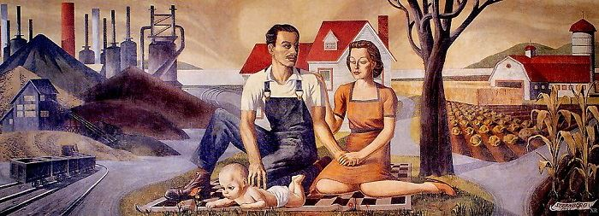
https://livingnewdeal.org/

