Slide 1
The 1960s

Slide 2
The Rise and Fall of Liberalism

Slide 3
Why did it “rise”?
Why did it “fall”?

Slide 4
1960-1963
Anticipation, or…
“A promising time”

Slide 5
The Election of 1960
“Time to get the country moving again.”

Slide 6
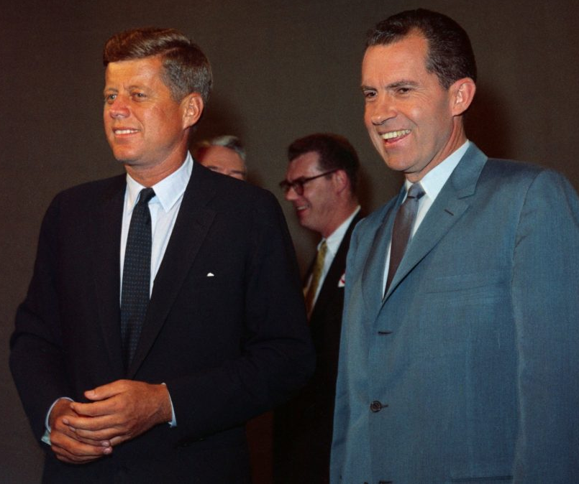
Kennedy vs Nixon

Slide 7
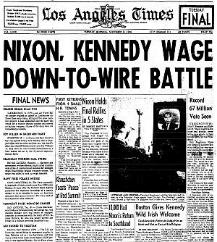

Slide 8
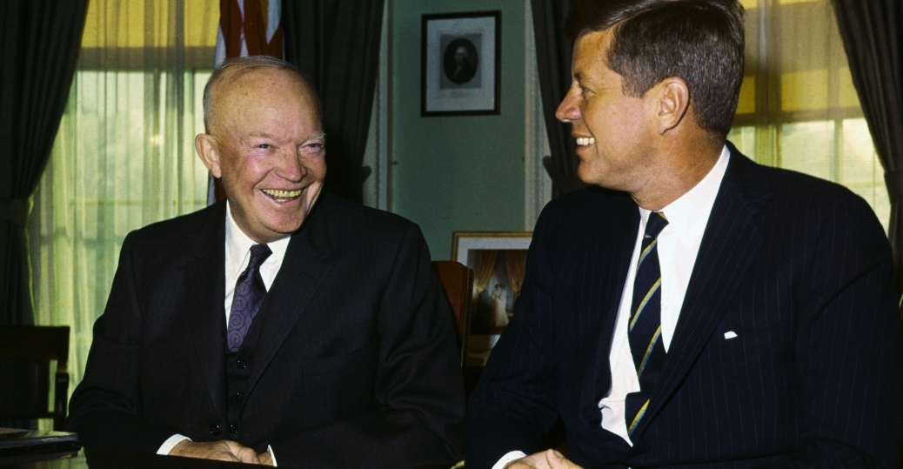
“The Torch is Passed”

Slide 9
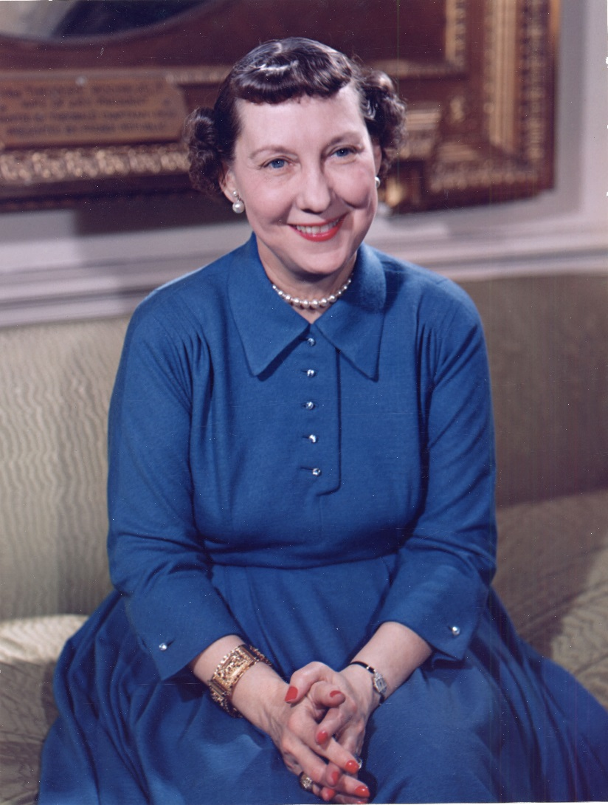
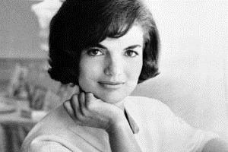
Mamie to Jackie…

Slide 10
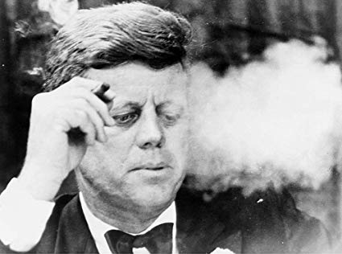
Kennedy Liberalism =
Activist Government

Slide 11
Aggressive, Anticommunist Foreign Policy
-- Cuba
-- Vietnam

Slide 12
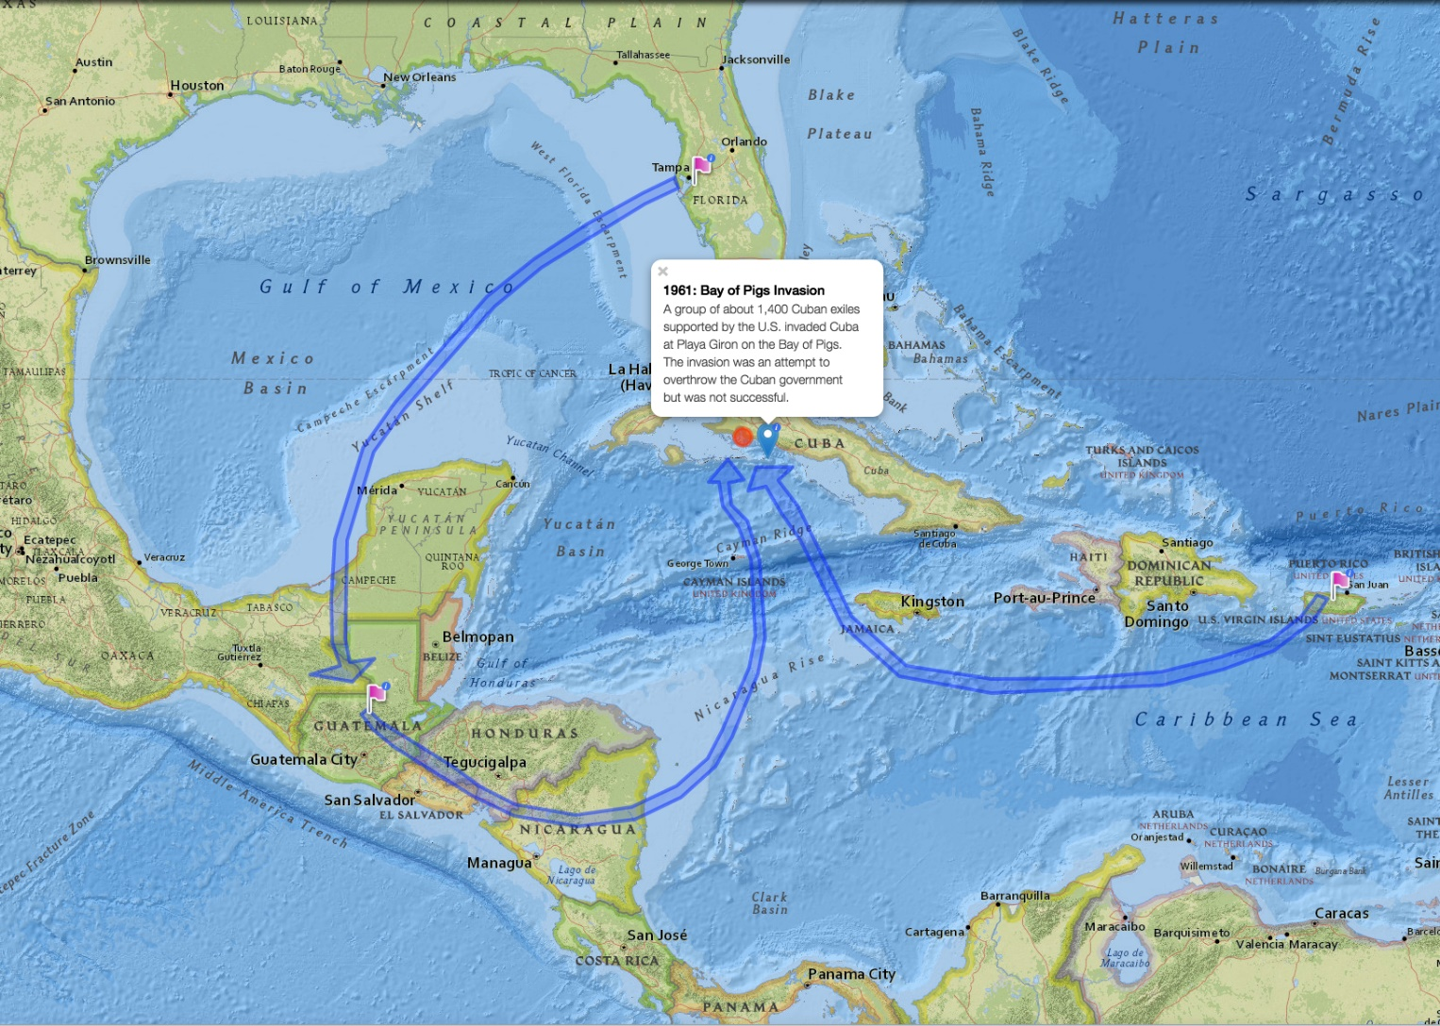
Bay of Pigs Invasion – Anti-Castro

Slide 13
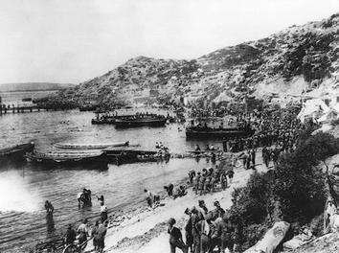

Slide 14
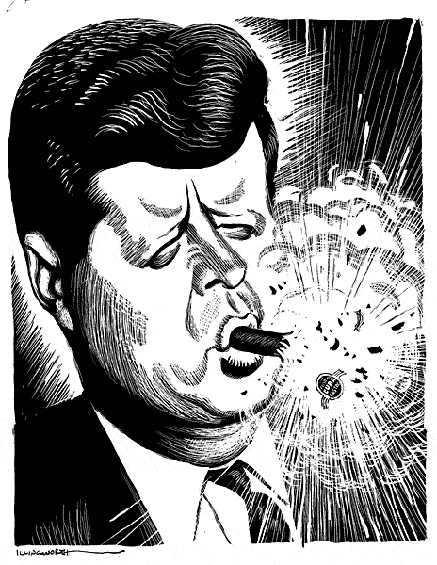

Slide 15
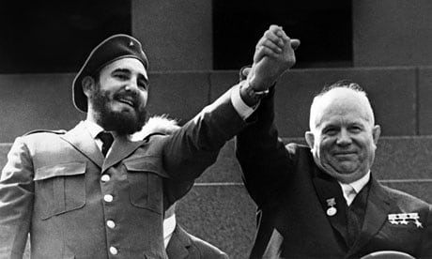

Slide 16
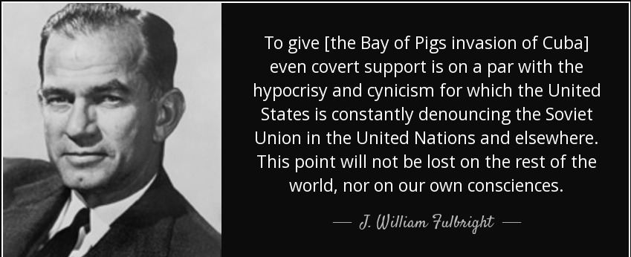

Slide 17
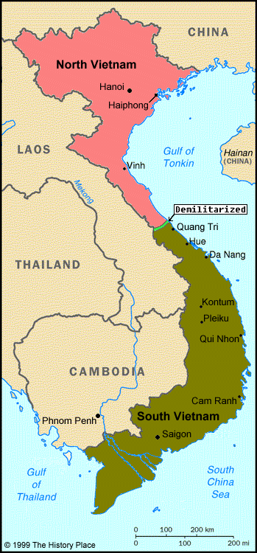
Cold War in Vietnam

Slide 18
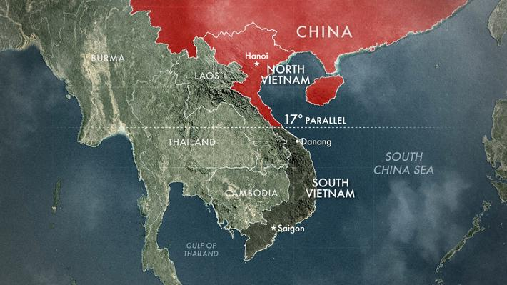
“Containment”

Slide 19
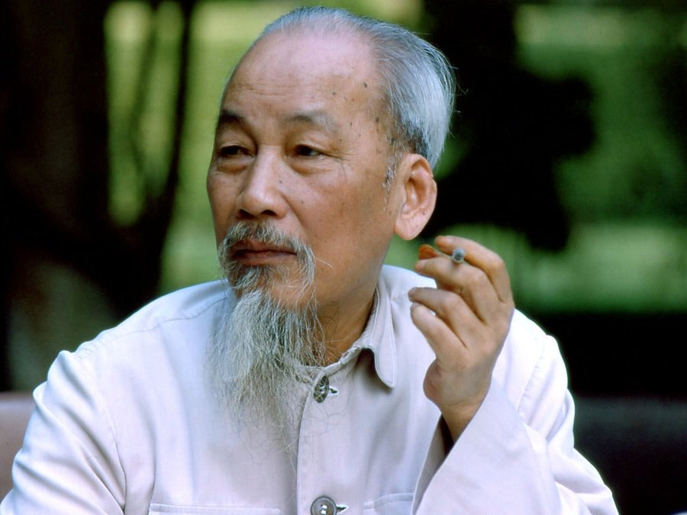
Ho Chi Minh – North Vietnam

Slide 20
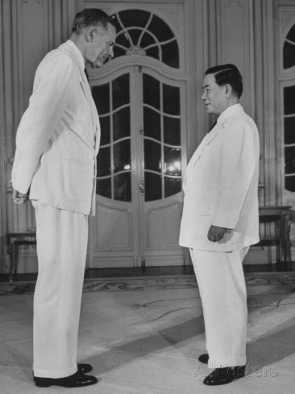
Ngo Dinh Diem – South Vietnam

Slide 21
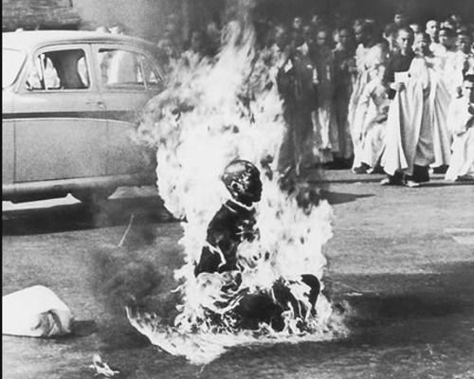

Slide 22
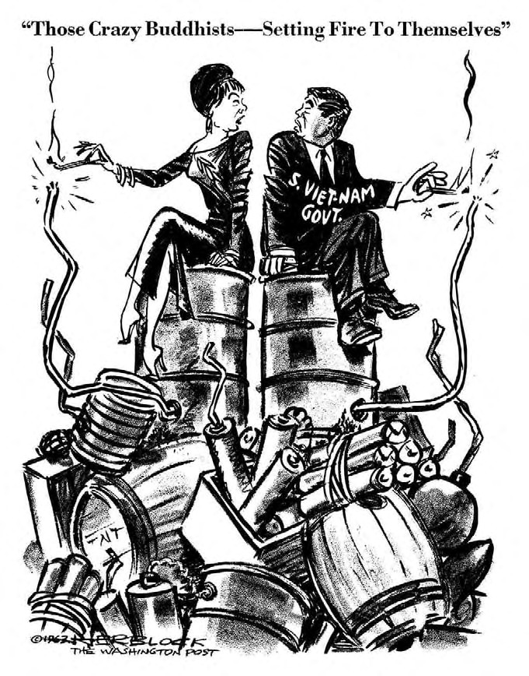

Slide 23
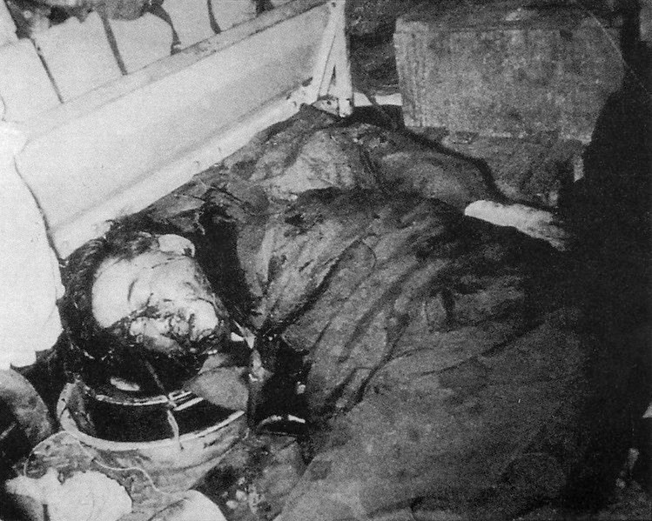

Slide 24
Cautious, Pragmatic Domestic Policy
-- support for Civil Rights…eventually
-- emphasis on equality of opportunity
-- tax cuts to stimulate the economy

Slide 25
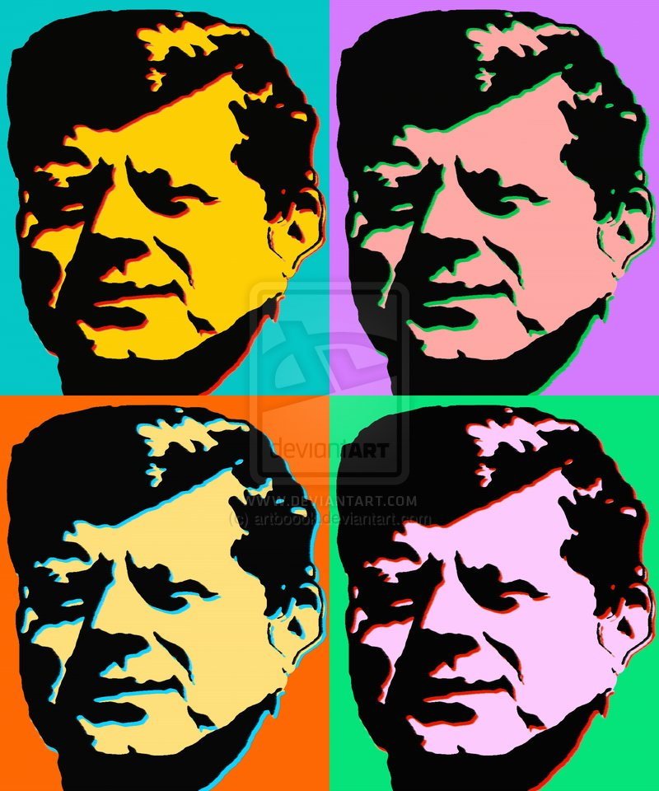
Kennedy: Image vs Reality

Slide 26
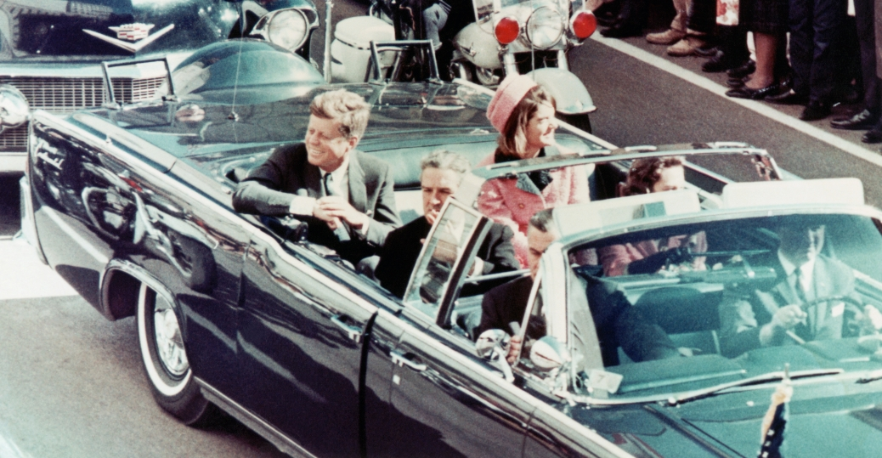
Dallas, November 22, 1963

Slide 27
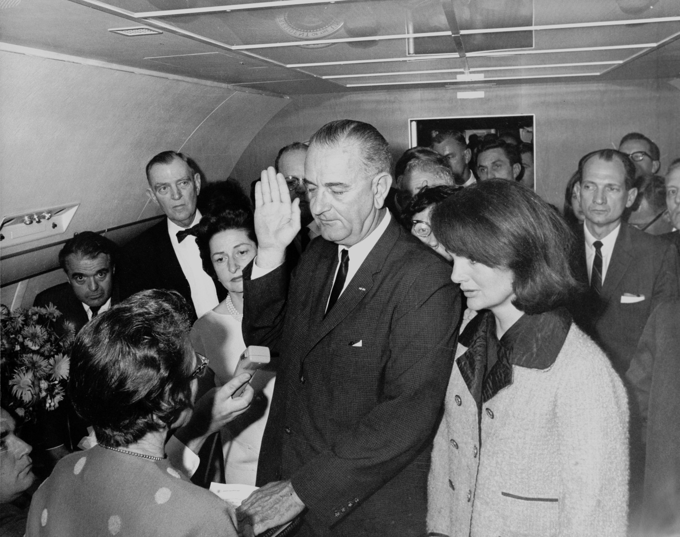

Slide 28
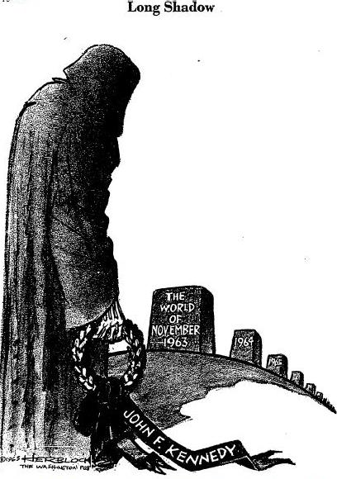

Slide 29
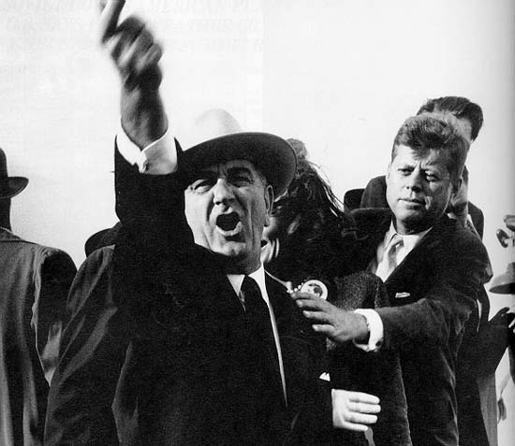

Slide 30
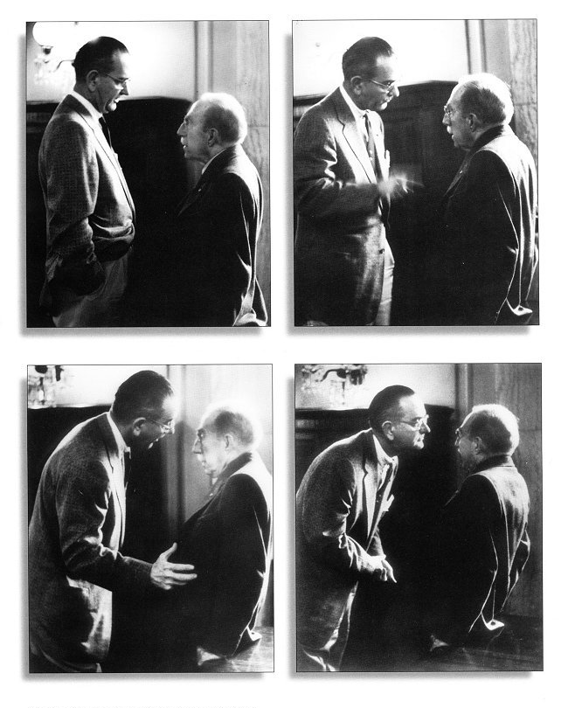
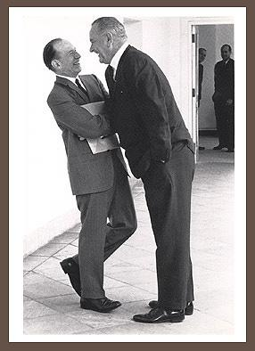
The “Johnson Treatment”

Slide 31
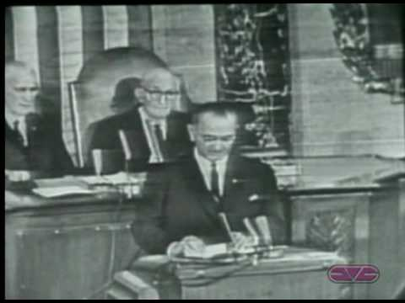
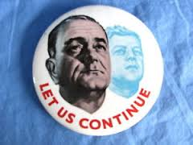
“Let us continue…”

Slide 32
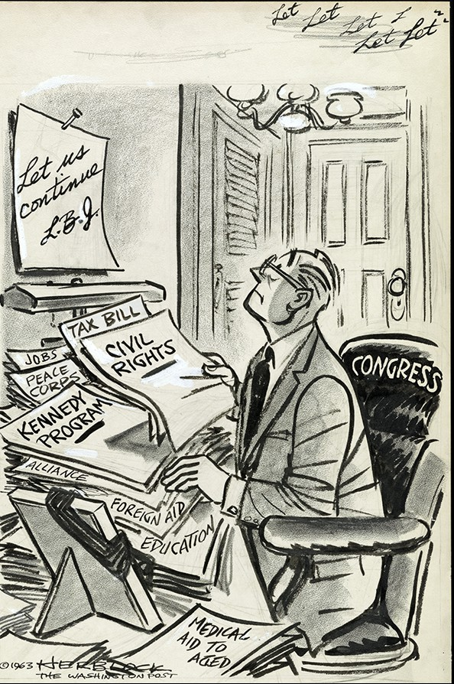

Slide 33
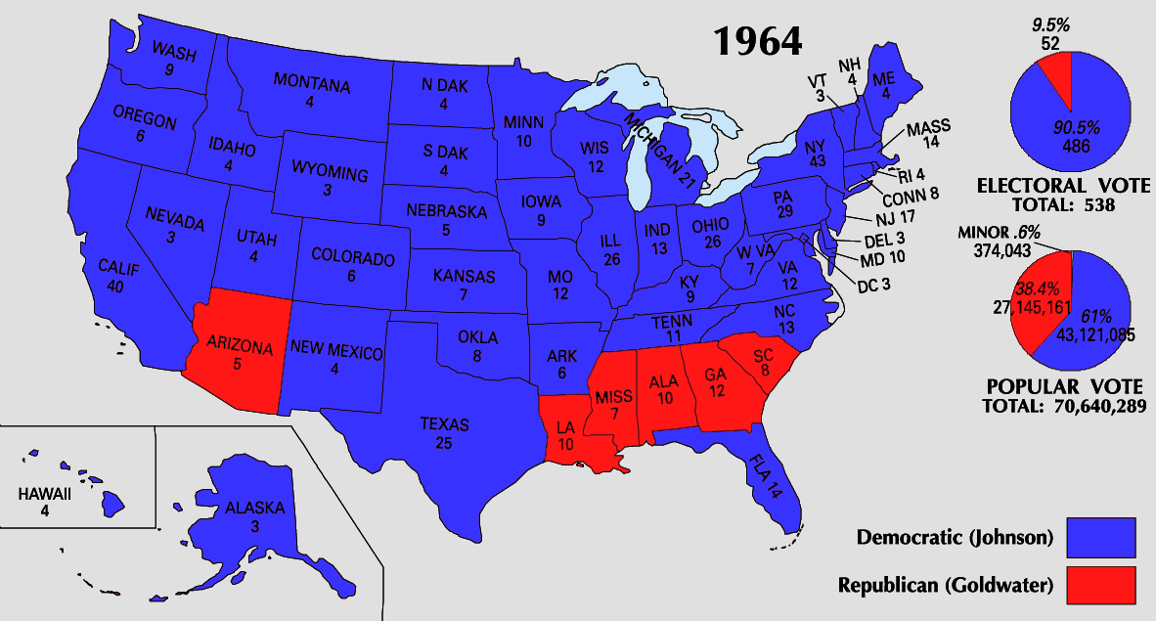
“The Liberal Hour”

Slide 34
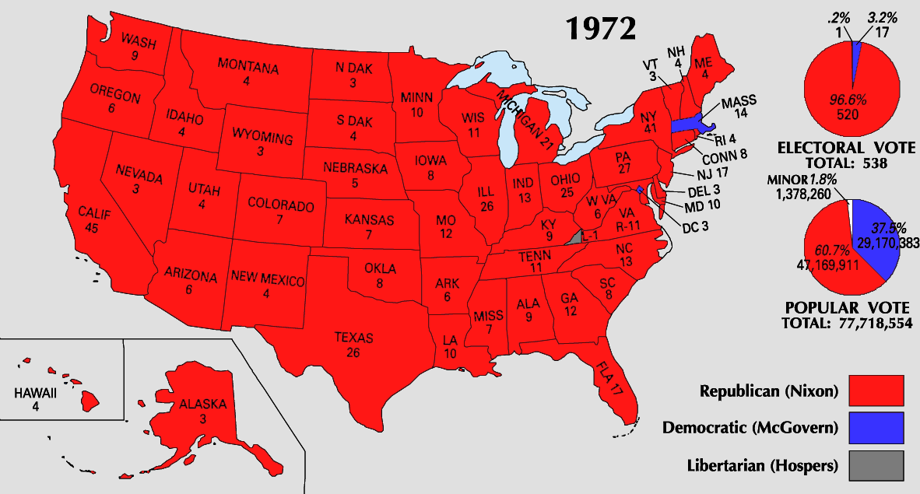
…And the FALL

Slide 35
What happened?
-- Urban Unrest
-- Vietnam

Slide 36
1965
“Guns AND Butter”
-- Escalation in Vietnam
-- War on Poverty
-- Over-promising?

Slide 37
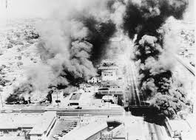
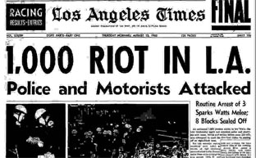
Watts

Slide 38
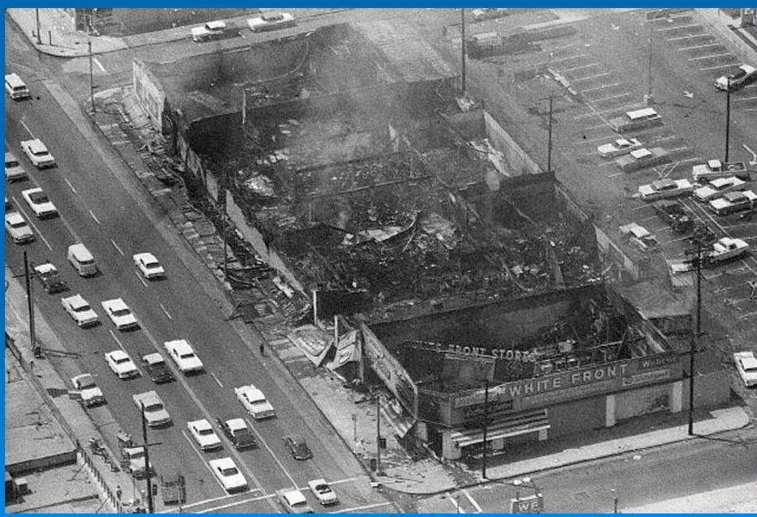

Slide 39
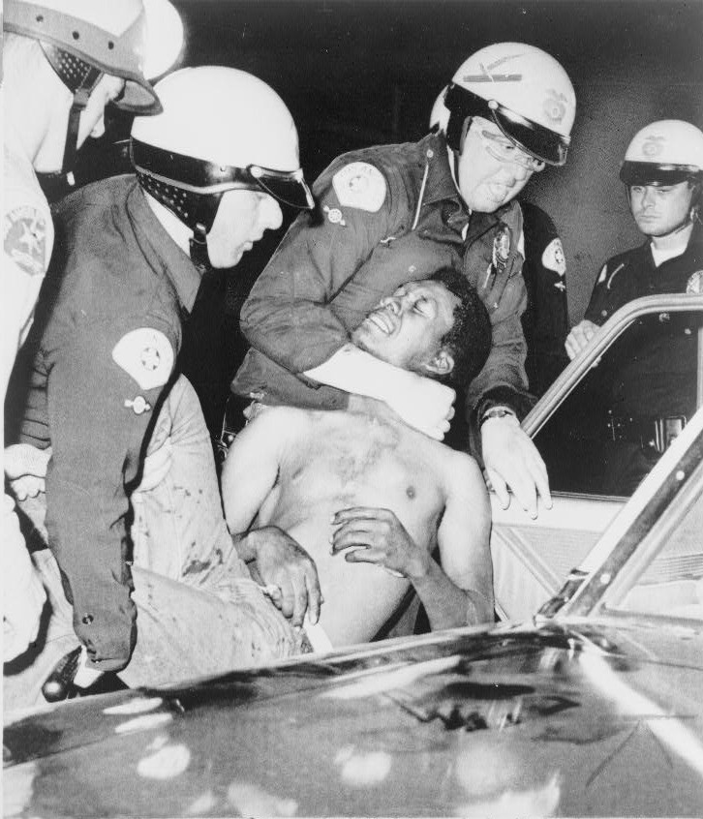

Slide 40
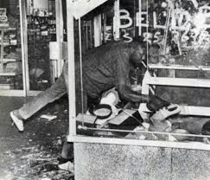

Slide 41
“Law and Order”
White Backlash Against Liberalism

Slide 42
The Vietnam Quagmire
-- disaster abroad
-- dissent and backlash at home

Slide 43
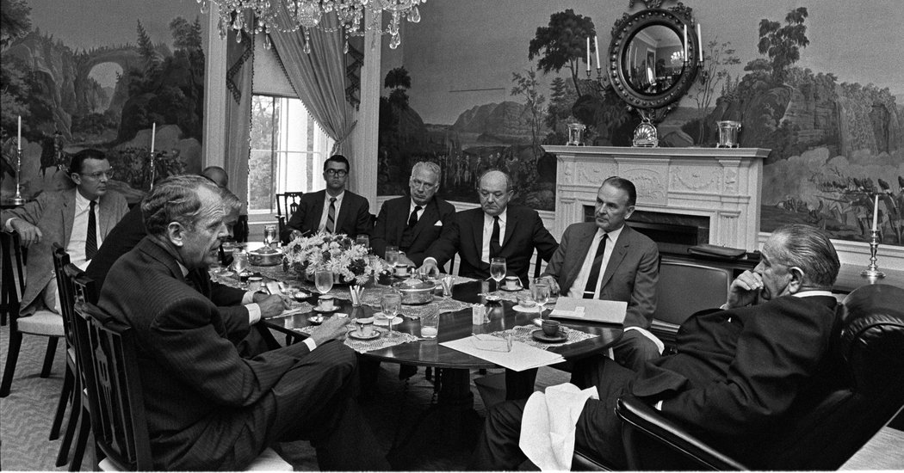
“The war is not going well…but pulling out is impossible.”

Slide 44
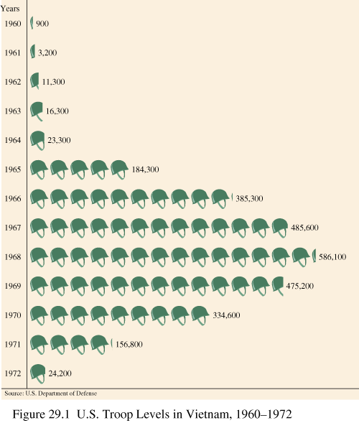

Slide 45
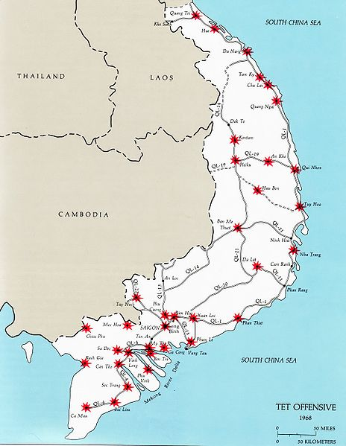
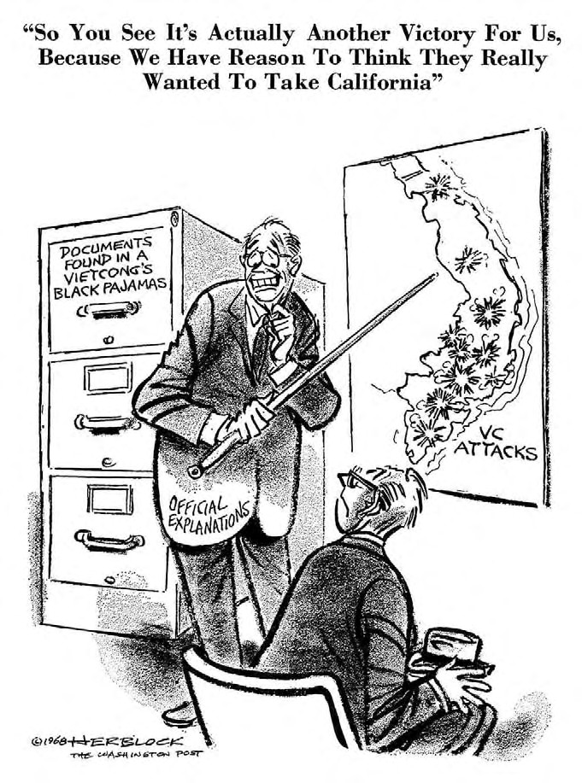
Tet Offensive January 31, 1968

Slide 46
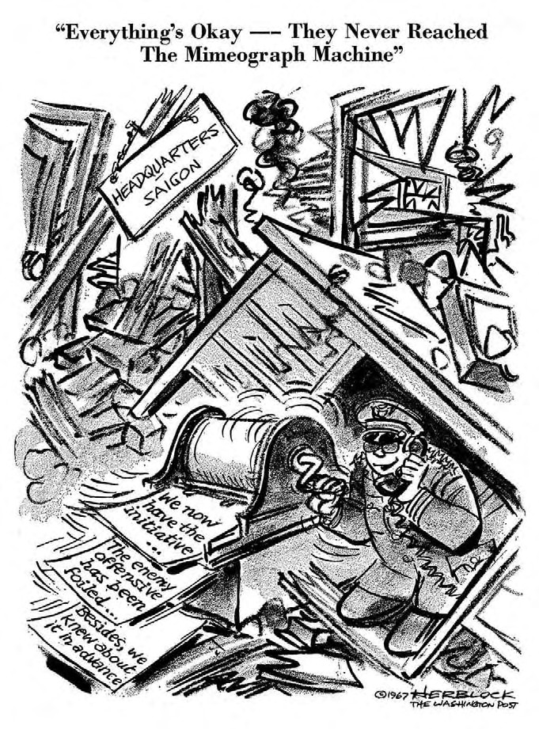

Slide 47
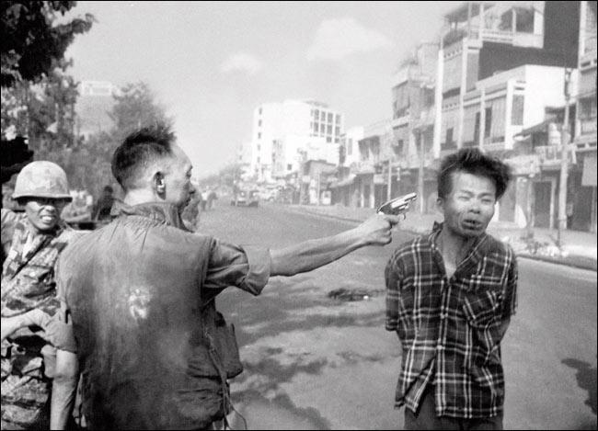

Slide 48
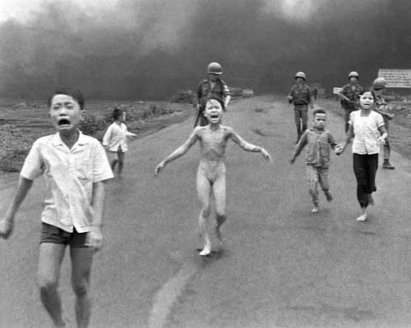

Slide 49
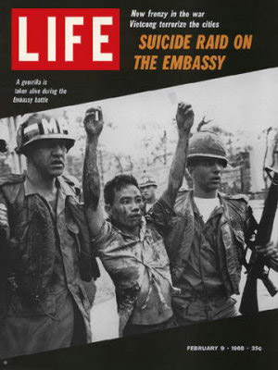
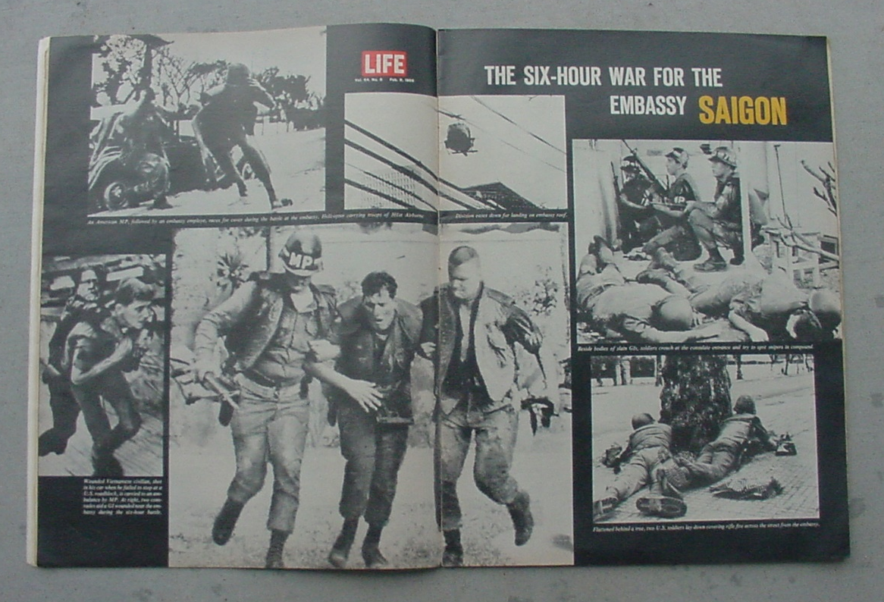
“What the hell is going on? I thought we were winning the War!”
– Walter Cronkite, CBS News

Slide 50
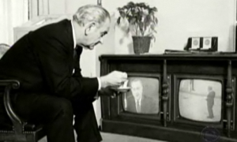
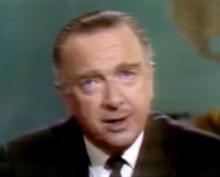
“If I’ve lost Cronkite,
I’ve lost Middle America”
– Lyndon Johnson, 2/27/68

Slide 51
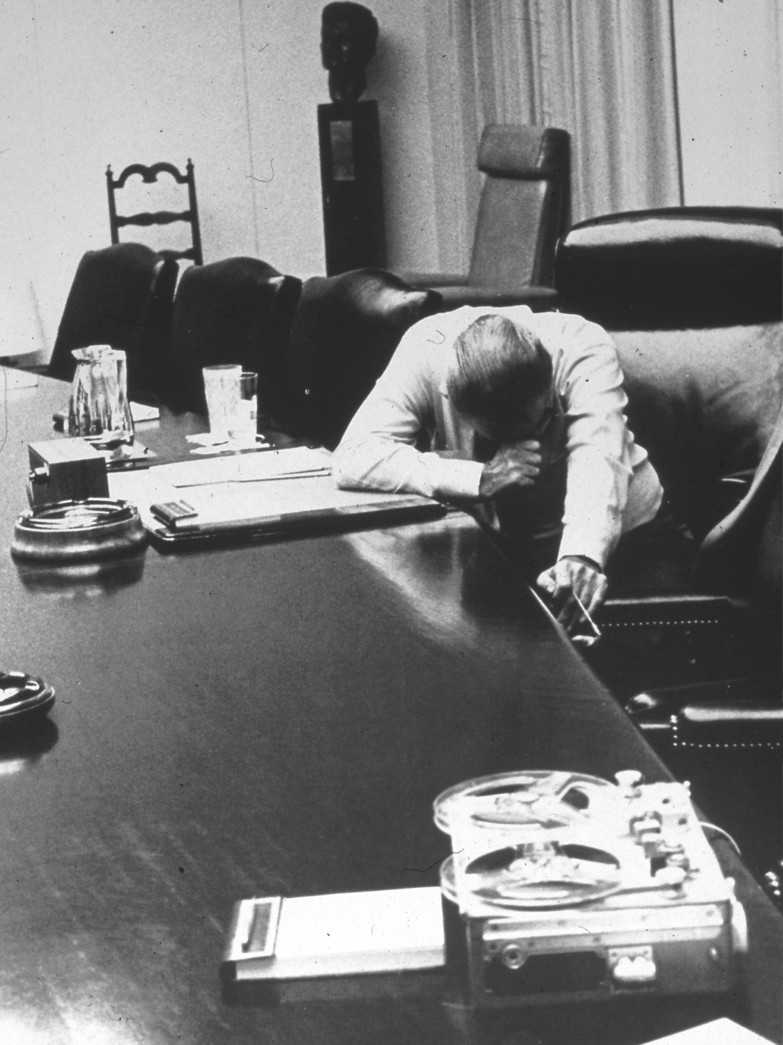

Slide 52
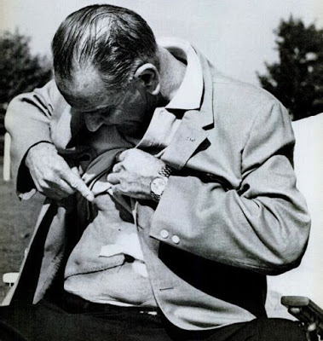
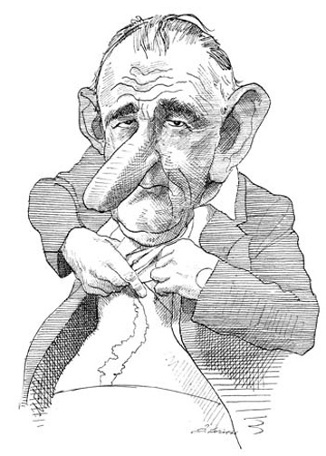

Slide 53
The Anti-War Minority &
The Anti-Anti War Majority
-- Cultural Clash
-- Class Divisions

Slide 54
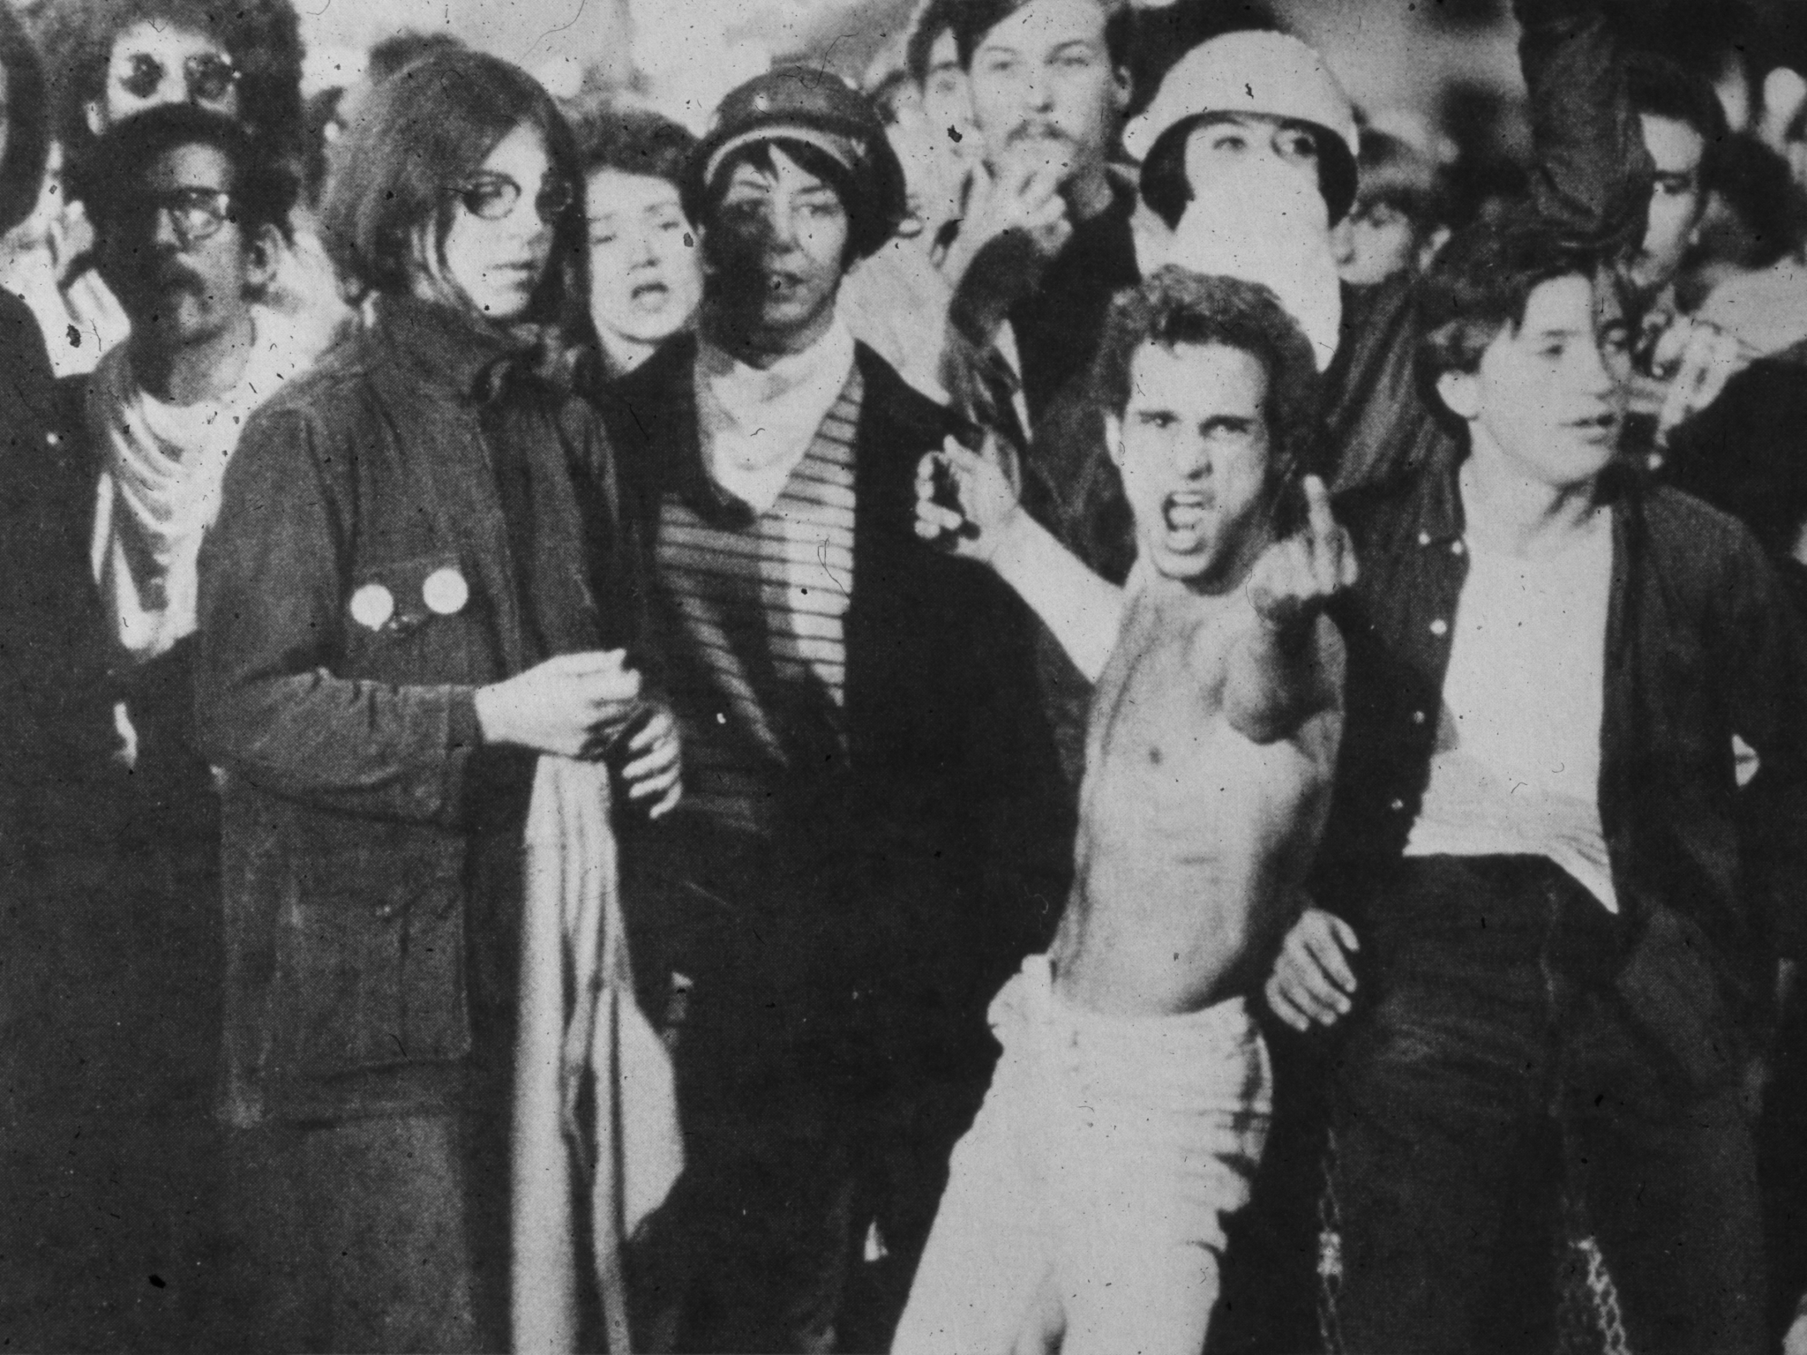

Slide 55


Slide 56


Slide 57

“Nixonland”

Slide 58
“The Liberal Hour”

Slide 59
…And the FALL

