Slide 1
History 271
Fall 2025
Dr. Devine

Slide 2
Link to Syllabus:
https://www.csun.edu/~twd61312/271%20fall%202025/271sylfall2025.htm
[Bookmark this link for easy access.]

Slide 3
Refer to the syllabus for deadlines, reading assignments, lecture notes, powerpoints, and other course information.

Slide 4
Course Password to access readings:
271

Slide 5
Attendance is optional, but class sessions are NOT recorded.

Slide 6
Tests will be taken DURING regularly scheduled class time:
SEPTEMBER 30TH
OCTOBER 28TH
DECEMBER 16TH
Mark the test days on your calendar NOW.

Slide 7
Office Hours – 624 Sierra Tower, 2:30-3:30 pm Tuesdays/Thursdays and by appointment gladly given.

Slide 8
The Civil War –
Who fought?
Who won?
What changed?
What stayed the same?
Why does it matter?

Slide 9
What did white, southern plantation owners lose?

Slide 10
Why were southern planters in such bad financial shape after the Civil War?

Slide 11
What did the freedmen win?

Slide 12
What did the freedmen lose?

Slide 13
Why could “freedom” be both a blessing and a curse for African Americans right after the Civil War?

Slide 14
What did non-planter white southerners lose?

Slide 15
What did northerners win?

Slide 16
How did the North’s victory in the Civil War change the United States?

Slide 17
How did the North’s victory in the Civil War change the United States?
-- politically?

Slide 18
Why does the North gain political power?
What does the North do with its political power?

Slide 19
How did the North’s victory in the Civil War change the United States?
-- politically?
-- economically?

Slide 20
Why did many (factory owners and workers) in the North support a high tariff on imports?
Why had southerners opposed raising tariffs before the Civil War?

Slide 21
How did the North’s victory in the Civil War change the United States?
-- politically
-- economically
-- psychologically

Slide 22
How did Americans think about their country differently after the war?

Slide 23
Before Reconstruction can begin – and even before the Civil War ends – what problems must the federal government address?

Slide 24
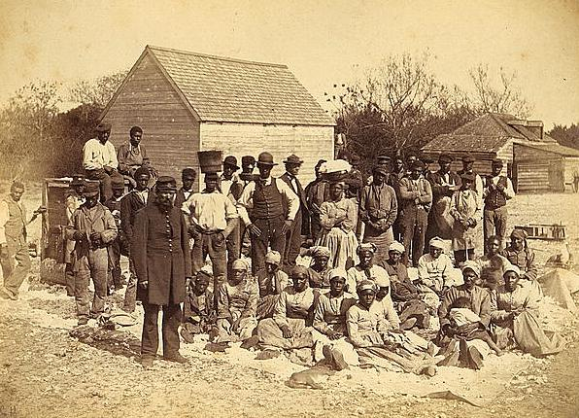
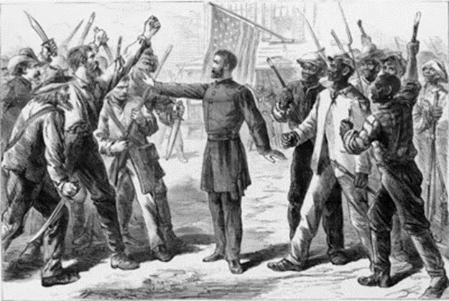
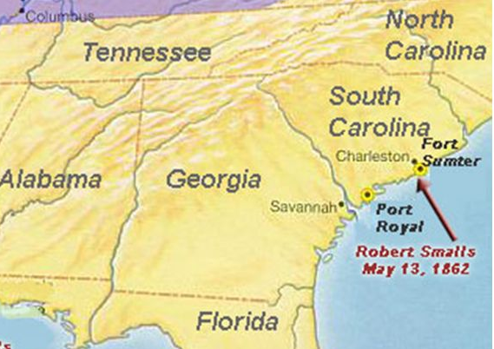
“Rehearsal for Reconstruction”
The Port Royal Experiment

Slide 25
The War to Save the Union? or
The War to End Slavery?

Slide 26
“The Union As It Was, The Constitution As It Is, and The Negroes Where They Are”
--Democratic Party Slogan, 1861

