Slide 1
The Civil War –
Who fought?
Who won?
What changed?
What stayed the same?
Why does it matter?

Slide 2
What did white, southern plantation owners lose?

Slide 3
Why were southern planters in such bad financial shape after the Civil War?

Slide 4
What did the freedmen win?

Slide 5
What did the freedmen lose?

Slide 6
Why could “freedom” be both a blessing and a curse for African Americans right after the Civil War?

Slide 7
What did non-planter white southerners lose?

Slide 8
What did northerners win?

Slide 9
How did the North’s victory in the Civil War change the United States?

Slide 10
How did the North’s victory in the Civil War change the United States?
-- politically?

Slide 11
Why does the North gain political power?
What does the North do with its political power?

Slide 12
How did the North’s victory in the Civil War change the United States?
-- politically?
-- economically?

Slide 13
Why did many (factory owners and workers) in the North support a high tariff on imports?
Why had southerners opposed raising tariffs before the Civil War?

Slide 14
How did the North’s victory in the Civil War change the United States?
-- politically
-- economically
-- psychologically

Slide 15
How did Americans think about their country differently after the war?

Slide 16
Before Reconstruction can begin – and even before the Civil War ends – what problems must the federal government address?

Slide 17
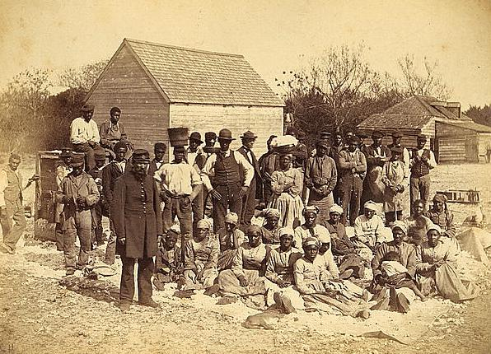
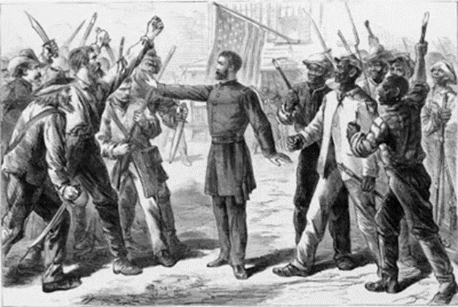
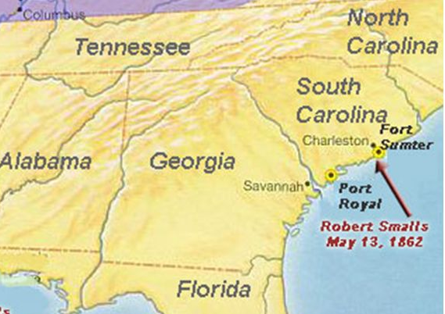
“Rehearsal for Reconstruction”
The Port Royal Experiment

Slide 18
The War to Save the Union? or
The War to End Slavery?

Slide 19
“The Union As It Was, The Constitution As It Is, and The Negroes Where They Are”
--Democratic Party Slogan, 1861

Slide 20
The War to Save the Union? or
The War to End Slavery?

Slide 21
Emancipation Proclamation:
What did it do?
Why did Lincoln issue it?

Slide 22
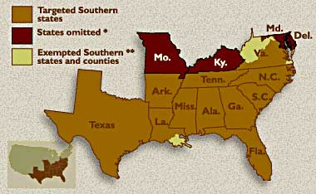
The Emancipation Proclamation

Slide 23
Reconstructing the Nation
How would the seceded states return to the union?
Who gets to decide?
How harsh/lenient will the process be?
What is the purpose of Reconstruction?

Slide 24
President vs Congress
Lincoln – 10% plan
Congress – Wade-Davis Bill

Slide 25
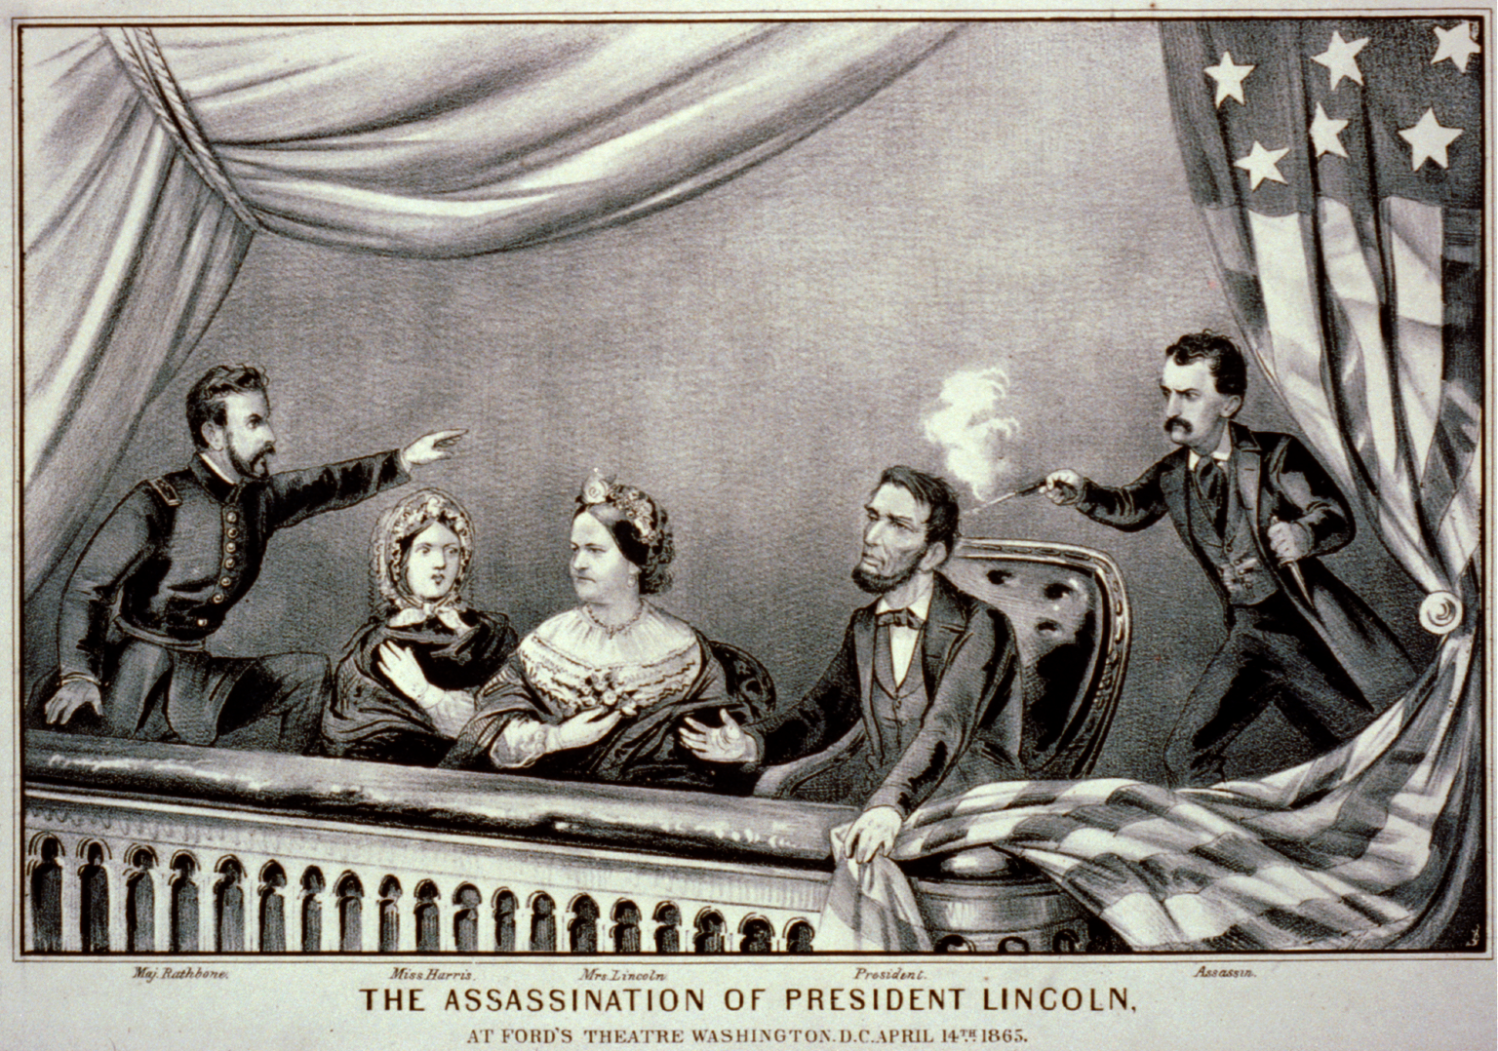

Slide 26
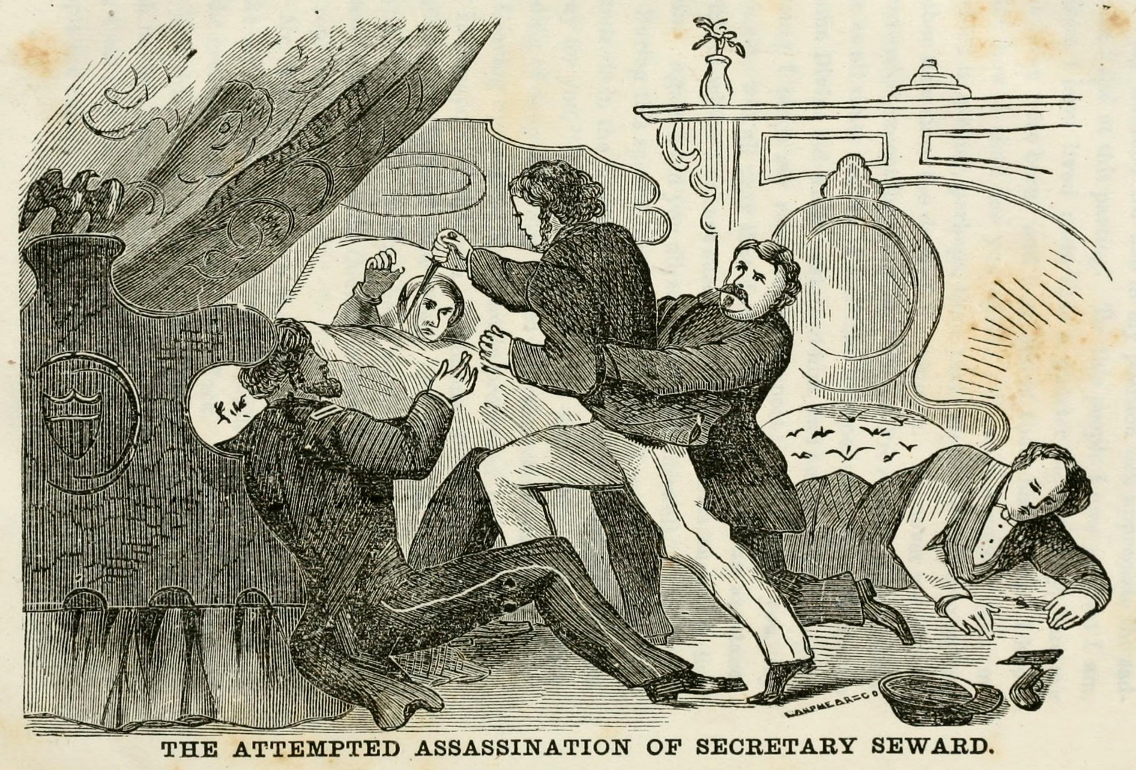

Slide 27
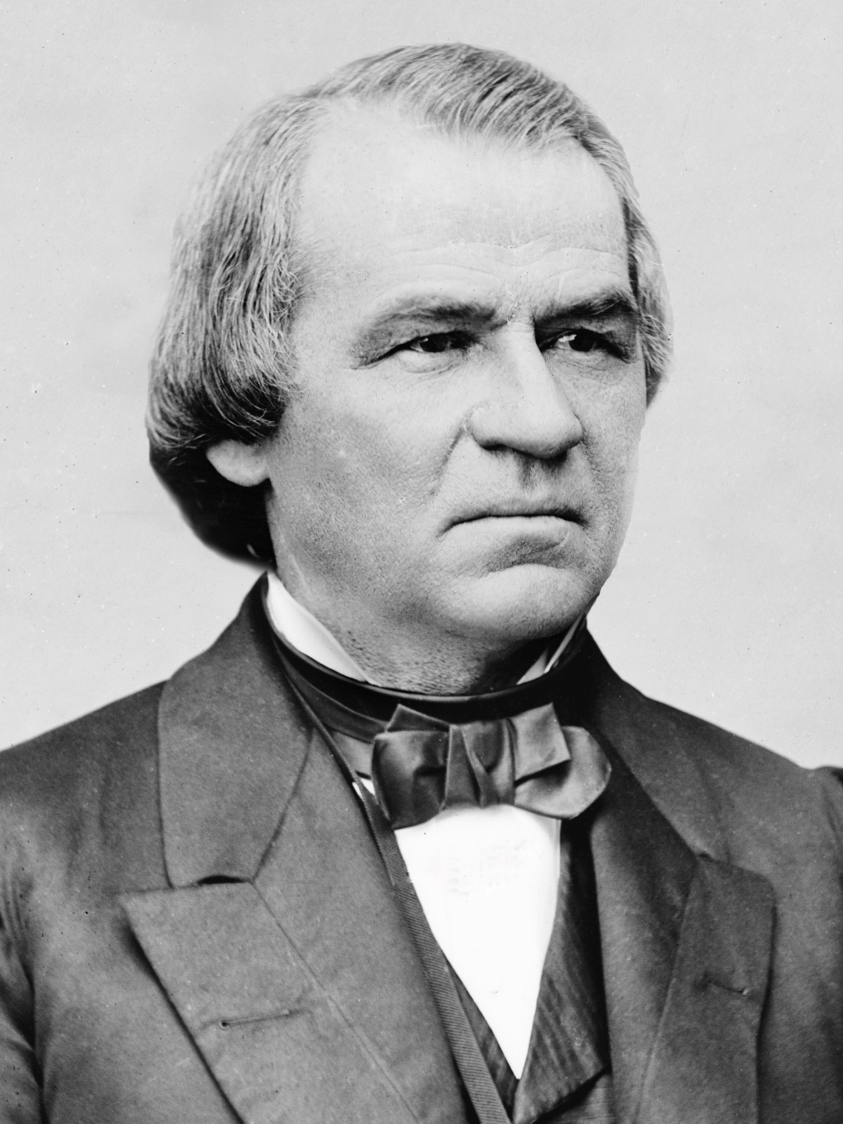

Slide 28
“Treason must be made odious, and traitors must be impoverished.”
  -- Andrew Johnson

Slide 29
“Reconstruction” or
“Restoration”?

Slide 30
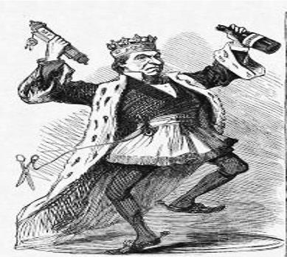
Johnson and “Restoration”
-- “black codes”
-- rampant violence
-- planters in control

Slide 31
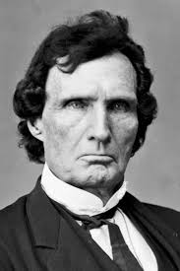
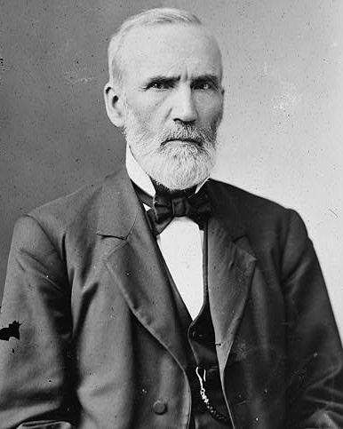
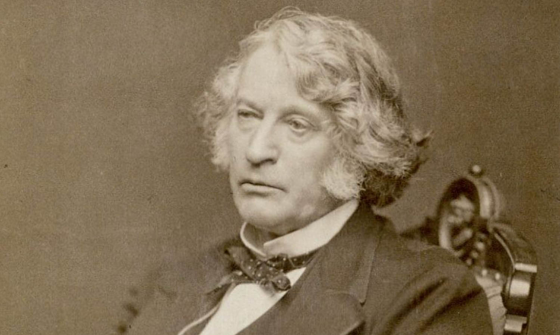
The Radicals and “Reconstruction”
(L to R: Thaddeus Stevens, Charles Sumner, George Julian)

Slide 32
Why is “Radical Reconstruction” radical?

Slide 33
“The whole fabric of southern society must be changed, and never can it be done if this opportunity is lost.”
  --Thaddeus Stevens

Slide 34
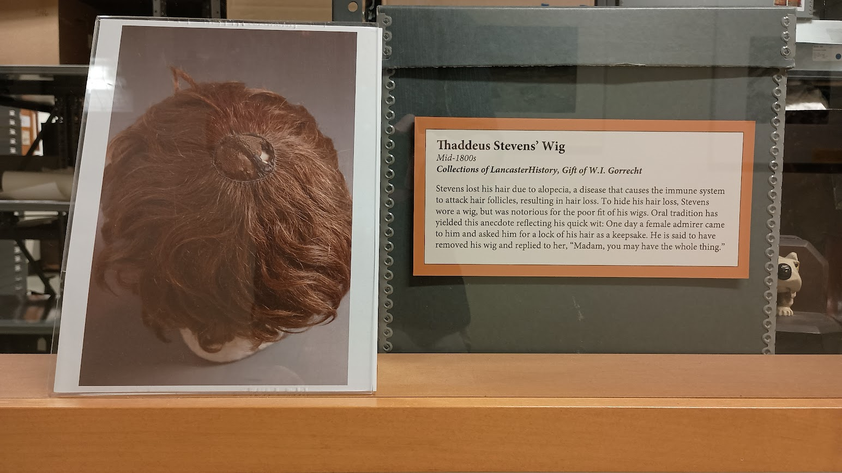

Slide 35
How to define “freedom”?
How to enforce “freedom”?

Slide 36
Radical Reconstruction in Practice
14th Amendment
Reconstruction Act of 1867

Slide 37
What is the reaction to “Radical Reconstruction”?
-- Johnson?
-- Congress?

Slide 38
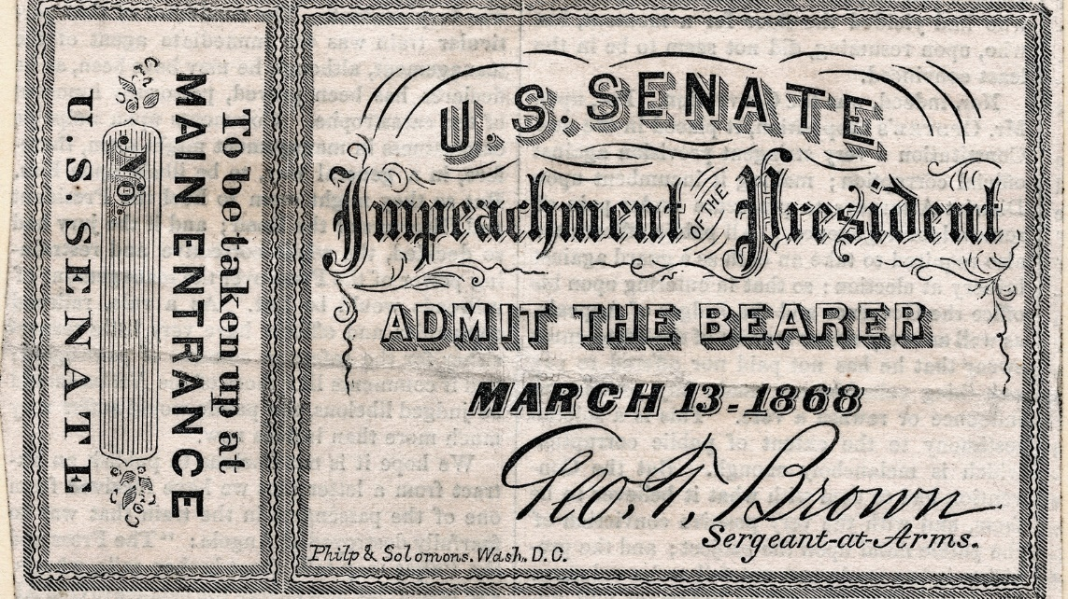
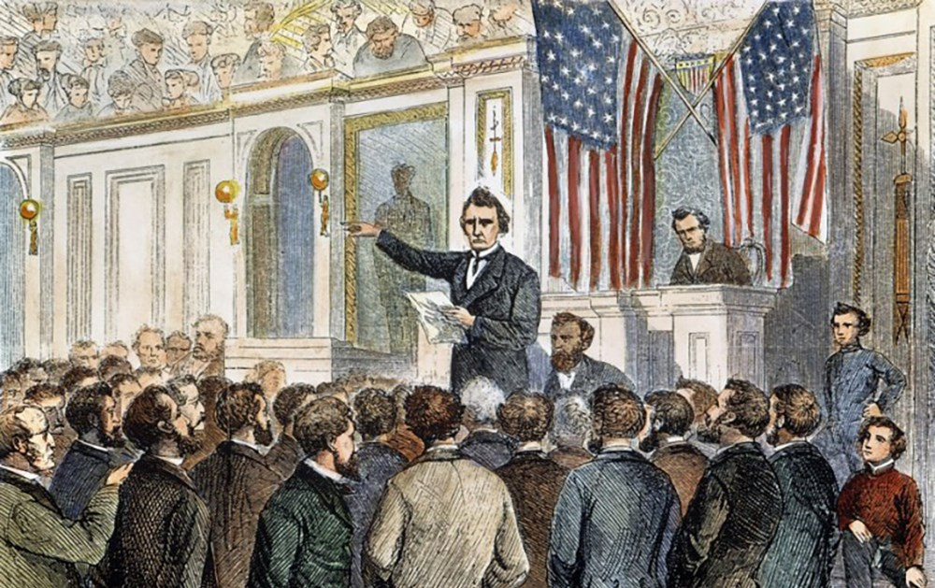
Johnson Impeached

Slide 39
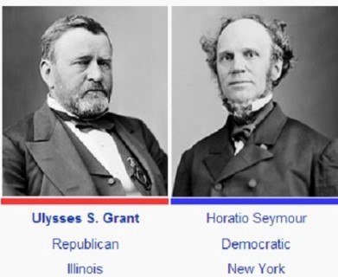
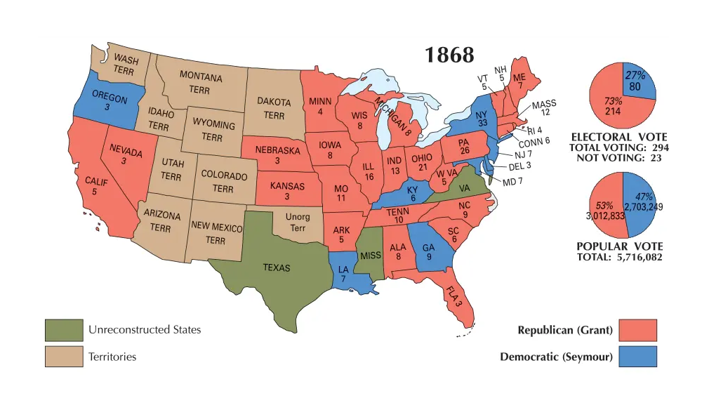
Presidential Election of 1868

Slide 40
“Let Us Have Peace”
Enhanced Enforcement of Civil Rights in the South? or
Retreat from Reconstruction?

Slide 41
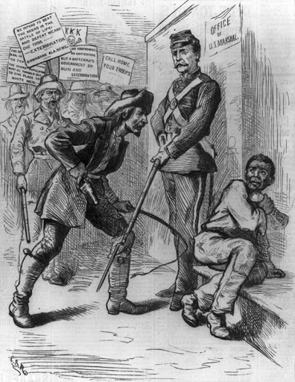
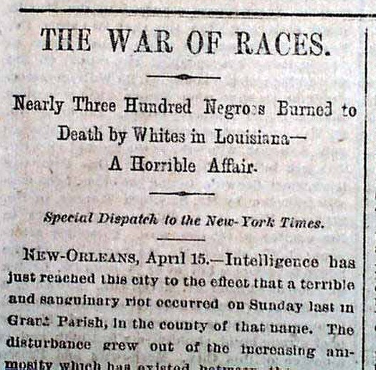
Shall we call our troops home ?

Slide 42
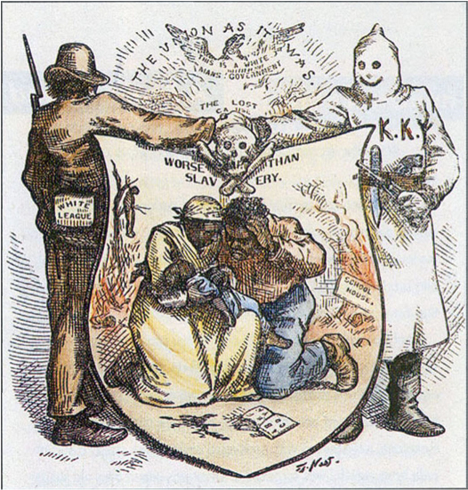
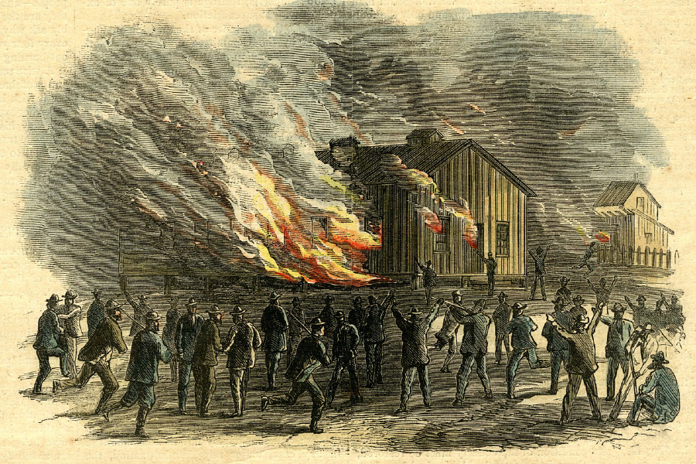
Terror and Violence Triumphs

Slide 43
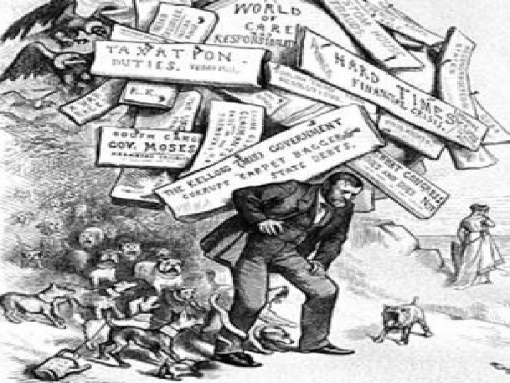
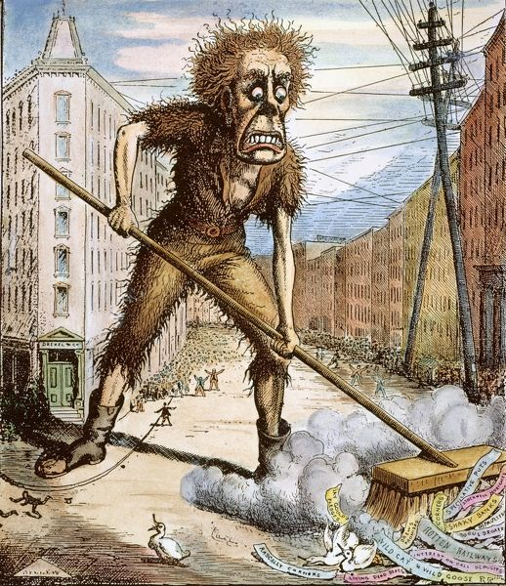
Economic Collapse – 1873

Slide 44
Moderates and Pragmatists:
Were Radicals’ policies enforceable?
Were Radicals’ policies constitutional?
Were Radicals’ policies popular?

Slide 45
“Compromise” of 1877
- President Hayes ends Military Reconstruction
- “Home Rule” begins in the South

Slide 46
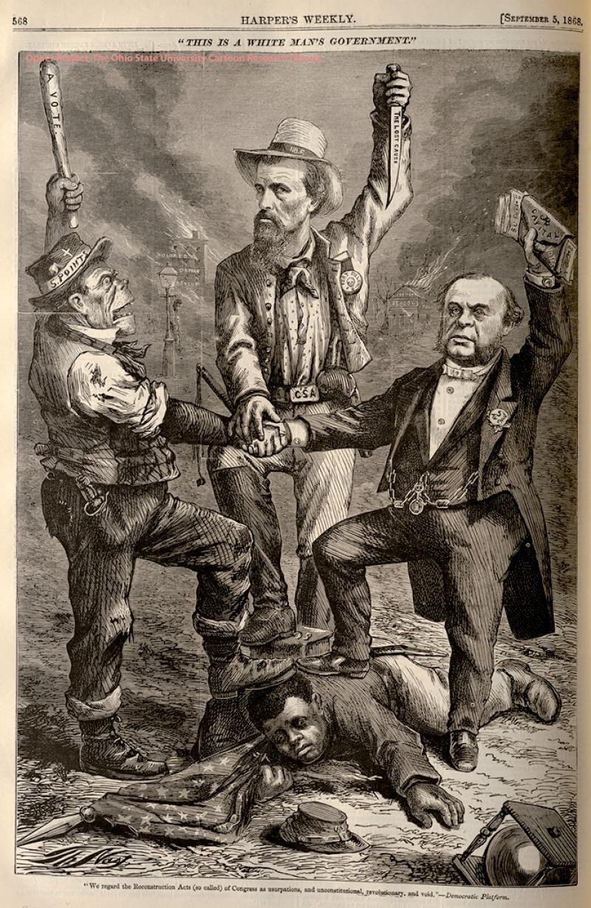
Legacy of Reconstruction?
“This is a white man’s government.”

