Slide 1
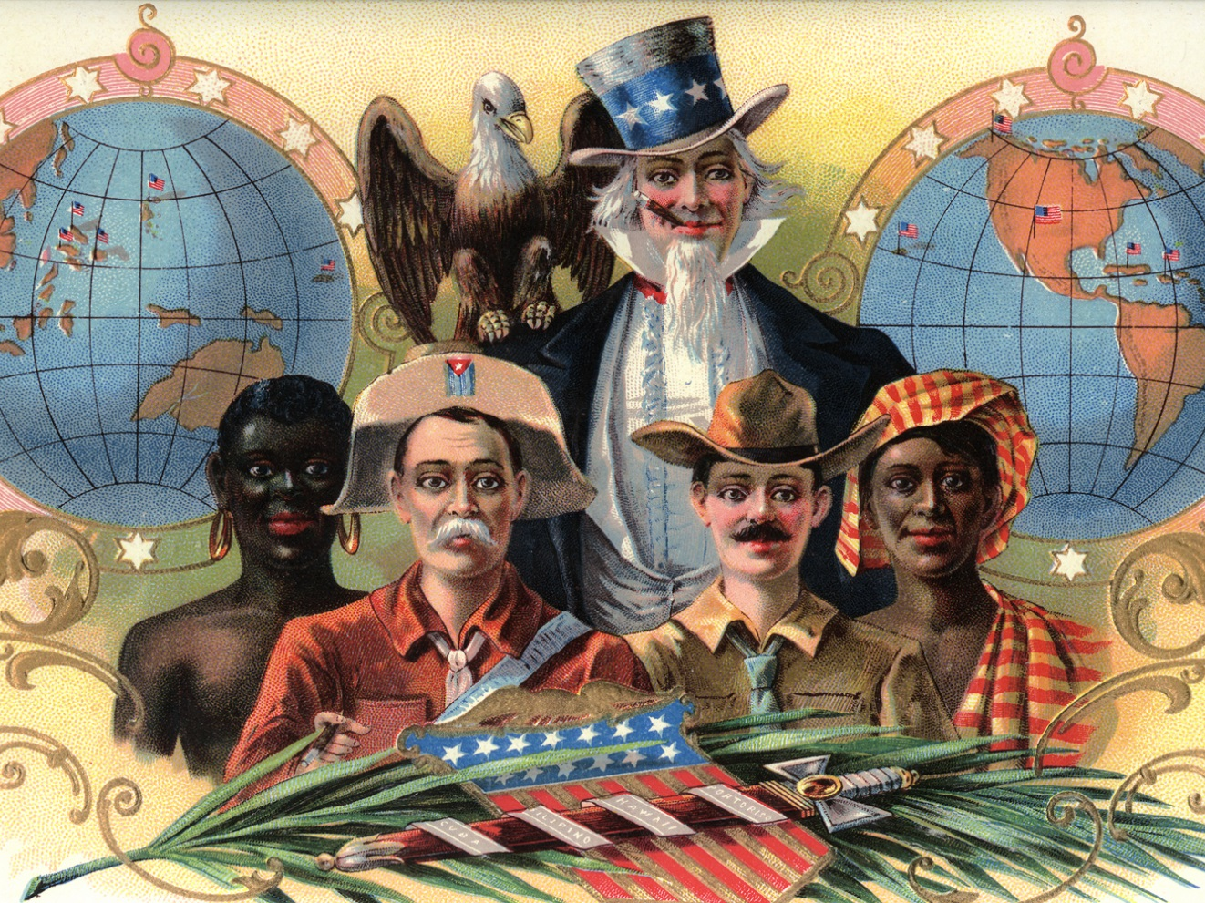
The Origins of American Empire

Slide 2
Timing for expansionist foreign policy:
Why now?

Slide 3
Economics
An Industrial Economy Needs “Markets”

Slide 4
Why does Depression of 1893 fuel the desire for foreign markets?

Slide 5
Unemployment Rate: 1890-1900
Year | Unemployment %
1890 | 4.0%
1891 | 5.4
1892 | 3.0
1893 | 11.7
1894 | 18.4
1895 | 13.7
1896 | 14.5
1897 | 14.5
1898 | 12.4
1899 | 6.5
1900 | 5.0

Slide 6
Geopolitics
“Great Powers” Compete for Global Influence

Slide 7
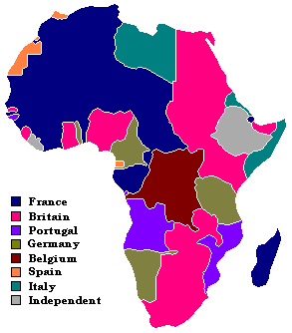

Slide 8
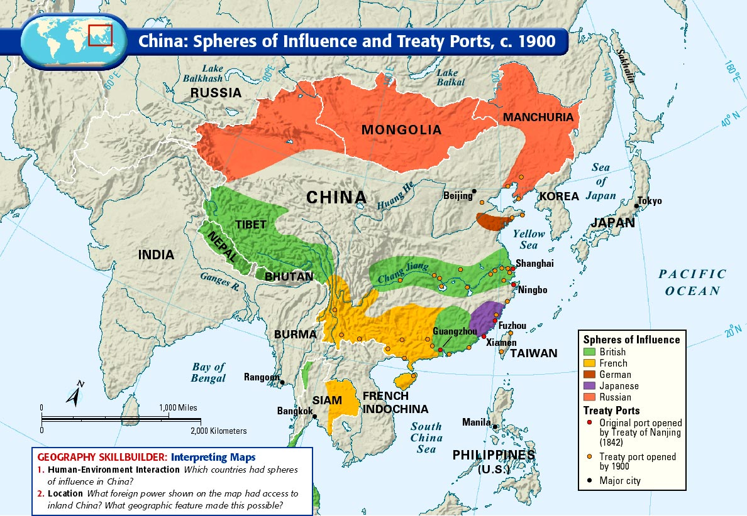

Slide 9
Politics
“Nothing solves a domestic problem better than a foreign crisis.”

Slide 10
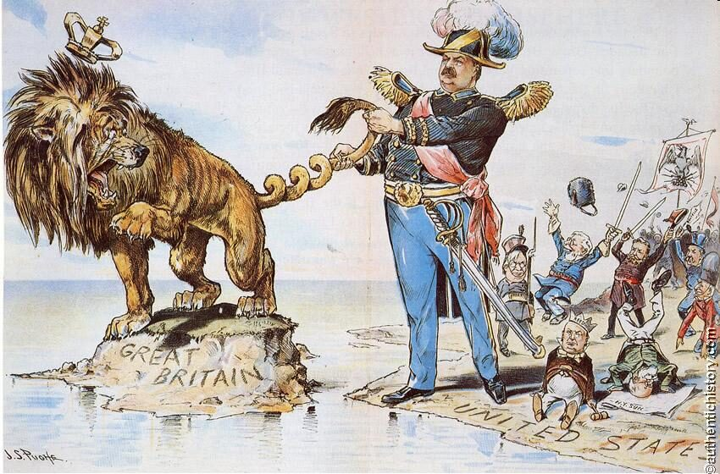

Slide 11
Gender
A “Crisis of Masculinity”

Slide 12
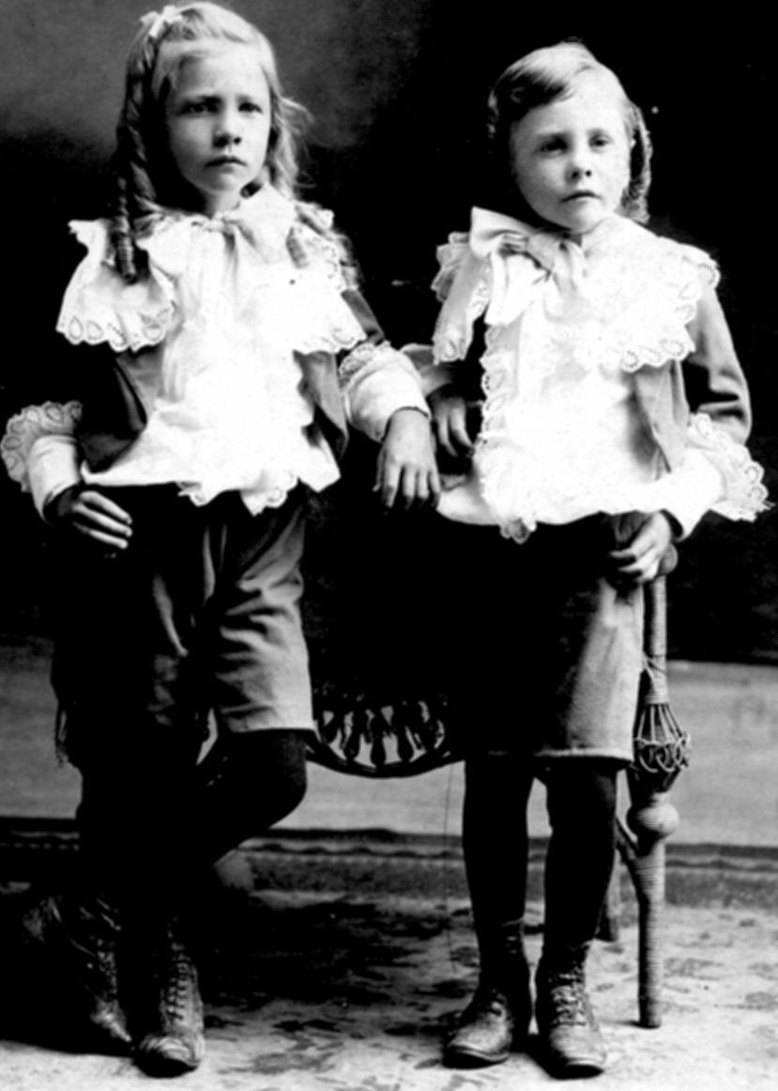

Slide 13
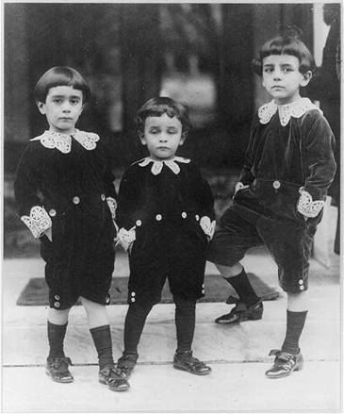

Slide 14
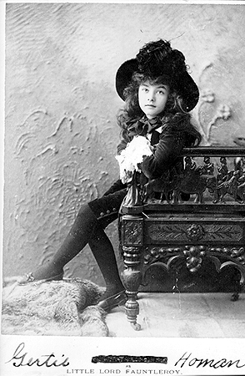

Slide 15
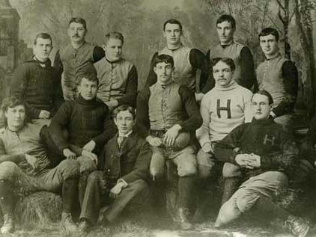

Slide 16
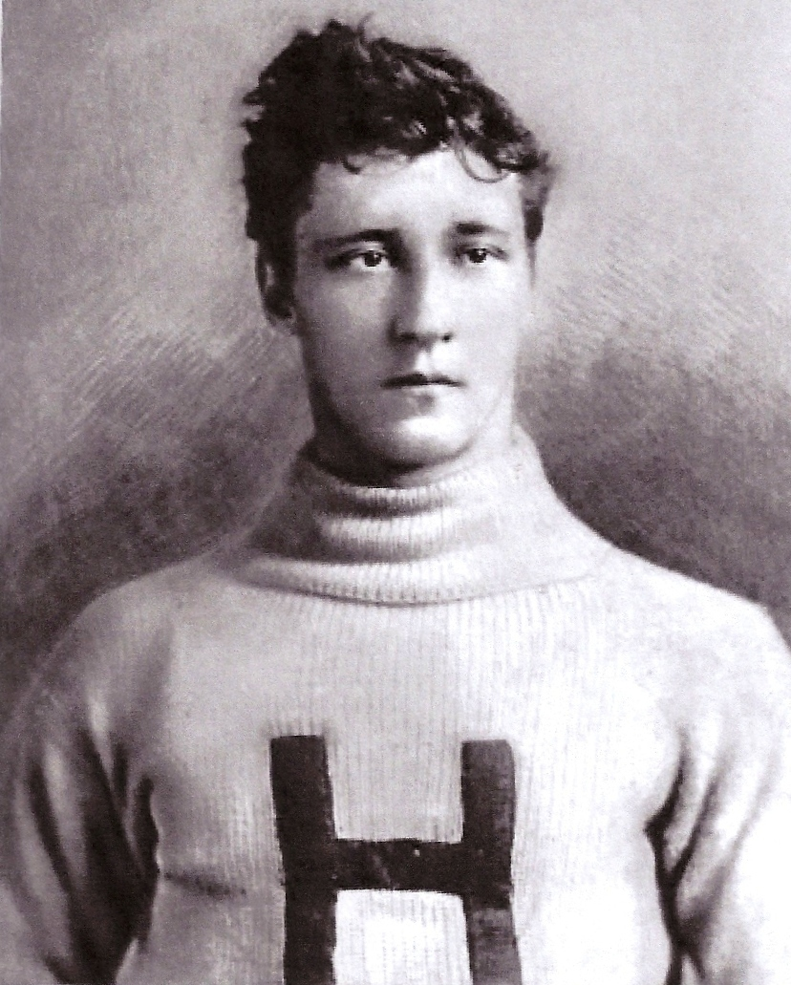

Slide 17
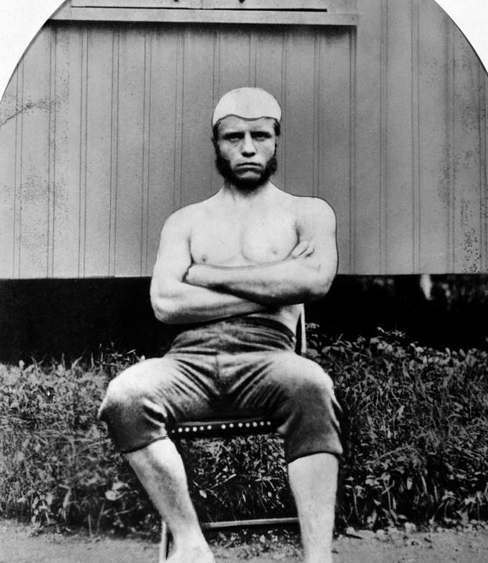

Slide 18
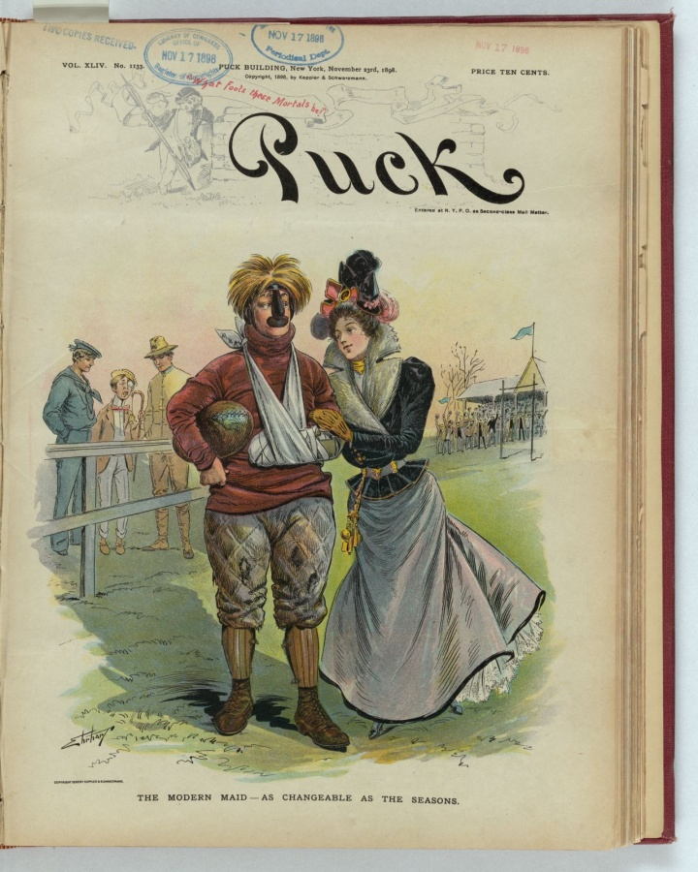

Slide 19
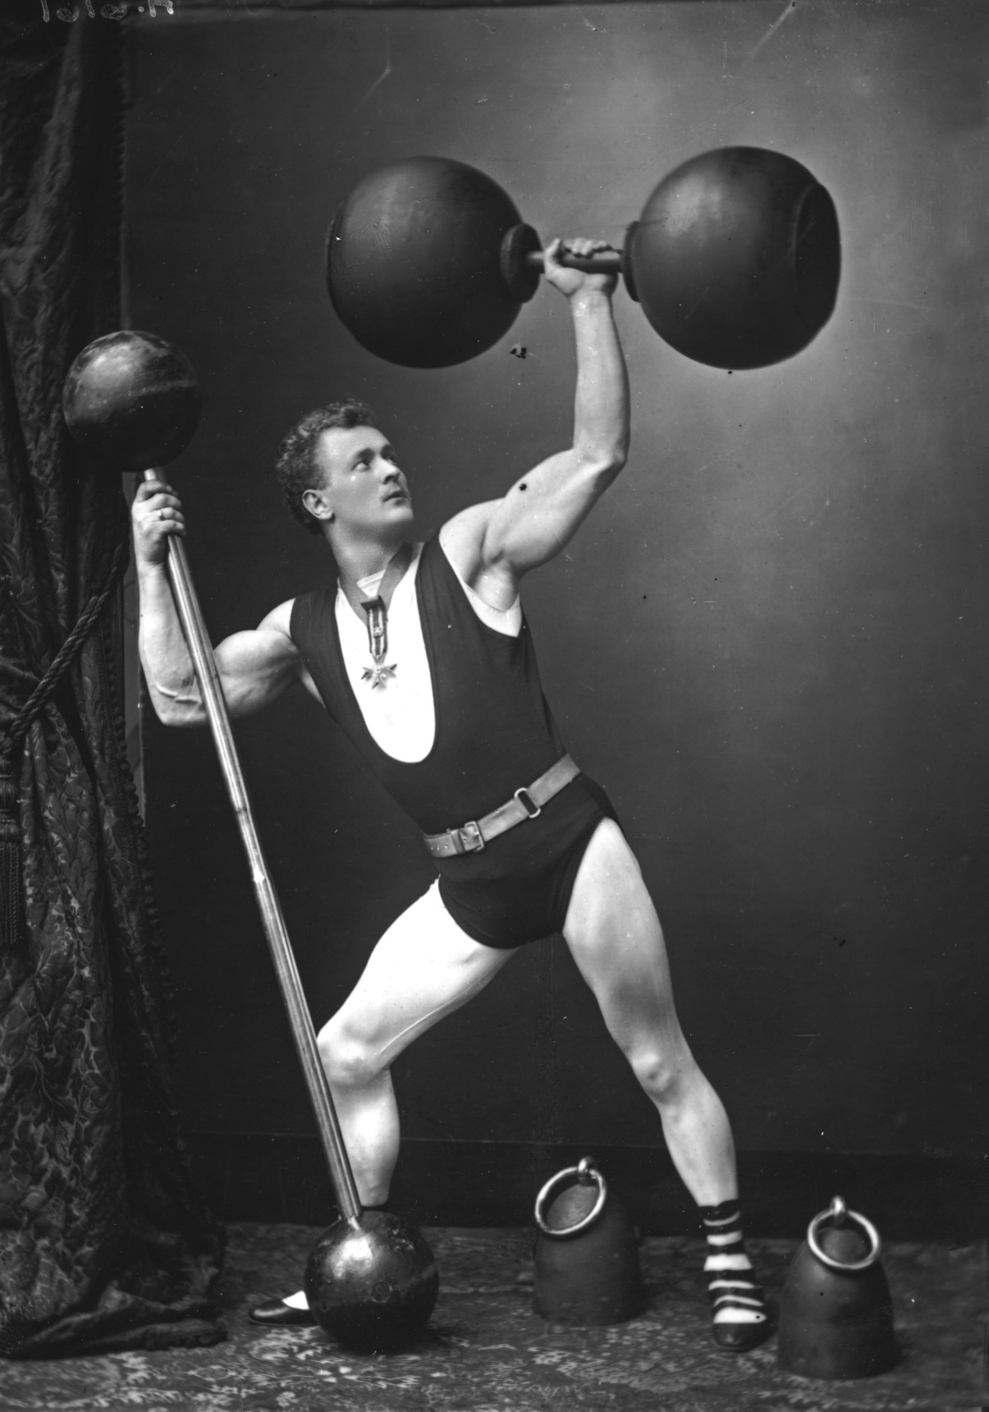

Slide 20
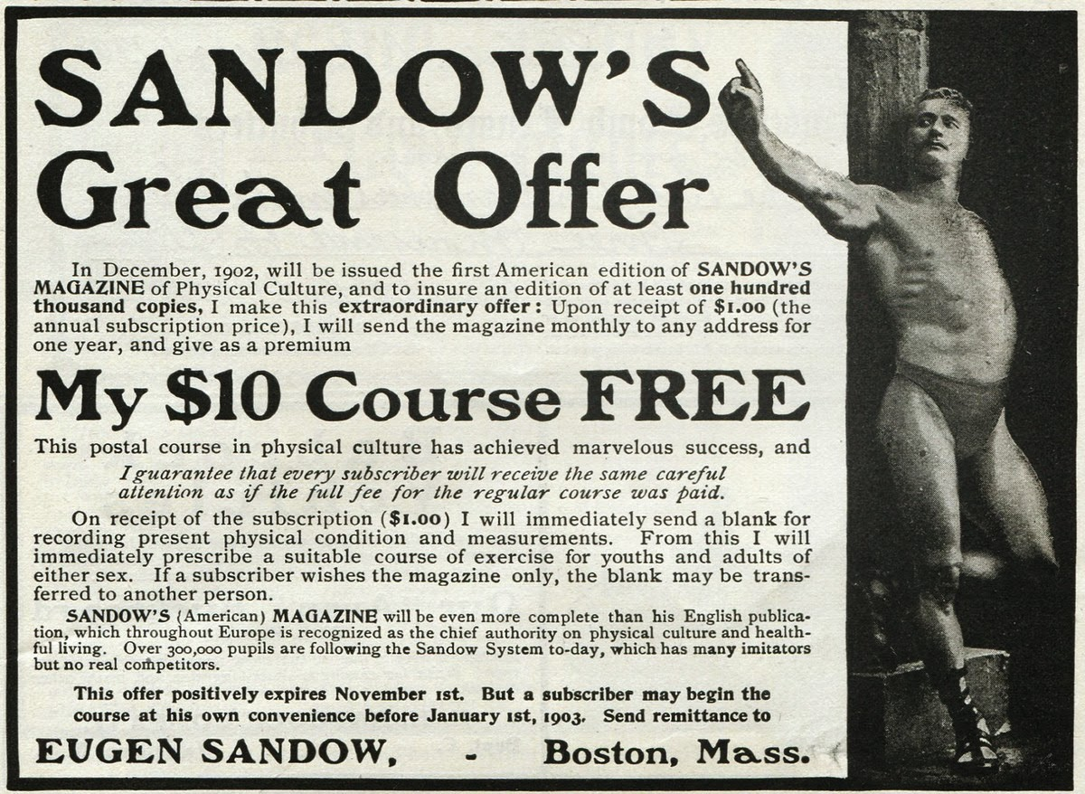

Slide 21
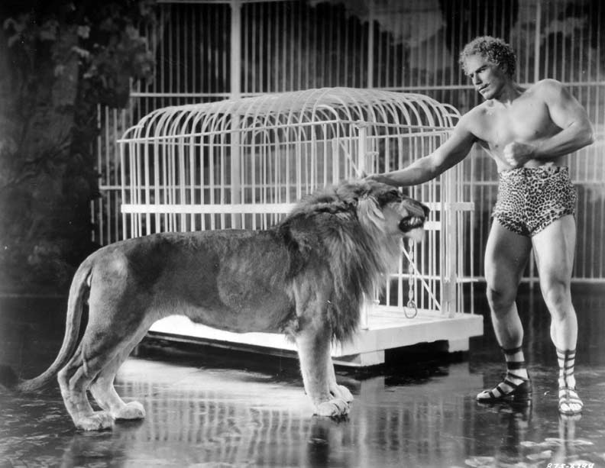

Slide 22
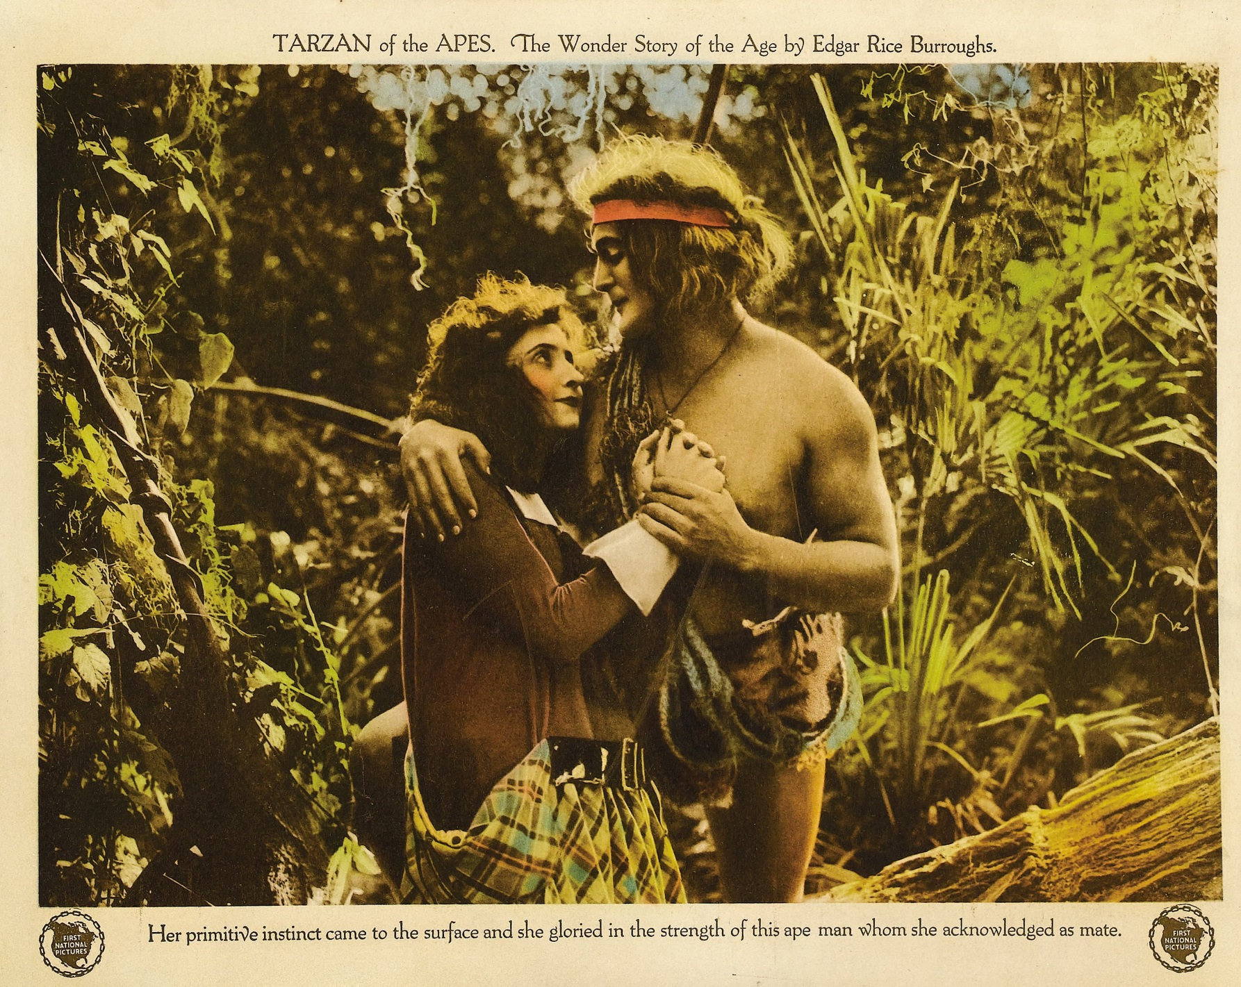

Slide 23
Religion
“A God-given civilizing mission”

Slide 24
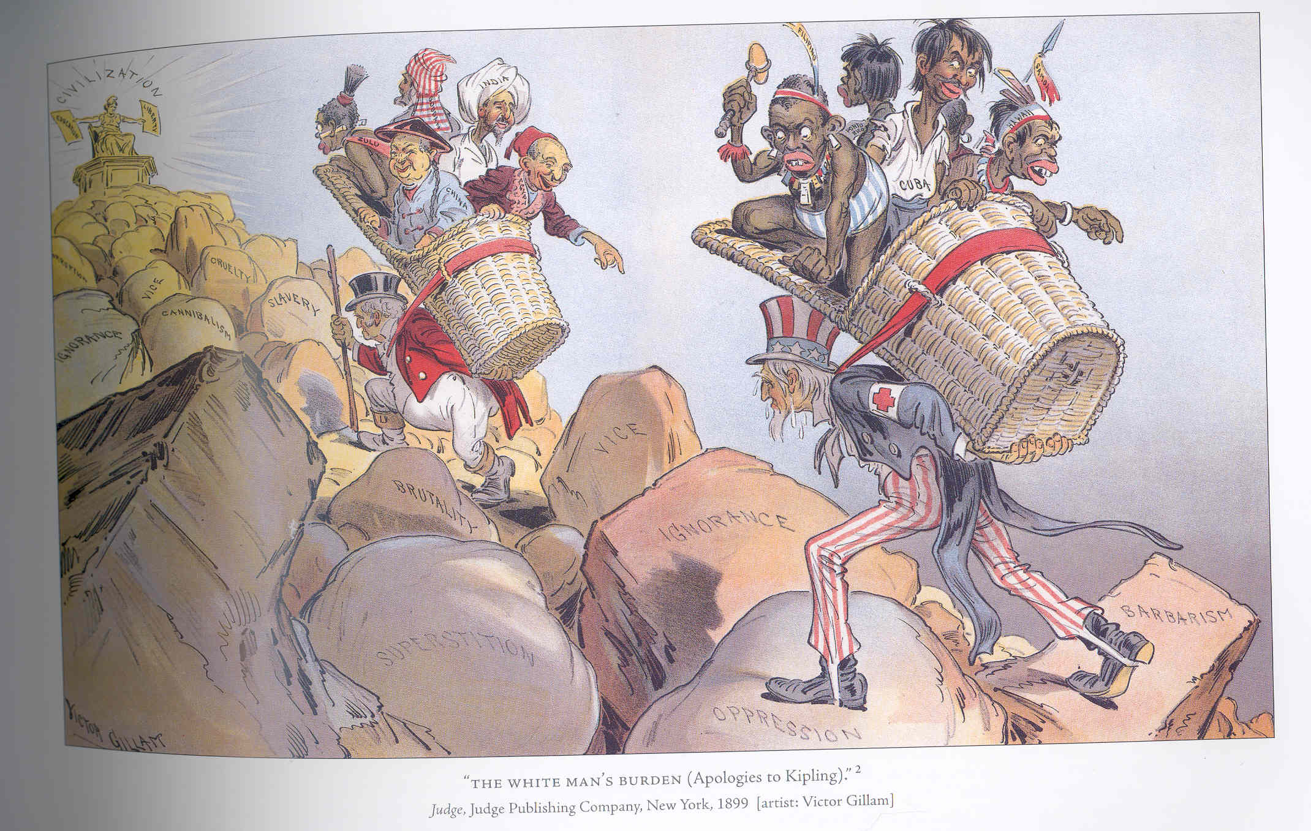

Slide 25
So…Why now?
Economics
Geopolitics
Politics
Gender
Religion

Slide 26
The Spanish-American War
Origins – “Cuba Libre!”
-- First Ten-years war 1868-1878
-- Second war begins, 1895

Slide 27
“Work is a crime against the Revolution. Blessed be the torch!”
-- Maximo Gomez

Slide 28
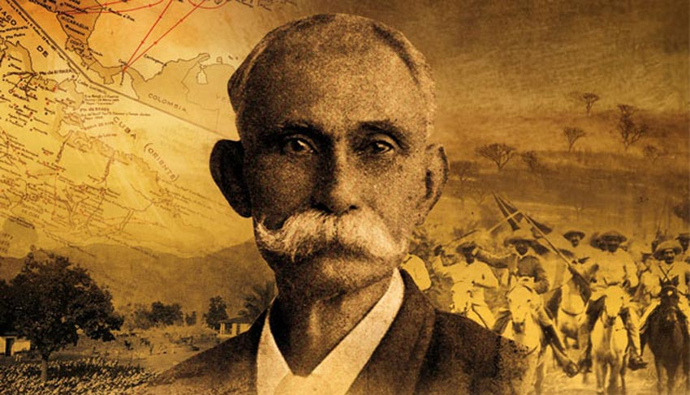

Slide 29
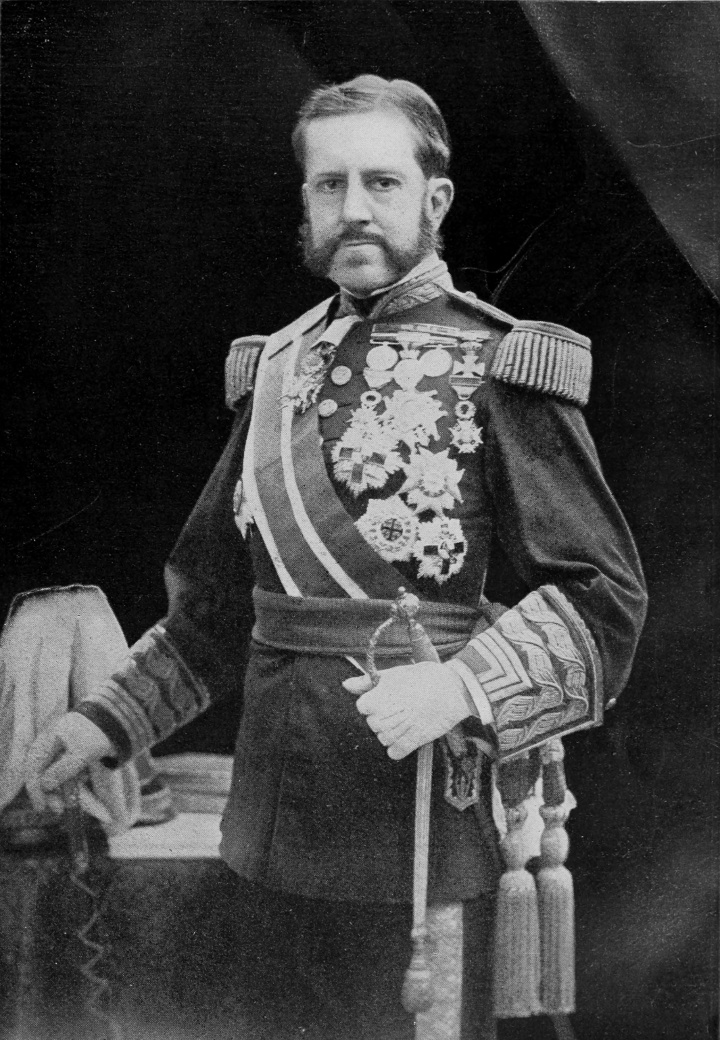

Slide 30
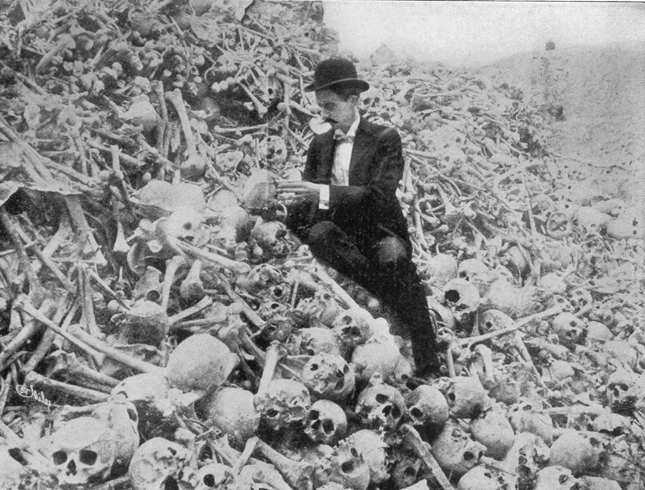
“Butcher” Weyler

Slide 31
Why was Weyler’s “reconcentration” policy not only immoral, but counterproductive?

Slide 32
What is the United States position on Cuba?

Slide 33
-- McKinley’s postion
-- the newspapers’ position
-- “Big Business’s” position
--The “jingoes’” position

Slide 34
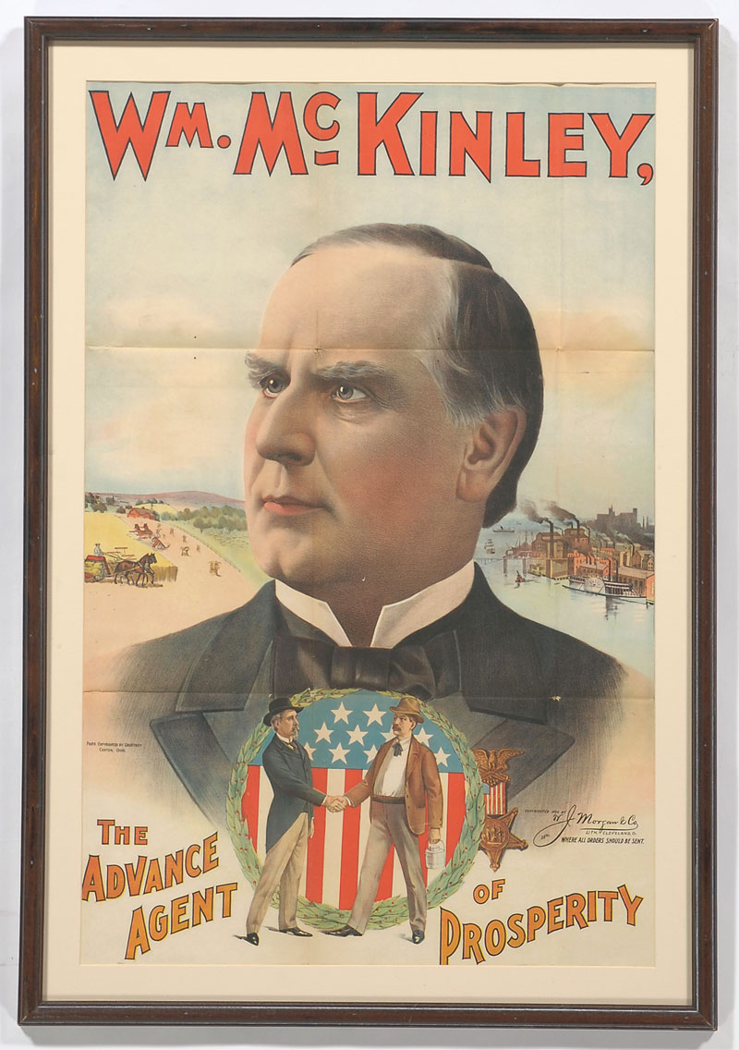

Slide 35
1. Spain must restore order on the island of Cuba.
2. To do so, Spain should grant Cuba self-government .
3. If Spain cannot restore order, the U.S. will mediate the conflict.

Slide 36
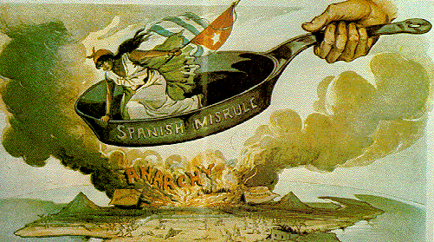

Slide 37
“Peace is preferable to war in almost every contingency.”
-- William McKinley, Inaugural Address, 1897

Slide 38
The position of the press:
Did the “yellow press” lead the U.S. into war?

Slide 39
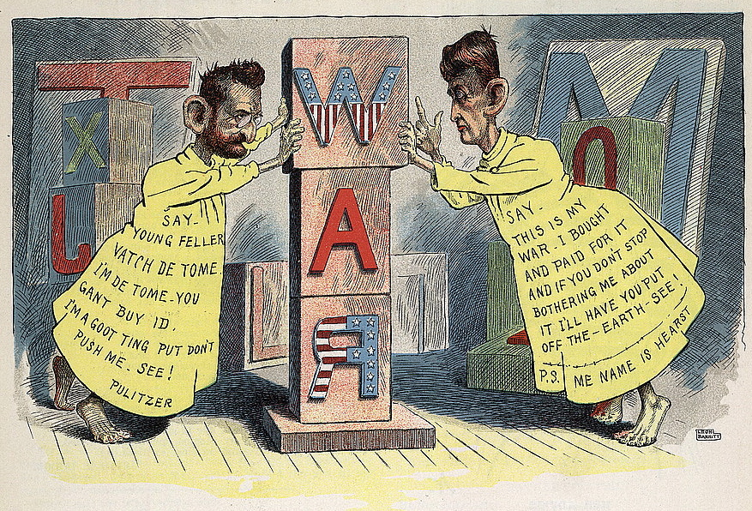

Slide 40
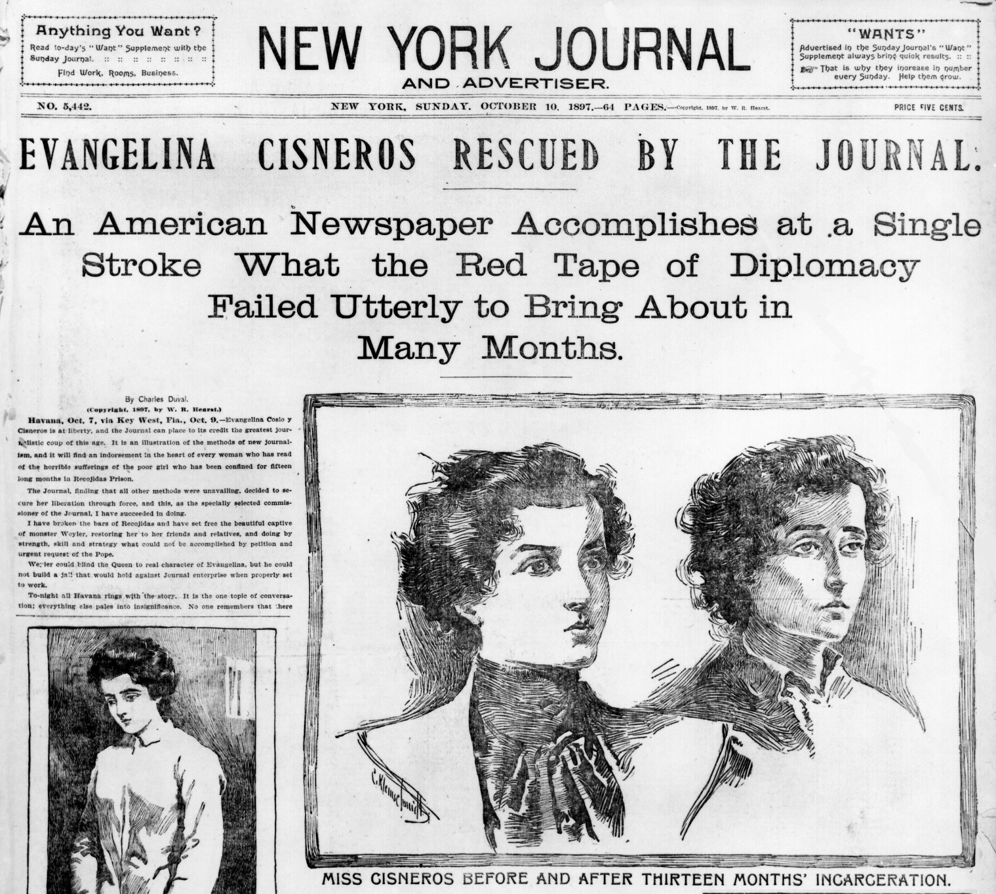

Slide 41
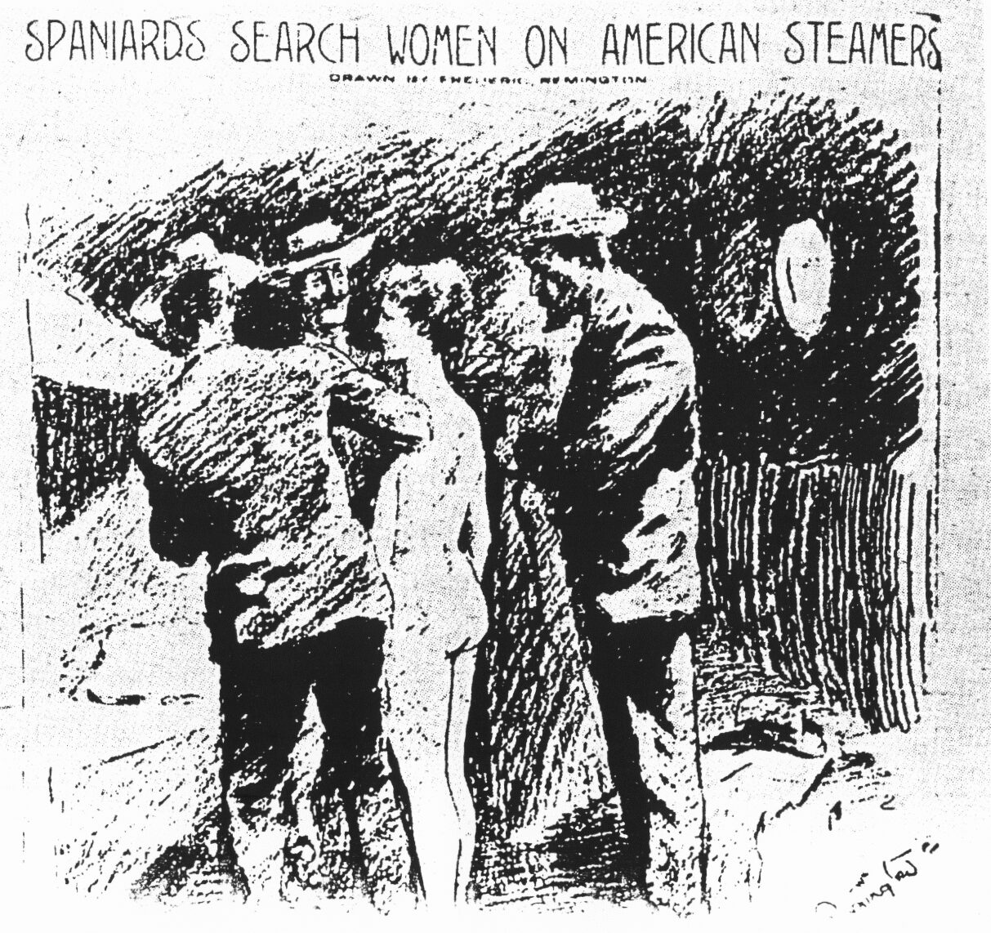

Slide 42
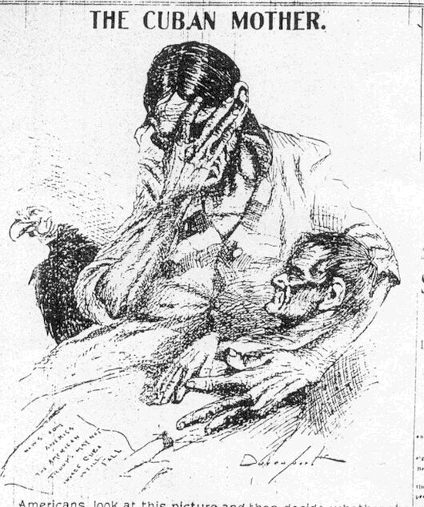

Slide 43
The position of business:
Was U.S. intervention a “big business conspiracy”?

Slide 44
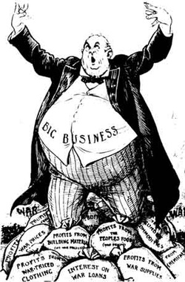

Slide 45
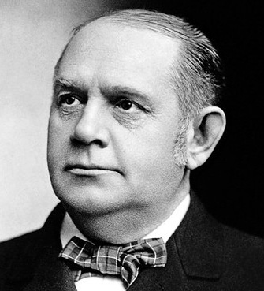
“There are two things that are important in politics. The first is money and I can’t remember what the second one is.” – “Dollar”Mark Hanna

Slide 46
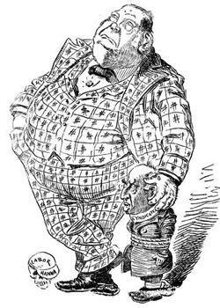

Slide 47
“War is just a damn nuisance!”
-- Mark Hanna

Slide 48
The jingoes’ position:
Did hyper-masculine “jingoism” push the U.S. into war?

Slide 49
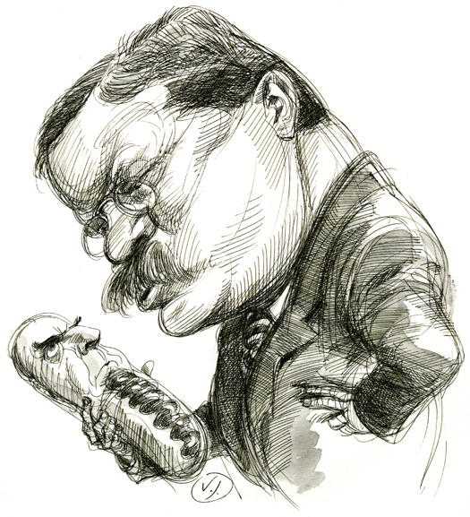
"McKinley has no more backbone than a chocolate eclair."- Teddy Roosevelt

Slide 50
“No triumph of peace is quite so great as the supreme triumph of war.”
-- Theodore Roosevelt, 1897

Slide 51
“Peace is preferable to war in almost every contingency.”
-- William McKinley, Inaugural Address, 1897

Slide 52
"We will have this war for the freedom of Cuba in spite of the timidity of the commercial classes!"
--Theodore Roosevelt, 1898

Slide 53
1898 – War Clouds Gathering

Slide 54
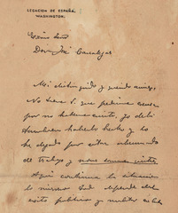

Slide 55
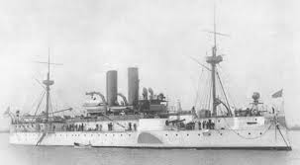
USS Maine

Slide 56
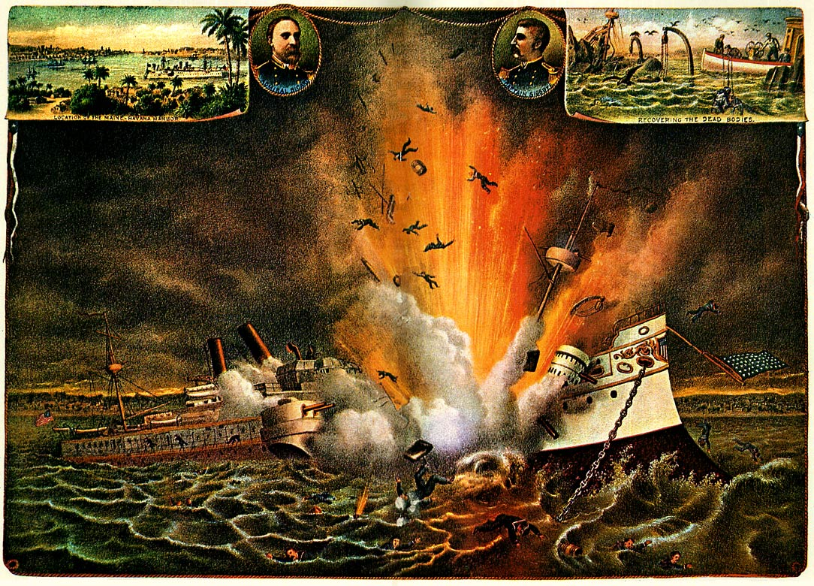

Slide 57
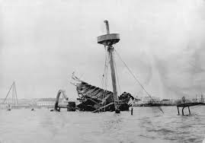

Slide 58
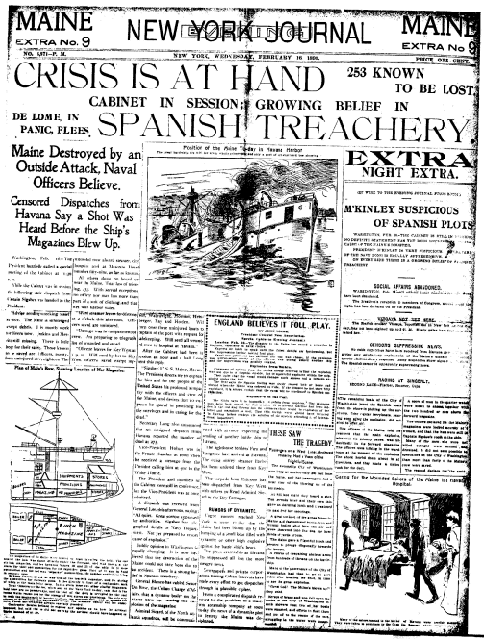

Slide 59
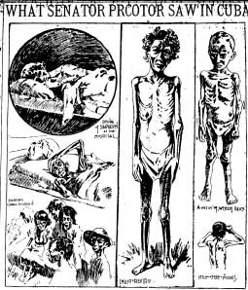

Slide 60
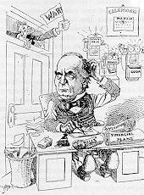

Slide 61
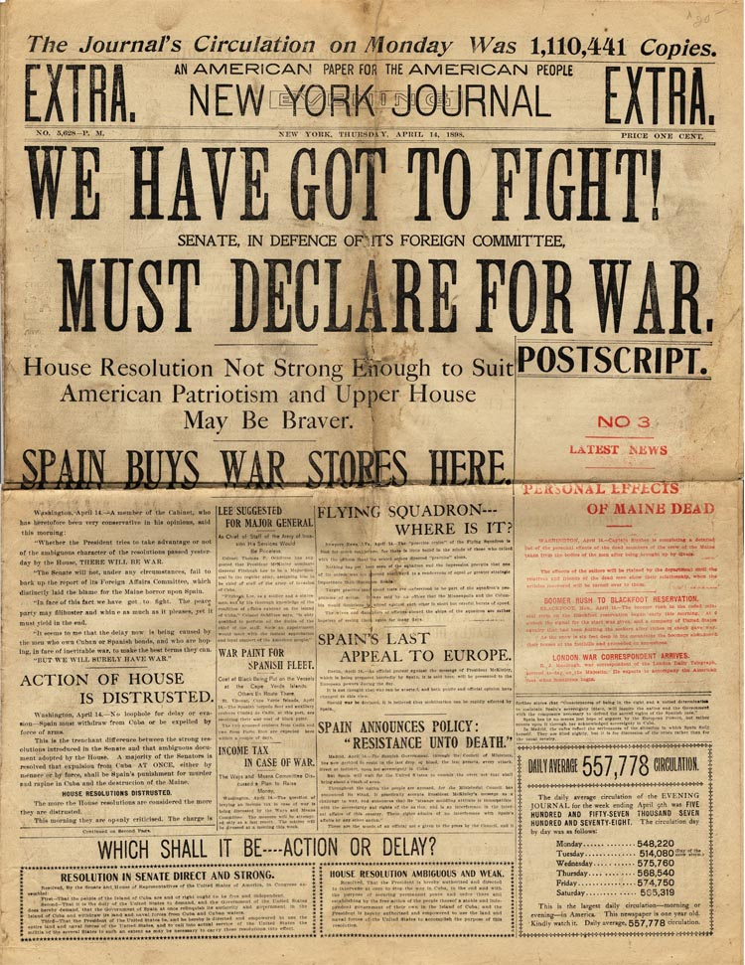

Slide 62
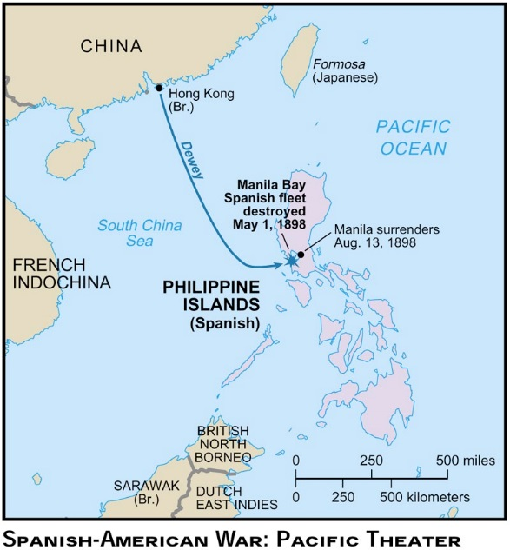

Slide 63
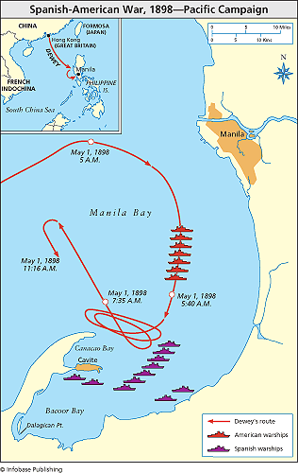

Slide 64
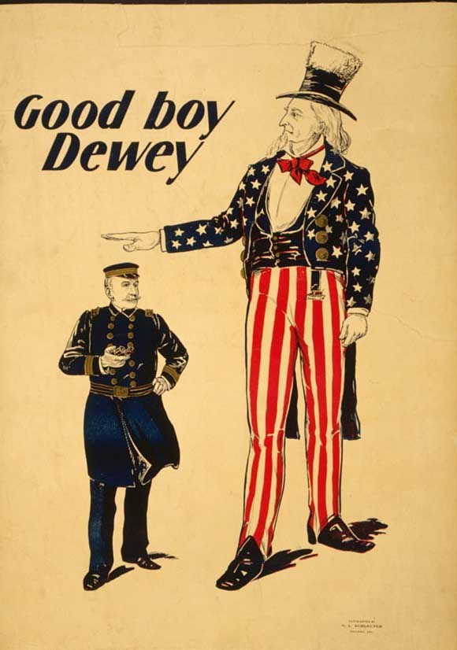

Slide 65
OH DEWEY WAS THE MORNING
UPON THE FIRST OF MAY
AND DEWEY WAS THE ADMIRAL
DOWN IN MAILLA BAY
AND DEWEY WERE THE REGENT’S EYES
THOSE ORBS OF ROYAL BLUE
AND DO WE FEEL DISCOURAGED?
I DO NOT THINK WE DO!

Slide 66
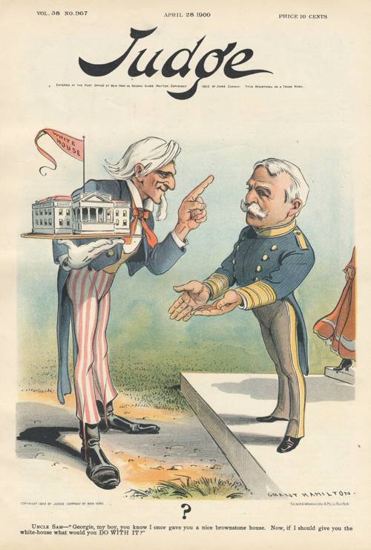

Slide 67
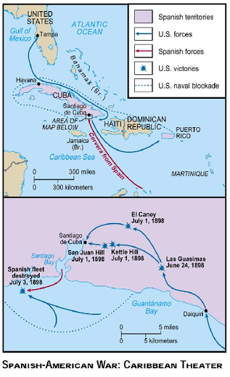

Slide 68
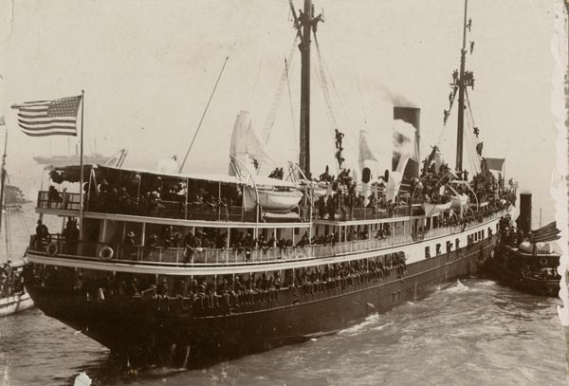

Slide 69
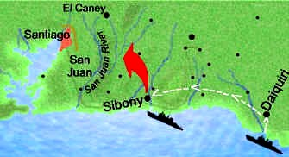

Slide 70
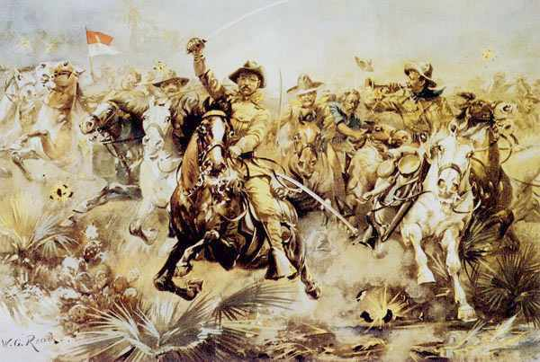

Slide 71
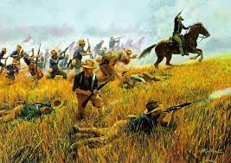

Slide 72
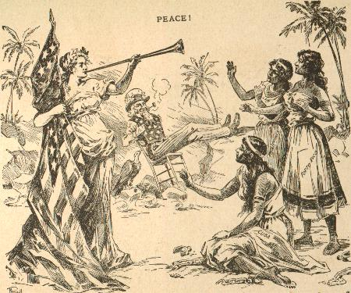

Slide 73
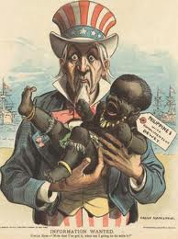

Slide 74
McKinley’s Policy:
Finding the “Sensible Center”

Slide 75
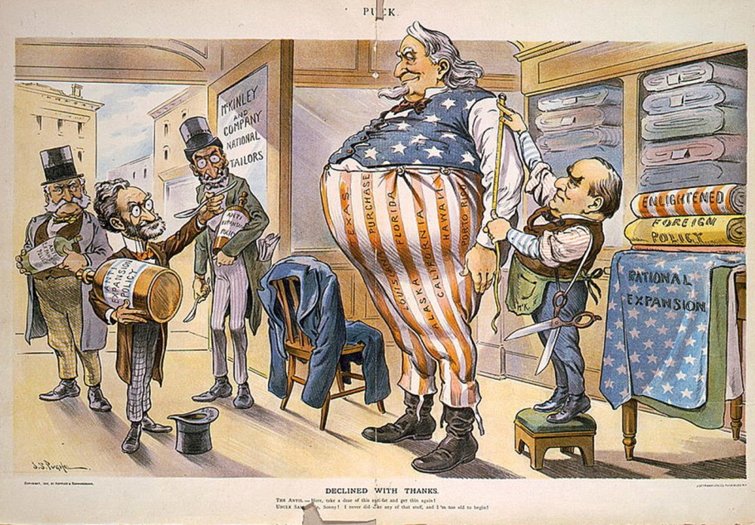

Slide 76
Motivations for Empire?

Slide 77
The Four “D”s
Duty
Destiny
Defense
Dollars

Slide 78
Duty
“White Man’s Burden”

Slide 79
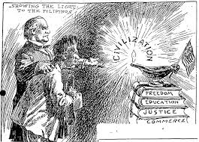

Slide 80



Slide 81
Destiny
“The Irony of Fate”

Slide 82


Slide 83
Defense
“The Projection of Power”

Slide 84


Slide 85
Dollars
“Market Mania”

Slide 86


Slide 87
Realism vs. Idealism
Interest vs Principle

Slide 88
Coda: The Philippine Insurrection
“Empire Can Wait”

Slide 89


Slide 90


Slide 91
Imperialists vs. Anti-Imperialists
(Beveridge vs Twain)

Slide 92
Redefining “Masculinity”
Flipping the Script

Slide 93
“This shooting human beings is a ‘hot game’ and beats rabbit hunting all to pieces.”
-- letter home from US solider serving
in the Philippines

Slide 94
“We have met the enemy…and they are us.”
-Pogo

Slide 95
The Crusading Spirit Turned Inward
The Advent of the Progressive Era

