Slide 1
How did the North’s victory in the Civil War change the United States?
-- politically
-- economically
-- psychologically

Slide 2
How did Americans think about their country differently after the war?

Slide 3
Before Reconstruction can begin – and even before the Civil War ends – what problems must the federal government address?

Slide 4
The War to Save the Union? or
The War to End Slavery?

Slide 5
“The Union As It Was, The Constitution As It Is, and The Negroes Where They Are”
--Democratic Party Slogan, 1861

Slide 6
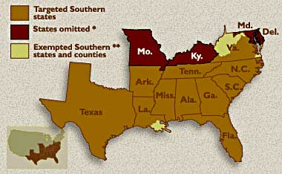
The Emancipation Proclamation

Slide 7
What did it do?
Why did Lincoln issue it?

Slide 8
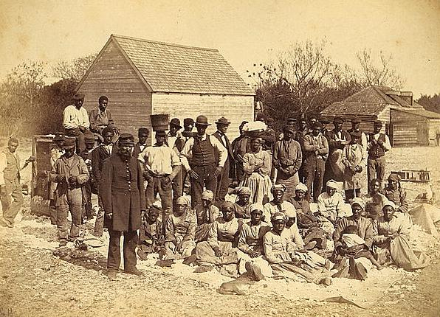
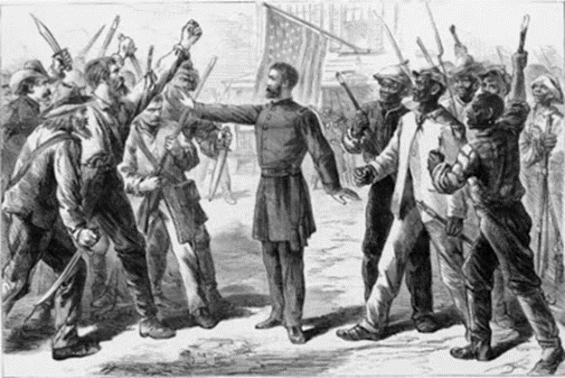
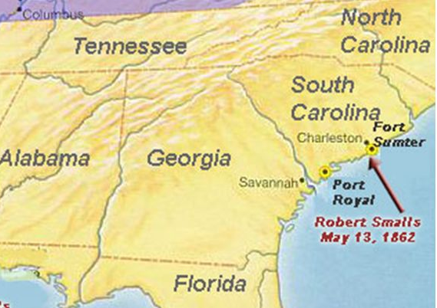
“Rehearsal for Reconstruction”
The Port Royal Experiment

Slide 9
Reconstructing the Nation
How would the seceded states return to the union?
Who gets to decide?
How harsh/lenient will the process be?
What is the purpose of Reconstruction?

Slide 10
President vs Congress
Lincoln – 10% plan
Congress – Wade-Davis Bill

Slide 11
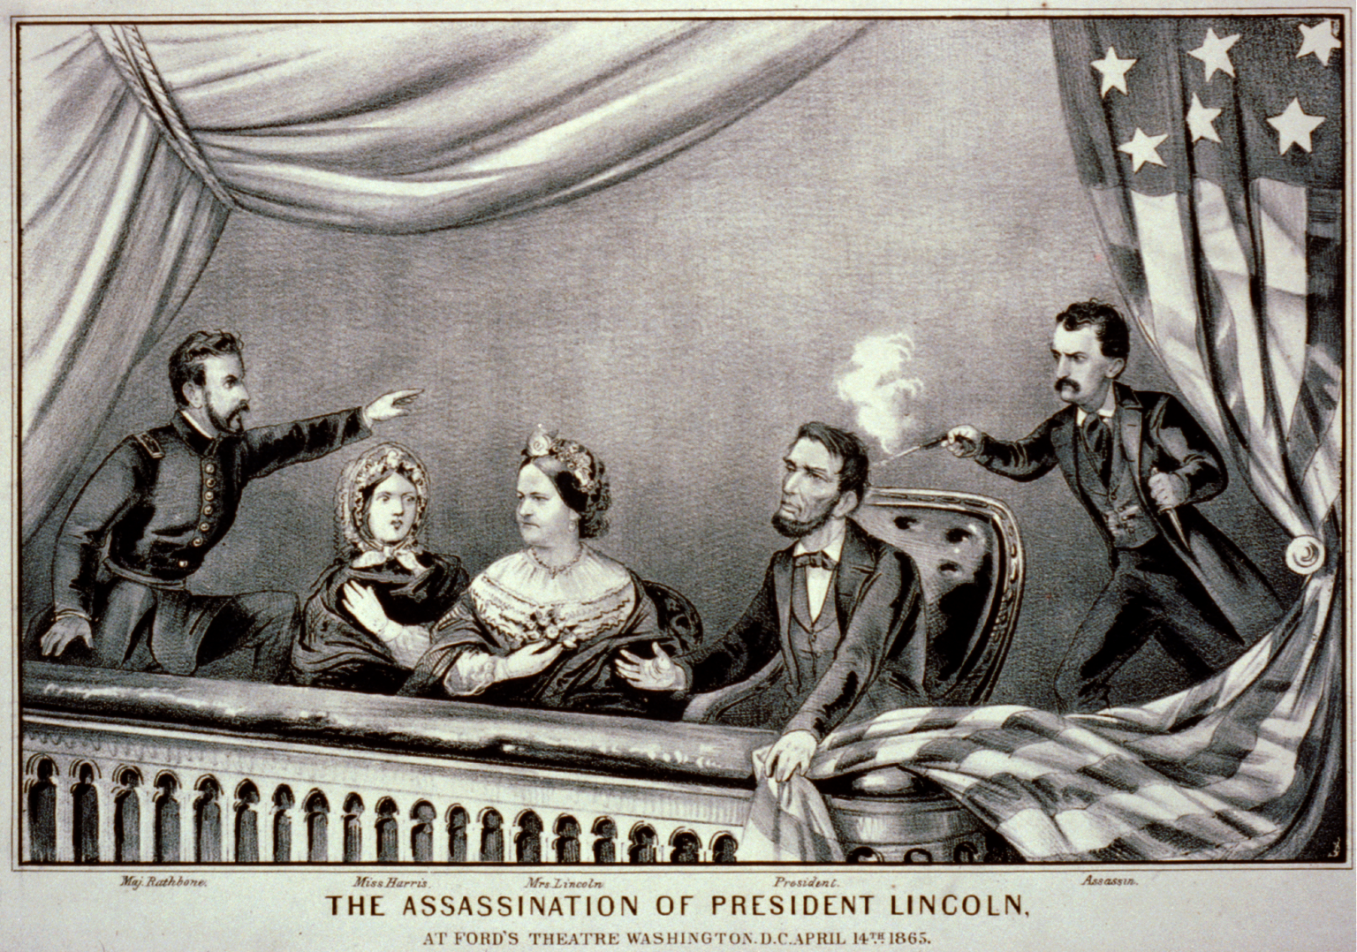

Slide 12
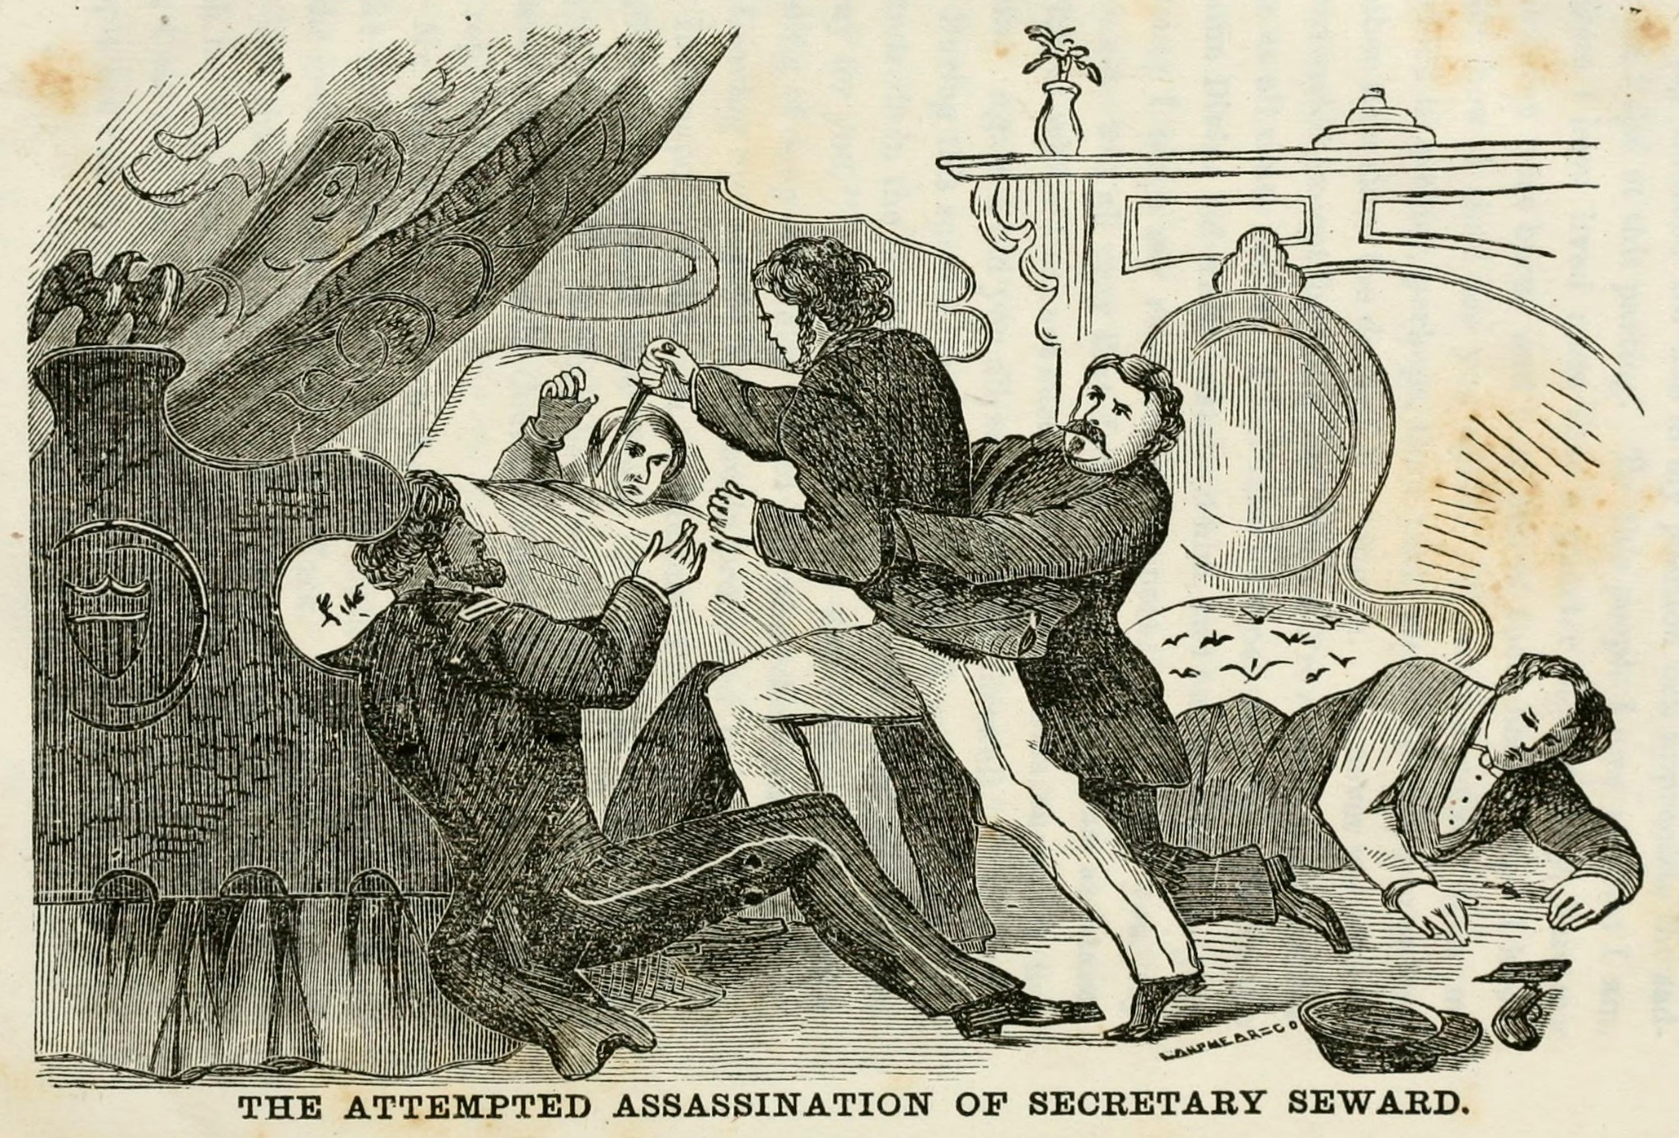

Slide 13
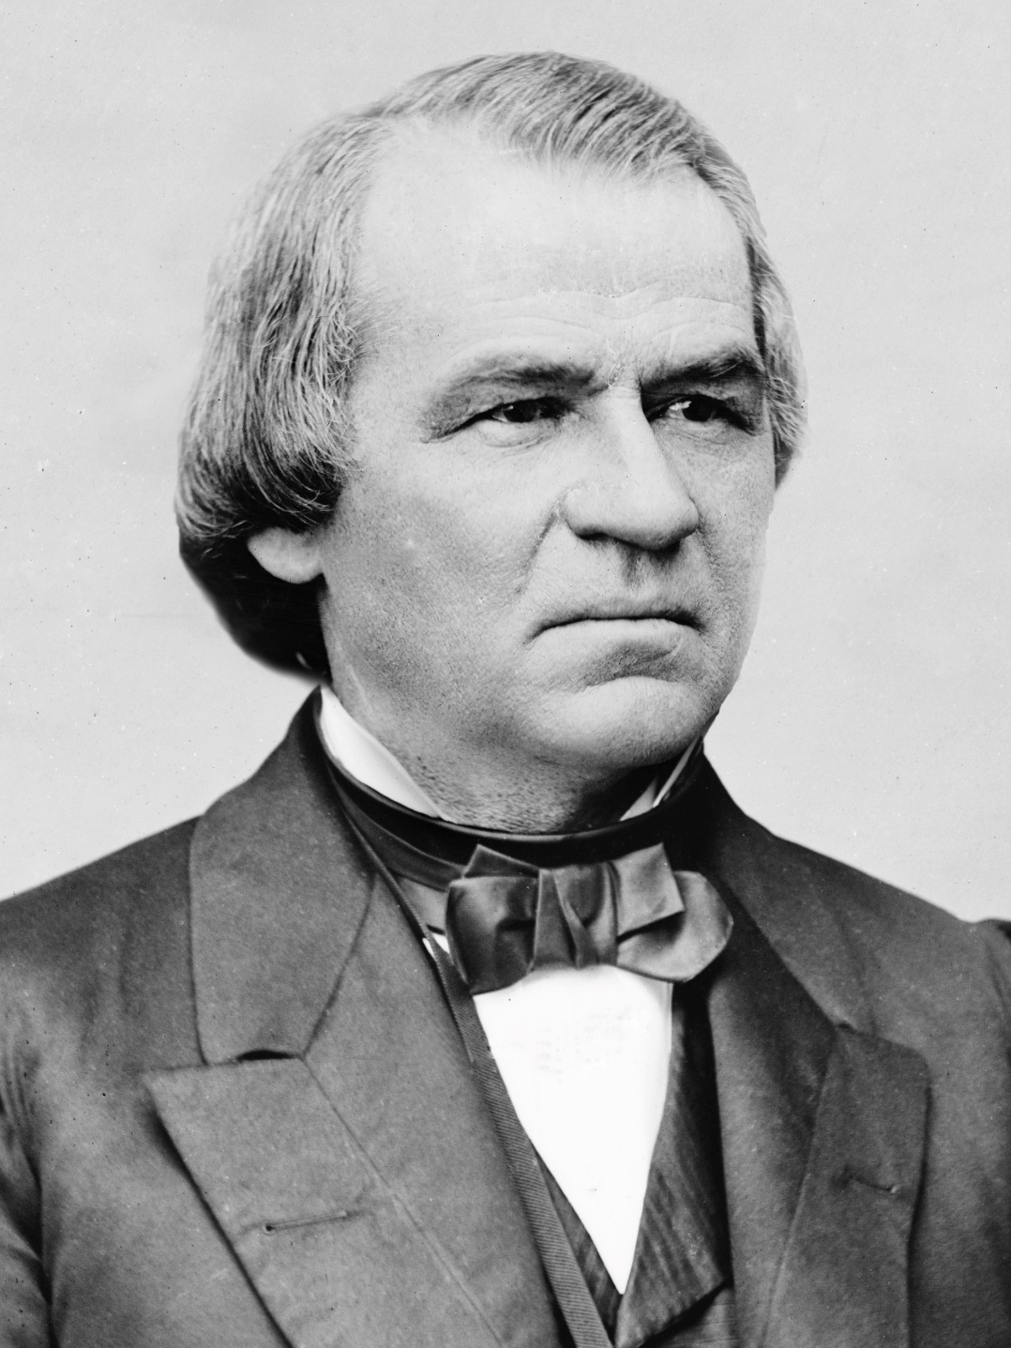

Slide 14
“Treason must be made odious, and traitors must be impoverished.”
  -- Andrew Johnson

Slide 15
“Reconstruction” or
“Restoration”?

Slide 16
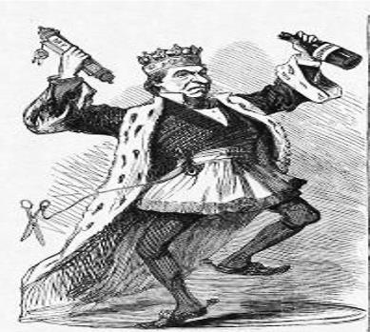
Johnson and “Restoration”
-- “black codes”
-- rampant violence
-- planters in control

Slide 17
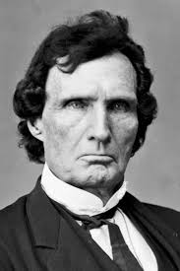
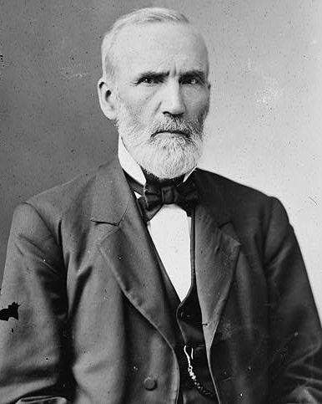
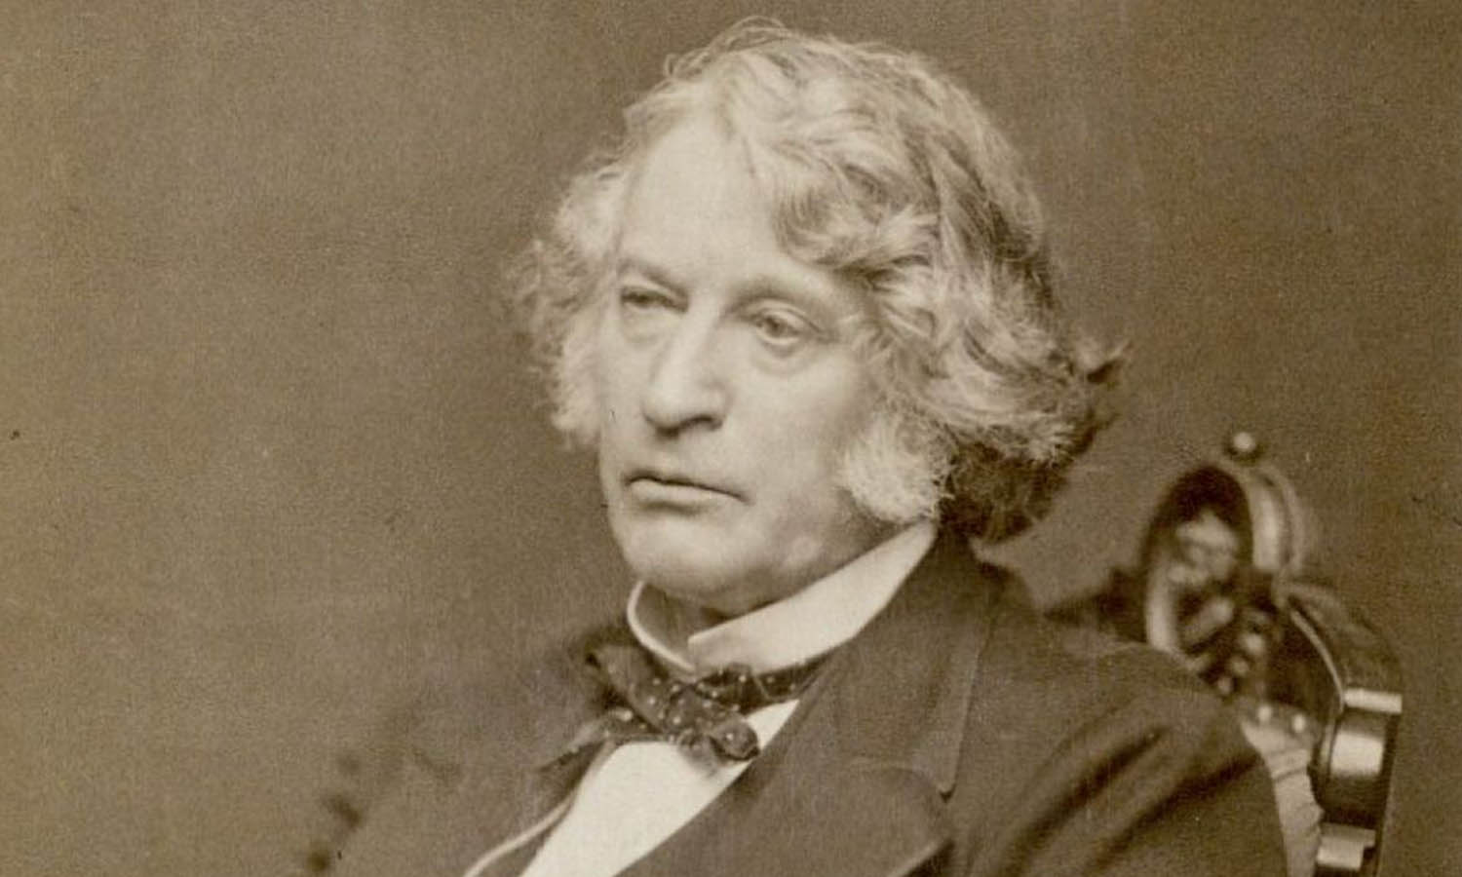
The Radicals and “Reconstruction”
(L to R: Thaddeus Stevens, Charles Sumner, George Julian)

Slide 18
Why is “Radical Reconstruction” radical?

Slide 19
“The whole fabric of southern society must be changed, and never can it be done if this opportunity is lost.”
  --Thaddeus Stevens

Slide 20
How to define “freedom”?
How to enforce “freedom”?

Slide 21
Radical Reconstruction in Practice
14th Amendment
Reconstruction Act of 1867

Slide 22
What is the reaction to “Radical Reconstruction”?
-- Johnson?
-- Congress?

Slide 23
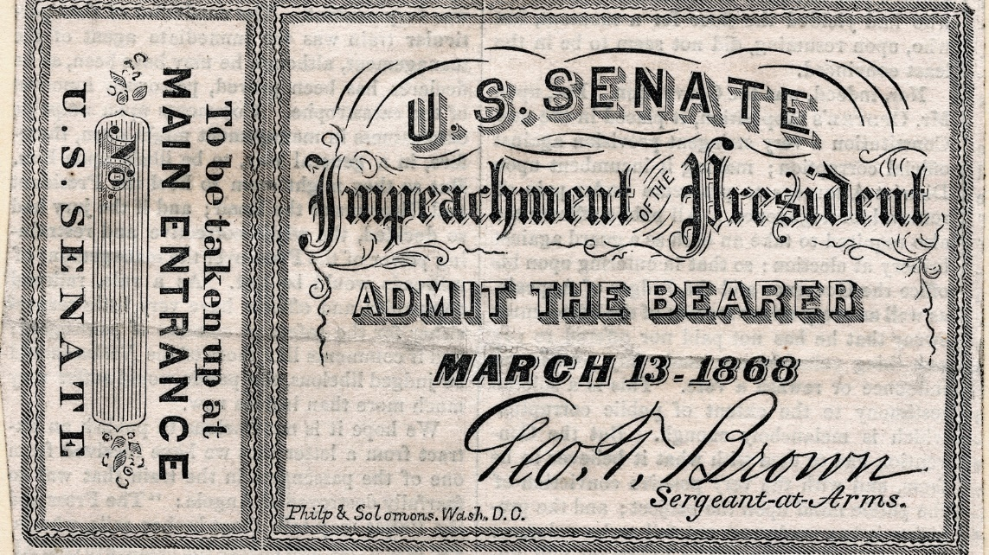
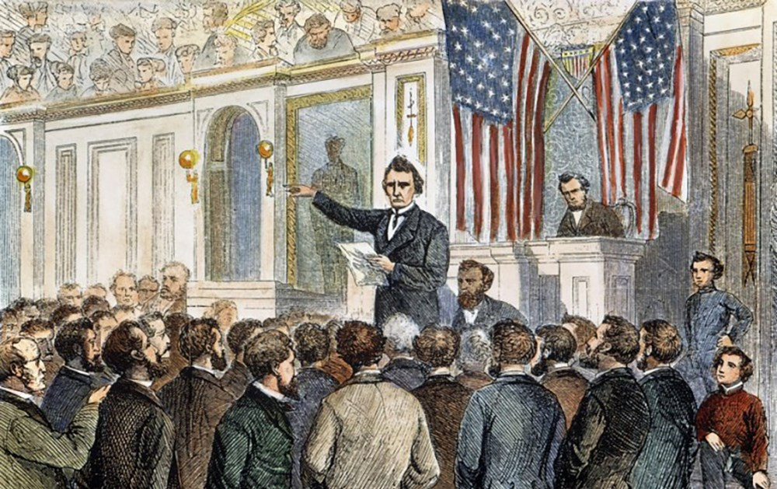
Johnson Impeached

Slide 24
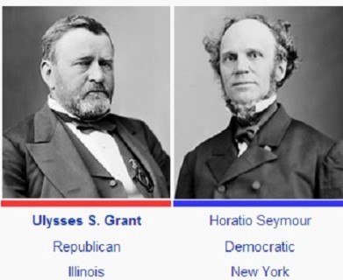
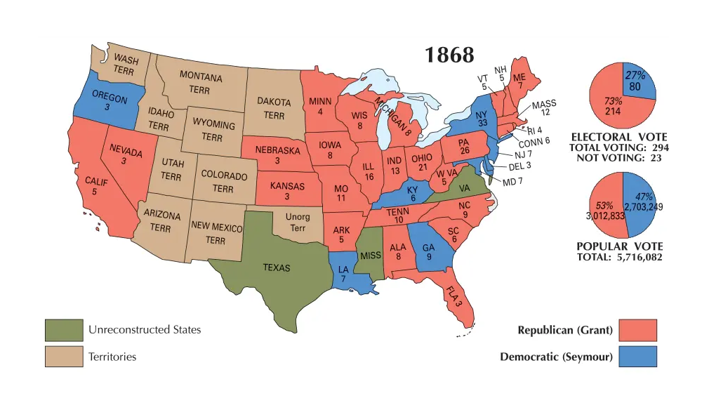
Presidential Election of 1868

Slide 25
“Let Us Have Peace”
Enhanced Enforcement of Civil Rights in the South? or
Retreat from Reconstruction?

Slide 26
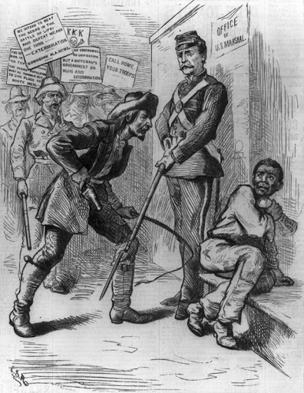
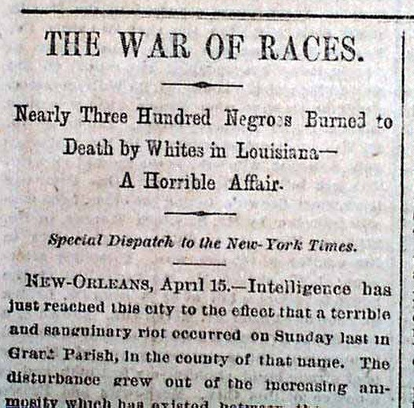
Shall we call home our troops?

Slide 27
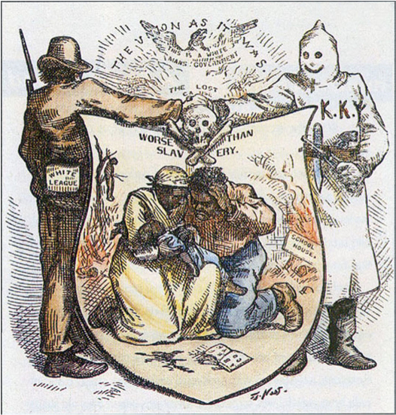
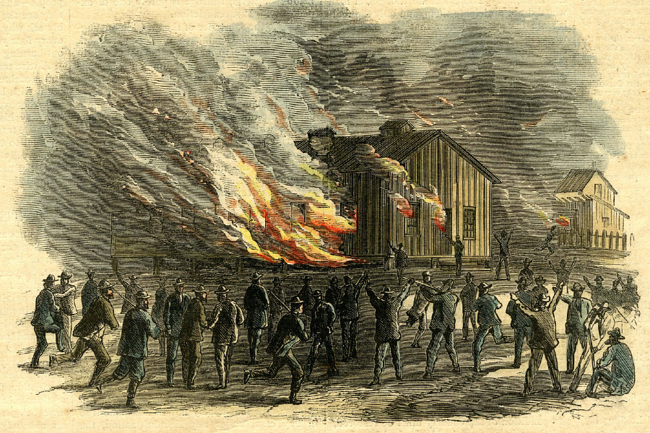
Terror and Violence Triumphs

Slide 28
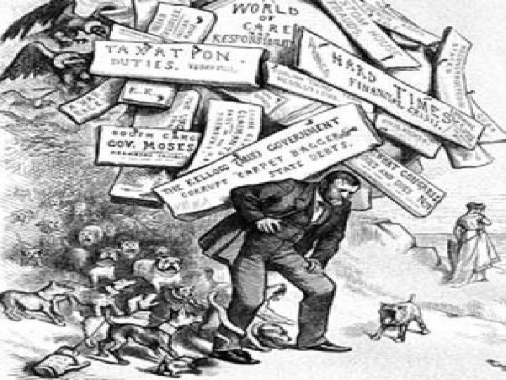
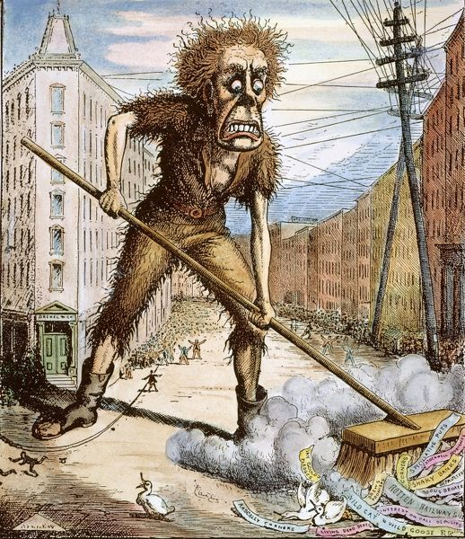
Economic Collapse – 1873

Slide 29
Moderates and Pragmatists:
Were Radicals’ policies enforceable?
Were Radicals’ policies constitutional?
Were Radicals’ policies popular?

Slide 30
“Compromise” of 1877
- President Hayes ends Military Reconstruction
- “Home Rule” begins in the South

Slide 31
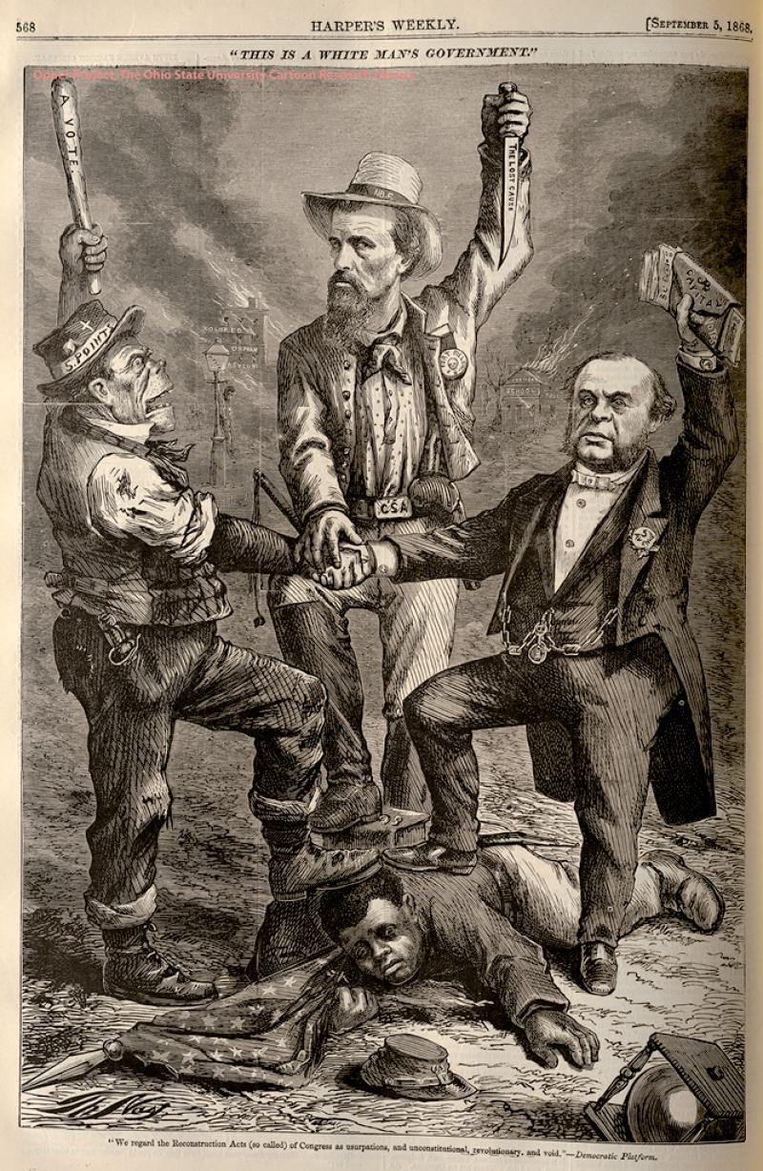
Legacy of Reconstruction?
“This is a white man’s government.”

