Slide 1
Industrialization in the Late Nineteenth Century

Slide 2
Some basic questions:
#1
What caused it (or at least helped it along)?

Slide 3
#2 and #3…
Coming soon!

Slide 4
The Railroads as a Catalyst
How do the railroads fuel economic expansion?

Slide 5
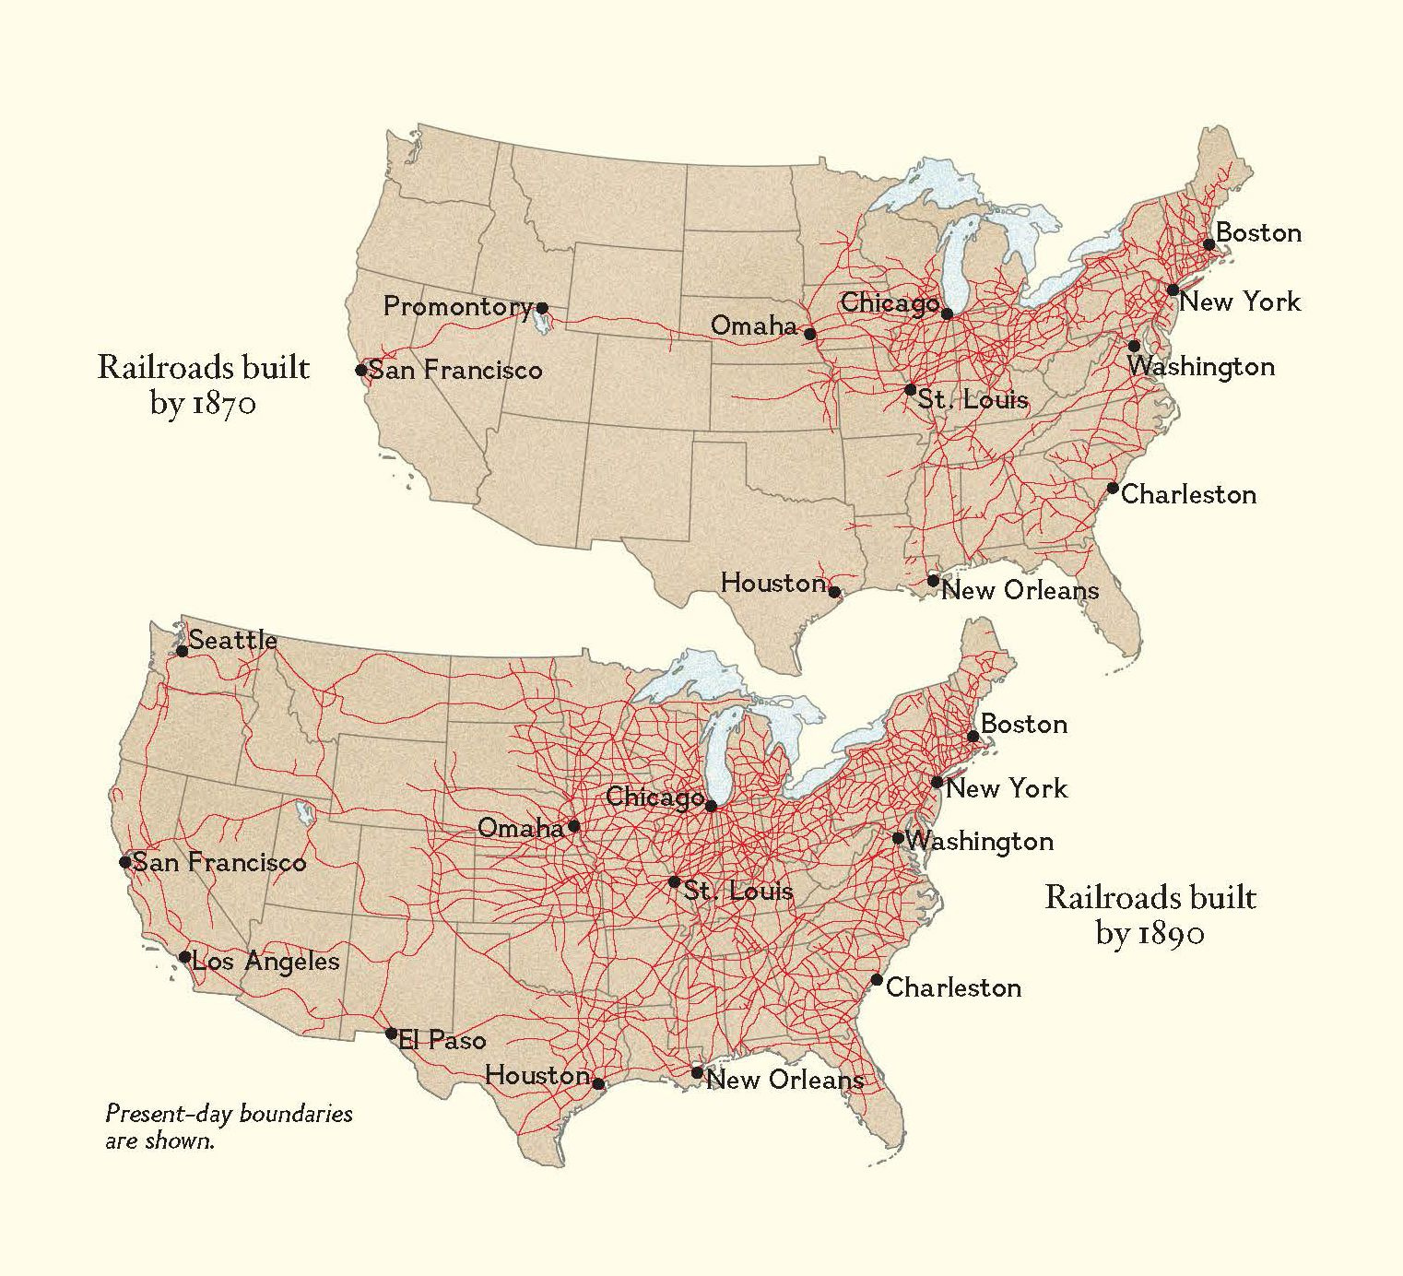
The 19th Century Internet

Slide 6
How did the railroads monetize “latent resources”?

Slide 7
How did the railroads create markets?

Slide 8
How did the railroad create jobs?

Slide 9
How did the railroads promote migration to the West?

Slide 10
How did the railroads change the way of “doing business”?

Slide 11
What other factors encourage economic growth?

Slide 12
How did each factor encourage economic growth?

Slide 13
Abundance of natural resources

Slide 14
Foreign investment
Follow up question:
Why Great Britain?

Slide 15
Government assistance to business

Slide 16
New Strategies and Processes
Manufacturing
Farming

Slide 17
New methods of financing and administering businesses

Slide 18
#2
HOW did the process of modern industrialization occur?

Slide 19
The Four “C”s

Slide 20
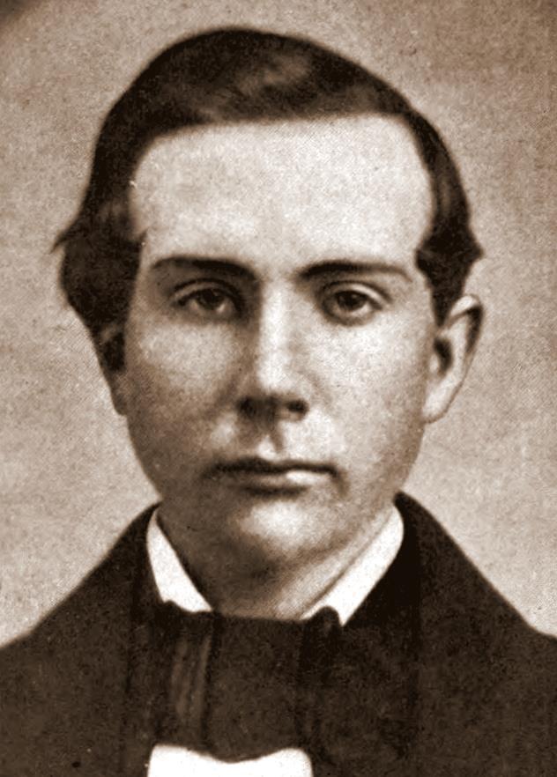
John D. Rockefeller

Slide 21
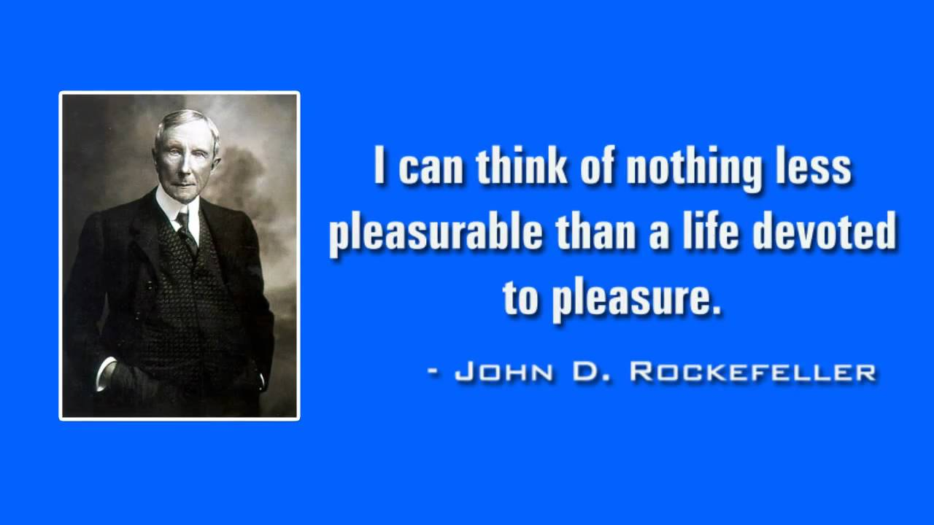

Slide 22
The Four “C”s
- Competition

Slide 23
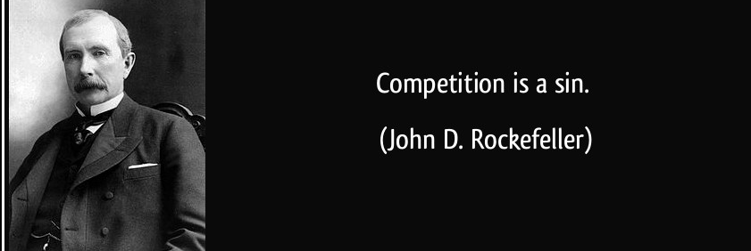

Slide 24
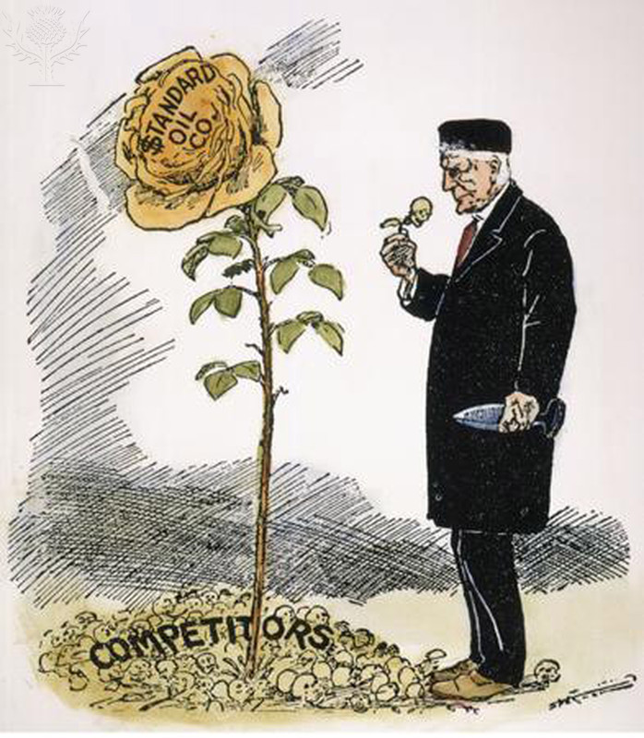

Slide 25
The Four “C”s
Competition
Cooperation

Slide 26


Slide 27
The Four “C”s
Competition
Cooperation
Consolidation
(Horizontal Integration)

Slide 28
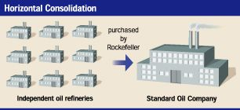

Slide 29
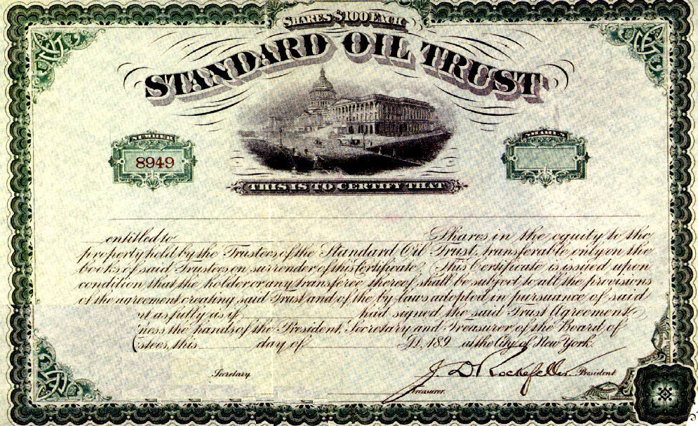

Slide 30
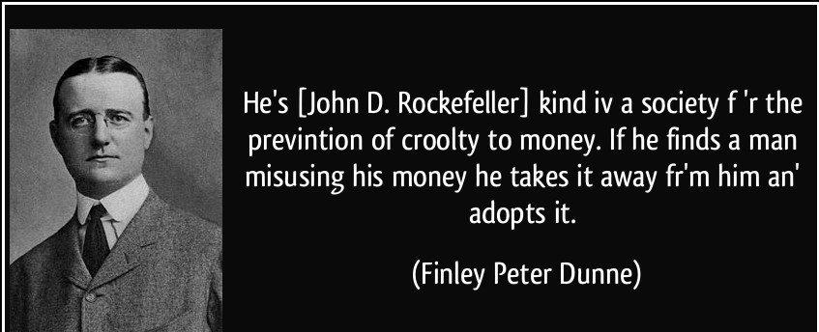

Slide 31
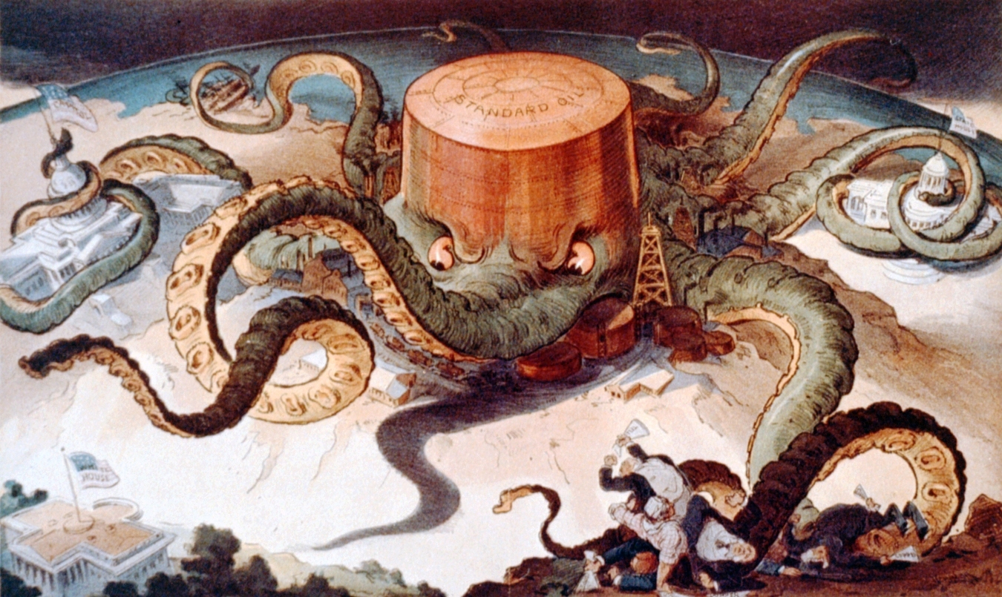
“Let us Prey”

Slide 32
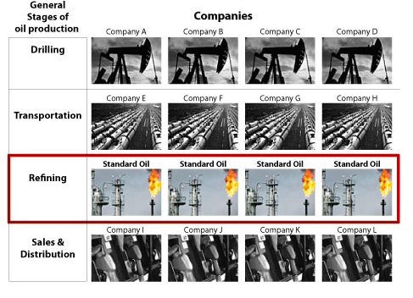

Slide 33
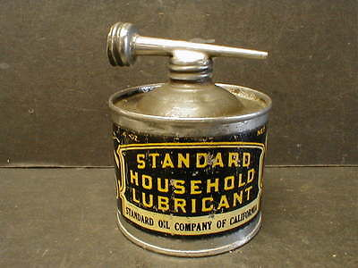

Slide 34
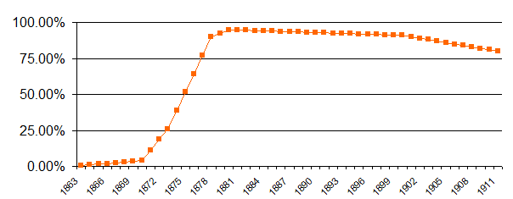
Rockefeller’s Market Share 1863-1911

Slide 35
The Four “C”s
Competition
Cooperation
Consolidation
(Horizontal Integration)
Centralization
(Vertical Integration)

Slide 36
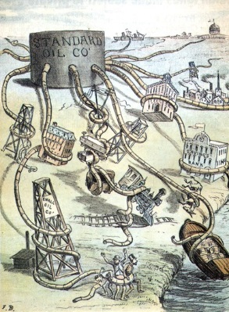

Slide 37
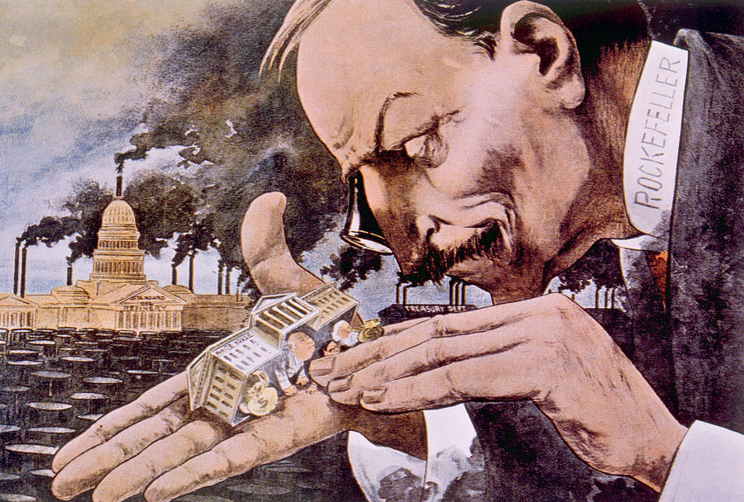

Slide 38
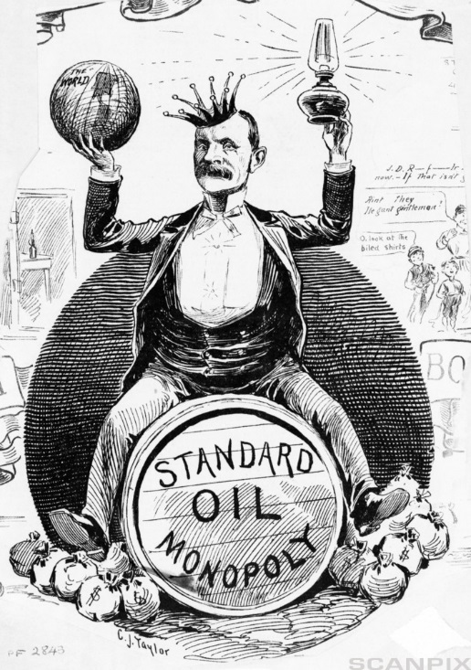

Slide 39
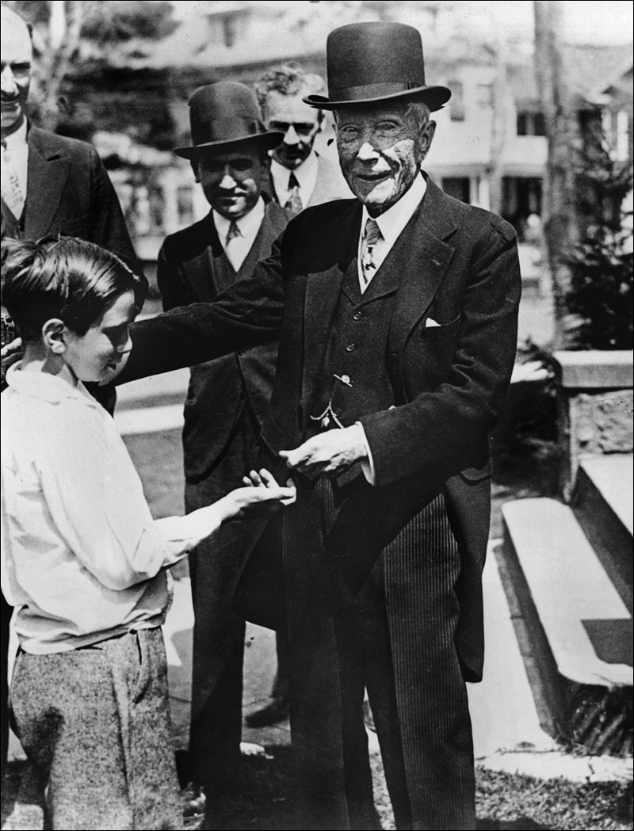

Slide 40
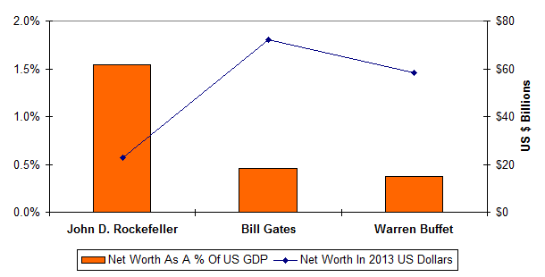

Slide 41
#3
How did the new economy affect people?

Slide 42
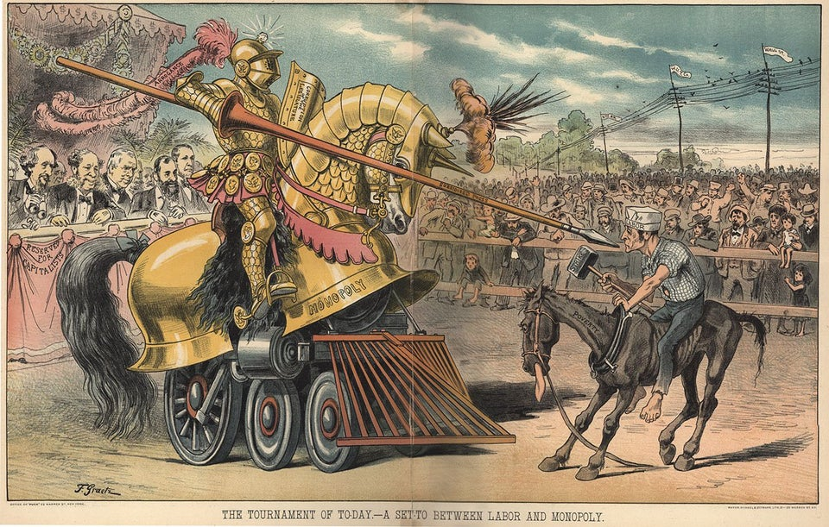

Slide 43
“Liberty produces wealth, and wealth destroys liberty.”
“Competition destroys competition.”
-Henry Demarest Lloyd

