Slide 1
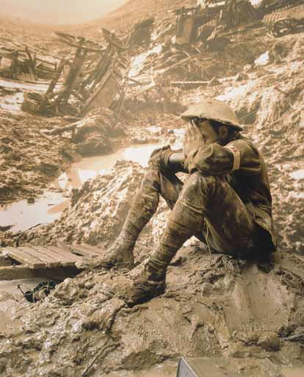
World War I – 1914 -1918

Slide 2
Four Major Questions:
Why did war break out in Europe in August 1914?
How did the United States respond to the European War?
Why did the United States support the Allies (Great Britain and France)?
What did Woodrow Wilson hope to achieve during and after the war?

Slide 3
So What?
U.S. emerges as a world power.
U.S. introduces an “American style” of foreign policy that remains with us today (for good or ill).
World War I unleashes forces that continue to cause bloody conflicts in the 21st Century.

Slide 4
Why did the war break out in Europe in August 1914?
Short term reasons
Long term reasons

Slide 5
Assassination of Archduke Franz Ferdinand
- Threat to the Austro-Hungarian Empire
- Catalyst for broader European conflict

Slide 6
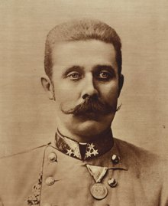
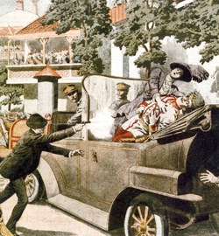
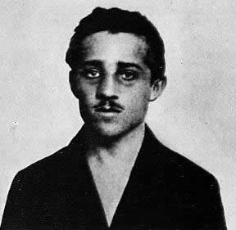

Slide 7
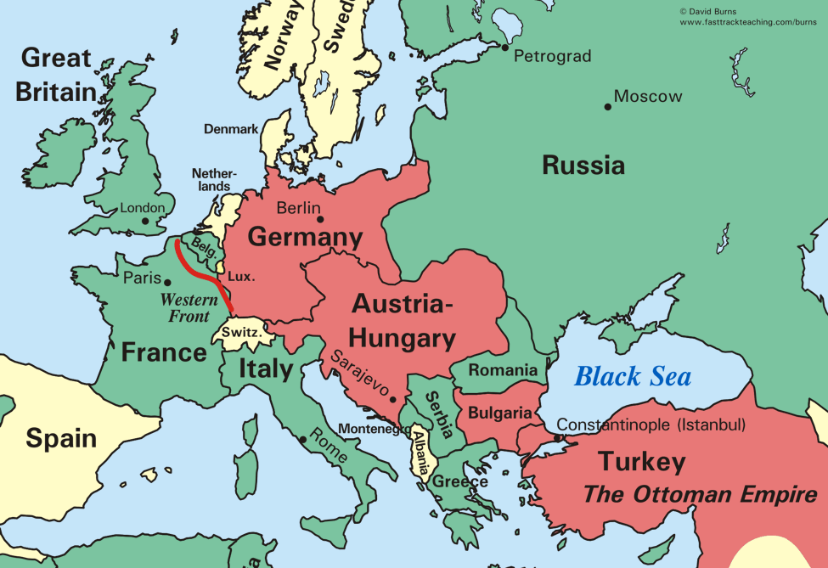

Slide 8
Long-term Causes
Germany “left behind” in scramble for colonies
British apprehension about Germany navy
Lingering resentment of France against Germany

Slide 9
“The lamps are going out all over Europe, we shall not see them lit again in our life-time.”
-- British Foreign Secretary Sir Edward Grey

Slide 10
NOT “home by Christmas”
-- Trench warfare
-- Weapons technology outpaces the advance of medicine

Slide 11
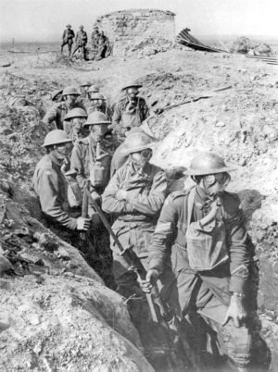

Slide 12
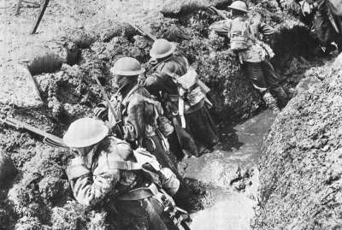

Slide 13
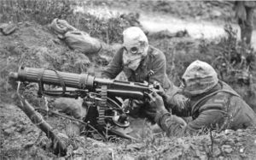

Slide 14
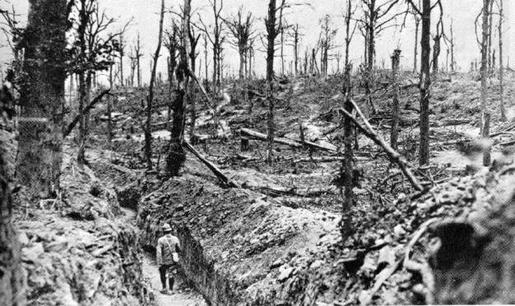

Slide 15
How did the U.S. respond to the European war?

Slide 16
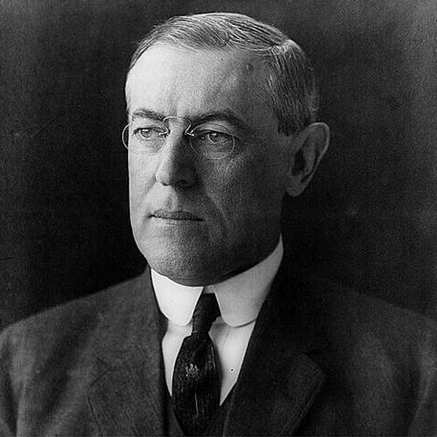

Slide 17
“Wilsonian” Foreign Policy
Progressives set out to “reform” the world.

Slide 18
“Like a troubled man angered by his own uncertainty, the country aggressively demanded international conformity to democratic goals it now believed might be slipping out of domestic reach.”
-Robert Dallek

Slide 19
“Old World” Tyranny vs
“New World” Democracy

Slide 20
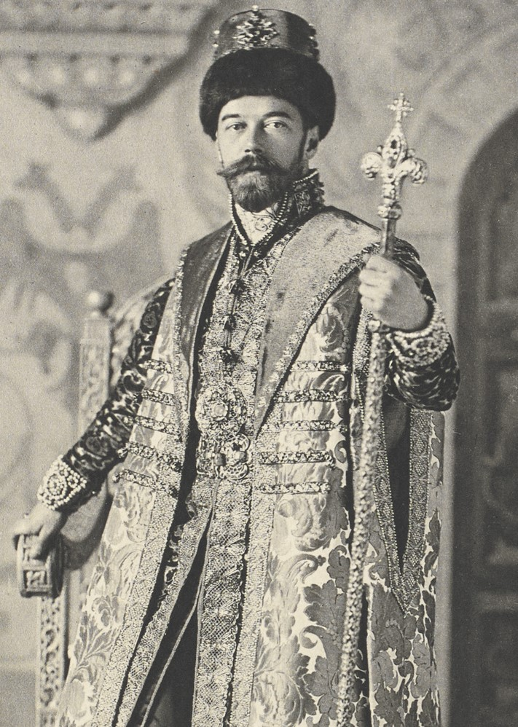
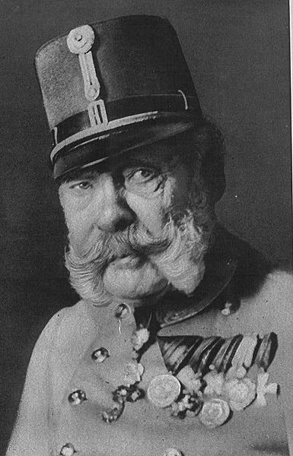
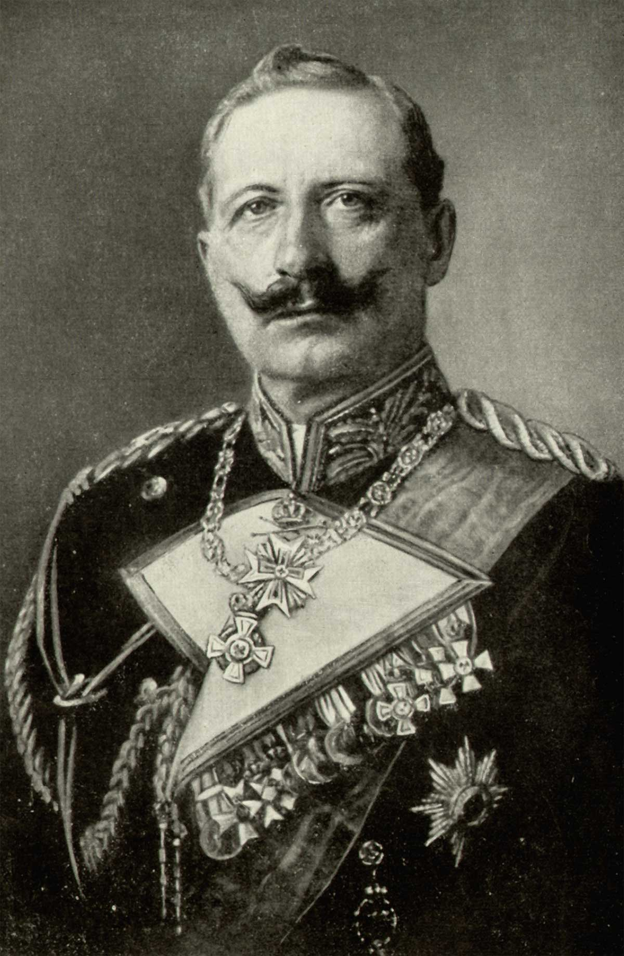

Slide 22
Neutrality:
Idealism or Naivete?

Slide 23
Why can’t we trade with everyone?

Slide 24
Is trade with the British and French a good thing?

Slide 25
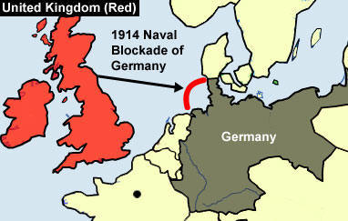

Slide 26
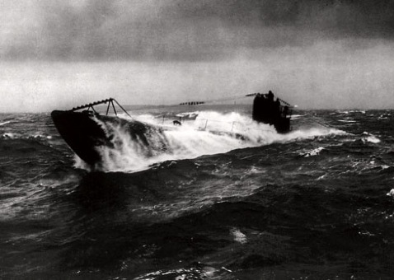
How do the Germans Respond?

Slide 27
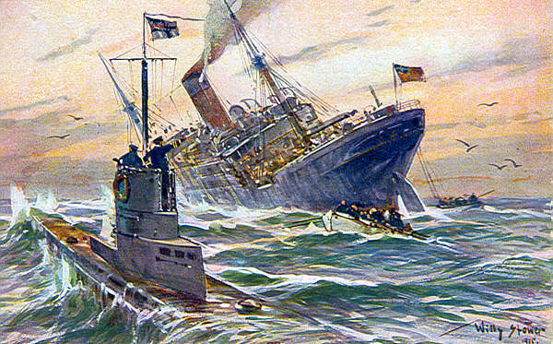

Slide 28
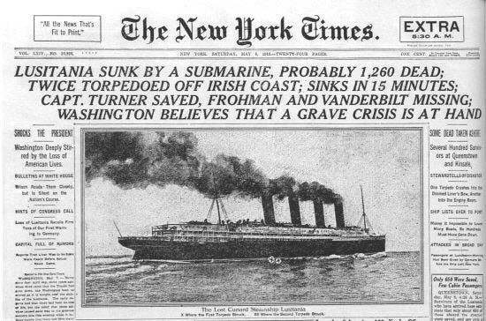

Slide 29
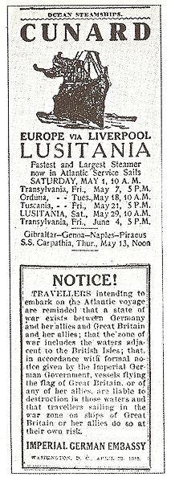

Slide 30
“Sussex Pledge”

Slide 31
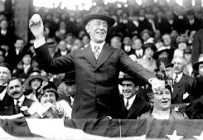

1916 Presidential Election

Slide 32
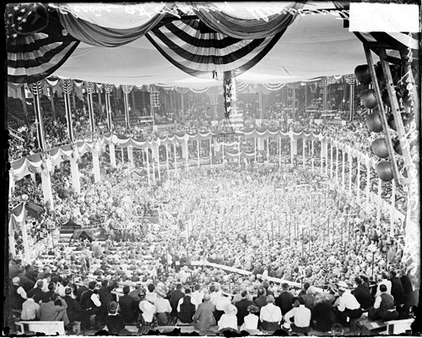
“He kept us out of war!”

Slide 34
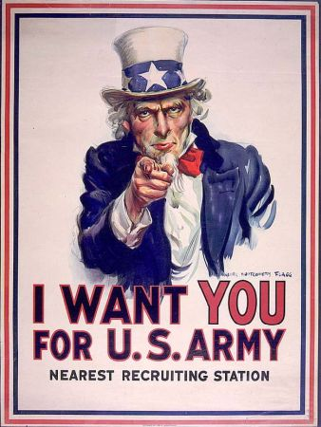
After staying out so long, why are we getting in?

Slide 35
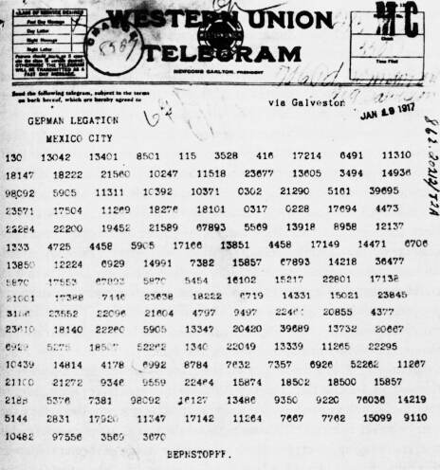
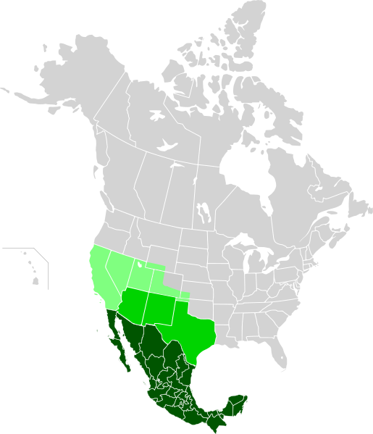
Zimmermann Telegram

Slide 36
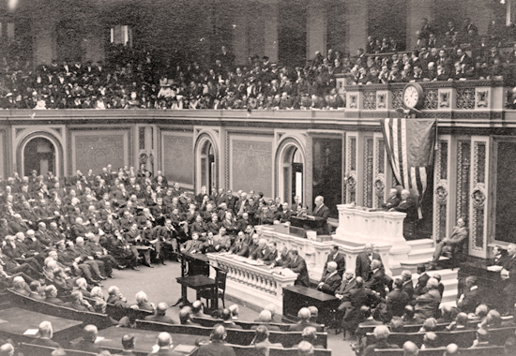
Unrestricted Submarine Warfare

Slide 38
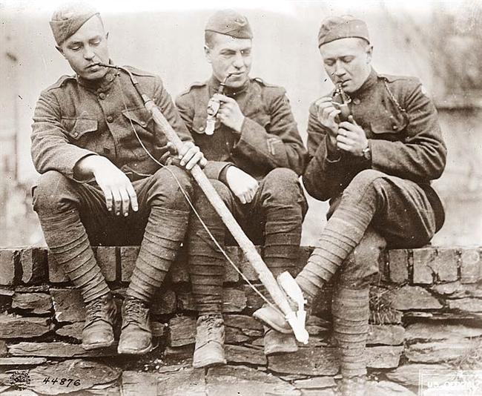
American Expeditionary Force
“Doughboys”

Slide 39
What did Woodrow Wilson hope to achieve during and after the war?

Slide 40
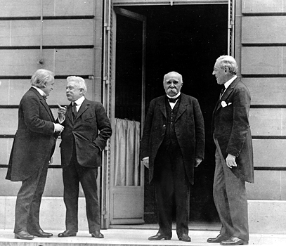
Treaty of Versailles

Slide 41
Lives Lost:
Russians – 3.3 million
Germans – 2.6 million
French – 1.9 million
Austro-Hungarians – 1.5 million
British 1.2 million
USA – 117,000

Slide 42
The Fourteen Points
1-8
Recommendations for New Boundaries in Europe

Slide 43
The Fourteen Points
9-13
Open Diplomacy
Freedom of Navigation
Removal of Trade Barriers
Arms Reductions
Self-Determination for Nations and Colonies

Slide 44
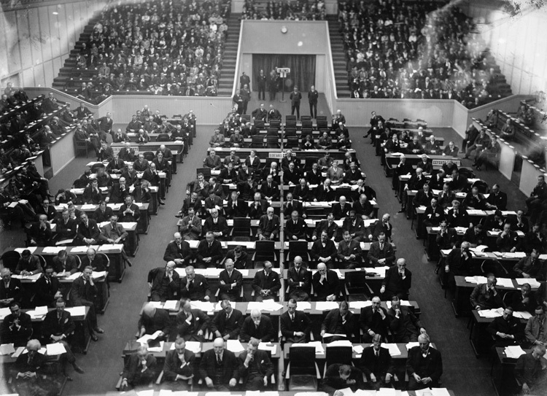
The Fourteenth Point
A League of Nations

Slide 45
What’s Wrong With The 14 points?

Slide 46
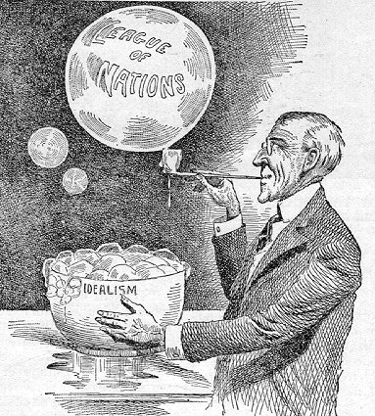

Slide 47
"God gave us the ten commandments and we broke them. Now Mr. Wilson has given us the Fourteen Points. We shall see."
--Georges Clemenceau

Slide 48
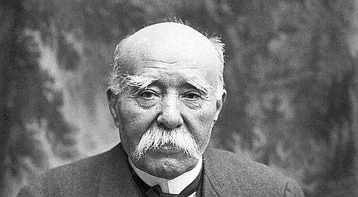

Slide 49
“There are twenty million Germans too many!”

Slide 50
Reparations?
War Guilt?

Slide 51
Legacies of World War I
- Disillusionment with Progressivism and crusading idealism
- Treaty of Versailles sets up economic instability

