Slide 1
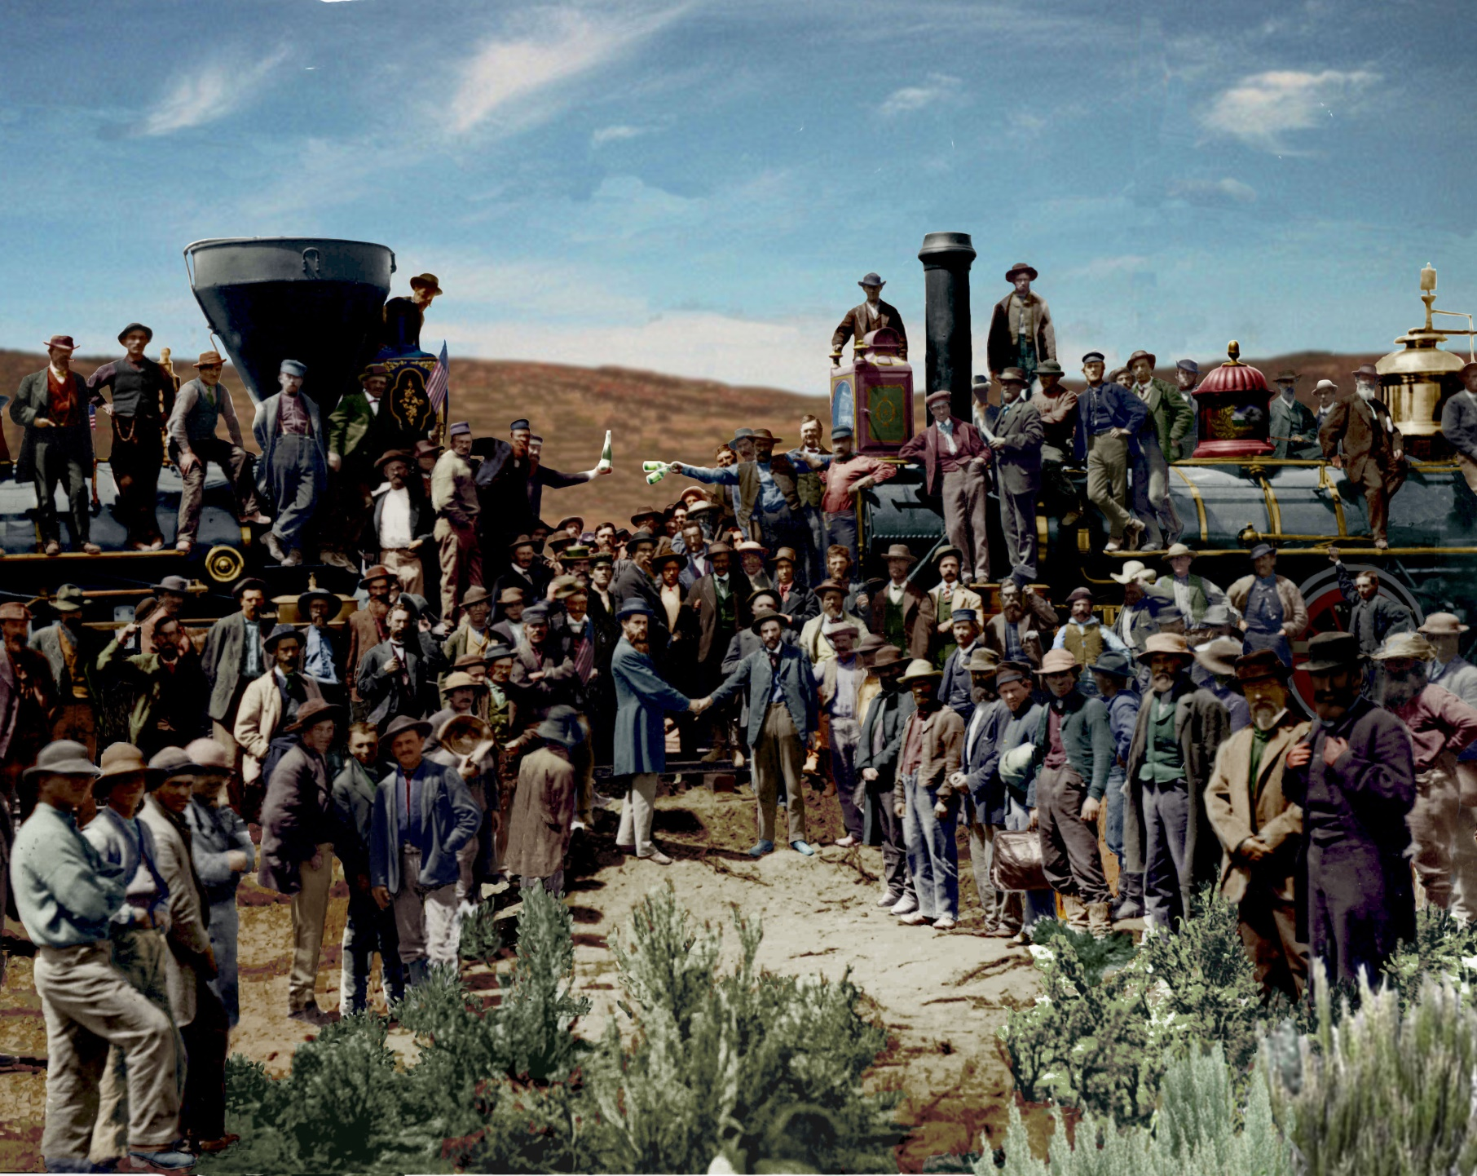

Slide 2
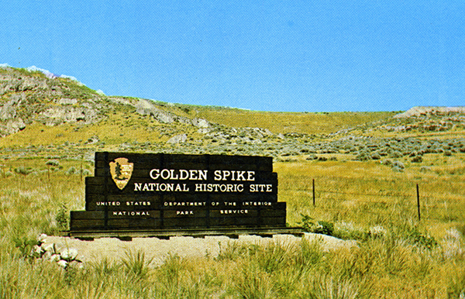

Slide 3
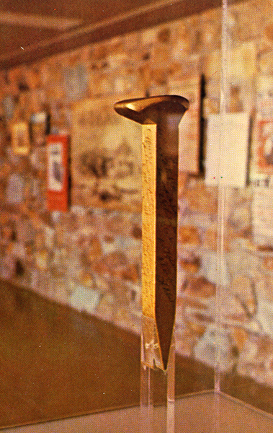

Slide 4
“Unless the government had been willing to build the transcontinental lines itself, some system of subsidy was essential.”

Slide 5
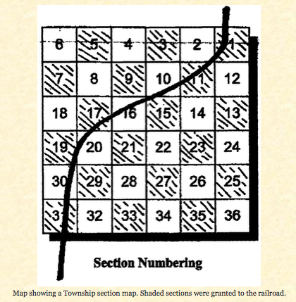

Slide 6
“Those [railroad line builders] who got federal aid ended up being hung by the strings that were attached to it.”
Folsom, 29

Slide 7
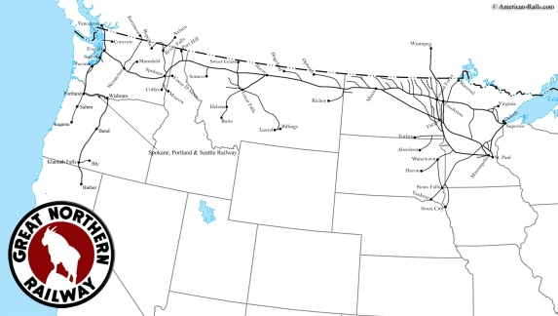

Slide 8
“The aid bred inefficiency; the inefficiency created consumer wrath; the consumer wrath led to government regulaton; and the regulation closed the UP’s options and helped lead to bankruptcy.”
Folsom, 22

Slide 9
Industrialization in the Late Nineteenth Century

Slide 10
Some basic questions:
#1
What caused it (or at least helped it along)?

Slide 11
The Railroads as a Catalyst
How do the railroads fuel economic expansion?

Slide 12
#2
HOW did the process of modern industrialization occur?

Slide 13
#4
How did the new economy affect people?
Who won?
Who lost?

Slide 14
#3
Why is “Big Business” something new?

