Slide 1
The Great Depression, 1929-1941
Origins → 1919-1929

Slide 2
Basic questions to consider:

Slide 3
What causes an economy to go into decline?
What (if anything) can the government do prevent this?
Why is it difficult for government to respond effectively to the conditions that bring on an economic decline?
Why does government policy sometimes make the economic decline worse?

Slide 4
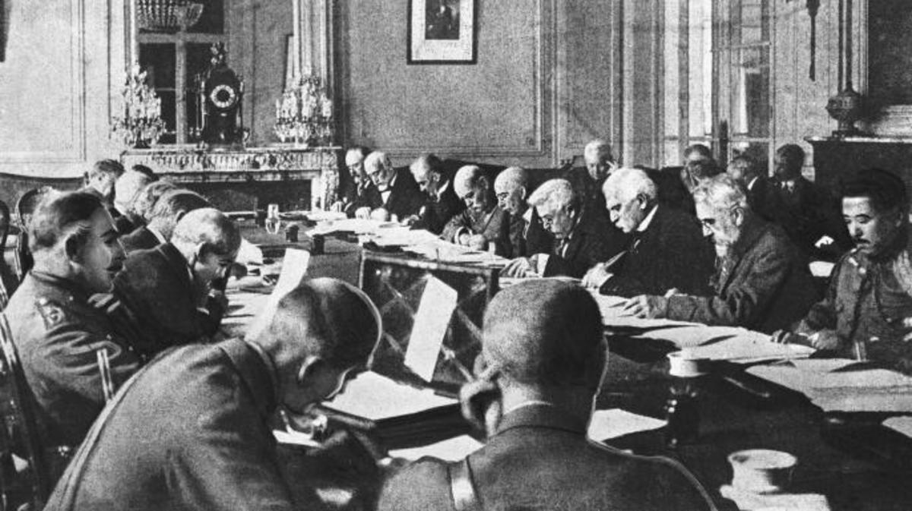
“The seeds of the Great Depression can be found in the Treaty of Versailles.”

Slide 5
Cause #1 –
The International Economic Situation

Slide 6
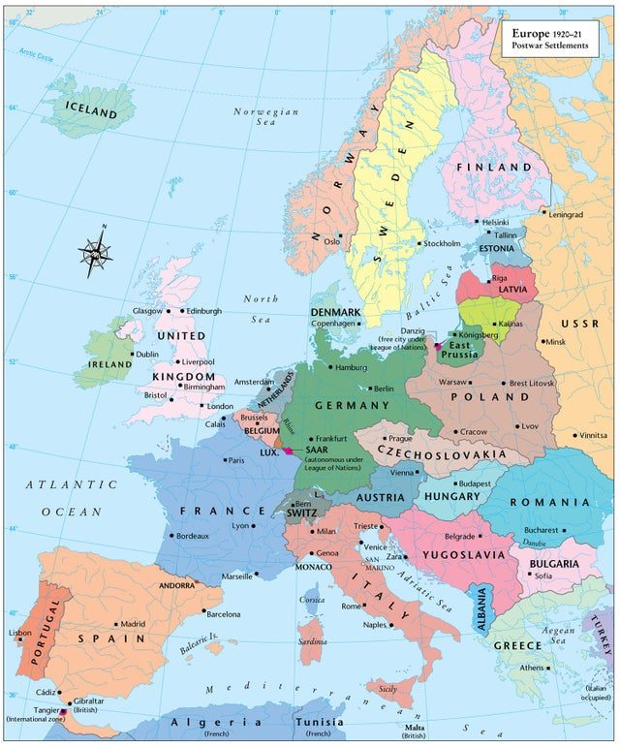

Slide 7
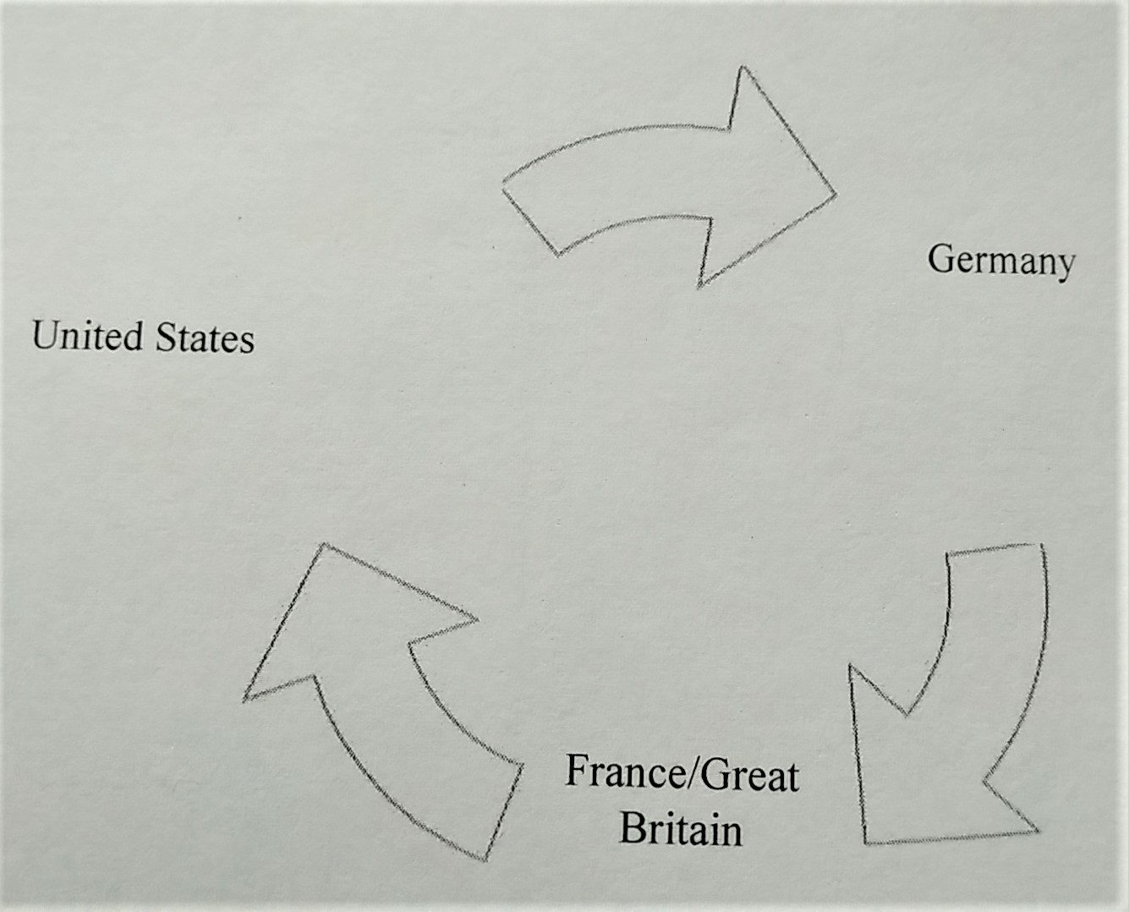

Slide 8
Why is this system unstable?
Why does it not even achieve the goal it was set up to accomplish?

Slide 9
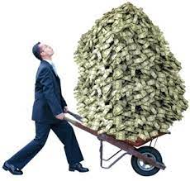
Hyperinflation in Germany, 1922-23

Slide 10
What about the stock market?
Contributes to….but does not “Cause” the Great depression

Slide 11
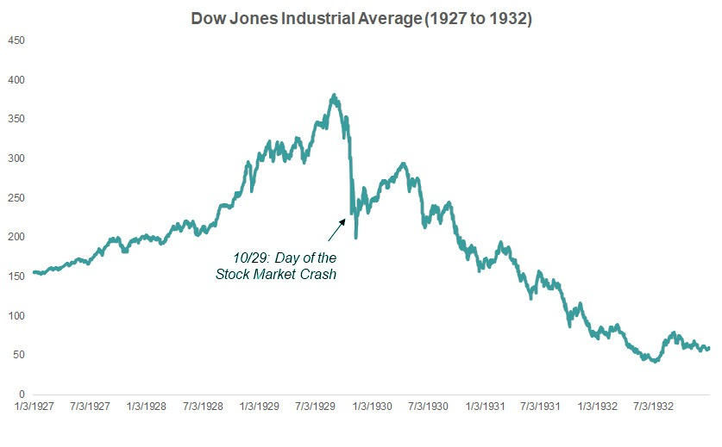

Slide 12
Things you need to know:
-- why were war debts and reparations a problem?
-- what causes inflation?
-- why was hyperinflation a bad thing?
-- what caused the stock market to rise so quickly?
-- why did the U.S. stock market crash have a global impact?

Slide 13
Cause #2 –
Unwise Tariff Policies

Slide 14
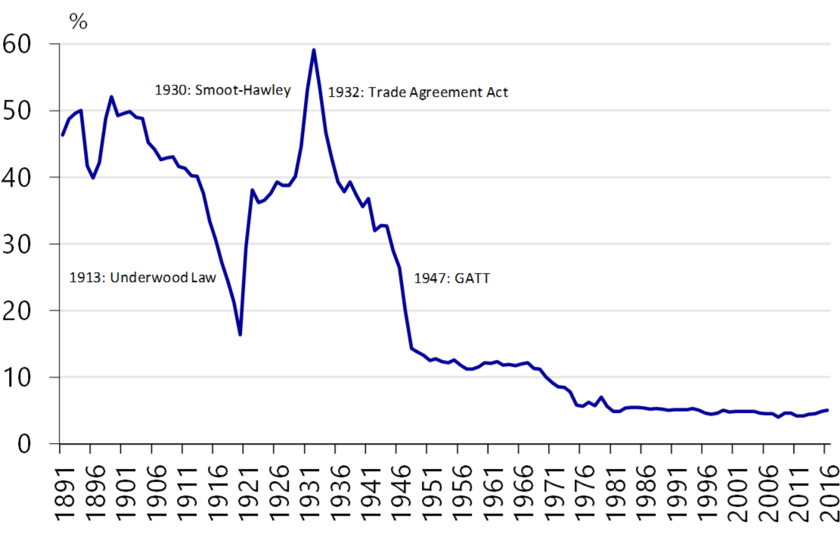

Slide 15
Things you need to know:
Why was raising the tariff the wrong solution to the problem of American companies not selling enough goods?
Why was the government’s decision to raise the tariff a bad idea?
How did raising the tariff end up making things worse not only for the US but for other nations as well?

Slide 16
Cause #3 –
Unwise Tax Policies

Slide 17
Things you need to know:
Why do tax cuts targeted at the wealthiest Americans not always help the overall economy?
Why are certain sectors of the economy (high tech, housing, and automobiles) crucial to the overall health of the economy?
How did the tax cuts of the 1920s contribute to the Stock Market crash of 1929?

Slide 18
Cause #4 –
Unwise decisions by the Federal Reserve

Slide 19
Things you need to know:
What are the main powers of the Federal Reserve?
What mistakes did the Federal Reserve make in response to the stock market boom and the stock market crash?
How do interest rates affect Americans’ spending habits?
How can adjusting interest rates speed up and slow down economic expansion?

Slide 20
Cause #4 –
Lack of Economic Knowledge

Slide 21
Things you need to know:
How did solutions to problems not only fail to solve the problem but also create larger problems?
Why was it so important to recognize that the economic policies must take a global perspective?
How did the economic chaos of the 1930s also create political instability throughout the world?

