Slide 1
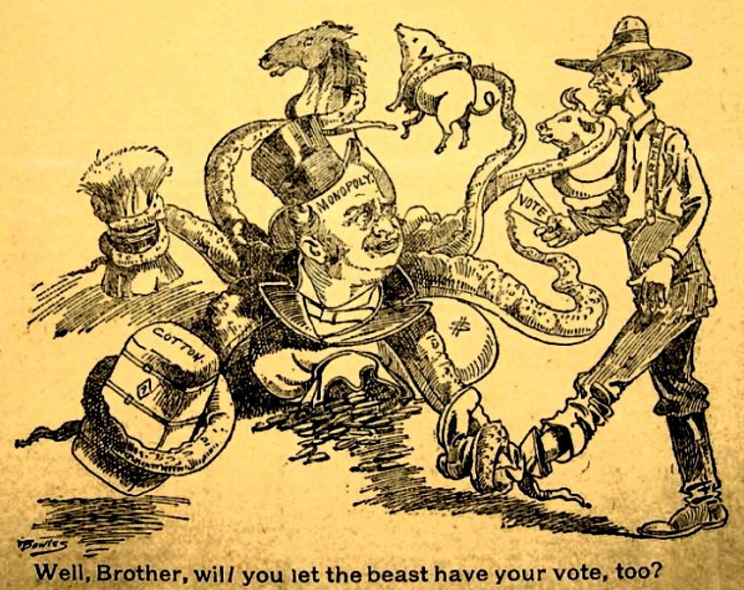
POPULISM:
Fire on the Prairie
1880s-1890s

Slide 2
Three Overall Questions…
1. Why are farmers hurting?
2. Who do they blame?
3. How do they propose to solve their problems?

Slide 3
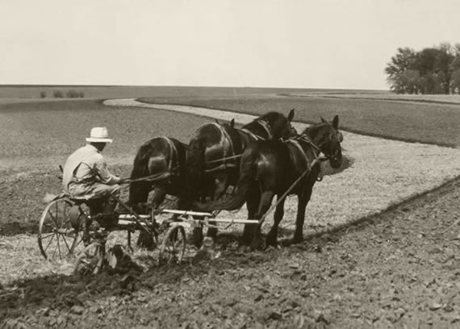
If I’m producing MORE, why am I making LESS??

Slide 4
Farmers’ Common Problems:
1.Debt
2. Middlemen and Speculators

Slide 5
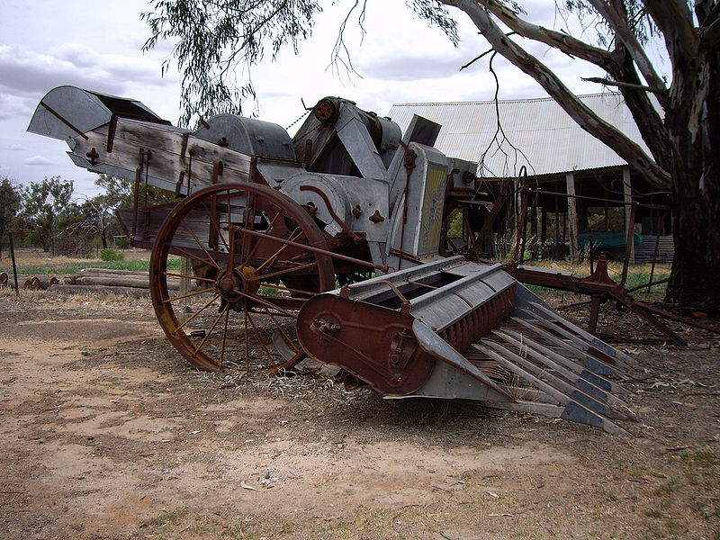
Why are Prices So Low?

Slide 6
Who are the EVIL MIDDLEMEN?

Slide 7
Who are the EVIL MIDDLEMEN?
RAILROADS

Slide 8
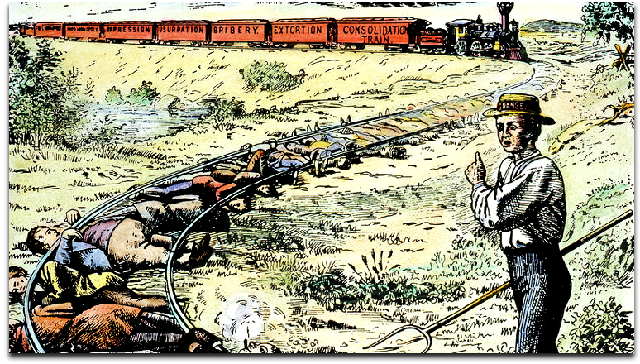

Slide 9
Who are the EVIL MIDDLEMEN?
RAILROADS
GRAIN ELEVATOR OPERATORS

Slide 10
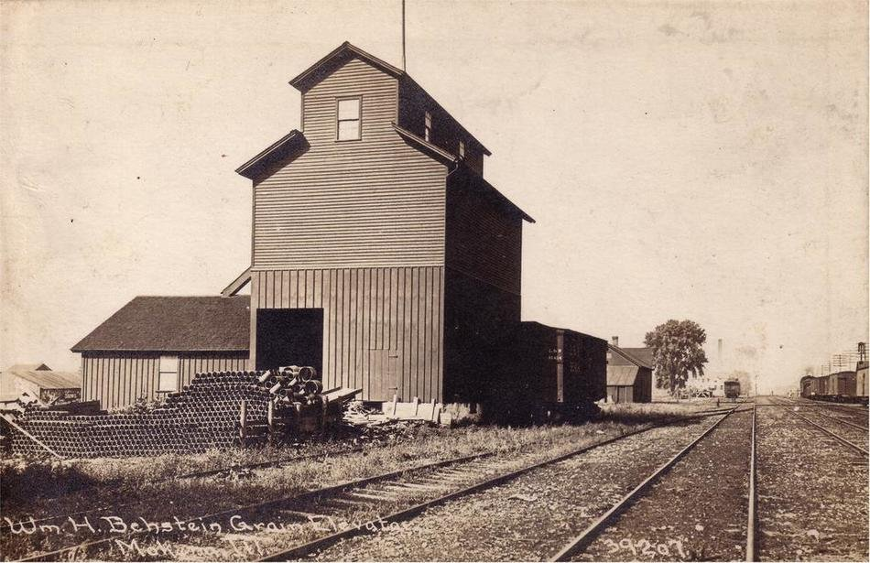

Slide 11
Who are the EVIL MIDDLEMEN?
RAILROADS
GRAIN ELEVATOR OPERATORS
SPECULATORS AND TRADERS

Slide 12
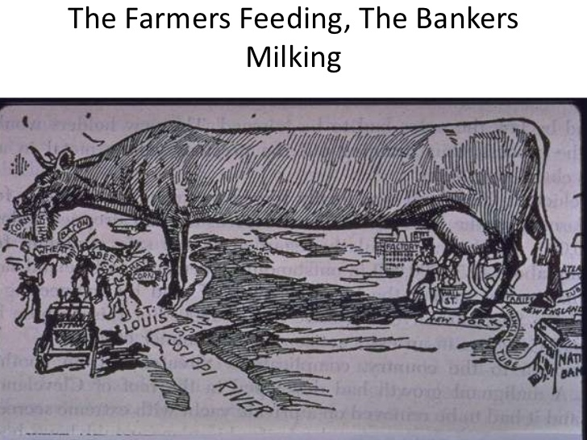

Slide 13
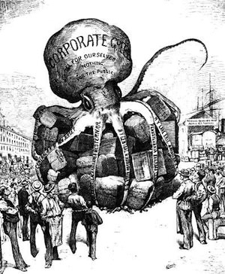

Slide 14
How do you get around the Middleman?

Slide 15
Self-help
1. Cooperatives
2. Farmer Alliances

Slide 16
Government Assistance
1. Granger Laws
2. Subtreasury System
2. Regulate the Railroads

Slide 17
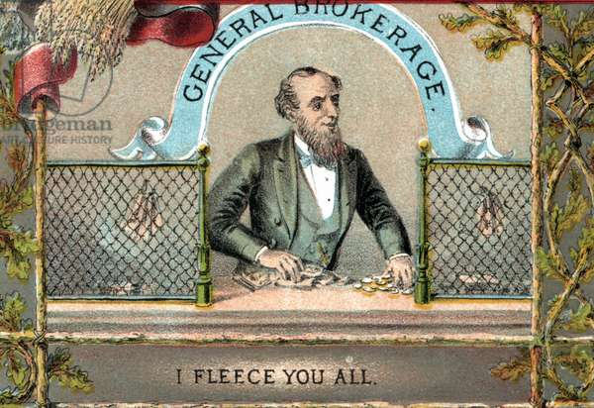
Granger Laws

Slide 18
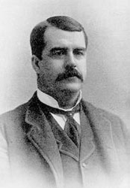
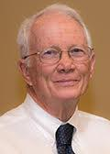
Subtreasury System
-- Access to Credit
-- Leverage over Prices
Charles W. Macune

Slide 19
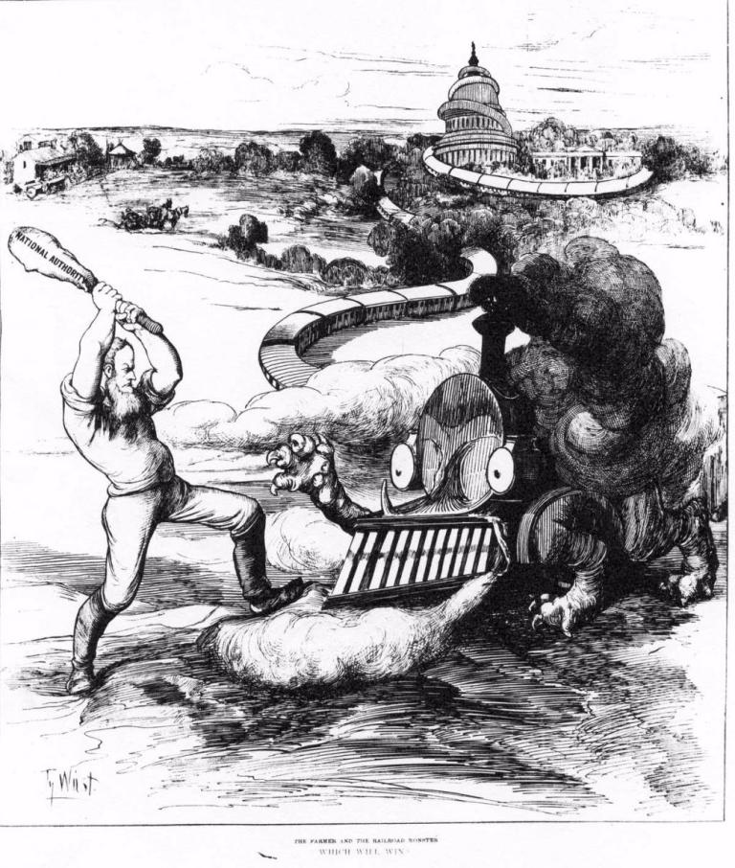
Railroad Regulation

Slide 20
What is DEFLATION and How Does it Affect DEBT?

Slide 21
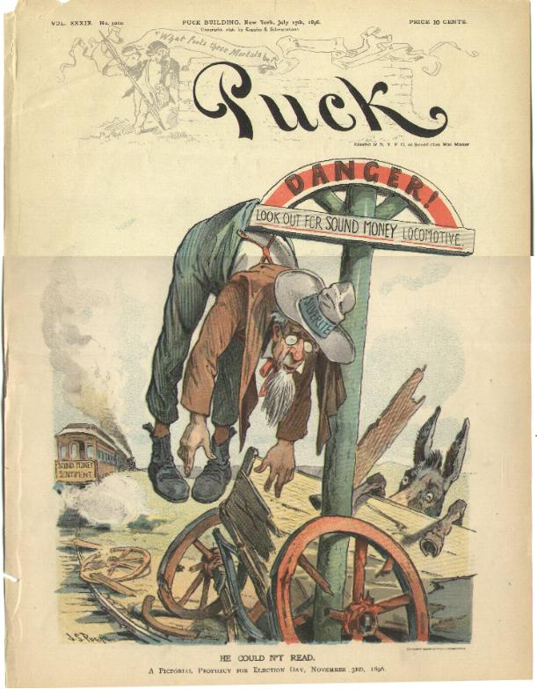
When all else fails…
Inflate the Currency
Why Silver?

Slide 22
What’s the argument for Gold?

Slide 23
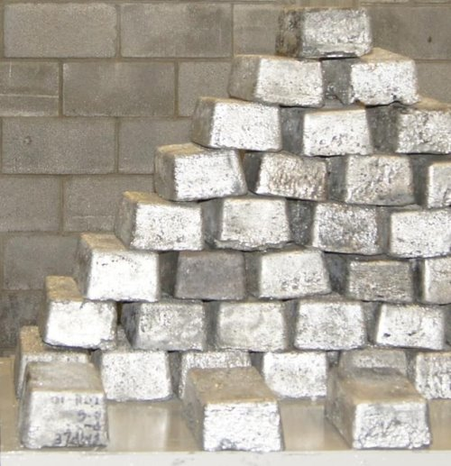
Who else might be for coinage of Silver?

Slide 24
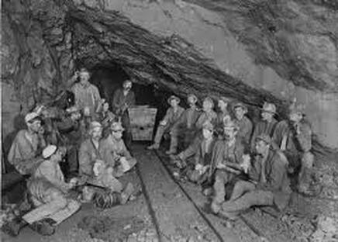
Who else might be for coinage of Silver?

Slide 25
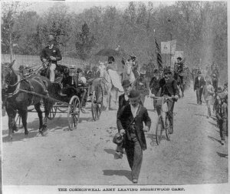
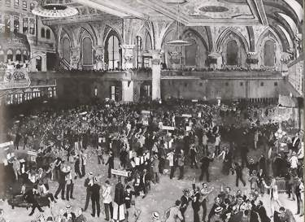
What happens in 1893?

Slide 26
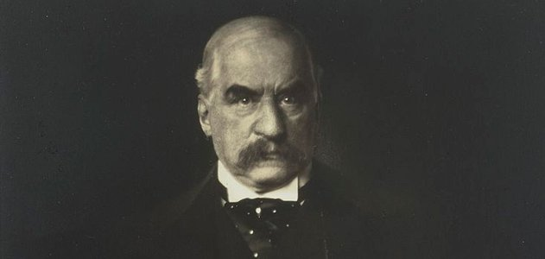
“I’ve got this.”
-- J. P. Morgan

Slide 27
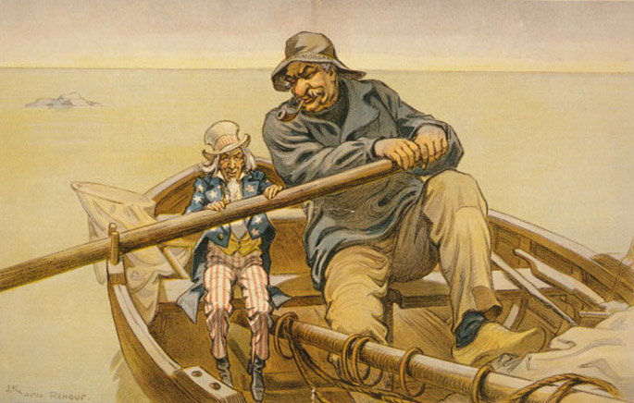
Economic Crisis → Political Debate

Slide 28
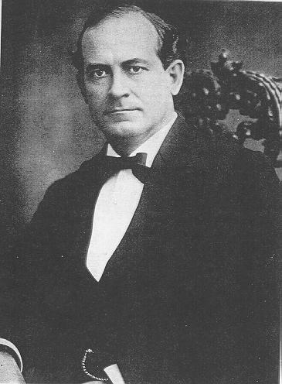
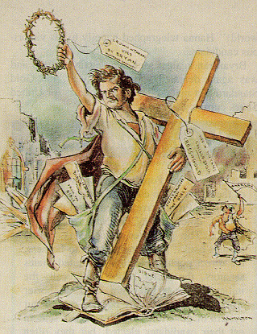
William Jennings Bryan

Slide 29
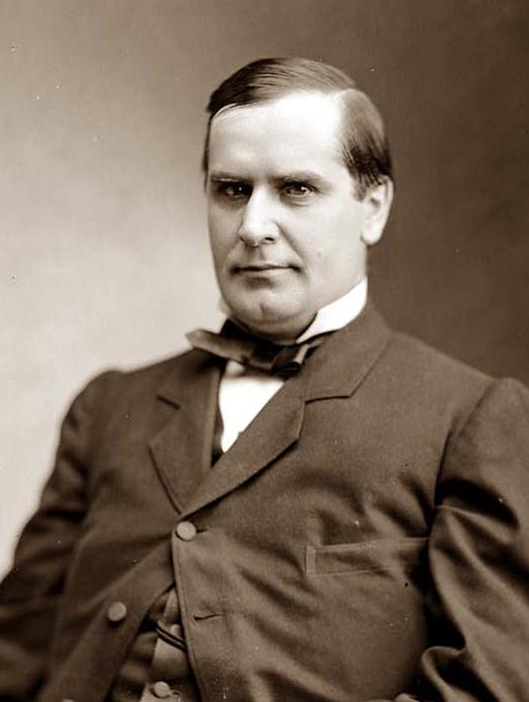
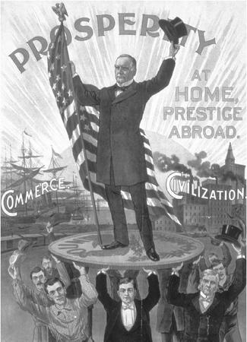
William McKinley

Slide 30
Why didn’t city workers join with farmers against the guys with money?

Slide 31
The Real Lesson of the Election of 1896?
As long as “have nots” (workers and farmers) remain divided, it will be hard to challenge the power of the corporate elite.

