Slide 1
The Fifties – The Four A’s
ANXIETY, ANTI-COMMUNISM, AFFLUENCE, ALIENATION

Slide 2

ANXIETY

Slide 3
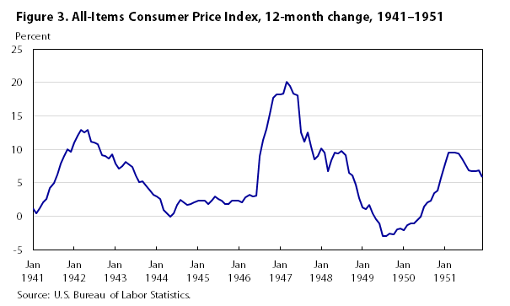
Inflation, not Unemployment

Slide 4
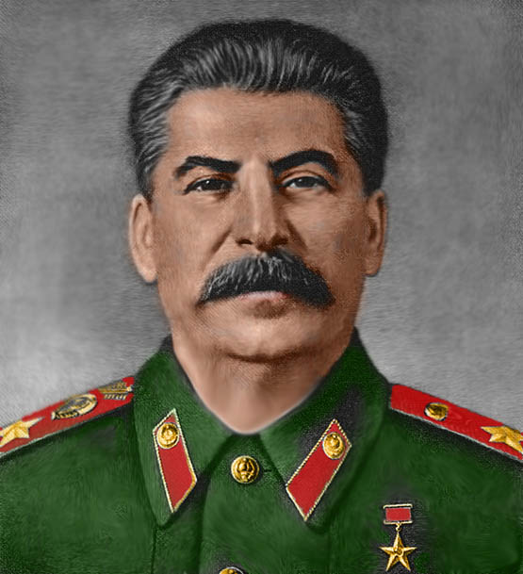
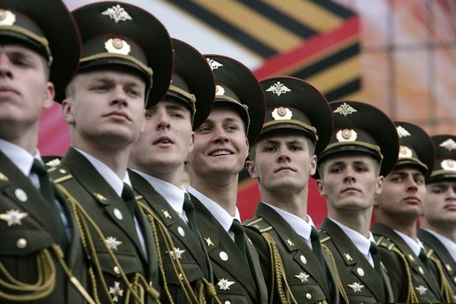
Notes:
Truman, the old county judge. Had said in ’41 if Germans are winning, help the Russians, and vice versa. Thought he could do business with Joe Stalin, like Tom Pedergast, local party boss, Kansas City. “From Stettin on the Baltic to Trieste on the Adriatic.” Soviets consider the Churchill Speech in March 5, 1946 the beginning of cold war. Arguments over who started go round and round. Truman erupts over Polish “elections”

Slide 5
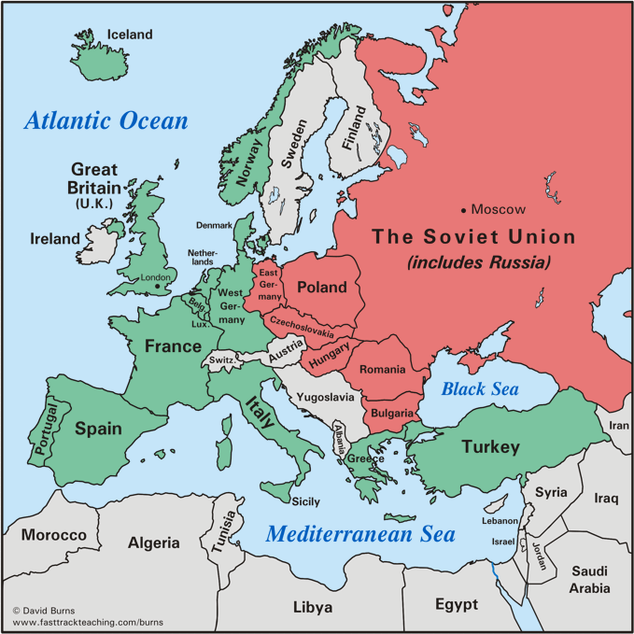
Postwar Europe - Split

Slide 6
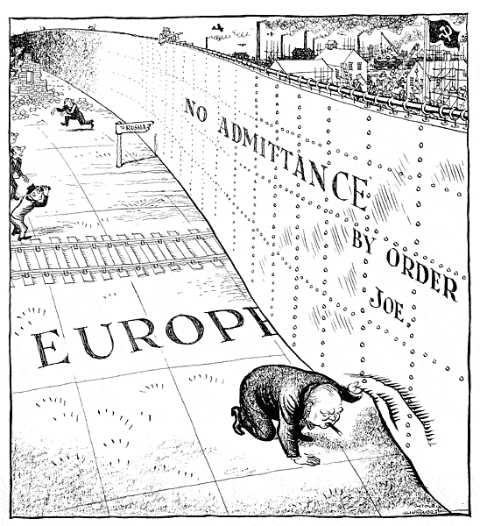
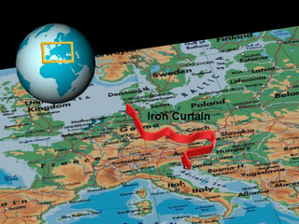
“Iron Curtain”

Slide 7
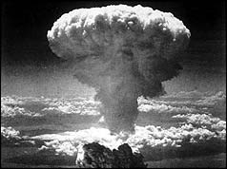

Slide 8
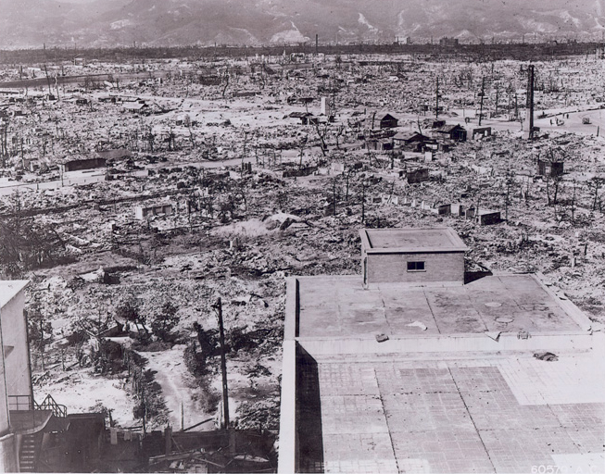
Hiroshima, August 7, 1945

Slide 9
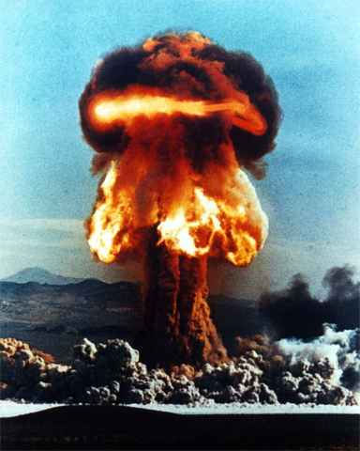
The Russian Bomb, ‘49

Slide 10

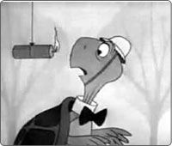
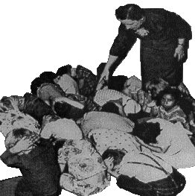
CD = Civil Defense
Bert the Turtle Says
“Duck and Cover”

Slide 11
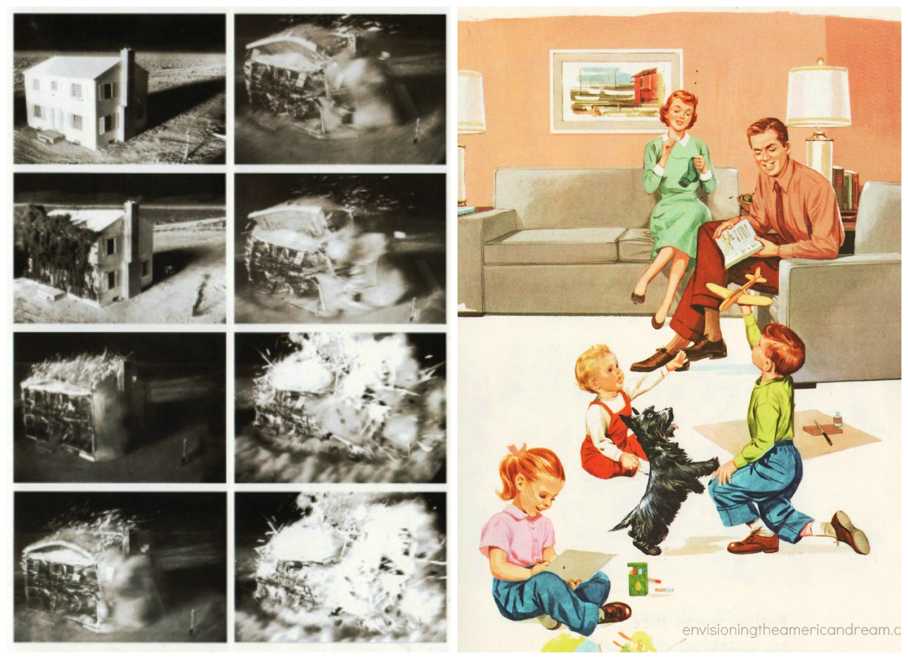
CD = Cognitive Dissonance

Slide 12
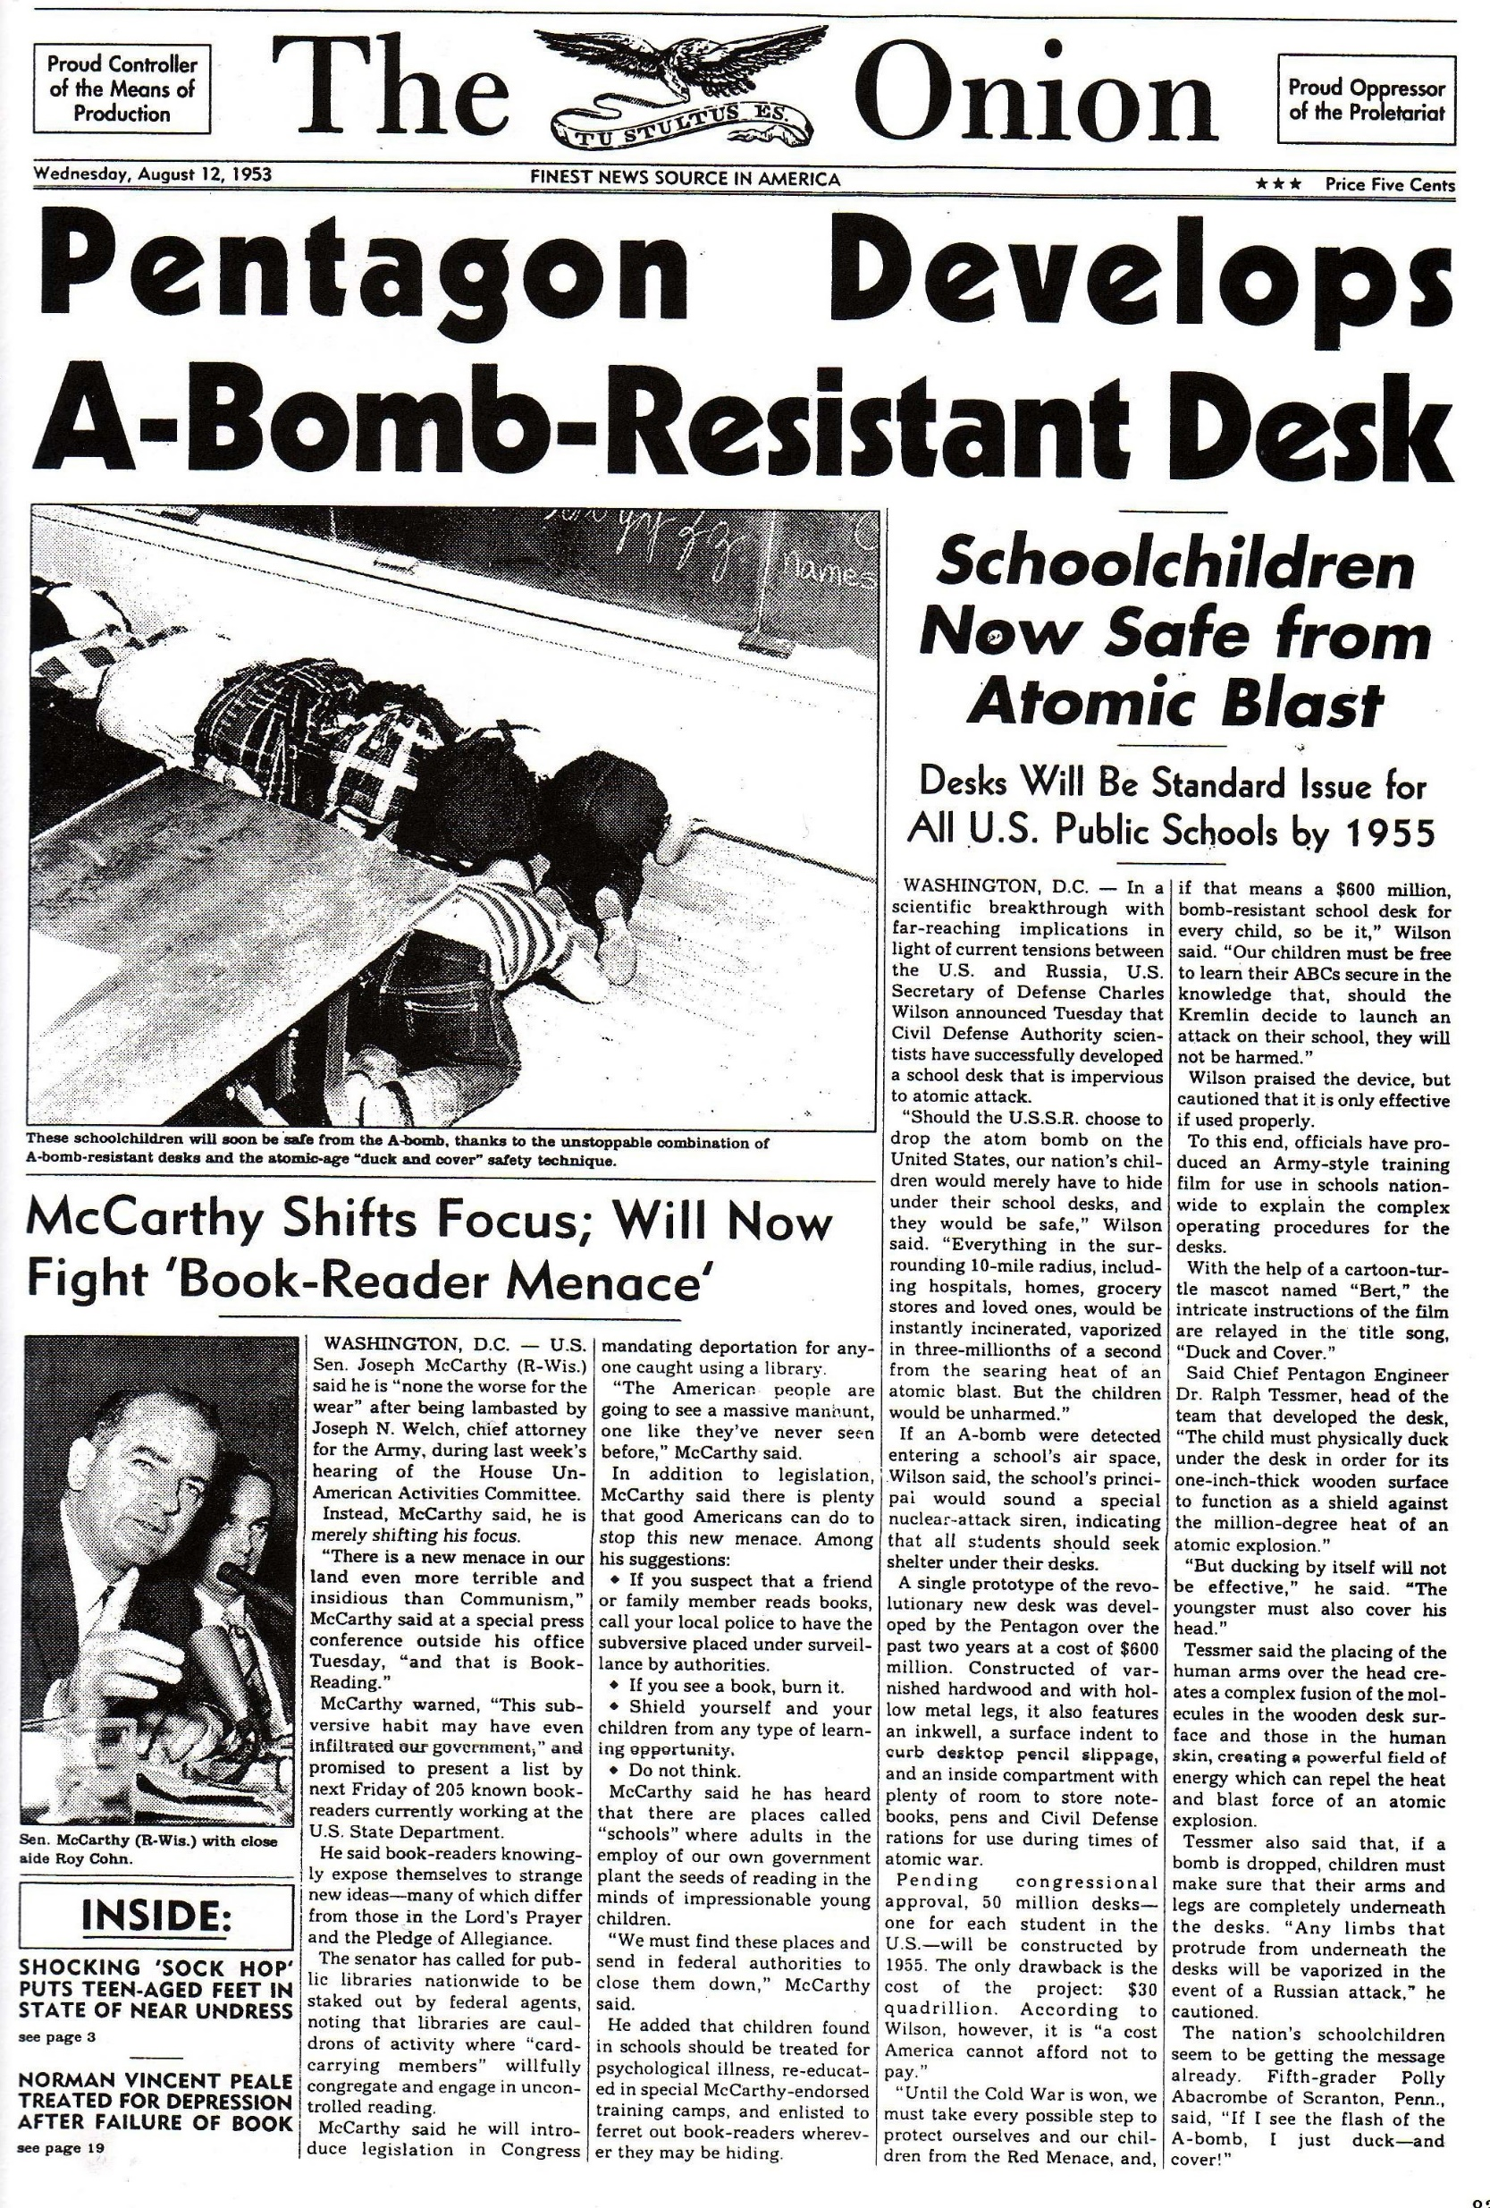

Slide 13
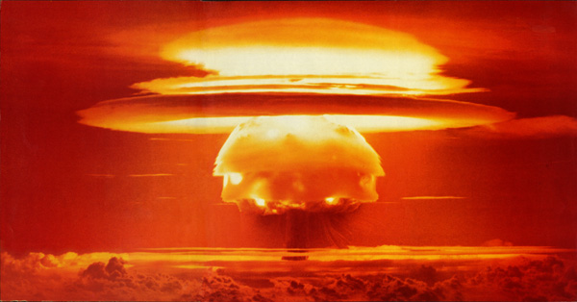
Our H-Bomb, ‘52

Slide 14
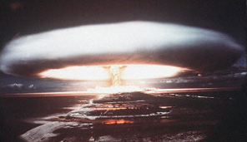
Their H-bomb, ‘53

Slide 15
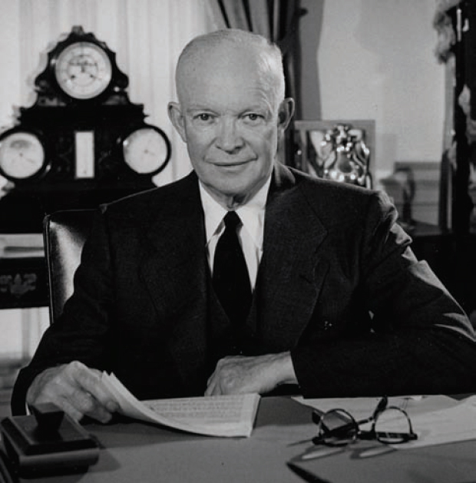

“New Look”
Mutual Assured Destruction
Dwight Eisenhower
“Ike”
B-52

Slide 16

This is Only A Test… https://www.youtube.com/watch?v=jzuTEPN8OlE

Slide 17

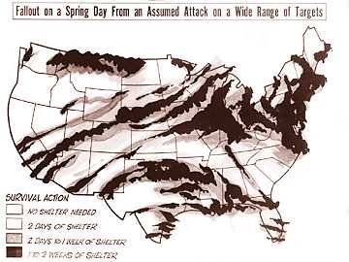
Fallout

Slide 18
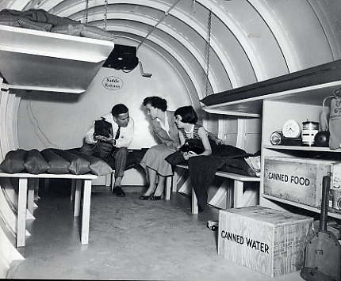


Slide 19
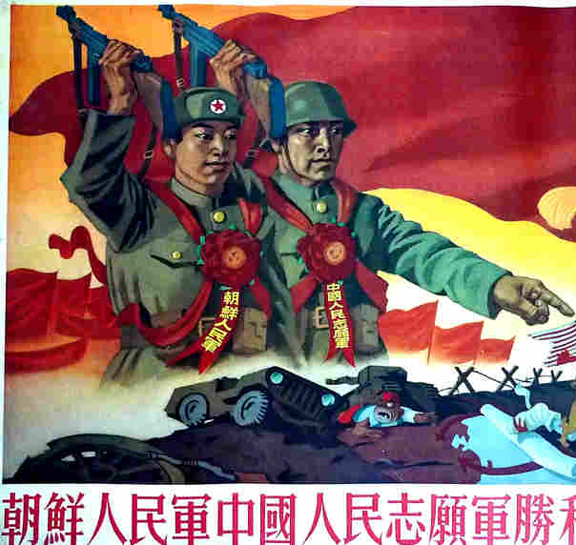
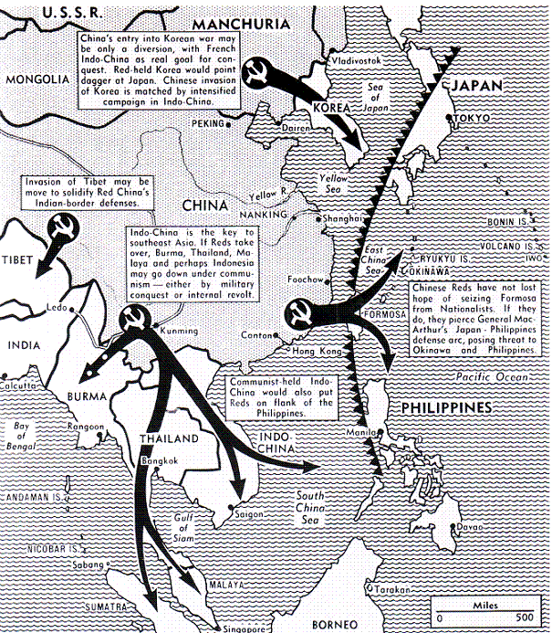
Communism SPREADING!

Slide 20
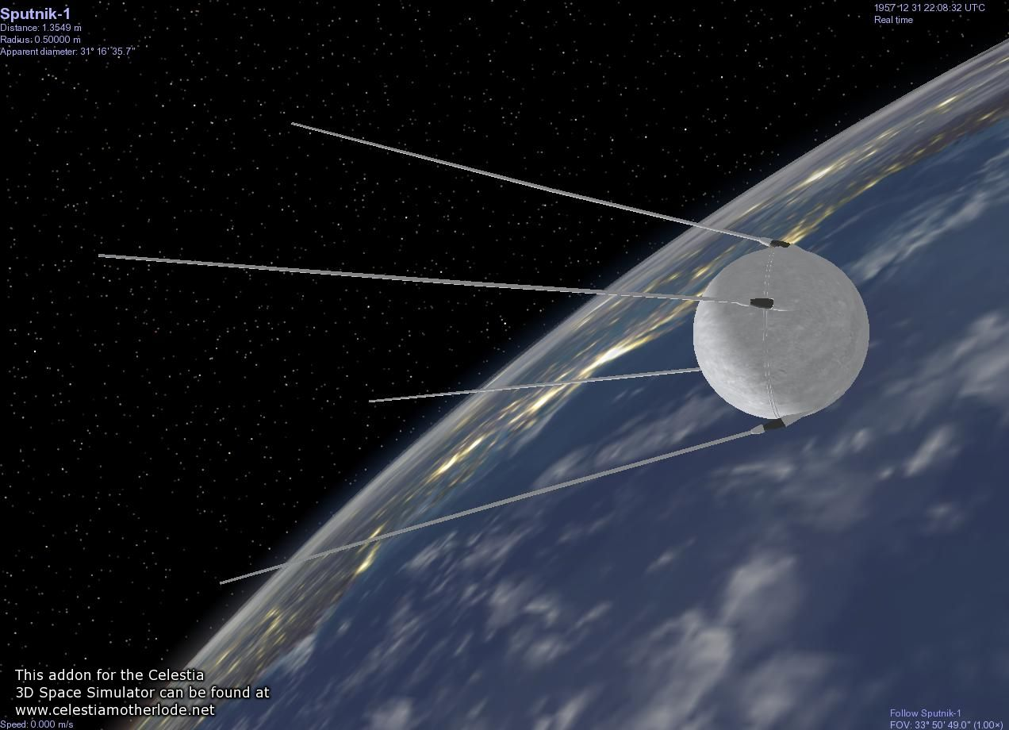
October 4, 1957 - Sputnik

Slide 21



No Need to Worry

Slide 22


There Wouldn’t Be Such Anxiety if it wasn’t for those Godless Communists!

Slide 23

ANTI-COMMUNISM

Slide 24

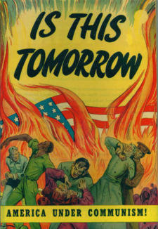
“Projecting”
Anti-Communism at Home

Slide 25
Anticommunism in American Politics and Culture
“Taking the Fifth”

Slide 26
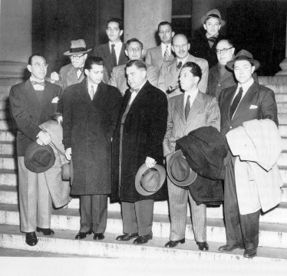
The “Hollywood Ten”
House Un-American Activities Committee (HUAC) asks…
“Are you Now or Have You Ever Been a Communist?”

Slide 27
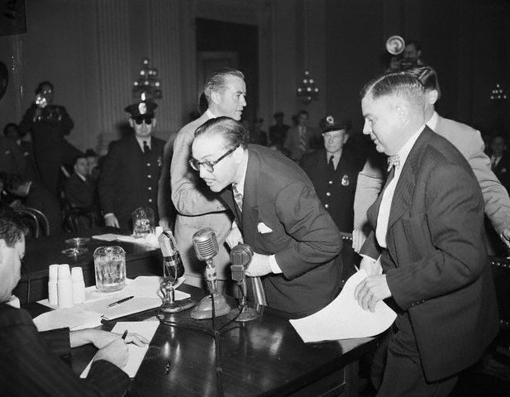
The Blacklist -- Why?
Dalton Trumbo – Blacklisted 13 years

Slide 28
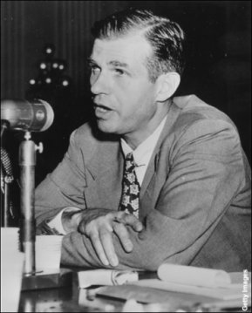
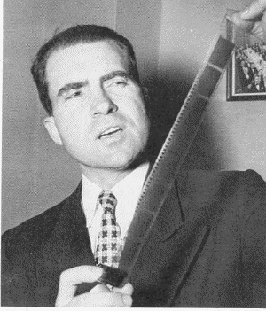
Who was Alger Hiss?

Slide 29
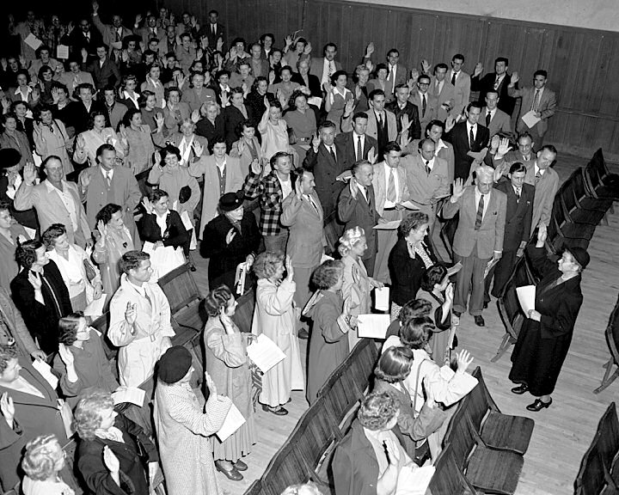
Who You Can Trust?
Loyalty Oaths, 1950

Slide 30
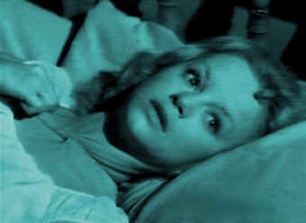
The Reds Could Be Hiding Under Your Bed!

Slide 31
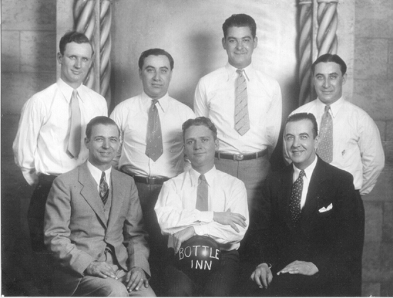
You Could Bowl with One on Tuesdays

Slide 32
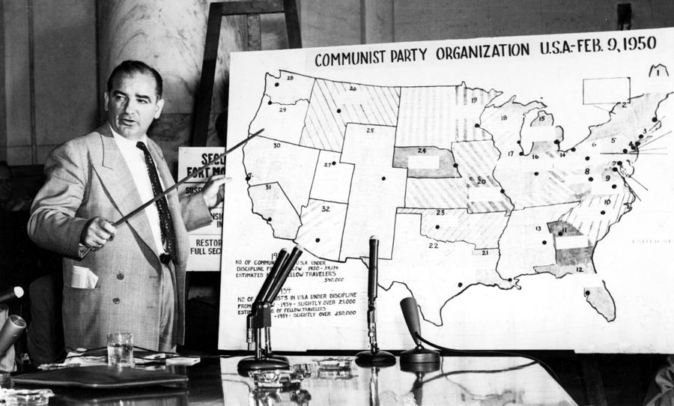
Red Scare or Red Menace?
What is McCarthyism?

Slide 33
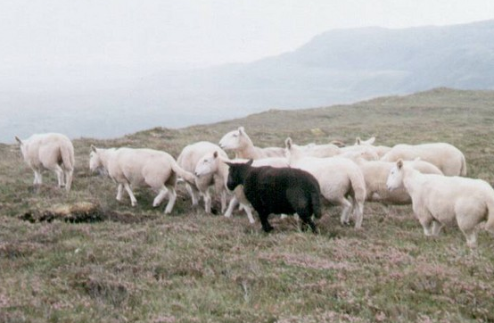
Conformist Society:
Don’t Stand Out in A Crowd

Slide 34
“Cultural Containment”
Clear Lines Drawn and Policed
Ambiguity and Complexity
Become Suspect

Slide 35
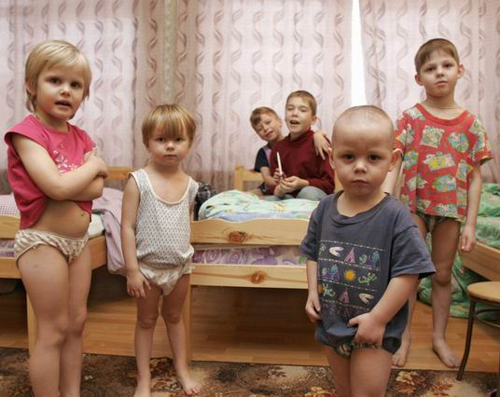

Whatever Communists Like,
We Don’t Like
All-Powerful State vs. “Nuclear” Family

Slide 36
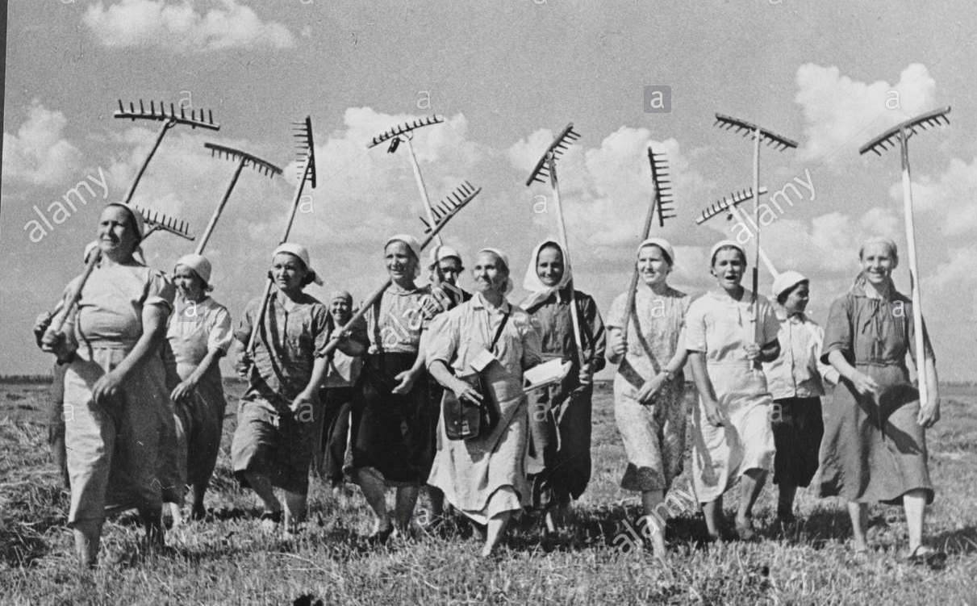
Soviet Collective Farms

Slide 37
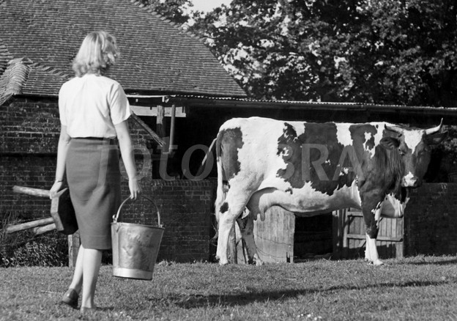
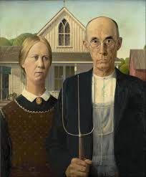
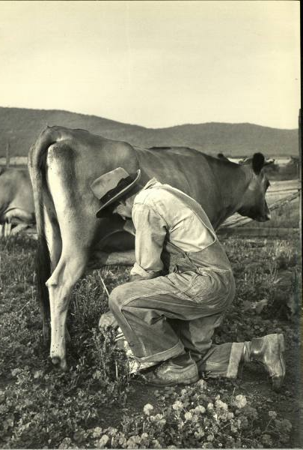

American Family Farms

Slide 38
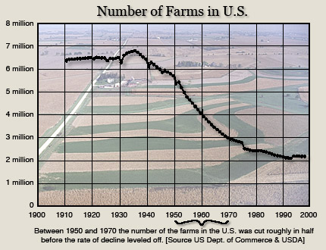

Slide 39

Soviet “Big Boxes”

Slide 40

American“Little Boxes”

Slide 41
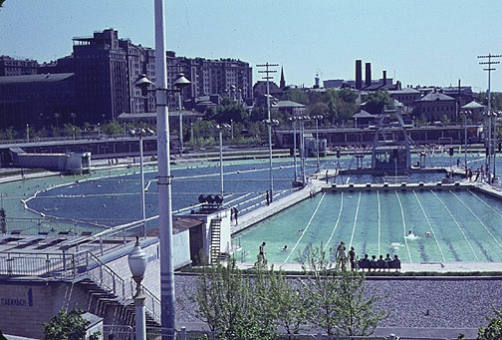
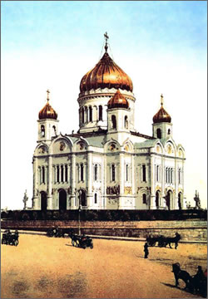
Soviet Athiesm

Slide 42

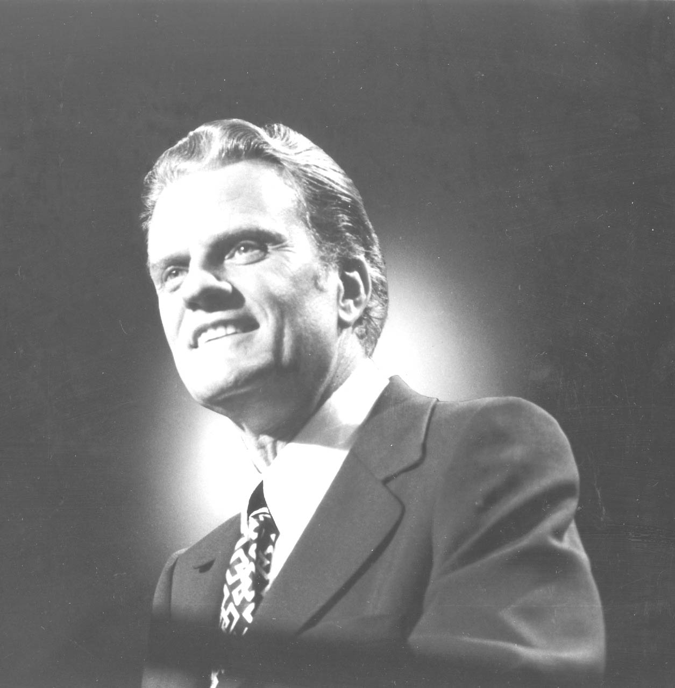
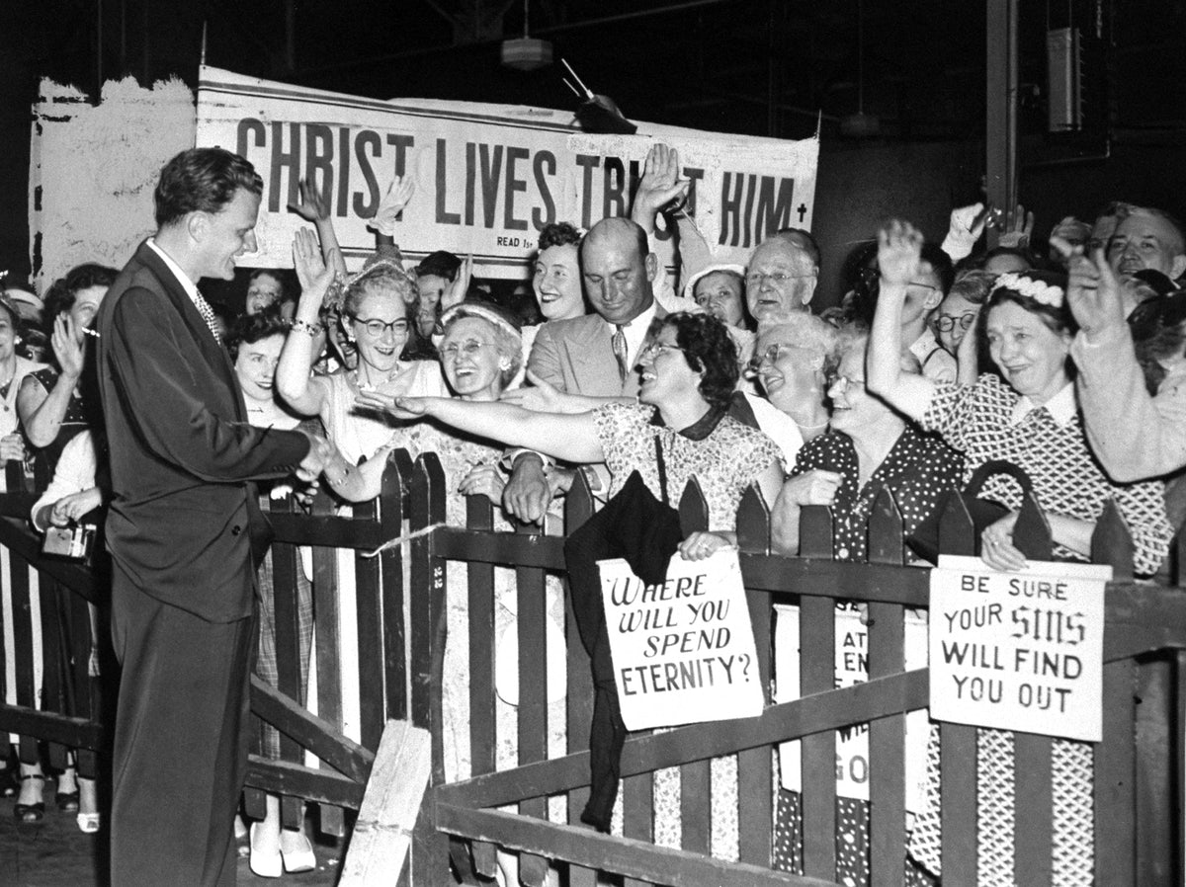
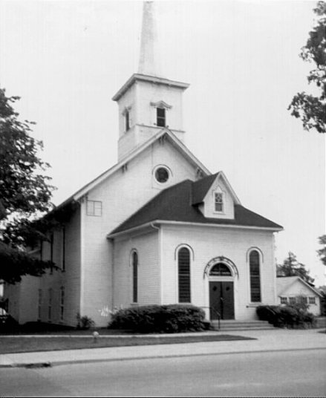
American Religious Fervor

Slide 43


“Under God…”

Slide 44


Slide 45
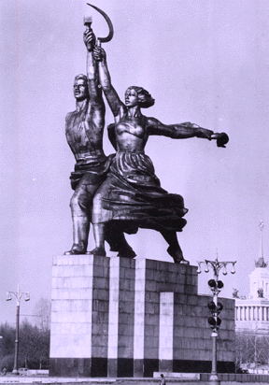

A Woman’s Place…

Slide 46



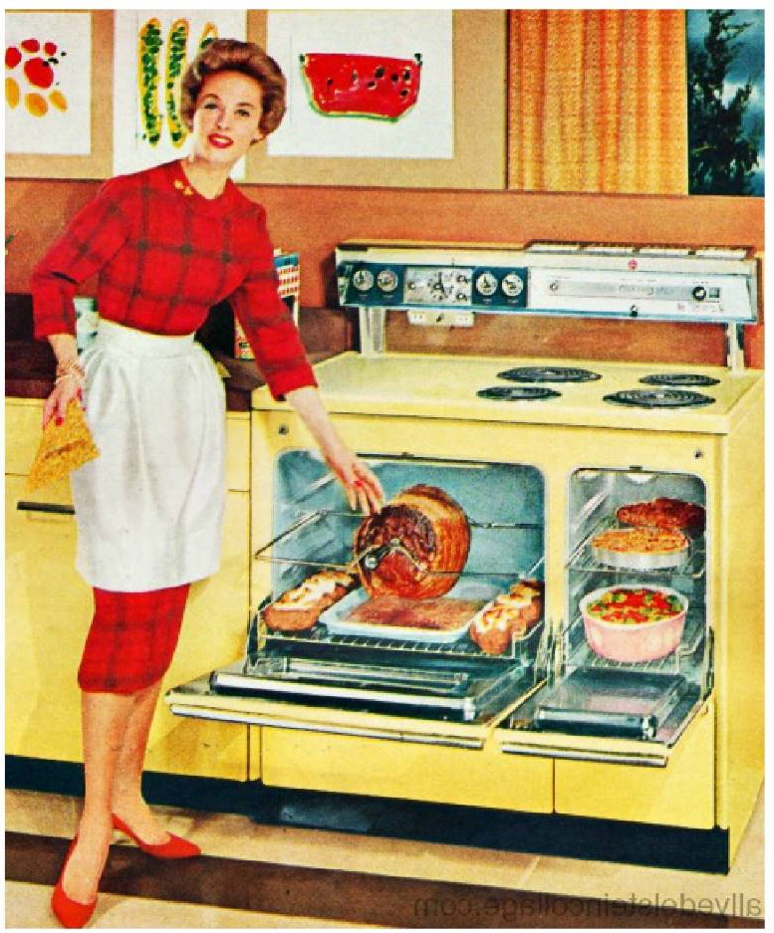
Rigid Gender Roles

Slide 47
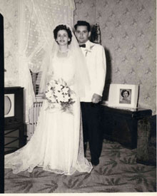
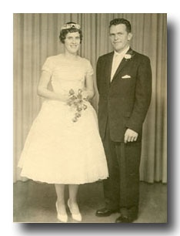

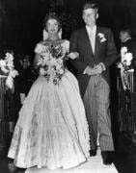
Domestic Containment: Everyone is Getting Married

Slide 48

Even in the Comics

Slide 49
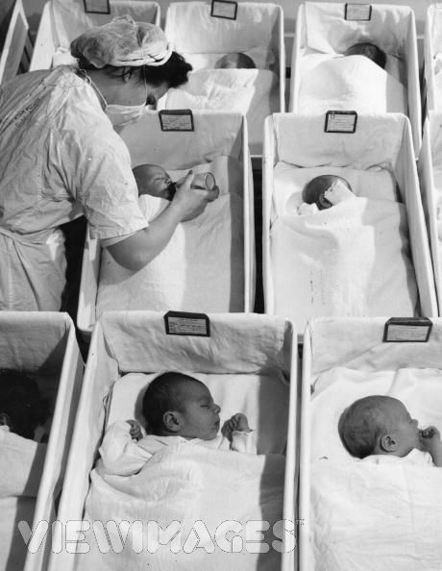
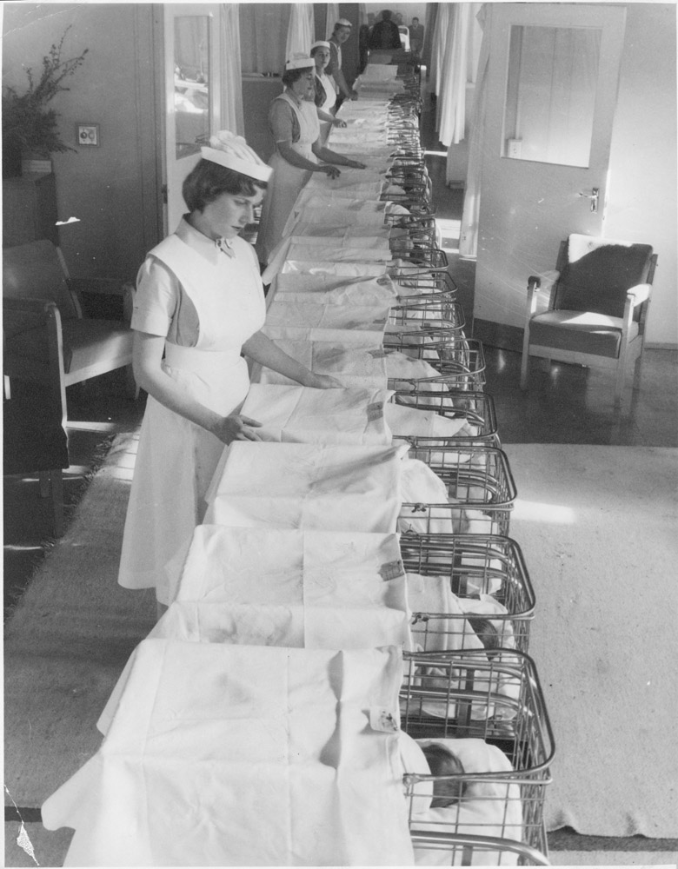
Postwar Baby Boom
“The Family is the key to beating the Soviets!”

Slide 50
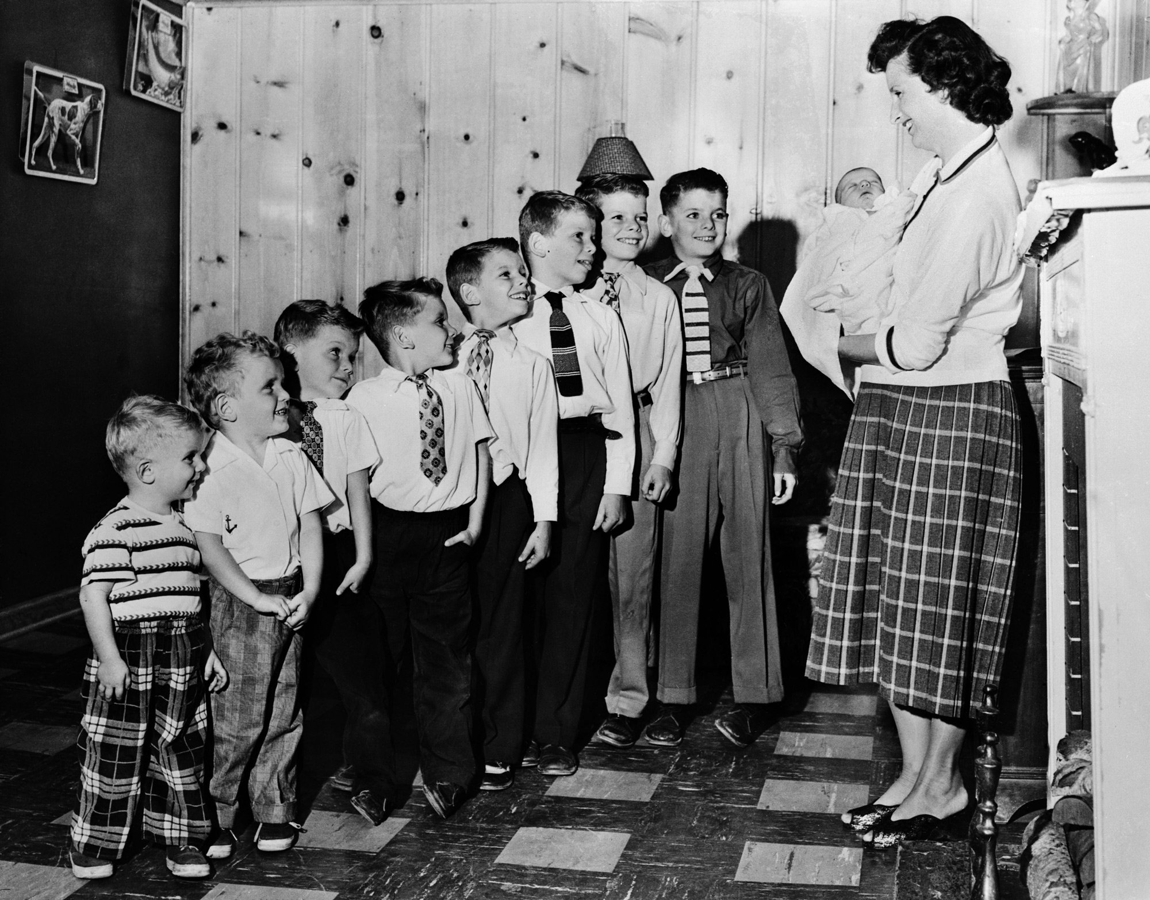

Slide 51


Our Television Families
“The Family is the key to beating the Soviets!”

Slide 52



Slide 53


Slide 54

“No one would believe it…”

Slide 55




Heroes or Villians…
“It’s Us or Them”

Slide 56



Return of the “Full-Figured Girl”

Slide 57


And the 100% Red-Blooded American Man
Rock Hudson

Slide 58
Family, Religion, Gender Roles
Separate Us from the Communists
But, being Anti-Communist is not enough…

Slide 59

Biggest Difference: We’re Wealthier!
Highest Standard of Living in History

Slide 60

AFFLUENCE

Slide 61
Why U.S. Economic Dominance After World War II?
Government Laws/Policies
Postwar Economic Growth
New Business Models and
Technologies
Notes:
July, ’44. In 1945, the U.S. produced half the world's coal, two-thirds of the oil, and more than half of the electricity. The U.S. was able to produce great quantities of machinery, including ships, airplanes, vehicles, armaments, machine tools, and chemicals. Reinforcing the initial advantage—and assuring the U.S. unmistakable leadership in the capitalist world—the U.S. held 80% of gold reserves and had not only a powerful army but also the atomic bomb. Other currencies fixed to dollar, dollar fixed at $35 per ounce. IMF policed exchange rates, needed approval to change. World Bank to make loans to help countries recover.

Slide 62

G.I. Bill
Maybe the Most Important Law passed in the U.S. in the 20th Century?

Slide 63


Marshall Plan, 1947
$13 Billion in aid to Western Europe
Notes:
Offered aid to Communist countries too…of course Stalin says no. There is a reason why East Europe never fully recovers under Soviets

Slide 64


Business and Labor Harmony
Big Business Booms
  Wartime contributions restores its reputation
Big Labor Prospers
  Good Union Contracts
  Factory Workers Buy Homes
  60% Americans Are Home Owners
Notes:
Big Business Booms – enjoys high reputation and image from wartime contribution

Slide 65


Suburban Housing Boom
$10,000 homes – FHA and VA Loans

Slide 66

Levittown

Slide 67


Interstate Highway System
Notes:
IKE started in 1956. Remembers traveling across country on Lincoln highway in 1919. Lobbied hard by automakers. Justification was Civil Defense and Military Movement. No question helped movement of goods cross the country.

Slide 68



Consumption Skyrockets!
It’s Patriotic!

Slide 69


Retailing
Southdale: Minneapolis, 1956
Notes:
“The parks are empty, the malls are full” Consumerism wins!

Slide 70



Slide 71

Credit Cards
Diners’ Club for the Jet Set
Sears cards for the rest of us
Notes:
Sears bets on abundance after war…MW bets on contraction. Guess who wins.

Slide 72



The Future Will be Fantastic!*
*If we don’t blow each other up

Slide 73


New Business Models to Serve the Leisure Market

Slide 74




New Industries

Slide 75

The Organization Men
Irony: What about Individualism?
Notes:
Big Business Booms – enjoys high reputation and image from wartime contribution

Slide 76
Fifties prosperity is delivering the highest standard of living in the world…
Who Could be Unhappy?

Slide 77

ALIENATION

Slide 78


Alienation due to Exclusion

Slide 79

Most African Americans Live Second Class Lives
De Jure or De Facto, It Still Spells Segregation

Slide 80



Slide 81


Sgt. Isaac Woodard

Slide 82


Suburban American Dream?

Slide 83




Slide 84

The Warren Court
Brown v Board of Education, 1954

Slide 85


School Integration
Little Rock, 1957

Slide 86


Public Accommodations and Jobs
Economic Justice No Less Important than Integration
Grass-roots activists persist in a prolonged struggle
Notes:
Importance of having ministers lead the movement…to counter complaints of Communism…student sit ins in Greensboro….

Slide 87

The Alienation from Affluence:
Chaos, Spontaneity, Noncomformity

Slide 88


Abstract Expressionism
Jackson Pollock

Slide 89


Literature
The BEATS
Burroughs, Ginsburg, Kerouac

Slide 90



Extreme Comics

Slide 91


Sex
Which View Represented the ‘50s?
Playboy
1953

Slide 92


Youth culture and rebellion
Anti-Materialism
Anti-Conformity
Marlon Brando
James Dean
Notes:
Sultry youth…looking for something besides the mainstream values…reaction against consensus, bland, bottled up and tranquilized 50’s.

Slide 93

Rock – Rebellion or Racket?
First Teen Market
New “technology”
  45s and Transistor Radios
Elvis Presley changes
everything
Notes:
Elvis rebels against norms about race, sex, class, and the protestant work ethic

Slide 94


The “threat” of Elvis Presley
Race
Sex
Protestant Work Ethic

Slide 95
A 5th “A”??

Slide 96

Anticipation

Slide 97
The Fifties – The Four A’s
ANXIETY, ANTI-COMMUNISM, AFFLUENCE, ALIENATION

