Slide 1
The War to Save the Union? or The War to End Slavery?

Slide 2
“The Union As It Was, The Constitution As It Is, and The Negroes Where They Are” --Democratic Party Slogan, 1861

Slide 3
The Emancipation Proclamation What did it do? Why did Lincoln issue it?

Slide 4
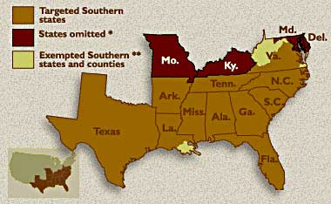

Slide 5
Reconstructing the Nation How would the seceded states return to the union?
--Who gets to decide?
--How harsh/lenient will the process be?
--What is the purpose of Reconstruction?

Slide 6
President vs Congress Lincoln – 10% plan Congress – Wade-Davis Bill

Slide 7
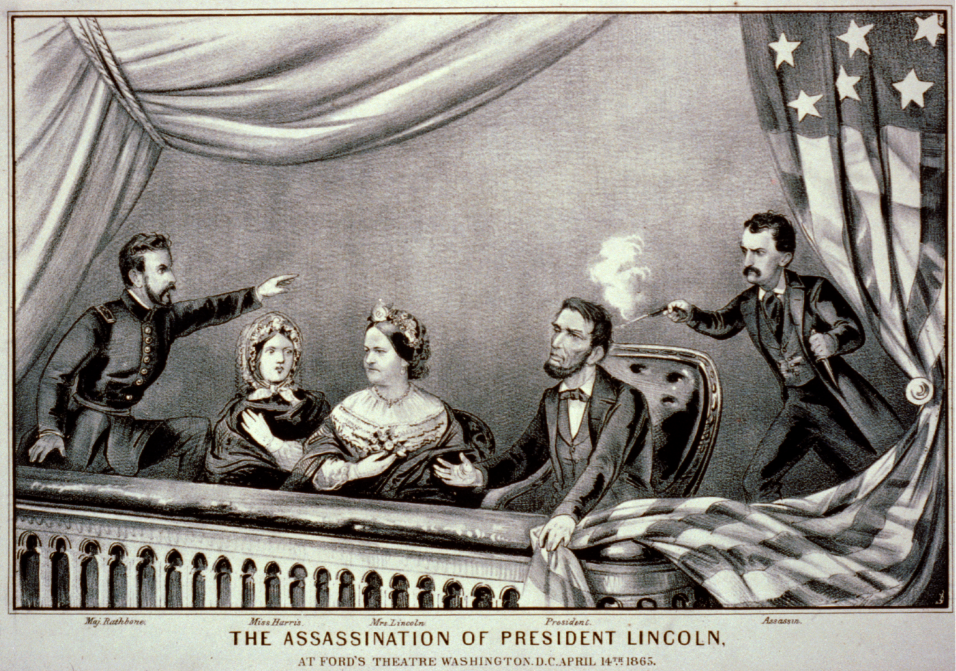

Slide 8
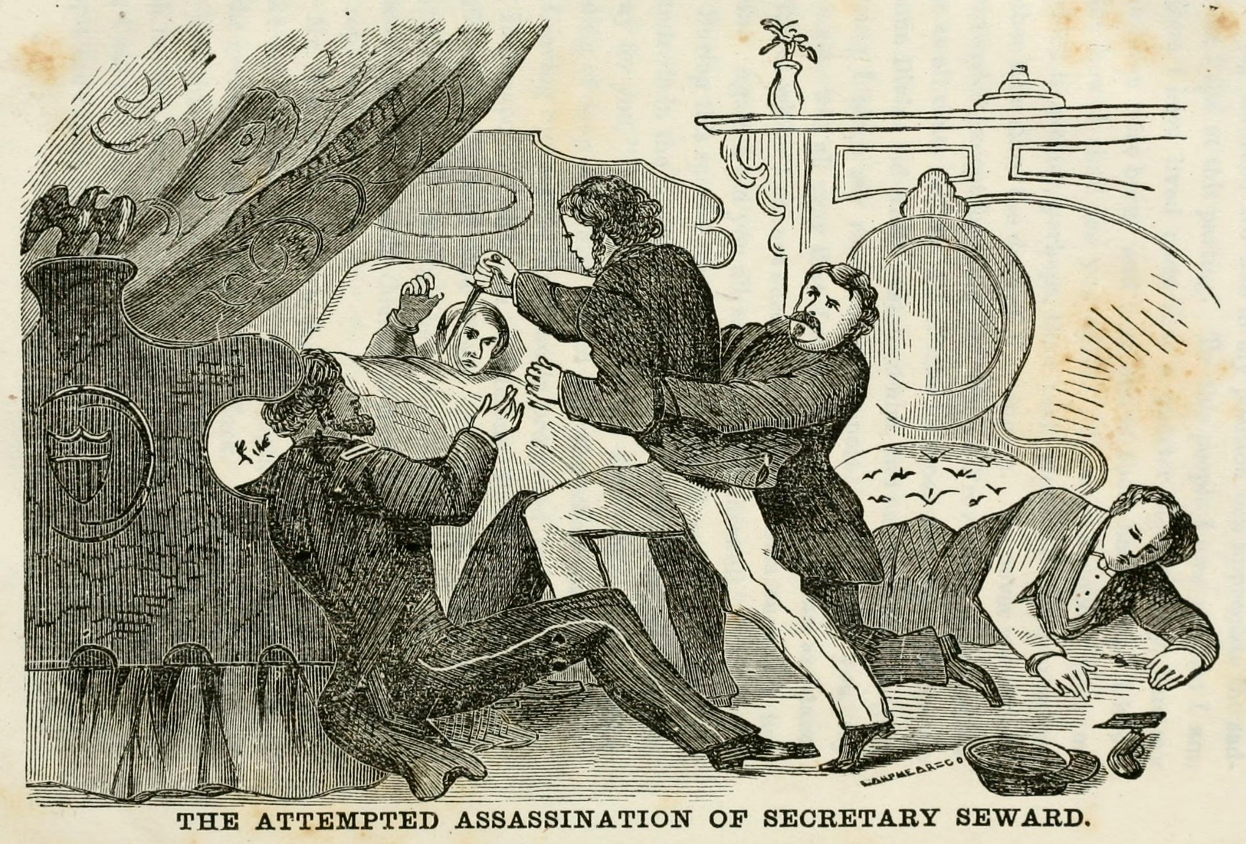

Slide 9
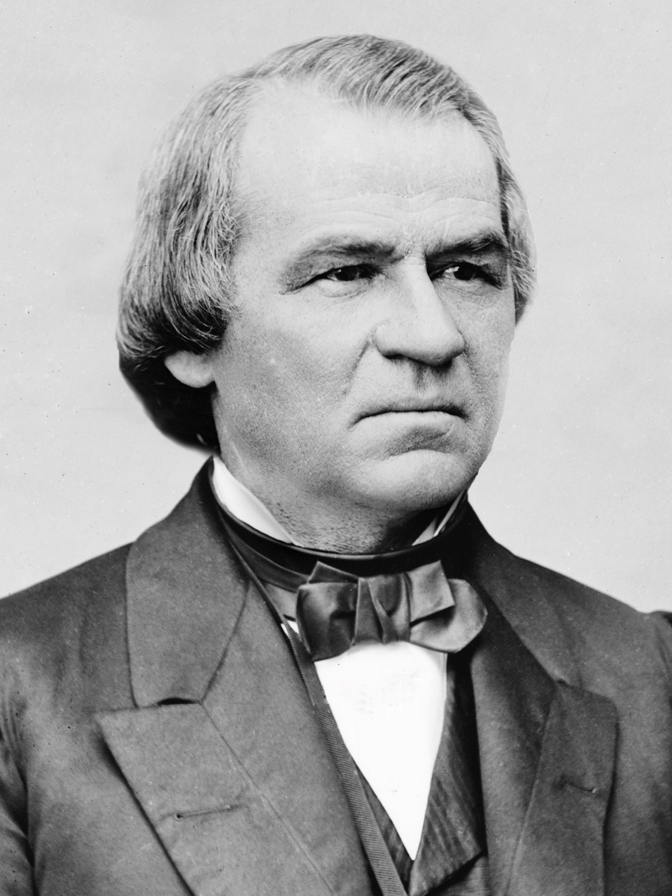

Slide 10
“Treason must be made odious, and traitors must be impoverished.”
-- Andrew Johnson

Slide 11
“Reconstruction” or “Restoration”?

Slide 12
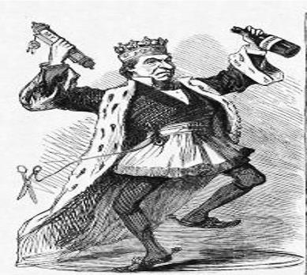
Johnson and “Restoration” -- “black codes” -- rampant violence -- planters in control

Slide 13
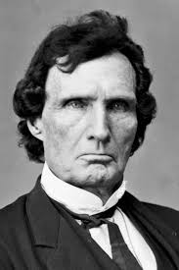
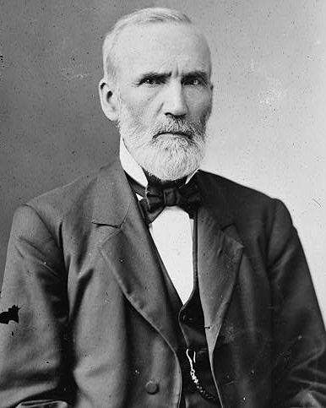
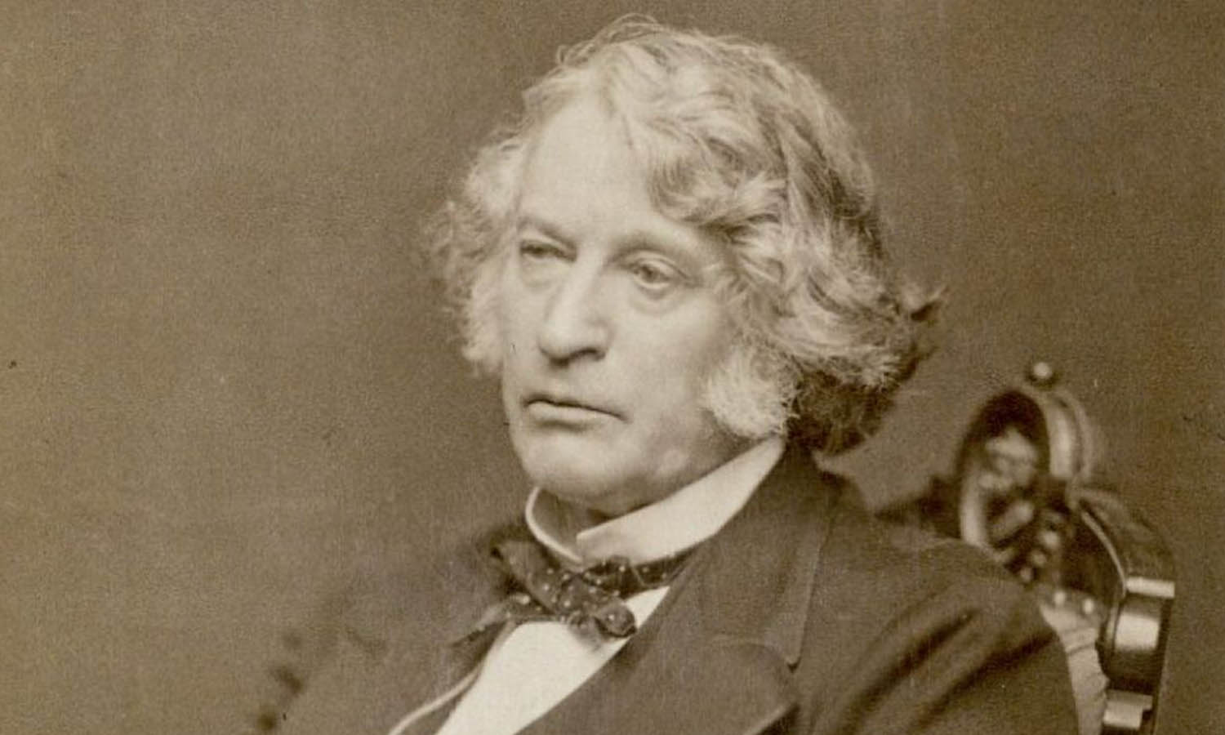
The Radicals and “Reconstruction”
(L to R: Thaddeus Stevens, Charles Sumner, George Julian)

Slide 14
Why is “Radical Reconstruction” radical?

Slide 15
“The whole fabric of southern society must be changed, and never can it be done if this opportunity is lost.”
--Thaddeus Stevens

Slide 16
How to define “freedom”? How to enforce “freedom”?

Slide 17
Radical Reconstruction in Practice 14th Amendment Reconstruction Act of 1867

Slide 18
What is the reaction to “Radical Reconstruction”? -- Johnson? -- Congress?

Slide 19
Moderates and Pragmatists: Were Radicals’ policies enforceable? Were Radicals’ policies constitutional?

Slide 20
Were Radicals’ policies Popular?

Slide 21
Legacy of Reconstruction?

