Slide 1
Industrialization in the Late Nineteenth Century

Slide 2
Some basic questions:
#1
What caused it (or at least helped it along)?

Slide 3
The Railroads as a Catalyst
How do the railroads fuel economic expansion?

Slide 4
#2
HOW did the process of modern industrialization occur?

Slide 5
The Four “C”s

Slide 6
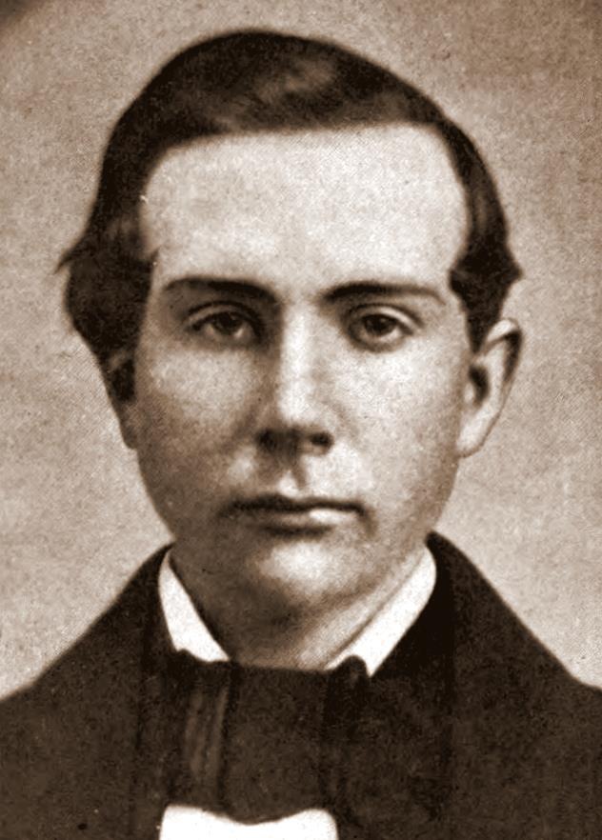
John D. Rockefeller

Slide 7
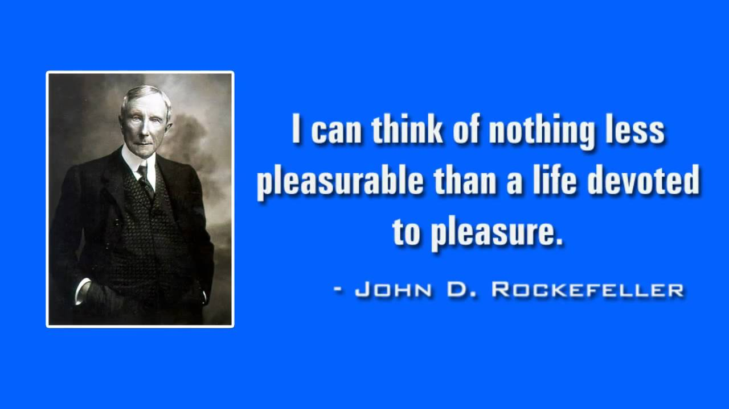

Slide 8
The Four “C”s
- Competition

Slide 9
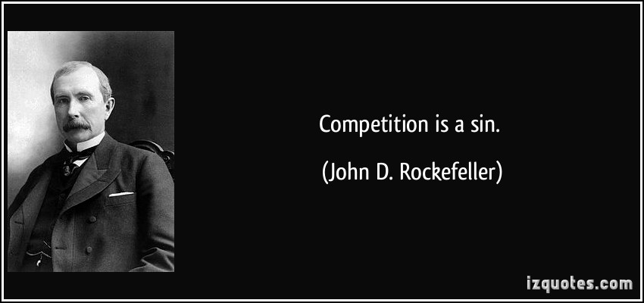

Slide 10
The Four “C”s
Competition
Cooperation

Slide 11
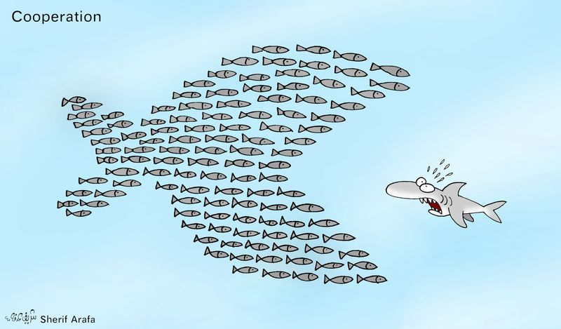

Slide 12
The Four “C”s
Competition
Cooperation
Consolidation
(Horizontal Integration)

Slide 13
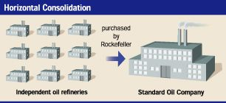

Slide 14
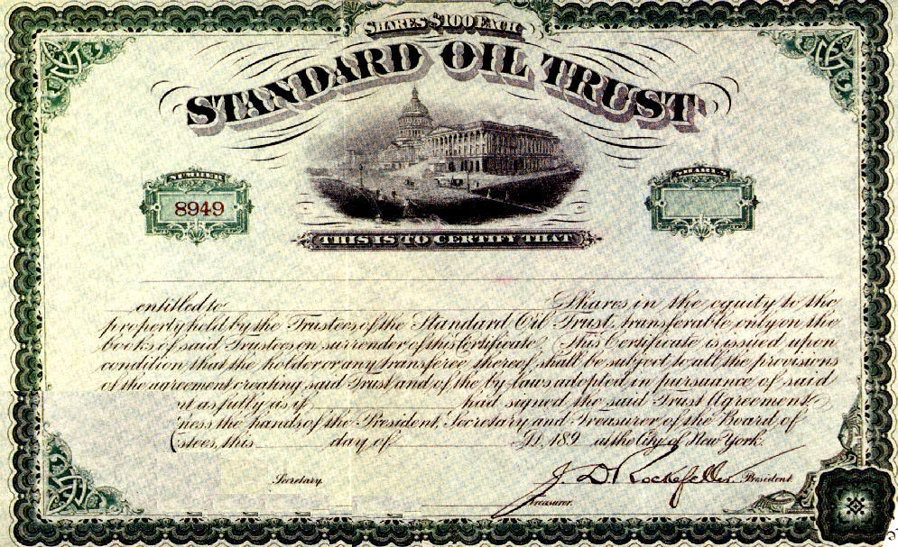

Slide 15
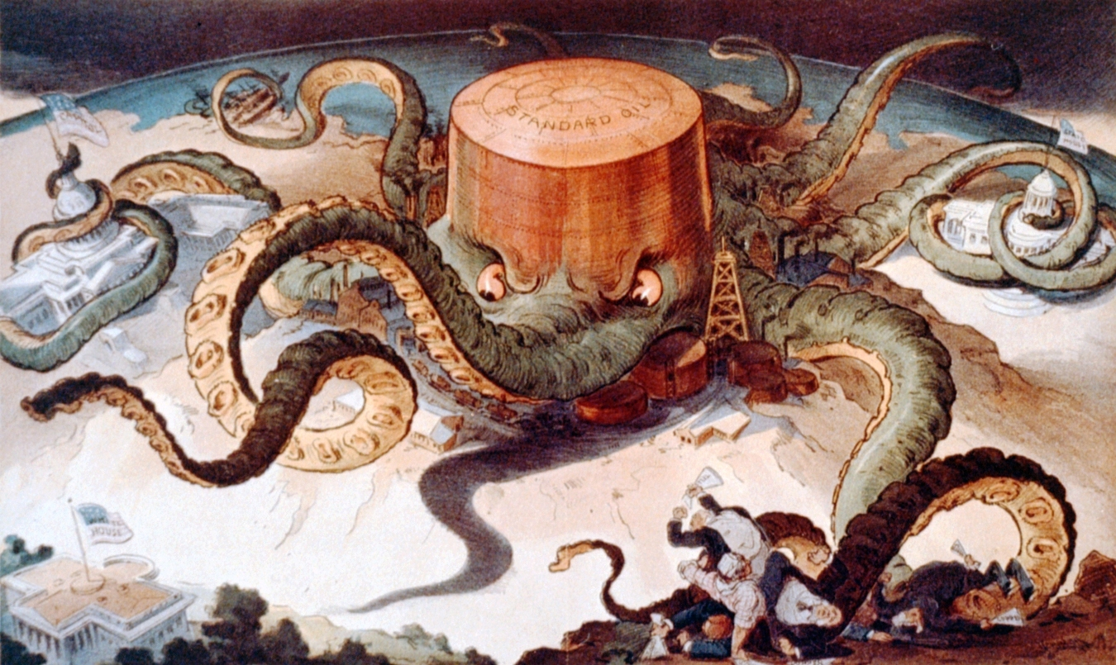
“Let us Prey”

Slide 16
The Four “C”s
Competition
Cooperation
Consolidation
(Horizontal Integration)
Centralization
(Vertical Integration)

Slide 17
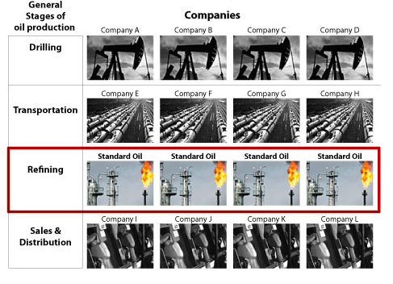

Slide 18
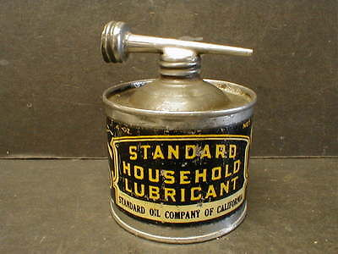

Slide 19
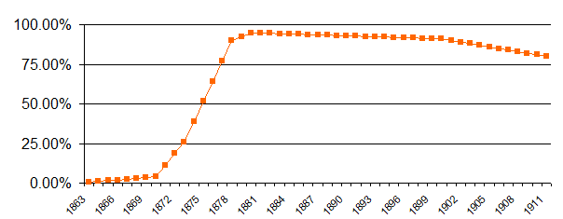
Rockefeller’s Market Share 1863-1911

Slide 20
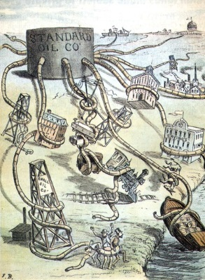

Slide 21
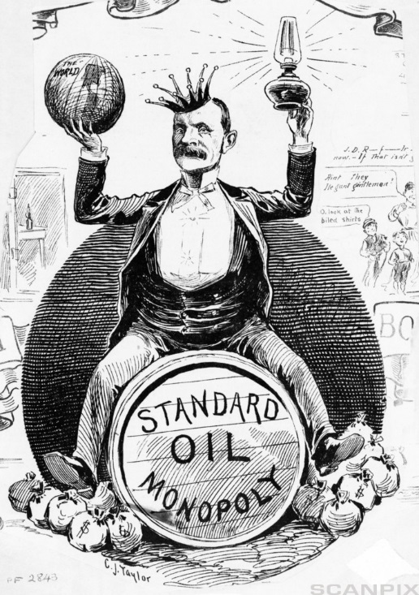

Slide 22
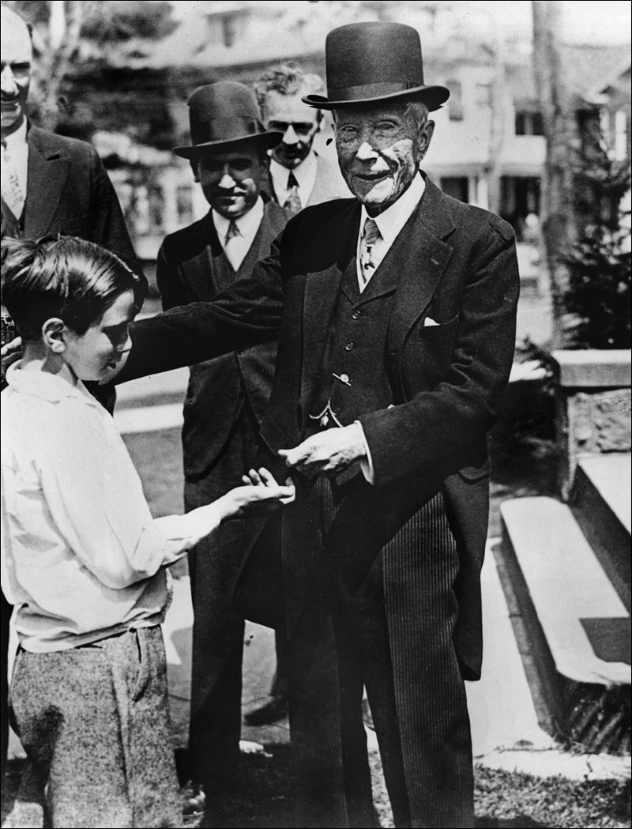

Slide 23
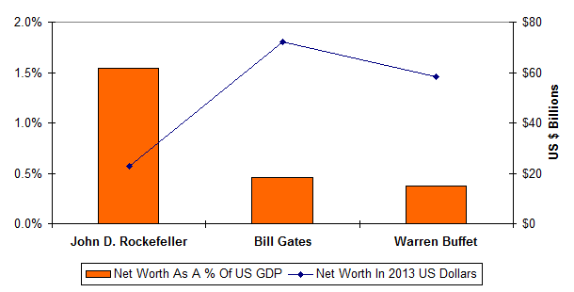

Slide 24
#3
How did the new economy affect people?

Slide 25
