Slide 1
History 271
Spring 2020
Dr. Devine

Slide 2
There is NO Canvas page for this class.

Slide 3
Course Web Page http://www.csun.edu/~twd61312/271%20Spring%202020/271sylsp2020tuth.htm

Slide 4
Buying your books
-- DON’T overpay at the Matador Bookstore
-- Buy on line at www.bookfinder.com
-- Join Amazon Student

Slide 5
ANY edition of the books is fine.
(That means buy the cheapest one available.)
You can search by the ISBN numbers given on the syllabus.

Slide 6
Course Password to access reading:
271

Slide 7
Two Ground Rules…

Slide 8
Attendance
Attendance is NOT required. In fact, if you are the kind of person who just sits in the back of the room (or the front of the room) and plays with your phone and talks to your friends, I STRONGLY ENCOURAGE YOU NOT TO ATTEND CLASS. There is absolutely no reason for you to be here wasting your time, my time, and your classmates’ time. It is perfectly acceptable to appear only for the quizzes and exams.

Slide 9
No Laptops or Tablets
I do not allow you to use a laptop or a tablet in my classroom unless you have a medical note stating that you must have one.
If you cannot stay off your computer or your phone for 75 minutes, you have the option not to attend class – and you should exercise it.

Slide 10
The Civil War –
Who fought?
Who won?
What changed?
What stayed the same?
Why does it matter?

Slide 11
What did white, southern plantation owners lose?

Slide 12
Why were southern planters in such bad financial shape after the Civil War?

Slide 13
What did the freedmen win?

Slide 14
What did the freedmen lose?

Slide 15
Why could “freedom” be both a blessing and a curse for African Americans right after the Civil War?

Slide 16
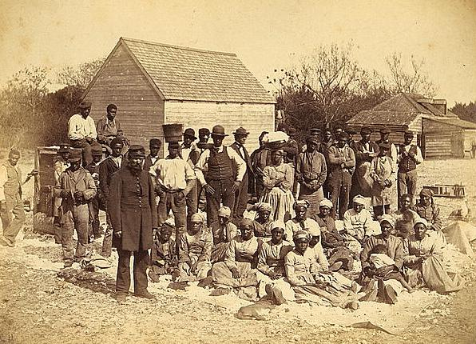
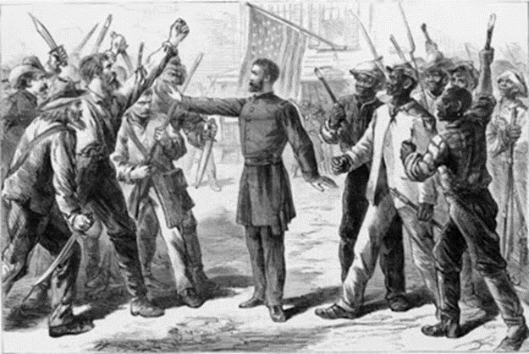
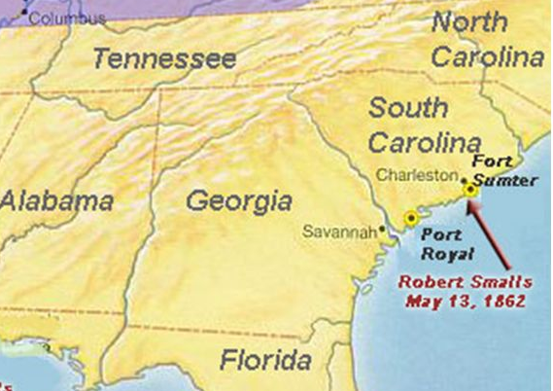
“Rehearsal for Reconstruction”
The Port Royal Experiment

Slide 17
What did non-planter white southerners lose?

Slide 18
What did northerners win?

Slide 19
How did the North’s victory in the Civil War change the United States?

Slide 20
How did the North’s victory in the Civil War change the United States?
-- politically?

Slide 21
Why does the North gain political power?
What does the North do with its political power?

Slide 22
How did the North’s victory in the Civil War change the United States?
-- politically?
-- economically?

Slide 23
Why did many (factory owners and workers) in the North support a high tariff on imports?
Why had southerners opposed raising tariffs before the Civil War?

Slide 24
How did the North’s victory in the Civil War change the United States?
-- politically
-- economically
-- psychologically

Slide 25
How did Americans think about their country differently after the war?

Slide 26
Before Reconstruction can begin, what problems must the federal government address?

