Slide 1
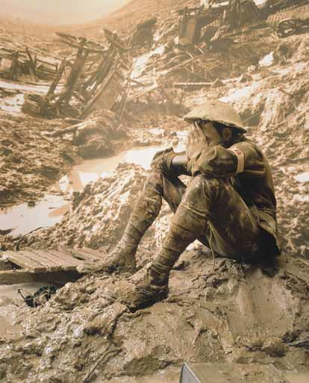
World War I – 1914 -1918

Slide 2
Four Major Questions:
Why did war break out in Europe in August 1914?
How did the United States respond to the European War?
Why did the United States support the Allies (Great Britain and France)?
What did Woodrow Wilson hope to achieve during and after the war?

Slide 3
So What?
U.S. emerges as a world power.
U.S. introduces an “American style” of foreign policy that remains with us today (for good or ill).
World War I unleashes forces that continue to cause bloody conflicts in the 21st Century.

Slide 4
Why did the war break out in Europe in August 1914?

Slide 5
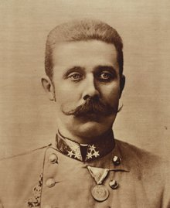
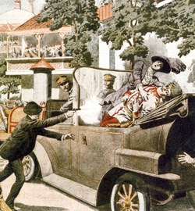
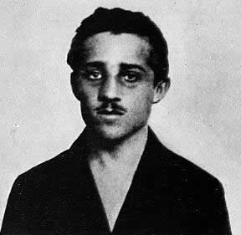

Slide 6
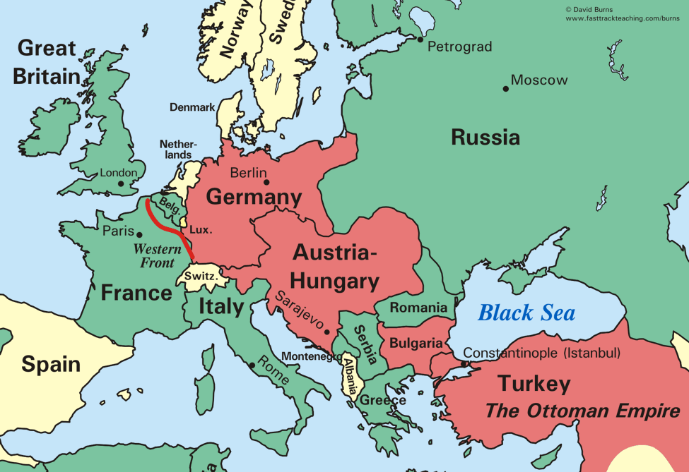

Slide 7
“The lamps are going out all over Europe, we shall not see them lit again in our life-time.”

Slide 8
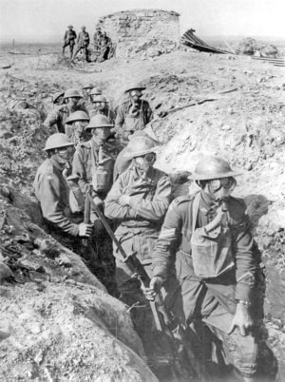

Slide 9
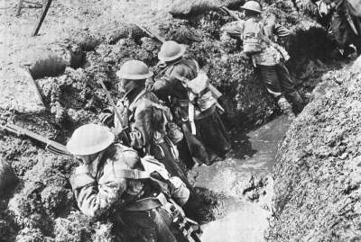

Slide 10
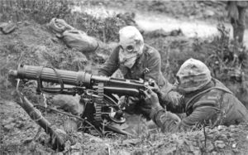

Slide 11
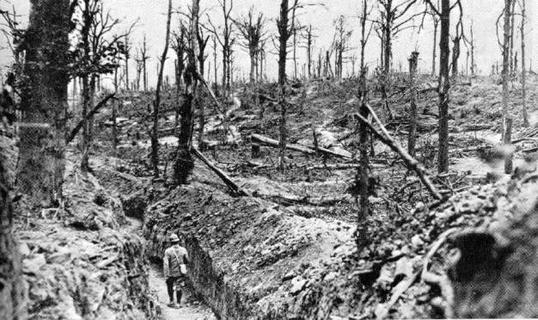

Slide 12
How did the U.S. respond to the European war?

Slide 13
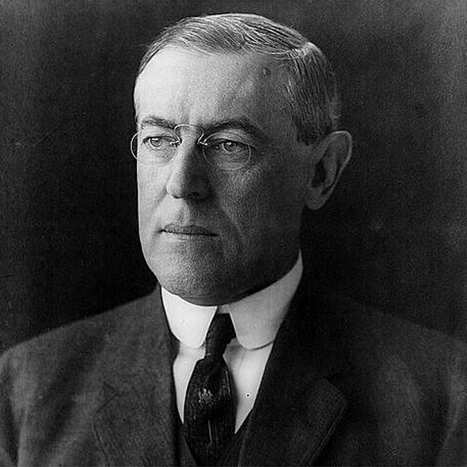

Slide 14
“Wilsonian” Foreign Policy
Progressives set out to “reform” the world.

Slide 15
“Like a troubled man angered by his own uncertainty, the country aggressively demanded international conformity to democratic goals it now believed might be slipping out of domestic reach.”
-Robert Dallek

Slide 16
“Old World” Tyranny vs
“New World” Democracy

Slide 17
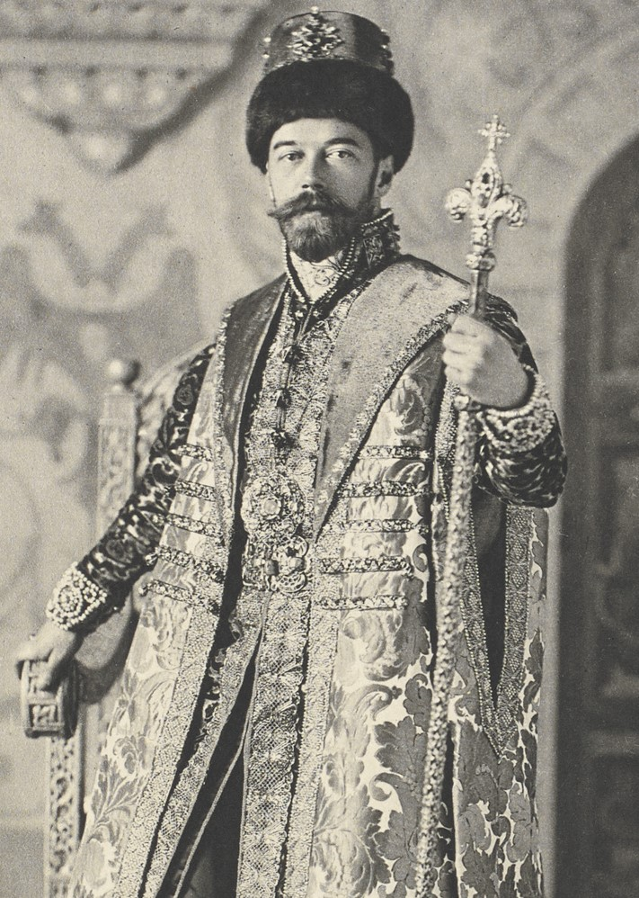
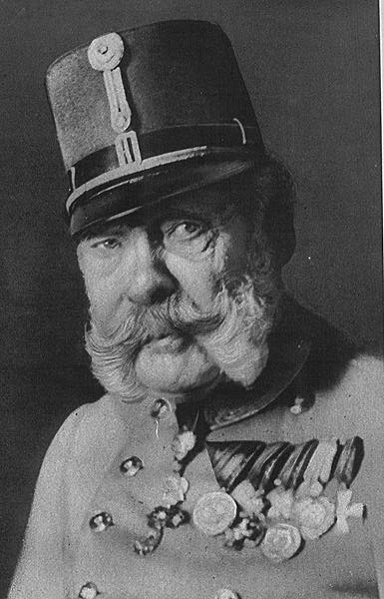
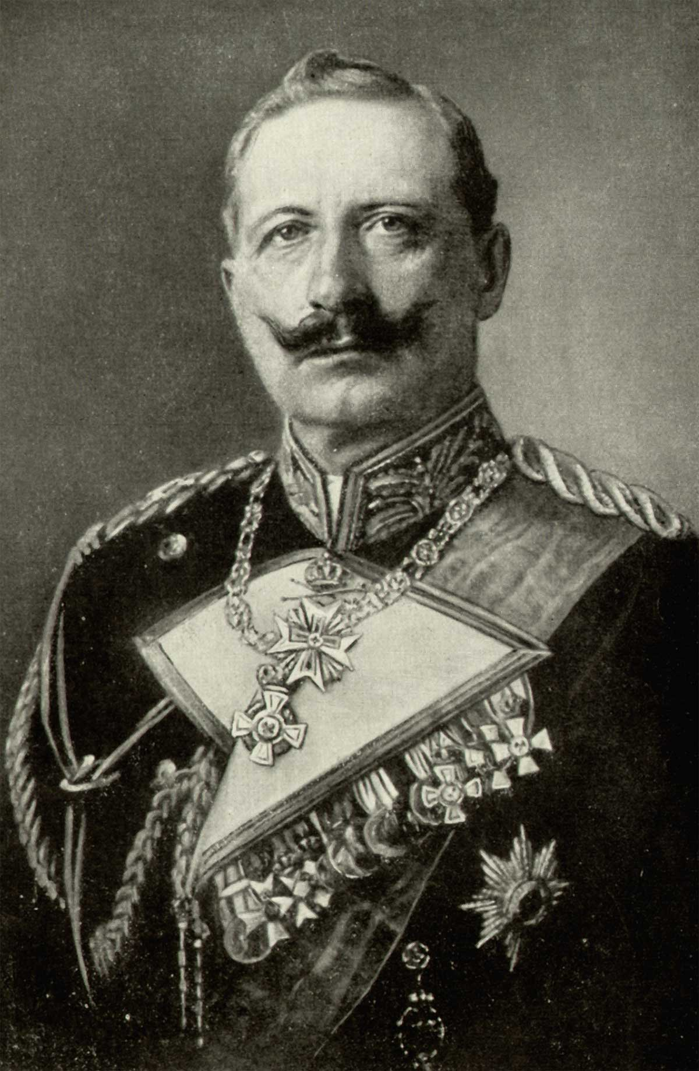

Slide 19
Neutrality:
Idealism or Naivete?

Slide 20
Why can’t we trade with everyone?

Slide 21
Is trade with the British and French a good thing?

Slide 22
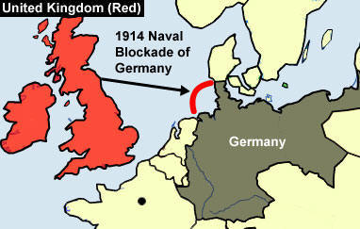

Slide 23
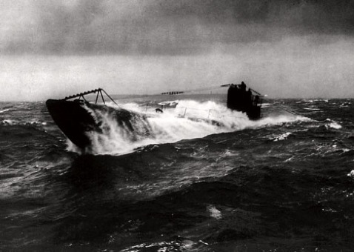
How do the Germans Respond?

Slide 24
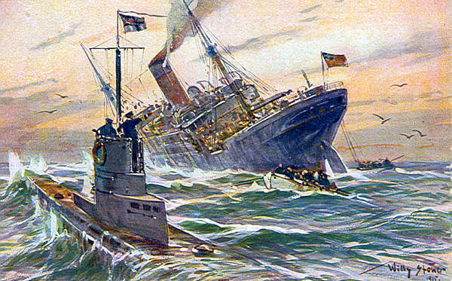

Slide 25
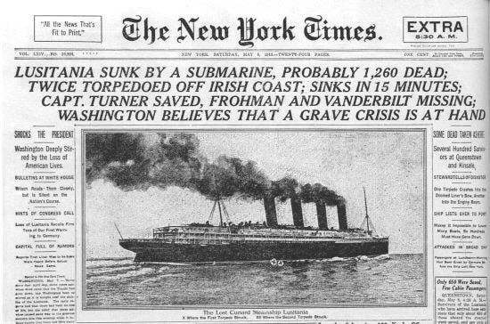

Slide 26
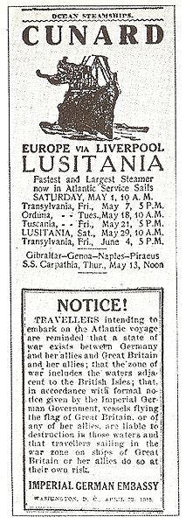

Slide 27
“Sussex Pledge”

Slide 28
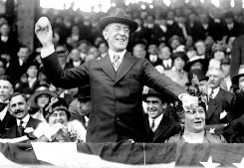

1916 Presidential Election

Slide 29
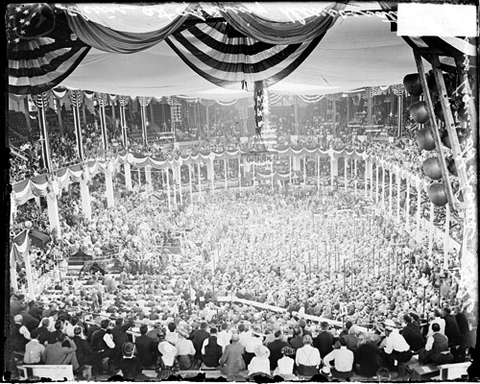
“He kept us out of war!”

Slide 30
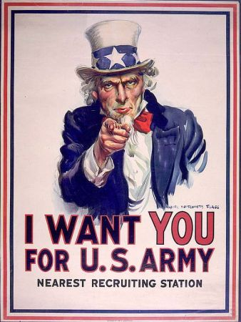
After staying out so long, why are we getting in?

Slide 31
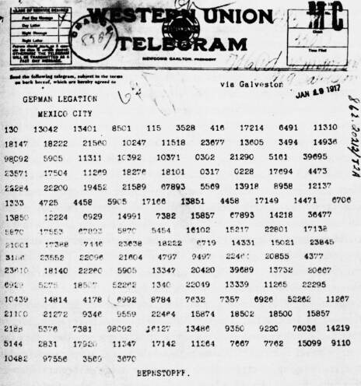
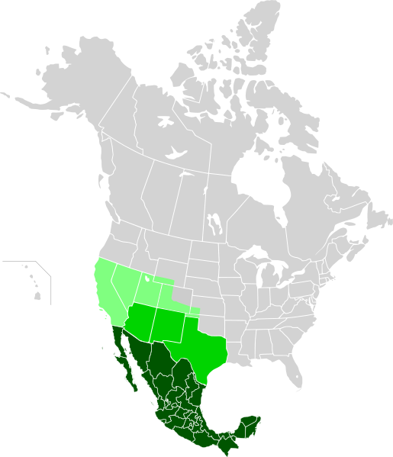
Zimmermann Telegram

Slide 32
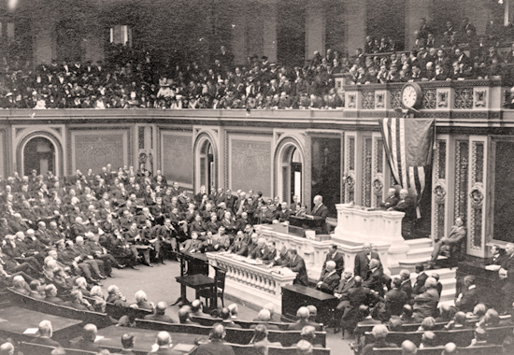
Unrestricted Submarine Warfare

Slide 33
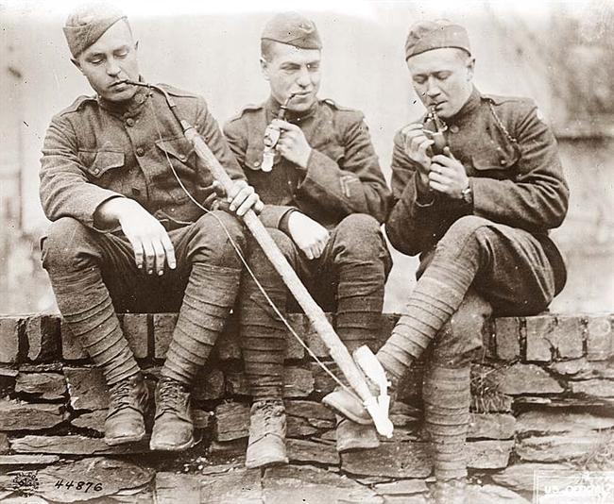
American Expeditionary Force
“Doughboys”

Slide 34
What did Woodrow Wilson hope to achieve during and after the war?

Slide 35
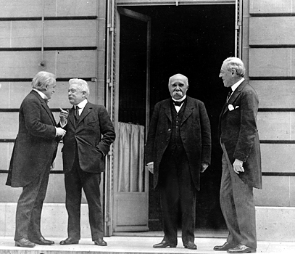
Treaty of Versailles

Slide 36
Lives Lost:
Russians – 3.3 million
Germans – 2.6 million
French – 1.9 million
Austro-Hungarians – 1.5 million
British 1.2 million
USA – 117,000

Slide 37
The Fourteen Points
1-8
Recommendations for New Boundaries in Europe

Slide 38
The Fourteen Points
9-13
Open Diplomacy
Freedom of Navigation
Removal of Trade Barriers
Arms Reductions
Self-Determination for Nations and Colonies

Slide 39
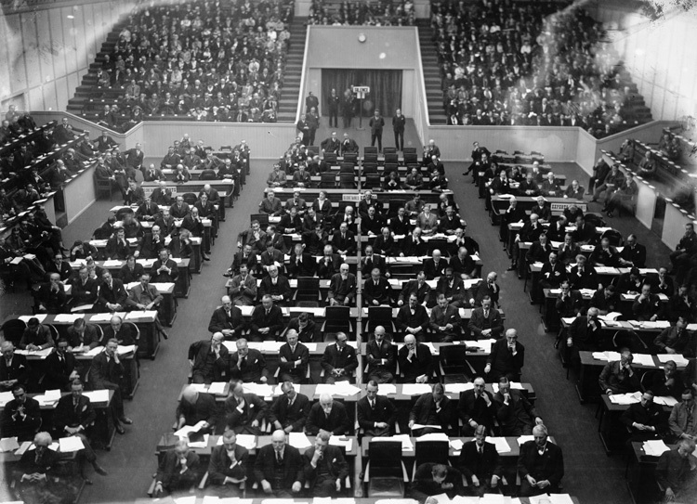
The Fourteenth Point
A League of Nations

Slide 40
What’s Wrong With The 14 points?

Slide 41
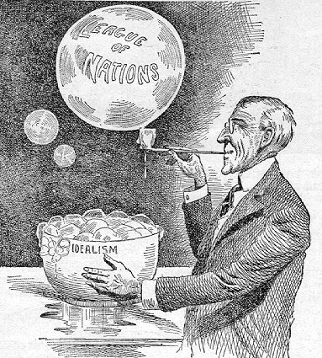

Slide 42
"God gave us the ten commandments and we broke them. Now Mr. Wilson has given us the Fourteen Points. We shall see."
--Georges Clemenceau

Slide 43
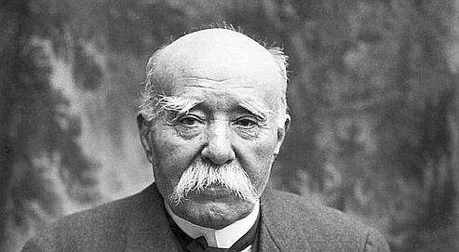

Slide 44
“There are twenty million Germans too many!”

Slide 45
Reparations?
War Guilt?

Slide 46
Legacies of World War I
- Disillusionment with Progressivism and crusading idealism
- Treaty of Versailles sets up economic instability

