Slide 1
The 1960s

Slide 2
The Rise and Fall of Liberalism

Slide 3
Why did it “rise”? Why did it “fall”?

Slide 4
1960-1963 Anticipation, or… “A promising time”

Slide 5
The Election of 1960
“Time to get the country moving again.”

Slide 6
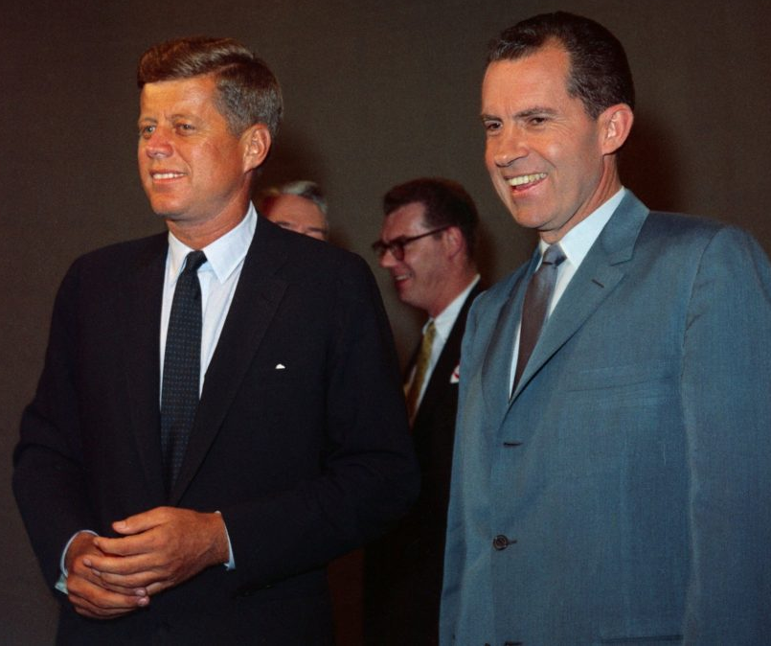
Kennedy vs Nixon

Slide 7
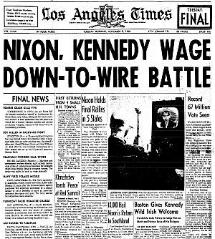

Slide 8
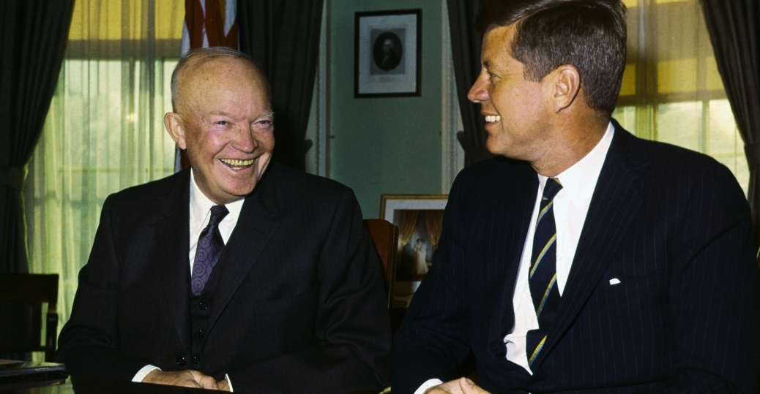
“The Torch is Passed”

Slide 9
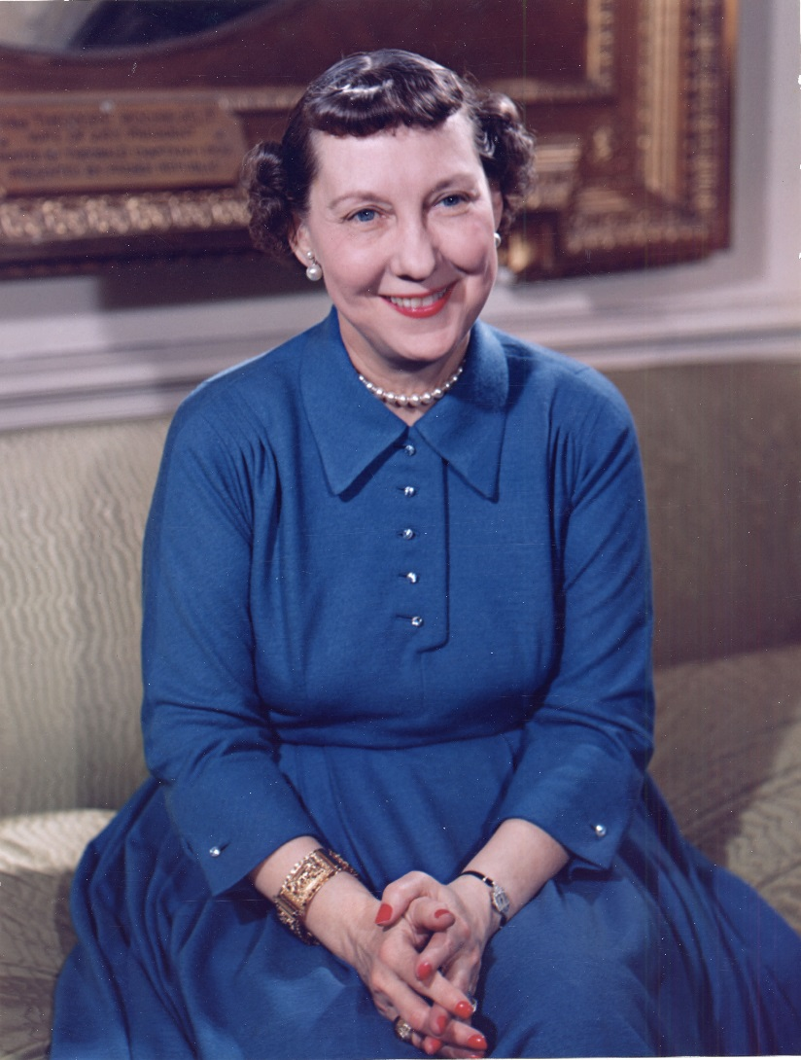
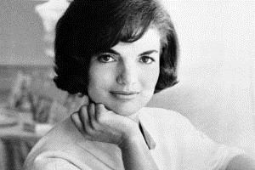
Mamie to Jackie…

Slide 10
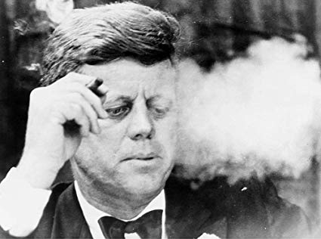
Kennedy Liberalism = Activist Government

Slide 11
Aggressive, Anticommunist Foreign Policy
-- Cuba
-- Vietnam

Slide 12
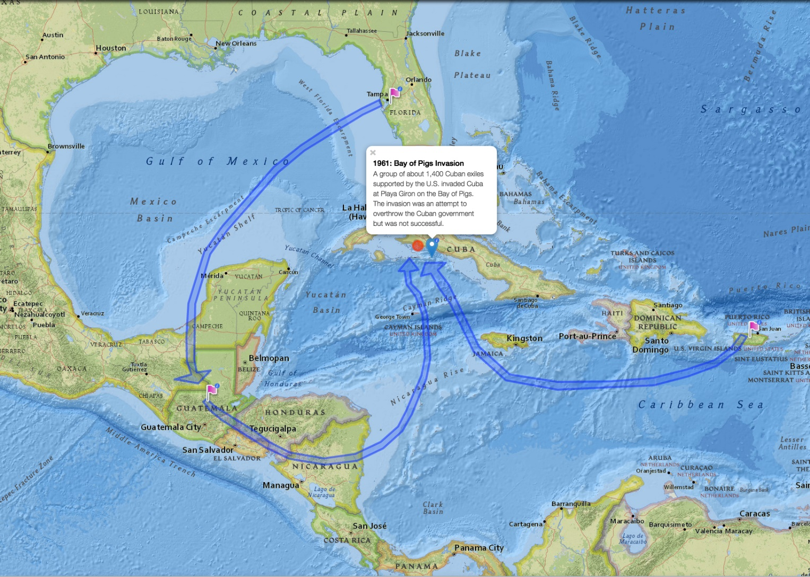
Bay of Pigs Invasion – Anti-Castro

Slide 13
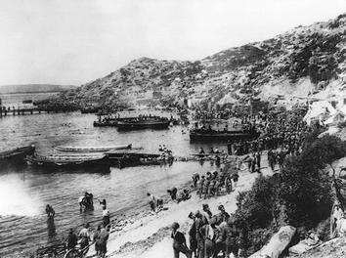

Slide 14
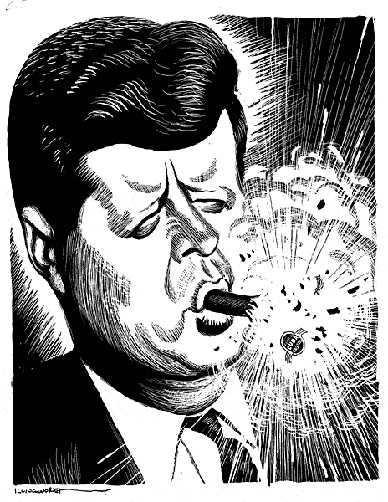

Slide 15
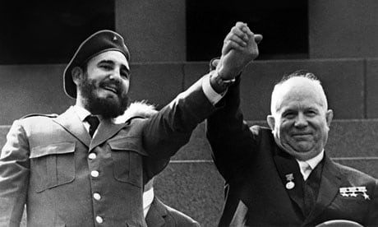

Slide 16
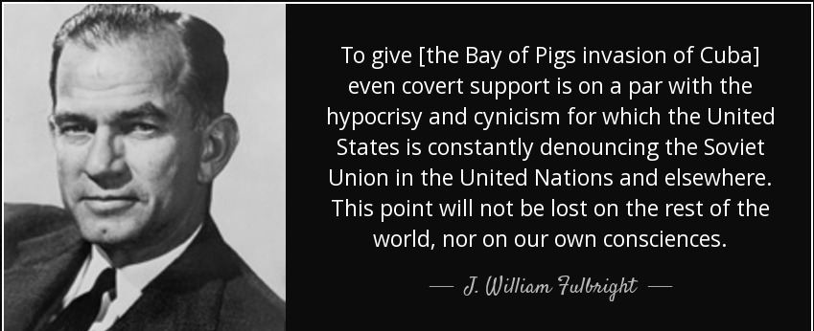

Slide 17
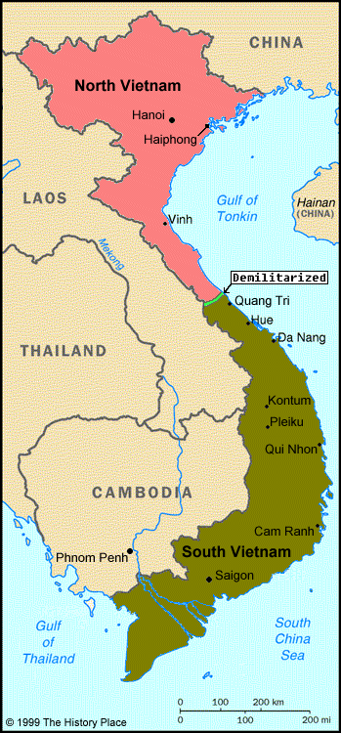
Cold War in Vietnam

Slide 18
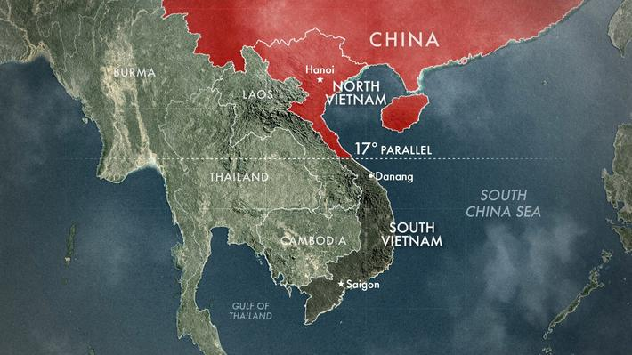
“Containment”

Slide 19
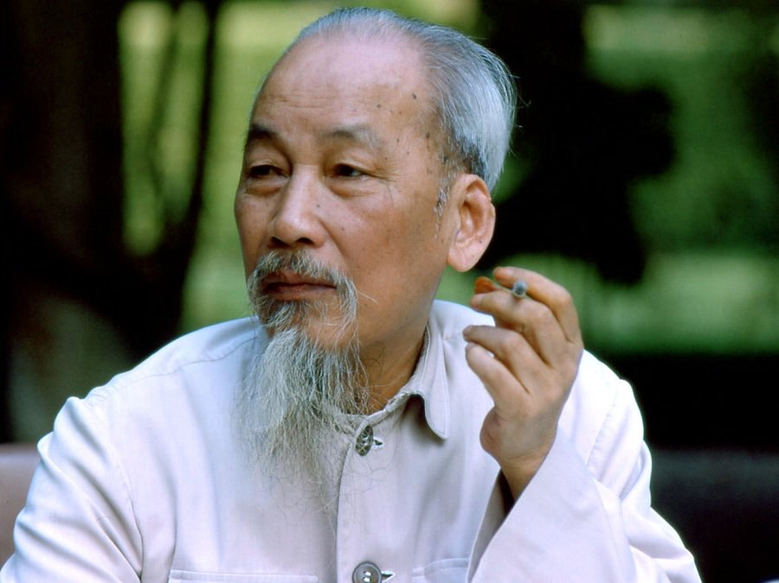
Ho Chi Minh – North Vietnam

Slide 20
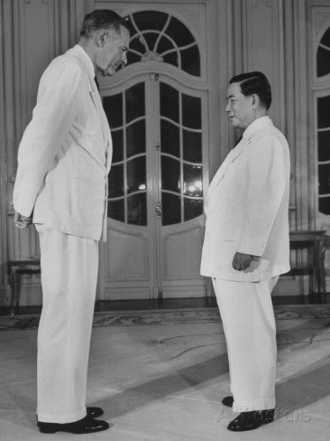
Ngo Dinh Diem – South Vietnam

Slide 21
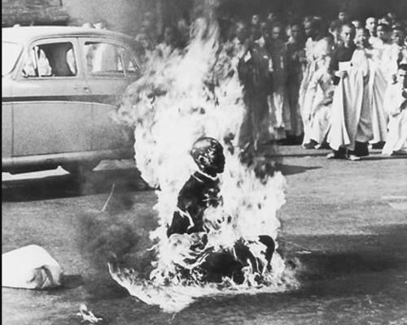

Slide 22
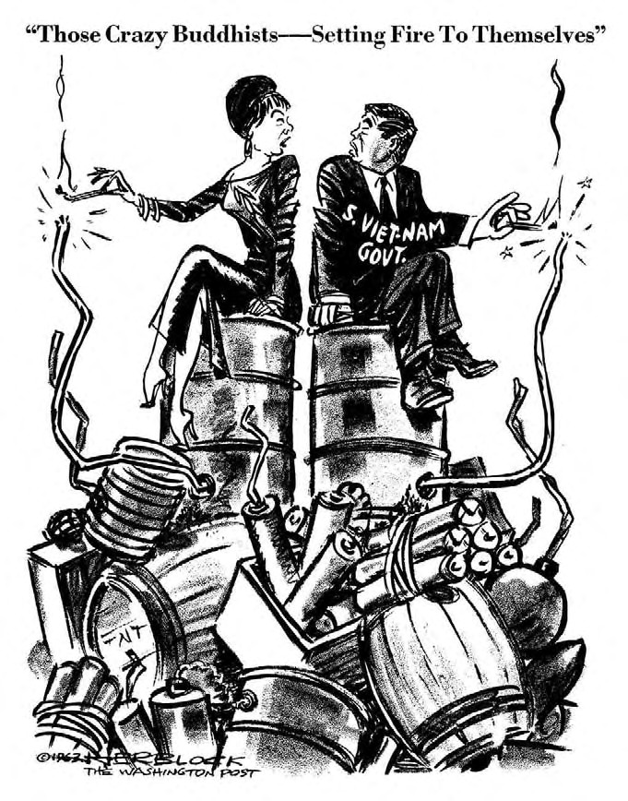

Slide 23
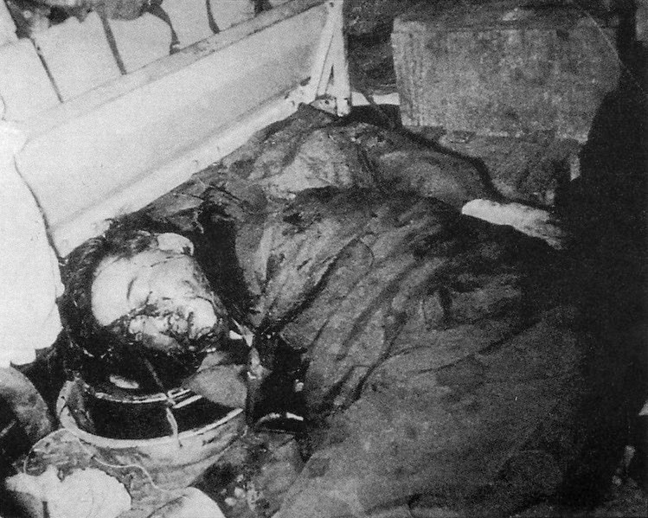

Slide 24
Cautious, Pragmatic Domestic Policy
-- support for Civil Rights…eventually
-- emphasis on equality of opportunity
-- tax cuts to stimulate the economy

Slide 25
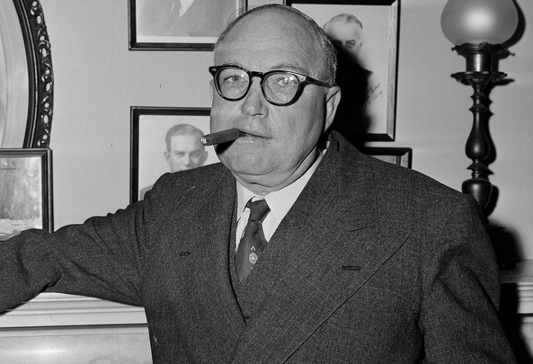
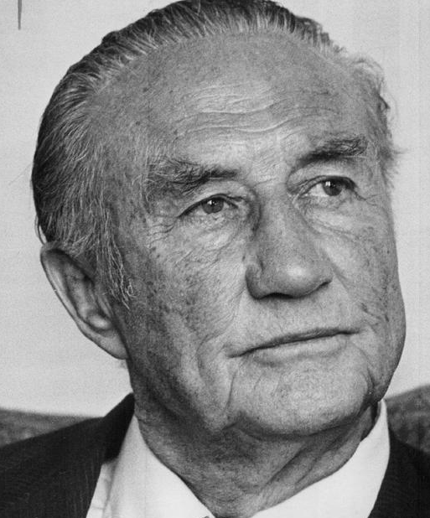
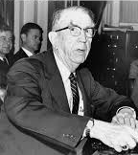
The “Southern Bloc(k)”

Slide 26

Kennedy: Image vs Reality

Slide 27
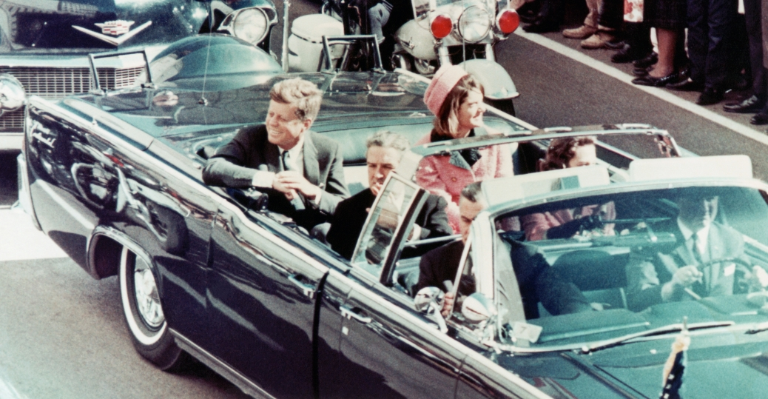
Dallas, November 22, 1963

Slide 28
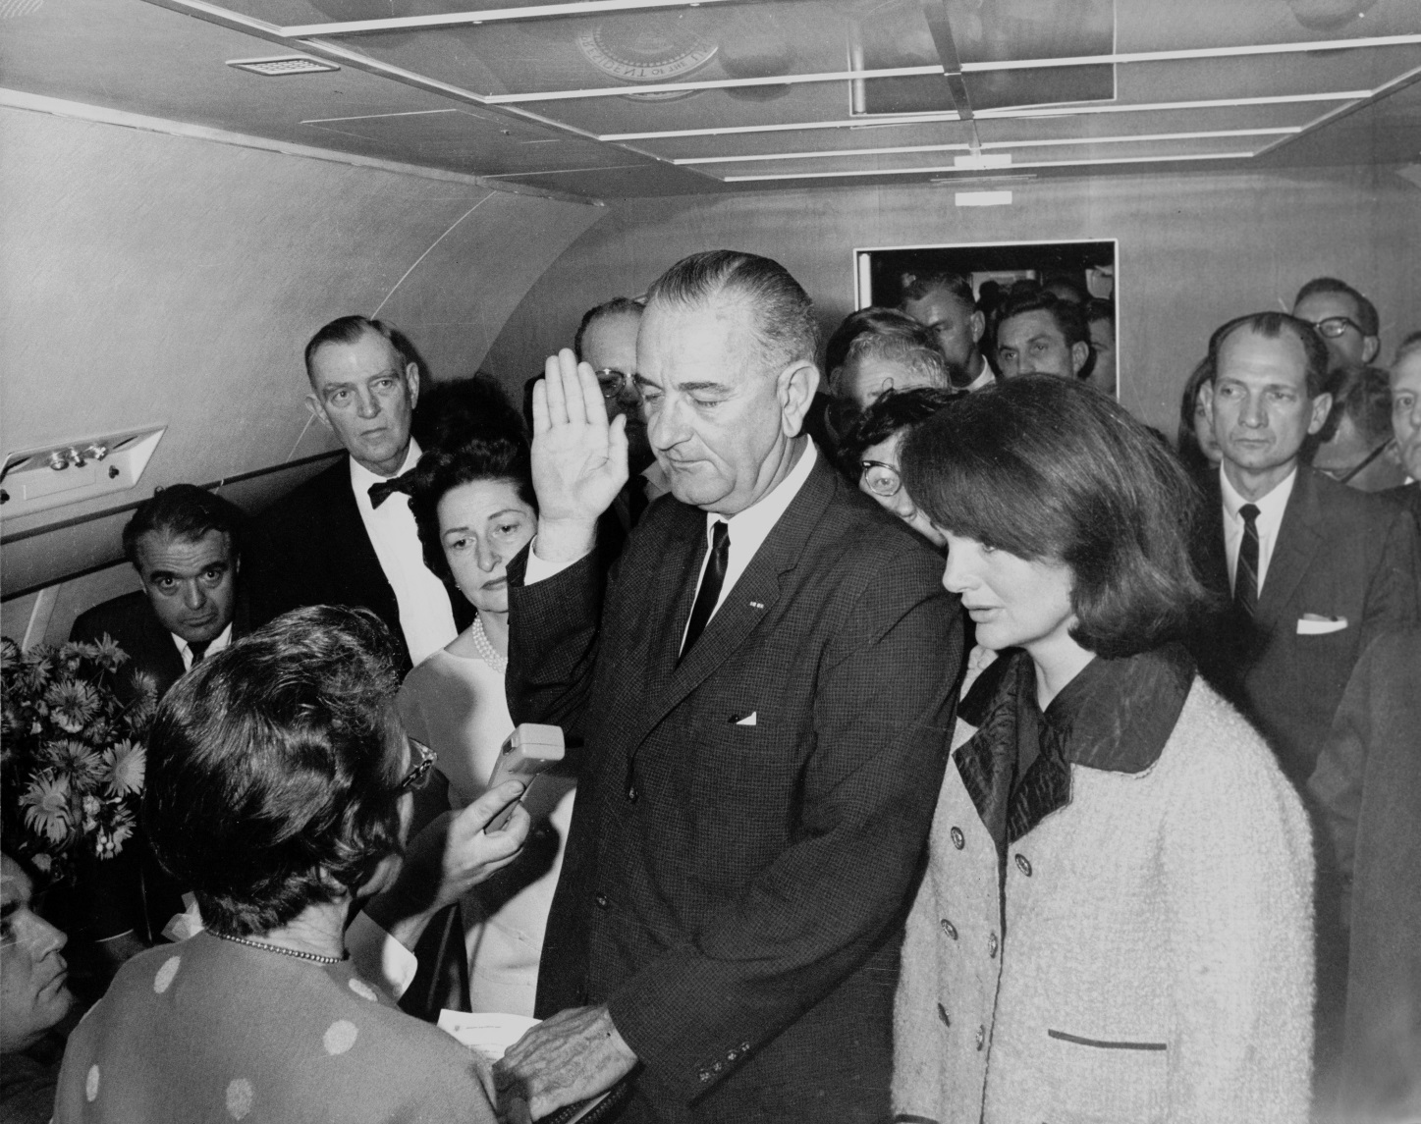
Eyewitness account of this moment:
https://www.youtube.com/watch?v=Ld7IV_HwTSM

Slide 29
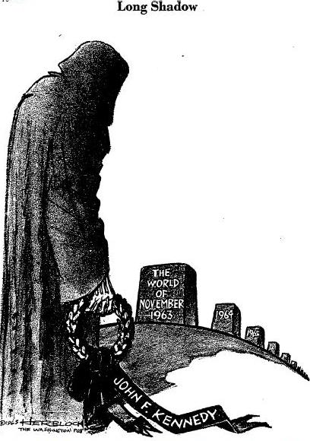

Slide 30
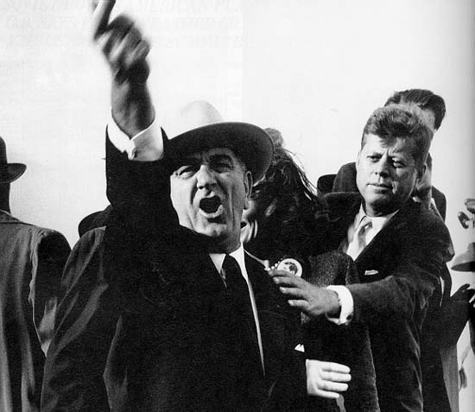

Slide 31
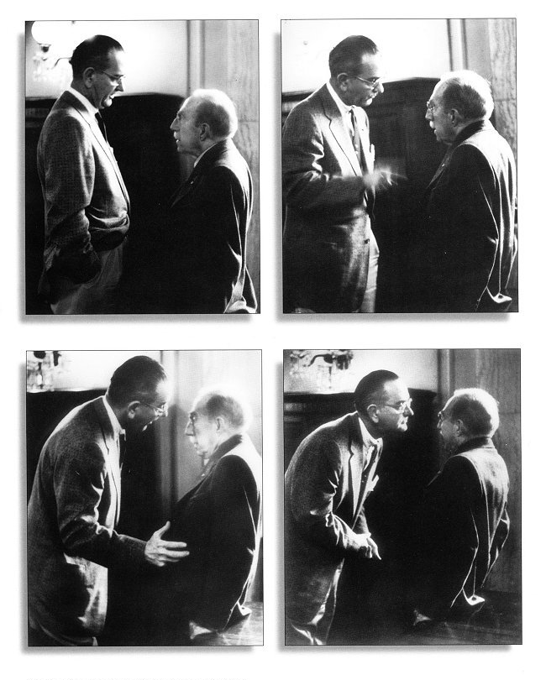
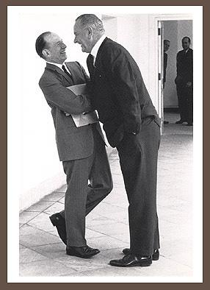
The “Johnson Treatment”

Slide 32
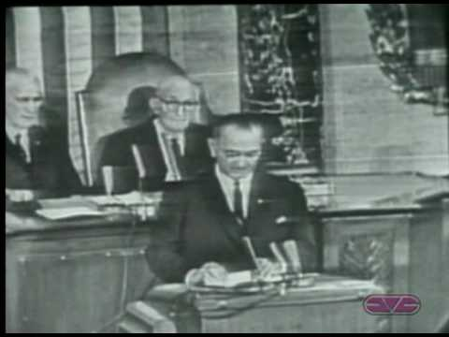
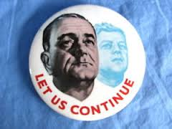
“Let us continue…”
Watch Johnson’s Speech:
https://www.youtube.com/watch?v=inE62gIoqyM

Slide 33
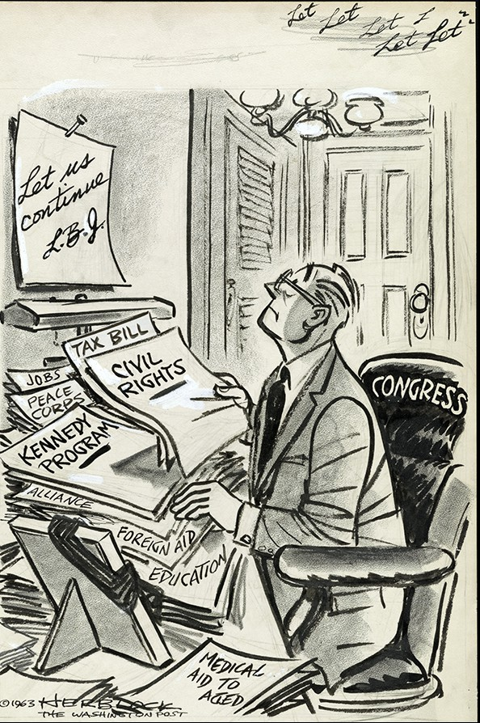

Slide 34
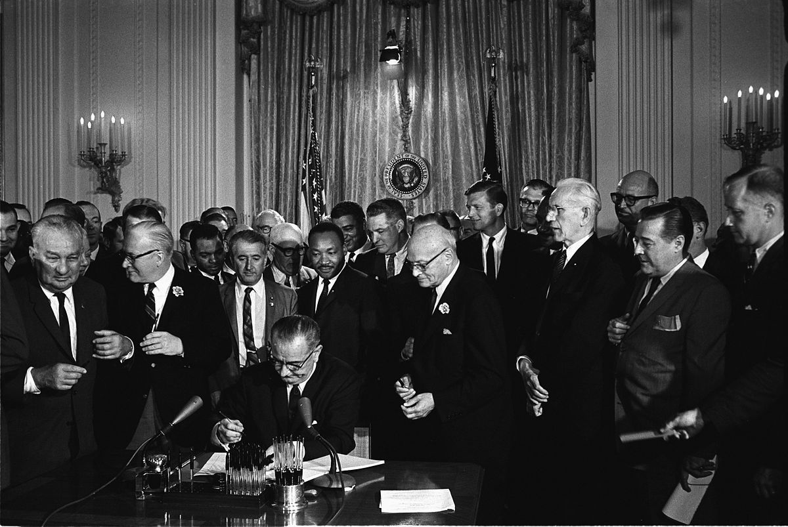
Civil Rights Act of 1964

Slide 35
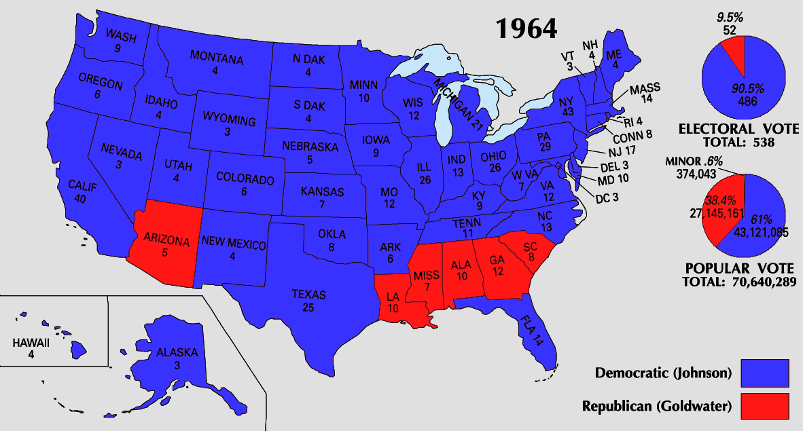
“The Liberal Hour”

Slide 36
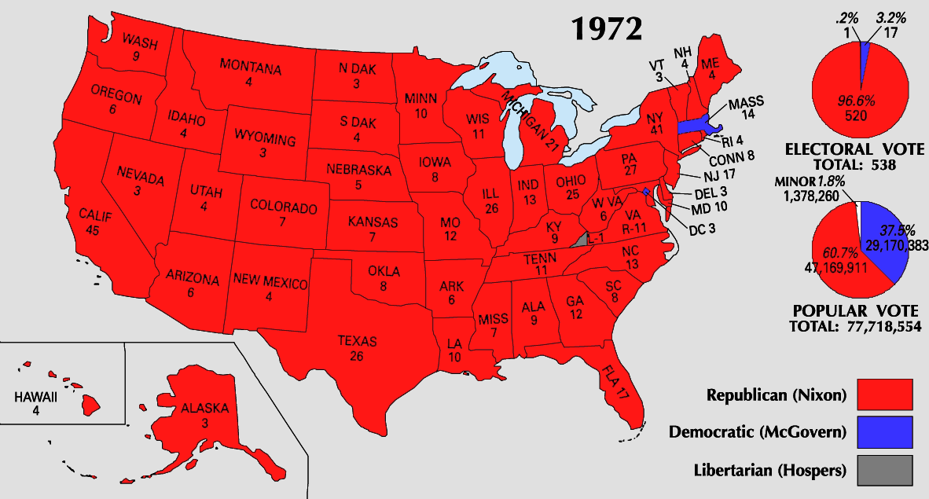
…And the FALL

Slide 37
What happened?
-- Urban Unrest
-- Vietnam

Slide 38
1965
“Guns AND Butter”
-- Over-promising?
-- War on Poverty
-- Escalation in Vietnam

Slide 39
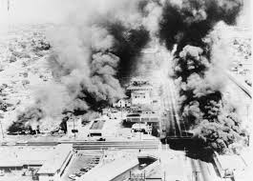
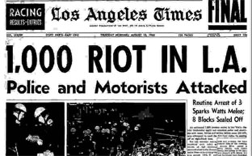
Watts

Slide 40
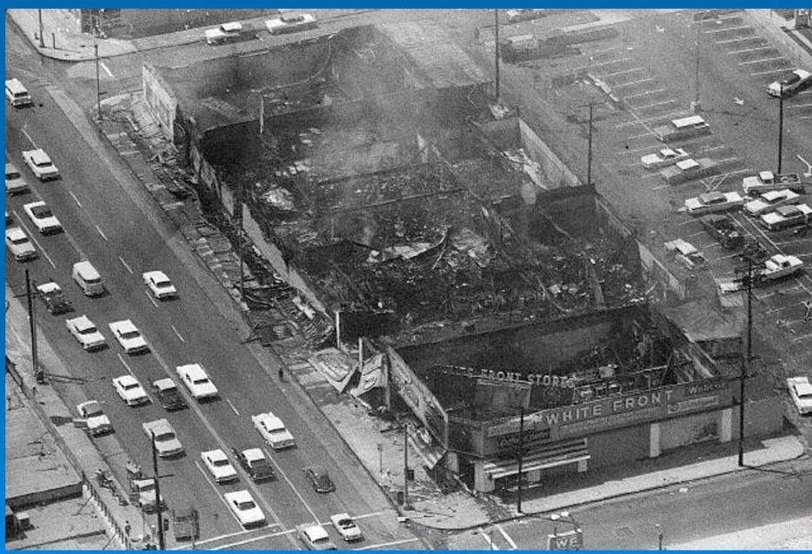

Slide 41
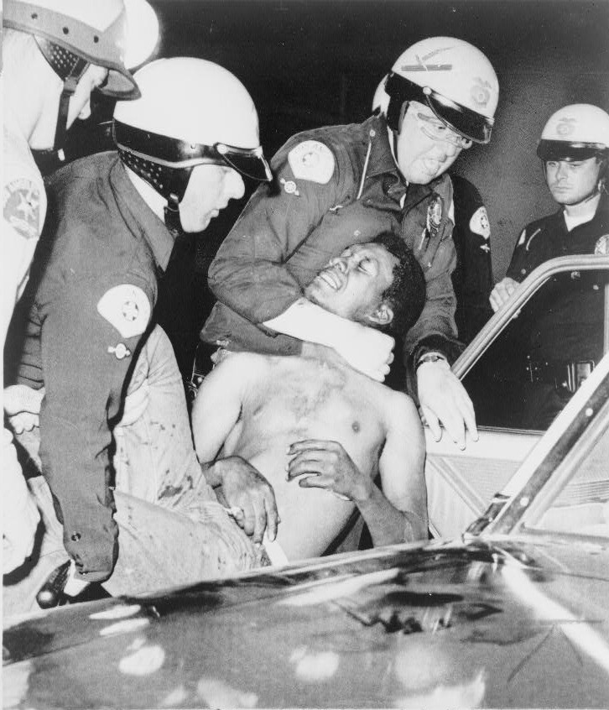

Slide 42
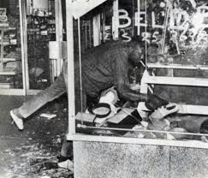

Slide 43
What went wrong?
What went wrong?
– Underfunding?
--Over-promising?

Slide 44
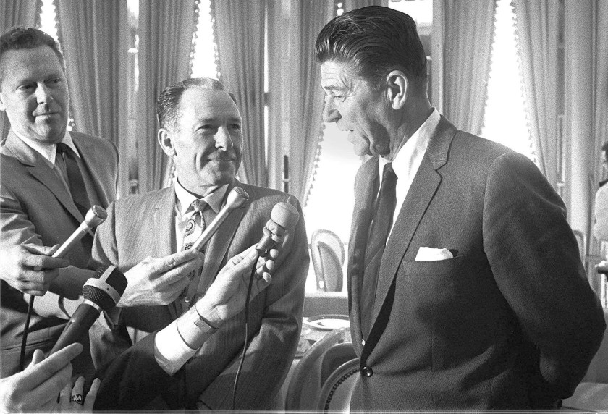
“Law and Order”
White Backlash Against Liberalism

Slide 45
The Vietnam Quagmire
-- disaster abroad
-- dissent and backlash at home

Slide 46
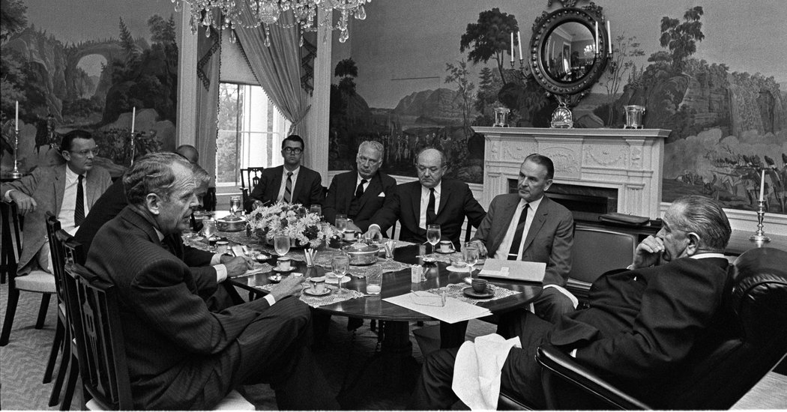
“The war is not going well…but pulling out is impossible.”

Slide 47
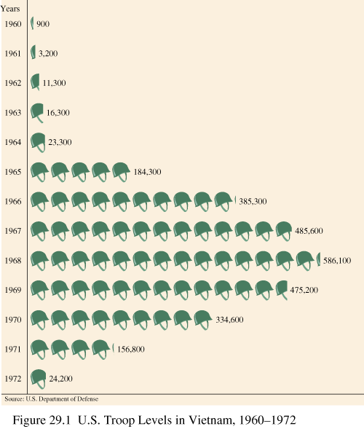

Slide 48
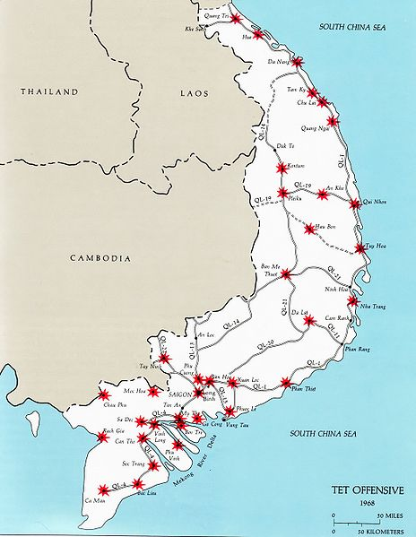
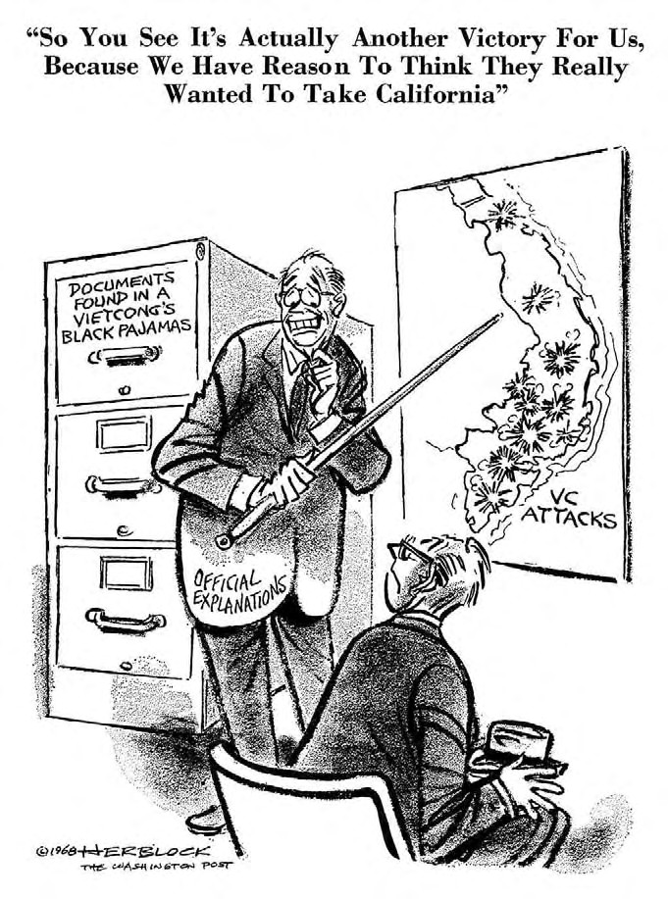
Tet Offensive January 31, 1968

Slide 49
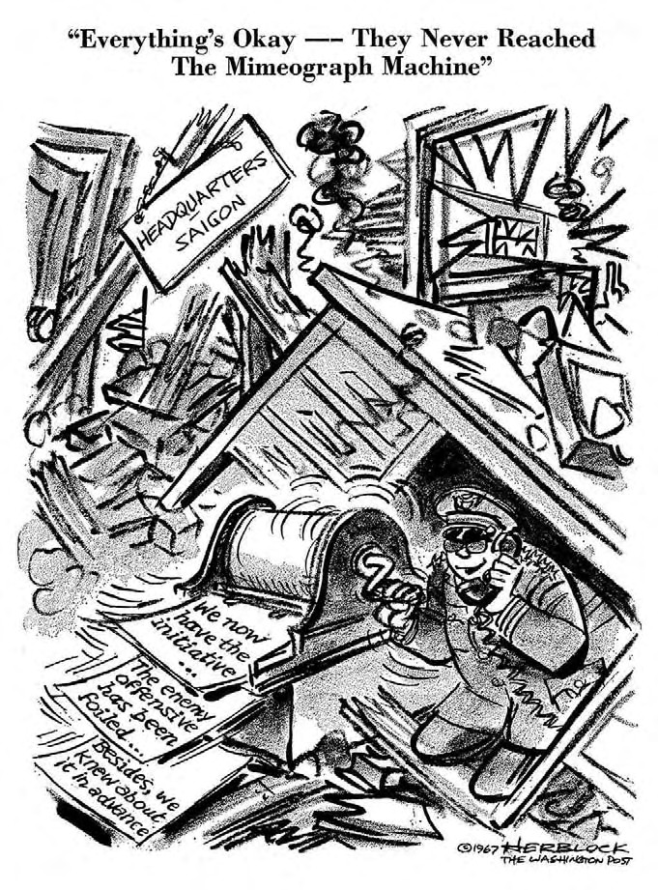

Slide 50
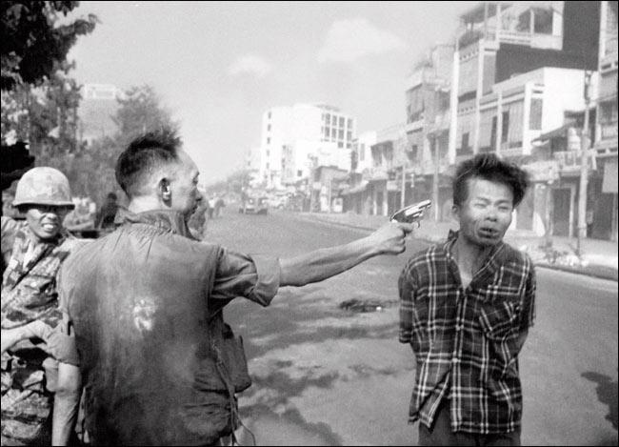

Slide 51
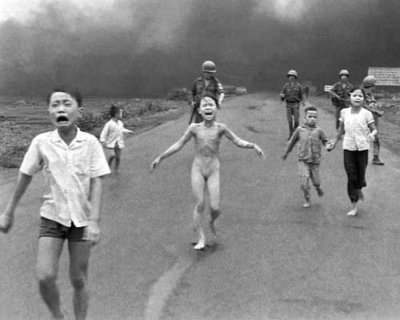

Slide 52
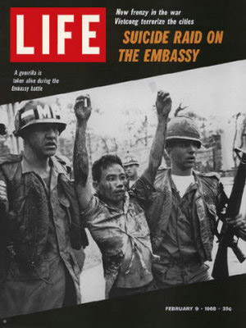
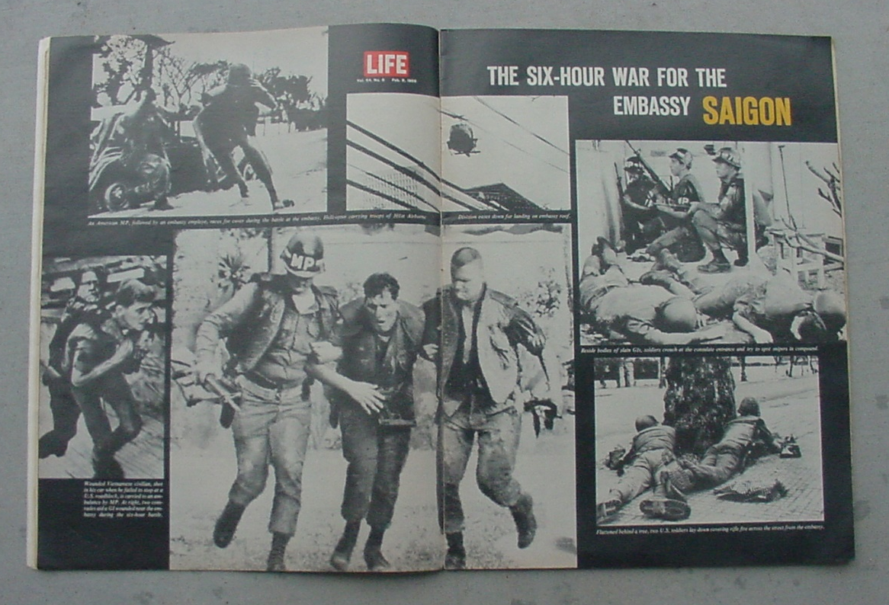
“What the hell is going on? I thought we were winning the War!” – Walter Cronkite, CBS News

Slide 53
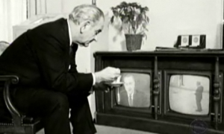
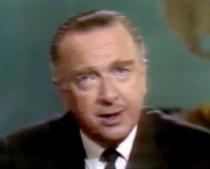
“If I’ve lost Cronkite, I’ve lost Middle America” – Lyndon Johnson, 2/27/68
https://www.youtube.com/watch?v=cXg8BbMp1Yg

Slide 54


Slide 55



Slide 56
The Anti-War Minority & The Anti-Anti War Majority
-- Cultural Clash
-- Class Divisions

Slide 57


Slide 58


Slide 59


Slide 60

“Nixon’s the One”

Slide 61
“The Liberal Hour”

Slide 62
…And the FALL

