Slide 1
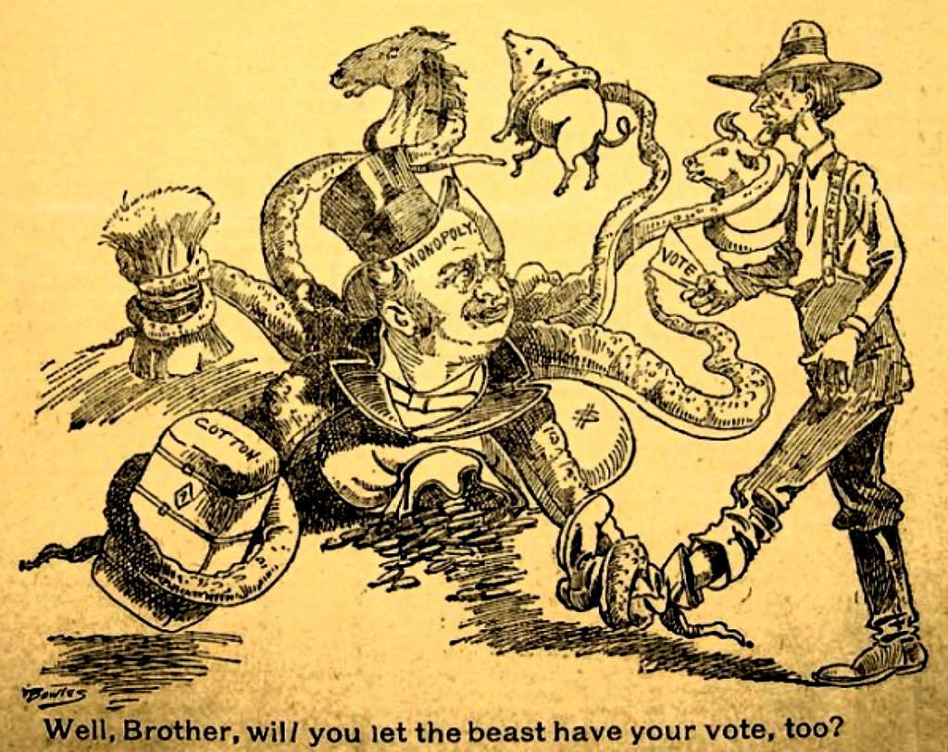
POPULISM:
Fire on the Prairie
1880s-1890s

Slide 2
Three Overall Questions…
1. Why are farmers hurting?
2. Who do they blame?
3. How do they propose to solve their problems?

Slide 3
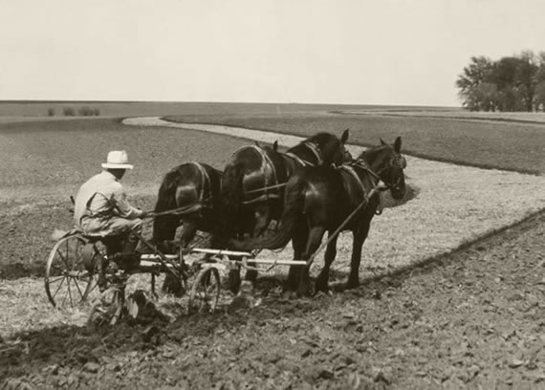
If I’m Producing More, How Come I’m Making Less?

Slide 4
Farmers’ Common Problems:
1.Debt
2. Middlemen and Speculators

Slide 5
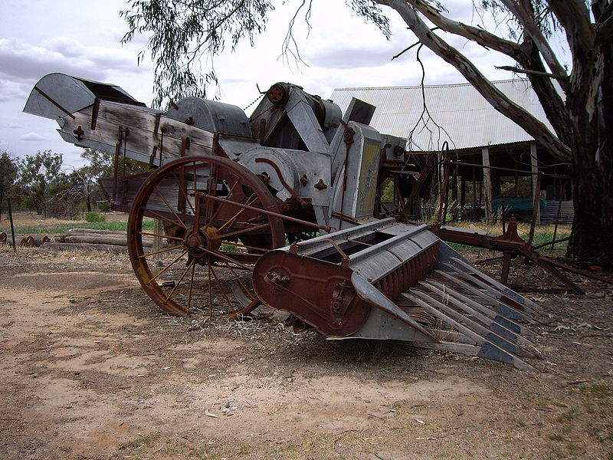
Why are Prices So Low?

Slide 6
What is DEFLATION and How Does it Affect DEBT?

Slide 7
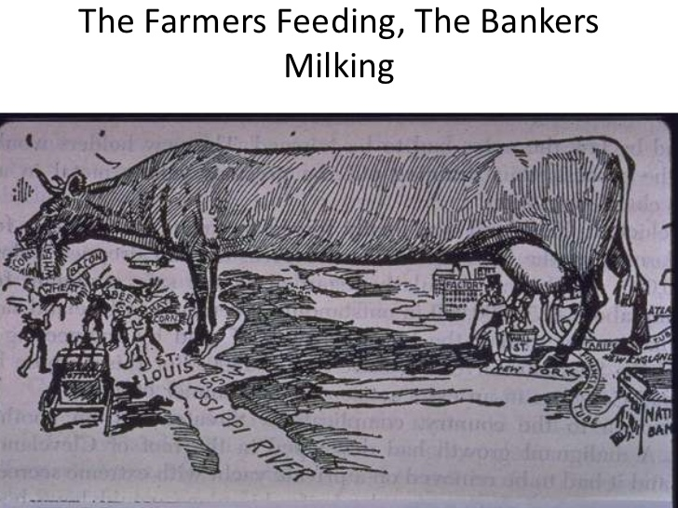

Slide 8
Who are the EVIL MIDDLEMEN?

Slide 9
Who are the EVIL MIDDLEMEN?
RAILROADS

Slide 10
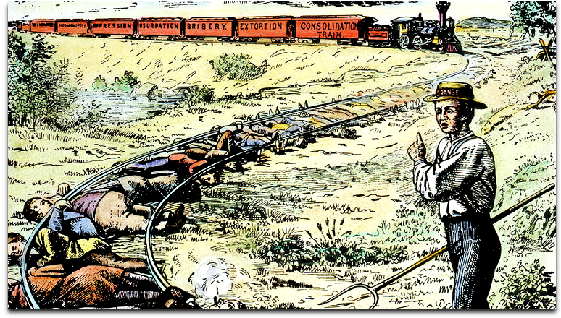

Slide 11
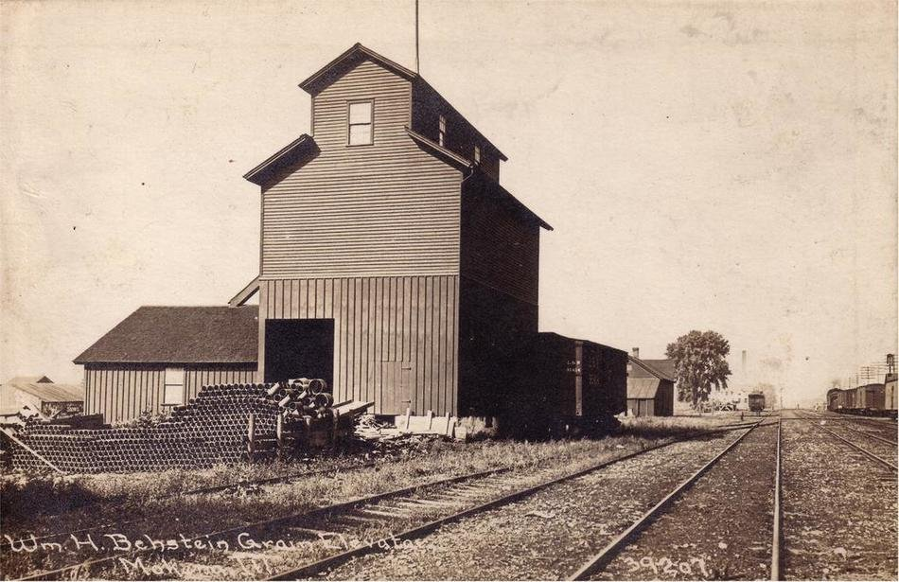

Slide 12
Who are the EVIL MIDDLEMEN?
RAILROADS
GRAIN ELEVATOR OPERATORS

Slide 13
Who are the EVIL MIDDLEMEN?
RAILROADS
GRAIN ELEVATOR OPERATORS
SPECULATORS AND TRADERS

Slide 14
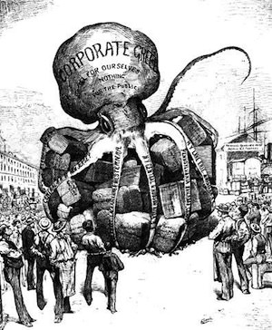

Slide 15
How do you get around the Middleman?

Slide 16
Look to Themselves: ORGANIZE
1. Cooperatives
2. Farmer Alliances

Slide 17
Look to Government
1. Create Fair Credit System
2. Regulate the Railroads

Slide 18
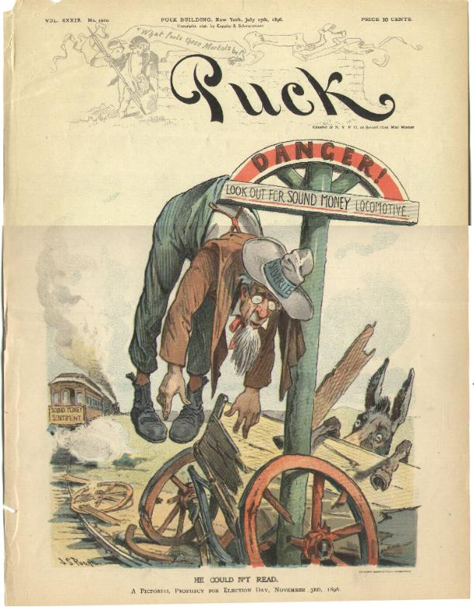
When all else fails…
Inflate the Currency
Why Silver?

Slide 19
What’s the argument for Gold?

Slide 20
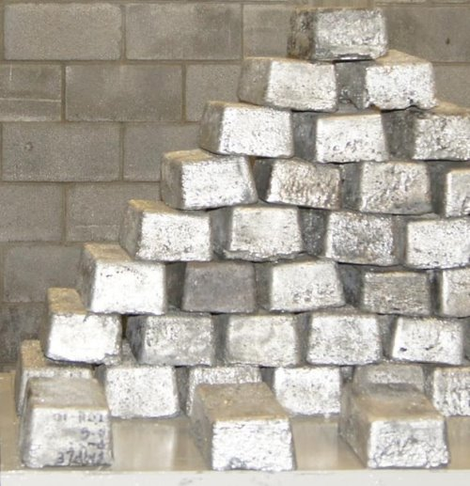
Who else might be for coinage of Silver?

Slide 21
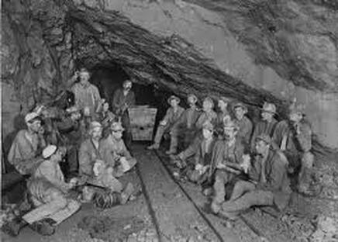
Who else might be for coinage of Silver?

Slide 22
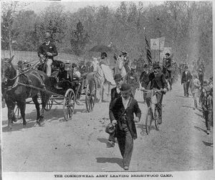
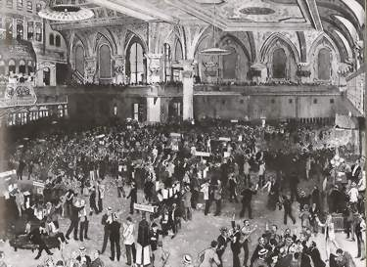
What happens in 1893?

Slide 23
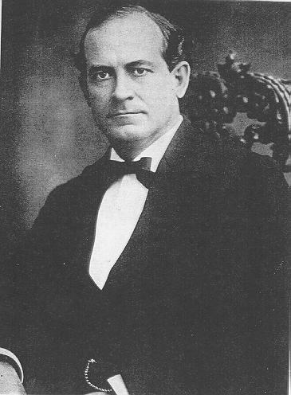
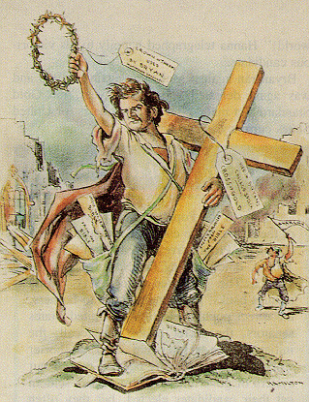
William Jennings Bryan

Slide 24
Why didn’t city workers join with farmers against the guys with money?

Slide 25
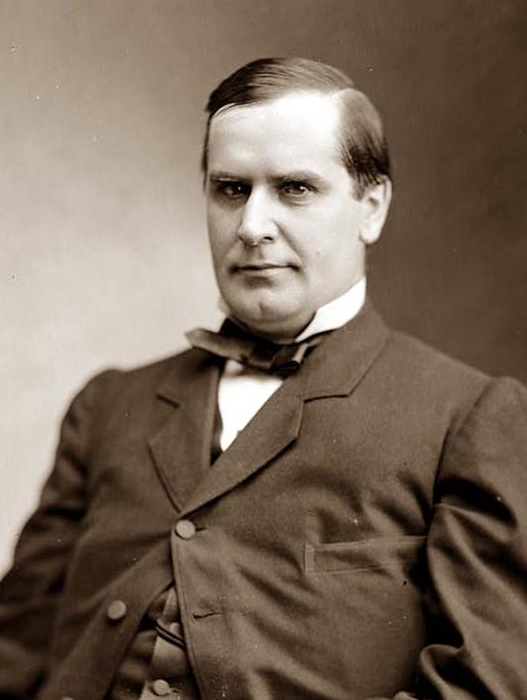
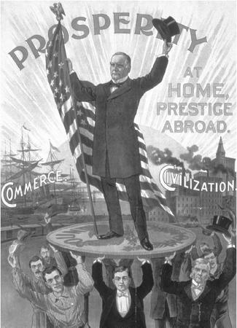
William McKinley

Slide 26
The Real Lesson of the Election of 1896

