Slide 1
COLLABORATIVE LEARNING
PROMOTING COLLABORATIVE AND PROBLEM-BASED LEARNING IN THE 21st CENTURY CLASSROOM
Dr. Susan Belgrad
California State University, Northridge

Slide 2
A Definition and a Distinction
Cooperative learning is the presence of joint goals, mutual rewards, shared resources and complementary roles among members of a learning group
Competitive learning conversely is the presence of a goal or reward that only one or a few group member(s) could achieve be outperforming the others.

Slide 3
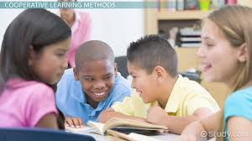
GETTING STARTED
WHY COOPERATIVE LEARNING
HOW TO GET STARTED
HOW TO ASSURE OPTIMAL LEARNING OF ALL STUDENTS

Slide 4
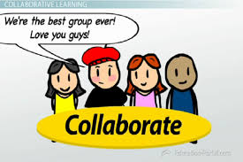
WHY COLLABORATE?

Slide 5
Why Do We Need to Engage Students in 21st CENTURY Learning Strategies?
THEY HELP TO:
Develop better attitudes toward school
Build better attitudes toward teachers’
Promote more on-task behavior
Develop students’ higher order thinking
Develop students’ perspective taking
Increase retention of new knowledge, skills, ideas
Resulting in higher achievement of diverse students

Slide 6
Why Do We Need to Engage Students in Cooperative Learning Strategies?
Develop students’ social skills
Result in more positive heterogeneous relationships
Increase diverse learners’ self-esteem
Provide greater social support throughout the K-12 learning environment

Slide 7
Why Do We Need to Engage Students in Cooperative Learning Strategies?
Create a learner-centered climate leading to positive psychological adjustment
Lead to greater intrinsic motivation for all learners

Slide 8
P.M.I. ON COOP LEARNING

Slide 9
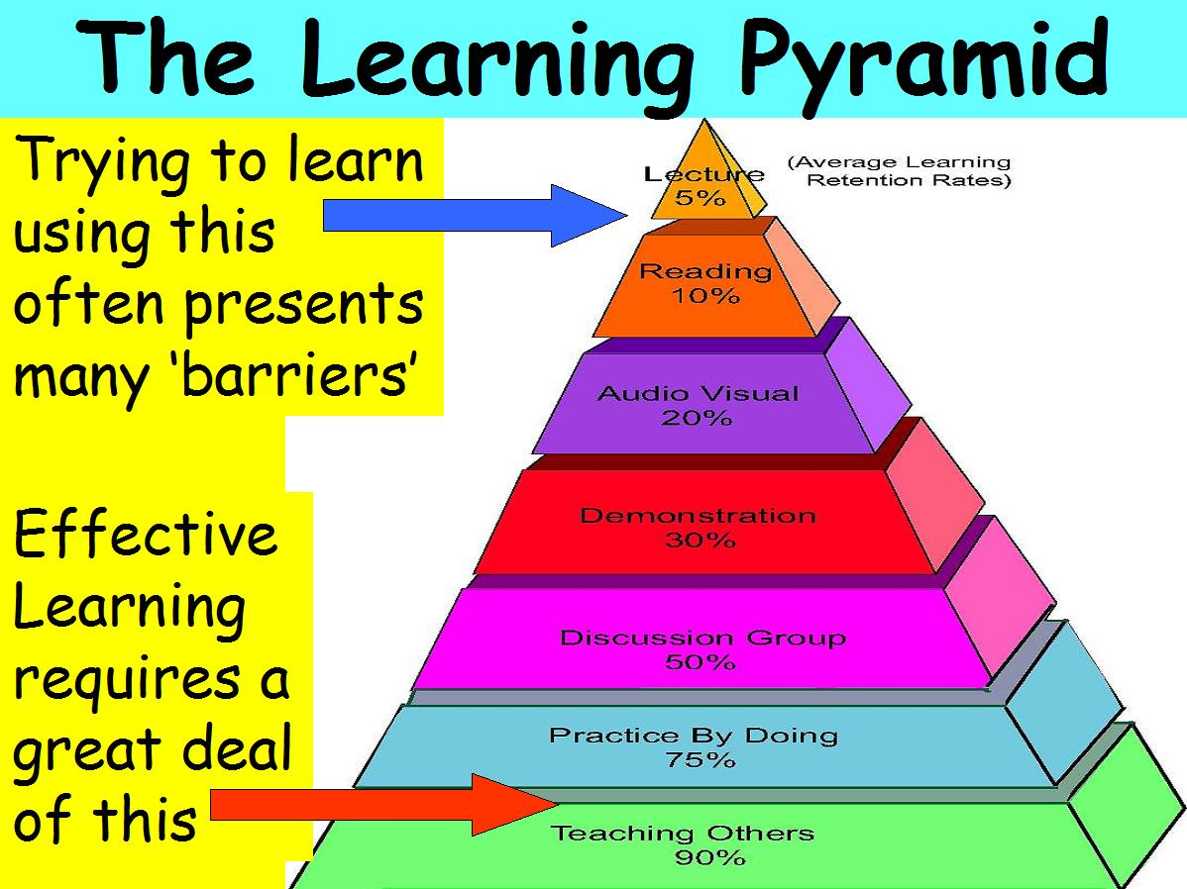
HOW WE LEARN
5% OF WHAT WE HEAR (lecture)
10% OF WHAT WE READ
20% OF WHAT WE BOTH SEE
AND HEAR
30% OF WHAT IS
DEMONSTRATED
50% OF WHAT IS DISCUSSED
WITH OTHERS
75% OF WHAT WE EXPERIENCE
PERSONALLY
90% OF WHAT WE TEACH

Slide 10
Old vs. New
Standards of Learning
OLD STANDARDS
Teach by telling
Paper-Pencil tasks
Competitive environment
Minimal technology-not allowed
Don’t think just do (only one right way)
Must follow the rules
Look for clues to the right solution
21ST CENTURY STANDARDS
Learning by doing in a collaborative classroom
Hands-on/Physical materials
Technology integration amplifies learning
Inquire, explore, justify thinking
Alternative approaches to problem solving
Respect for others and flexibility in thinking.

Slide 11
Old vs. New Standards of Learning
OLD STANDARDS
Topic Isolation
Teacher talks
Individual responsibility for learning
NEW STANDARDS
Integrated topics
Students discuss/develop ideas
Activity between students/ group responsibility and individual responsibility; learner interdependence

Slide 12
AGREE/DISAGREE

Slide 13
AGREE/DISAGREE

Slide 14
CHARACTERISTICS OF INTELLIGENT BEHAVIOR
PERSISTENCE
DECREASING IMPULSIVITY
EMPATHIC LISTENING
FLEXIBILITY IN THINKING
METACOGNITIVE AWARENESS
CHECKING FOR ACCURACY

Slide 15
CHARACTERISTICS OF INTELLIGENT BEHAVIOR
QUESTIONING
PROBLEM POSING
DRAWING ON PAST KNOWLEDGE
APPLYING TO NEW SITUATIONS
PRECISION OF LANGUAGE AND THOUGHT
USING ALL THE SENSES

Slide 16
CHARACTERISTICS OF INTELLIGENT BEHAVIOR
INGENUITY, ORIGINALITY, INSIGHTFULNESS & CREATIVITY
INQUISITIVENESS AND CURIOSITY
ENJOYMENT OF PROBLEM SOLVING

Slide 17
HOW TO PROMOTE COOPERATIVE LEARNING
THE GOOSE STORY

Slide 18
THE GOOSE STORY
Next fall when you see geese heading south for the winter flying along in a “V” formation, you might be interested in knowing why they fly that way. It has been learned that as each bird flaps its wings, it creates an uplift for the bird immediately following. By flying in a “V” formation, the whole flock adds at least 71% greater flying range than if each bird flew on its own.

Slide 19
People who share common direction and sense of community can get where they are traveling on the thrust of one another. Whenever a goose falls out of formation, it suddenly feels a drag and resistance of trying to go it alone, and quickly gets into formation to take advantage of the lifting power of the bird immediately in front. If we have as much sense as a goose, we will stay in formation with those who are headed the same way we are going.

Slide 20
When the lead goose gets tired, he rotates back in the wing and another goose flies to point. It pays to take turns doing hard jobs.
The geese honk from behind to encourage those up front to keep up their speed.. An encouraging word goes a long way
Finally, when a goose gets sick, or is wounded by a gun shot and falls out, two geese fall out of formation and follow him down to help and protect him.

Slide 21
They stay with him until he is either able to fly or until he is dead, and they launch out on their own or with another formation to catch up with the group.
If we have the sense of a goose we will stand by each other like that.
Author Unknown

Slide 22
HOW COOP GROUPS DIFFER
TRADITIONAL GROUPS
One goal/task learned at a time
Groups are done when product/task is done
Social skills are taken as a given
One leader gets main role
COOPERATIVE GROUPS
Higher order thinking is woven into every lesson
Groups continue to work together
Social skills are taught
Roles are shared and mixed

Slide 23
HOW COOP GROUPS DIFFER
TRADITIONAL GROUPS
Group is assessed without looking at individual efforts
Teacher grades product
Homogenous groups created
COOPERATIVE GROUPS
Individual contribution to group goal is assessed
Groups look back and process interactions and group work
Students with different characteristics are mixed/matched

Slide 24
HOW COOP GROUPS DIFFER
TRADITIONAL GROUPS
Students only responsible for themselves
Each student relies on him/herself
COOPERATIVE GROUPS
Members share responsibility for the group
Students rely on each other

Slide 25
TRIPLE T-CHART
ATTENTIVE LISTENING

Slide 26
TRIPLE T-CHART
TEAM BUILDING

Slide 27
SOCIAL SKILLS WE NEED TO TEACH IN COOPERATIVE LEARNING
FORMATION OF GROUPS
SUPPORT
COMMUNICATION
CONFLICT RESOLUTION

Slide 28
FORMATION OF GROUPS
FORM GROUPS QUIETLY
SIT EYEBALL TO EYEBALL
MAKE EYE CONTACT
USE EACH OTHER’S NAMES
SHARE MATERIALS
FOLLOW ROLE ASSIGNMENTS

Slide 29
SUPPORT
CHECK FOR UNDERSTANDING
OFFER YOUR HELP
ASK YOUR GROUP FIRST FOR
HELP IF YOU DON’T
UNDERSTAND
ENCOURAGE EACH OTHER
ENERGIZE THE GROUP
DISAGREE WITH THE IDEA-
NOT THE PERSON

Slide 30
COMMUNICATION
USE 6-INCH VOICES
TAKE TURNS
MAKE SURE EVERYONE
SPEAKS
WAIT UNTIL SPEAKER IS
FINISHED BEFORE YOU SPEAK

Slide 31
CONFLICT RESOLUTION
DISAGREE WITH THE IDEA-
NOT THE PERSON
RESPECT THE OPINIONS OF
OTHERS
THINK FOR YOURSELF

Slide 32
CONFLICT RESOLUTION
EXPLORE DIFFERENT POINTS
OF VIEW
NEGOTIATE AND/OR
COMPROMISE
REACH CONSENSUS

Slide 33
COOPERATIVE GROUP ACTIVITIES FOR TODAY
SHARING P.M.I. STATEMENTS
SHARING THE AGREE/DISAGREE
PORTMANTEAU
ATTENTIVE LISTENING SOCIAL SKILL LESSON

Slide 34
PORTMANTEAU
ASSIGN GROUP ROLES
DISTRIBUTE PORTMANTEAU WORD LISTS
ENCOURAGER TEACHES 3 WORDS TO GROUP
CHECKER CHECKS
WORRIER TEACHES 3 WORDS
CHECKER CHECKS ETC....

Slide 35
PORTMANTEAU
ORAL GROUP QUIZ
TEAMS PROCESS
FACILITATOR PROCESSES

Slide 36
PLANNING A COOPERATIVE GROUP ACTIVITY
FORMATION OF GROUPS
ROLE ASSIGNMENTS
TASK
TIME LIMITS
SOCIAL SKILL TO BE ASSESSED
INTELLIGENT BEHAVIOR TO BE
ASSESSED
PROCESSING
ENCOURAGING ENERGIZER

Slide 37
TYPES OF COOPERATIVE GROUPS
INFORMAL TASK GROUPS
FORMAL TASK GROUPS
BASE GROUPS

Slide 38
PHASES OF SOCIAL SKILLS INTRODUCTION
FORMING
NORMING
CONFORMING
STORMING
PERFORMING
RE-FORMING

Slide 39
COOPERATIVE GROUP FORMING SKILLS
MOVE INTO A GROUP
MOVE OUT OF A GROUP
ONE PERSON TALKS AT A TIME
STAY WITH THE GROUP
CONTROL VOLUME OF TALK (3”
6”, 12” VOICES
PRACTICE ALL RULES

Slide 40
Q & A SESSION
WHAT’S LEFT?
WHAT TO DO WITH THE KID WHO?

Slide 41
CONCLUSION
GOOD LUCK!!

