Slide 1


Why do students need STEM learning for 21st century education?
Science, Technology, Engineering, and Mathematics authentically integrated in meaningful contexts.
Notes:
We are all here to increase our STEM literacy and infuse good STEM instruction into our classrooms.
So in that quick overview of the history of scientific literacy in the US, we see the progression of change from many concepts to few high level standards … and while the acronym STEM was not used in 1950’s, since Sputnik, we see a race to become better in educating in the fields of STEM.
So, what exactly is STEM and how will we address it in Endeavor?
Cutting edge content
Genuine, real, verifyable
Data, NASA resources

Slide 2
STEM requires us to connect these areas in our K-12 schools and colleges.
Education
Science
Technology
Engineering
Math

Slide 3
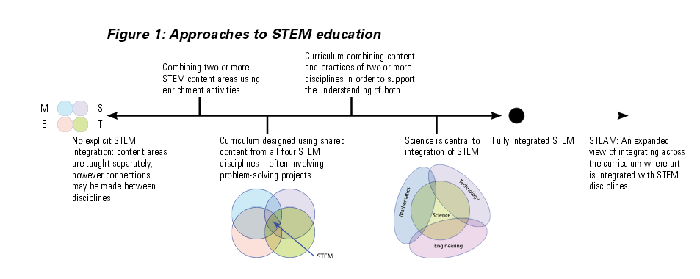
What’s the best approach?
Where is your school on this continuum?
Barakos et al., 2012
Notes:
There are many ways that people are appraoching stame-
On the left we see the separate areas and as we move to the right a more integrated approach, sharing content.
Separate classes that overlap content areas occasionally with specific projects or units.
There is a movement towards full integration, and I also want to mention STEAM, that integrates the arts and acknowledges the benefits of visuals, drawings and diagrams in teaching and learning.
This overlap is actually a central idea of NGSS

