Slide 1


Dean Michael E. Spagna and Dean S. K. Ramesh
and the
CSUN STEM Innovations Team

Slide 2

With our esteemed Keynote speaker,
Dean and Director of the Museum of Science, Boston
Dr. Ioannis Miaoulis
Presents
Enhancing the “T – E “ in STEM Learning

Slide 3
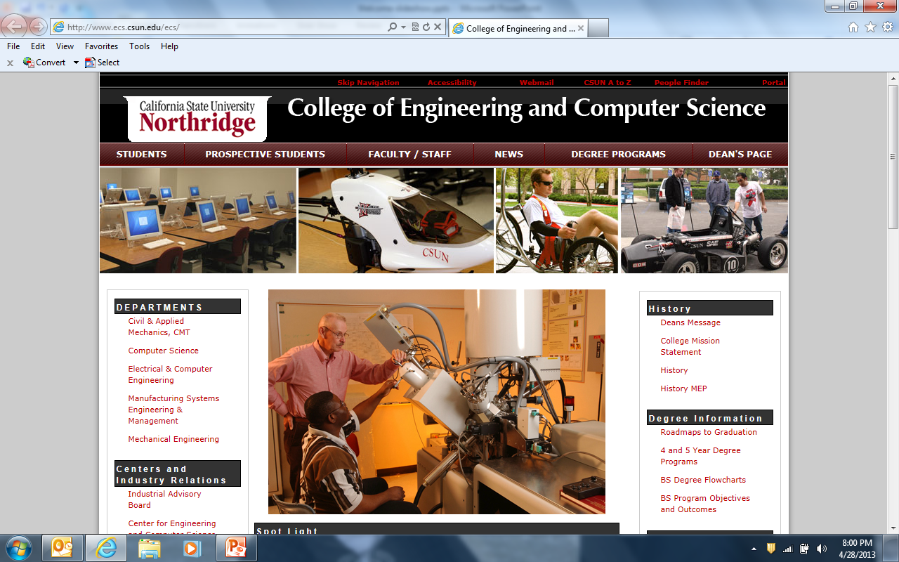


Slide 4
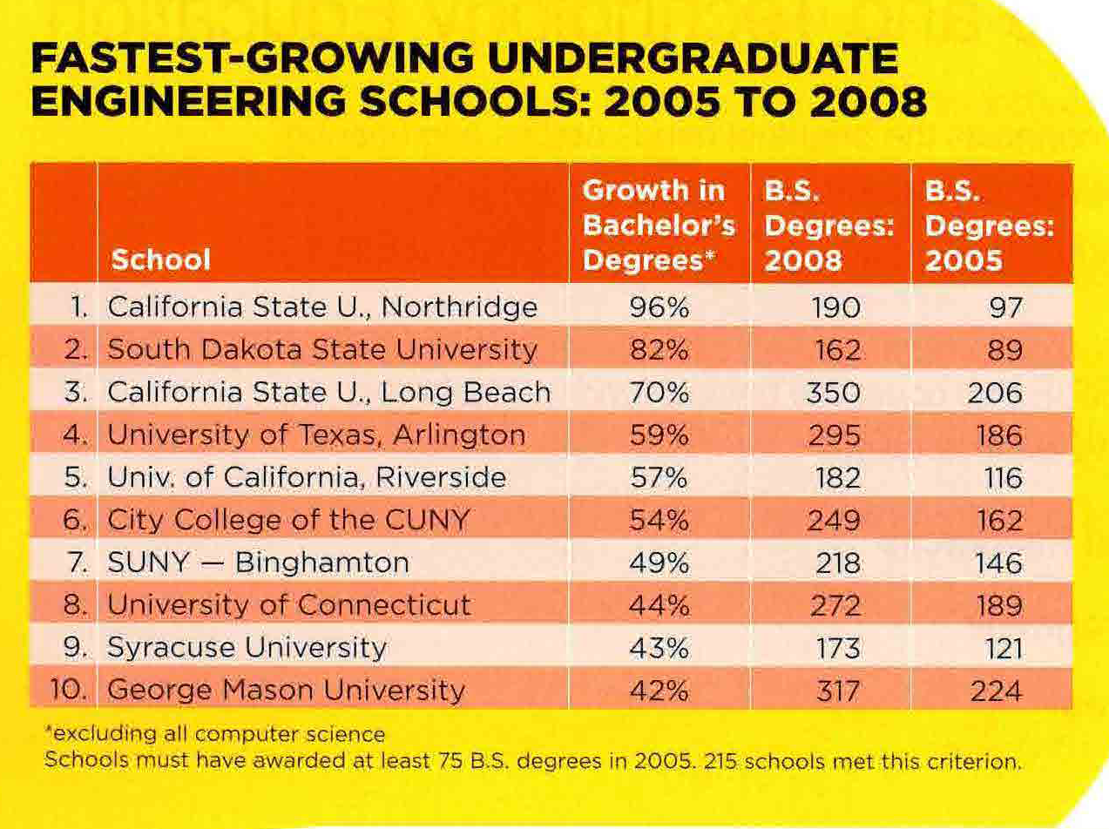

CSUN’s Undergraduate Engineering Programs..
  CSUN’s undergraduate engineering programs were the fastest growing in the nation in the 3 years from ‘05-’08 (96% growth)- ASEE March 2010

Slide 5

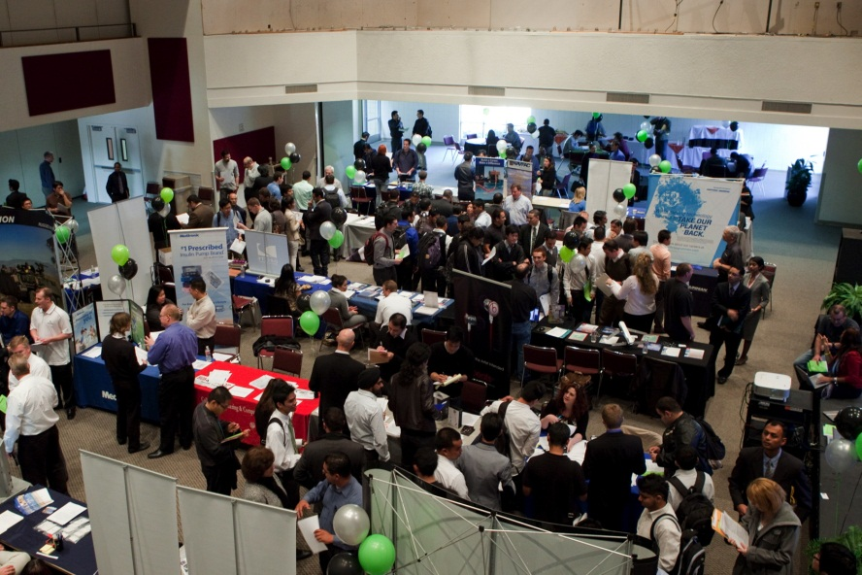
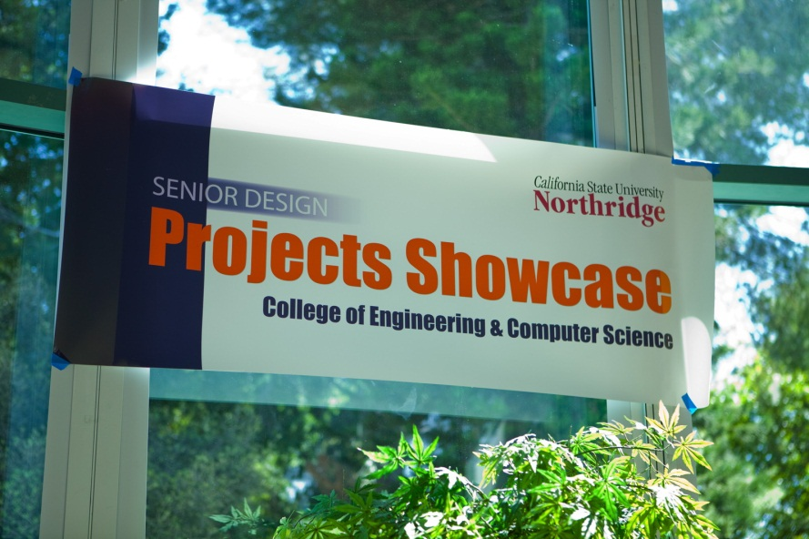
Unique Programs
Tech Fest (2008- present)
Biannual event
Career opportunities for students and alumni
Information Sessions
Approximately ~ 60 companies in 2012-2013
Projects Showcase(2010- present)
Annual Senior Design Showcase highlighting capstone design projects across the college
Held in April and open to the public
Judged by industry panels

Slide 6

US Department of Education Grant
CSUN Receives $5.5 Million Federal Grant to Increase Number of Minorities Studying in Engineering, Computer Science
http://blogs.csun.edu/news/2011/10/engineering-grant/
The San Fernando Valley Business Journal (10/6) reports, "California State University, Northridge has received a five-year, $5.5 million" HSI STEM grant "to increase underrepresented and low-income students in engineering, science and math." The piece notes that the goal of the ED HSI STEM Program is to "help students transfer from area community colleges and then graduate from CSUN with degrees in engineering or computer science."
Cal State Northridge, Harbor College Awarded Federal Science, Tech Grants.
The Los Angeles Times (10/4, Rivera) "LA Now" blog reported, "Cal State Northridge received $5.5 million from the Department of Education's Hispanic-Serving Institutions STEM program to boost the number of students who transfer from a community college and graduate with degrees in engineering and computer science." CSUN "will work with Glendale Community College and College of the Canyons in Santa Clarita to identify potential students who will receive tutoring, mentoring, research opportunities, career advice and stipends to help pay education costs. Faculty from the three institutions will also collaborate on curriculum." The Times reported

Slide 7
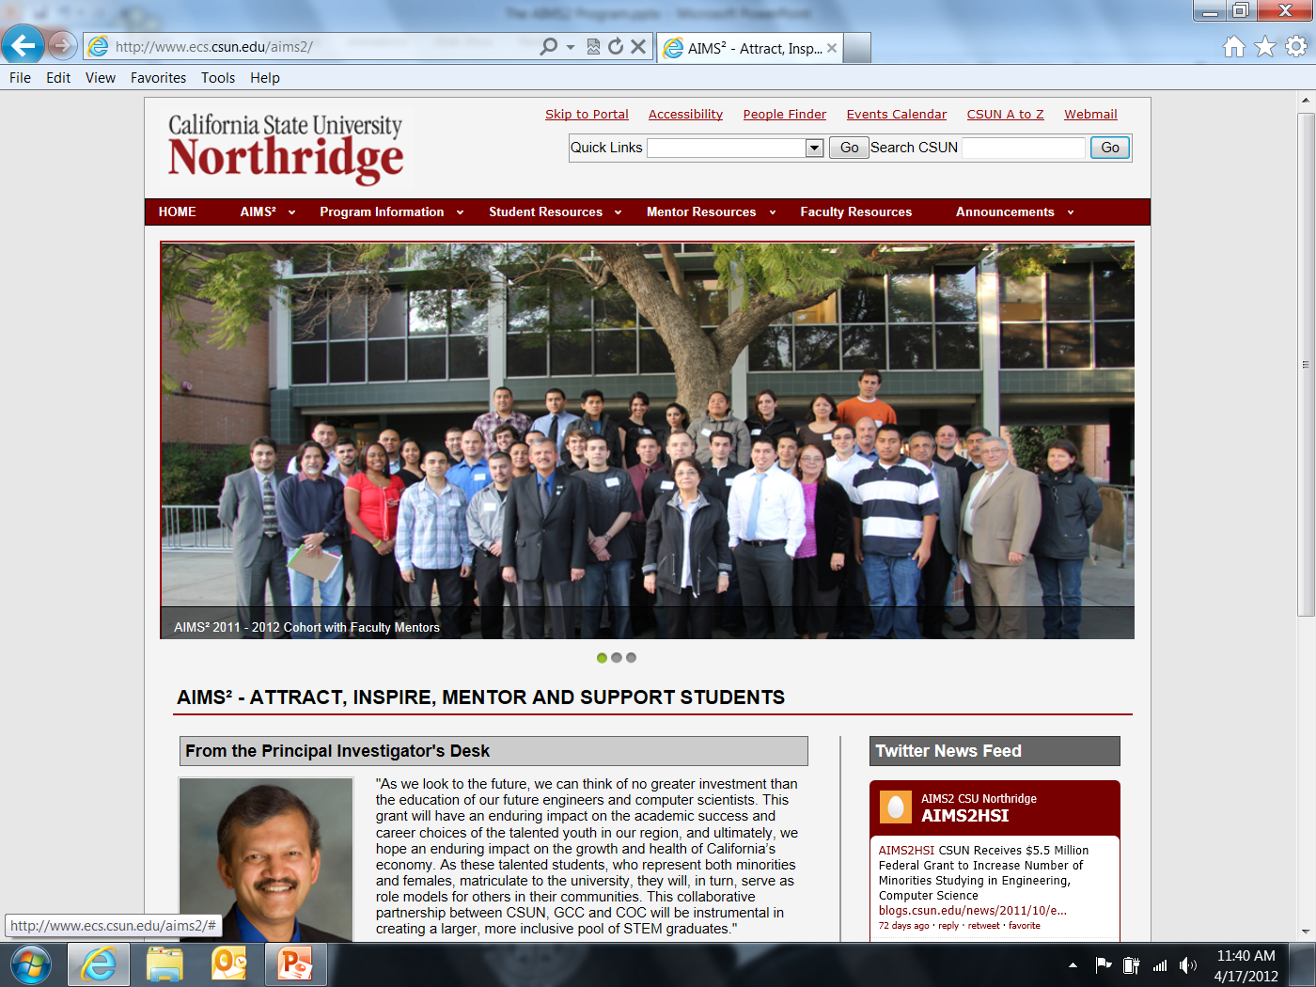
AIMS² Project Website: http://www.ecs.csun.edu/aims2/

Slide 8
ACCESS
ACCESS Program (Accelerated Coursework in Computer Science and Engineering for Student Success)
Talented High School Program (CSUN)
Sponsored by the College of Engineering and Computer Science, at CSUN
Designed for talented high school juniors and seniors who are interested in the field of Engineering and/or Computer Science
MSE 101/L—Intro to Engineering course online & lab portion at local high school campus
Students will earn two college credits

Slide 9
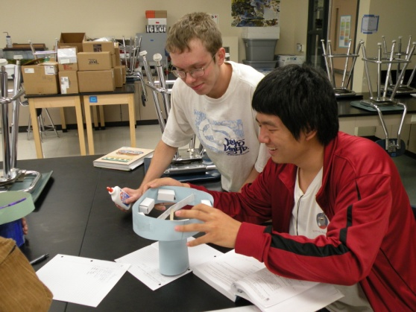
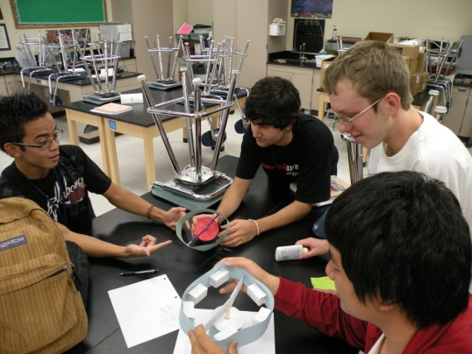
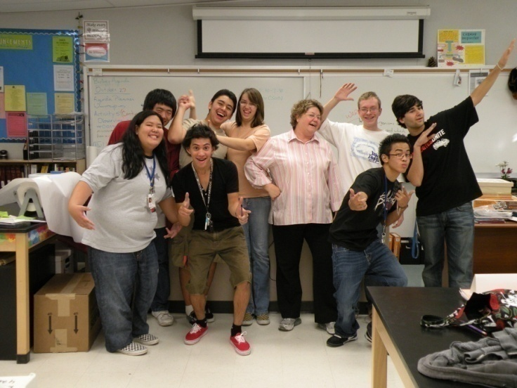
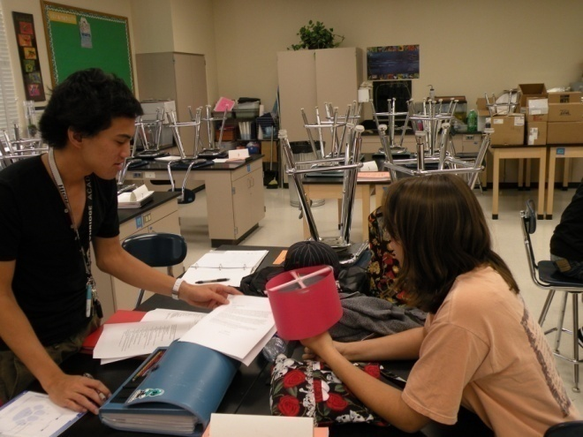
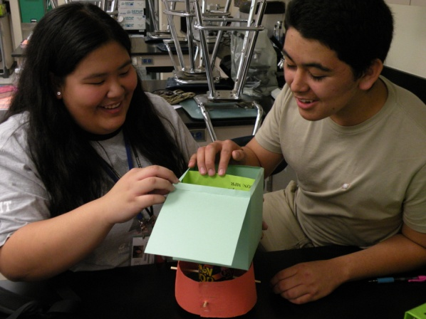
Northridge Academy High School
MSE 101/L ACCESS PROGRAM

Slide 10
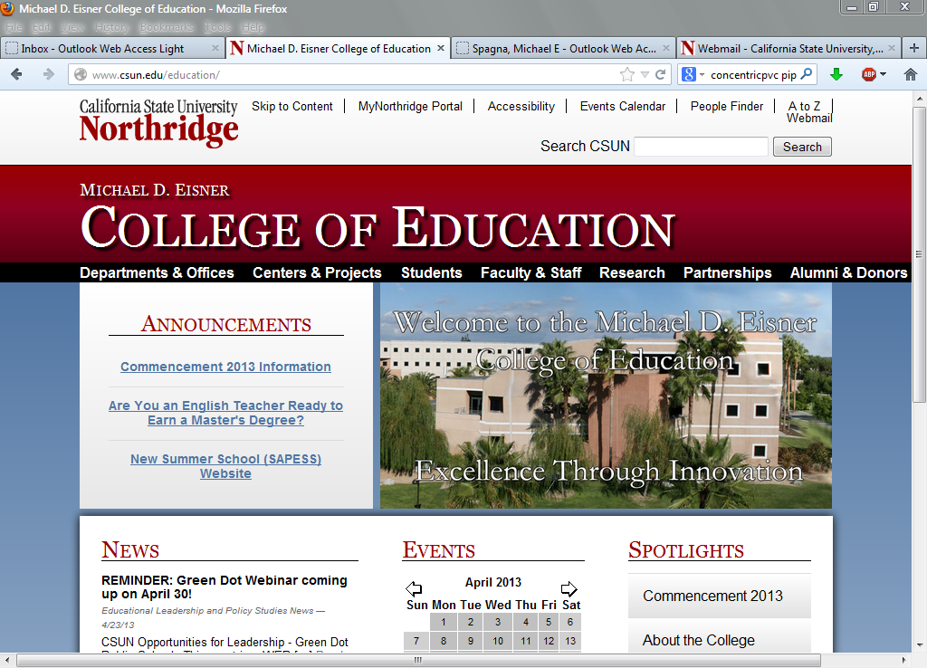

Slide 11
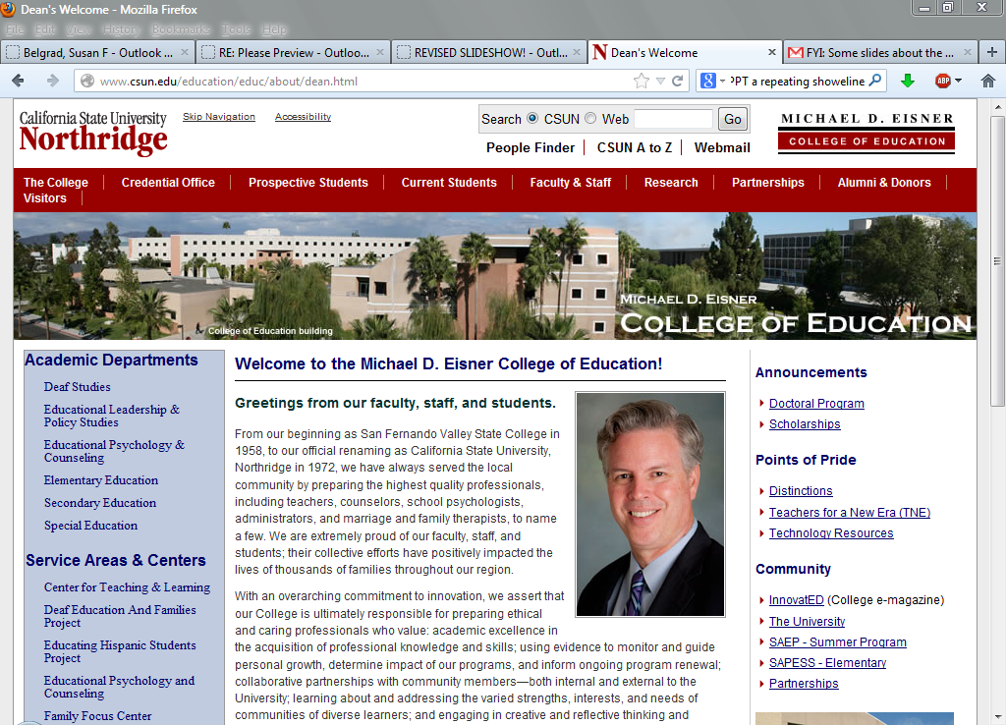

Slide 12
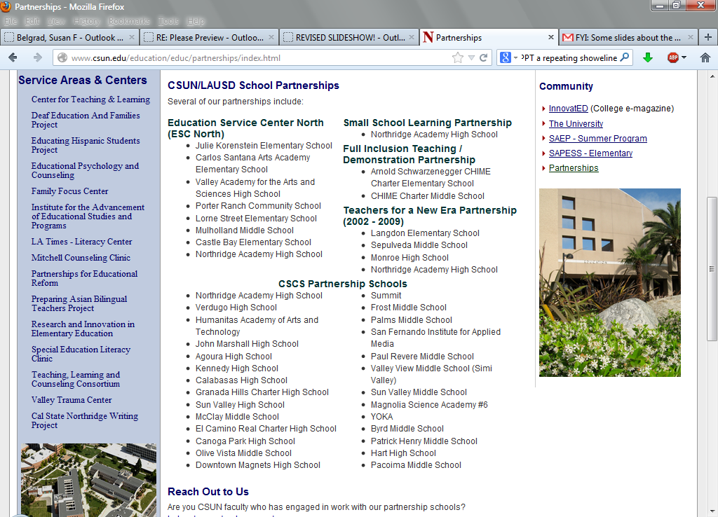

Slide 13
STEM INNOVATIONS TEAM -- Mapping a Pipeline to
Enhance the E in STEM Education (ESTEME)
Michael D. Eisner College of Education – Dean Michael E. Spagna
Susan Belgrad, Elementary Education
Raymond Brie, Elementary Math and Technology Education
Steve Holle, Elementary Education
Julie Gainsburg, Secondary Math Education
Brian Foley, Secondary Educational Technology
Julie Hau, Educational Psychology and Counseling
Joshua Einhorn, Grant Officer
College of Engineering and Computer Science – Dean S. K. Ramesh
Ileana Costea, Chair, Manufacturing Systems Engineering & Management
Robert Dale Conner, Manufacturing Systems Engineering & Management

Slide 14
The CSUN STEM Innovations Team …
Is a dynamic collaboration between the Michael D. Eisner College of Education and the College of Engineering and Computer Science. We pursue a vision to provide a seamless, academic pipeline of early and sustained K-16 STEM curricula to educators in the Los Angeles Unified School District as well as schools and community colleges in the San Fernando, Simi and Santa Clarita Valleys. we recognize the need for elementary, secondary and post-secondary educators together with formal and informal science and industry leaders, to move swiftly and strategically in delivering world-class STEM curricula to schools in our service area. this presentation is part of our action plan to promote a workforce development model that reaches diverse, underserved students through a Supported K-16 STEM School-to-College-Career Network, which we believe will assure their access to promising STEM school achievement, employment and careers.

Slide 15
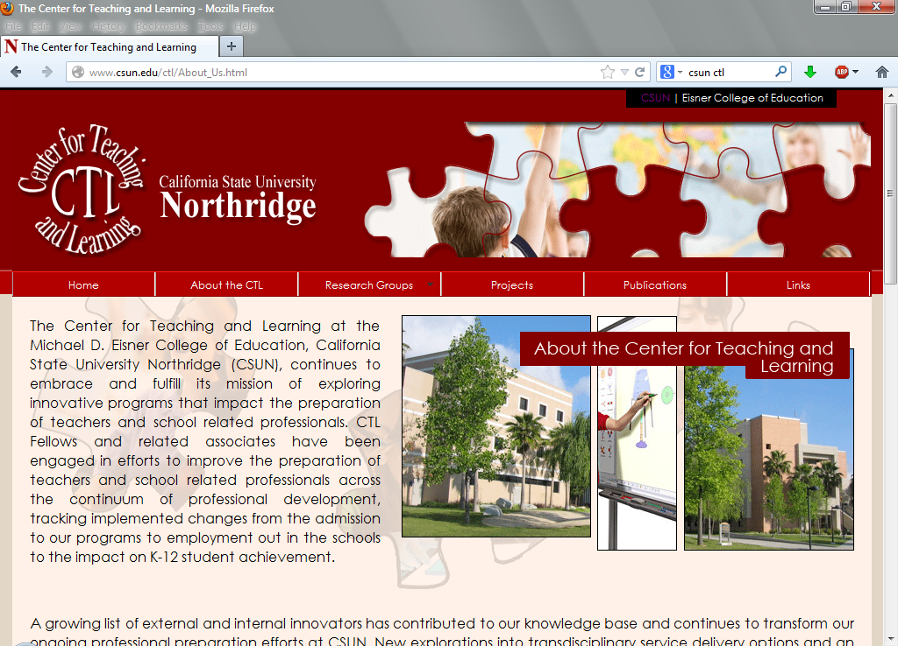
CSUN CTL Promoting STEM-School Professional Development –PBL, Technology, Portfolios

Slide 16
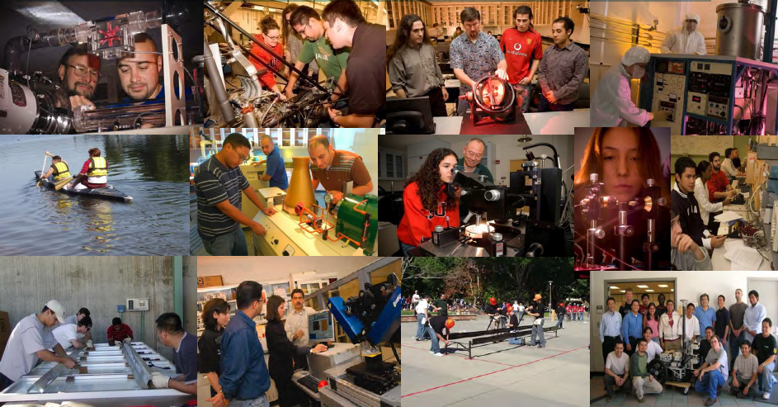
ESTEME Schools Learn How to Engage Students through Project Based Learning

Slide 17
Hot Jobs in STEM
DOL Bureau of Labor Statistics
Occupation | Median Pay, 2011 | Growth, 2010-2020
Biomedical Engineers | $81,540 | 62%
Medical Scientists | $76,700 | 36%
Geographers | $72,800 | 35%
Database Administrators | $73,490 | 31%
Biochemists and Biophysicists | $79,390 | 31%
Software Developers | $90,530 | 30%
Network and Computer Systems Administrators | $69,160 | 28%
Surveyors | $54,880 | 25%
Environmental Engineering Technicians | $43,390 | 24%
Architects | $72,550 | 24%
Environmental Science and Protection Technicians | $41,380 | 24%
Epidemiologists | $63,010 | 24%
Survey Researchers | $36,050 | 24%
Information Security Analysts, Web Developers, and Computer Network Architects | $75,660 | 22%
Computer Systems Analysts | $77,740 | 22%
Cartographers and Photogrammetrists | $54,510 | 22%
Environmental Engineers | $78,740 | 22%
Psychologists | $68,640 | 22%
Anthropologists and Archeologists | $54,230 | 21%
Geoscientists | $82,500 | 21%
Source: U.S. Bureau of Labor Statistics, Occupational Employment Statistics (OES)

Slide 18
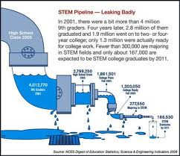
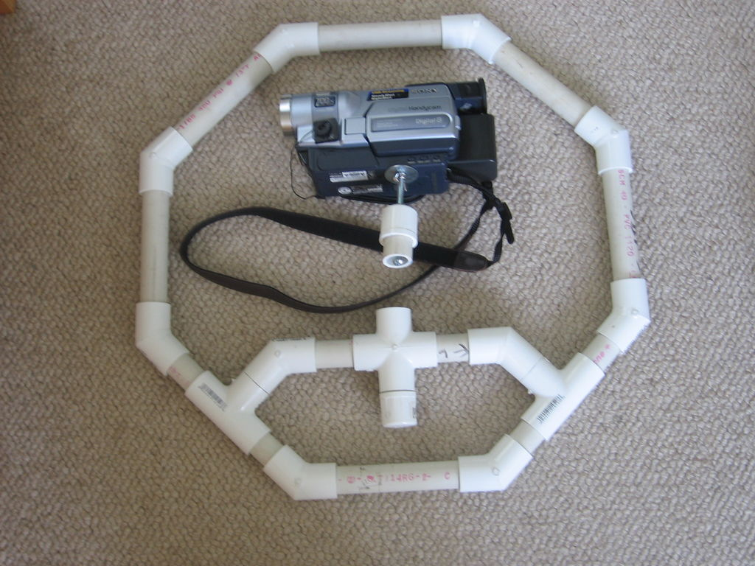
STEM INNOVATIONS TEAM VISION:
FROM
TO
A Sustainable, Connected Pipeline of K-16 Stem Achievers

Slide 19
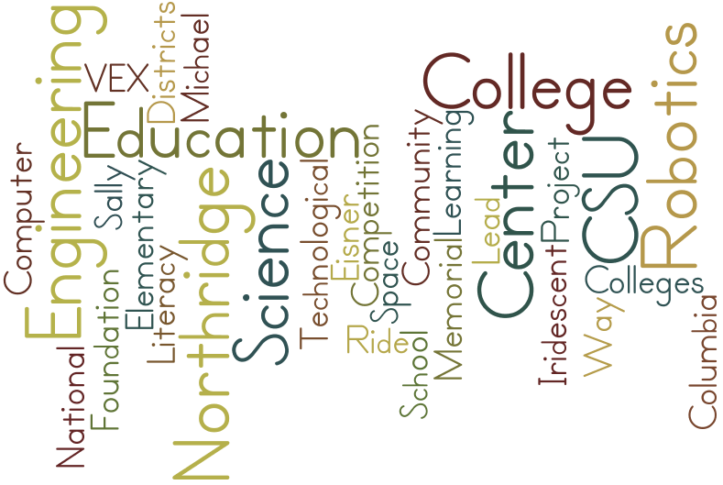
ESTEME Collaborators

Slide 20







ESTEME NETWORK PARTNERS

Slide 21



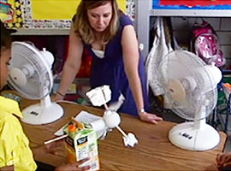
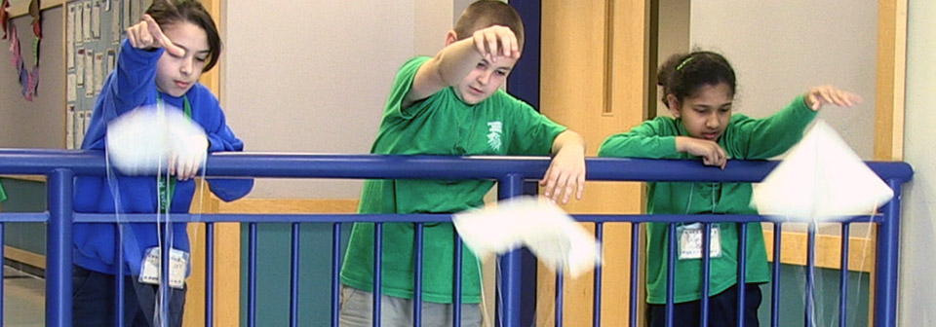

Slide 22

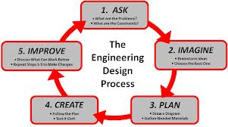

Slide 23


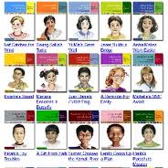



Slide 24

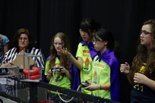

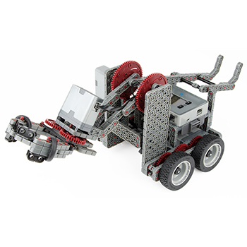
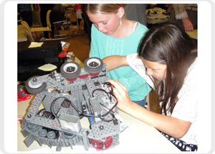

Slide 25
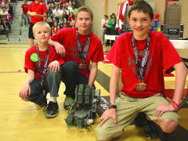


Slide 26


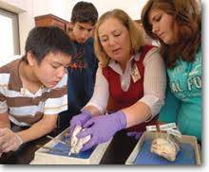
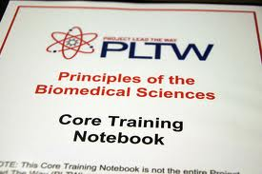
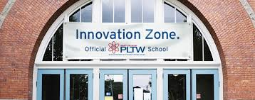
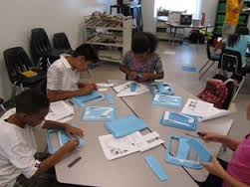

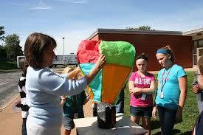
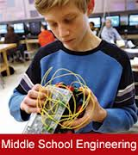
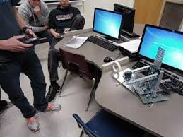

Slide 27






Cool Careers in Science
for Upper Elementary Students

Slide 28
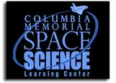
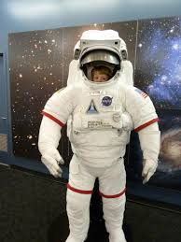
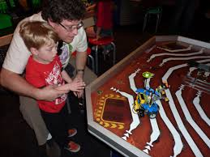
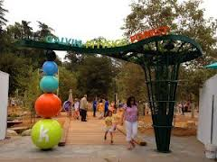
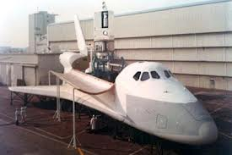
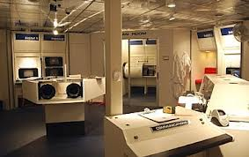
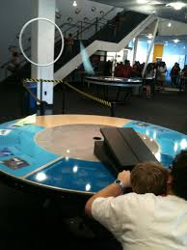
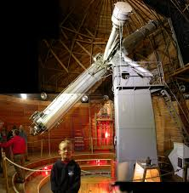

Slide 29

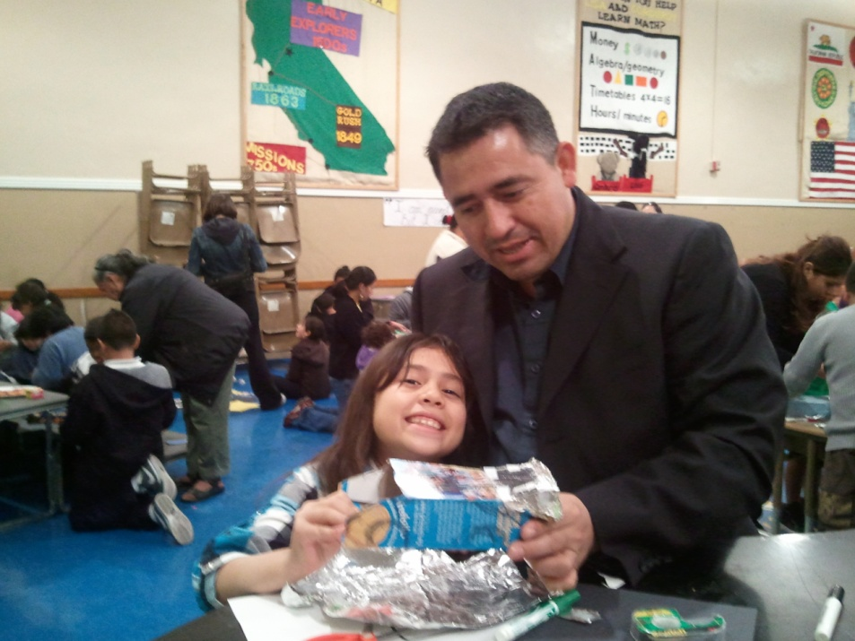
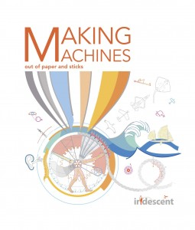
The Iridescent Family Science Program invites elementary school students and their families to learn science concepts, and design and build projects applying those concepts, while working with university and professional engineering instructors and mentors. Family Science programs are free for schools and families.

Slide 30



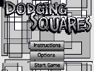


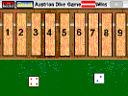


Slide 31
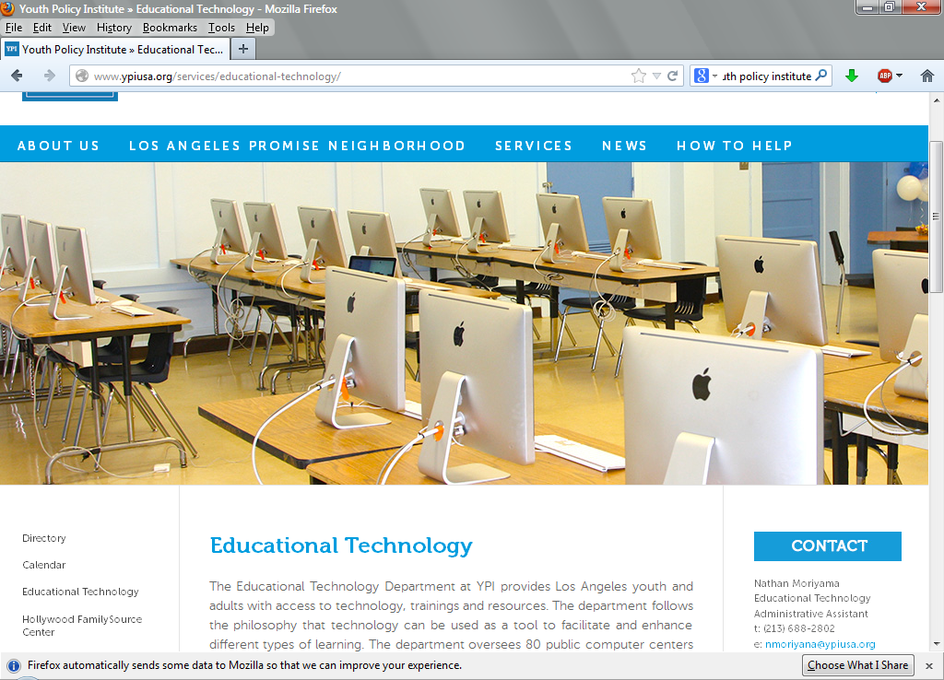


Slide 32


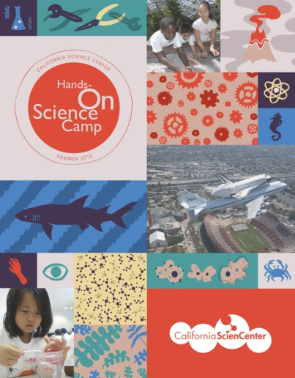
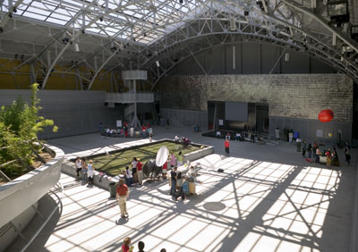
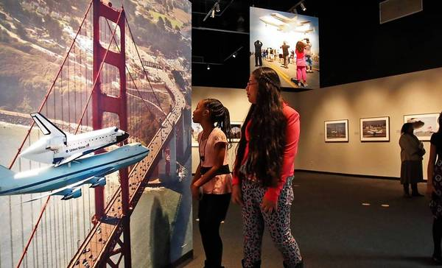
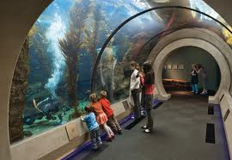

Slide 33

Monroe High School Engineering Students Mentor Vintage 5th Grade Class– Bridge Building
Monroe High School Engineering and Design students have joined up with 5th grade students at Vintage Elementary School to build bridges. Each 5th grade class is represented by four students from that class. Working in groups along with their high school mentors, students are building bridges out of popsicle sticks and glue. Their goal is to build the strongest bridge. All bridges must have a 14 inch span. Students meet at lunch time on Wednesdays, Thursdays and Fridays.

Slide 34
CSUN ESTEME School Network Initiative
Districts | High Schools | Middle Schools | Elementary Schools | Postsecondary
LAUSD | Monroe HS Reseda HS | Sepulveda MS | Plummer ES Vintage Magnet | LA Valley CC Pierce College CSUN
Glendale USD | High School | Theodore Roosevelt MS | Cerritos Elementary | Glendale CC CSUN
Vaughn Next Century Learning Center P-12 Charter Pacoima | Vaughn Next Century Learning Center-VISA | Vaughn Next Century Learning Center- M.I.T. | Vaughn Next Century Learning Center- Pandaland Mainland | Mission College CSUN
Hart Union Saugus Union Santa Clarita | Saugus HS | Rio Norte JHS (Invited) | West Creek Academy K-6 Emblem STEM Academy (K-6) | College of the Canyons CSUN

Slide 35
For information about your school becoming a stem center
Contact:
Susan Belgrad susan.belgrad@csun.edu
Raymond Brie raybrie@aol.com
(Simi-Oxnard-Ventura)
Steve Holle holle@csun.edu

