Slide 1
How (Why) to Transform Your School into an
Inclusive STEM Learning Center
Dr. Susan Belgrad
Professor of Elementary Education
CSUN STEM Innovations Team Leader

Slide 2
CSUN STEM Innovations Team
Faculty in the
Michael D. Eisner College Education
and the
College of Engineering and Computer Sciences

Slide 3
1. Create a climate for all students to achieve a
STEM-discipline sense of belonging and a growth mindset
2. Become a part of ASCD’s Whole Child Initiative; ASCD
3. Seek school-wide Project-Based Learning strategies
(offered through CTL);
4. Implement Common Core State Standards with focus on these essential elements:
- Science ( and related learning dispositions)
- Digital Literacy - Engineering
- Mathematics (deep conceptual learning)
How Do Schools become Effective
STEM Centers for Learning?
Notes:
Technology and communication See: What is an Engineer?

Slide 4
Questions we are pursuing:
What is the concept of “workforce development strategy? ” Who needs this? Who is on board to deliver it? Who will fund it?
Is it possible for diverse (all) learners to access and maintain achievement of the career paths that require STEM leaning?
Is the concept of stereotype threat (ST) real and persistent? For girls and women? For students who are Hispanic or African American? What are the costs of this to U.S. education, workforce, quality of life, economy?
How might we mitigate any effects of ST by introducing students and their parents to engineering activities as early as the first grade? (Sense of Belonging)

Slide 5
Questions we are currently pursuing:
4) If it is true that STEM-based knowledge will drive the workforce over the next three decades, why aren’t educators being advanced and engaged as major players in solving the problem? Isn’t teaching math and science in ways that promote conceptual understanding now more important than ever?
5) Should CSUN as a principal agent in the preparation and continuing professional development of teachers and school administrators be responsible for getting this information into schools and helping them to “gear up” towards bringing Career Technology Education (CTE) pathways into K-12 schooling?

Slide 6
Questions we are currently pursuing:
And should we not also be responsible for bringing awareness of the “Cool Careers in Science and Engineering” to the attention of educators in the Los Angeles region? To parents? To children?
7) How do we begin to engage our elementary, middle school and high school educators?

Slide 7
STEM became an acronym for the fields of study in the categories of science, technology, engineering, and mathematics.
The acronym has been used regarding access to United States work visas for immigrants who are skilled in these fields.
It has also become commonplace in education discussions as a reference to the shortage of skilled workers and inadequate education in these areas. The initiative began to address the perceived lack of qualified candidates for high-tech jobs.
STEM also addresses concern that the subjects are often taught in isolation, instead of as an integrated curriculum. Maintaining a citizenry that is well versed in the STEM fields is a key portion of the public education agenda of the United States.
Wikipedia
Why STEM? Why now?
Notes:
What IS STEM?
Why must K-12 Educators Understand the Need to Create STEM-Centered Schools? Become aware of why STEM is an area of critical economic demand now.
Understand why K-12 educators are central to achievement of a "workforce development strategy"
for the U.S. and CA.

Slide 8
What are the California
Workforce Needs in STEM?
There is a diverse range of industries and STEM occupations:
Industries in the Professional, Scientific and Technical Services sector:
Accounting and Bookkeeping Services
Architectural Services, Management Consulting Services
Engineering Services- Computer-Integrated Manufacturing
Computer Systems Design, Coding and Related Services
Research AND Development in Bio-technology
These industries also employ workers in a wide variety of
STEM occupations such as operations research, analysts,
engineers, biochemists and biophysicists, graphic designers,
and computer programmers.
Notes:
What are the most important careers to pursue in today's workforce?

Slide 9
Hot Jobs in STEM
Occupation | Median Pay, 2011 | Growth, 2010-2020
Biomedical Engineers | $81,540 | 62%
Medical Scientists | $76,700 | 36%
Geographers | $72,800 | 35%
Database Administrators | $73,490 | 31%
Biochemists and Biophysicists | $79,390 | 31%
Software Developers | $90,530 | 30%
Network and Computer Systems Administrators | $69,160 | 28%
Surveyors | $54,880 | 25%
Environmental Engineering Technicians | $43,390 | 24%
Architects | $72,550 | 24%
Environmental Science and Protection Technicians | $41,380 | 24%
Epidemiologists | $63,010 | 24%
Survey Researchers | $36,050 | 24%
Information Security Analysts, Web Developers, and Computer Network Architects | $75,660 | 22%
Computer Systems Analysts | $77,740 | 22%
Cartographers and Photogrammetrists | $54,510 | 22%
Environmental Engineers | $78,740 | 22%
Psychologists | $68,640 | 22%
Anthropologists and Archeologists | $54,230 | 21%
Geoscientists | $82,500 | 21%
Source: U.S. Bureau of Labor Statistics, Occupational Employment Statistics (OES)

Slide 10
How do we begin to engage our elementary, middle school and high school educators?
Many already have!

Slide 11
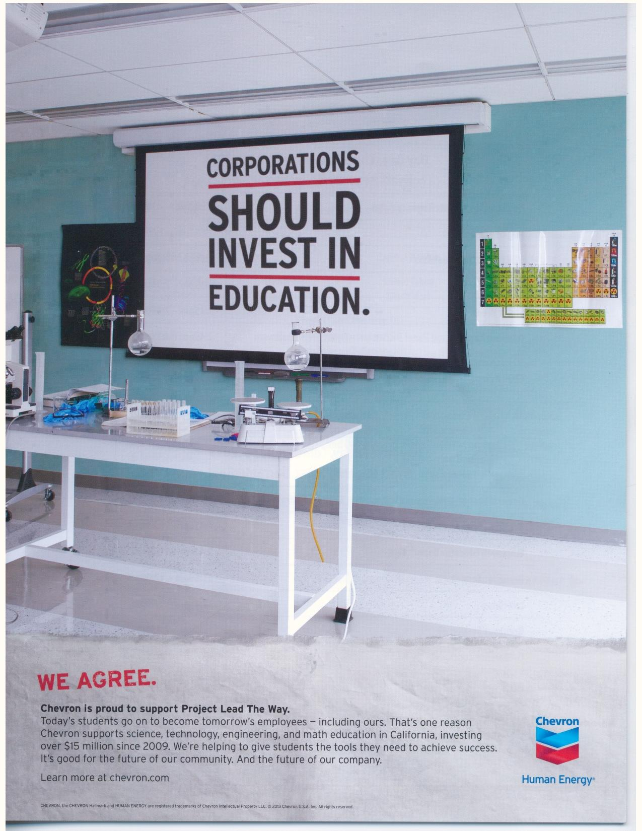
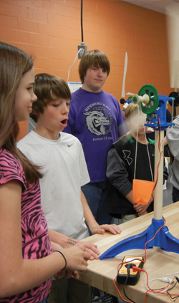
How do we fund next generation school innovation?
Notes:
The Boeing Company donated to the University of South Carolina’s College of Engineering and Computing (CEC). The $100,000 grant will allow the CEC to expand its Project Lead the Way (PLTW) program into four middle schools

Slide 12

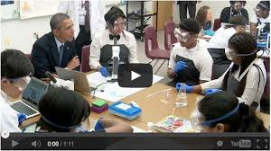
How do we fund next generation school innovation?
Notes:
http://le.utah.gov/publicweb/HILLYLW/PublicWeb/25261/25261.html

Slide 13

How do we fund next generation school innovation?
Pathways Trust Grants

Slide 14
While CA does not have Computer Technology and Engineering standards, many schools have some level of
E in STEM engagement.
Here is one example:
Sound Familiar?

Slide 15
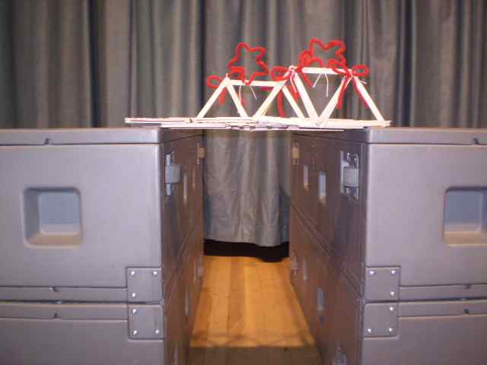
Monroe HS Builds Bridges with Vintage
Equlilaterals
Monroe High School Engineering and Design students have joined up with 5th grade students at Vintage Elementary School to build bridges. Each 5th grade class is represented by four students from that class. Working in groups along with their high school mentors, students are building bridges out of popsicle sticks and glue. Their goal is to build the strongest bridge. All bridges must have a 14 inch span. Students meet at lunch time on Wednesdays, Thursdays and Fridays.
Wednesday, 12 December 2012 18:29 | Written by Debbie Stone

Slide 16
A Brief STEM Activity
Sample COOPERATIVE GROUP ACTIVITY
Task: Each Team will be responsible for achieving an engineering design with the blocks provided; discussing the science, technology and math principles that affect decisions making and task completion; and completing the engineering notebook page.
Time Limit for Creating the structure: 3 minutes

Slide 17
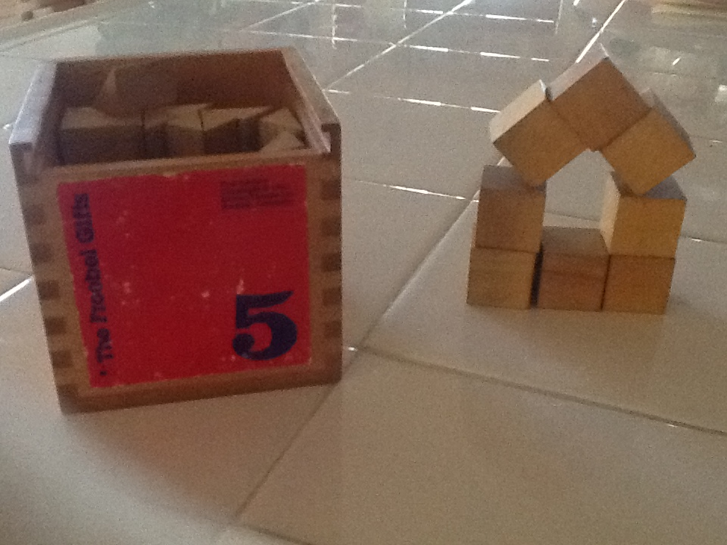
Create a Structure with a Keystone

Slide 18
Scratch
Here is another example of STEM preparation local schools are using:
http://iridescentlearning.org/programs/familycs/

Slide 19
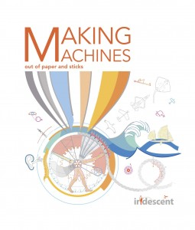
Student/Family STEM Engagement
https://picasaweb.google.com/113239471880384339965/BestOfIridescent?feat=flashalbum#slideshow/5676104508449069666

Slide 20
Engineering is Elementary
Museum of Science, Boston
Engineering is Elementary
CSUN will train teachers in this program.
http://legacy.mos.org/eie/20_unit.php

Slide 21

PROJECT LEAD THE WAY
Gateway To Technology Middle School Program
Foundation Units
Design and Modeling
Automation and Robotics
Energy and the Environment
Specialization Units
Flight and Space
Science and Technology
Magic of Electrons
Green Architecture

Slide 22
PROJECT LEAD THE WAY
Pathway to Engineering High School Program
Foundation Courses
Introduction to Engineering Design
Principles Of Engineering
Specialization Courses
Aerospace Engineering
Biotechnical Engineering
Specialization Units
Civil Engineering and Architecture
•Computer Integrated Manufacturing
•Digital Electronics
Capstone Course
•Engineering Design and Development

Slide 23
PROJECT LEAD THE WAY
High School Program Biomedical Science
Medical Interventions Students investigate various medical interventions that extend and improve quality of life, including gene therapy, pharmacology, surgery, prosthetics, rehabilitation, and supportive care
Biomedical Innovation/Capstone Course
Students work with a mentor, identify a science
research topic, conduct research, write a scientific
paper, and defend
Foundation Units
Principles of the Biomedical Sciences Students study research processes, human medicine and are introduced to bio-informatics
•Human Body Systems Students study basic human physiology, especially in relationship to human health

Slide 24
CSUN ESTEME SCHOOL NETWORK
The Enhancing the E in STEM (ESTEME) Initiative is the focus of a vibrant, ongoing partnership of the College of Engineering and Computer Science and the Michael D. Eisner College of Education. It maintains a strong relationship and shared vision to create a sustained Academic Pipeline of engineering and computer-technology curriculum throughout K-16 schooling for all learners.

Slide 25
CSUN ESTEME SCHOOL NETWORK
Several informal science organizations join us in offering activities that will inspire students and parents to pursue their STEM studies in which they become prepared to enter the growing high-technology-high knowledge workforce as scientists, engineers, information technology specialists and leaders. Our important ongoing collaboration with the Robotics Education and Competition Foundation (REC); and new relationship with the National Center for Technological Literacy (NCTL) of the Museum of Science, Boston has been further enhanced with our recent agreement to become a Hub-Site Provider for the Engineering is Elementary school program they have offered since 2004. And CSUN is now strongly engaged with Project Lead the Way as we introduce and deliver the resources of their Computer Science and Engineering, Green Technology and Biomed curricula to the schools we serve in the San Fernando, Simi and Santa Clarita Valleys of Southern California.

Slide 26
CSUN ESTEME SCHOOL NETWORK
In addition, Iridescent Learning, Los Angeles, an organization that has been funded by NSF is providing the Project with assistance in delivering DIY workshops and E in STEM family activities. The Columbia Memorial Space Center, an organization dedicated to aerospace science and exploration that has been funded by NASA, together with the Sally Ride Science Community, will assist us to assure increased STEM discipline career awareness and school success for elementary-level underserved students and their families. The funding of this Project will result in a disseminatable “workforce development strategy” for other University-School/Community-Informal Science Networks.

Slide 27
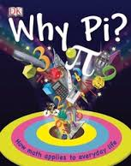
Did you celebrate PI Day with your students last week? Here is an Activity to take home

Slide 28
Celebrate Math
Everyday—
Math Achievement Matters!
University of Chicago Everyday Math --- Minute Math
Math Their Way Daily Activities

Slide 29
Contact the Stem Innovations Team:
Dr. Susan Belgrad susan.belgrad@csun.edu
Steve Holle, Center for Teaching and Learning holle@csun.edu

