Slide 1

HUBBARD ELEMENTARY
October 29, 2013
Susan Belgrad & Steve Holle

Slide 2

“PASS THE PULSE” ACTIVITY http://www.online-stopwatch.com/large-stopwatch/
Notes:
Prediction: How long will it take to pass the pulse clockwise?
Counterclockwise?

Slide 3

TODAY’S GOALS
Understand:
Importance of nonfiction literacy
How to connect nonfiction literacy, science and engineering careers, and scientists and engineers

Slide 4
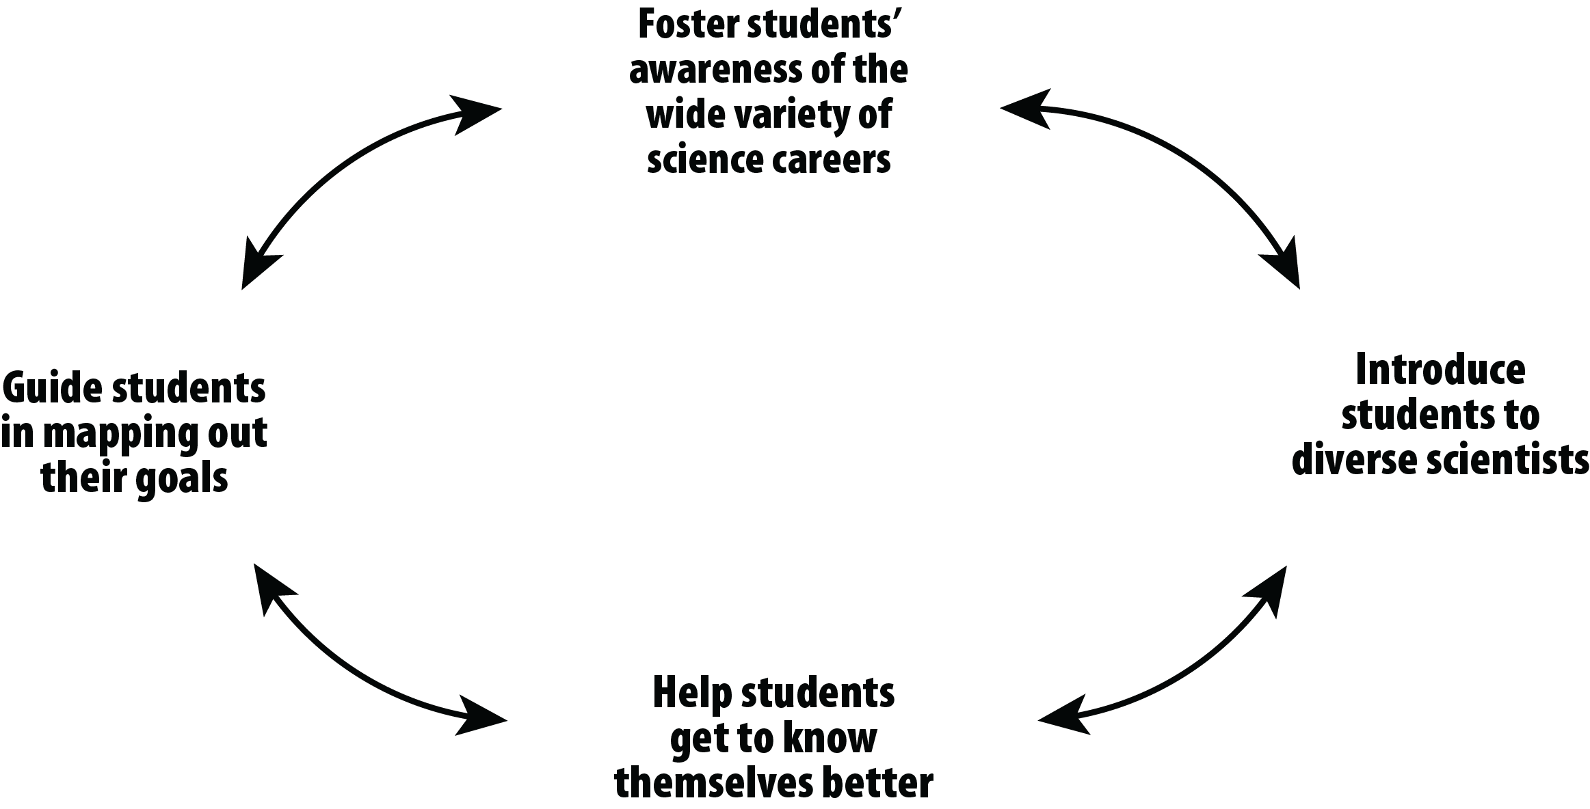
Building Nonfiction Literacy Has Never Been More Important

Slide 5
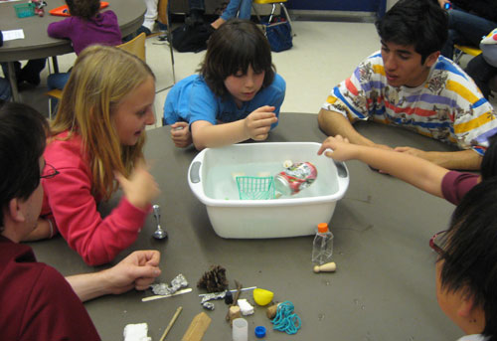
http://www.nextgenscience.org/case-next-generation-science-standards

Slide 6
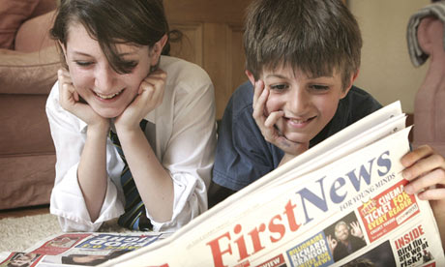
Science plays a larger role in our daily lives than ever before. So, it’s essential for students to become skilled at nonfiction reading and writing.
Being able to read a newspaper and make informed decisions about one’s health, the environment, and local and global affairs requires solid nonfiction reading and writing skills.

Slide 7
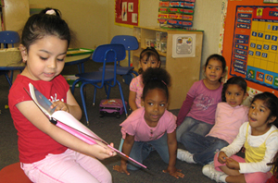
CONNECTING TO COMMON CORE
Reading Anchor #1: Read closely to determine what the text says explicitly and to make logical inferences from it; cite specific textual evidence when writing or speaking to support conclusion drawn from the text.
Reading Anchor #3: Analyze how and why individuals, events, or ideas develop and interact over the course of a text.
Writing Anchor #7: Conduct short as well as more sustained research projects based on focused questions, demonstrating understanding of the subject under investigation.
Speaking & Listening Anchor #1: Prepare for and participate effectively in a range of conversations and collaborations with diverse partners, building on others’ ideas and expressing their own clearly and persuasively.
Notes:
Activity on Common Core in Action:

Slide 8
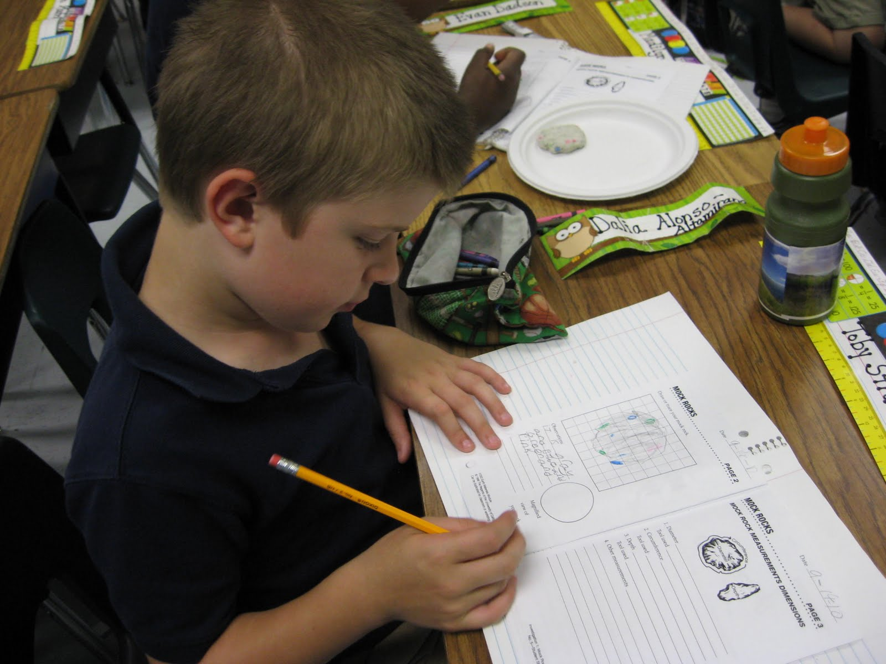
As You Teach Nonfiction Literacy
Use science and the lives and work of scientists and engineers to:
Build nonfiction reading and writing skills
Foster students’ awareness of the wide variety of science careers and the vibrant women and men working in science
Help students explore who they are and connect their interests to science

Slide 9
Reading! A Science Article
Take a few minutes to read the articles about science and engineering.
Purpose:
To demonstrate connecting engaging
expository reading to science careers.

Slide 10
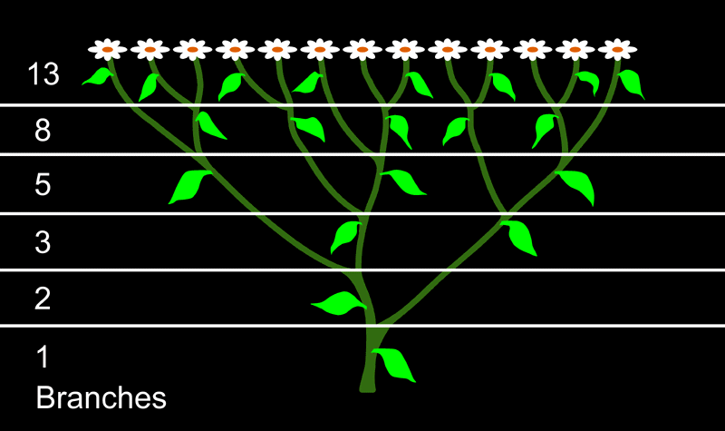
As you read, analyze how the article . . .
Captured your interest.
Described the details of the innovation.
Made you feel like you could know a student like this.
Share in teams. Complete the PMI graphic organizer. Then we’ll discuss the article as a group.

Slide 11
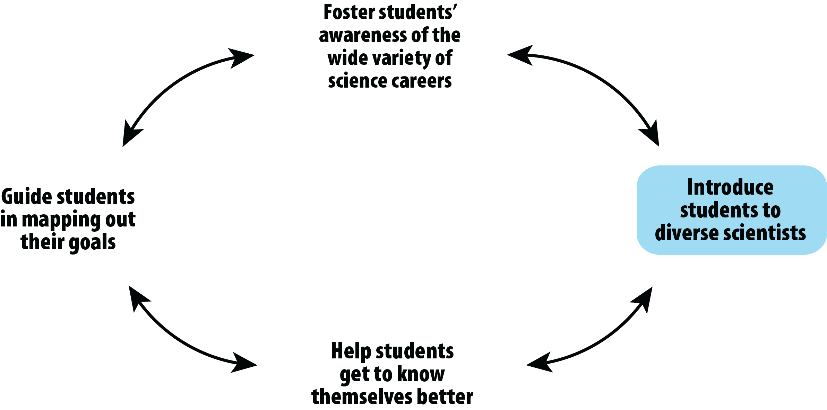
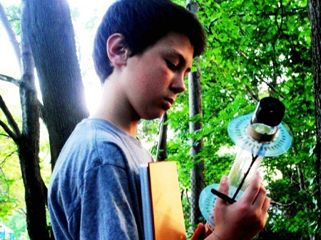
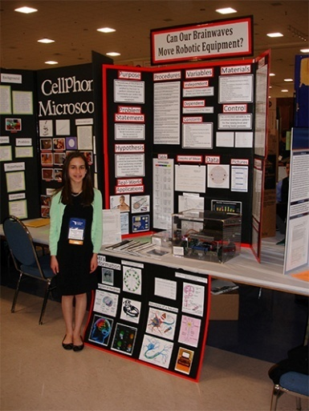
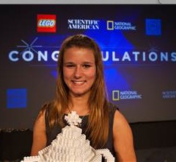
What began the scientific journey of the inventor?
Explain how the observation resulted in problem solving?
What is something new that you learned?
If you were a student wanting to learn more about our world, where would you look online? Check out Youngzine.org

Slide 12
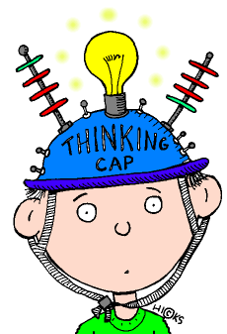
Now - Let’s Process This Activity
How did you connect with the nonfiction literacy?
What was science?
What was engineering?
Did it show how students can access careers, as scientists and engineers?
How will you apply this?

Slide 13

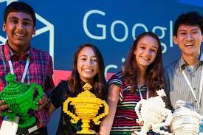
The Winners Have Been Announced!
The Google Science Fair is an online competition open to students aged 13-18 around the globe. Our Goal is to inspire the students WE teach to know that they can acquire the knowledge, skill and creativity to make a difference too!

Slide 14
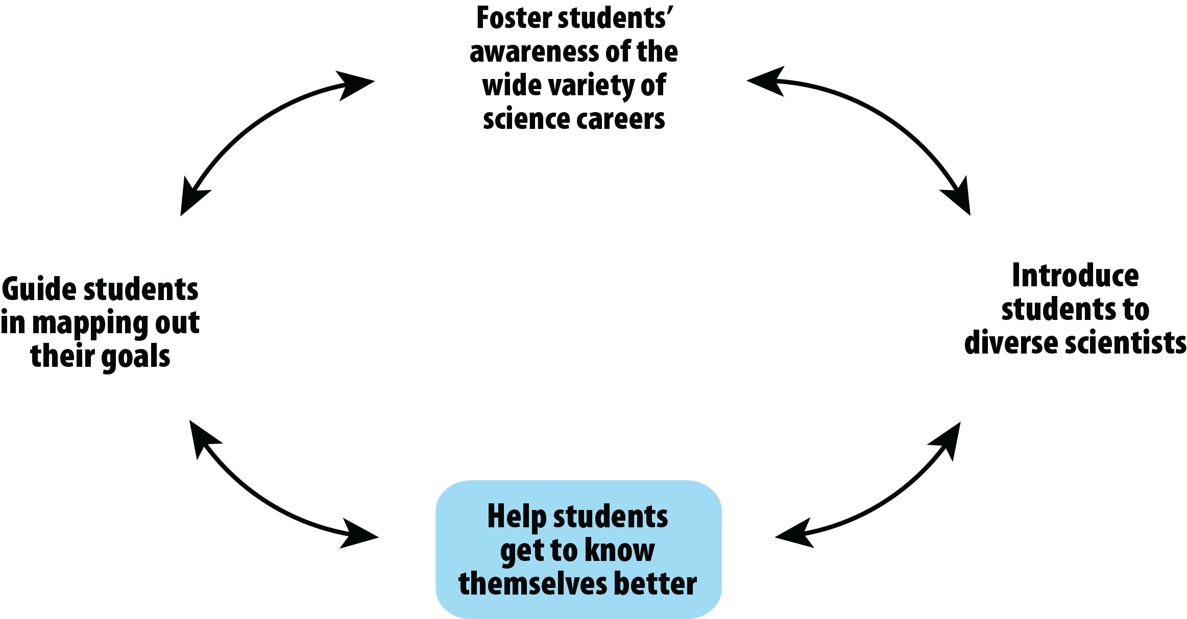
Take a minute to complete

Slide 15
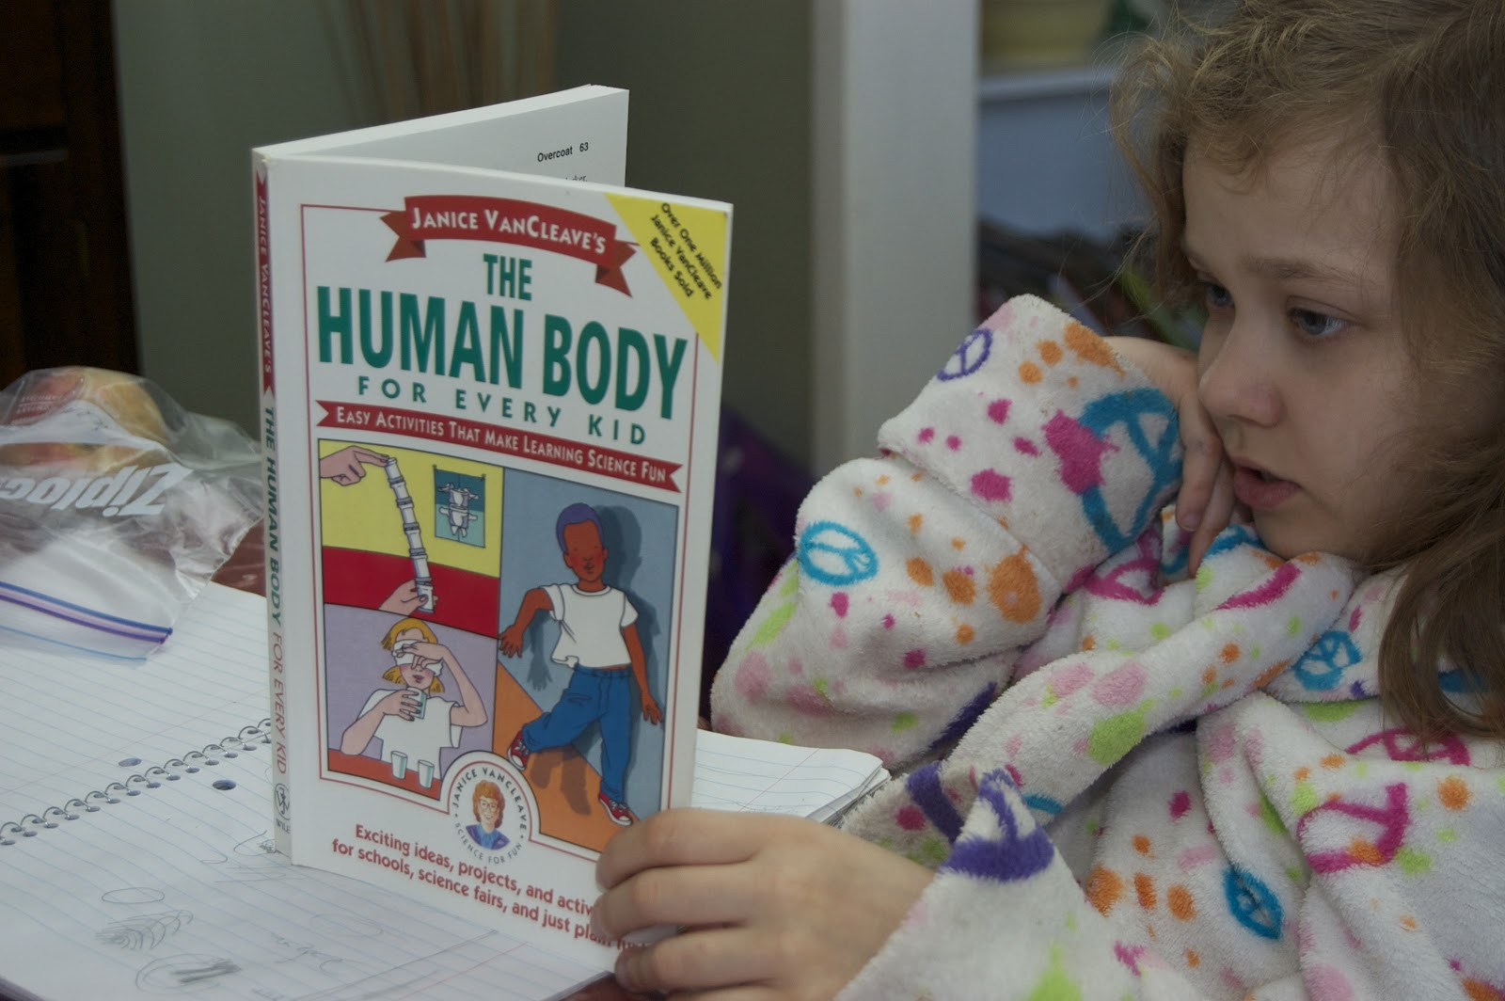
THANK YOU

