Slide 1
LESSON DESIGN STUDY
SUPPORT PROVIDER
INFORMATION SESSION
ALIGNING INDUCTION CANDIDATE’S LESSON STUDY WITH
TEACHER –DRIVEN PROFESSIONAL
GROWTH AND DEVELOPMENT
Dr. Susan Belgrad, November 4, 2015

Slide 2
NPR ED http://www.npr.org/sections/ed/2015/03/21/393344523/with-fewer-new-teachers-why-do-some-stick-around
With Fewer New Teachers, Why Do Some Stick Around?

Slide 3

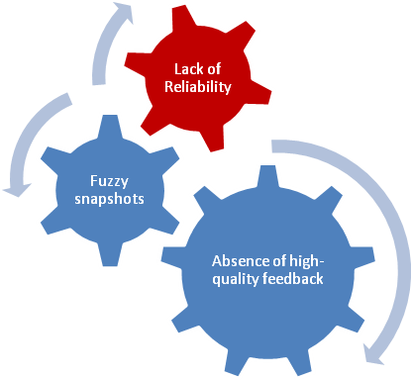

Teacher Evaluation Current Reality
From C. Danielson Webinar Series

Slide 4
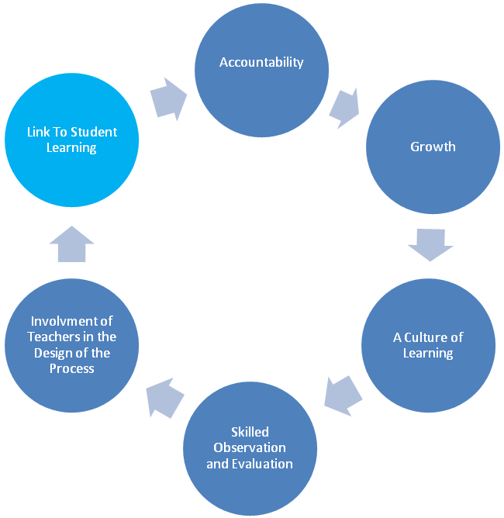
Lesson Study– Desired Result
From C. Danielson Webinar Series

Slide 5
So why does lesson design study bridge our professional stages of growth and development?
It responds to the following concerns about promoting a highly-effective teaching workforce.
Dr. Susan Belgrad, November 4, 2015

Slide 6
Here’s What We Know about the
Importance of Effective Teaching
Student achievement will not improve unless teaching
improves.
Teachers working alone without feedback will not be able to improve no matter how much professional development they receive.
The challenge is to create a system of continuous improvement of instruction, supervision and instructional leadership
Collaboration/Supervision needs to be frequent and focused on the teacher’s goals for improvement of instruction.
Marzano Evaluation Model

Slide 7
Lesson Design Study’s Potential
Communicates the common language of teaching efficiently
Facilitates the observation and feedback cycle.
Promotes teacher reflection and collaboration.
Offers targeted & aligned professional development
Provides conditions for deliberate practice
Connects growth, development and performance
management for the individual practitioner.
Marzano Causal Teacher Evaluation Model MarzanoEvaluation.com

Slide 8
So where do you begin the lesson design study process with your Induction Teacher?
Take a look at the FACT Organizer on the next slide.
Dr. Susan Belgrad, November 4, 2015

Slide 9
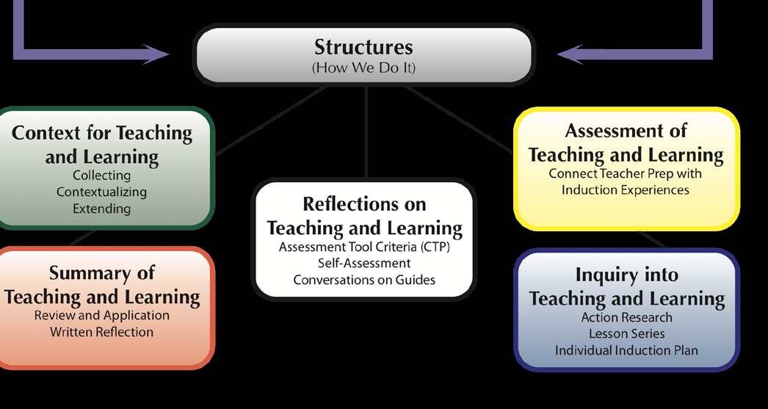

Slide 10
Assessment of
Teaching and Learning
Connect Teacher Prep with
Induction Experiences
In the next week you will assist your Candidate with the FACT B-Series Forms as shown in the next slides.

Slide 11
K-W-O Chart (B-2)
DIRECTIONS: Candidate determines a specific area of focus for the support provider’s observation.
Reflects on current practice and indicate:
What I know about my instructional practice
What I want to know about my instructional practice
What I would like my support provider to observe

Slide 12
Initial Classroom/Assignment Observation (B-3)
Collection of Evidence: California Standards for the Teaching Profession
See FACT User’s Guide
1: Engaging and Supporting All Students in Learning
2: Creating and Maintaining Effective Environments for Student Learning
3: Understanding and Organizing Subject Matter for Student Learning
4: Planning Instruction and Designing Learning Experiences for All Students
5: Assessing Students
for Learning
6: Developing as a Professional Educator

Slide 13
Post-Observation Reflection (B-4)
DIRECTIONS: With your support provider,
use evidence from the observation to
capture key insights about your teaching.
Post-Observation Key Insights:
Key evidence shared after observation
Insights

Slide 14
Research tells us that the role of the teacher is the single greatest factor on student learning.(Sanders & Horn, 1998) .
Research also tells that one of the greatest factors central office [administrators] can contribute is to maintain a singular focus on improving instruction. (Marzano and Waters, 2009)
Research tells us that an improved focus on teacher evaluation and professional development will improve retention of teachers S.M. Johnson, J.H. Berg, M.L. Donaldson. (2005).

Slide 15
Next You will guide your Candidate into Lesson Study as Inquiry into Teaching and Learning
See FACT User’s Guide
Individual Induction Plan C-1 (pp.39-44)
Lesson Study that includes C-2-C-5(pp.45-50)
Action Research on Target
Student Learning C-6-C-8 (pp 54-55)
LAUSD TEACHERS: SEE NEXT SLIDE

Slide 16
LAUSD Faculty
Individual Induction Plan See FACT User’s Guide C-1 (pp.39-44)
LAUSD New Teacher Guide
LAUSD Teaching and Learning Framework
Lesson Study Template (LAUSD)

Slide 17
The Final Form is the D-1 Conversation to Promote Reflection on Teaching and Learning

Slide 18
Culminating Questions and Reflections Guide (D-1)
Yourself –
What were your growth goals?
How would you measure your progress toward meeting those goals?
Your students –
What did you learn about your students’ needs?
What did you learn about differentiating instruction?
What did your student assessments tell you about your teaching?
Evidence –
Reflect on evidence collected during the three modules (Context for Teaching and Learning, Assessment of Teaching and Learning, and Inquiry into Teaching and Learning) in the following areas:
  Focus students
  State-adopted Content and Common Core Standards
  Instructional strategies
  Assessments

Slide 19
References
Danielson, C. (2007) Handbook on the Framework for Professional Development. Arlington VA: ASCD.
Marzano , R. and Waters, T. (2009) District Leadership That Works: Striking the Right Balance. Bloomington, IN: Solution Tree.
NPR-ED. 2015 http://www.npr.org/sections/ed/2015/03/21/393344523/with-fewer-new-teachers-why-do-some-stick-around
Sanders, W.L. & Horn, S.P. (1998). Research Findings from the Tennessee Value-Added Assessment System (TVAAS) Database:
Implications for Educational Evaluation and Research. Journal of Personnel Evaluation in Education,12(3),247-256.
SandersW. L, (2004) A summary of conclusions drawn from longitudinal analysis of student achievement data over the past 22 years. Paper presented to Governors Education Symposium, Ashville, NC.http://www.sas.com/govedu/edu/hunt_summary.pdf
S.M. Johnson, J.H. Berg, M.L. Donaldson. (2005, January).
Who Stays in Teaching and Why: A Review of the Literature on Teacher Retention. The Project on the Next Generation of Teachers, Harvard Graduate School of Education. http://assets.aarp.org/www.aarp.org_/articles/NRTA/Harvard_report.pdf

