Slide 1
Sustainability Project
At Pacoima Charter

Slide 2
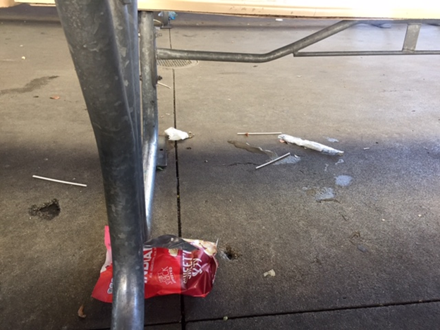
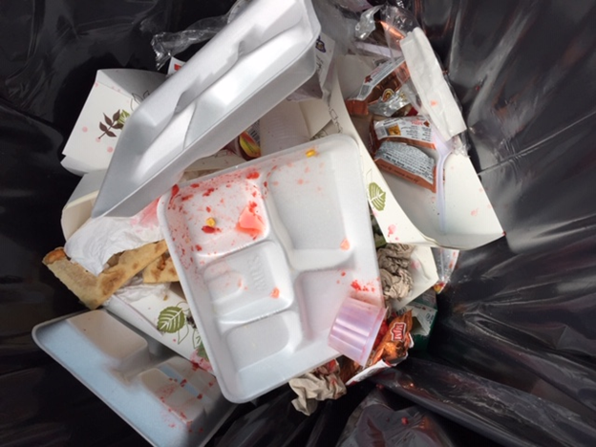
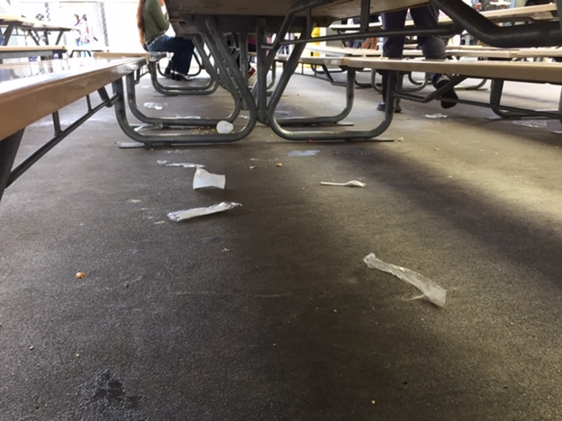
Our project was inspired by the use of plastics and waste at PCS.

Slide 3
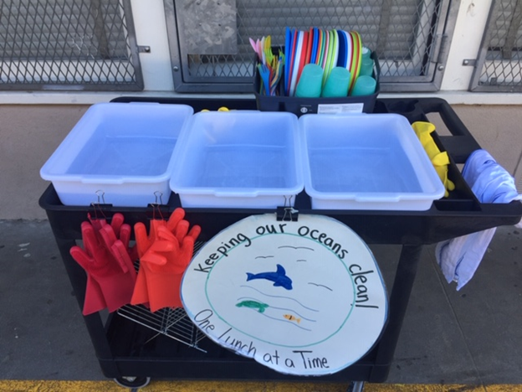
So we created a wash station!

Slide 4
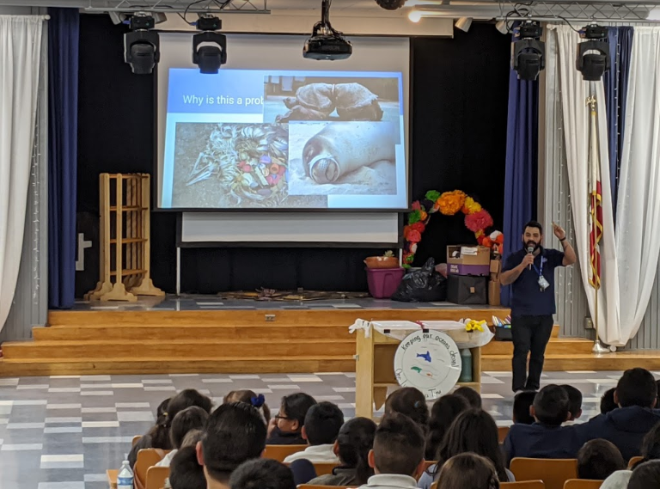
We also held an assembly to educate students about the importance of our project.

Slide 5
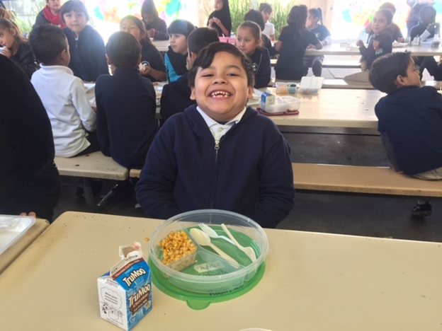
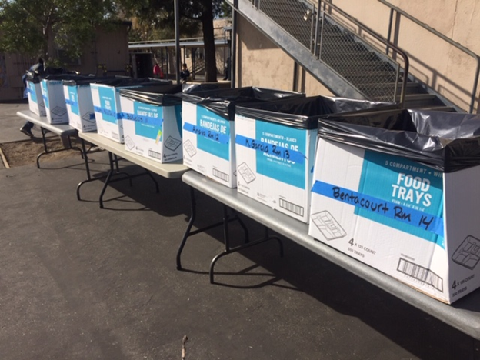
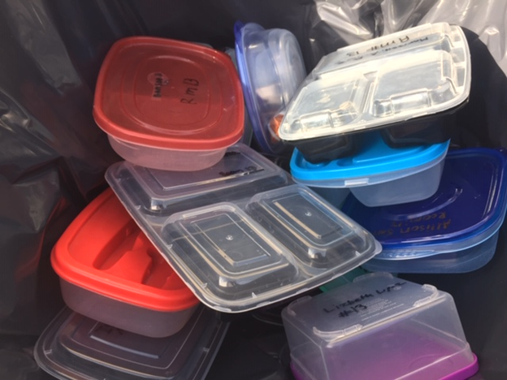
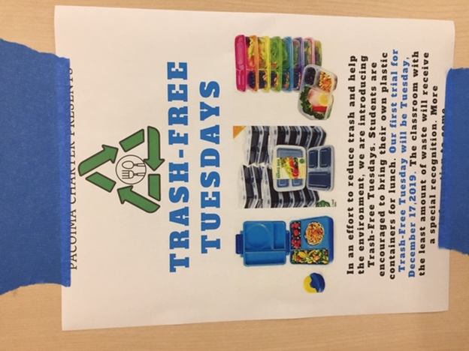
Our school is implementing a
Trash Free Tuesday!

Slide 6
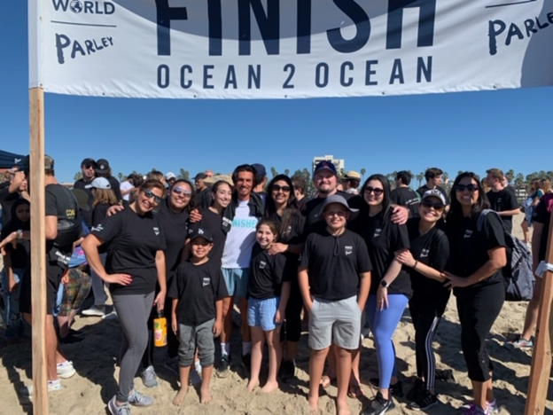
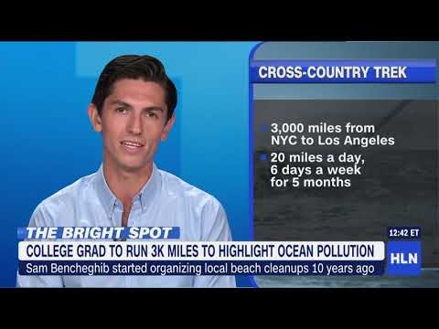
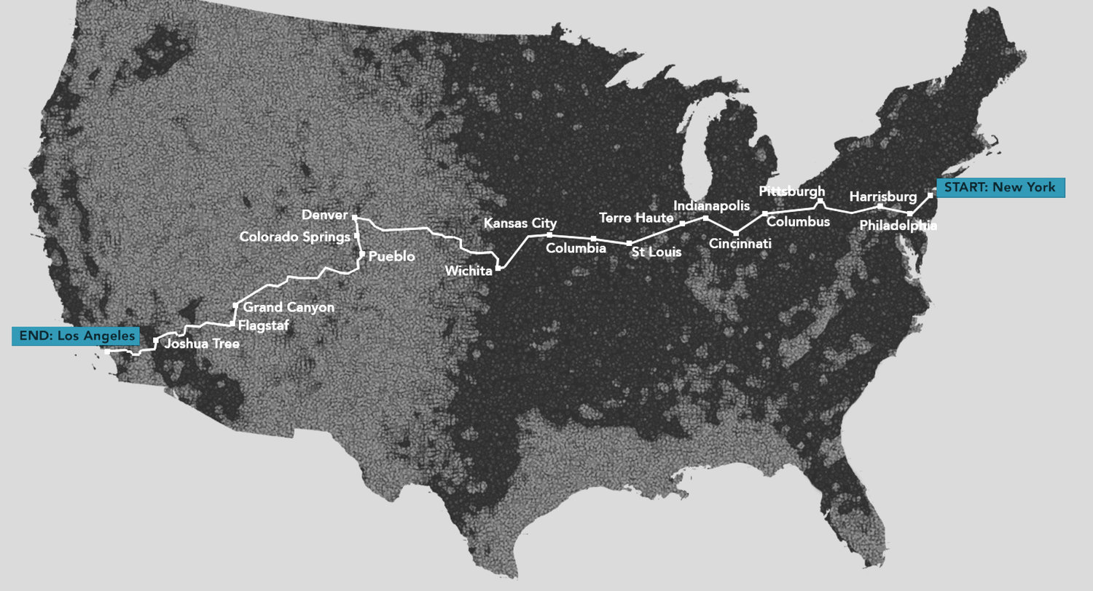
Mrs. Betancourt in 4th grade arranged for Sam Bencheghib to give us a visit.
He ran across the U.S to bring awareness to the problem of plastic pollution!

Slide 7
Progress so far...
We have spent $366 on materials for our project.
As of February 29th we have saved 1575 units.
Side note:
  Box of 500 trays cost $22.00
  Box of 1000 spork and straw packets cost $13

Slide 8

Moving forward (There is still much to do)
We will continue to add classes to our project and increase the amount of units saved.

