Slide 1
How to Help Children Develop a Resilient Attitude
Diana Orellana
Karla Mercado
Hillary Sampson

Slide 2
“Don’t handicap your children by making their lives easy.”
-Robert A. Heinlein

Slide 3
What is a resilient child?
A resilient child is one who:
Overcomes obstacles
Perseveres through hardships (academic and social)
A child who adapts and bounces back quickly
A child who does not allow their mistakes to define them

Slide 4
What obstacles do children face?
Obstacles that children face can range from:
Being lonely during recess/lunch.
The death of a parent or close family member.
A bad score on an assignment or test.
Not making a sports team.
Being new to a school.
Divorce in the family.

Slide 5
Why is it Important?
Throughout life we all experience hardships and it is crucial for students to learn to not let these hardships define them. We want children to learn to “dust themselves off and try again” and again and again without feeling defeated or less than.

Slide 6
Resiliency and Growth Mindset
Helping children to develop a resilient attitude goes hand in hand with Carol Dweck’s concept of Growth Mindset.
Practicing a growth mindset in our classrooms will help our students be: Be more confident, risk takers, less stressed out, embrace imperfections, create individual goals, and persevere through obstacles feeling proud of themselves and not defeated. This will lead to resilient attitudes.

Slide 7
How do we as teachers help to develop resilient attitudes?
We develop a relationship with each of our students!
We ask our students to try their best.
We monitor their individual progress throughout the year. This will help our students see their own personal growth and achievements.

Slide 8
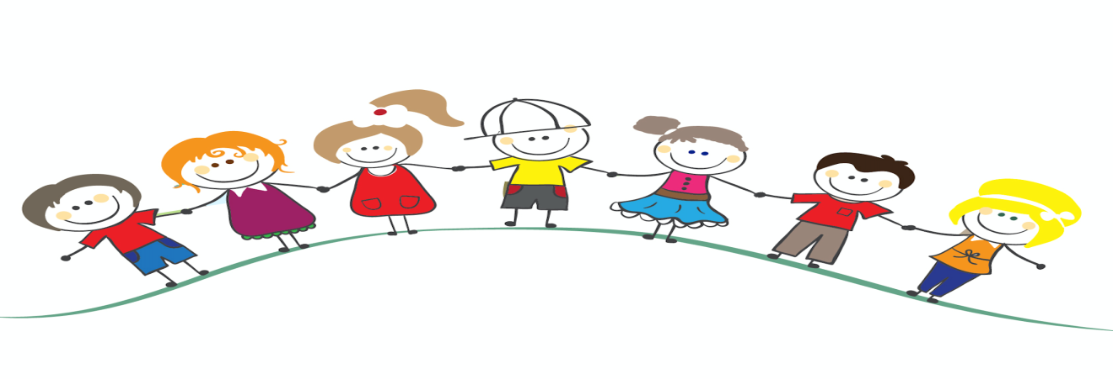
We encourage and do not scold!
We teach children that their weaknesses are goals to overcome!
We teach students to self-reflect:
What are you most proud of?
What was the most difficult?
How did you feel while completing the assignment/assessment/activity, etc.?

Slide 9
The 7 C’s
Building resilience in children is an ongoing process but the lifetime benefits are great! In an article from HealthyChildren.Org we found “The 7 C’s of Resilience” created by Dr. Kenneth Gisnburg from The Children's Hospital of Philadelphia .
Competence
Confidence
Connections
Character
Contribution
Coping
Control
https://healthychildren.org/English/healthy-living/emotional-wellness/Building-Resilience/Pages/Building-Resilience-in-Children.aspx

Slide 10
How can we develop the 7 C’s?
Competence
Have children focus on individual strengths.
Allow children to make their own decisions.
Confidence
Allow students to complete what they can realistically handle.
Praise them honestly and individually.
Connections
Have a caring classroom community.
Allow students to express their emotions without any condescending responses.

Slide 11
Character
Discuss how individual behaviors affect others.
Discuss the importance of being a team and seeing your classmates as team members and not competition.
Contribution
Allow all students to contribute to the class in one way or another.
Coping
Model and offer positive coping mechanisms. For example, if a child is angry allow them to be able to go for a run instead of impulsively lashing out at their peers.
Control
Use discipline to TEACH not to control behavior.
We want our students to learn and grow from mistakes not feel humiliated or less than.

Slide 12
But HOW do we do all that AND teach the curriculum?
Developing resilient attitudes is not an overnight task! It is impossible for us as educators to go through each of the 7 C’s while teaching the curriculum. However, resilient attitudes can be developed a little bit every day if we seek the opportunities we do have and use them to our advantage to model resiliency!

Slide 13
My Gifts and Qualities
This exercise will focus on who you are inside.
Identify qualities from the worksheet that you feel you have.
Cut those qualities out.
Share qualities with the class.
Explain why you chose certain qualities.
Decorate your gift box and glue it.
Make it look great!
These gift boxes are gifts that you each have inside. They make each one of you special and unique.

Slide 14
In conclusion…
Helping our students develop a resilient attitude can be done in the everyday moments that we share with them in class or with activities like “My Gifts and Qualities”.
Using these moments as opportunities to model resiliency and mold our students is how we help them to become resilient children and face adversity head on!

