Slide 1

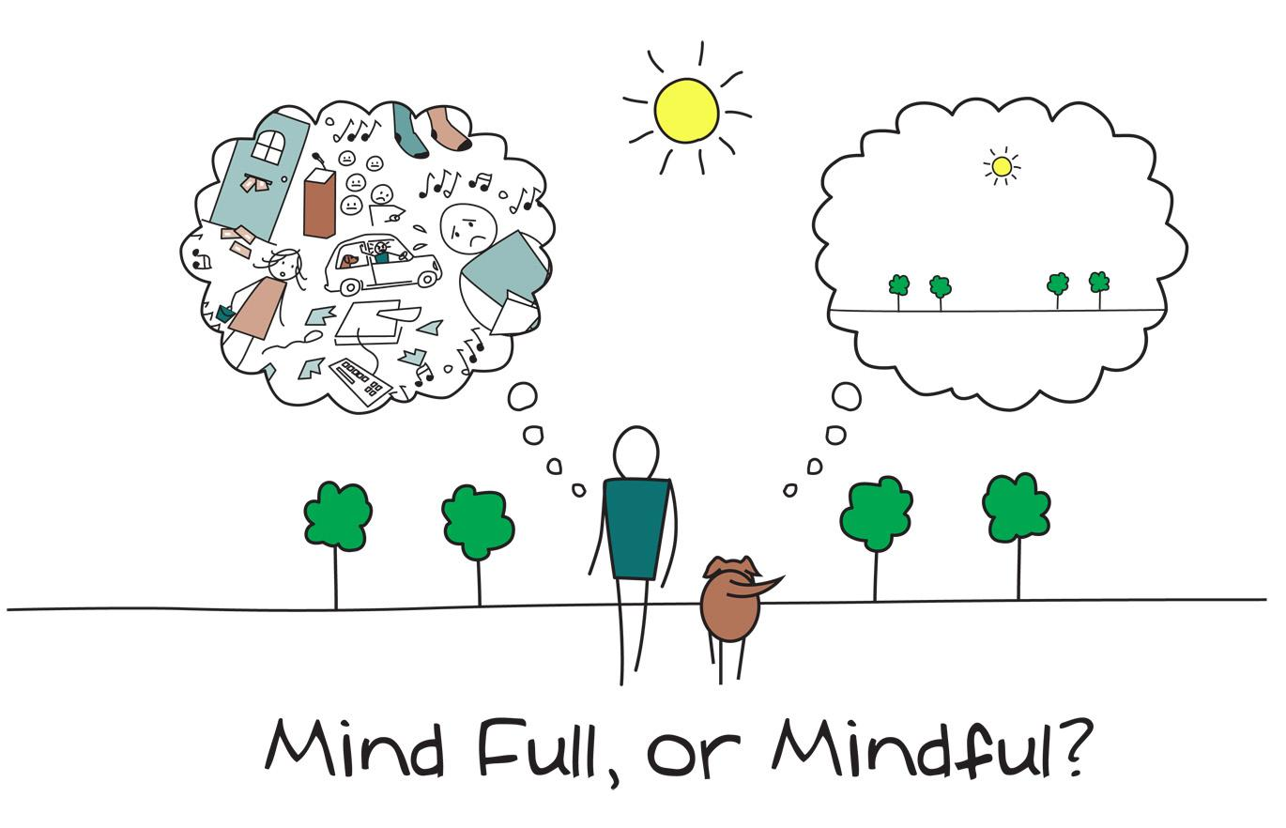
MINDFULNESS
Anna Arakelian, Melody Lin, Shanilla Natanzi

Slide 2
What is MINDFULNESS?
“Mindfulness is the basic human ability to be fully present, aware of where we are and what we’re doing, and not overly reactive or overwhelmed by what’s going on around us.”
Source: https://www.mindful.org/what-is-mindfulness/

Slide 3
Mindful meditation
“Meditation begins and ends in the body. It involves taking the time to pay attention to where we are and what’s going on, and that starts with being aware of our body.”
Important things to remember:
1, Posture
2. Breathe
3. Be present in the moment

Slide 4
MINDFUL meditation
I’ve got my feet on the floor
I’ve got my spine in a line
I’ve got my hands in my lap
I’ve got my heart to the sky
Now close your eyes
Let's try it!

Slide 5
MINDFULNESS in the classroom
When to do it?
Start of a day (Mindful Monday)
Before a test
Brain break
It can be as short and simple as…

Slide 6
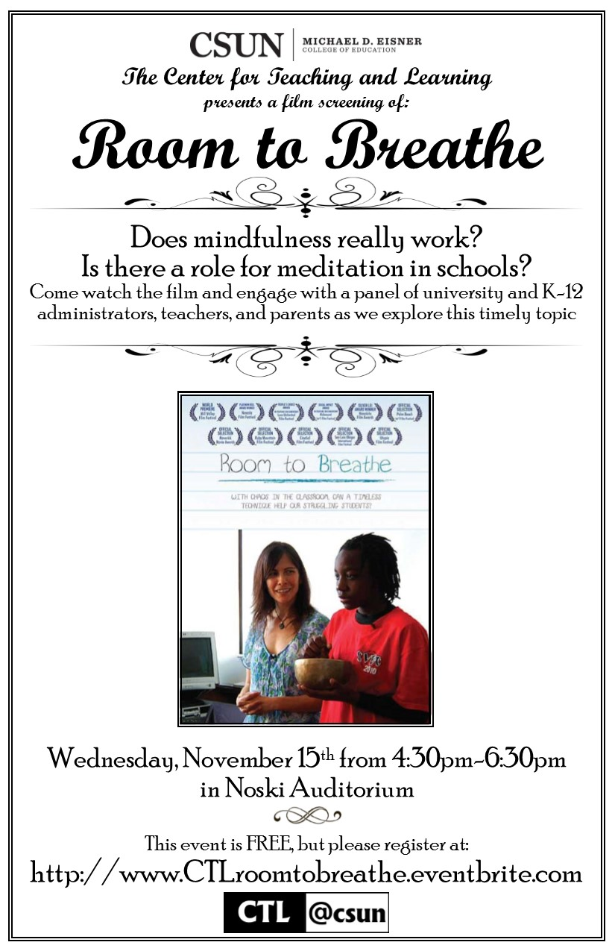
Learn More

Slide 7

Morning Meetings

Slide 8
Purpose
Sets the tone for a respectful learning environment and establishes a climate of trust
Motivates children by addressing two human needs: a sense of significance and belonging & the need to have fun
repetitive routine
Source: http://images.slideplayer.com/20/6024873/slides/slide_4.jpg

Slide 9
May Include:
Unpacking routine
Morning question to take attendance
Daily agenda
Goal setting
Pledge of allegiance
Journal quick write
Morning message (proofreading)
School/ Classroom messages

Slide 10
(possible) PRocedure
Greeting: Students and teachers greet one another by name.
Sharing: Students share information about important events in their lives. Listeners often offer empathetic comments or ask clarifying questions.
Group Activity: Everyone participates in a brief, lively activity that fosters group cohesion and helps students practice social and academic skills (for example, reciting a poem, dancing, singing, or playing a game).
Morning Message: Students read and interact with a short message written by their teacher. The message is crafted to help students focus on the work they’ll do in school that day.
Source: https://www.responsiveclassroom.org/what-is-morning-meeting/

