Slide 1
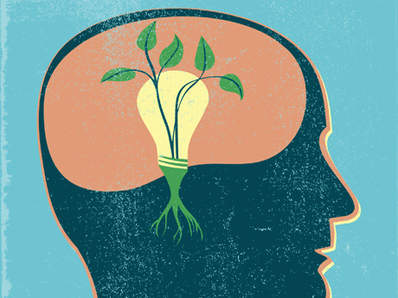
GROWTH MINDSET
Luz, Naomi, & Rai

Slide 2
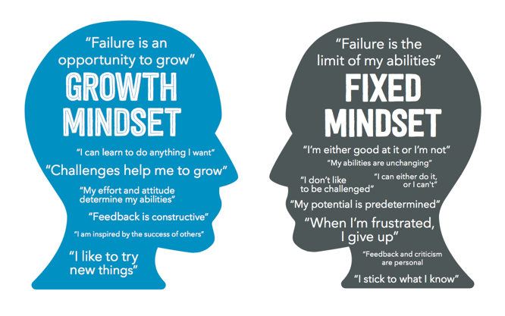
MINDSET
Research was done by Carol Dweck.
Fixed mindset- People believe their basic qualities are simply fixed traits. They also believe talent alone creates success.
Growth mindset- People believe that their most basic abilities can be developed through dedication and hard work.

Slide 3


Two Mindsets in the Classroom
Fixed mindset students focused on grades.
Growth mindset students focused more on learning than getting good grades.

Slide 4
Fixed Mindset vs Growth Mindset
https://www.youtube.com/watch?v=KUWn_TJTrnU

Slide 5
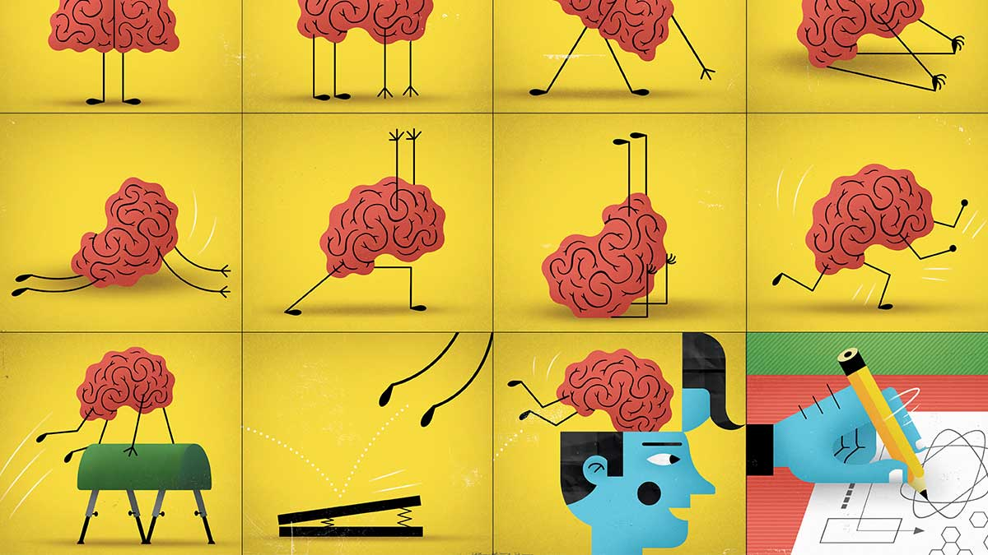
WHY IS GROWTH MINDSET IMPORTANT?
A simple belief that intelligence is malleable can better equip children for challenging tasks and difficult subject matter.
Helping students realize that they can succeed through effort and dedication can create love for learning.

Slide 6
QUESTION:
THINK OF A TIME WHEN YOU ACCOMPLISHED SOMETHING THAT YOU THOUGHT YOU WOULD HAVE NEVER ACCOMPLISHED.
  How did you feel when you struggled?
  What motivated you to keep pushing?

Slide 7
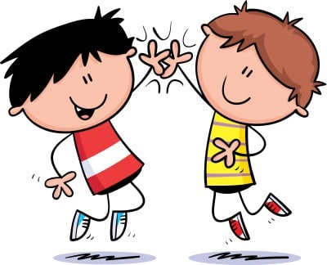
PROMOTE GROWTH MINDSET
Celebrate small victories
Praise their efforts and strategies
Help students focus on and value the process of learning
Activities that involves collaboration

Slide 8
PROMOTE GROWTH MINDSET
https://www.youtube.com/watch?v=aNHas97iE78

Slide 9
Mindset Thinking
What do you say to yourself when things get hard? When you’re stuck and want to quit?
What do you say to your kids when things get hard? When they’re stuck and want to quit?

Slide 10
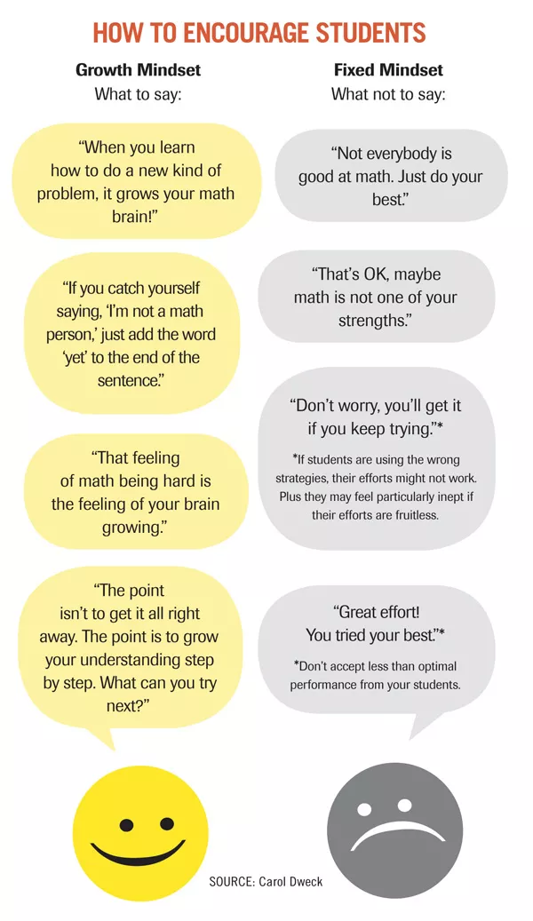
Model Growth Mindset

Slide 11
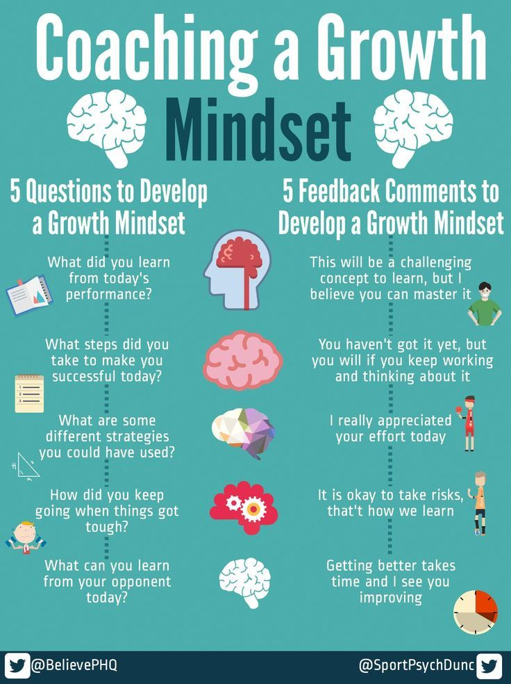
Model Growth Mindset

Slide 12
EXAMPLE OF GROWTH MINDSET IN EVERYDAY LIFE
Feedback:
  Fixed Mindset: Teachers/students would often beat themselves up and think/feel that they are not good enough to do the job.
  Growth Mindset:Teachers/students would use the feedback to reflect and improve their performance.

Slide 13

The Power of YET

Slide 14
Those using Growth Mindset say:
“We had no idea that it could have such a powerful impact. It may that these most important discoveries about the human brain will revolutionize the way we think about motivating students and empowering educators”
Bill Morones, High School Principal

Slide 15
Common Misconception #1
A body of research has shown that telling children that they’re smart and implying that their success depends on it fosters fixed mindsets.
When these children later experience struggle, they tend to conclude that their ability is not high after all, and as a result they lose confidence, so our praise has the opposite effect of what we intended.
Praising hard work or strategies used, things that children control, has been shown to support a growth mindset.
To foster a growth mindset, simply praise children for working hard

Slide 16
Common Misconception #2
- Encourage the adults to start with themselves. If we don’t work to shift our own mindset about ourselves and our students, then we won’t work to change many other important things in the system necessary to improve education.
- If the adults teaching growth mindset don’t take on the growth mindset ideal, the efforts to foster growth mindsets in students are likely to fail because we will say and do things that reflect our fixed mindset beliefs, which students will notice.
- Authentically working to become better at what we do throughout our lives, including how we teach and how we create contexts that help students thrive, and making our learning process visible to one another and to students.
Growth mindset is about changing young people, not adults

Slide 17
Common Misconception #3
Another confusion about mindset is that the only determinant of success is our mindset. But that’s not the case. Context, culture, environment, and systems matter. For one thing, people’s mindsets (as well as other beliefs and behaviors) are strongly shaped by the people around them.
All that matters is what is in the mind.

Slide 18
Common Misconception #4
Carol Dweck has talked extensively about changing learning tasks, testing practices, and grading systems. Too many tasks and teaching approaches are superficial, irrelevant, unengaging, and not learner-centered. We do need to change these tasks, the curriculum, and the pedagogy. We need to change the idea that school is about testing rather than about learning.
Improvement is all about changing beliefs and not doing anything else

Slide 19
False Growth Mindset
False growth mindset is saying you have growth mindset when you don't really have it or you don’t really understand [what it is].
It’s also false in the sense that nobody has a growth mindset in everything all the time. Everyone is a mixture of fixed and growth mindsets.
You could have a predominant growth mindset in an area but there can still be things that trigger you into a fixed mindset trait. Something really challenging and outside your comfort zone can trigger it, or, if you encounter someone who is much better than you at something you pride yourself on, you can think “Oh, that person has ability, not me.” So I think we all, students and adults, have to look for our fixed-mindset triggers and understand when we are falling into that mindset.
I think a lot of what happened [with false growth mindset among educators] is that instead of taking this long and difficult journey, where you work on understanding your triggers, working with them, and over time being able to stay in a growth mindset more and more, many educators just said, “Oh yeah, I have a growth mindset” because either they know it’s the right mindset to have or they understood it in a way that made it seem easy.
According to Dweck:

Slide 20



Resources to Promote Growth Mindset
https://www.edutopia.org/article/growth-mindset-resources

Slide 21
Test your Mindset
https://mindsetonline.com/testyourmindset/step1.php

