Slide 1

E ED 480 Science and Social Studies Curriculum Methods
FALL, 2019
Dr. Susan Belgrad
WEEK THREE

Slide 2
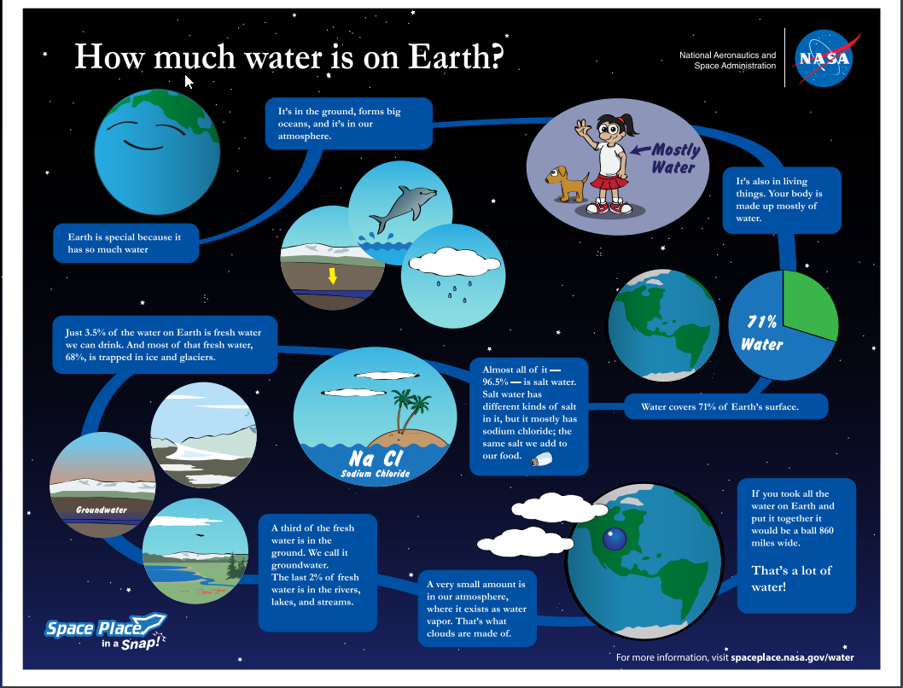

Slide 3
WEDNESDAY, SEPTEMBER 18
Sharing Cooperative Learning Lessons ACTIVITY FIVE: Kahoot JIGSAW Presentations: CA K-5 Social Science Studies Content Standards ACTIVITY SIX: Global Awareness and 21st Century Citizenship--Social Studies Standards in Action for a Sustainable Planet Complete Session Log |  Review – the script and structure of the Amazing Egg Drop -- noting the format of cooperative learning, formative and summative assessment.  Review the Social Studies Planning Template in Course Documents and Rubric in Course Assessments Read Packet: Creating Rubrics and Checklists in Course Documents --Authentic Assessments FOR Student Learning. Assessment FOR Learning  Read K-6 Next Generation Science Standards Be prepared to discuss how to use the NGSS Placemat next session. Reflective Journal 2: How does assessment FOR learning result in more student engagement and goal setting for successful achievement in global citizenship for a sustainable planet?

Slide 4
Social Studies
Lesson Planning
Identify the discipline you wish to teach:
Big Idea: “How will it promote citizenship in a global community”?
Each team will begin to plan a social studies lesson that addresses a National Theme and an elementary grade-level standard. The lesson should meet each of the criteria of the Social Studies Rubric.

Slide 5
Social Studies
Lesson Planning
ORGANIZATION
Hook
Engagement
Reflection
Self-Assessment
Dimensionality
COOPERATION
Plan for Assigning Teams
Plan for Defining Group Roles
ASSESSMENT
Plan for Assessing Group Performance
Assessment FOR Learning Plan
Assessment of Individual Learning Plan

Slide 6


Beginning your group planning of social studies lessons
Big Ideas
What is a big idea? A big idea is exactly what it sounds like: a major question or view or belief

Slide 7
Beginning your group planning of social studies lessons
How might we incorporate a BIG IDEA in social studies that engages students in a variety of content areas as they pursue understanding of the ten themes of social science?
Visual Arts:
Language Arts:
Music:
Math:
Science, Technology, Engineering.

Slide 8

Creating a cooperative learning social studies lesson plan
Review the structures of the STEM-Workshop
THE AMAZING EGG DROP
Examine How Cooperative Learning promoted Constructivist Practices and Participant Engagement and Utilize the Lesson as a Template for Planning.

Slide 9


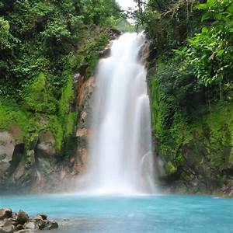

THE FOUR ELEMENTS OF NATURE
EARTH | AIR | WATER | FIRE

Slide 10
PREPARING FOR THE ACTIVITY
CSSS | CCSS | LEARNING COMMUNITY

Slide 11
Cooperative Learning Template
Following statement of Learning Outcomes
Include Social Studies and Common Core Standards
I. Formation of Groups: ( e.g. Human Graph-Knowledge) ___________________________
II. Role Assignments: Beginning with the Checker all roles are assigned to the right (clockwise)
Materials Manager/ Encourager: ________________________________
Checker/Timekeeper: _____________________________________________
Data Recorder: _____________________________________________
Observer/Reporter: _____________________________________________
Other: Traveler/Spy: Can be the checker ________________________
III. Task (See element 1):____________________________________________________________
IV. Time Limits: __________
V. Social Skills and or Habits of Mind to Engage/Assess:
(Attentive Listening; Disagree with Idea- Not the Person; Flexibility in Thinking; Perseverance; Team Work)
VI Level of Voice: (Classroom Level 2 – Normal Voice Table Talk)
VII. Processing--Questions for groups and individual reflections:
VIII. Assessment Content:
Assessment of Cooperation/Collaboration and Student Self-Assessment of Collaborative Performance
(Rate Your Mates)
VIII. Encouraging Energizer: Varied: Team selected

Slide 12

Contacting Dr. Belgrad
The best way to contact Dr. Belgrad is via email
susan.belgrad@csun.edu
You may also leave a voicemail at campus phone
#818-677-4901
You may also arrange for an individual meeting in Dr. Belgrad's Office ED 4901 or during office hours—2-3:30 PM Mondays and Wednesdays

