Slide 1
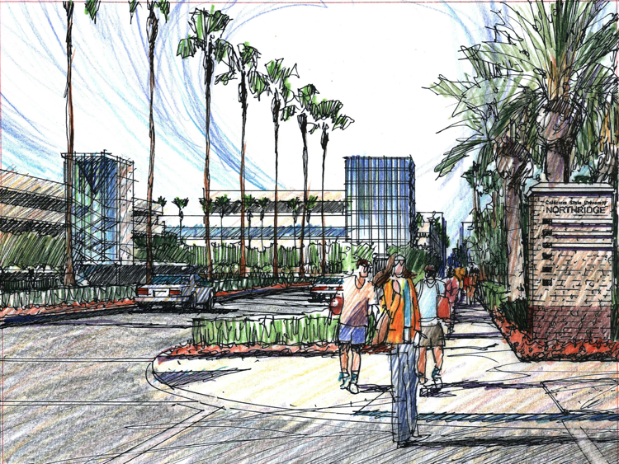
concerted curriculum
Notes:
[Image credit: Northridge Vision 2012.]

Slide 2
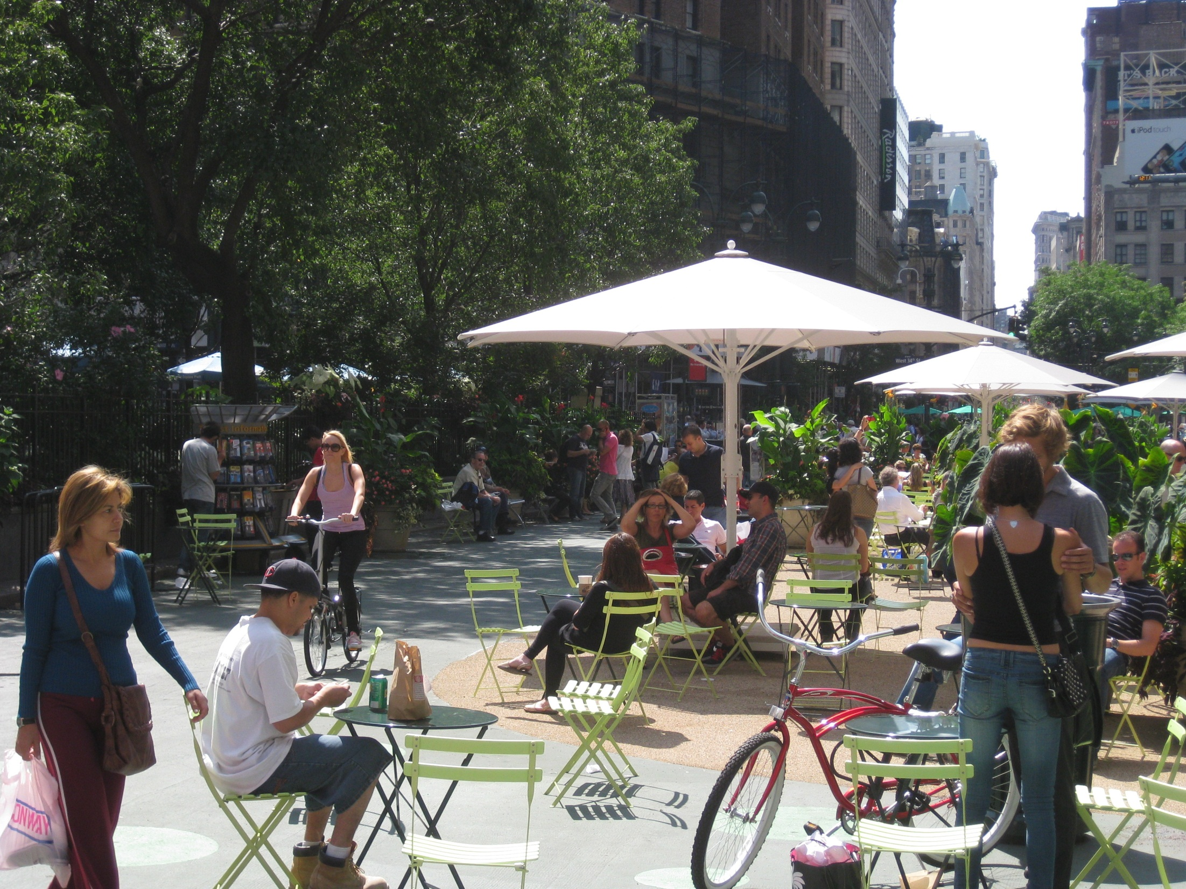
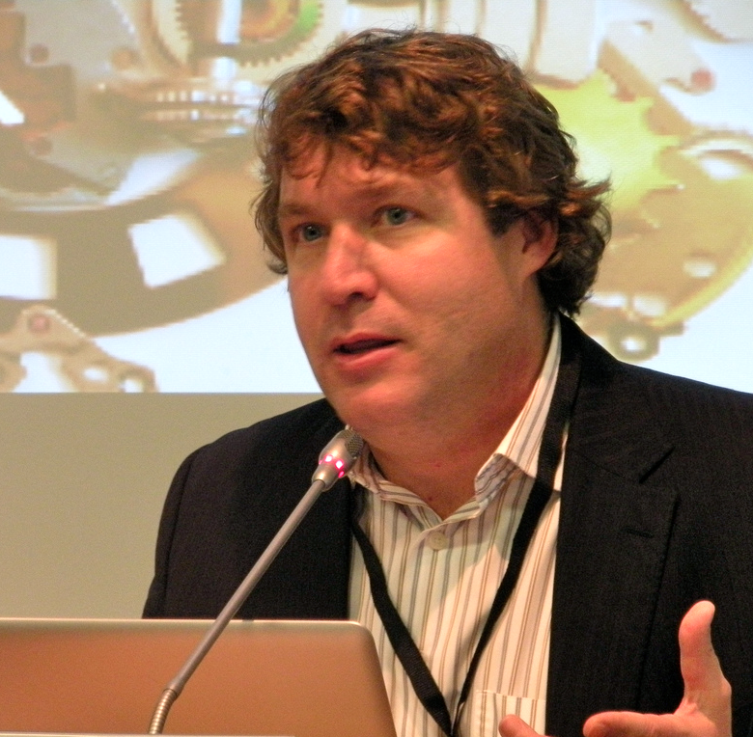
“In global, digital, distributed, and complex settings, a networked model of learning and knowledge is critical.
“Most disciplines in society have become too specialized to function in isolation. Global problems are too intractable to be tackled by any structure other than networks.”
George Siemens
Technology Enhanced Knowledge Research Institute, Alberta, Canada
anytime, anywhere access to information
multiple careers in a lifetime
continuous learning
anytime, anywhere access to information
multiple careers in a lifetime
continuous learning

Slide 3
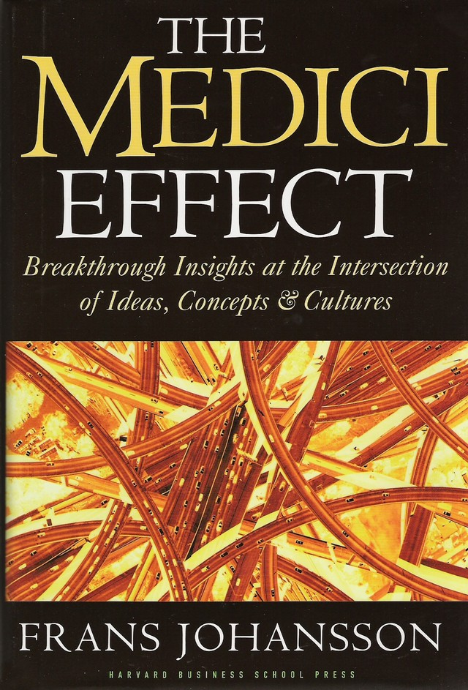
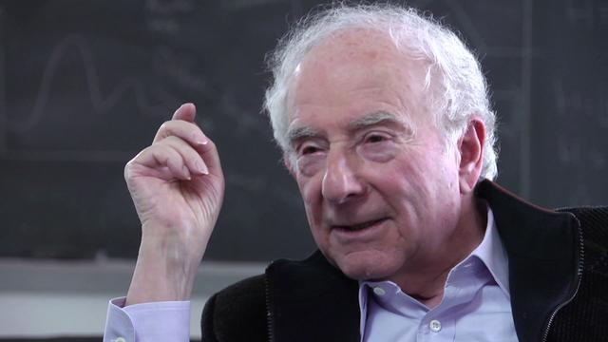
almost everything
“Today the Brain Science Program consists of researchers in the cognitive sciences, neuroscience, computer science, biology, medicine, psychology, psychiatry, physics, and mathematics . . . The researchers are not quite sure when something interesting will happen, but if they keep talking, they know that something eventually will.”
“Today the Brain Science Program consists of researchers in the cognitive sciences, neuroscience, computer science, biology, medicine, psychology, psychiatry, physics, and mathematics . . . The researchers are not quite sure when something interesting will happen, but if they keep talking, they know that something eventually will.”
Leon Cooper
Columbia University
Nobel Prize in Physics

Slide 4
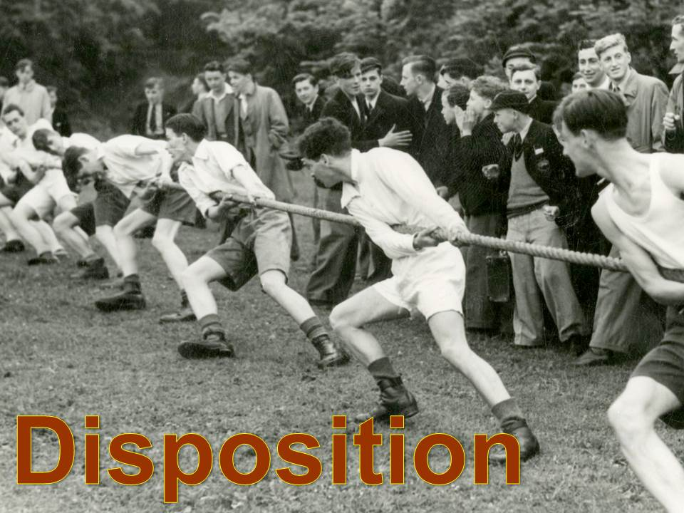
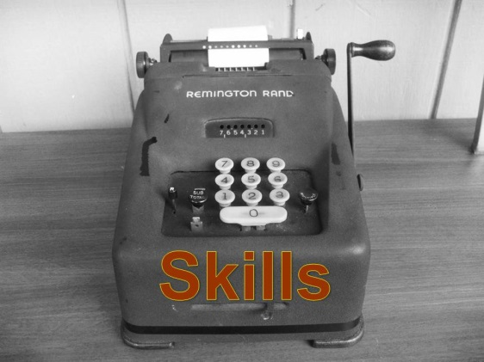

Slide 5
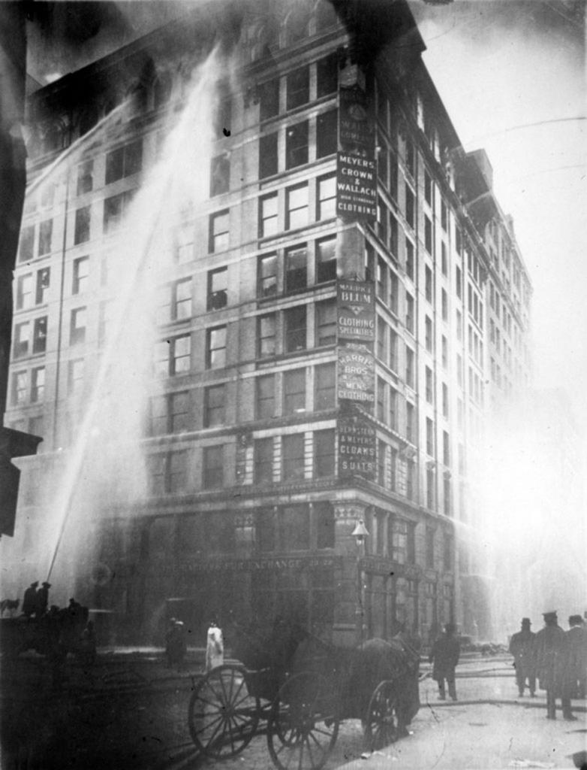
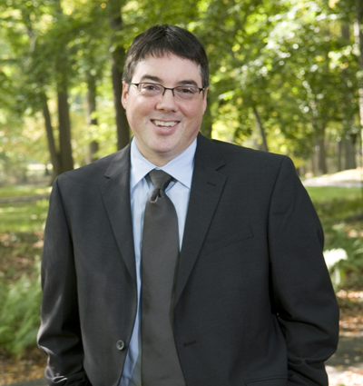
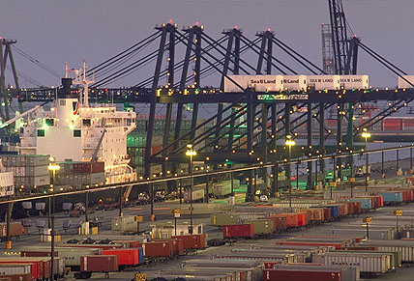
“We are witnessing a new way of working developing before our eyes.
“Today, breadth, cultural knowledge and sensitivity, flexibility, the ability to continually learn, grow and reinvent, technical skills, as well as drive and passion, define the road to success.”
The Triangle Fire (2005)
The World in a Box:
Containerization (2011)
Richard A. Greenwald
Drew University
October 1, 2010

Slide 6
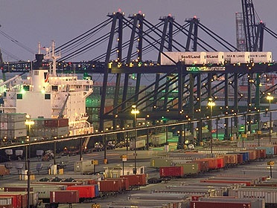
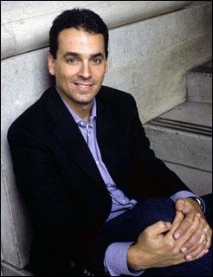
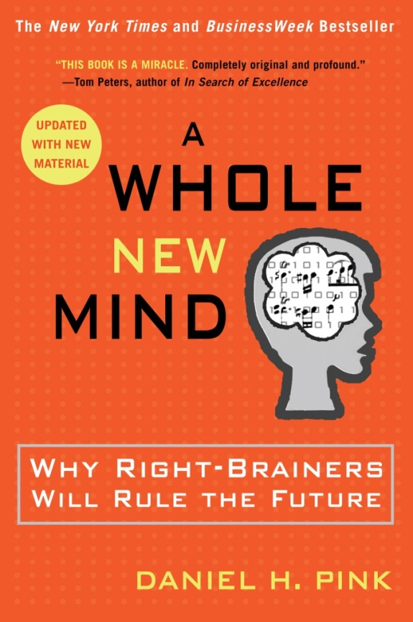
The new kind of work will reward those who master:
design
story
symphony
empathy
play
meaning
“Globalization is shipping white-collar work overseas, and powerful technologies are eliminating certain kinds of work altogether.”

Slide 7
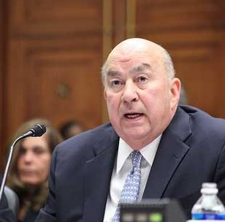
Charles B. Reed
February 25, 2008
We held a series of meetings with agriculture, engineering, entertainment, biotech, teacher education, criminal justice, and tourism and hospitality.
No matter the industry, we found similarities in the skills they wanted from our graduates:
* Come ready to work the first day
* Communicate and think critically
* Work in teams
* Use technology
* Speak multiple languages and
* Think and communicate globally
* Come ready to work the first day
* Communicate and think critically
* Work in teams
* Use technology
* Speak multiple languages and
* Think and communicate globally
* Come ready to work the first day
* Communicate and think critically
* Work in teams
* Use technology
* Speak multiple languages and
* Think and communicate globally

Slide 8
concerted curriculum
accelerants:
societal need
workforce demands
barriers:
Notes:
[Image credit: Northridge Vision 2012.]

Slide 9
3%
5%
24% transferred
once
67% never transferred
fall 2006 cohort
2,803,472
Source: National Student Clearinghouse Research Center
Notes:
Improving student success and time to degree means working together, because so many students transfer.
In California the portion is greater. Almost all of those students take courses in --

Slide 10
General Education Certification
English Communication | A
Math & Quantitative Reasoning | B4
Arts & Humanities | C
Social Science | D
Science (including lab) | B1-3
Self-Development | E

Slide 11
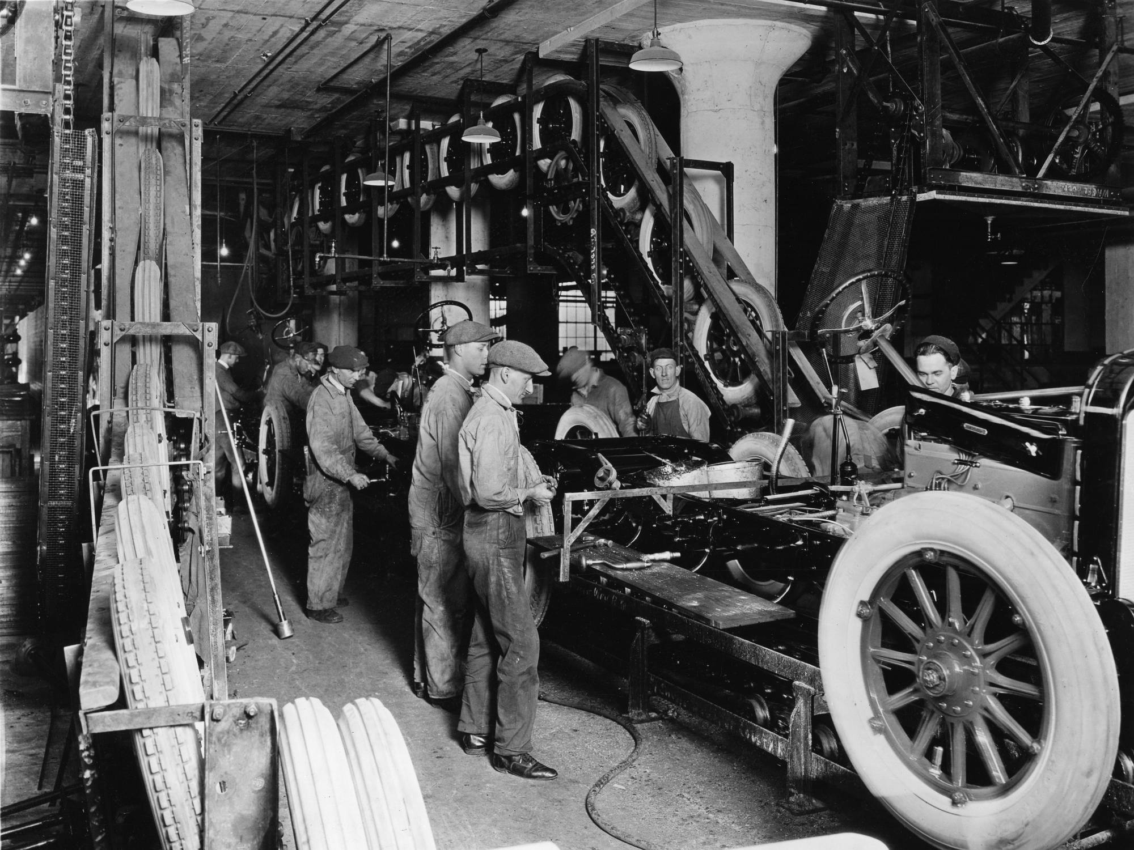
Sources of General Education (48 units total)
prior learning at the
baccalaureate level
(“pass-along”)
* other CCCs or four-years
* military and other training
* external exams (AP or IB)
up to 39 units
certifying
California Community College
(“sending institution”)
39 lower-division units
California State University (“receiving institution”)
nine upper-division units

Slide 12
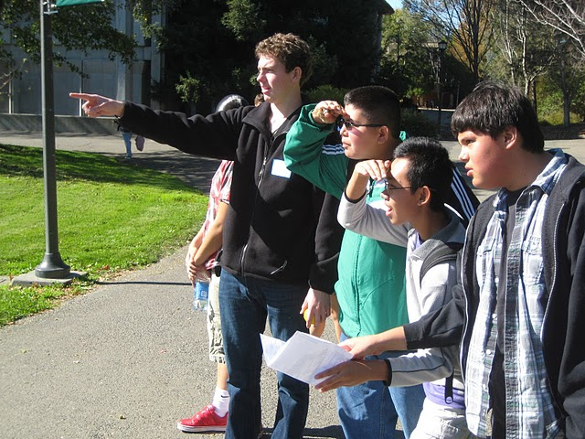
Unique Benefits of General Education
hook

Slide 13
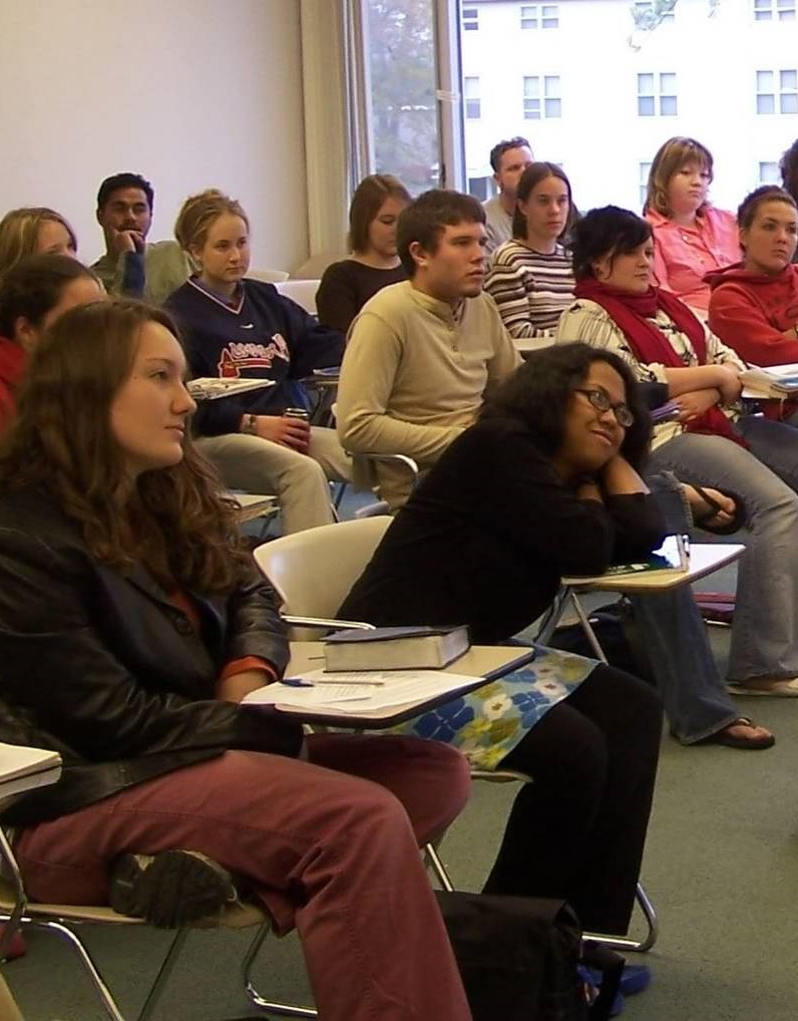
Unique Benefits of General Education
hook
reach

Slide 14
Unique Benefits of General Education
hook
reach
employability

Slide 15
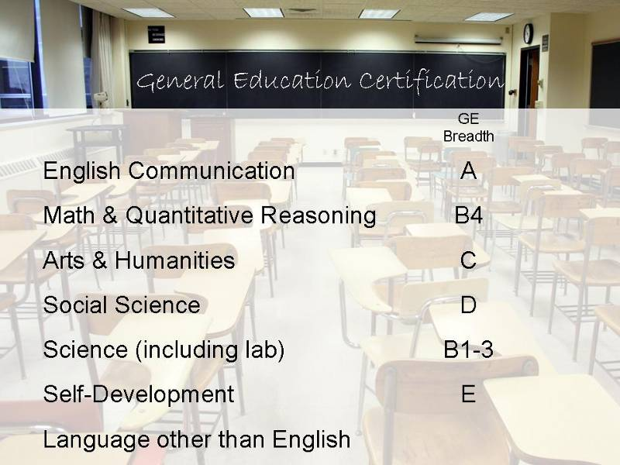
what we have
what we want
reach
hook
employability

Slide 16
alienation
apathy
attrition

Slide 17
concerted curriculum
accelerants:
societal need
workforce demands
barriers:
student mobility
FTE funding model
Notes:
[Image credit: Northridge Vision 2012.]

Slide 18
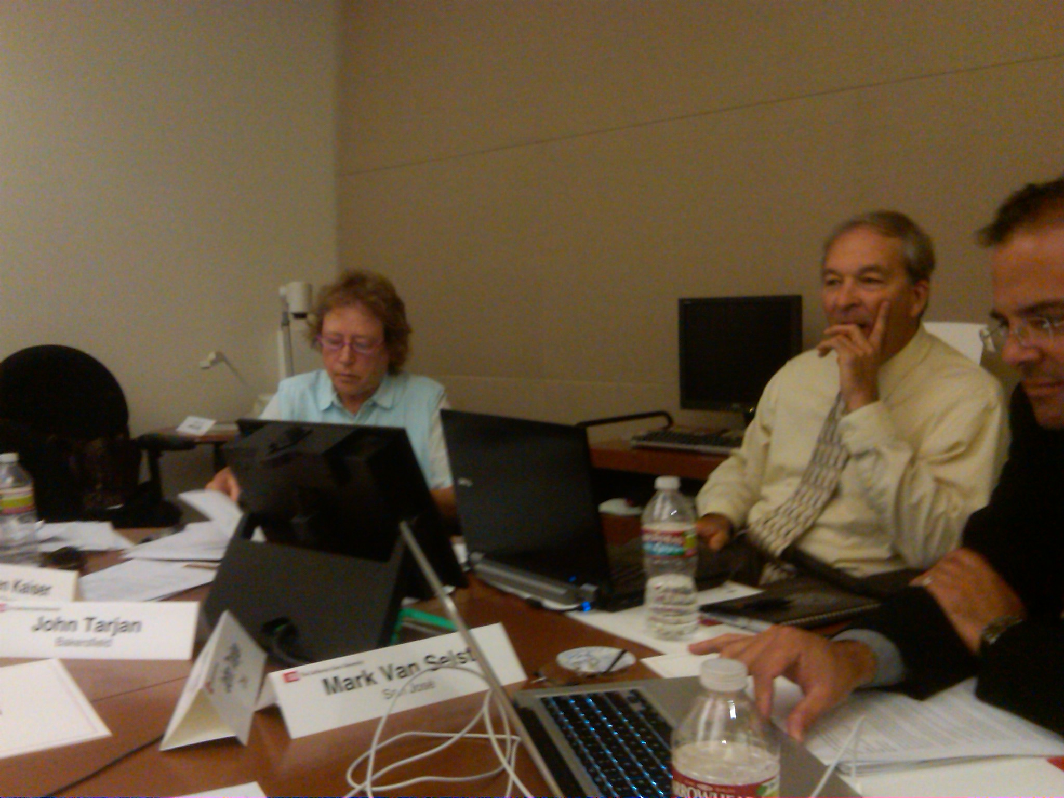
CSU Chancellor’s General Education Advisory Group
2007-2008 revision of Executive Order on GE Breadth
Article 1 Applicability
Article 2 Pathways to Meet Requirements
Article 3 Premises
Article 4 Distribution of Units
Article 5 Transfer and Articulation
Article 6 Implementation and Governance
Article 1 Applicability
Article 2 Pathways to Meet Requirements
Article 3 Premises
Article 4 Distribution of Units
Article 5 Transfer and Articulation
Article 6 Implementation and Governance
LEAP Essential Learning Outcomes

Slide 19
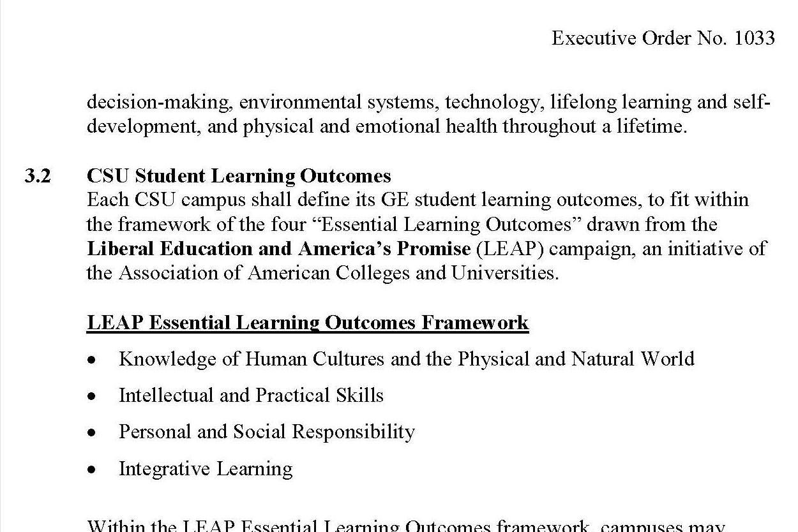
CSU GE Breadth
certification
outcomes orientation
recognition of how students really learn

Slide 20
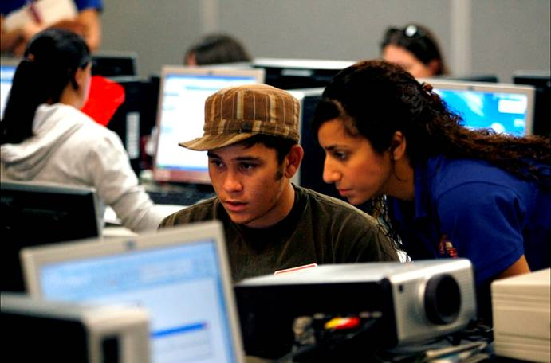
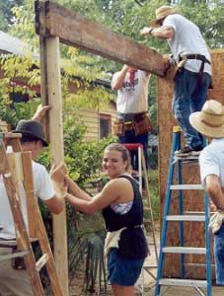
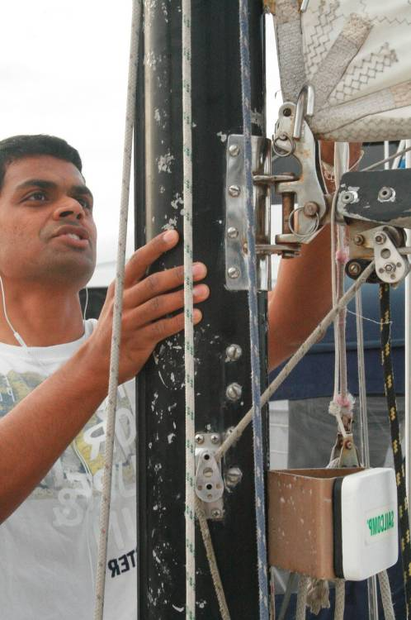
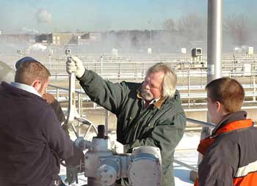

Slide 21
Graduation Rates by Ethnicity and participation in High-Impact Practices
Source: CSU Northridge Institutional Research
August, 2010
68%
65%
63%
55%
49%
38%
0
1
2
0
1
2
Latino/a
not Latino/a

Slide 22
concerted curriculum
accelerants:
societal need
workforce demands
student interest
barriers:
student mobility
FTE funding model
Notes:
[Image credit: Northridge Vision 2012.]

Slide 23
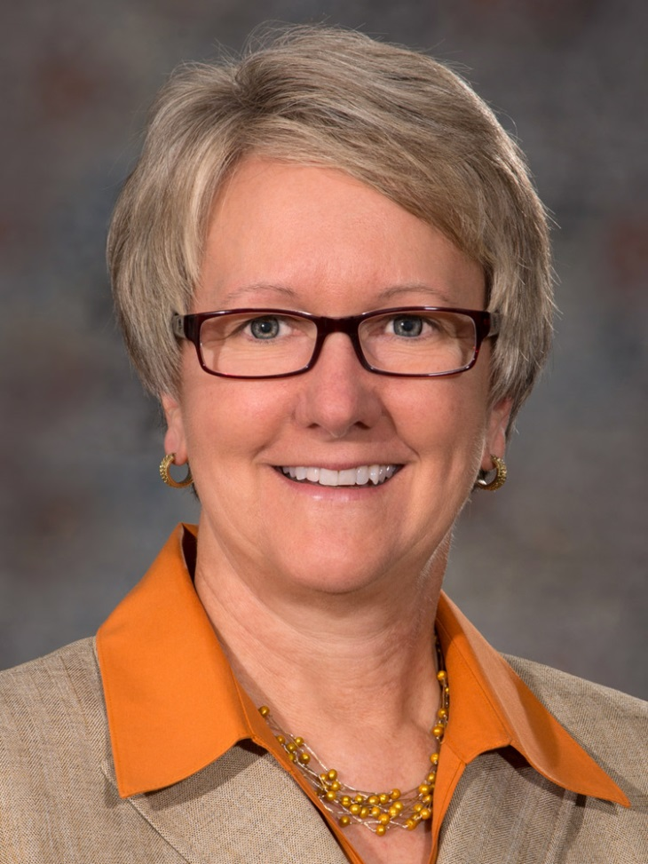
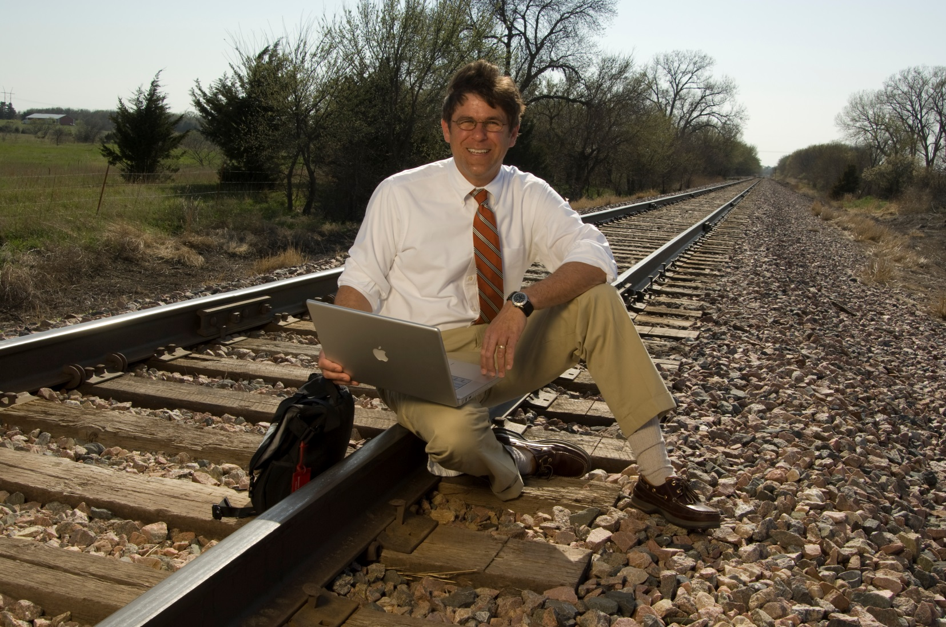
“Grand Challenges” curriculum for interdisciplinary research
digital humanities
early childhood development
sustainable irrigation
Ellen Weissinger
Provost
William G. Thomas, Chair, History
2009 winner NSF & NEH
“Digging into Data” Challenge
Notes:
[Thomas image and story: http://newsroom.unl.edu/releases/2009/12/04/Project+to+computer-analyze+railroads+history+awarded+funds; Aquifer image: Wikipedia]
Re the digital humanities: The project will integrate large-scale historical data sources from various repositories -- such as time schedules, newspaper accounts, payrolls and maps -- and align them with other data, such as county-level census data. The project aims to demonstrate how scholars of American history, working on a range of subjects from global finance, to capital markets, labor migration, the law, environmental change and culture, could "dig in" to this data to produce new forms of "cyberscholarship."

Slide 24
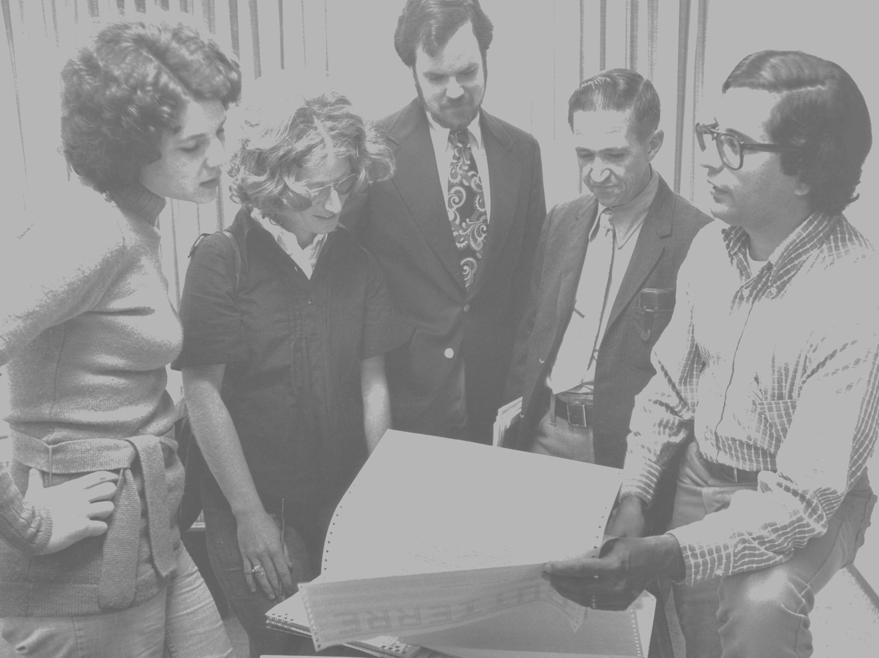
Area A
Area B
Area C
Area D
Area E
civic engagement
civic engagement
globalization
social justice
sustainability

Slide 25
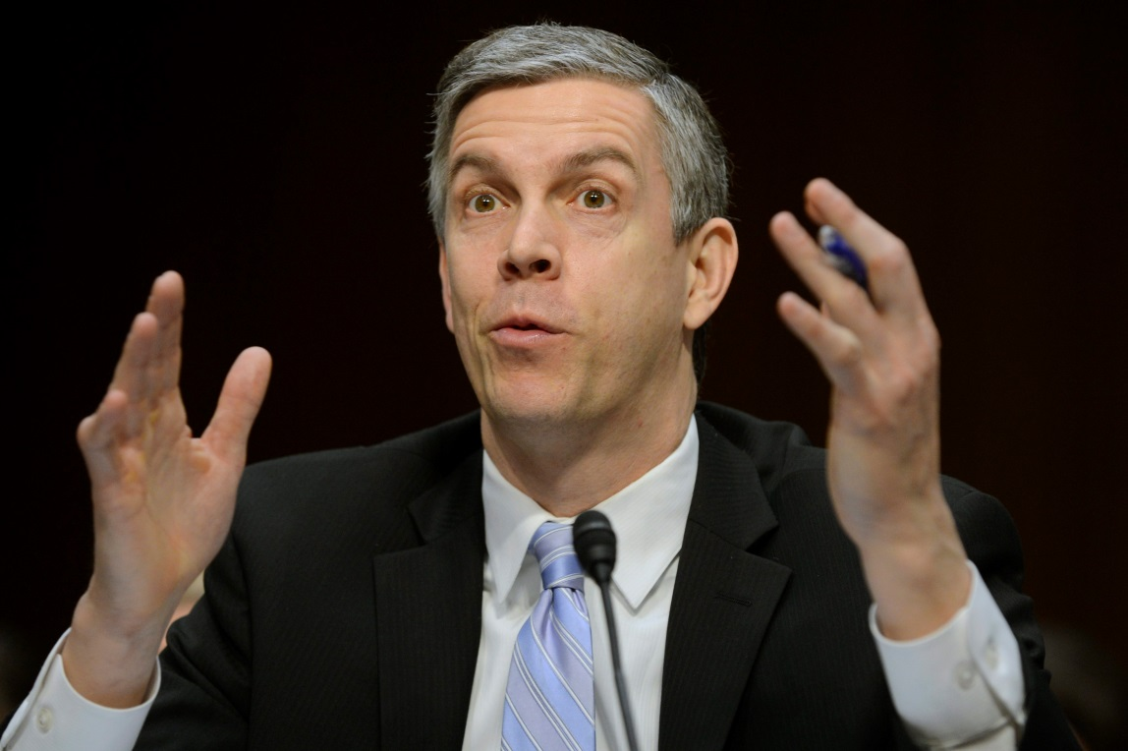
“. . . state and federal grants and loans will shift more toward a performance-based and outcomes-based system than is the case today – and one that does more to reward innovation.”
Arne Duncan
U.S. Secretary of Education
July 9, 2013

Slide 26
concerted curriculum
diffusionoflight.wordpress.com
Notes:
[Image credit: Northridge Vision 2012.]

