Slide 1
Scheduling
For Engineering Students

Slide 2
Expectations
1 unit ≈ 1 hour of class time per week
1 hour of class time ≈ 2.5 hours of homework/study time per week
  Ex: A Student taking 15 units should expect to spend 15 hours a week in class and 37.5 hours a week preparing for class, a total of 52.5 hours per week.

Slide 3
Time Management
Part time job ≈ 20 hours per week
Total work hours per week: 52.5 + 20 = 72.5 hours
8 hours of rest per day = 56 hours per week
This leaves 39.5 (=168-56-72.5) hours per week or 5.6 hours per day for EVERYTHING else: commuting, eating, grooming, exercise, shopping, video games, sports, significant others, family, etc!
Is a job really worth it?

Slide 4
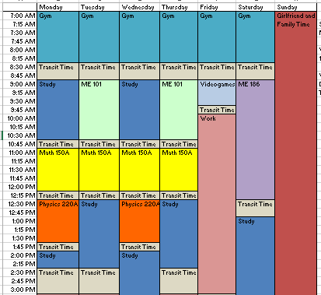
Personal Schedule Assignment
The purpose is to see just how much time you will need to spend on your education
Put together a weekly schedule using Excel
Include classes, study time, and any other responsibilities you may have
Due date: See Syllabus

