Slide 1
DILUTIVE EPS & SECURITIES
CHAPTER 19
PART II

Slide 2
Learning objectives
The accounting for Stock Award Plans
The accounting for Stock Options
Distinguish between a simple & complex capital structure
Determine Weighted Average # of C/S
Determine Basic EPS
Determine Dilutive EPS
Presentation of EPS

Slide 3
Key concepts:
PART B:
Capital Structure: Simple/Complex
Basic EPS / Dilutive EPS
Presentation

Slide 4
CHAPTER 19
BASIC & DILUTIVE EPS
EARNINGS PER SHARE
PART II
COMPLEX STRUCTURE
Professor Vedd

Slide 5
CAPITAL STRUCTURE & EPS
A COMPLEX CAPITAL STRUCTURE:
(potential convertible securities)
-POTENTIAL COMMON SHARES:
  Bonds
  Convertible Preferred stock
  Stock options /warrants/Rights
  Other: Participating securities
Impact: Increase in # of shares
  EPS is decreased.
  These convertible securities are said to dilute (reduce) earnings per share.

Slide 6
DILUTIVE EPS
“Dilutive” means the ability to influence the EPS in a downward
Direction – i.e. the inclusion of the dilutive security in the
Calculation – decreases the resultant EPS figure

Slide 7
Convertible Securities
Dilutive earnings per share may decrease or increase after the assumed conversion.
If dilutive earnings per share decreases, the securities are dilutive and are assumed converted.
If dilutive earnings per share increases, the securities are antidilutive and are not considered converted.
Notes:
Dilutive earnings per share may increase or decrease as a result of the assumed conversion. If diluted earnings per share decreases, the securities are in fact dilutive and are assumed converted. If the diluted earnings per share increases, the securities are antidilutive and are not considered in the calculation of diluted earnings per share.

Slide 8
DILUTIVE EFFECT ON EPS
What are potentially dilutive securities?
1. CONVERTIBLE SECURITIES
  A. Convertible bonds
  B. Convertible preferred stock
2. STOCK OPTIONS, WARRANTS, & RIGHTS

Slide 9
CONVERTIBLE SECURITIES
FASB 128
The dilutive effect of convertible securities is measured by: if-converted /‘What if’ exercised!!!
Each convertible security is assumed to have been converted into common Shares
Assumes conversion at the beginning of the period (or date of issue if later)

Slide 10
Convertible Securities
BONDS (if converted)
Net Income is Adjusted:
  The related interest effect (net of tax)
The weighted average # of shares is increased
  Due to: additional common shares assumed issued (at the beginning)

Slide 11
Diluted Earnings per Share-
Options, Warrants, and Rights
Only if dilutive!!!
  If exercise price is higher than the average market price – no exercise would take place – pose NO potential dilution. –Anti-dilutive

Slide 12
Diluted Earnings per Share-
Options, Warrants, and Rights
If exercise (price less than market)
resources (cash) would produce
- either net income must be increased (inc. in revenue) or
(cash is assumed to be used for some non-revenue-producing purposes)

Slide 13
Diluted Earnings per Share
- Options, Warrants, and Rights
Proceeds from conversion are assumed to be used for purchase of treasury stock at current market price.
Treasury stock is assumed to be reissued to option or warrant holders.
THEREFORE: method dealing with Options, Warrants and Rights – TREASURY STOCK METHOD
Any additional shares issued, over treasury stock, are added to “weighted- average shares outstanding.”

Slide 14
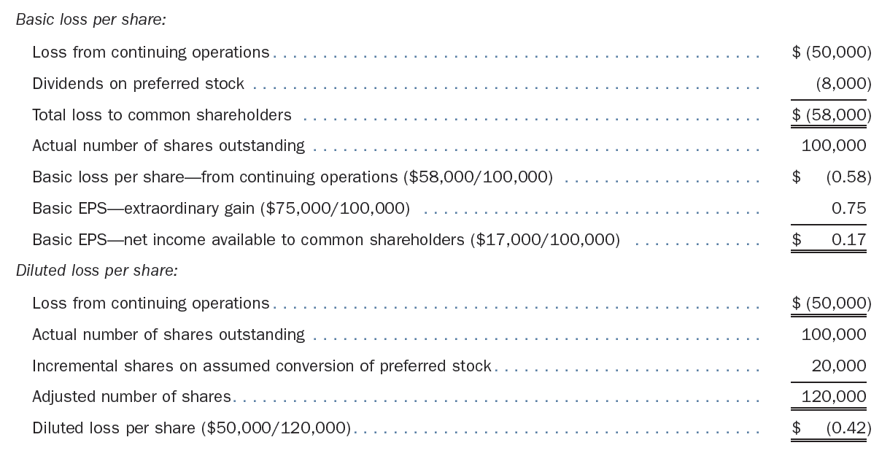
Effect of a Loss from Continuing Operations on Earnings per Share

Slide 15
Dilutive EPS: comprehensive:
Calculations: Weighted Average No of shares
  Outstanding shares Beg of the year
  Issue of shares during the year
  Repurchased stock (Treasury)
  Stock dividends
  Stock split
1. Basic EPS:
  with Preferred dividends (cumulative/non cumulative)
2. Dilutive EPS:
  With Convertible preferred
  With convertible bonds
  With stock options
  With warrants

Slide 16
Presentation and disclosure.
a. EPS is presented for income from continuing operations, income before extraordinary items or change in accounting principle, and net income.
b. Reported for all periods presented
c. Prior period EPS is restated for any prior period adjustments.
d. Footnotes are required for diluted EPS.

