Slide 1
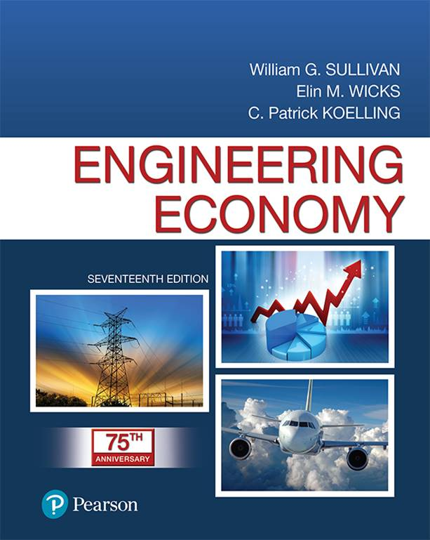
Engineering Economy
Seventeenth Edition
Chapter 06
Comparison and Selection Among Alternatives
Copyright © 2019, 2016, 2013 Pearson Education, Inc. All Rights Reserved

Slide 2
Objective
The objective of chapter 6 is to evaluate correctly capital investment alternatives when the time value of money is a key influence.

Slide 3
Making Decisions Means Comparing Alternatives
In this chapter we examine feasible design alternatives.
The decisions considered are those selecting from among a set of mutually exclusive alternatives—when selecting one excludes the choice of any of the others.

Slide 4
Mutually Exclusive Alternatives (MEAs)
We examine these on the basis of economic considerations alone.
The alternatives may have different initial investments and their annual revenues and costs may vary.
The alternatives must provide comparable “usefulness”: performance, quality, etc.
The basic methods from chapter 5 provide the basis for economic comparison of the alternatives.

Slide 5
Apply this Rule, Based on Principle 2 from Chapter 1
The alternative that requires the minimum investment of capital and produces satisfactory functional results will be chosen unless the incremental capital associated with an alternative having a larger investment can be justified with respect to its incremental benefits. This alternative is the base alternative.

Slide 6
For Alternatives that have a Larger Investment than the Base…
If the extra benefits obtained by investing additional capital are better than those that could be obtained from investment of the same capital elsewhere in the company at the MARR, the investment should be made.
(Please note that there are some cautions when considering more than two alternatives, which will be examined later.)

Slide 7
There are Two Basic Types of Alternatives
Investment Alternatives
Those with initial (or front-end) capital investment that produces positive cash flows from increased revenue, savings through reduced costs, or both.
Cost Alternatives
Those with all negative cash flows, except for a possible positive cash flow from disposal of assets at the end of the project’s useful life.

Slide 8
Select the Alternative that Gives you the Most Money!
For investment alternatives the PW of all cash flows must be positive, at the MARR, to be attractive. Select the alternative with the largest PW.
For cost alternatives the PW of all cash flows will be negative. Select the alternative with the largest (smallest in absolute value) PW.

Slide 9
Investment Alternative Example
Use a MARR of 10% and useful life of 5 years to select between the investment alternatives below.
 |  | Alternative
 |  | A | B
Capital investment |  | -$100,000 | -$125,000
Annual revenues less expenses |  | $34,000 | $41,000
Both alternatives are attractive, but Alternative B provides a greater present worth, so is better economically.

Slide 10
Cost Alternative Example
Use a MARR of 12% and useful life of 4 years to select between the cost alternatives below.
 |  | Alternative
 |  | C | D
Capital investment |  | -$80,000 | -$60,000
Annual expenses |  | -$25,000 | -$30,000
Alternative D costs less than Alternative C, it has a greater PW, so is better economically.

Slide 11
Pause and Solve (1 of 2)
Your local foundry is adding a new furnace. There are several different styles and types of furnaces, so the foundry must select from among a set of mutually exclusive alternatives. Initial capital investment and annual expenses for each alternative are given in the table below. None have any market value at the end of its useful life. Using a MARR of 15%, which furnace should be chosen?
 | Furnace
 | F1 | F2 | F3
Investment | $110,000 | $125,000 | $138,000
Useful life | 10 years | 10 years | 10 years
Total annual expenses | $53,800 | $51,625 | $45,033

Slide 12
Solution (1 of 2)
Using a MARR of 15%, the PW is shown for each of the three alternatives in the table below.
 | Furnace
 | F1 | F2 | F3
Investment | $110,000 | $125,000 | $138,000
Useful life | 10 years | 10 years | 10 years
Total annual expenses | $53,800 | $51,625 | $45,033
Present Worth @ 15%
The largest value is -$364,010, indicating that Furnace F3 is the best alternative.

Slide 13
Determining the Study Period
A study period (or planning horizon) is the time period over which MEAs are compared, and it must be appropriate for the decision situation.
MEAs can have equal lives (in which case the study period used is these equal lives), or they can have unequal lives, and at least one does not match the study period.
The equal life case is straightforward, and was used in the previous two examples.

Slide 14
Unequal lives are handled in one of two ways
Repeatability assumption
  The study period is either indefinitely long or equal to a common multiple of the lives of the MEAs.
  The economic consequences expected during the MEAs’ life spans will also happen in succeeding life spans (replacements).
Coterminated assumption: uses a finite and identical study period for all MEAs. Cash flow adjustments may be made to satisfy alternative performance needs over the study period.

Slide 15
Comparing MEAs with Equal Lives
When lives are equal adjustments to cash flows are not required. The MEAs can be compared by directly comparing their equivalent worth (PW, FW, or AW) calculated using the MARR. The decision will be the same regardless of the equivalent worth method you use. For a MARR of 12%, select from among the MEAs below.
 |  | Alternatives
 |  | A | B | C | D
Capital investment |  | -$150,000 | -$85,000 | -$75,000 | -$120,000
Annual revenues |  | $28,000 | $16,000 | $15,000 | $22,000
Annual expenses |  | -$1,000 | -$550 | -$500 | -$700
Market Value (EOL) |  | $20,000 | $10,000 | $6,000 | $11,000
Life (years) |  | 10 | 10 | 10 | 10

Slide 16
Selecting the Best Alternative
Present worth analysis → select Alternative A (but C is close).
Annual worth analysis—the decision is the same.

Slide 17
Using Rates of Return is Another Way to Compare Alternatives
The return on investment (rate of return) is a popular measure of investment performance.
Selecting the alternative with the largest rate of return can lead to incorrect decisions—do not compare the IRR of one alternative to the IRR of another alternative. The only legitimate comparison is the IRR to the MARR.
Remember, the base alternative must be attractive (rate of return greater than the MARR), and the additional investment in other alternatives must itself make a satisfactory rate of return on that increment.

Slide 18
Use the Incremental Investment Analysis Procedure
Arrange (rank order) the feasible alternatives based on increasing capital investment.
Establish a base alternative.
  Cost alternatives—the first alternative is the base.
  Investment alternatives—the first acceptable alternative (IRR>MARR) is the base.
Iteratively evaluate differences (incremental cash flows) between alternatives until all have been considered.

Slide 19
Evaluating Incremental Cash Flows
Work up the order of ranked alternatives smallest to largest.
Subtract cash flows of the lower ranked alternative from the higher ranked.
Determine if the incremental initial investment in the higher ranked alternative is attractive (e.g., IRR>MARR, PW, FW, AW all >0). If it is attractive, it is the “winner.” If not, the lower ranked alternative is the “winner.” The “loser” from this comparison is removed from consideration. Continue until all alternatives have been considered.
This works for both cost and investment alternatives.

Slide 20
Incremental Analysis
 |  | Alt. A | Alt. B | Alt. B-Alt. A
Initial cost |  | -$25,000 | -$35,000 | -$10,000
Net annual income |  | $7,500 | $10,200 | $3,200
IRR on total cash flow |  | 15% | 14% | 11%
Which is preferred using a 5 year study period and MARR=10%?
Both alternatives A and B are acceptable—each one has a rate of return that exceeds the MARR. Choosing Alternative A because of its larger IRR would be an incorrect decision. By examining the incremental cash flows we see that the extra amount invested in Alternative B earns a return that exceeds the IRR—so B is preferred to A. Also note…

Slide 21
Pause and Solve (2 of 2)
Acme Molding is examining 5 alternatives for a piece of material handling equipment. Each has an expected life of 8 years with no salvage value, and Acme’s MARR is 12%. Using an incremental analysis, which material handling alternative should be chosen? The table below includes initial investment, net annual income, and IRR for each alternative.
 | Alternative
 | A | B | C | D | E
Capital investment | $12,000 | $12,500 | $14,400 | $16,250 | $20,000
Net annual income | $2,500 | $2,520 | $3,050 | $3,620 | $4,400
IRR | 12.99% | 12.04% | 13.48% | 14.99% | 14.61%

Slide 22
Solution (2 of 2)
Alternative A is the base alternative, with an IRR > MARR. The next largest investment is in Alternative B, so first examine the incremental investment of B over A. In the table below the IRR of B – A is shown.
 | Alternative
 | A | B | B-A
Capital investment | $12,000 | $12,500 | $500
Net annual income | $2,500 | $2,520 | $20
IRR | 12.99% | 12.04% | -20.11%
Alternative B is not better than A—A “wins.”

Slide 23
Solution (Stage 2)
The next largest investment is in Alternative C, so examine the incremental investment of C over A. In the table below the IRR of C – A is shown.
 | Alternative
 | A | C | C-A
Capital investment | $12,000 | $14,400 | $2,400
Net annual income | $2,500 | $3,050 | $550
IRR | 12.99% | 13.48% | 15.86%
15.86% > MARR, so Alternative C “wins.”

Slide 24
Solution (Stage 3)
The next largest investment is in Alternative D, so examine the incremental investment of D over C. In the table below the IRR of D – C is shown.
 | Alternative
 | C | D | D - C
Capital investment | $14,400 | $16,250 | $1,850
Net annual income | $3,050 | $3,620 | $570
IRR | 13.48% | 14.99% | 25.94%
25.94% > MARR, so Alternative D “wins.”

Slide 25
Solution (Final Stage)
Finally, examine the incremental investment of E over D.
 | Alternative
 | D | E | E - D
Capital investment | $16,250 | $20,000 | $3,750
Net annual income | $3,620 | $4,400 | $780
IRR | 14.99% | 14.61% | 12.95%
12.95% > MARR, so Alternative E “wins,” and we would select Alternative E as the best of these five alternatives.

Slide 26
Comparing MEAs with Unequal Lives
The repeatability assumption, when applicable, simplified comparison of alternatives.
If repeatability cannot be used, an appropriate study period must be selected (the coterminated assumption). This is most often used in engineering practice because product life cycles are becoming shorter.

Slide 27
The Useful Life of an Alternative is Less than the Study Period (1 of 2)
Cost alternatives
  Contracting or leasing for remaining years may be appropriate
  Repeat part of the useful life and use an estimated market value to truncate
Investment alternatives
  Cash flows reinvested at the MARR at the end of the study period
  Replace with another asset, with possibly different cash flows, after the study period

Slide 28
The Useful Life of an Alternative is Less than the Study Period (2 of 2)
Truncate the alternative at the end of the study period, using an estimated market value.
The underlying principle in all such analysis is to compare the MEAs in a decision situation over the same study (analysis) period.

Slide 29
Equivalent Worth Methods can be Used for MEAs with Unequal Lives
If repeatability can be assumed, the MEAs are most easily compared by finding the annual worth (AW) of each alternative over its own useful life, and recommending the one having the most economical value.
For cotermination, use any equivalent worth method using the cash flows available for the study period.

Slide 30
We can Use Incremental Rate of Return Analysis on MEAs with Unequal Lives
Equate the MEAs annual worths (AW) over their respective lives.
 | A | B
Capital Investment | $3,500 | $5,000
Annual Cash Flow | $1,255 | $1,480
Useful Live (years) | 4 | 6
Solving, we find i*=26%, so Alt B is preferred.

Slide 31

Copyright

