Slide 1
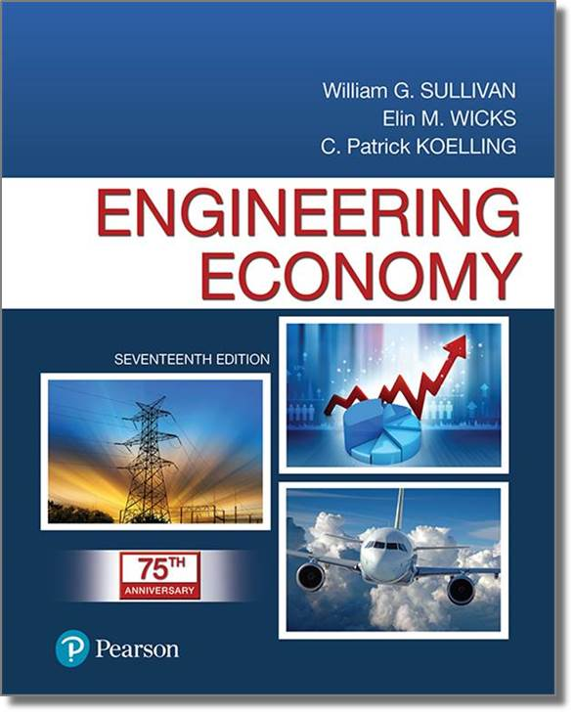
Engineering Economy
Seventeenth Edition
Chapter 04
The Time Value of Money
Copyright © 2019, 2016, 2013 Pearson Education, Inc. All Rights Reserved

Slide 2
Objective
The objective of Chapter 4 is to explain time value of money calculations and to illustrate economic equivalence.
Notes:
Slide 2 is list of textbook LO numbers and statements

Slide 3
Money Has a Time Value
Capital refers to wealth in the form of money or property that can be used to produce more wealth.
Engineering economy studies involve the commitment of capital for extended periods of time.
A dollar today is worth more than a dollar one or more years from now (for several reasons).
Notes:
Slide 2 is list of textbook LO numbers and statements

Slide 4
Return to Capital in the Form of Interest and Profit is an Essential Ingredient of Engineering Economy Studies
Interest and profit pay the providers of capital for forgoing its use during the time the capital is being used.
Interest and profit are payments for the risk the investor takes in letting another use his or her capital.
Any project or venture must provide a sufficient return to be financially attractive to the suppliers of money or property.
Notes:
Slide 2 is list of textbook LO numbers and statements

Slide 5
Simple Interest is Used Infrequently
When the total interest earned or charged is linearly proportional to the initial amount of the loan (principal), the interest rate, and the number of interest periods, the interest and interest rate are said to be simple.
Notes:
Slide 2 is list of textbook LO numbers and statements

Slide 6
Computation of Simple Interest (1 of 3)
The total interest, I, earned or paid may be computed using the formula below.
P = principal amount lent or borrowed
N = number of interest periods (e.g., years)
i = interest rate per interest period
The total amount repaid at the end of N interest periods is P + I.
Notes:
Slide 2 is list of textbook LO numbers and statements

Slide 7
Computation of Simple Interest (2 of 3)
If $5,000 were loaned for five years at a simple interest rate of 7% per year, the interest earned would be
So, the total amount repaid at the end of five years would be the original amount ($5,000) plus the interest ($1,750), or $6,750.
Notes:
Slide 2 is list of textbook LO numbers and statements

Slide 8
Computation of Simple Interest (3 of 3)
Compound interest reflects both the remaining principal and any accumulated interest. For $1,000 at 10%…
Period | (1) Amount owed at beginning of period | (2)=(1)×10% Interest amount for period | (3)=(1)+(2) Amount owed at end of period
1 | $1,000 | $100 | $1,100
2 | $1,100 | $110 | $1,210
3 | $1,210 | $121 | $1,331
Compound interest is commonly used in personal and professional financial transactions.
Notes:
Slide 2 is list of textbook LO numbers and statements

Slide 9
Economic Equivalence Allows us to Compare Alternatives on a Common Basis
Each alternative can be reduced to an equivalent basis dependent on
  interest rate,
  amount of money involved, and
  timing of monetary receipts or expenses.
Using these elements we can “move” cash flows so that we can compare them at particular points in time.
Notes:
Slide 2 is list of textbook LO numbers and statements

Slide 10
We Need Some Tools to Find Economic Equivalence
Notation used in formulas for compound interest calculations.
  i = effective interest rate per interest period
  N = number of compounding (interest) periods
  P = present sum of money; equivalent value of one or more cash flows at a reference point in time; the present
  F = future sum of money; equivalent value of one or more cash flows at a reference point in time; the future
  A = end-of-period cash flows in a uniform series continuing for a certain number of periods, starting at the end of the first period and continuing through the last
Notes:
Slide 2 is list of textbook LO numbers and statements

Slide 11
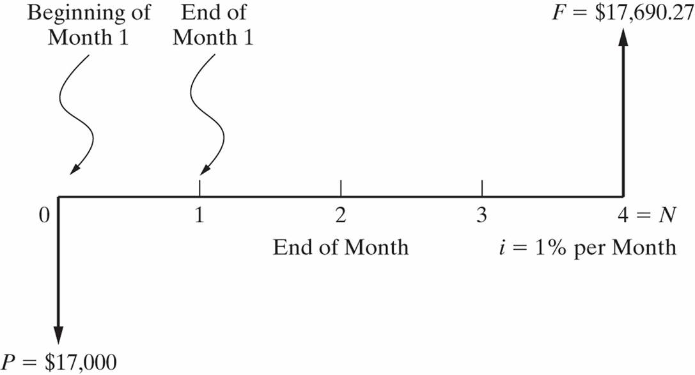
A Cash Flow Diagram is an Indispensable Tool For Clarifying and Visualizing a Series of Cash Flows

Slide 12
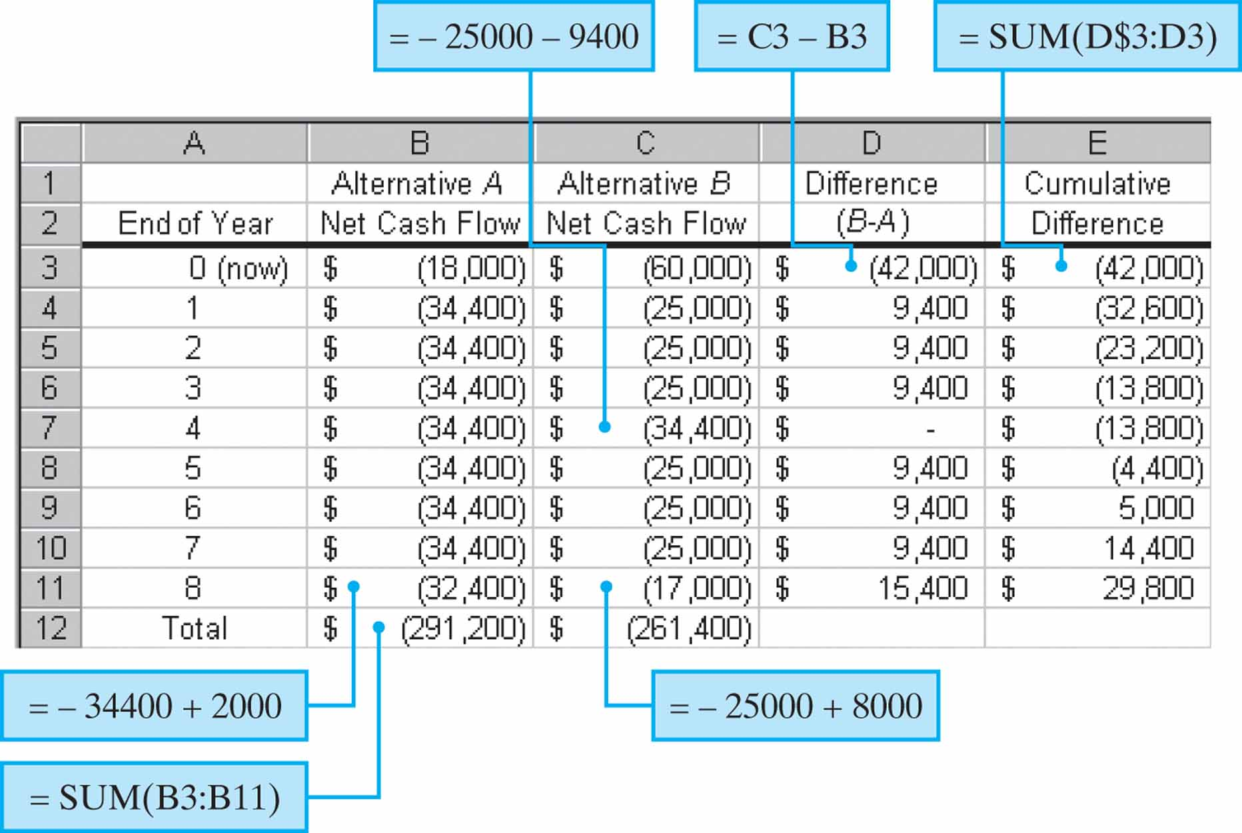
Cash Flow Tables are Essential to Modeling Engineering Economy Problems in a Spreadsheet

Slide 13
We Can Apply Compound Interest Formulas to “Move” Cash Flows Along the Cash Flow Diagram
Using the standard notation, we find that a present amount, P, can grow into a future amount, F, in N time periods at interest rate i according to the formula below.
In a similar way we can find P given F by
Notes:
Slide 2 is list of textbook LO numbers and statements

Slide 14
It is Common to Use Standard Notation for Interest Factors
This is also known as the single payment compound amount factor. The term on the right is read “F given P at i% interest per period for N interest periods.”
is called the single payment present worth factor.
Notes:
Slide 2 is list of textbook LO numbers and statements

Slide 15
We Can Use These to Find Economically Equivalent Values at Different Points in Time
$2,500 at time zero is equivalent to how much after six years if the interest rate is 8% per year?
$3,000 at the end of year seven is equivalent to how much today (time zero) if the interest rate is 6% per year?
Notes:
Slide 2 is list of textbook LO numbers and statements

Slide 16
Pause and Solve (1 of 4)
Betty will need $12,000 in five years to pay for a major overhaul on her tractor engine. She has found an investment that will provide a 5% return on her invested funds. How much does Betty need to invest today so she will have her overhaul funds in five years?
Notes:
Slide 2 is list of textbook LO numbers and statements

Slide 17
Solution (1 of 4)
Betty’s required investment is
Notes:
Slide 2 is list of textbook LO numbers and statements

Slide 18
There are Interest Factors for a Series of End-of-Period Cash Flows
How much will you have in 40 years if you save $3,000 each year and your account earns 8% interest each year?
Notes:
Slide 2 is list of textbook LO numbers and statements

Slide 19
Finding the Present Amount From a Series of End-of-Period Cash Flows
How much would is needed today to provide an annual amount of $50,000 each year for 20 years, at 9% interest each year?
Notes:
Slide 2 is list of textbook LO numbers and statements

Slide 20
Finding A When Given F
How much would you need to set aside each year for 25 years, at 10% interest, to have accumulated $1,000,000 at the end of the 25 years?
Notes:
Slide 2 is list of textbook LO numbers and statements

Slide 21
Finding A when given P
If you had $500,000 today in an account earning 10% each year, how much could you withdraw each year for 25 years?
Notes:
Slide 2 is list of textbook LO numbers and statements

Slide 22
Pause and Solve (2 of 4)
Acme Steamer purchased a new pump for $75,000. They borrowed the money for the pump from their bank at an interest rate of 0.5% per month and will make a total of 24 equal, monthly payments. How much will Acme’s monthly payments be?
Notes:
Slide 2 is list of textbook LO numbers and statements

Slide 23
Solution (2 of 4)
Acme’s monthly payments are
Notes:
Slide 2 is list of textbook LO numbers and statements

Slide 24
It Can be Challenging to Solve for N or i
We may know P, A, and i and want to find N.
We may know P, A, and N and want to find i.
These problems present special challenges that are best handled on a spreadsheet.
Notes:
Slide 2 is list of textbook LO numbers and statements

Slide 25
Finding N
Acme borrowed $100,000 from a local bank, which charges them an interest rate of 7% per year. If Acme pays the bank $8,000 per year, now many years will it take to pay off the loan?
So,
This can be solved by using the interest tables and interpolation, but we generally resort to a computer solution.
Notes:
Slide 2 is list of textbook LO numbers and statements

Slide 26
Finding i
Jill invested $1,000 each year for five years in a local company and sold her interest after five years for $8,000. What annual rate of return did Jill earn?
So,
Again, this can be solved using the interest tables and interpolation, but we generally resort to a computer solution.
Notes:
Slide 2 is list of textbook LO numbers and statements

Slide 27
There are Specific Spreadsheet Functions to Find N and i
The Excel function used to solve for N is
NPER(rate, pmt, pv), which will compute the number of payments of magnitude pmt required to pay off a present amount (pv) at a fixed interest rate (rate).
One Excel function used to solve for i is
RATE(nper, pmt, pv, fv), which returns a fixed interest rate for an annuity of pmt that lasts for nper periods to either its present value (pv) or future value (fv).
Notes:
Slide 2 is list of textbook LO numbers and statements

Slide 28
We Need to be Able to Handle Cash Flows That do not Occur Until Some Time in the Future
Deferred annuities are uniform series that do not begin until some time in the future.
If the annuity is deferred J periods then the first payment (cash flow) begins at the end of period J+1.
Notes:
Slide 2 is list of textbook LO numbers and statements

Slide 29
Finding the Value at Time 0 of a Deferred Annuity is a Two-step Process
Use (P/A, i%, N-J) find the value of the deferred annuity at the end of period J (where there are N-J cash flows in the annuity).
Use (P/F, i%, J) to find the value of the deferred annuity at time zero.
Notes:
Slide 2 is list of textbook LO numbers and statements

Slide 30
Pause and Solve (3 of 4)
Irene just purchased a new sports car and wants to also set aside cash for future maintenance expenses. The car has a bumper-to-bumper warranty for the first five years. Irene estimates that she will need approximately $2,000 per year in maintenance expenses for years 6-10, at which time she will sell the vehicle. How much money should Irene deposit into an account today, at 8% per year, so that she will have sufficient funds in that account to cover her projected maintenance expenses?
Notes:
Slide 2 is list of textbook LO numbers and statements

Slide 31
Solution (3 of 4)
Present value, at EOY 5, of maintenance expenses in years 6-10, is
Now move this value to time zero
Notes:
Slide 2 is list of textbook LO numbers and statements

Slide 32
Sometimes Cash Flows Change by a Constant Amount Each Period
We can model these situations as a uniform gradient of cash flows. The table below shows such a gradient.
End of Period | Cash Flows
1 | 0
2 | G
3 | 2G
: | :
N | (N-1)G
Notes:
Slide 2 is list of textbook LO numbers and statements

Slide 33
It is Easy to Find the Present Value of a Uniform Gradient Series
Similar to the other types of cash flows, there is a formula (albeit quite complicated) we can use to find the present value, and a set of factors developed for interest tables.
Notes:
Slide 2 is list of textbook LO numbers and statements

Slide 34
We can Also Find A or F Equivalent to a Uniform Gradient Series (1 of 2)
Notes:
Slide 2 is list of textbook LO numbers and statements

Slide 35
We can Also Find A or F Equivalent to a Uniform Gradient Series (2 of 2)
The annual equivalent of this series of cash flows can be found by considering an annuity portion of the cash flows and a gradient portion.
End of Year | Cash Flows ($)
1 | 2,000
2 | 3,000
3 | 4,000
4 | 5,000
End of Year | Annuity ($) | Gradient ($)
1 | 2,000 | 0
2 | 2,000 | 1,000
3 | 2,000 | 2,000
4 | 2,000 | 3,000
Notes:
Slide 2 is list of textbook LO numbers and statements

Slide 36
Sometimes Cash Flows Change by a Constant Rate, f̅, Each Period--This is a Geometric Gradient Series (1 of 2)
This table presents a geometric gradient series. It begins at the end of year 1 and has a rate of growth, f̅, of 20%.
End of Year | Cash Flows ($)
1 | 1,000
2 | 1,200
3 | 1,440
4 | 1,728
Notes:
Slide 2 is list of textbook LO numbers and statements

Slide 37
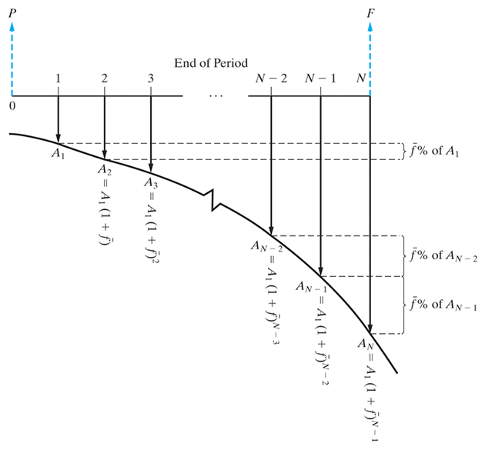
Sometimes Cash Flows Change by a Constant Rate, f̅, Each Period--This is a Geometric Gradient Series (2 of 2)

Slide 38
We Can Find the Present Value of a Geometric Series by Using the Appropriate Formula Below
Where is the initial cash flow in the series.

Slide 39
Pause and Solve (4 of 4)
Acme Miracle projects good things for their new weight loss pill, LoseIt. Revenues this year are expected to be $1.1 million, and Acme believes they will increase 15% per year for the next 5 years. What are the present value and equivalent annual amount for the anticipated revenues? Acme uses an interest rate of 20%.
Notes:
Slide 2 is list of textbook LO numbers and statements

Slide 40
Solution (4 of 4)
Use the geometric gradient formula to find the present value, then convert the present amount to an annual amount.
Notes:
Slide 2 is list of textbook LO numbers and statements

Slide 41
When Interest Rates Vary With Time Different Procedures are Necessary
(1 of 2)
Interest rates often change with time (e.g., a variable rate mortgage).
We often must resort to moving cash flows one period at a time, reflecting the interest rate for that single period.
Notes:
Slide 2 is list of textbook LO numbers and statements

Slide 42
When Interest Rates Vary With Time Different Procedures are Necessary
(2 of 2)
The present equivalent of a cash flow occurring at the end of period N can be computed with the equation below, where i_{k} is the interest rate for the k^{th} period.
Notes:
Slide 2 is list of textbook LO numbers and statements

Slide 43
Nominal and Effective Interest Rates
More often than not, the time between successive compounding, or the interest period, is less than one year (e.g., daily, monthly, quarterly).
The annual rate is known as a nominal rate.
A nominal rate of 12%, compounded monthly, means an interest of 1% (12%/12) would accrue each month, and the annual rate would be effectively somewhat greater than 12%.
The more frequent the compounding the greater the effective interest.
Notes:
Slide 2 is list of textbook LO numbers and statements

Slide 44
The Effect of More Frequent Compounding Can be Easily Determined
Let r be the nominal, annual interest rate and M the number of compounding periods per year. We can find, i, the effective interest by using the formula below.
Notes:
Slide 2 is list of textbook LO numbers and statements

Slide 45
Finding Effective Interest Rates
For an 18% nominal rate, compounded quarterly, the effective interest is.
For a 7% nominal rate, compounded monthly, the effective interest is.

Slide 46
Interest can be Compounded Continuously
Interest is typically compounded at the end of discrete periods.
In most companies cash is always flowing, and should be immediately put to use.
We can allow compounding to occur continuously throughout the period.
The effect of this compared to discrete compounding is small in most cases.
Notes:
Slide 2 is list of textbook LO numbers and statements

Slide 47
We Can Use the Effective Interest Formula to Derive the Interest Factors
As the number of compounding periods gets larger (M gets larger), we find that
Notes:
Slide 2 is list of textbook LO numbers and statements

Slide 48
Continuous Compounding Interest Factors
The other factors can be found from these.
Notes:
Slide 2 is list of textbook LO numbers and statements

Slide 49

Copyright
Notes:
If this slide was not included in the original PPT, it should be added.

