Slide 1
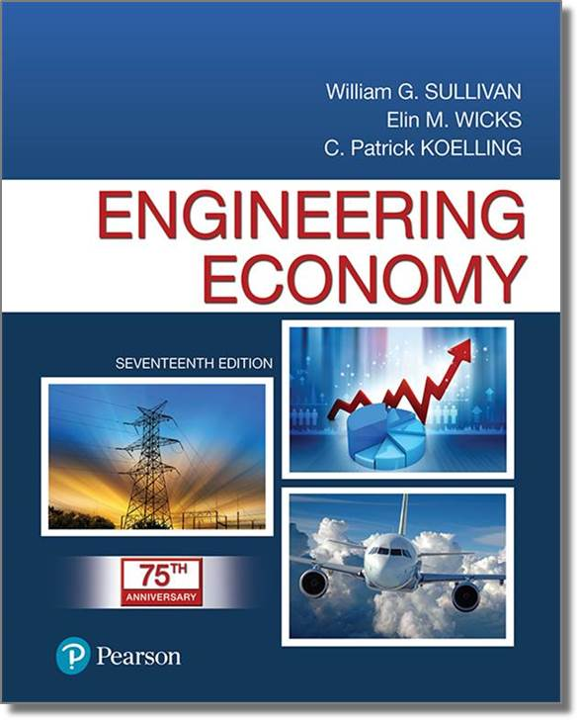
Engineering Economy
Seventeenth Edition
Chapter 03
Cost Estimation Techniques
Copyright © 2019, 2016, 2013 Pearson Education, Inc. All Rights Reserved

Slide 2
Objective
The objective of Chapter 3 is to present various methods for estimating important factors in an engineering economy study.
Notes:
Slide 2 is list of textbook LO numbers and statements

Slide 3
Estimating the Future Cash
Estimating the future cash flows for feasible alternatives is a critical step in engineering economy studies. Estimating costs, revenues, useful lives, residual values, and other pertinent data can be the most difficult, expensive, and time-consuming part of the study.
Notes:
Slide 2 is list of textbook LO numbers and statements

Slide 4
Results of Cost Estimating are Used for a Variety of Purposes
Setting selling prices for quoting, bidding, or evaluating contracts.
Determining if a proposed product can be made and distributed at a profit.
Evaluating how much capital can be justified for changes and improvements.
Setting benchmarks for productivity improvement programs.
Notes:
Slide 2 is list of textbook LO numbers and statements

Slide 5
The Two Fundamental Approaches are “Top-down” and “Bottom-up”
Top-down uses historical data from similar projects. It is best used when alternatives are still being developed and refined.
Bottom-up is more detailed and works best when the detail concerning the desired output (product or service) has been defined and clarified.
Notes:
Slide 2 is list of textbook LO numbers and statements

Slide 6
The Integrated Cost Estimation Approach has Three Major Components (1 of 2)
Work breakdown structure (WBS)
Cost and revenue structure (classification)
Estimating techniques (models)
Notes:
Slide 2 is list of textbook LO numbers and statements

Slide 7
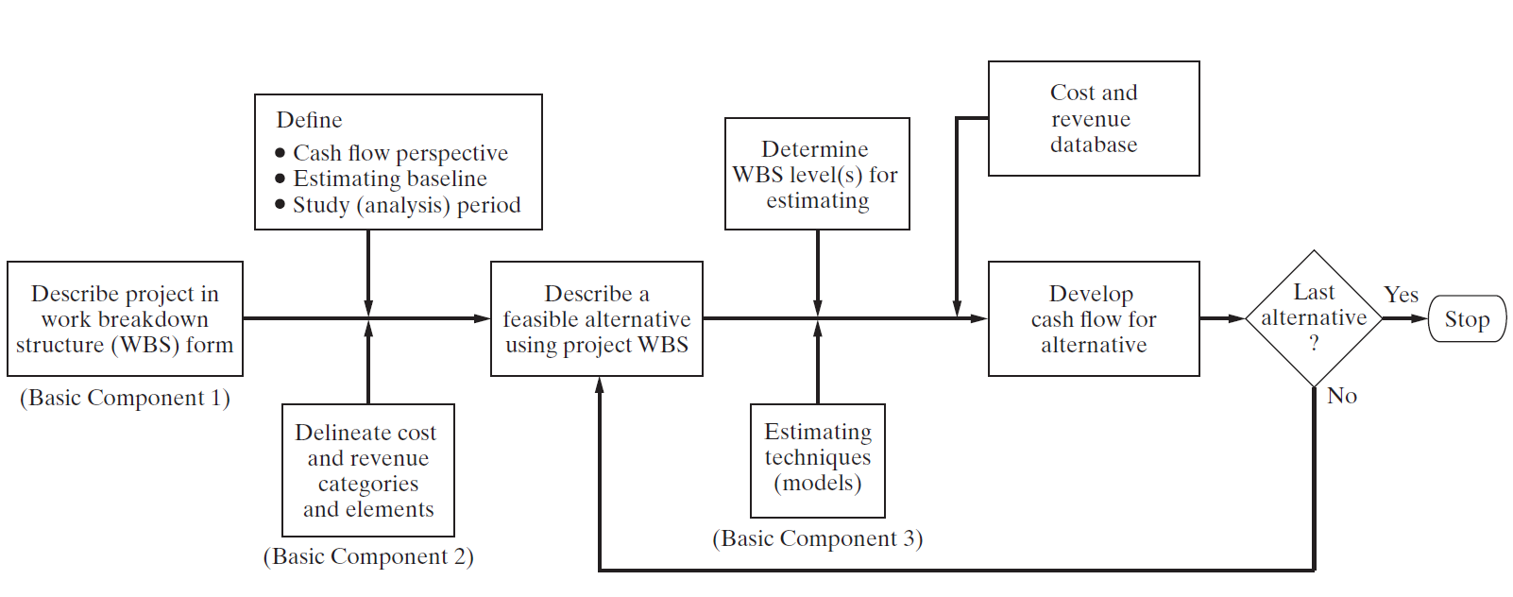
The Integrated Cost Estimation Approach has Three Major Components (2 of 2)
Notes:
Slide 2 is list of textbook LO numbers and statements

Slide 8
Work Breakdown Structure (WBS)
(1 of 2)
A basic tool in project management
A framework for defining all project work elements and their relationships, collecting and organizing information, developing relevant cost and revenue data, and management activities.
Each level of a WBS divides the work elements into increasing detail.
Notes:
Slide 2 is list of textbook LO numbers and statements

Slide 9
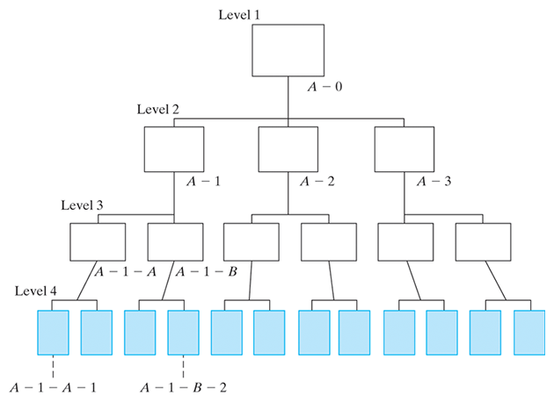
Work Breakdown Structure (WBS)
(2 of 2)
Notes:
Slide 2 is list of textbook LO numbers and statements

Slide 10
A WBS has Other Characteristics
Both functional and physical work elements are included.
The content and resource requirements for a work element are the sum of the activities and resources of related subelements below it.
A project WBS usually includes recurring and nonrecurring work elements.
Notes:
Slide 2 is list of textbook LO numbers and statements

Slide 11
Cost and Revenue Structure
Used to identify and categorize the costs and revenues that need to be included in the analysis.
The life-cycle concept and WBS are important aids in developing the cost and revenue structure for a project.
Perhaps the most serious source of errors in developing cash flows is overlooking important categories of costs and revenues.
Notes:
Slide 2 is list of textbook LO numbers and statements

Slide 12
Estimating Techniques
REMEMBER! The purpose of estimating is to develop cash-flow projections—not to produce exact data about the future, which is virtually impossible. Cost and revenue estimates can be classified according to detail, accuracy, and their intended use.
Order-of-magnitude estimates (±30%)
Semidetailed, or budget, estimates (±15%)
Definitive (detailed) estimates (±5%)
Notes:
Slide 2 is list of textbook LO numbers and statements

Slide 13
The Level of Detail and Accuracy of Estimates Depends on
time and effort available as justified by the importance of the study,
difficulty of estimating the items in question,
methods or techniques employed,
qualifications of the estimator(s), and
sensitivity of study results to particular factor estimates.
Notes:
Slide 2 is list of textbook LO numbers and statements

Slide 14
A Variety of Sources Exist for Cost and Revenue Estimation
Accounting records: good for historical data, but limited for engineering economic analysis.
Other sources inside the firm: e.g., sales, engineering, production, purchasing.
Sources outside the firm: U.S. government data, industry surveys, trade journals, and personal contacts.
Research and development: e.g., pilot plant, test marketing program, surveys.
Notes:
Slide 2 is list of textbook LO numbers and statements

Slide 15
These Models can be Used in Many Types of Estimates
Indexes
Unit technique
Factor technique
Notes:
Slide 2 is list of textbook LO numbers and statements

Slide 16
Indexes, I, Provide a Means for Developing Present and Future Cost and Price Estimates from Historical Data
k = reference year for which cost or price is known.
n = year for which cost or price is to be estimated (n>k).
C_{n} = estimated cost or price of item in year n.
C_{k} = cost or price of item in reference year k.
Indexes can be created for a single item or for multiple items (eqs. 3-1, 3-2).
Notes:
Slide 2 is list of textbook LO numbers and statements

Slide 17
Pause and Solve (1 of 2)
In 2002 Acme Chemical purchased a large pump for $112,000. Acme keys their cost estimating for these pumps to the industrial pump index, with a baseline of 100 established in 1992. The index in 2002 was 212. Acme is now (2010) considering construction of a new addition and must estimate the cost of the same type and size of pump. If the industrial pump index is currently 286, what is the estimated cost of the new pump?
Notes:
Slide 2 is list of textbook LO numbers and statements

Slide 18
Solution (1 of 2)
Cost of the new pump (using eq. 3-1)
Notes:
Slide 2 is list of textbook LO numbers and statements

Slide 19
The Unit Technique is One that is Widely Known and Understood
A “per unit factor” is used, along with the appropriate number of units, to find the total estimate of cost. An often used example is the cost of a particular house. Using a per unit factor of, say, $120 per square foot, and applying that to a house with 3,000 square feet, results in an estimated cost of $120 x 3,000 = $360,000.
This techniques is useful in preliminary estimates, but using average costs can be very misleading.
Notes:
Slide 2 is list of textbook LO numbers and statements

Slide 20
The Factor Technique is an Extension of the Unit Technique Where the Products of Several Quantities are Summed and Then Added to Components Estimated Directly
C = cost being estimated
C_{d} = cost of the selected component d estimated directly
f_{m} = cost per unit of component m
U_{m} = number of units of component m
Notes:
Slide 2 is list of textbook LO numbers and statements

Slide 21
Parametric Cost Estimating
Parametric cost estimating is the use of historical cost data
and statistical techniques (e.g., linear regression) to
predict future costs. Parametric models are used in the
early design stages to get an idea of how much the product
(or project) will cost, on the basis of a few physical attributes
(such as weight, volume, and power).
Notes:
Slide 2 is list of textbook LO numbers and statements

Slide 22
The Power-sizing Technique (or Exponential Model) is Frequently Used for Developing Capital Investment Estimates for Industrial Plants and Equipment
(both in $ as of the point in
time for which the estimate
Is desired)
(both in the same physical
units)
Notes:
Slide 2 is list of textbook LO numbers and statements

Slide 23
Pause and Solve (2 of 2)
Acme Logistics provides “less than truck load” (LTL) services throughout the U.S. They have several hubs where they use cross-docking to move goods from one trailer to another. Acme built its last hub 10 years ago, and it had 36 dock doors. The cost index at that time was 140, and the total cost was $6 million. Acme plans a new hub that will have 48 dock doors. The cost index now is 195, and Acme will use a capacity factor of 0.82. What is the estimated cost of the new hub?
Notes:
Slide 2 is list of textbook LO numbers and statements

Slide 24
Solution (2 of 2)
Cost of the new hub (using eqs. 3-1 and 3-4)
Notes:
Slide 2 is list of textbook LO numbers and statements

Slide 25
A Learning Curve
A learning curve reflects increased efficiency and performance with repetitive production of a good or service. The concept is that some input resources decrease, on a per-output-unit basis, as the number of units produced increases.
Notes:
Slide 2 is list of textbook LO numbers and statements

Slide 26
Most Learning Curves Assume a Constant Percentage Reduction Occurs as the Number of Units Produced is Doubled
Notes:
Slide 2 is list of textbook LO numbers and statements

Slide 27
Learning Curve Example: Assume the First Unit of Production Required 3 Hours Time for Assembly. The Learning Rate is 75%. Find (a) the Time to Assemble the 8th Unit, and (b) the Time Needed to Assemble the First 6 Units
Notes:
Slide 2 is list of textbook LO numbers and statements

Slide 28
A Cost Estimating Relationship (CER) Describes the Cost of a Project as a Function of Design Variables.
There are four basic steps in developing a CER.
Problem definition
Data collection and normalization
CER equation development
Model validation and documentation
Notes:
Slide 2 is list of textbook LO numbers and statements

Slide 29

Copyright
Notes:
If this slide was not included in the original PPT, it should be added.

