Slide 1
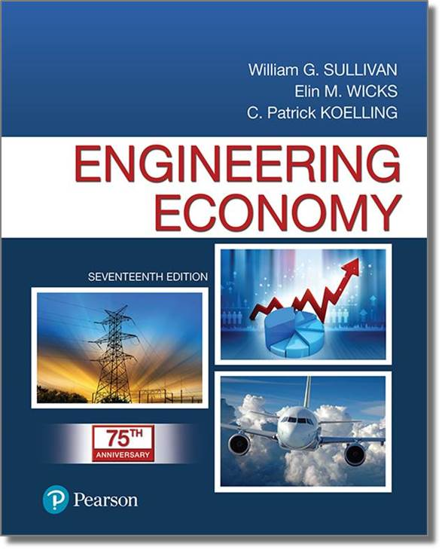
Engineering Economy
Seventeenth Edition
Chapter 02
Cost Concepts and Design Economics
Copyright © 2019, 2016, 2013 Pearson Education, Inc. All Rights Reserved

Slide 2
Objective
The objective of Chapter 2 is to analyze short-term alternatives when the time value of money is not a factor.
Notes:
Slide 2 is list of textbook LO numbers and statements

Slide 3
Costs Can be Categorized in Several Different Ways
Fixed cost: unaffected by changes in activity level
Variable cost: vary in total with the quantity of output (or similar measure of activity)
Incremental cost: additional cost resulting from increasing output of a system by one (or more) units
Notes:
Slide 2 is list of textbook LO numbers and statements

Slide 4
More Ways to Categorize Costs
Direct: can be measured and allocated to a specific work activity
Indirect: difficult to attribute or allocate to a specific output or work activity (also overhead or burden)
Standard cost: cost per unit of output, established in advance of production or service delivery
Notes:
Slide 2 is list of textbook LO numbers and statements

Slide 5
We Need to Use Common Cost Terminology
Cash cost: a cost that involves a payment of cash.
Book cost: a cost that does not involve a cash transaction but is reflected in the accounting system.
Sunk cost: a cost that has occurred in the past and has no relevance to estimates of future costs and revenues related to an alternative course of action.
Notes:
Slide 2 is list of textbook LO numbers and statements

Slide 6
More Common Cost Terminology
Opportunity cost: the monetary advantage foregone due to limited resources. The cost of the best rejected opportunity.
Life-cycle cost: the summation of all costs related to a product, structure, system, or service during its life span.
Notes:
Slide 2 is list of textbook LO numbers and statements

Slide 7
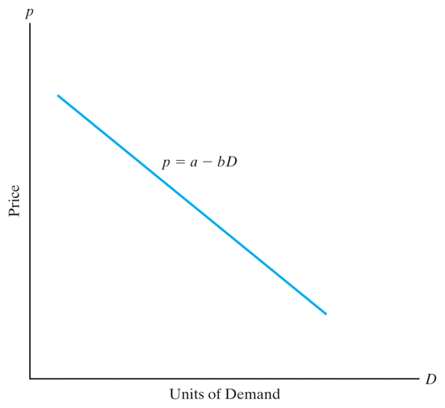
The General Price-Demand Relationship
The demand for a product or service is directly related to its price according to
p = a – bD
where p is price, D is demand, and a and b are constants that depend on the particular product or service.
Notes:
Slide 2 is list of textbook LO numbers and statements

Slide 8
Total Revenue Depends on Price and Demand
Total revenue is the product of the selling price per unit, p, and the number of units sold, D (eq. 2-4).
Notes:
Slide 2 is list of textbook LO numbers and statements

Slide 9
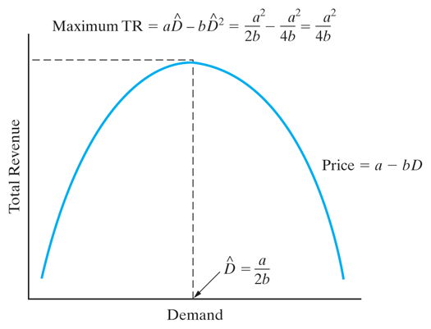
Calculus Can Help Determine the Demand That Maximizes Revenue
Solving, the optimal demand is (eq. 2-6)
Notes:
Slide 2 is list of textbook LO numbers and statements

Slide 10
We Can Also Find Maximum Profit…
Profit is revenue minus cost, so
Differentiating, we can find the value of D that maximizes profit (eq. 2-10).
Notes:
Slide 2 is list of textbook LO numbers and statements

Slide 11
Pause and Solve (1 of 2)
Acme Manufacturing is a major player in the lawn sprinkler business. Their high-end sprinkler is used commercially, and is quite popular with golf course greens keepers. In producing these sprinklers Acme’s fixed cost (C_{F}) is $55,000 per month with a variable cost (c_{v}) of $15.50 per unit. The selling price for these high-end sprinklers is described by the equation p=$87.50 – 0.02(D).
What is the optimal volume of sprinklers? Does Acme make a profit at that volume?
What is the range of profitable demand?
Notes:
Slide 2 is list of textbook LO numbers and statements

Slide 12
Solution (1 of 2)
What is the optimal volume of sprinklers? Does Acme make a profit at that volume?
What is the range of profitable demand?
Notes:
Slide 2 is list of textbook LO numbers and statements

Slide 13
And we Can Find Revenue/Cost Breakeven
Breakeven is found when total revenue = total cost. Solving, we find the demand at which this occurs (eq. 2-12).
Notes:
Slide 2 is list of textbook LO numbers and statements

Slide 14
Engineers Must Consider Cost in the Design of Products, Processes and Services
“Cost-driven design optimization” is critical in today’s competitive business environment.
In our brief examination we examine discrete and continuous problems that consider a single primary cost driver.
Notes:
Slide 2 is list of textbook LO numbers and statements

Slide 15
Two Main Tasks are Involved in Cost-driven Design Optimization
Determine the optimal value for a certain alternative’s design variable.
Select the best alternative, each with its own unique value for the design variable.
Cost models are developed around the design variable, X.
Notes:
Slide 2 is list of textbook LO numbers and statements

Slide 16
Optimizing a Design With Respect to Cost is a Four-Step Process
Identify the design variable that is the primary cost driver.
Express the cost model in terms of the design variable.
For continuous cost functions, differentiate to find the optimal value. For discrete functions, calculate cost over a range of values of the design variable.
Solve the equation in step 3 for a continuous function. For discrete, the optimum value has the minimum cost value found in step 3.
Notes:
Slide 2 is list of textbook LO numbers and statements

Slide 17
Here is a Simplified Cost Function
where,
a is a parameter that represents the directly varying cost(s),
b is a parameter that represents the indirectly varying cost(s),
k is a parameter that represents the fixed cost(s), and
X represents the design variable in question.
Notes:
Slide 2 is list of textbook LO numbers and statements

Slide 18
“Present Economy Studies” Can Ignore the Time Value of Money
Alternatives are being compared over one year or less.
When revenues and other economic benefits vary among alternatives, choose the alternative that maximizes overall profitability of defect-free output.
When revenues and other economic benefits are not present or are constant among alternatives, choose the alternative that minimizes total cost per defect-free unit.
Notes:
Slide 2 is list of textbook LO numbers and statements

Slide 19
Pause and Solve (2 of 2)
As energy costs continue to rise, power efficiency is increasingly important. Acme Chemical is evaluating two different electric motors to drive a mixing motor and needs to perform a present economy study. The motor will produce 75 hp and will be operated eight hours per day, 365 days for one year (maintenance will be performed on second shift—assume no down time during operation), after which time the motor will have no value. Select the most economical motor. Assume Acme’s electric power costs $0.16 per kWh. 1 hp = 0.746 kW.
 | Motor A | Motor B
Purchase price | $3,200 | $5,900
Annual maintenance cost | $250 | $450
Efficiency | 75% | 85%
Notes:
Slide 2 is list of textbook LO numbers and statements

Slide 20
Solution (2 of 2)
Motor A
Motor B
Notes:
Slide 2 is list of textbook LO numbers and statements

Slide 21

Copyright
Notes:
If this slide was not included in the original PPT, it should be added.

