Slide 1
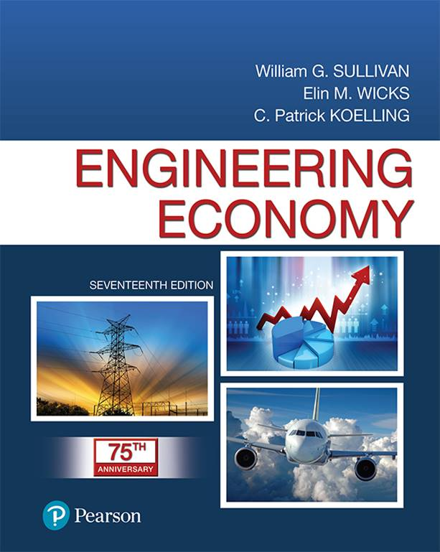
Engineering Economy
Seventeenth Edition
Chapter 11
Breakeven and Sensitivity Analysis
Copyright © 2019, 2016, 2013 Pearson Education, Inc. All Rights Reserved

Slide 2
Objective
The objective of Chapter 11 is to illustrate breakeven and sensitivity methods for investigating variability in outcomes of engineering projects.
Notes:
Slide 2 is list of textbook LO numbers and statements

Slide 3
To this Point we have Assumed a High Degree of Confidence in Estimated Values (1 of 2)
The degree of confidence is sometimes called assumed certainty, and decisions made on the basis of this kind of analysis are called decisions under certainty.
In virtually all situations, ultimate economic results are unknown.
Breakeven and sensitivity analysis are used to help understand how our decision might be affected if our original estimates are incorrect.
Notes:
Slide 2 is list of textbook LO numbers and statements

Slide 4
To this Point we have Assumed a High Degree of Confidence in Estimated Values (2 of 2)
The breakeven point is the value of a key factor at which we are indifferent between two alternatives (one may be “do nothing”).
The breakeven point is the value of y where
Notes:
Slide 2 is list of textbook LO numbers and statements

Slide 5
Common Factors to Consider for Breakeven Analysis
annual revenue and expenses
rate of return
market (or salvage) value
equipment life
capacity utilization
Notes:
Slide 2 is list of textbook LO numbers and statements

Slide 6
Should Jim Sell his Gas-Guzzler?
Jim's 1998 minivan is quite functional, but it only averages 20 miles per gallon (mpg). He has found a somewhat newer vehicle (roughly the same functionality) that averages 26 mpg. He can sell his current minivan for $2800 and purchase the newer vehicle for $4,000. Assume a cost of gasoline $4.00 per gallon How many miles per year must Jim drive if he wants to recover his investment in three years? Assume an interest rate of 6%, zero salvage value for either vehicle after three years, and identical maintenance cost.
Notes:
Slide 2 is list of textbook LO numbers and statements

Slide 7
Gas-Guzzler Solution
Current minivan
New vehicle
Equating these, and solving for x, we find
Notes:
Slide 2 is list of textbook LO numbers and statements

Slide 8
Pause and Solve (1 of 2)
The “one time good deal” Cash-For-Clunkers program offered by the federal government proved a temporary boon for car dealers. In addition to this program, dealers were eager to add their own incentives. Bill Mitselfik was considering two different deals he could make for his new car. He can finance the purchase price, $25,000, entirely through the dealer at a 1.9% APR (compounded monthly) for 5 years, with payments monthly. Alternatively, the dealer will give Bill a cash rebate and provide financing at 9% APR (compounded monthly) for 5 years, with monthly payments. What is the value of the rebate for which Bill would be indifferent between the two financing options?
Notes:
Slide 2 is list of textbook LO numbers and statements

Slide 9
We Use Sensitivity Analysis to See What Happens to Project Profitability When the Estimated Value of Study Factors are Changed
What if expenses are 10% higher than expected—is the project profitable?
What if sales revenue is 15% lower than expected?
What change in either expenses or revenues will cause the project to be unprofitable (decision reversal)?
Notes:
Slide 2 is list of textbook LO numbers and statements

Slide 10
Reconsidering Jim's Gas-Guzzler
Considering that Jim drives about 10,000 miles per year, our previous analysis would indicate that he should purchase the vehicle that gets better mileage. However, what if gas prices drop by 10%? Should Jim still sell his gas-guzzling minivan?
So, if gas prices drop by 10%, Jim should keep his minivan.
Notes:
Slide 2 is list of textbook LO numbers and statements

Slide 11
Pause and Solve (2 of 2)
Acme Delivery is considering a proposal for new package tracking technology. The system has an estimated initial cost of $1.9 million and will require upgrades and maintenance of $140,000 each year. Acme estimates that improved tracking will save approximately $680,000 per year, after system operating expenses. Acme has a MARR of 15% per year, and the study period for this technology is 6 years, after which time Acme expects the entire system will need to be replaced. The PW of this proposal is
PW(15%) = -$1,900,000+($680,000 - $140,000)(P/A,15%,6) = PW(15%) = $143,630
Determine how sensitive the decision to invest in the system is to the estimates of initial investment cost and annual savings.
Notes:
Slide 2 is list of textbook LO numbers and statements

Slide 12
Spreadsheets are Very Useful in Performing Sensitivity Analysis (1 of 2)
Formulas easily reflect changes in parameter values.
Tables and plots can provide quick answers and visual cues to the effect of changes.
A spider plot can be especially useful in sensitivity studies.
It can be useful to examine more than one alternative on a plot, or to examine sensitivity of incremental cash flows.
Notes:
Slide 2 is list of textbook LO numbers and statements

Slide 13
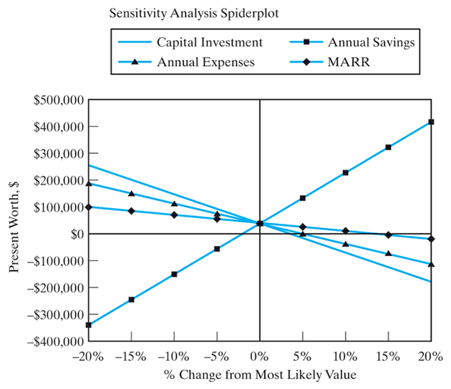
Spreadsheets are Very Useful in Performing Sensitivity Analysis (2 of 2)
[Note that the steeper the curve, the more sensitive is the PW to the factor.]

Slide 14
Changing the Value of More Than One Factor at a Time
To this point we have only looked at changes in one factor at a time.
In reality, each factor considered can change, so it is useful to look at the effect of simultaneous changes in factors of interest.
One way to accomplish this is to use the Optimistic-Most Likely-Pessimistic (O-ML-P) technique.
Notes:
Slide 2 is list of textbook LO numbers and statements

Slide 15
Optimistic-Most Likely-Pessimistic
Establish optimistic (the most favorable), most likely, and pessimistic (the least favorable) estimates for each factor.
The optimistic condition, which should occur about 1 time out of twenty, is when all factors are at their optimistic levels. Similarly for pessimistic condition.
The most likely condition should occur roughly 18 times out of 20.
Perform EW calculations under each condition for insight into the sensitivity of the solution.
The results can be seen on a spider plot for further insight.
Notes:
Slide 2 is list of textbook LO numbers and statements

Slide 16
Consider Investment in a New Crane. Assume a MARR of 8%.
Estimation Condition
 | Optimistic (O) | Most Likely (M) | Pessimistic (P)
Investment, I | $240,000 | $270,000 | $340,000
Useful life, N | 10 yr | 8 yr | 5 yr
Market value, MV | $20,000 | $15,000 | $8,000
Annual revenues, R | $100,000 | $80,000 | $50,000
Annual expenses, E | $10,000 | $15,000 | $20,000
Notes:
Slide 2 is list of textbook LO numbers and statements

Slide 17
Considering O-ML-P for I and R (Fix E, MV, and Life at Their ML Levels). Value in Each Cell is the PW for the Project
Investment, I
Revenues, R | Optimistic (O) | Most Likely (M) | Pessimistic (P)
Optimistic, (O) | $256,568 | $226,568 | $156,568
Most Likely, (M) | $141,636 | $111,636 | $41,636
Pessimistic, (P) | -$30,764 | -$60,764 | -$130,764
This suggests that perhaps some additional effort should be place on getting refined estimates of revenues. Of course, the complete study needs to consider the other factors.
Notes:
Slide 2 is list of textbook LO numbers and statements

Slide 18

Copyright
Notes:
If this slide was not included in the original PPT, it should be added.

