Slide 1
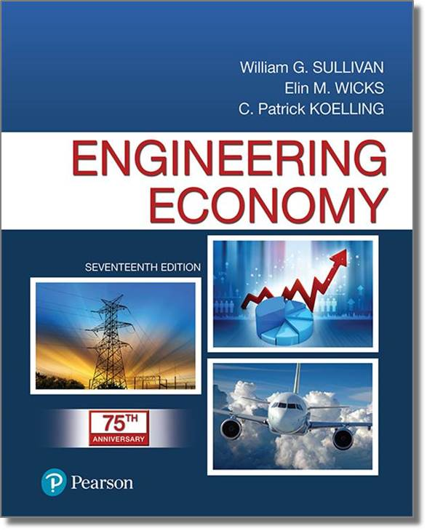
Engineering Economy
Seventeenth Edition
Chapter 01
Introduction to Engineering Economy
Copyright © 2019, 2016, 2013 Pearson Education, Inc. All Rights Reserved

Slide 2
Objective
The purpose of this book is to develop and illustrate the principles and methodology required to answer the basic economic question of any design: Do its benefits exceed its costs?
Notes:
Slide 2 is list of textbook LO numbers and statements

Slide 3
Engineering Economy…
involves the systematic evaluation of the economic merits of proposed solutions to engineering problems.
Notes:
Slide 2 is list of textbook LO numbers and statements

Slide 4
Solutions to Engineering Problems Must
promote the well-being and survival of an organization,
embody creative and innovative technology and ideas,
permit identification and scrutiny of their estimated outcomes, and
translate profitability to the “bottom line” through a valid and acceptable measure of merit.
Notes:
Slide 2 is list of textbook LO numbers and statements

Slide 5
Engineering Economic Analysis Can Play a Role in Many Types of Situations
Choosing the best design for a high-efficiency gas furnace.
Selecting the most suitable robot for a welding operation on an automotive assembly line.
Making a recommendation about whether jet airplanes for an overnight delivery service should be purchased or leased.
Determining the optimal staffing plan for a computer help desk.
Notes:
Slide 2 is list of textbook LO numbers and statements

Slide 6
There are Seven Fundamental Principles of Engineering Economy
Develop the alternatives
Focus on the differences
Use a consistent viewpoint
Use a common unit of measure
Consider all relevant criteria
Make uncertainty explicit
Revisit your decisions
Notes:
Slide 2 is list of textbook LO numbers and statements

Slide 7
Engineering Economic Analysis Procedure
Problem definition
Development of alternatives
Development of prospective outcomes
Selection of a decision criterion
Analysis and comparison of alternatives.
Selection of the preferred alternative.
Performance monitoring and post evaluation of results.
Notes:
Slide 2 is list of textbook LO numbers and statements

Slide 8
Electronic Spreadsheets are a Powerful Addition to the Analysis Arsenal
Most engineering economy problems can be formulated and solved using a spreadsheet.
Large problems can be quickly solved.
Proper formulation allows key parameters to be changed.
Graphical output is easily generated.
Notes:
Slide 2 is list of textbook LO numbers and statements

Slide 9

Copyright
Notes:
If this slide was not included in the original PPT, it should be added.

