Slide 1
Public Policy & Lobbying
Introduction
Why are laws and policies implemented
Public Policy defined
Lobbying defined
Lobbying is an effect of Public Policy.
History
Political systems as old as monarchy, theocracy, and dictatorship have shaped different forms of public policy all across the world.
Lobbying protected under the First Amendment of the United States Constitution, right to petition.
President Ulysses S. Grant’s term.

Slide 2
Current Process | Lobbying for Public Policy
Planning and Decision Matrix
Process
  Decision Matrix
  Write Bill or Opinion
  Research Who to Lobby
    Local, State, Federal, Agency, etc…
  Select a Lobbyist
    Revolving Door (32.5% 111th US congress employed as lobbyists)
  Lobby
    Ethical (Best, Good, Bad)
    Transparency (California Issue Re: Legislator Schedules)
  Return to Decision Matrix
Current Big industries for Lobbying
  Finance/Insurance/Real Estate, Health, Communication/Electronics, Energy/Natural Resources, Transportation
Decision to Lobby | Laws Changed | Laws Unchanged | Totals
Lobby | $8,000,000 | $-1,000,000 | $4,850,000
Do Not Lobby | $6,000,000 | $0 | $3,900,000
Probability | 65% | 35%
Christopher Norman

Slide 3
Pros Of Lobbying
Enlighten the Representatives
  Inform on bills to be voted on
  Inform on the pros and cons of bill
Enlighten the Populace
  Inform on current bills
  Inform on what the representatives are doing
Passing Regulations
  Clean air act
  Financial reform
Repealing Regulations
O.T. Okpechi
Notes:
Pros of Lobbying
Enlightening the representatives or members of regulatory agencies
Enlightening the Populace
Passing Regulations for the benefit of the populace
Repealing regulations for the benefit of the populace

Slide 4
Advantage of Public Policy
Role of Government in developing Technology
Institutional Infrastructure
Research Infrastructure
Military Technology
Government Regulation &
Standard Settings
Government subsidies
Government Directives
Health
Environment
Technology
Security
Safety
Abdulrahman Alansari

Slide 5
Cons of Public Policy and Lobbying
Public Policy can have an unclear objective
Short Term Versus Long Term Changes
Corruption
  Bribes
  Checks and Balances
Jas Sehmbey

Slide 6
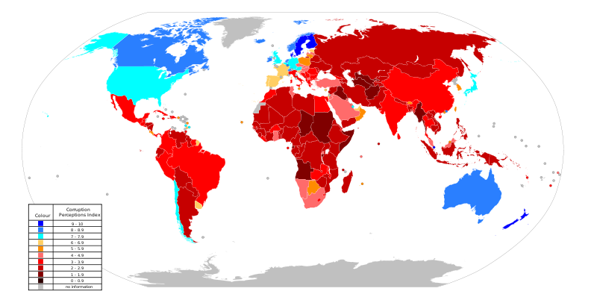
World map of the 2010 Corruption Perceptions Index by Transparency International, which measures "the degree to which corruption is perceived to exist among public officials and politicians". High numbers (blue) indicate less perception of corruption, whereas lower numbers (red) an indicate higher perception of corruption.
Political Corruption
Jas Sehmbey

